Slide 1
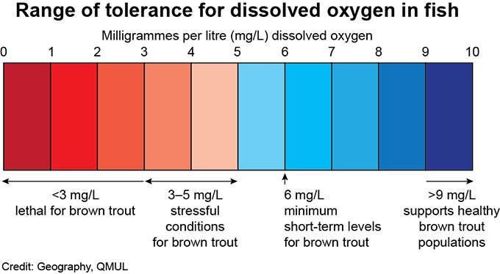
Dissolved oxygen
Dissolved oxygen is the concentration of oxygen gas in water.
It is typically measured in units of parts per million (ppm) or milligrams per liter (mg/L). 1 ppm = 1 mg/L
Many aquatic organisms require dissolved oxygen to survive.
Notes:
Dissolved oxygen is the concentration of oxygen gas in water.
It is typically measured in units of parts per million (ppm) or milligrams per liter (mg/L). 1 ppm = 1 mg/L
Many aquatic organisms require dissolved oxygen to survive. For example, the figure on the bottom of the slide shows dissolved oxygen tolerance ranges for brown trout. If oxygen is less than three mg/L, trout will die. Brown trout survive best at dissolved oxygen levels of 9 mg/L or above.

Slide 2
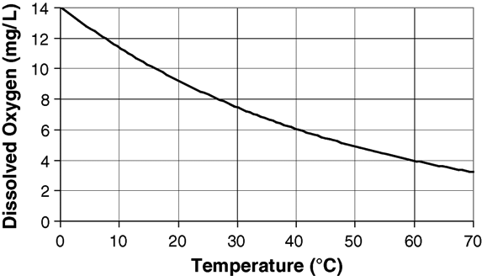
Dissolved oxygen and water temperature
Colder water can carry more dissolved oxygen than warm water (see figure).
Image source: Kenneth C. Waterman, accessed at: https://www.researchgate.net/figure/Effect-of-temperature-on-oxygen-solubility-in-water-generated-by-extrapolation-of-data_fig5_7957124
Notes:
Colder water can carry more dissolved oxygen than warm water. However, this does not mean that colder water always has more dissolved oxygen in it; it only means that it has the potential to carry more dissolved oxygen than warm water. Next, we will revisit how temperature and dissolved oxygen in a reservoir can interact to affect water quality.

Slide 3
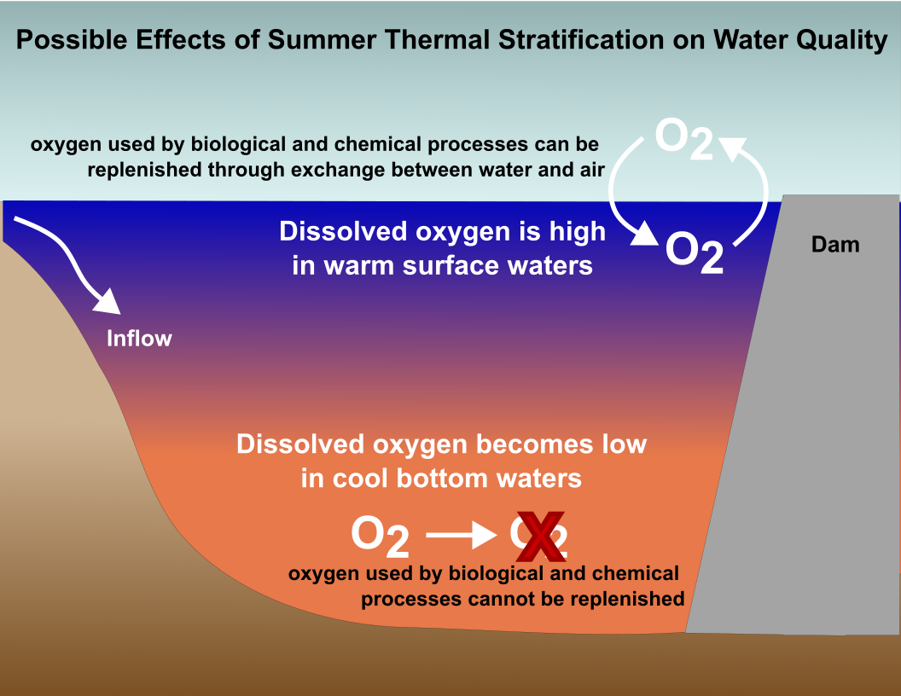
During summer thermal stratification, dissolved oxygen may become depleted in the cold, bottom waters of the reservoir.
Notes:
Remember that during summer stratification, the water at the surface is warmer than the cool bottom waters. Since we just learned that cold water can carry more dissolved oxygen than warm water, shouldn’t this mean that the bottom waters have more oxygen than the surface? Not necessarily. Over time, biological and chemical processes, such as use of oxygen by aquatic animals for respiration, uses up oxygen in the water. In the surface, the oxygen used up by biological and chemical processes can be easily replenished from the atmosphere. However, oxygen in the air can’t mix all the way to the bottom of the reservoir due to stratification. This means that dissolved oxygen may become depleted in the bottom waters of a reservoir over time.

Slide 4
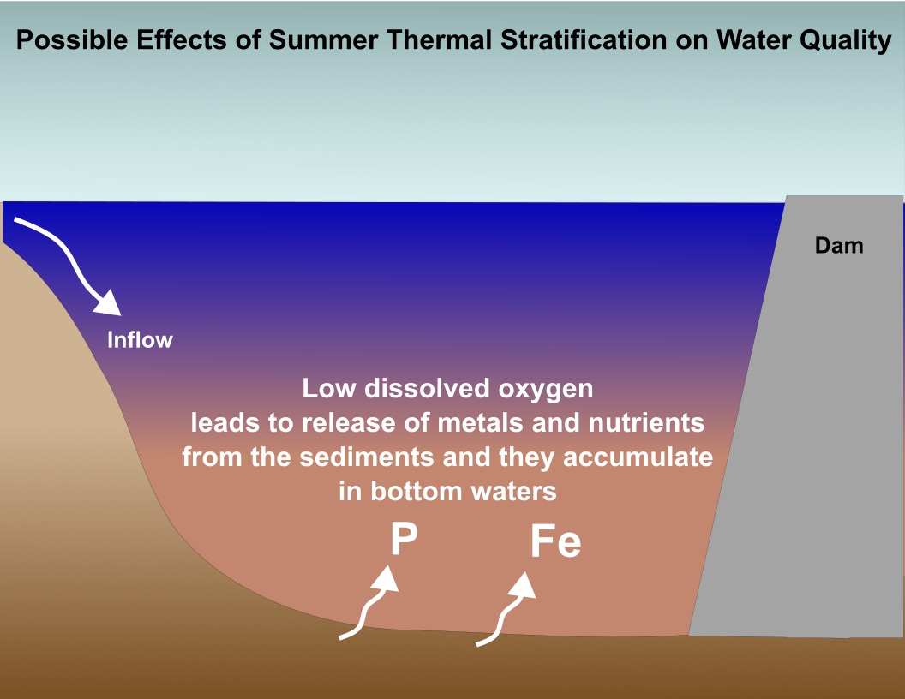
Often, higher levels of dissolved oxygen indicate better water quality, while lower levels of dissolved oxygen indicate worse water quality. This is because low levels of dissolved oxygen can cause the release of metals (iron, manganese) and nutrients (phosphorus, nitrogen) from the sediments, which may cause taste and odor concerns and stimulate harmful algal blooms.
Notes:
Often, higher levels of dissolved oxygen indicate better water quality, while lower levels of dissolved oxygen indicate worse water quality. This is because low levels of dissolved oxygen can cause the release of metals (iron, manganese) and nutrients (phosphorus, nitrogen) from the sediments, which may cause taste and odor concerns and stimulate harmful algal blooms.
Remember, not all reservoirs experience depleted dissolved oxygen and water quality problems in the bottom waters during summer thermal stratification. Whether or not dissolved oxygen becomes depleted depends on a number of factors, such as how much biological activity occurs in the reservoir. The more biological activity and growth of phytoplankton occurs in a reservoir, the more likely oxygen is to become depleted in the bottom waters.

