Slide 1
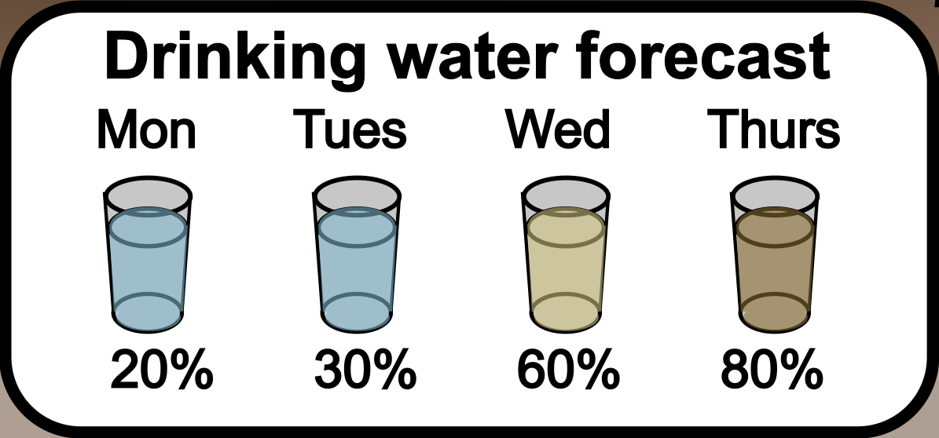
What is a water quality forecast?
A forecast is a prediction of a future event with uncertainty
A water quality forecast is a future prediction of a water quality variable (such as water temperature) with uncertainty
Image: Wikimedia commons
Notes:
In the next section of the module, you will be asked to make water treatment decisions using water quality forecasts. A forecast is a prediction of a future event with uncertainty. Including uncertainty is important because it is impossible to perfectly know the future in advance. More specifically, A water quality forecast is a future prediction of a water quality variable (such as water temperature) with uncertainty

Slide 2
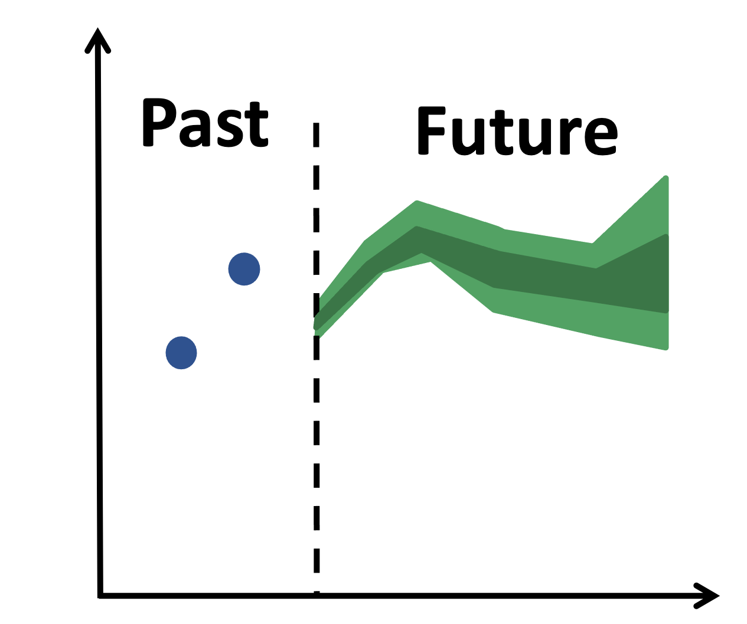
What is forecast uncertainty?
Forecast uncertainty: the set of possible alternate future conditions predicted by a model and the chance of observing each outcome.
We generate multiple different predictions of the future because the future is inherently unknown.
Uncertainty generally increases as the time into the future increases.
Image: Wikimedia commons
Notes:
Forecast uncertainty is the set of possible alternate future conditions predicted by a model and the chance of observing each outcome.
We generate multiple different predictions of the future because the future is inherently unknown.
Uncertainty generally increases as the time into the future increases. As an example, think of the weather forecast. If you are leaving on a trip and a 90% chance of rain is predicted for tomorrow, you are likely to bring waterproof shoes and a raincoat. If a 90% chance of rain is predicted for a week from tomorrow, you are more likely to think, “well, I’ll wait and see whether the forecast changes as we get closer to that day”. By making these decisions, you are acknowledging that forecast uncertainty is greater the farther into the future we predict.

Slide 3
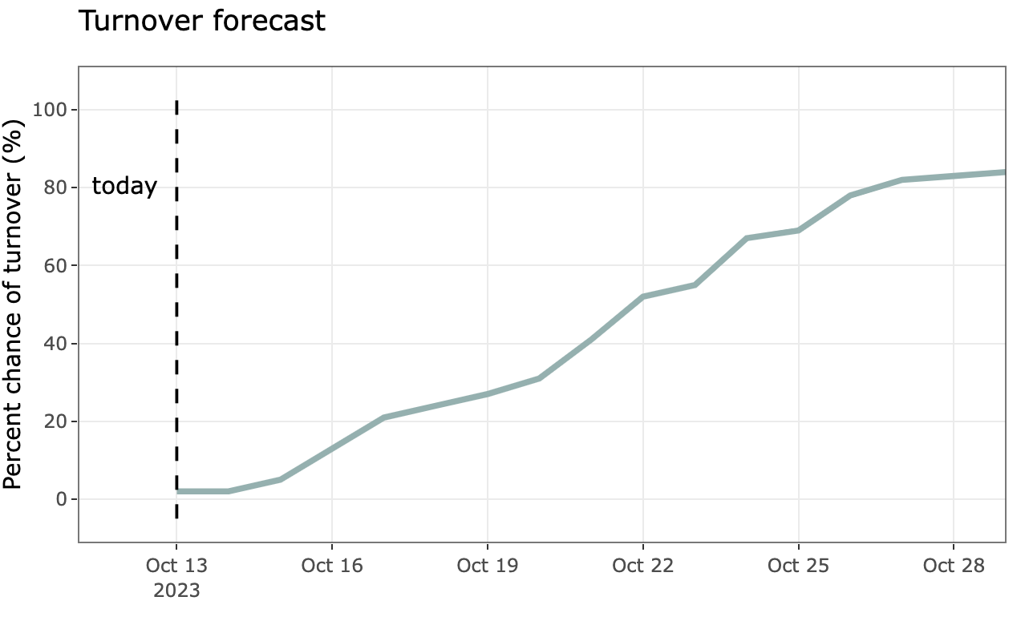
How to interpret a turnover forecast
Y axis is the probability of turnover – this is where the uncertainty is! We are not sure if turnover will happen, so we provide a probability.
X axis is date that is being forecasted
Image: Wikimedia commons
Notes:
Here is an example forecast for fall turnover in a drinking water reservoir. Let’s examine how to interpret this forecast. The X axis is the date that is being forecasted. So on this figure, ”today” is Oct. 13, 2023, and the forecast is for about two weeks into the future. The Y axis is the percent chance of turnover – this is where the uncertainty is located! The higher the percent chance of turnover, the more likely turnover is to occur. We can see from this figure that turnover is very unlikely to occur tomorrow, but it’s quite likely that turnover will occur by the end of October. A value of over 50% on the y axis indicates that turnover is more likely to occur than to not occur.

