Slide 1
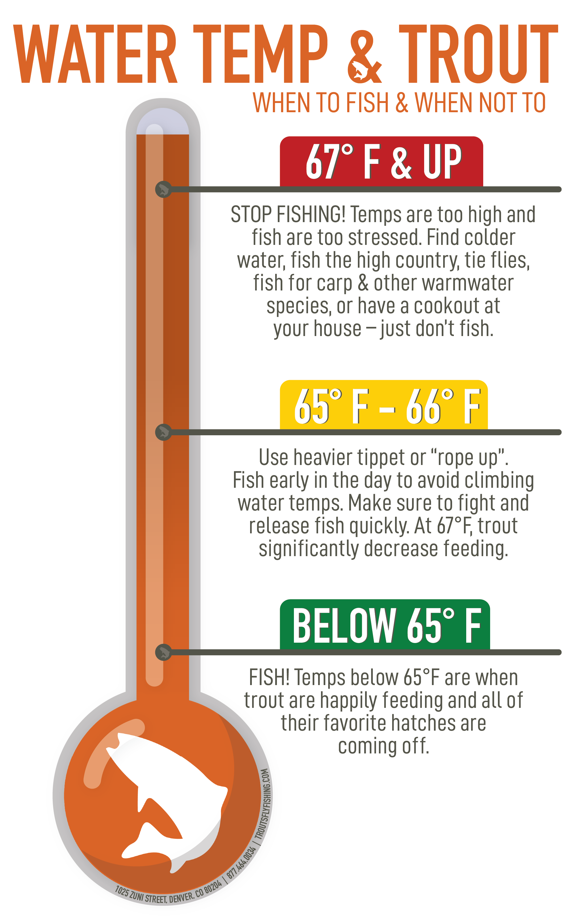
Water temperature
Water temperature influences
Biological activity and growth
Water chemistry
Biodiversity
Water quality
Land use change and climate change can affect water temperature
Predicting future water temperatures can help resource managers prevent water quality degradation
TroutFlyFishing.com
Notes:
Water temperature exerts a major influence on biological activity and growth, has an effect on water chemistry, can influence water quantity measurements, and governs the kinds of organisms that live in water bodies.
For example, trout do best in a certain range of water temperature, and above this temperature they are more likely to exhibit stress signals.
Freshwater ecosystems are currently experiencing a multitude of stressors such as land use change and climate change.
Being able to predict how such systems can change in the short-term (up to 7-days into the future) will provide natural resource managers with critical information to take pro-active actions to prevent degradation of water quality.

Slide 2
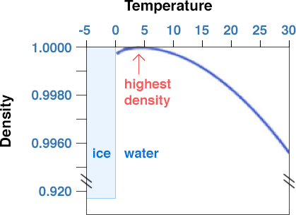
Thermal stratification
Thermal stratification refers to differences in water temperature at different depths in a reservoir.
This occurs because the density of water depends on its temperature.
Denser water sinks to the bottom of the reservoir, while less dense water is at the surface.
Thermal stratification changes over the course of a year in reservoirs located in temperate regions, such as in most of the United States.
Temperature (℃)
Image source: Mike Arthur and Demian Saffer, accessed at: https://www.e-education.psu.edu/earth111/node/842
Notes:
Thermal stratification refers to differences in water temperature at different depths in a reservoir. This occurs because the density of water depends on its temperature, as shown in the figure on the right. In general, colder water is denser than warmer water. However, the highest density of water is at 4 degrees Celsius. Once water becomes colder than 4 degrees Celsius, it starts to become less dense again. This explains why ice, which is always colder than 4 degrees Celsius, floats on top of liquid water. Denser water sinks to the bottom of the reservoir, while less dense water is at the surface. This leads to thermal stratification, which changes over the course of a year in reservoirs located in temperate regions, such as in most of the United States. I will now give an overview of how thermal stratification changes over the course of a year in a temperate reservoir.

Slide 3
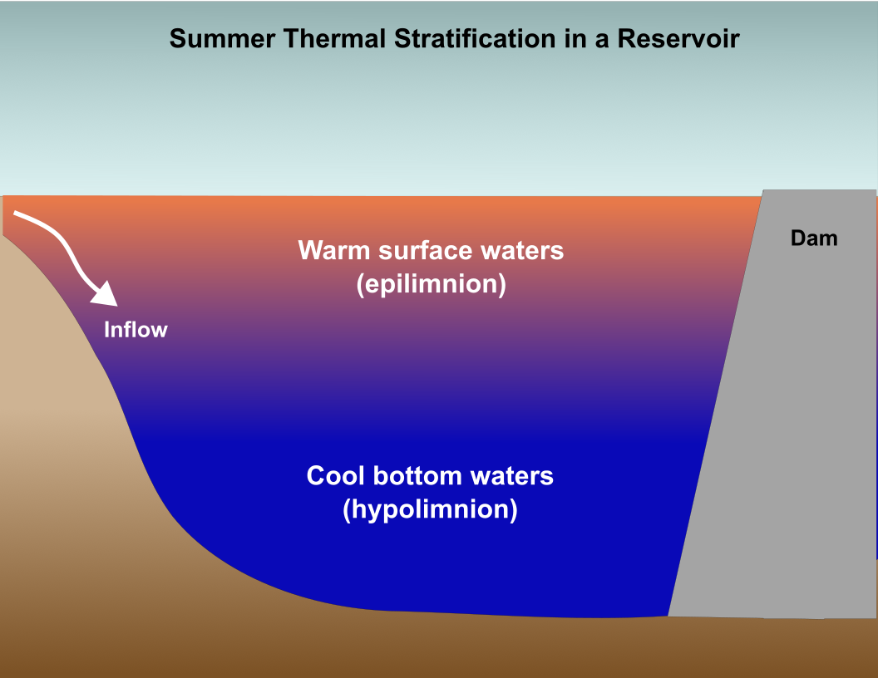
In summer, warmer, less dense water stays at the surface of the reservoir, while colder, denser water sinks. This leads to 'summer stratification', where the water is warmest at the surface and coldest at the sediments.
Notes:
Here I am showing a cross-section of a reservoir, from the surface to the bottom. The dam is shown in gray on the right. The inflow stream is indicated on the left. The brown area under the reservoir represents the sediments at the bottom of the reservoir. (read slide text)

Slide 4
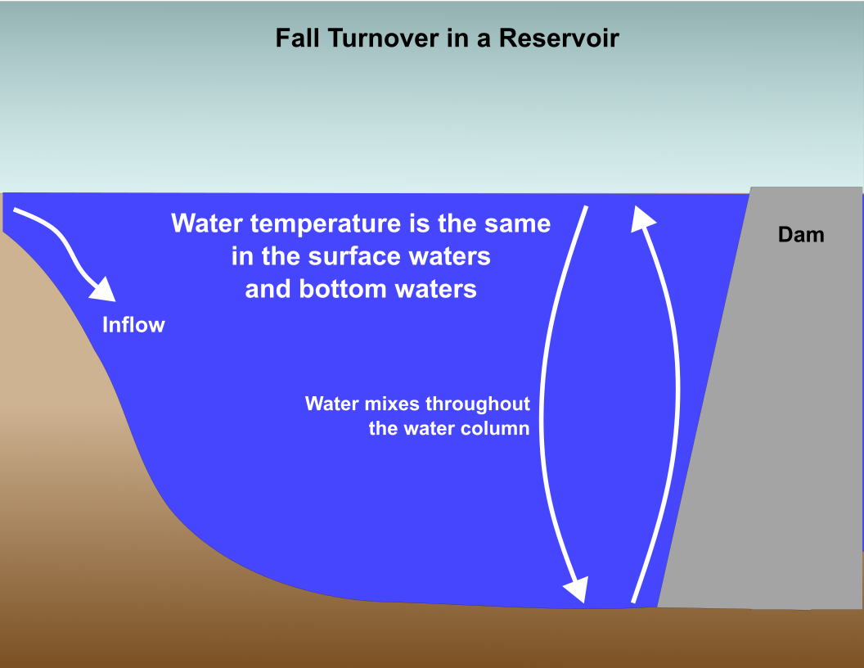
Turnover is when thermal stratification dissipates due to seasonal changes in air temperature. In the fall, turnover occurs as air temperatures decrease, cooling the surface waters. Water temperature becomes the same from the top to the bottom of the water column. When this occurs, we refer to the reservoir as 'mixed'.
Notes:
As air temperatures cool in the fall, thermal stratification in the reservoir changes. This change is referred to as fall turnover. Fall turnover in a reservoir is when (read text).

Slide 5
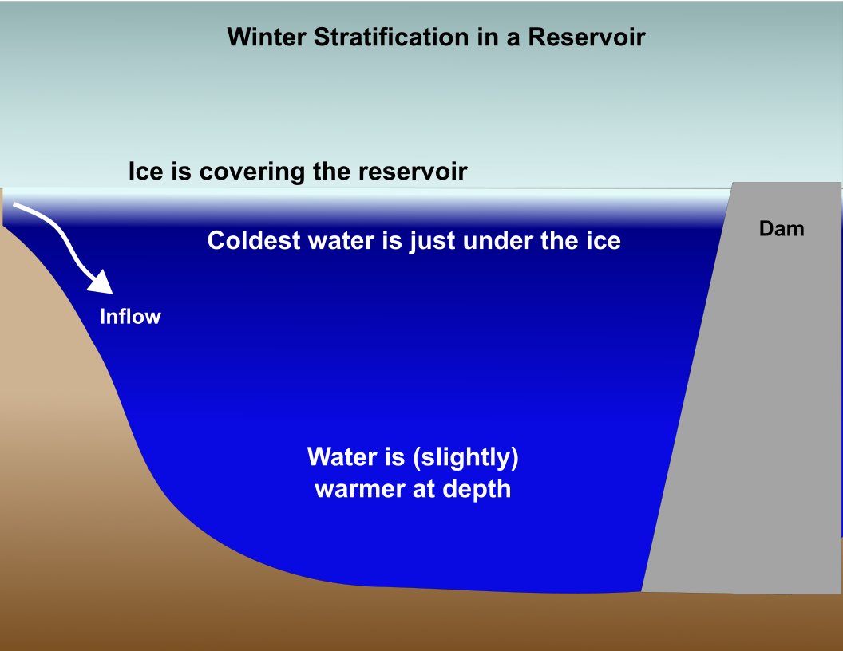
In winter, if ice forms on the reservoir, 'inverse stratification' may occur. In this case, because water is densest at 4 degrees Celsius, the water is slightly warmer at depth than at the icy surface (remember, ice forms at 0 degrees Celsius!).
Notes:
(read text)

Slide 6
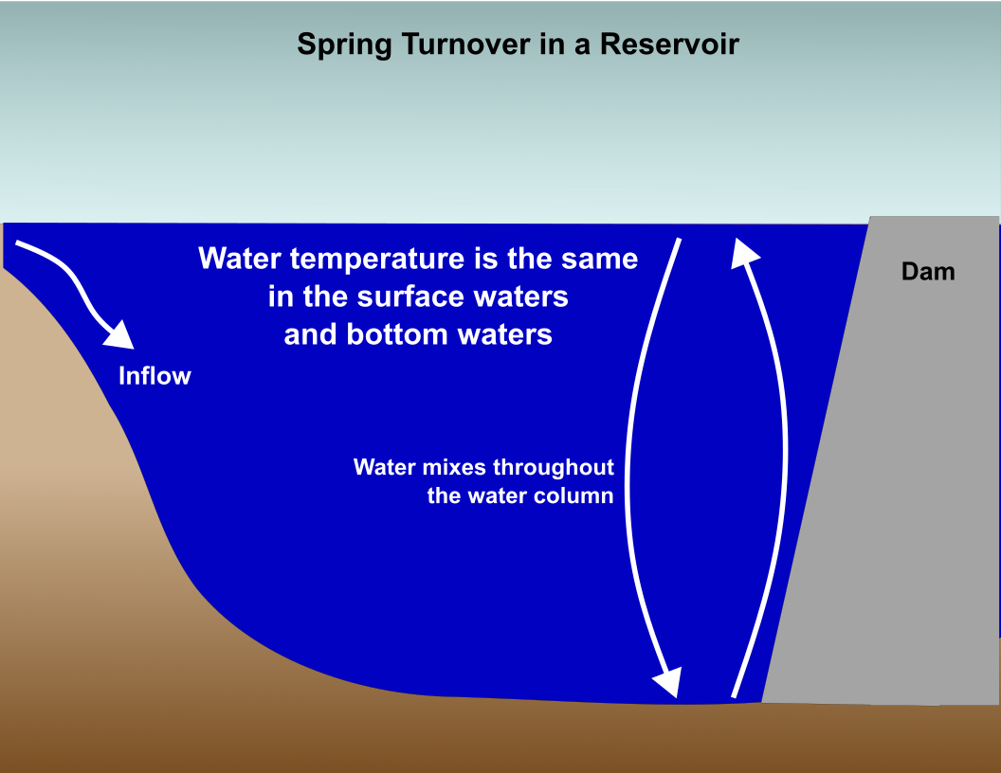
In spring, turnover occurs as ice melts. Once again, water temperature becomes the same from the top to the bottom of the water column.
Notes:
In spring, air temperatures begin to warm again. If ice has formed on the reservoir, the melting of the ice leads to spring turnover. Once again, water temperature becomes the same from the top to the bottom of the water column. If no ice has formed on the reservoir during the winter, the reservoir may stay mixed all winter long. Next, I’ll describe how thermal stratification in a reservoir can affect water quality.

Slide 7
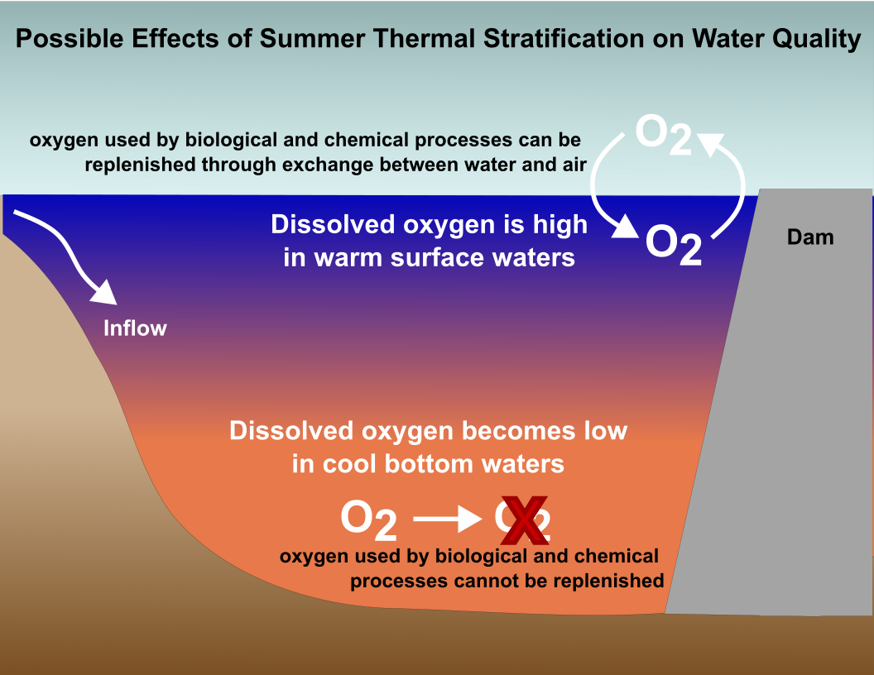
During summer stratification, water quality conditions can be very different in the surface and bottom depths of a reservoir.
Notes:
During summer stratification, water quality conditions can be very different in the surface and bottom depths of a reservoir. These differences are primarily due to differences in the amount of dissolved oxygen in the water. Dissolved oxygen is necessary for aquatic animals to survive and can influence water chemistry as well. In the surface during summer stratification, there is often plentiful dissolved oxygen in the water as oxygen can be introduced from the air into the water. However, biological and chemical processes in the cool bottom waters uses up the available dissolved oxygen in the bottom of the reservoir over time, and because of thermal stratification, it is not possible for oxygen from the atmosphere to mix all the way to the bottom of the reservoir. This leads to very low concentrations of dissolved oxygen in the bottom of the reservoir.

Slide 8
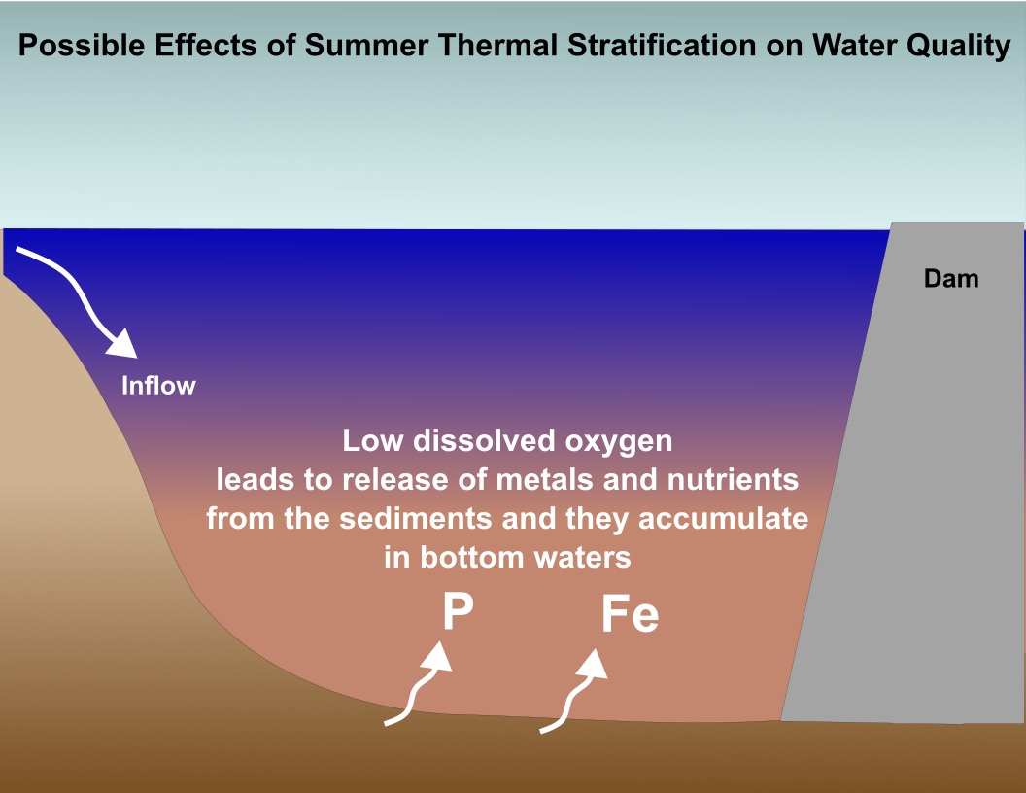
Depleted oxygen in the bottom of the reservoir can lead to water quality concerns such as release of metals (iron, manganese) and nutrients (nitrogen, phosphorus) from the sediments.
Notes:
Depleted oxygen in the bottom of the reservoir can lead to water quality concerns. Low dissolved oxygen leads to release of metals and nutrients from the sediments and they accumulate in the bottom waters. This is not good for drinking water quality. For example, some metals, such as iron and manganese, can cause taste and odor concerns in drinking water.

Slide 9
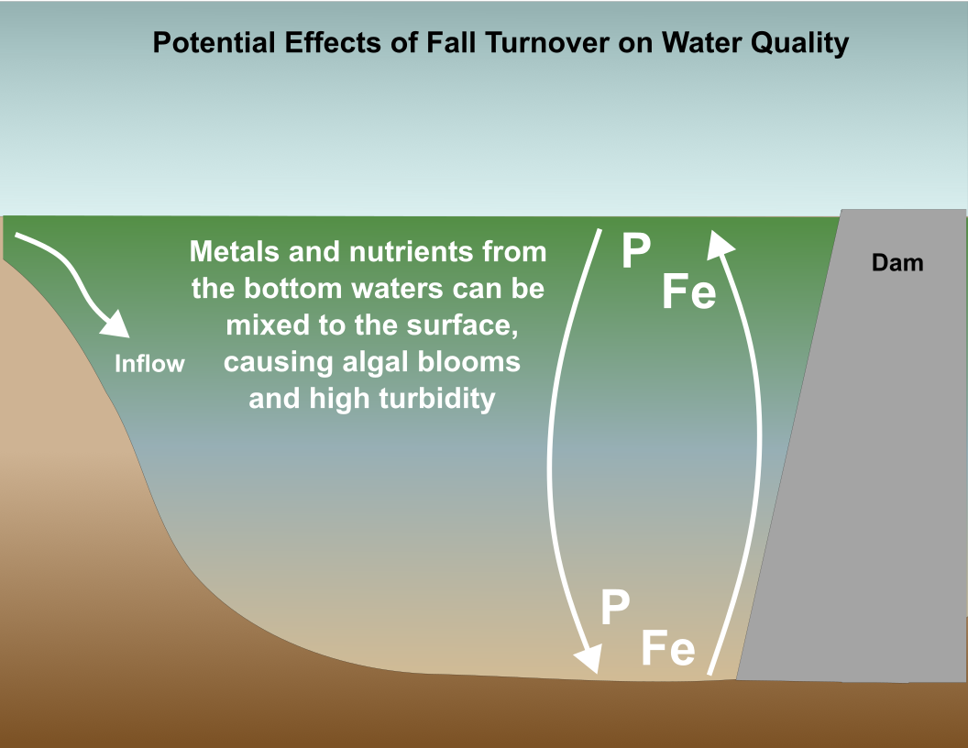
During fall turnover, metals and nutrients that have been released into the bottom waters of the reservoir during the summer can be released to the surface, potentially leading to taste and odor concerns or stimulating harmful algal blooms.
Notes:
Fall turnover can also have important effects on water quality. If metals and nutrients have built up in the bottom waters during summer stratification, they can be mixed to the surface of the reservoir during fall turnover. This can lead to high turbidity, or increased cloudiness of the water, as well as taste and odor concerns. In addition, nutrients mixed to the surface may stimulate harmful algal blooms.
Keep in mind that the water quality concerns I have described here do not apply to all thermally stratified reservoirs, only some of them. It is important to understand the individual characteristics of your water source and treatment plant in order to make informed water treatment decisions.

