Slide 1
Community conflict analysis and prediction
5组：余筱涵 侯昱晨 潘思余

Slide 2
Abstract
Understanding how communities fight and how to prevent conflicts
Motivation:
Inter-community interaction and conflict analysis
community conflict prediction model
Evaluation:
AUC
F1 score
Method:
PageRank and its variations(APageRank & DpageRank)
Link prediction model:
LSTM
GCN
EnvolveGCN (dynamic link prediction)

Slide 3
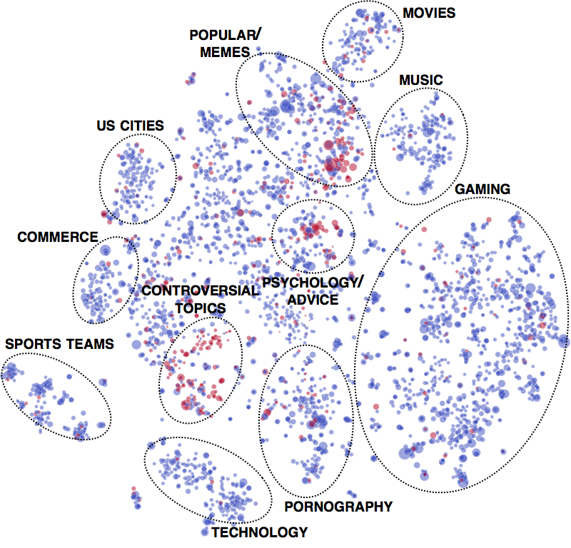
Dataset
SNAP Reddit Hyperlink Net work
Nodes:
110000 + users
Node feature:
50000+ subreddit(community)
Edge:
4 month 280000+ post
Edge feature:
300 length post context embedding
[1]https://snap.stanford.edu/conflict

Slide 4
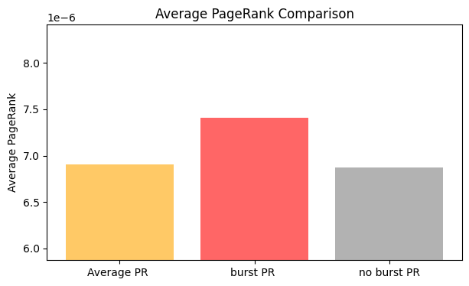
Community conflict model: mobilization
Members of source may be mobilized to comment in the linked target post
Attackers
Defenders
how community interaction occurs
Successfully mobilizing posts(burst) are created by highly active ‘core’ members(with high page rank) of the source community.
[2]Community Interaction on Conflict on the Web. S. Kumar, W.L. Hamilton, D. Jurafsky, and J. Leskovec. TheWebConf (WWW) 2018.

Slide 5
Attacker PageRank & Defender PageRank
Legend:
Attacker node
Defender node
A-PageRank: Run PageRank but restrict the teleport set to just attackers.
Quantifies node centrality with respect to all attackers.
D-PageRank: Run PageRank but restrict the teleport set to just defenders.
Quantifies node centrality with respect to all defenders

Slide 6
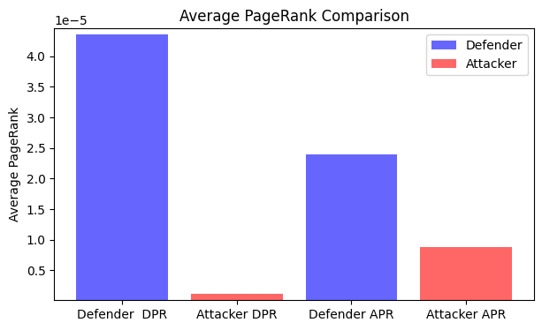
Community conflict model: Echo chambers
Attacker node
Defender node
attackers and defenders primarily reply to users of the same type

Slide 7
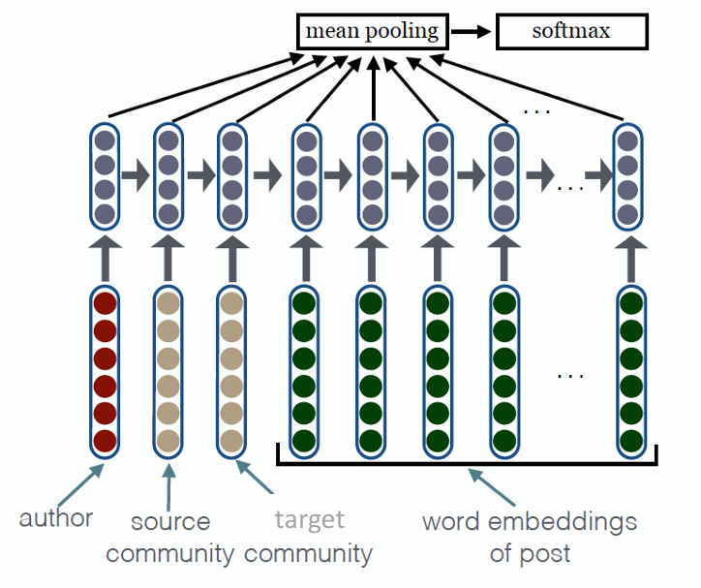
Community conflict prediction: LSTM
an LSTM layer and social embeddings using GloVe pre-trained word vectors
The embedding layer consists of user embeddings, community embeddings, and word embeddings
dataset loaded using pickle.
divided into training, validation and test batches.
Data transferred to GPU to accelerate training
to improve the understanding and prediction of social media conflicts.

Slide 8
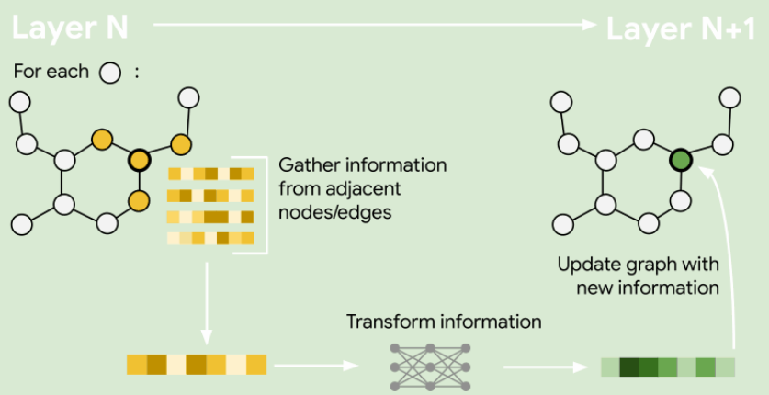
Community conflict prediction: GCN
How to generate graph?
Starting and Ending Post names Edge Index
batch
Subs name for Posts Node Feature
Content Edge Feature

Slide 9
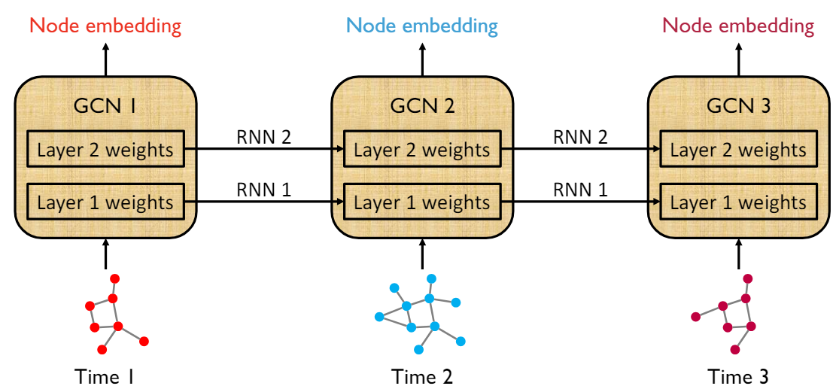
Community conflict prediction: EnvolveGCN
Recent 7 days
Node: subreddit
Node features:
LSTM embeddings
Edge features:
Text embeddings
Task:
edge classification
[5] EvolveGCN: Evolving Graph Convolutional Networks for Dynamic Graphs", Aldo Pareja, Giacomo Domeniconi, AAAI 2020.

Slide 10
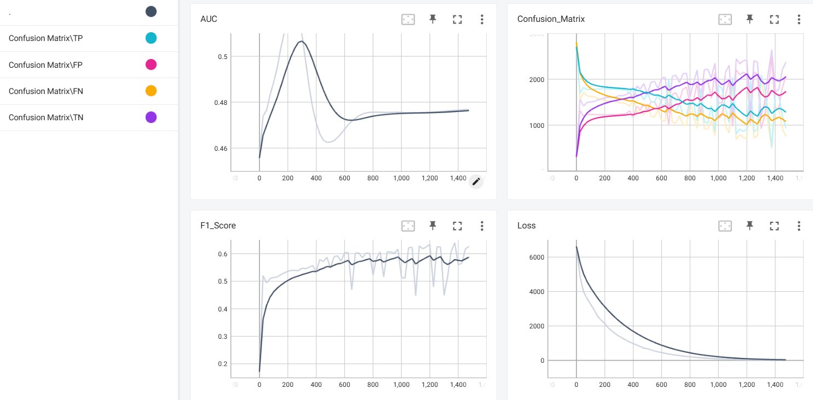
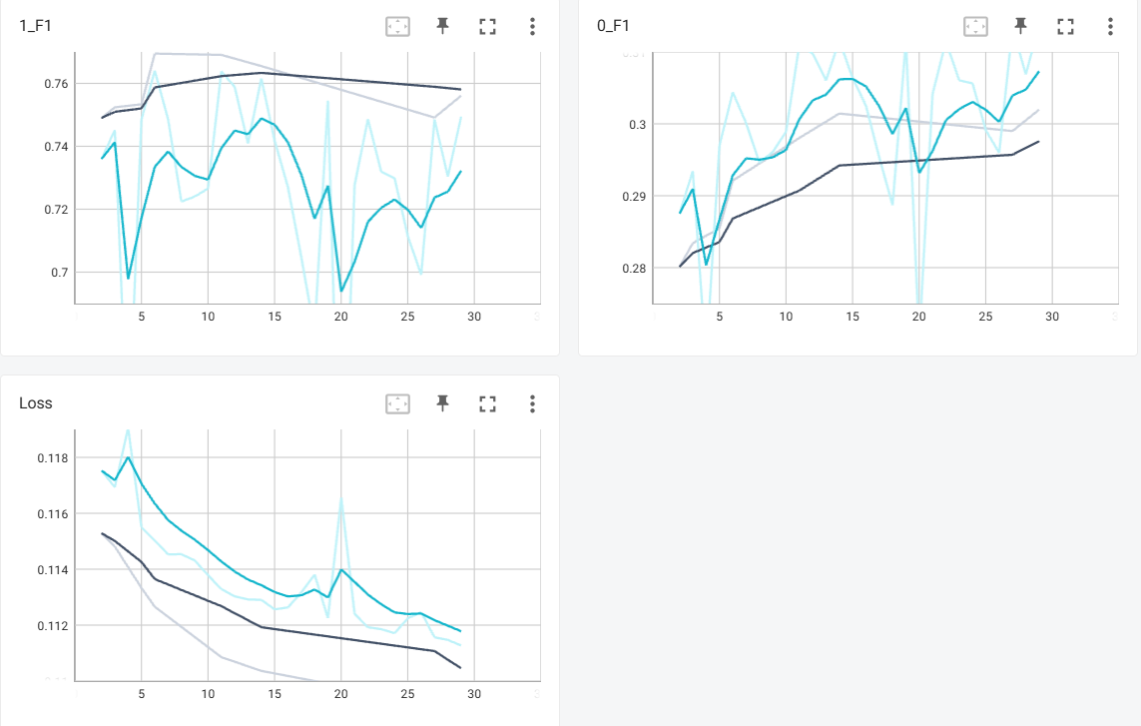
Community conflict prediction: performance
model | AUC
LSTM | 0. 75
GCN | 0.58
EGCN(dynamic) | 0.78

Slide 11
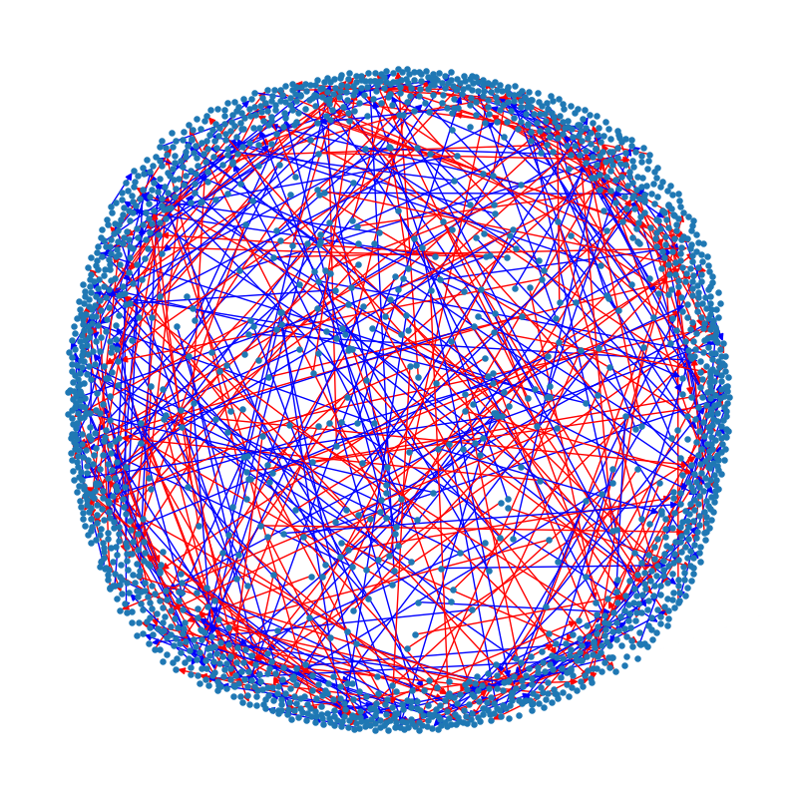
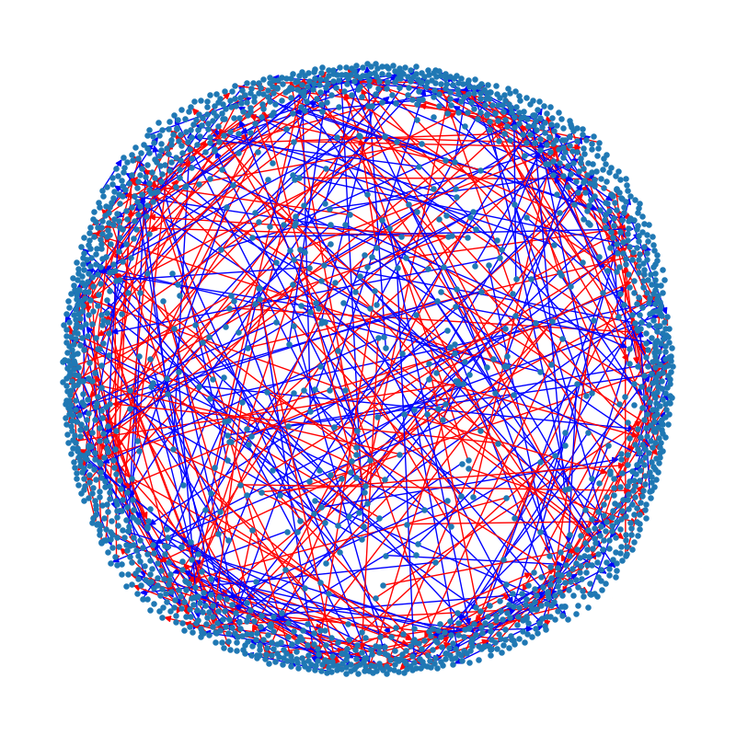
Community conflict prediction: performance
The visualisation part
uses Matplotlib and NetworkX libraries to convert the test data into graphs and colour the edges according to the actual and predicted labels, and then saves the graphical image

Slide 12
Conclusion and Discussion
Communities conflicts initiated by core members
Conflicts create echo-chambers
Conflicts predicted with 0.78 AUC
Conflicts predicted in dynamic graph and LSTM beat static graph

Slide 13
THANK YOU

Slide 14
