Slide 1

ECE6024 – VLSI Verification Methodologies
J COMPONENT REVIEW 1
GROUP 3
SIMPLE PROCESSOR
Winter Semester 2021-2022 Shreyas S Bagi 21MVD0086
M.Tech VLSI Design Panchagnula Krishna Vamsidhar 21MVD0085
School of Electronics Engineering Srinidhi K S 21MVD0105
Vellore Institute of Technology

Slide 2
AIM
Architecture Design of Simple Processor.

Slide 3
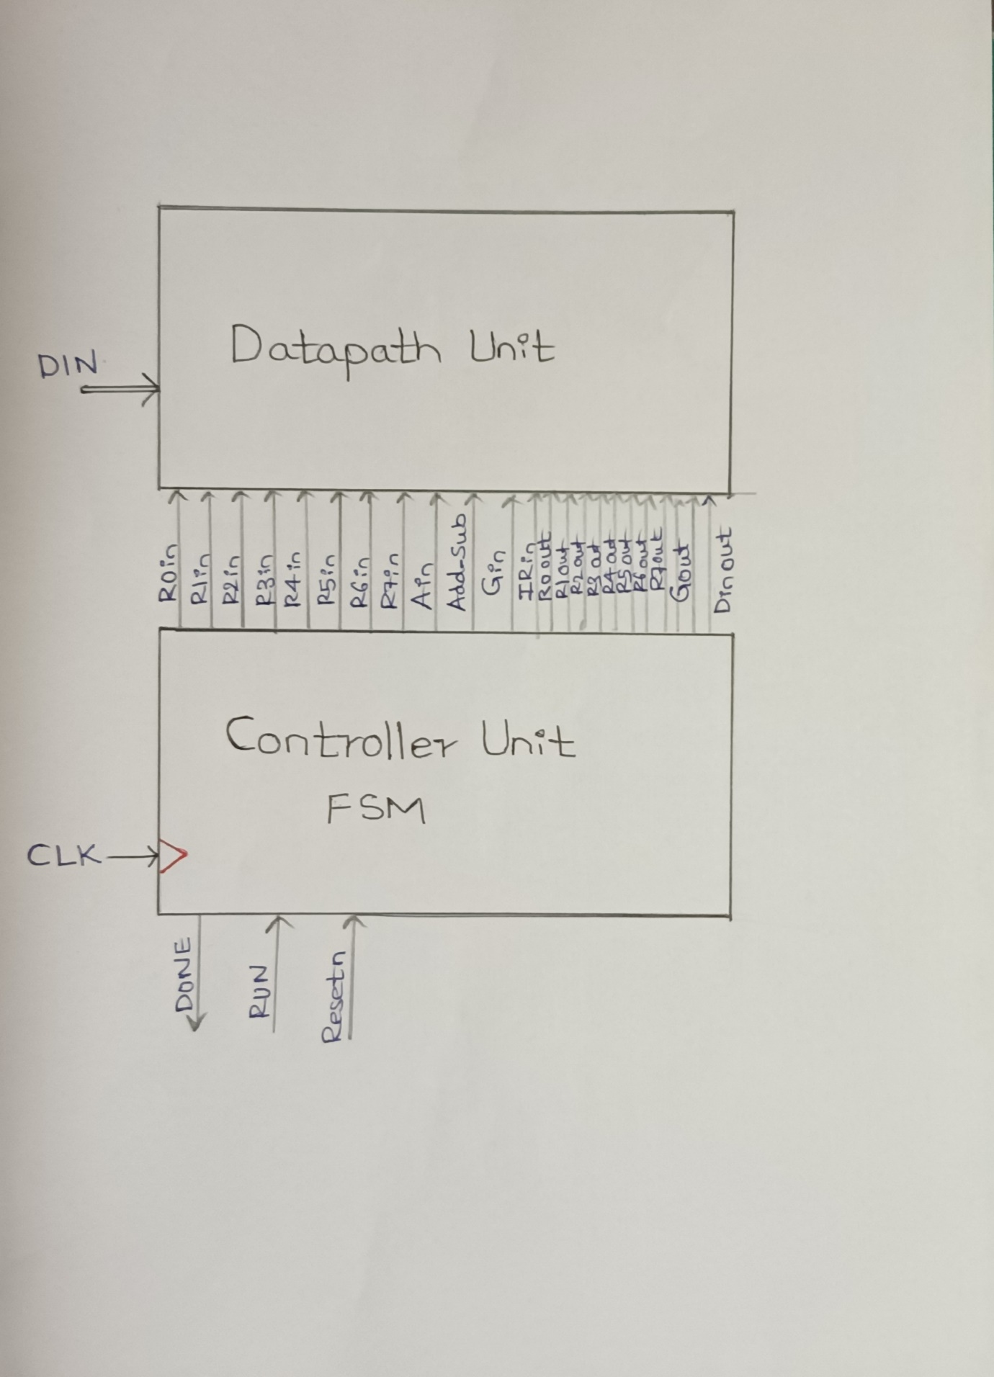
ARCHITECTURE DESIGN OF SIMPLE PROCESSOR:
Figure 1.1 The Block diagram of Simple processor showing Datapath and Control path block.

Slide 4
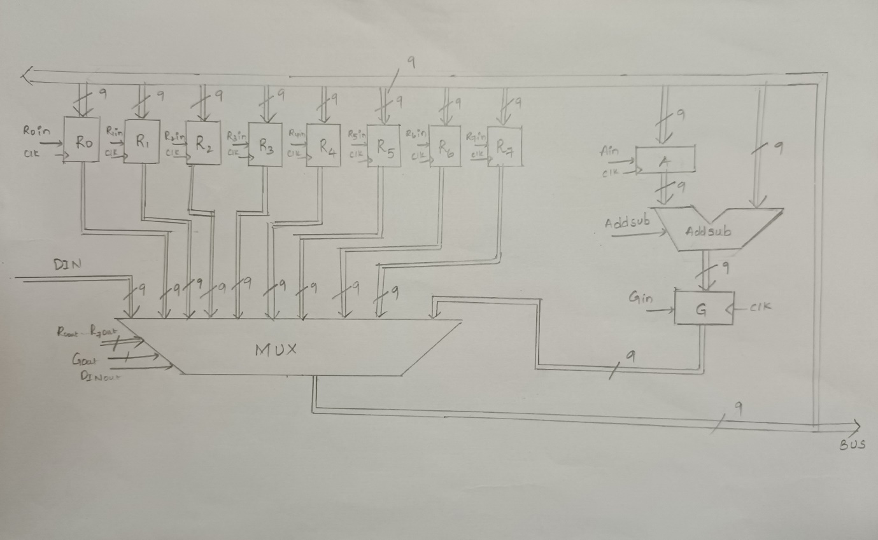
DATAPATH OF SIMPLE PROCESSOR
Figure 1.2 The Block diagram of Simple processor showing Datapath block.

Slide 5
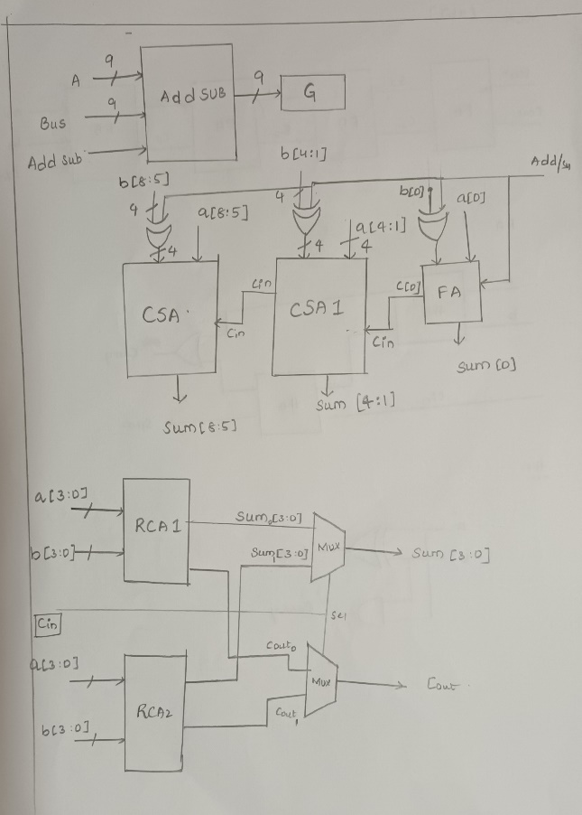
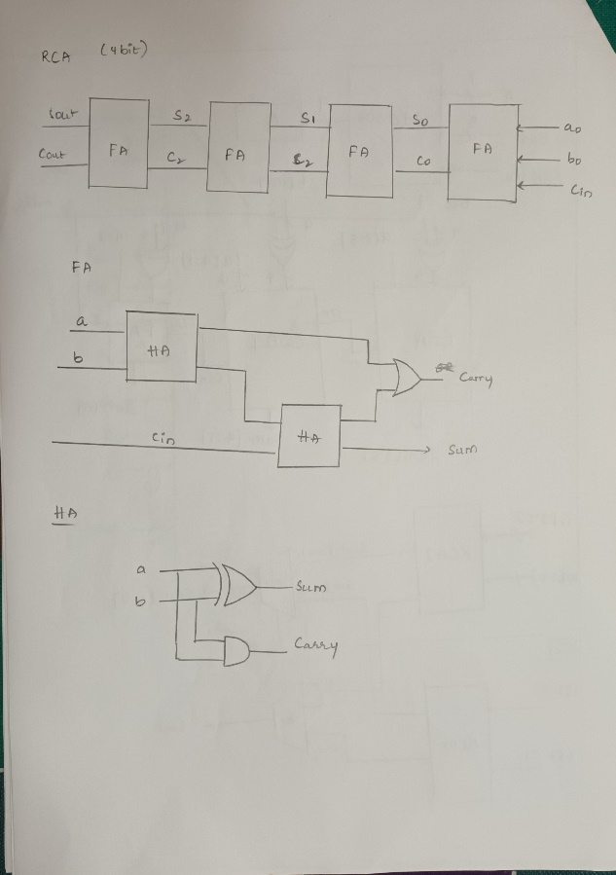
DATAPATH SUBMODULES
Figure 1.3 The Block diagram of Adder and Subtractor block.

Slide 6
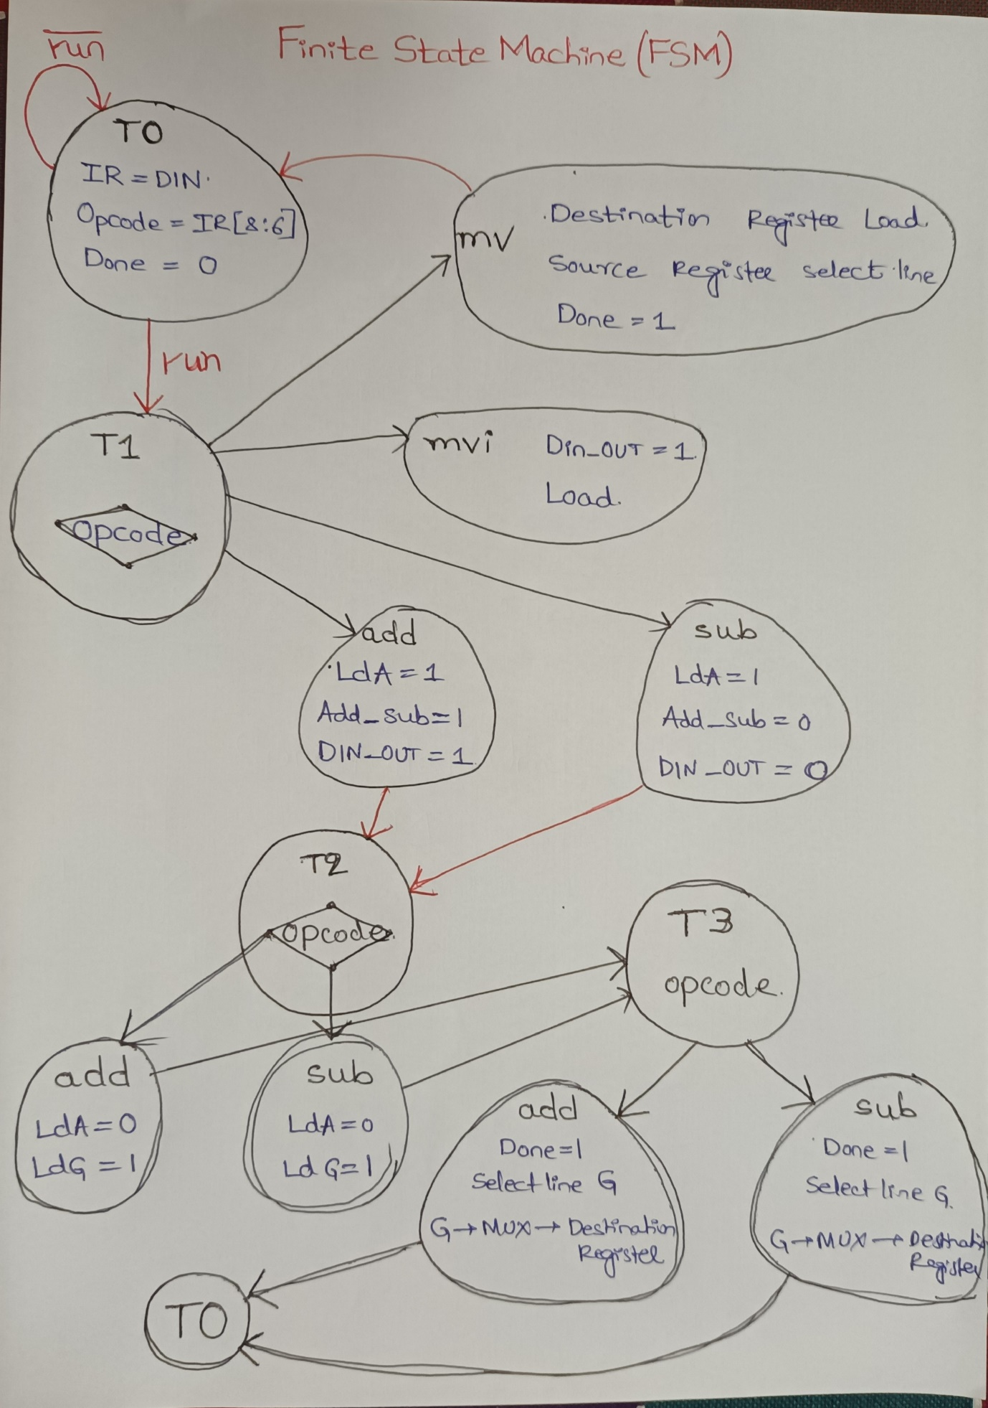
FINITE STATE MACHINE FOR CONTROLLER BLOCK
Figure 1.4 The Finite State Machine for Controller Block.

Slide 7
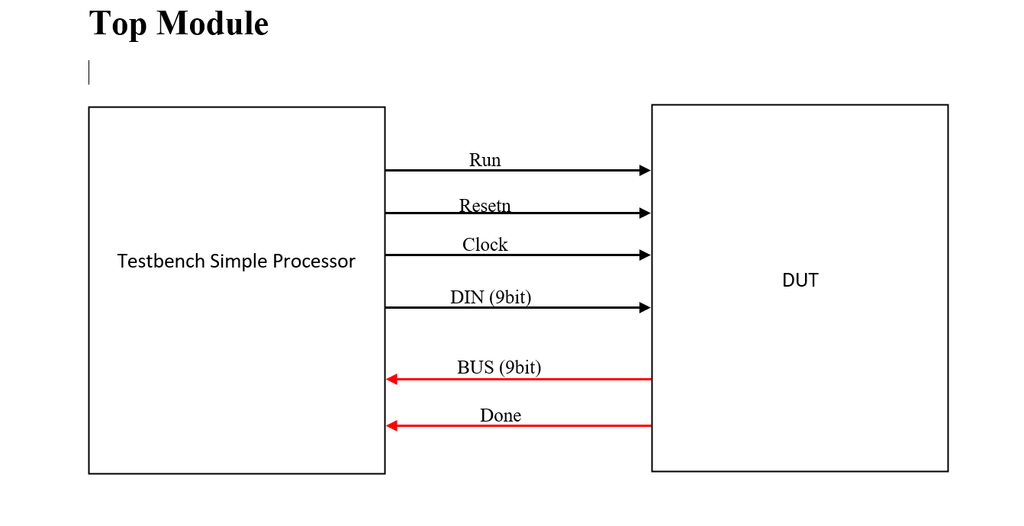
TOP MODULE

Slide 8
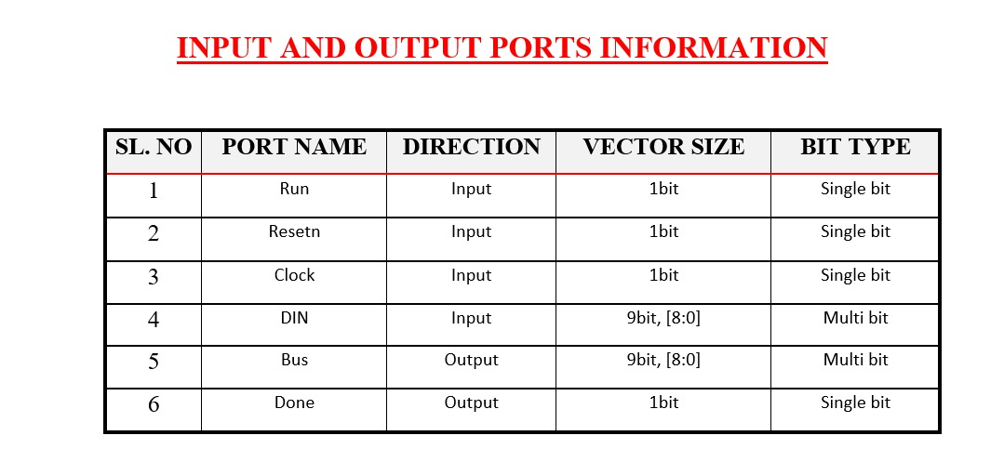

Slide 9
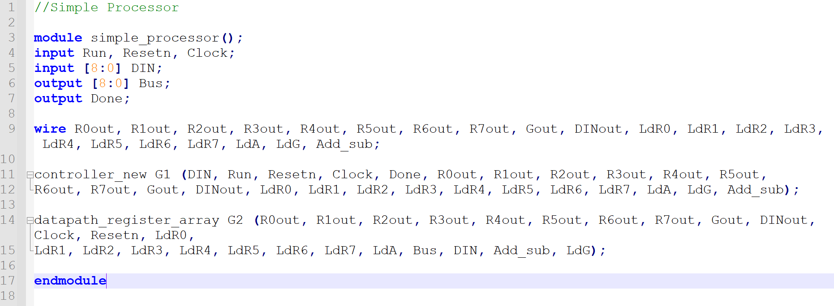
TOP MODULE CODE SNIPPET

Slide 11
THANK YOU

