Slide 1

Introduction to Version Control and GitHub
By: Muhammad Elsadany
Notes:
Good morning/afternoon everyone,
I hope you're all doing well today. I'm really excited to be here with you all to talk about something that's not only incredibly important in the world of research computing but also has the potential to revolutionize the way we collaborate on projects.
To set the stage, let's take a little journey together. Imagine for a moment that we're all artists. Each of us has our own canvas, and while we're individually talented, we've been given a challenge: to create a masterpiece together.
Now, how might we go about this? How can we ensure that our artistic visions align, that our strokes complement each other, and that we're able to combine our talents seamlessly? That's where our collaborative art studio comes in - and in the world of technology, this studio is known as GitHub.
In this studio, we'll have tools that allow us to work on our own pieces (our local machines), make changes, and even experiment with new techniques (thanks to Git). We'll have a gallery, where we'll display our work, discuss ideas, and improve upon each other's contributions.
We'll have a bulletin board, too, for those moments when we have brilliant flashes of insight or notice areas that could use a little extra attention. And for the organizers among us, we'll have an exhibition space to help us see the bigger picture and understand how all our pieces fit together.
But what truly makes this studio special is the collaborative spirit. Every idea, every brushstroke, every stroke of the keyboard, contributes to our shared masterpiece. We all have a stake in this creation, and together, we can achieve something truly remarkable.
So, today, we're going to dive deep into this collaborative art studio called GitHub. We'll explore its tools, understand how it empowers us to work together seamlessly, and how it can enhance the way we approach research computing.
Are you all ready to embark on this creative journey with me?
Let's dive in!

Slide 2
Outline
Understanding Version Control
Navigating GitHub
Benefits of GitHub in Research
Challenges and Considerations
Q&A

Slide 3
Version Control
Definition:
A system that records changes to a file or set of files over time so that you can recall specific versions later.
Importance in Research Computing:
Ensures tracking of changes in code and documentation.
Facilitates collaboration among team members.
Notes:
Definition of Version Control:
"Imagine you're working on a group project. How do you keep track of changes and ensure everyone is on the same page?"
Importance in Research Computing:
"Version control does just that. It's like a time machine for your project."

Slide 4
Version Control System (VCS)
﻿A way to manage files and directories
﻿﻿Track changes over time
﻿﻿Recall previous versions
Notes:
Definition of Version Control:
"Imagine you're working on a group project. How do you keep track of changes and ensure everyone is on the same page?"
Importance in Research Computing:
"Version control does just that. It's like a time machine for your project."
What is it
A method for centrally storing files
Keeping a record of changes
Who did what, when in the system - Covering yourself when things inevitably go wrong

Slide 5


What is Git?
Definition:
A distributed version control system that allows multiple people to work on the same project at the same time.
Basic explanation of how Git works
Each user has a local copy of the entire project, including its history.
A command line version control program
Cross-platform (including Windows!)
Open source, free
Linus Torvalds
Notes:
Definition of Git:
"Git is like the magic behind version control. It allows multiple people to work on the same project at the same time, like a digital playground."
Basic explanation of how Git works:
"Each of you has your own sandbox (local copy), but you can still share toys (project files) with others."
﻿created by Linus Torvalds, April 200

Slide 6

Is Git for me?
People primarily working with source code
Anyone wanting to track edits (especially changes to text files)
review history of changes
anyone wanting to share, merge changes
Anyone not afraid of command line tools

Slide 7
Collaborative Art Studio VS. Git
Canvas | Repository (Repo)
Tools | Git
Easel | Local Machine
Gallery | Github
Collaboration | Pull Requests
Versioning | Commits and Branches
Notes:
Imagine you and your friends are artists. Each of you has a canvas to work on, but you want to create a masterpiece together. This is where the collaborative art studio, GitHub, comes in.
Canvas (Repository): Your canvas is your project. It could be a painting, a sculpture, or even a multimedia installation - in the world of code, it's your software project.
"repo" = repository
usually used to organize a single project repos can contain folders and files, images, videos, spreadsheets, and data sets - anything
your project needs
Tools (Git): Git is like your magical paintbrush. It allows you to make changes, add details, and even undo if something doesn't turn out as expected.
Easel (Local Machine): Each artist (developer) has their own easel (local machine). This is where you work on your part of the project.
Gallery (GitHub): GitHub is the gallery where all the canvases are displayed. It's where you and your friends showcase your work, discuss ideas, and make improvements together.
Collaboration (Pull Requests): Let's say you want to add a beautiful sunset to the background of the painting. You create a sketch, take a picture, and share it with your friends. They can look at it, suggest changes, and discuss until everyone agrees it's perfect. This is like creating a pull request on GitHub.
Versioning (Commits and Branches): If someone wants to try a different technique, they can create a copy of the canvas, make changes, and compare. This is similar to creating branches in Git. And when you're happy with a particular version, you save it as a milestone - this is like making a commit.

Slide 8
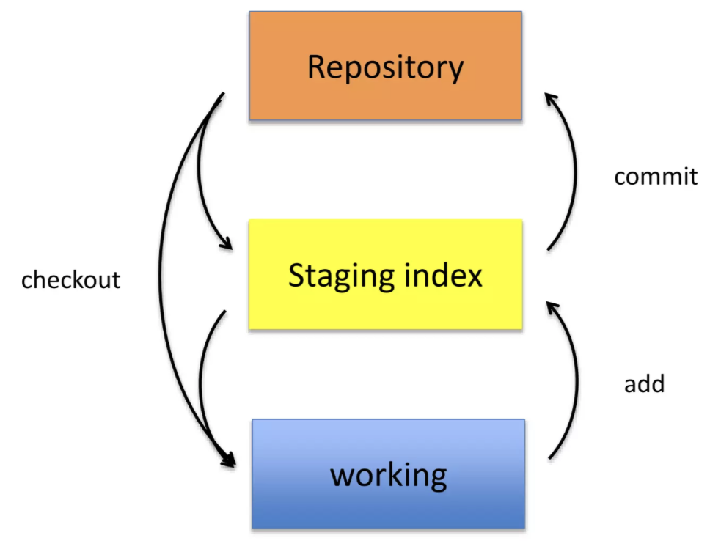
Git uses a three-tree architecture
Working Directory:
The actual files on your local system.
Where you make changes and edits to your project.
Staging Area (Index):
Acts as a middle ground between your Working Directory and the Repository.
Files here are ready to be committed.
Repository (Commit History):
Contains all the committed versions of your project.
Each commit represents a snapshot of the project at a specific point in time.
Notes:
Commits:
A commit is a snapshot of your project at a specific point in time.
"Commits are like snapshots of your project. Think of them as milestones on your journey."
Branches:
Branches allow you to work on different parts of the project simultaneously.
"Branches are like different storylines in a choose-your-own-adventure book. You can explore new ideas without messing up the main story."
Merging:
Merging combines changes from different branches into a single branch.
"Merging is like weaving those storylines back together when you're ready to continue with one main narrative."
Pull Requests:
Pull requests are proposed changes that can be reviewed before merging.
"Pull requests are like invitations to a group discussion. They allow team members to review and discuss proposed changes."

Slide 9
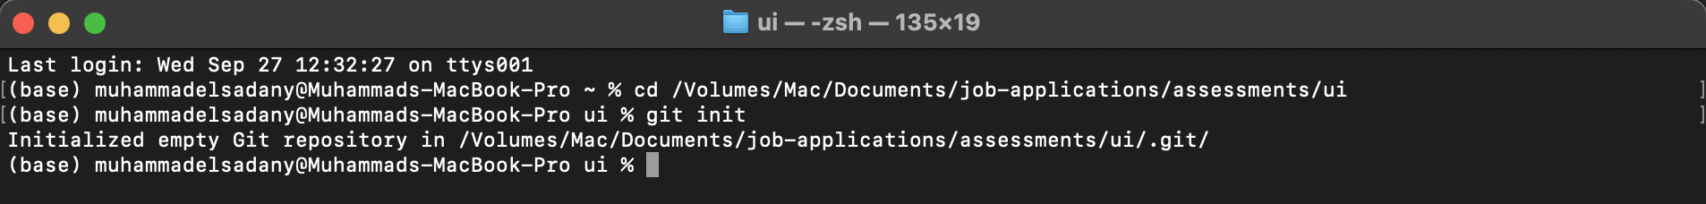
A Simple Git Workflow
Initialize a new project in a directory
git init
Add a file using a text editor to the directory
Add every change that has been made to the directory
git add .
Commit the change to the repo
git commit -m "important message here"

Slide 10
A Simple Git Workflow
Initialize a new project in a directory
git init
Add a file using a text editor to the directory
Add every change that has been made to the directory:
git add .
Commit the change to the repo:
git commit -m "important message here"

Slide 11
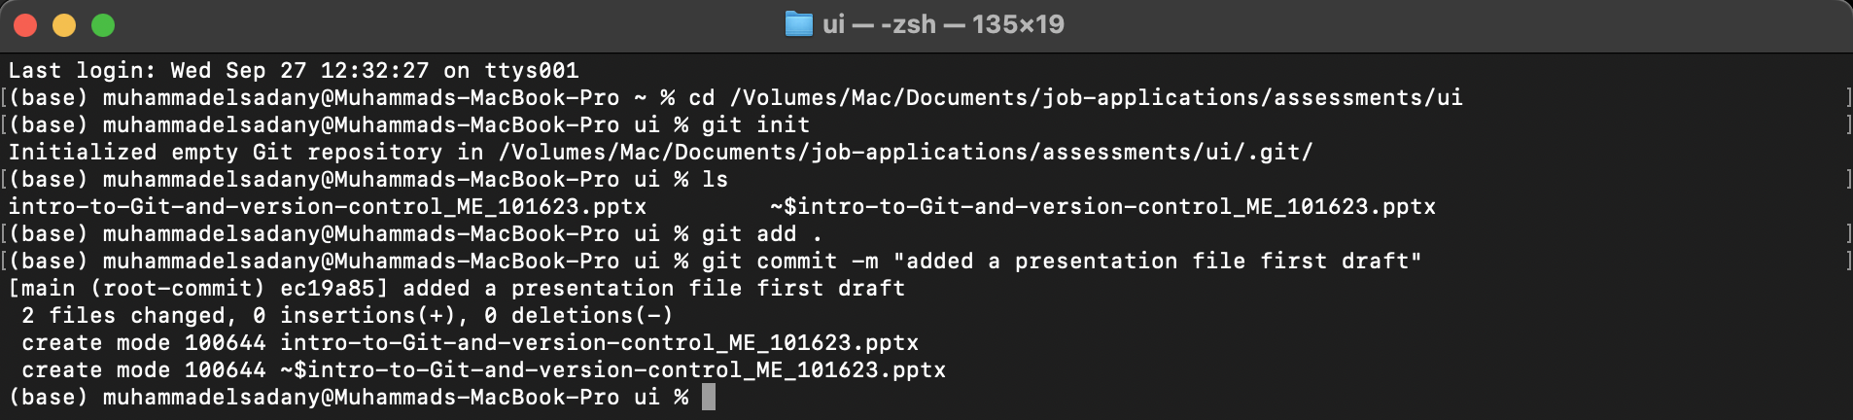
A Simple Git Workflow
Initialize a new project in a directory
git init
Add a file using a text editor to the directory
Add every change that has been made to the directory
git add .
Commit the change to the repo:
git commit -m "important message here"

Slide 12
A Simple Git Workflow
Initialize a new project in a directory
git init
Add a file using a text editor to the directory
Add every change that has been made to the directory
git add .
Commit the change to the repo
git commit -m "important message here"

Slide 13
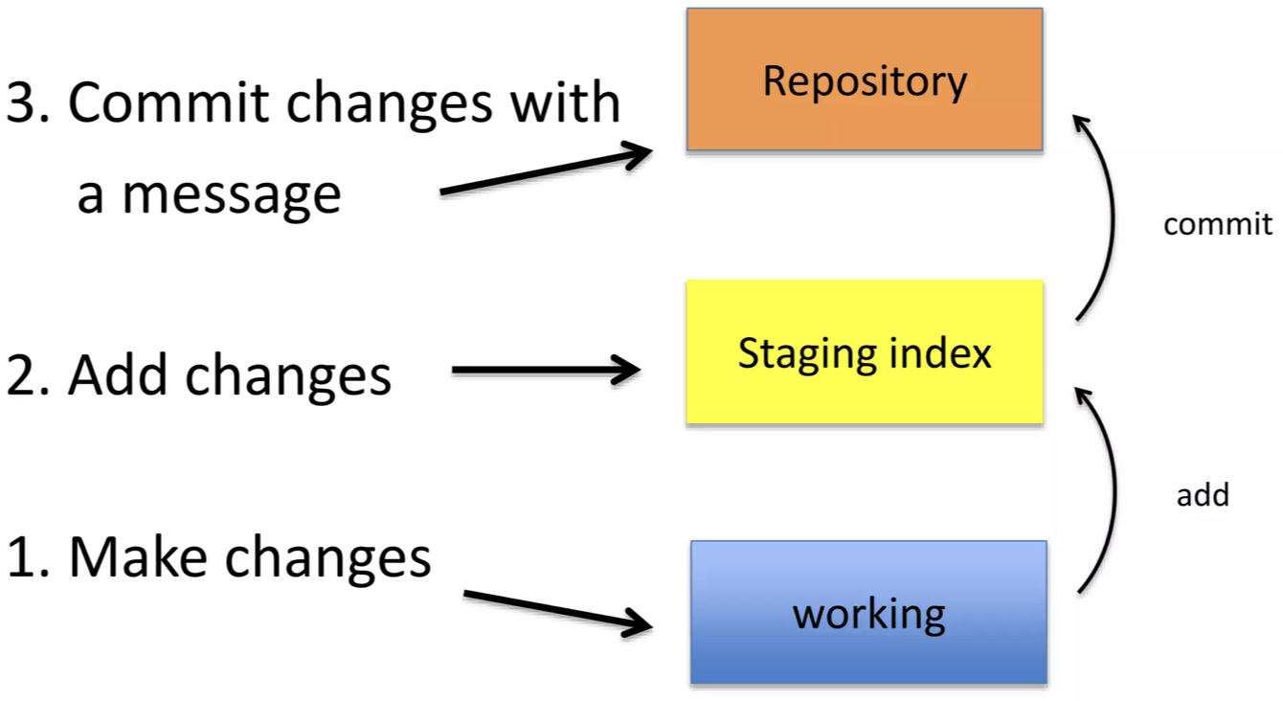
After Initializing a Git Repo..

Slide 14

A note about commit messages
Tell what it does (present tense)
Single line summary followed by blank space followed by more complete description
Keep lines to <= 72 characters

Slide 15
Good and bad examples
Bad:
"Typo fix"
Good:
"Add missing / in CSS section"
Bad:
"Updates the table. We'll discuss next

Slide 16
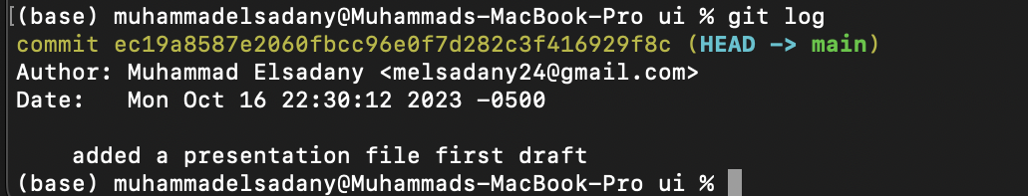
How to I see what was done?
git log

Slide 17
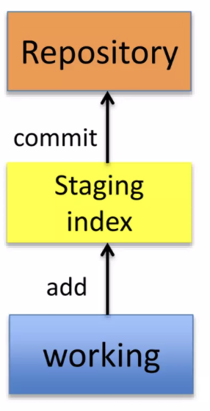
Which files were changed and where do they sit in the three tree?
git status
Allows one to see where files are in the three-tree scheme

Slide 19
Introducing GitHub
Definition of GitHub
GitHub is a web-based platform that provides hosting for Git repositories and a range of collaboration features.
How GitHub enhances Git
Offers a user-friendly interface for managing repositories.
Facilitates easy collaboration among team members.
Notes:
Definition of GitHub:
"GitHub is like a central meeting place for your project. It provides a space for storing and collaborating on your work."
How GitHub enhances Git:
"It's like adding a cozy lounge area to your playground. It makes collaboration more comfortable and organized."

Slide 20
Creating a Repository on GitHub
Walkthrough of creating a new repository on GitHub:
Go to GitHub and click on "New" to create a new repository.
Provide a name, description, and choose privacy settings.
Notes:
Walkthrough of creating a new repository on GitHub:
"Let's create a virtual sandbox together. Go to GitHub, click 'New,' and give it a name, like 'MyAwesomeProject.'"

Slide 21
Cloning a Repository
Explanation of cloning:
Cloning means creating a local copy of a repository from GitHub to your computer.
How to clone a repository:
Use the command git clone [repository URL] in your terminal.
Notes:
xplanation of cloning:
"Now, let's bring that virtual sandbox to your computer. Use the command git clone [repository URL]."
How to clone a repository:
"Watch as your sandbox materializes on your computer!"

Slide 22
Making Changes and Committing
Demonstrating how to make changes and commit them using Git:
Make changes to files in your local repository.
Use git add [file] to stage changes and git commit -m "message" to commit.
Notes:
Demonstrating how to make changes and commit them using Git:
"Alright, let's build something! Make some changes, stage them with git add, and give your changes a meaningful description."

Slide 23
Branching and Merging
Explanation of branching and merging in Git:
Branches allow you to work on different features or fixes simultaneously.
Merging combines changes from one branch into another.
How to create and merge branches:
Use git branch [branch name] to create a new branch.
Use git merge [branch name] to merge changes.
Notes:
Explanation of branching and merging in Git:
"Time for a creative exercise! Create a new branch and try out a different idea."
"When you're ready, let's merge our ideas back into the main story."

Slide 24
Pull Requests and Collaboration
Definition of pull requests:
Pull requests are proposed changes that can be reviewed and discussed before merging.
How pull requests facilitate collaboration:
Allows for feedback and discussion on proposed changes.
Ensures code quality and consistency.
Notes:
Definition of pull requests:
"Now, let's open the floor for discussion. Create a pull request and let your team members review your work."

Slide 25
Issues and Project Management
How GitHub helps in issue tracking and project management:
Users can create and assign issues for tasks or bugs.
Projects and milestones can be used for organization and tracking progress.
Notes:
How GitHub helps in issue tracking and project management:
"Imagine a bulletin board where you can pin tasks or notes. That's what issues are for. They help organize and keep track of what needs to be done."

Slide 26
Best Practices in Version Control and GitHub
Clear commit messages
Using branches effectively
Collaborative workflows

Slide 27
Demo
Show a brief live demo of creating a repository, making changes, creating a pull request, and merging.
Notes:
how a brief live demo of creating a repository, making changes, creating a pull request, and merging.

Slide 28
Benefits of Using Version Control and GitHub in Research Computing
improved Collaboration
Reproducibility
Versioning and History

Slide 29
Challenges and Considerations
Potential challenges and how to address them
Data privacy and security considerations

Slide 30
Q&A

