Slide 1

CLINICAL DATA SCIENCE
OMOP Concept Mapping
From a hospital's private codes to the common language of research
COMET · Central Online Mapping & Export Tool
Notes:
Welcome. This talk is about turning a hospital's private codes into the shared language of research — OMOP concept mapping — and the tool we built to do it: COMET. We'll cover the problem, the two vocabulary worlds we bridge, how the mapping actually builds the research database, and what the new COMET adds. Keep the through-line simple: incompatible local codes in, clean standardized data out.

Slide 2

The problem: a Babel of health data
Every hospital records the same care in a different, private code language
Two hospitals ask the same question
— how many diabetic patients received a drug, and what happened? Both hold the answer. Neither can combine it.
The obstacle isn't missing data. It's that local codes mean nothing outside the walls that made them — diagnoses, drugs, labs, units, all defined in-house and subtly incompatible.
"diabetes" → 2119534 at Hospital A "diabetes" → 44054006 at Hospital B
Fragmented islands of incompatible code languages
Not a shortage of data — a Babel of it.
Notes:
The core problem isn't missing data — it's incompatible data. Every hospital invents its own codes, so the same fact, "diabetes," is a different number in each system. Point at the example: same word, two codes, and you can't combine them. That is exactly what mapping fixes.

Slide 3


OMOP: one shared vocabulary
The OHDSI Common Data Model gives every clinical fact a universal concept
Every fact points at a concept in one giant reference table — millions of rows spanning SNOMED, LOINC, RxNorm and more.
One vocabulary per domain is the standard everyone analyzes against. A source code reaches it through the "Maps to" relationship.
ICD-10-CA
I10
non-standard source
SNOMED
59621000
standard target
"Maps to"
how the hospital wrote it
how OMOP analyzes it
many local codes → one standard concept
The deliverable: SOURCE_TO_CONCEPT_MAP
a clean list of local-code → standard-concept, ready to drive the ETL that populates the CDM.
Notes:
OMOP is the shared language that fixes Babel. Every clinical fact points to one concept in a giant reference table. Each domain has one "standard" vocabulary everyone analyzes against, and a source code reaches it through the "Maps to" relationship. The picture on the left is the whole idea: many local codes collapse into one standard concept.

Slide 4





Why mapping is hard
It is not one hard decision — it is a hundred thousand small ones
Ambiguity "Ca" = cancer? calcium? Terse clinical shorthand needs judgement, not string matching.
The one rule that
makes it work
Granularity & cardinality Source codes are broader or narrower than any one concept; rarely a tidy 1-to-1.
A map may only target a standard, valid concept.
Scale & the long tail 100,000+ codes per hospital. You must map by impact — highest-usage first.
Map to a non-standard or retired code and the data silently drops out of every standard analysis. COMET enforces this at the moment of decision — and offers the correct replacement.
Drift & versioning Quarterly vocabulary releases retire and replace concepts; correct maps silently rot.
Notes:
Set expectations: this isn't one hard decision, it's a hundred thousand small ones. Codes are ambiguous, rarely one-to-one, and there's a huge long tail — so you map by impact. Vocabularies also change quarterly, so correct maps silently rot. The one rule that makes it all work: only ever map to a standard, valid concept.

Slide 5




The source side: Cerner Millennium terminology
How a Millennium build names the things it records
Nomenclature
Clinical Event Codes
Coded clinical terms — diagnoses & problems. Each row is a nomenclature_id + mnemonic + description.
event_cd identifies every kind of clinical event — labs, vitals, observations, documents.
MR sheet: Diagnosis & Problem
MR sheet: Event · Event Result
Code Sets & Code Values
Multum
Enumerated attributes — admit source, discharge disposition, encounter type — keyed by code_set + code_value.
Cerner's bundled medication vocabulary for orders & meds — becomes RxNorm on the OMOP side.
MR sheet: Admit Source · Encounter
MR sheet: Medication orders
Every entry is a local, numeric id with a mnemonic and free-text description — configured per Millennium build, and exported to COMET as "MR sheets," one per Cerner area.
Notes:
Now the source side. Cerner Millennium names things four ways: nomenclature for diagnoses, event codes for labs and vitals, code sets for enumerated attributes, and Multum for drugs. Key point: these are local, numeric ids configured per hospital build, exported to COMET as "MR sheets" — one per Cerner area.

Slide 6




Why Cerner codes need mapping
Local, build-specific, and only sometimes carrying a standard reference
Site & build specific
the same term gets a different nomenclature_id in every Millennium build — ids don't travel between hospitals
A real source row
Mixed provenance
some rows carry a CKI pointing at SNOMED / ICD-10 / Multum (a head start); many are pure local free-text
nomenclature_id
270660884
description
"Abdominal pain (3),
moderate… GI003"
Up to six code "spots" per row
mnemonic, description, source vocabulary, source code… COMET reconciles them into one decision
source vocabulary
Cerner (local)
CKI
— none
Usage-weighted long tail
a few codes cover most records; tens of thousands of rare ones form the tail — so you map by impact
records
60,055
no standard reference → a human maps it
Notes:
Why not use these codes as-is? They're build-specific — the same term has a different id at every site. Some carry a CKI hint to SNOMED or ICD, but many are pure local free-text. Walk through the example: no standard reference, 60,000 records behind it — so a human has to map it.

Slide 7


From Cerner area to OMOP domain
Each source area lands in the CDM table built for it
Cerner area
OMOP domain
CDM table
Diagnosis & Problem
→ Condition
CONDITION_OCCURRENCE
Event Result — labs & vitals
→ Measurement / Observation
MEASUREMENT · OBSERVATION
Medications (Multum)
→ Drug
DRUG_EXPOSURE
Procedures
→ Procedure
PROCEDURE_OCCURRENCE
Encounter · Admit · Discharge
→ Visit
VISIT_OCCURRENCE
Location · Org · Provider
→ Metadata
CARE_SITE · PROVIDER
The target concept's domain decides the destination — pick the right standard concept and the ETL routes the record to the correct CDM table automatically.
Notes:
This crosswalk answers "where does each thing go?" Diagnoses become Conditions, labs become Measurements, meds become Drugs, and so on — each landing in the CDM table built for it. The important idea: you don't choose the table. The target concept's domain decides it, and the ETL routes the record automatically.

Slide 8



Where the MR sheets come from
Extracted from Millennium, versioned, and weighted by real-world use
Extracted per area
Millennium exports each Cerner area as a tab-delimited MappingReport — the "MR sheet" COMET imports
The scale COMET imports
Weighted by usage
every row carries its record volume — a handful of codes cover most data, so you map by impact first
189k
source terms across 22 Cerner areas
1.5B
patient records those terms describe
Versioned & drifting
each new MR marks a term New, Still present, or Absent as the Millennium build evolves
60,055
records behind the single busiest term
A snapshot in time
a map is made against the term as captured — COMET stores that snapshot so the decision stays auditable
Map the top of the curve and you standardize the bulk of the data.
Notes:
Context on the source data itself. Millennium exports each area as a MappingReport that COMET imports. Every row carries its record volume, so we map the busiest terms first. Reports are versioned — terms appear as New, Still present, or Absent as the build evolves. Note the scale: 189,000 terms describing 1.5 billion records.

Slide 9

OHDSI Athena: the standardized vocabularies
One harmonized, versioned download that defines every standard concept
The reference side
What's in the bundle
CONCEPT
CONCEPT_RELATIONSHIP
Athena (athena.ohdsi.org) is the OHDSI download portal for the OMOP Standardized Vocabularies, curated by the OHDSI Vocabulary team.
CONCEPT_ANCESTOR
CONCEPT_SYNONYM
It bundles 100+ source vocabularies into one model — standard-concept flags and every "Maps to" are pre-computed, so you never harmonize them yourself. You pick vocabularies and download a versioned bundle (a "vintage"); a few (e.g. CPT-4) need a UMLS licence.
VOCABULARY
DOMAIN
CONCEPT_CLASS
DRUG_STRENGTH
Bundled source vocabularies SNOMED · RxNorm · LOINC · ICD-10 · ICD-10-CM · ATC · UCUM · HCPCS · CVX · Multum · NDC · read …
Notes:
This is where the standard vocabulary comes from — Athena, the OHDSI download portal. The big win: it bundles 100-plus source vocabularies into one model with standard flags and "Maps to" already computed, so we never harmonize them ourselves. You pick vocabularies and download a versioned "vintage"; a few, like CPT-4, need a licence.

Slide 10





How COMET consumes Athena
Load once, version forever — the reference behind search, domains & drift detection
Download
Stage
Atomic swap
Vintage stamped
pick vocabularies,
get a vintage
bulk-load into
*_stg tables
RENAME live ⇄ staged
— zero downtime
recorded & shown
on the home page
Every table earns its keep
CONCEPT + CONCEPT_SYNONYM → the hybrid ranked search
CONCEPT_ANCESTOR → hierarchy browse & roll-ups
DOMAIN → the OMOP-domain view
CONCEPT_RELATIONSHIP → guardrails + vocabulary-impact report across vintages
Canadian extensions load alongside as custom vocabularies · validated on real data — GiBleed: 444 concepts, 65,690 ancestors.
Notes:
How COMET uses that download. Load it once through staged tables with an atomic swap — zero downtime — and stamp the vintage on the home page. Then every table earns its keep: concepts and synonyms drive search, ancestors drive hierarchy, domain drives the domain view, relationships drive guardrails and the impact report. Validated on real data.

Slide 11
Anatomy of a standard concept
Every row in the CONCEPT table — and what each field decides
Eight fields carry the entire meaning of a clinical fact — the standard_concept flag is the one that decides whether your data is analyzable.
concept_id the universal key
concept_name human-readable label
domain_id routes it to a CDM table
vocabulary_id SNOMED · RxNorm · LOINC…
concept_class_id granularity / type
standard_concept 'S' std · 'C' class · — source ★
concept_code the code in its own vocabulary
valid dates · invalid_reason lifecycle & retirement
A real concept: 316866 · Hypertensive disorder · Condition · SNOMED · concept_class Clinical Finding · standard_concept = 'S'
Notes:
Zoom into a single concept. Eight fields carry the whole meaning of a clinical fact. The one to remember is standard_concept — "S" means it's a valid analysis target. Everything else routes or describes it. The bottom row is a real one: 316866, Hypertensive disorder, marked "S".

Slide 12


Domains & hierarchy — how concepts connect
The standard concept you pick decides where the record lands and how it rolls up
Domain routes the record
Hierarchy enables roll-ups
Condition → CONDITION_OCCURRENCE
Disorder of cardiovascular system
Drug → DRUG_EXPOSURE
↳
Hypertensive disorder "Is a"
Measurement → MEASUREMENT
↳
Essential hypertension "Is a"
Procedure → PROCEDURE_OCCURRENCE
Query a parent, get every descendant. CONCEPT_ANCESTOR turns one query into a whole subtree — and "Maps to" / "Concept replaced by" keep source links and deprecations honest.
one domain per concept — no ambiguity about the destination table
Notes:
Two mechanics that matter downstream. First, a concept's domain decides its CDM table — one domain per concept, no ambiguity. Second, hierarchy: because concepts are linked by "Is a," you can query a parent like "Hypertensive disorder" and automatically get every descendant. That's what makes standardized data powerful, not just tidy.

Slide 13

COMET: the bridge
Two streams flow in, people map in the middle, one clean stream flows out
Athena
OMOP vocabulary
STCM
+ releases
OMOP CDM
analyzable
COMET
Cerner
MappingReports
search · guardrails
map · review
Human-in-the-loop by design. COMET never writes a map on its own — it is a shared web app (Laravel + PostgreSQL) that accelerates expert judgement and records every decision.
Notes:
Pull it together. Two streams flow in — the OMOP vocabulary from Athena, and Cerner's source terms. People map in the middle, and one clean stream flows out to the CDM. The line to land: COMET never writes a map on its own. It's a shared web app that accelerates expert judgement and records every decision.

Slide 14

SOURCE_TO_CONCEPT_MAP: the key the ETL turns
COMET's export isn't the destination — it's the lookup that populates the CDM
Raw Cerner event
code 273564275
"Hypertension"
SOURCE_TO_CONCEPT_MAP
join on source_code → target_concept_id 316866
CDM · CONDITION_OCCURRENCE
condition_concept_id
= 316866
Hypertensive disorder
Every raw record is joined to STCM on its source code — one lookup turns a local code into a standard concept.
Anatomy of one mapping row
source_code
the hospital's local code
source_code_description
human-readable label
source_vocabulary_id
which Cerner sheet
source_concept_id
2-billion custom id
target_concept_id
the standard concept ★
target_vocabulary_id
SNOMED · RxNorm · LOINC
valid_start / _end_date
versioning window
invalid_reason
retire / deprecate flag
Notes:
This is the deliverable and how it builds the CDM. Follow the flow: a raw Cerner event, joined to STCM on its source code, becomes a CDM row with a standard concept_id filled in. Below is what's in each mapping row — the one that matters is target_concept_id, the standard concept the map points to.

Slide 15




One row, a million records — provenance intact
Why a clean STCM is the highest-leverage artifact in the pipeline
One reviewed source term
"Hypertension" · code 17806565 · 31,558 occurrences
Leverage
one reviewed row standardizes every matching event — millions of records from a single decision
Provenance kept
the *_source_value and *_source_concept_id columns retain exactly what was captured
via STCM
Every matching CONDITION_OCCURRENCE row
Cross-site analysis
because targets are standard & valid, the same query runs at every OMOP site
condition_concept_id
316866 · Hypertensive disorder STANDARD — for analysis
condition_source_value
"Hypertension" kept verbatim
Versioned & reproducible
STCM releases are vocab-tagged — re-running the ETL reproduces the CDM exactly
condition_source_concept_id
2,000,000,017 · custom provenance preserved
A clean SOURCE_TO_CONCEPT_MAP is the hinge between raw records and research-ready data.
Notes:
Why STCM is so high-leverage. One reviewed row standardizes every matching record — one decision, millions of events. And nothing is lost: the CDM keeps the original source value and source concept id alongside the standard one, so every fact traces back. Because targets are standard and valid, the same query runs at every OMOP site.

Slide 16






Usagi — the OHDSI reference for mapping
The community's standard tool — and the philosophy COMET shares
How Usagi works
COMET shares it — at team scale
Similarity search
Lucene term matching proposes ranked standard-concept candidates, boosted by usage & translations
Same loop, more reach
web-based and multi-user, not a single-seat desktop app
Human review
a curator approves, rejects, or flags each suggested map — machine proposes, human decides
Guardrailed & governed
live OMOP vocab in Postgres, CDM v5.4 guardrails, review workflow, drift report, dashboards
STCM export
approved maps become a SOURCE_TO_CONCEPT_MAP — the very artifact COMET produces
Interoperable
COMET exports Usagi format, so it drops into existing OHDSI pipelines
Usagi's candidates are purely lexical — strong on clean terms, weaker on abbreviations and misspellings. That gap is exactly what comes next.
Notes:
Situate COMET in the OHDSI ecosystem. Usagi is the community's standard mapping tool: it proposes candidates by lexical similarity, a human approves them, and it exports a source-to-concept map. COMET shares that exact philosophy — machine proposes, human decides — but makes it web-based, multi-user, and guardrailed, and it even exports Usagi format. The catch to flag: Usagi's candidates are purely lexical, which is where the next slides pick up.

Slide 17
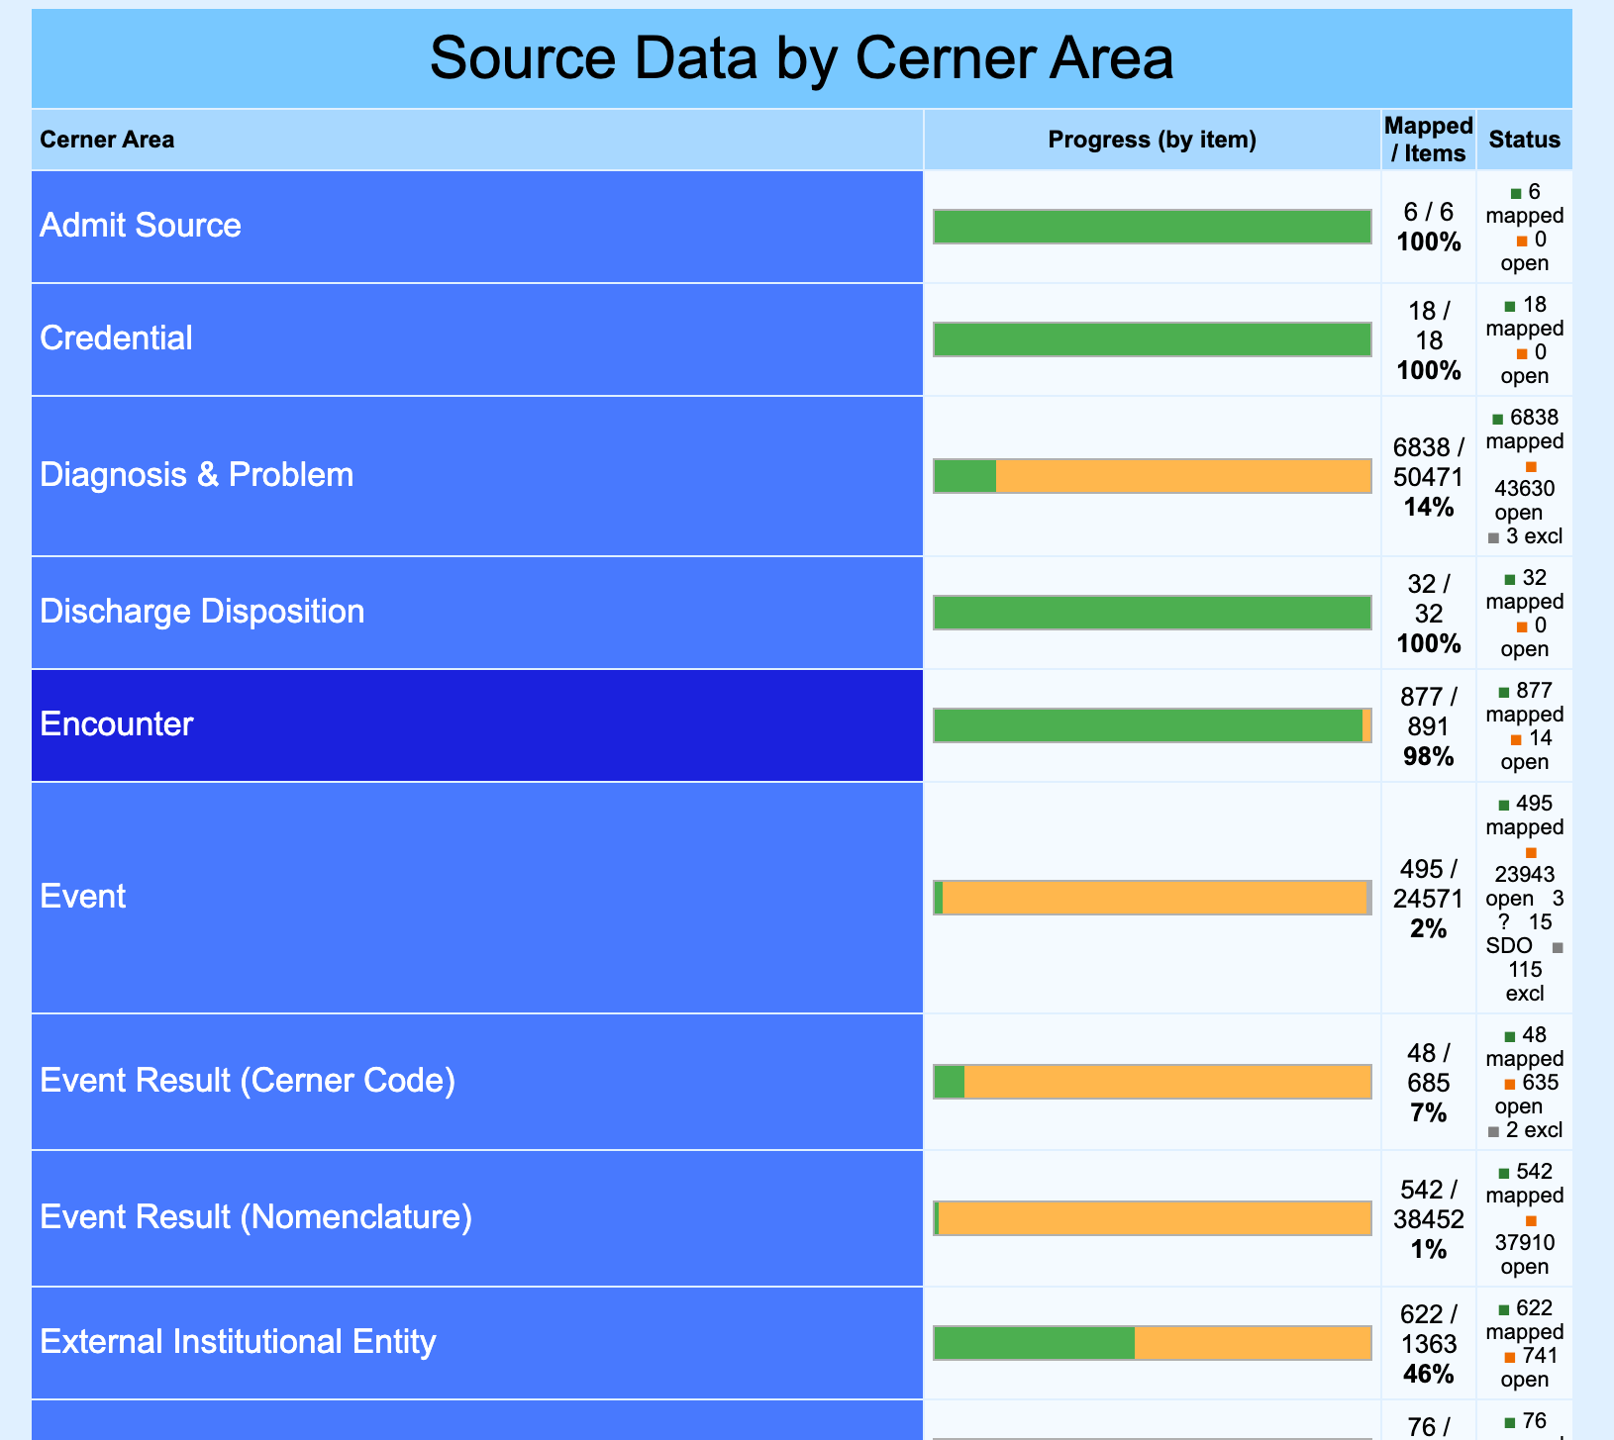


The original COMET
A legacy PHP tool that did the job — and showed where the ceiling was
Served its purpose
Procedural PHP — no framework, no tests, no linter — hard to change safely
Literal search — exact-string lookups; mappers transcribed from Athena by hand
No drift control — vocabulary updates silently broke existing maps
Fragile & unsafe — string-built SQL, local password login, and audit history that silently failed under strict mode
Roles and a review flow existed — but the foundation wasn't built to scale, was difficult to evolve.
Notes:
Now the product story. The original COMET did the job — and to be fair it already had multi-user accounts, the four roles, and a reviewer approval flow. But it was procedural PHP with literal search, no drift control, string-built SQL, and an audit trail that silently failed under strict mode. The mapping logic was sound; the foundation was fragile. That's what the rebuild set out to fix — same ideas, production-grade.

Slide 18
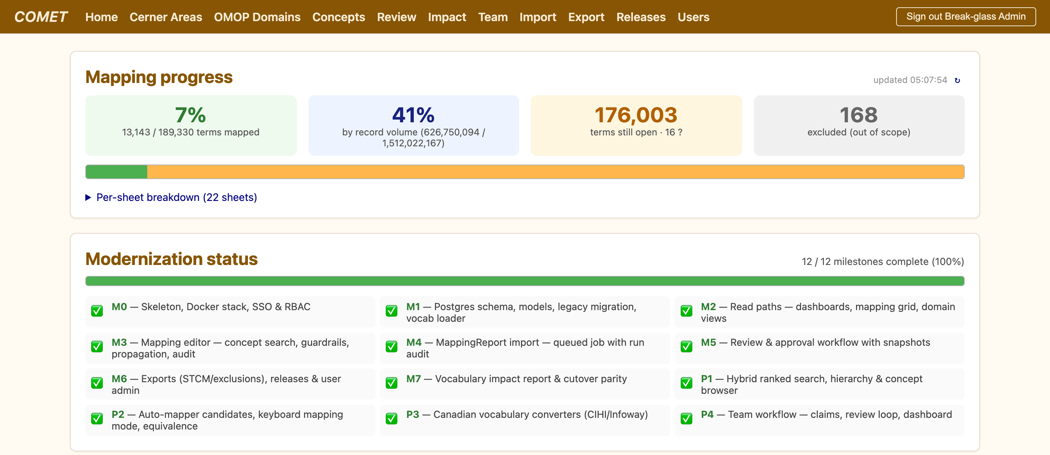




Rebuilt for scale & trust
A ground-up rebuild on a modern, OMOP-native stack
Laravel 12 + PostgreSQL 16
the vocabulary's natural home in OHDSI
Entra ID SSO + role-based access
mapper / importer / reviewer / admin
70 automated tests, CI, static analysis
correctness you can prove
16,111 maps migrated — parity verified
identical to the legacy system
12 / 12 modernization milestones complete — the full mapping loop, rebuilt
Notes:
The rebuild, on a modern OMOP-native stack: Laravel and Postgres, single sign-on with roles, 70 automated tests, and 16,000 maps migrated with verified parity — identical to the old system. Headline: all 12 modernization milestones complete. The full mapping loop, rebuilt.

Slide 19
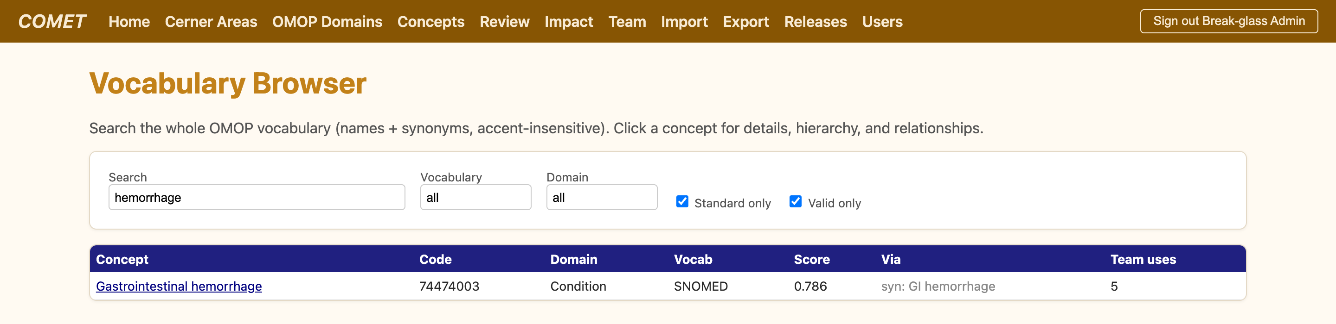

Enhancement 1 — search that understands clinical language
Not string matching: a layered, accent-insensitive ranking engine
Exact code
always ranked first
Trigram + accent-insensitive
typos & French synonyms match
Token coverage
reordered phrases still match
Real matches
"Emphysema of lung"
→ Pulmonary emphysema
"hemorrage stomach"
→ GI hemorrhage (synonym)
"Brain, concussion"
→ Concussion injury of brain
Notes:
First enhancement — search. This isn't string matching. It's layered: exact code first, then trigram and accent-insensitive matching for typos and French synonyms, then token coverage for reordered phrases. The examples on the right are real: messy input still finds the right concept.

Slide 20
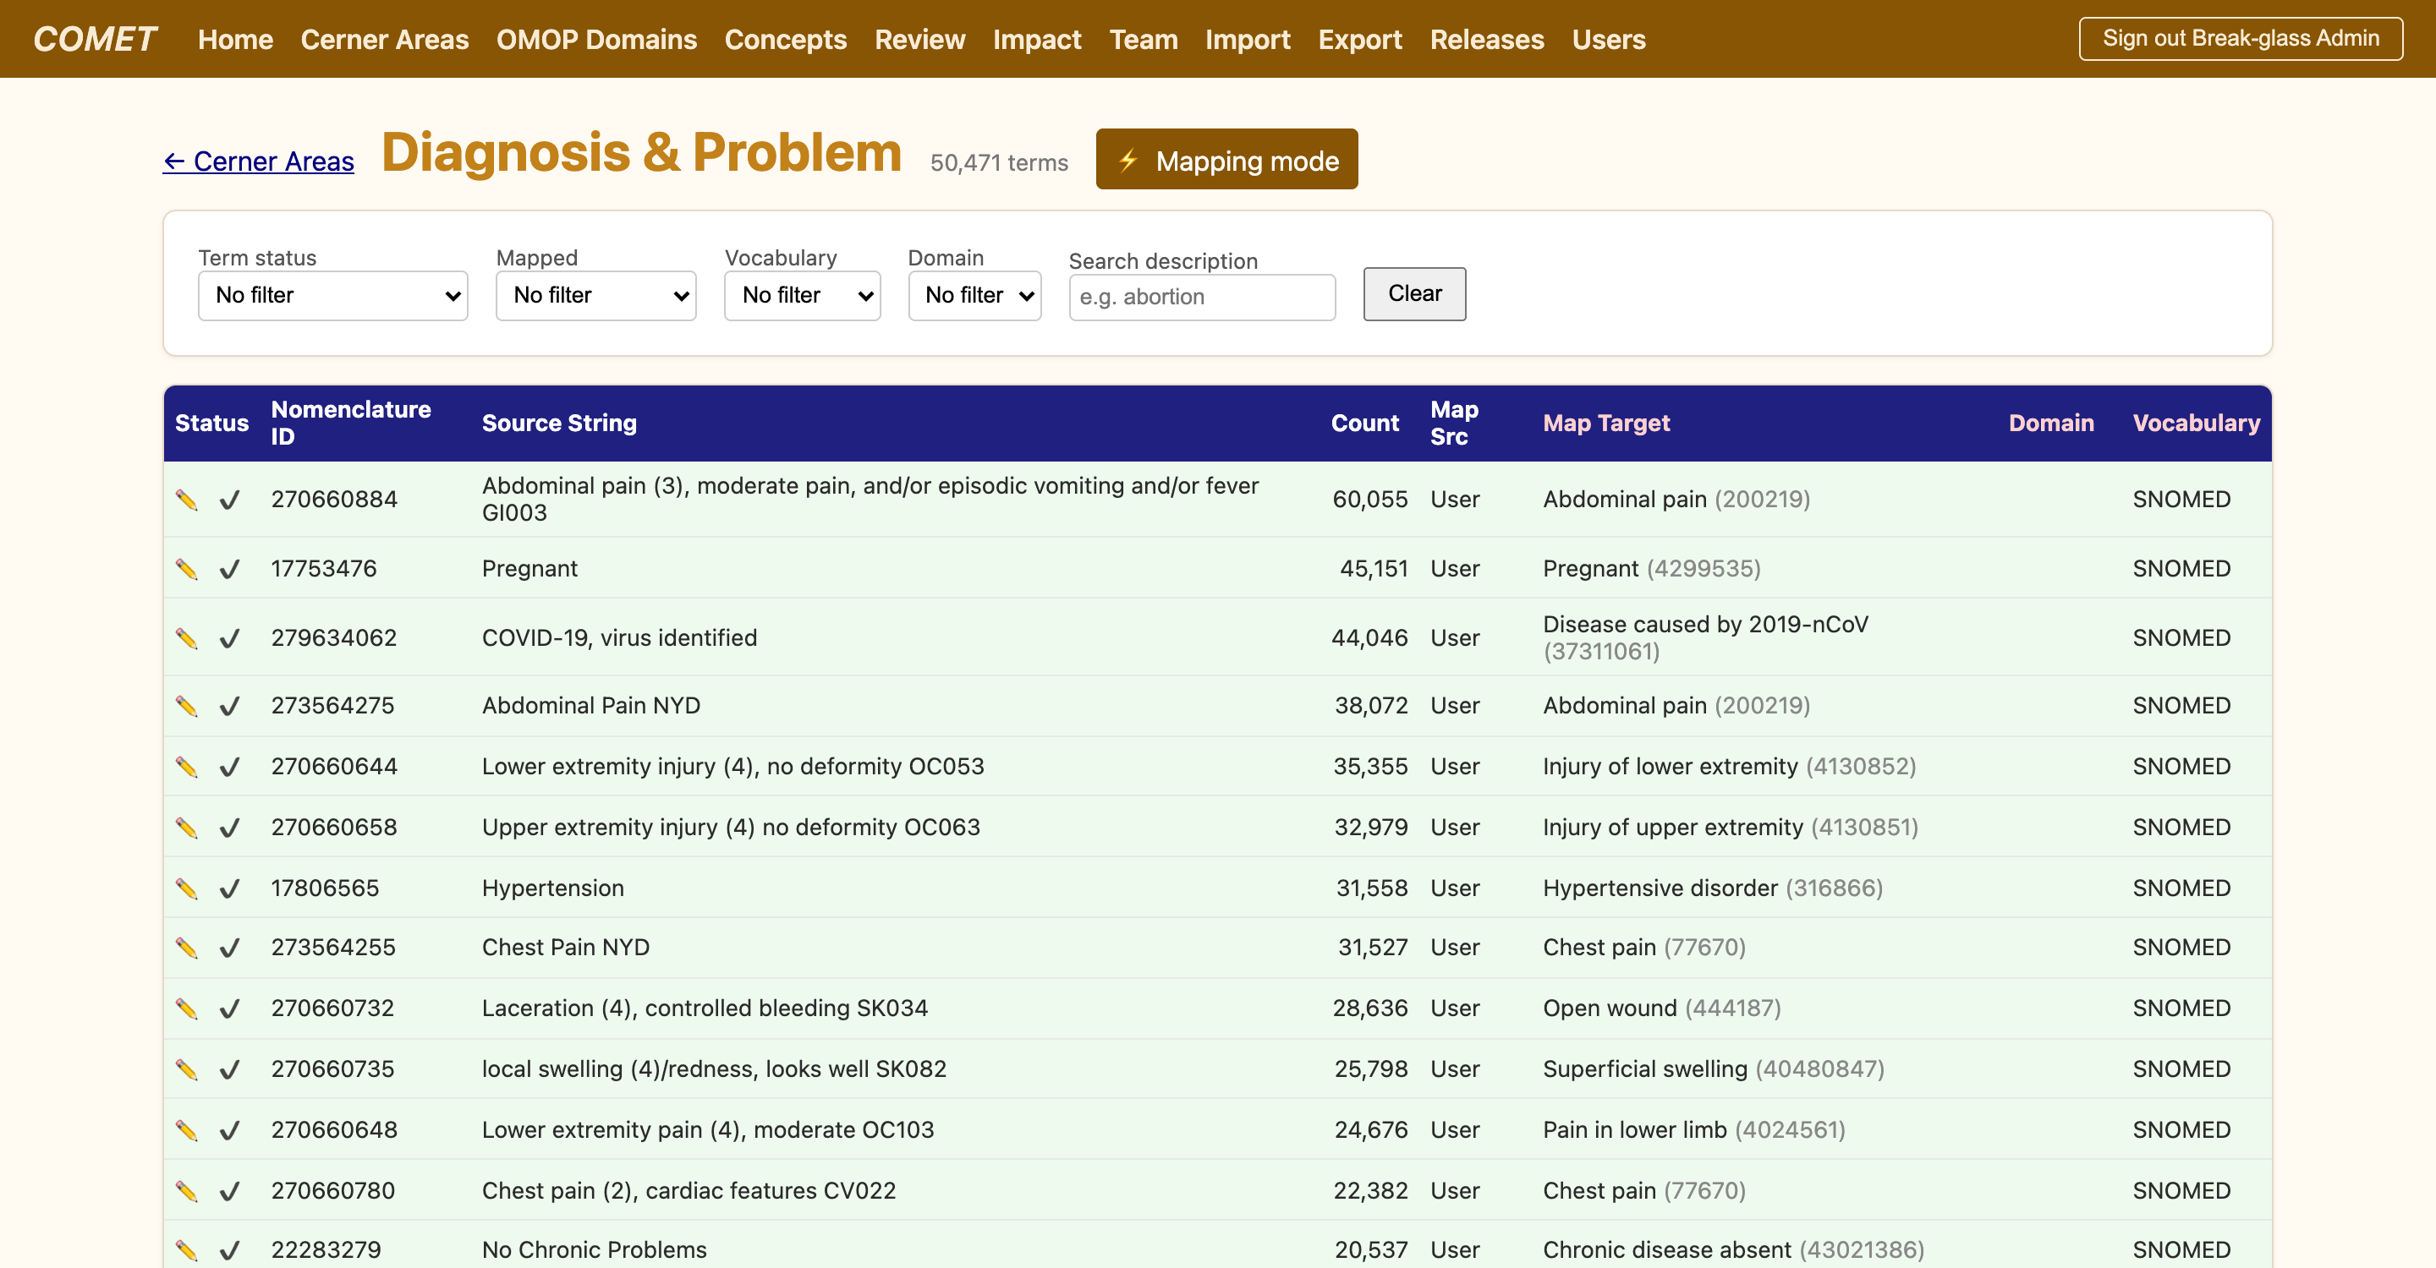



Enhancement 2 — mapping at scale
Candidates precomputed, then a keyboard-fast queue drives the volume
Batch auto-mapper
ranked candidates precomputed for every unmapped term
Keyboard mapping mode
1–9 to map, letters to set status, walk by usage
Equivalence
record EQUAL / WIDER / NARROWER fidelity
Propagation
apply one decision to all identical terms at once
124,621 candidates precomputed
across
48,180 terms — never a wait
Notes:
Second — mapping at scale. Candidates are precomputed for every unmapped term, so there's never a wait. A keyboard-driven mapping mode lets you fly down the queue, record equivalence, and propagate one decision to all identical terms. That's 124,000 candidates precomputed across 48,000 terms.

Slide 21


Enhancement 3 — guardrails, review & teamwork
Correctness enforced, drift caught, every decision remembered
CDM v5.4 guardrails
Immutable audit trail
Review & approve loop
block non-standard targets; offer the standard replacement
who mapped what, when — with a source snapshot
before/after, approve or return with a comment
Vocabulary impact report
Lightweight claims
Team dashboard
after each release, find & repair broken maps
two mappers never collide on the same term
throughput, backlog aging, pipeline at a glance
Every map is enforceable, reversible, and attributable — the difference between a spreadsheet and a system of record.
Notes:
Third — the trust layer. Guardrails block non-standard targets and offer the replacement. Every decision is audited. There's a review-and-approve loop, the vocabulary impact report catches drift after each release, lightweight claims stop collisions, and a dashboard shows the team's throughput. The line: the difference between a spreadsheet and a system of record.

Slide 22

Canadian vocabularies & real-world validation
First-class support for the codes Canadian hospitals actually use
Bringing Canada into OMOP
Validated on a real vocabulary sample (OHDSI Eunomia)
Vocabulary | Covers
ICD-10-CA | Diagnoses (CIHI)
CCI | Procedures (CIHI)
SNOMED CT-CA | Canadian concepts (Infoway)
pCLOCD | Lab observations
444+
real OMOP concepts loaded, with a 65k-row hierarchy
1.0
score: "Coronary arteriosclerosis" → the exact SNOMED concept
16,111
maps — byte-for-byte parity with the legacy system
Custom concepts use the reserved 2-billion id range; genuinely unmappable terms are escalated via the SDO submission path — never a forced, wrong map.
Real vocabulary → indexed search → auto-map → correct candidates. End to end, on real data.
Notes:
Two things to close the substance. One: first-class Canadian support — ICD-10-CA, CCI, SNOMED CT-CA, pCLOCD — with custom concepts in the 2-billion range and an SDO path for genuinely unmappable terms, so we never force a wrong map. Two: it's validated end-to-end on a real vocabulary, with byte-for-byte parity against the legacy system.

Slide 23
Usagi, original COMET, new COMET — side by side
Same philosophy — machine proposes, human decides — realized at team scale
Usagi
Original COMET
New COMET
Platform
Java desktop, single-seat
Procedural PHP web
Laravel 12 + Postgres 16
Users & roles
Single user
4 roles, local login
Same roles + SSO · claims · dashboard
Candidate search
Lucene lexical
Literal string match
Hybrid ranked + auto-map
Guardrails (CDM v5.4)
—
—
Enforced, offers replacements
Review & audit
Personal flags
Reviewer flow; fragile audit
Approve loop + immutable audit
Vocabulary drift
Manual re-map
No control
Vocabulary impact report
Canadian vocab
Generic only
Ad hoc
ICD-10-CA · CCI · SNOMED CT-CA
Export / interop
STCM
Custom files
STCM · Usagi · releases
Not a different idea from Usagi — a production-grade, team-scale realization of it, hardened for correctness and Canadian coverage.
Notes:
The synthesis slide — two comparisons in one table. Versus Usagi: COMET is a multi-user web app with hybrid search, enforced guardrails, a real review-and-audit trail, drift detection, Canadian vocabularies, and Usagi-compatible export — same core loop, machine proposes and human decides. Versus the original COMET, be precise: the original already had the four roles and a reviewer flow, so the rebuild's real gains are SSO, enforced guardrails, an audit that actually works, drift detection, and team features like claims and a dashboard. Land it: not a different idea from Usagi — a production-grade, team-scale realization of it.

Slide 24

Where this is heading: multi-agent LLM mapping
Automated OMOP mapping with LLM agents + graph-enhanced retrieval — Ahmed et al., OHDSI 2025
Source term
Agent 1
Retrieve + graph
Agent 2
Agent 3
"URINE PROTEIN
RANDOM - SLH"
expand &
normalize the term
PubMedBERT +
OMOP graph, top-20
filter candidates
High / Med / Low
select + justify
+ confidence
3 specialized LLM agents · orchestrated with LangGraph · outputs a concept_id with rationale for human review
Graph-enhanced retrieval
embeddings shortlist candidates; the OMOP graph — ancestors, descendants, synonyms, panels, units — enriches each one for the agents to reason over
Explainable by design
every pick carries a natural-language justification, a confidence, and alternative concept ids — built for validation, not blind trust
On 100 real lab terms: 48% exact match with the manual maps · 70% within the top candidates · ~$5 per 100 terms
Notes:
This is a real, recent result — Ahmed and colleagues at Montefiore, presented at OHDSI 2025. Walk the pipeline: one agent expands the messy source term, then semantic embeddings plus the OMOP graph shortlist candidates, then a second agent filters and a third selects — each with a justification and a confidence. The headline: on 100 real lab terms, 48% matched the manual map exactly and 70% were within the top candidates, for about five dollars per hundred. The point isn't that it's perfect — it's that semantic, graph-aware mapping now works.

Slide 25

How it could plug into COMET
An agentic suggestion layer — on the guardrails and human review COMET already has
Source term
LLM agents
+ graph retrieval
map_candidates
guardrails +
human review
STCM
NEW LAYER
already in COMET
already in COMET
already in COMET
The graph is already there
concepts, synonyms, ancestors & relationships live in Postgres today — add pgvector embeddings and the retrieval layer exists
Guardrails stay the safety net
every suggestion is checked against CDM v5.4 — standard, valid, right domain — before it can be accepted
Explainable & audited
the model, confidence and rationale for each suggestion are logged; a human still approves the final map
Private & evaluated
self-hostable models keep PHI in-tenant; A/B against approved maps and enable it only where it beats the lexical baseline
COMET stays deterministic by default and human-in-the-loop — LLM agents augment candidate generation; they don't replace judgement or the guardrails.
Notes:
Why this fits COMET specifically. COMET already loads the exact graph the approach needs — concepts, synonyms, ancestors, relationships — into Postgres. The agents' output would land in the same map_candidates slot our auto-mapper already fills, so the mapping screen doesn't change. Crucially, the guardrails and human review stay in place: suggestions are validated against CDM v5.4 and a person still approves, with the model and rationale logged for audit. Keep the principle explicit — COMET stays deterministic by default and human-in-the-loop; this augments candidate generation, it doesn't hand over judgement. And we'd evaluate it blind before trusting it.

Slide 26


FROM BEDSIDE TO BENCHMARK
A mapping tool a team can trust
Original COMET
legacy PHP · string search · no drift control · single-user
New COMET
Laravel + Postgres · hybrid search · guardrails & review · Canadian-ready · team workflow
12/12
70
189k
124k
milestones
automated tests
source terms
candidates
The goal was never to map faster than a human — but to help a team map consistently, correctly, and accountably, at a scale no human could manage alone.
Notes:
Wrap up. From the original COMET to the new one: a tool a team can trust — modern stack, smart search, guardrails and review, Canadian-ready, built for teams. The numbers tell the story: 12 of 12 milestones, 70 tests, 189,000 terms, 124,000 candidates. And the real point: the goal was never to map faster than a human, but to help a team map consistently, correctly, and accountably, at a scale no one could manage alone. Thank you — happy to take questions.

