Slide 1
Computer Science Fundamentals
Seminar 2

Slide 2
Seminar objectives
Part A
Applications types and their suitability for purpose
Software review sites
Trello, Miro
Part B
Practise basic cmd commands
Practise basic git commands
Practise basic python

Slide 3
Part A

Slide 4
Applications types and their suitability
Do you use telegram to communicate when you work in group?
Imagine a busy (software or any other product) production team, that has intensive communication load on daily basis to deliver multiple products (majority products being developed in parallel and different speed). Will Telegram suit them?

Slide 5
Applications types and their suitability
How to find needed application(s) among the multitude of available options?
Identify general categories of needed software
Consider number of users, business requirements, software features
Consider budget limitations
Consider compatibility with existing OS and/or related software
Research what software do companies similar to yours use
Read reviews and look for alternatives on sites like:
https://www.g2.com/
https://alternativeto.net/
https://www.capterra.com/ and many others
Compile initial set of options and compare software solutions

Slide 6
G2Crowd.com
Explore
https://www.g2crowd.com > Software > Collaboration and Productivity>Team collaboration > Screen Sharing software

Slide 7
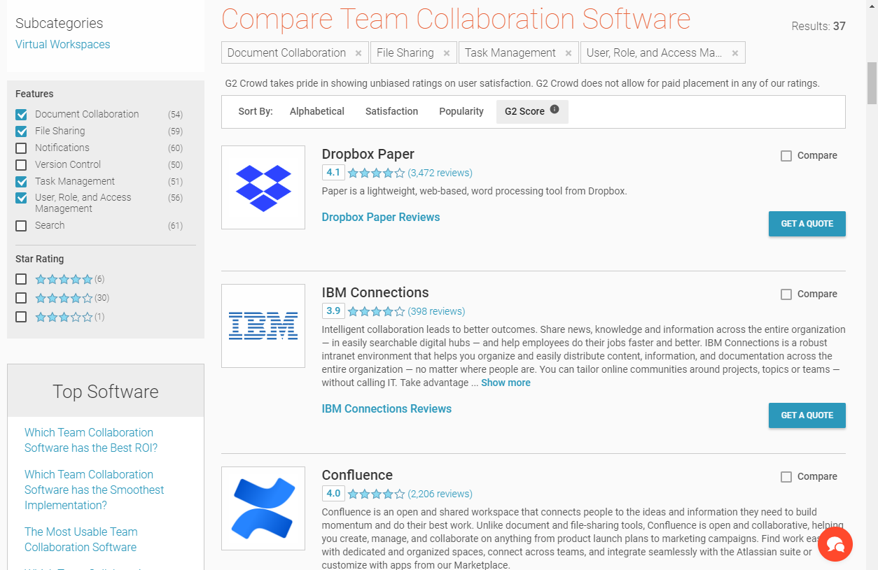
1. Filter the solutions by features
2. Filter the solutions by rating
3. Checkout recommendations
4. Select several items to compare
Notes:
This link https://www.g2.com/categories/screen-sharing can be used as example for demo

Slide 8
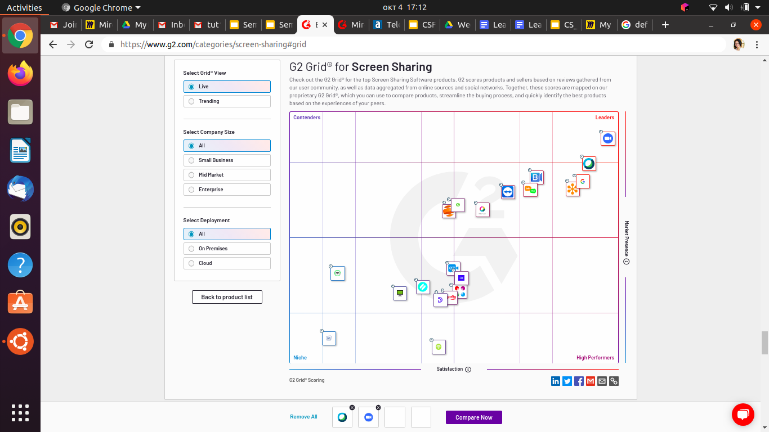
G2Crowd.com
https://www.g2.com/categories/screen-sharing#grid
Explore G2Crowd Grid:
Satisfaction and Market presence
Leaders (higher satisfaction score, higher market presence)
Contenders (lower satisfaction score, higher market presence)
High performers (higher satisfaction score, lower market presence)
Niche (lower satisfaction score, lower market presence)
Search for particular product and locate it on grid
Filter solutions by categories (All segments, Small business and etc)
Click on solution icons on the grid and access to reviews

Slide 9
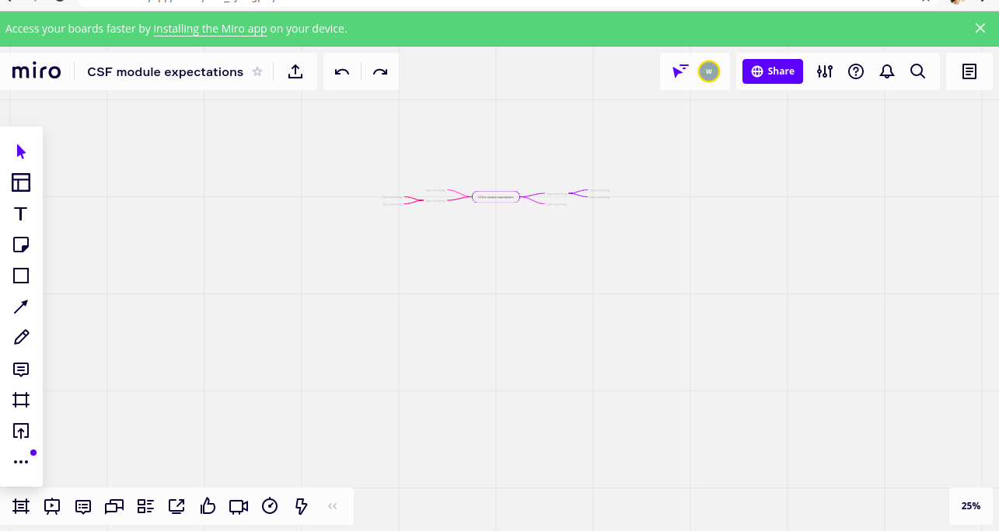
Let’s try Miro
Access the following shared Miro board
Board for groups 1, 2, 3, 4
Board for groups 5, 6 7
Register on Miro
Explore interface
Let’s collaborate and
list module expectations
Explore interface
Notes:
Miro credentials
wiut.tutor@gmail.com
Wiuttut0r
Ali your groups’ link is the second one

Slide 10
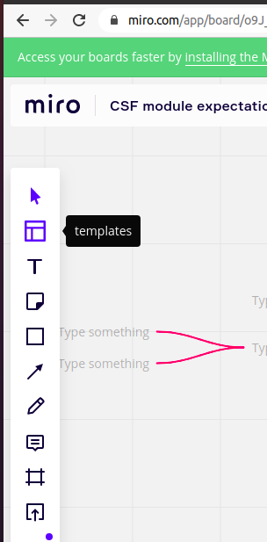
Miro
Click on logo to access your boards
Create your own board
Access templates
Experiment with sharing options
Access templates

Slide 11
Homework: Try Trello
Watch introduction into Trello
Register on Trello using your gmail account (student id based) and plan a trip or any other desired activity in pair. Share with wiut.tutor@gmail.com
Try:
Change of the status of the task by moving it to a relevant board (planned ->in progress -> done)
Assign the task
Set deadline of the task
Color code the task
Notes:
wiut.tutor@gmail.com is registered on trello. Password is the same as for email

Slide 12
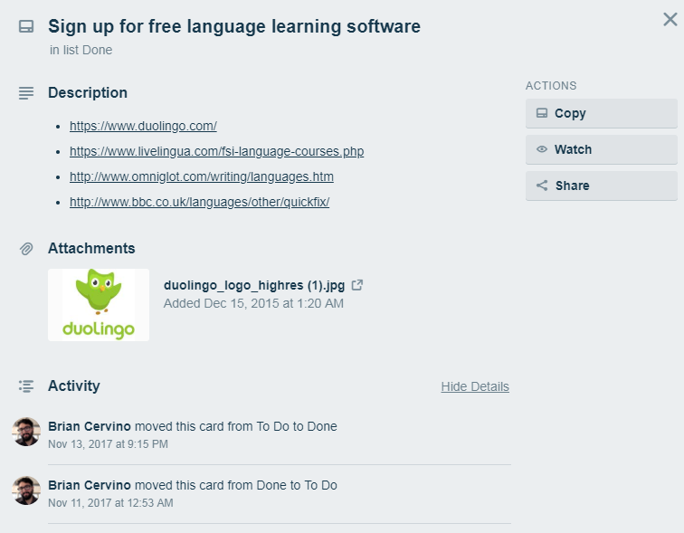
Homework: Trello review ready boards
Review examples of Trello boards
https://trello.com/b/ijCThESo/goal-learn-a-language
https://trello.com/inspiringboards
Note the status of the card can be monitored.
So when you use Trello for CW planning we will also be able to monitor the progress. Even if all cards will end up in Done list, we will see the history of changed card status.

Slide 13
Homework: more on Trello
Video on how to use Trello for beginners
Using Trello - Reference
10 Ways to Use Trello

Slide 14
Part B

Slide 15
A bit of history...1980s
Before Windows OS, the most common operating system that ran on IBM PC compatibles was DOS (Disk Operating System)
not graphical, purely textual
command line interface
to run programs or manipulate the operating system you had to type in commands
When Windows was first created it was actually a graphical user interface that was created in order to make using the DOS operating system easier for a novice user

Slide 16
Command prompt a.k.a. a shell, console window, a cmd prompt
Though the newer operating systems do not run on DOS, they do have the command prompt (cmd.exe), which has a similar appearance to DOS. Other OS families like Macintosh, Unix, Linux have slightly different analogue to Windows command prompt under different name terminal.
So why bother with cmd if we have graphical interface?
To become expert computer user
It enables you to work faster
Basic commands are needed while using Git

Slide 17
Command prompt or terminal
WIndows:
Click on the Start Menu
Search for cmd.exe
OR
Ubuntu:
Press Ctrl+Alt+T or
Click on Show applications icon and search for Terminal
The command prompt is simply a window that by default displays the current directory, or in windows term a folder, that you are in and has a blinking cursor ready for you to type your commands. To use the command prompt you would type in the commands and instructions you want and then press enter.
Notes:
I will add Ubuntu related commands later

Slide 18
Help command
This command lists all the commands built into the command prompt. If you would like further information about a particular command you can type help command name. For example help cd will give you more detailed information on a command dir.
In command prompt:
Type help
Select any command from the list and type help [command]
E.g. help cd

Slide 19
MKDIR command or MD
Creates directory
Syntax mkdir [Drive:]Path md [Drive:]Path Parameters Drive: Specifies the drive on which you want to create the new directory. Path: Required. Specifies the name and location of the new directory. The maximum length of any single path is determined by the file system. /? : Displays help on the command
Try yourself type in command prompt
md /?
md 2020-2021\csf

Slide 20
Dir command
Lists the files and directories contained in your current directory, if used without an argument, or the directory you specify as an argument.
Type dir and press enter and you will see
a listing of the current files in the directory you are in
information about their file sizes
date and time they were last written to
how much space the files in the directory are using and the total amount of free disk space available on the current hard drive.

Slide 21
Dir command continued
Note two directories named . and .., which have special meaning in operating systems. . stands for the current directory and
.. stands for the previous directory in the path.
Also note for many commands you can use the * symbol which stands for wildcard.
E.g. typing dir *.txt will only list those files that end with .txt.

Slide 22
Cd command or CHDIR
Displays name of or allows you to change your current directory to the one specified
Syntax chdir [Drive:] [Path]
cd [Drive:] [Path]
cd [/d] [Drive:] [Path] - changes the drive
Parameters Drive: Specifies the drive Path: Required. Specifies the name and location of the new directory. The maximum length of any single path is determined by the file system. /? : Displays help on the command
Try yourself type in command prompt
cd /?
cd 2020-2021\csf
cd..
cd /d e:\users
cls

Slide 23
Task 1
Navigate to local Downloads folder and list only pdf files.

Slide 24
Task 2
Delete CSF folder in previously created directory hierarchy (Z:\2020-2021\CSF) using rmdir command and make semester 1 folder with CSF folder inside
Add other modules directories

Slide 25
Task 3
Using MKDIR, MOVE, RMDIR, DEL, COPY, ECHO, MORE commands do the following:
Inside CSF folder, create Lectures and Seminars folders
Organize previously copied files into relevant folders
Make nested directory in CSF/Seminars/seminar2/task2/try1
Create a file try1.txt
Run a notepad program by typing notepad.exe
OR
Write a some text to a try1.txt file in a created directory using echo command
Print the content on a screen using more command
Hint: Refer to using help or /? to explore how to use new commands
Notes:
Print on screen (more)

Slide 26
Git
Let’s review from previous tutorial
What is Git?
What is it used for?

Slide 27
Some terminology
Repository
Initialize
Commit
Status

Slide 28
Configure git
Open git-cmd.exe
Type the following commands
git config --global user.name "Your name" git config --global user.email "youremail@gmail.com"
You first type "git", followed by a command – "config" and pass an option, which is "--global" in the code above.
The option "--global" means that you set your username and email for Git globally on your computer. No matter how many projects with separate local repositories you create, Git will use the same username and email to mark your commits.

Slide 29
Let’s try it
Go to directory
cd 2020-2021\CSF\
md seminar2
cd seminar2
Type git init - to initialize, this command creates new git repository
Type git status - to check the status of the files
Type echo some text>text.txt - just for demo purpose
git status - again, this time note untracked file appeared
git add text.txt
git commit -m “added files first time”

Slide 30
Task 4
Copy some new files to the directory created (any docs, jpeg, source code, folders)
Check status
Add files to commit (note you can select only needed files out of all copied to the repository) or use git add --all to add all new files in the repository
Update text.txt file with new text “new updates from student”
Commit changes with message “new updates”

Slide 31
Task 5
Open PyCharm (last seminar you were asked to install it as homework)
If not installed yet, use https://repl.it/languages/python3
Create new project “seminar2”
Write a small program that asks for name and prints “Hello {name}”

Slide 32
Important terms
Variables are simply places to store information and to give that information a name. As the term indicates the information stored is "variable", meaning that it can change
Expressions are combinations of values, variables, and operators that the Python interpreter evaluates to compute a resulting value.
Statements are units of code that have an effect, like creating a variable or displaying a value. The Python interpreter executes statements to produce the effect. (When executing a statement, the interpreter evaluates any expressions included in the statement.)
Functions are named sequences of statements that perform computations. After you define a function, you can call it any number of times to have the Python interpreter execute the statements in the function.
Notes:
A critical advantage of variables, expressions, statements, and functions is that they allow you to take small building blocks of functionality and compose them into larger features.

Slide 33
Data types
Variables can store data of different types, and different types do different things.
Python has the following data types built-in by default:
Text Type: | str
Numeric Types: | int, float, complex
Sequence Types: | list, tuple, range
Mapping Type: | dict
Set Types: | set, frozenset
Boolean Type: | bool
Binary Types: | bytes, bytearray, memoryview

Slide 34
Data types
In Python, the data type is set when you assign a value to a variable:
Data type of any object can be identified by using the type() function:
year = 2020
module_name = “CSF”
print(type(year))
print(type(module_name))

Slide 35
Expression vs statement
Here are some examples of expressions:
2 + 2
3 * 7
1 + 2 + 3 * (8 ** 9) - sqrt(4.0)
min(2, 22)
max(3, 94)
round(81.5)
"foo"
"bar"
"foo" + "bar"
None
True
False
2
3
4.0
All of the above can be printed or assigned to a variable.
Here are some examples of statements:
if CONDITION:
elif CONDITION:
else:
for VARIABLE in SEQUENCE:
while CONDITION:
try:
except EXCEPTION as e:
class MYCLASS:
def MYFUNCTION():
return SOMETHING
raise SOMETHING
with SOMETHING:
None of the above constructs can be assigned to a variable. They are syntactic elements that serve a purpose, but do not themselves have any intrinsic “value”. In other words, these constructs don’t “evaluate” to anything.
Notes:
The statements will be covered in greater detail in upcoming seminars

Slide 36
Function
In Python a function is defined using the def keyword:
def my_function():
print("Hello!")
The function can be called multiple times by using function name followed by parenthesis
my_function()

Slide 37
Python task 1
https://intranet.wiut.uz/LearningMaterial/Pages/Details?ID=887&moduleID=0&way=lm
Notes:
Those students who finish first can be asked to demonstrate

Slide 38
Homework 1: Python task 2
https://intranet.wiut.uz/LearningMaterial/Pages/Details?ID=888&moduleID=0&way=lm

Slide 39
Homework 2:
Register on Github with your google account (containing ID, not your name)
Create a new repository and push python tasks 1 and 2 there (see instructions on next slide)
Share your repository link in discussion
https://intranet.wiut.uz/LearningMaterial/Discussion/Details/649?moduleId=559

Slide 40
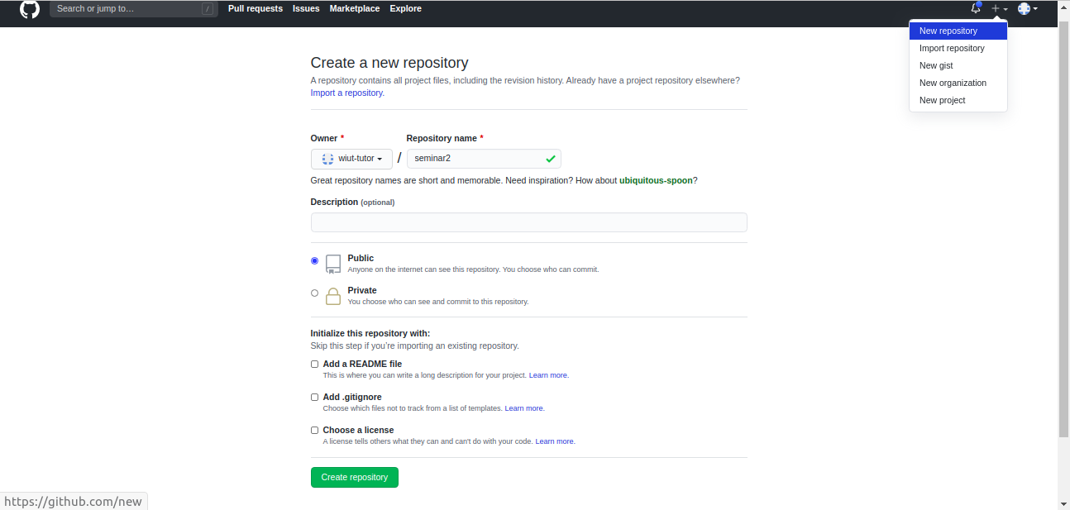
Github instructions 1
Click on + and select New Repository
Specify repository name
Keep the repository public
Skip the checkboxes as you will be pushing
exisiting repository

Slide 41
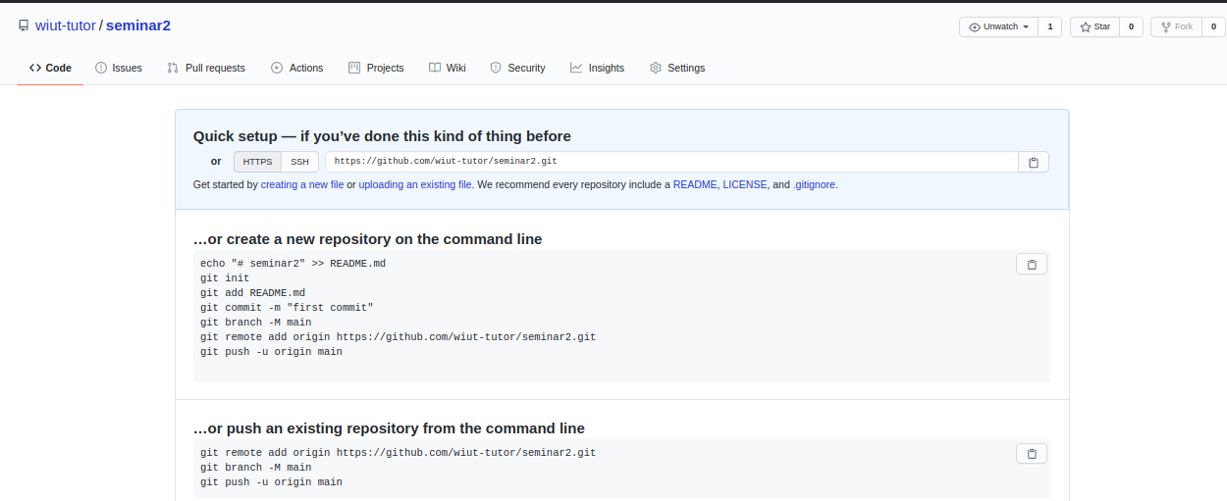
Github instructions 2
Follow instructions on the next page

Slide 42
Recommended actions
Downey, A. (2015). Think Python: How to think like a computer scientist. Green Tea Press. Ch1, 2, 3, available on intranet
Top Software Review Sites + How to Use Them to Find the Perfect App for Your Small Business
For CW up to 5 extra marks can be assigned in border-line cases (i.e. 29, 39, 49 and etc) if there is evidence of participation in in-class activities and doing h/w
Read and practice Git
http://rogerdudler.github.io/git-guide/
https://git-scm.com/about
https://rubygarage.org/blog/most-basic-git-commands-with-examples
https://ru.atlassian.com/git/tutorials

