Slide 1
How Our Atmosphere Obscures Planets: a Model of the Effect of Telluric Contamination on Solar Emission Lines
By: Meltem Acar

Slide 2
Starlight, Electromagnetic Radiation, and Spectral Lines

Slide 3
Starlight, Electromagnetic Radiation, and Spectral Lines

Slide 4
Starlight, Electromagnetic Radiation, and Spectral Lines
Absorbs specific wavelengths

Slide 5

Starlight, Electromagnetic Radiation, and Spectral Lines
Absorbs specific wavelengths
Spectral lines

Slide 6
Starlight, Electromagnetic Radiation, and Spectral Lines
Absorbs specific wavelengths
374.55 nm
Chemical fingerprint
Spectral lines

Slide 7
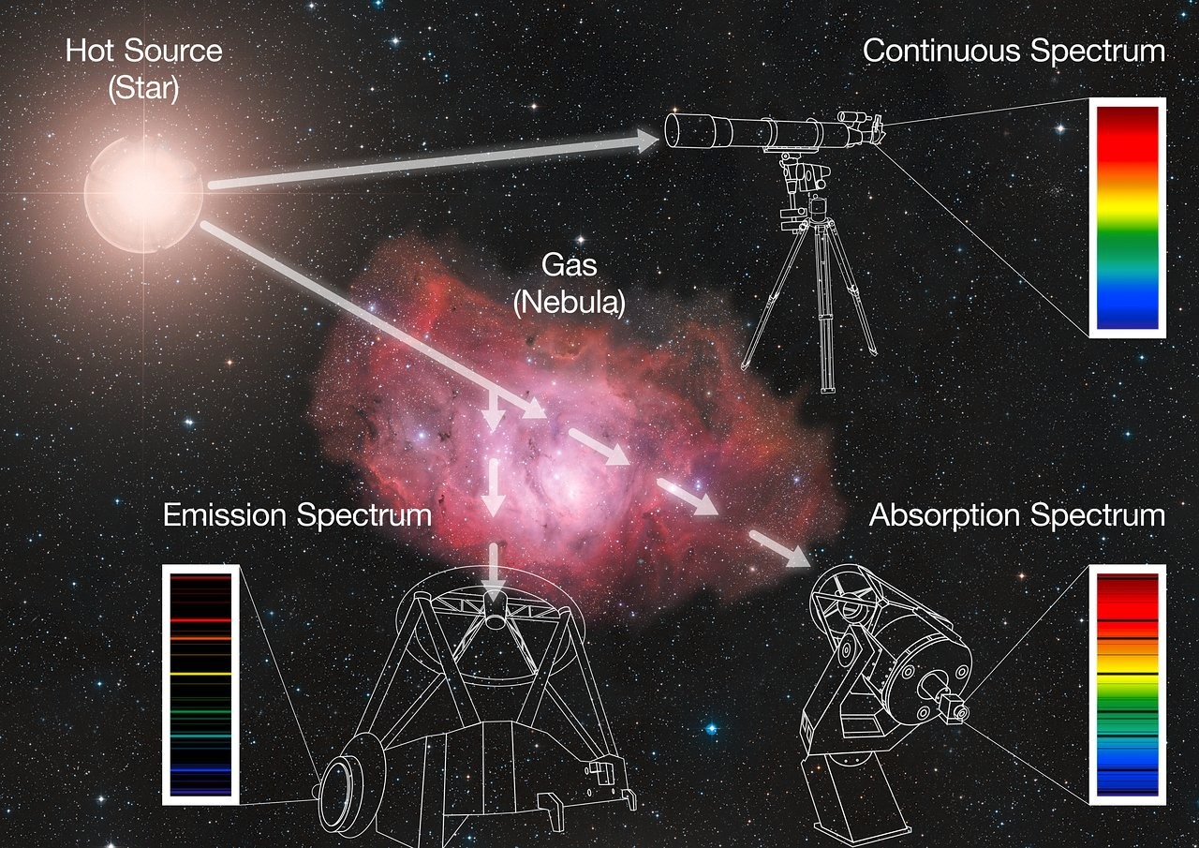
Spectroscopy

Slide 8
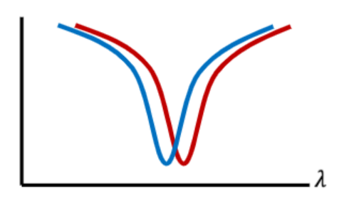
Spectroscopy doesn’t just show us that spectral lines exist…
Sometimes these lines are not where we expect them to be
Shifted?
Spectral line is shifting

Slide 9
Spectroscopy doesn’t just show us that spectral lines exist…
Sometimes these lines are not where we expect them to be
Shifted?
Why?
Spectral line is shifting

Slide 10
The Doppler Effect

Slide 11
The Doppler Effect
Defined as the change in the observed frequency and wavelength of light caused by the relative motion between the light source and observer

Slide 12
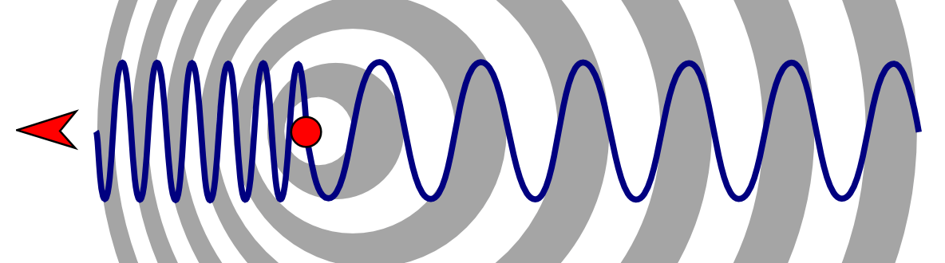
The Doppler Effect
Blueshift

Slide 13
The Doppler Effect
Blueshift
Shifting towards shorter wavelengths

Slide 14
The Doppler Effect
Blueshift
Redshift
Shifting towards shorter wavelengths

Slide 15
The Doppler Effect
Blueshift
Redshift
Shifting towards shorter wavelengths
Shifting towards longer wavelengths

Slide 16
The Doppler Effect
Blueshift
Redshift
Shifting towards shorter wavelengths
Shifting towards longer wavelengths

Slide 17
The Doppler Effect
Stars do this but why…?

Slide 18
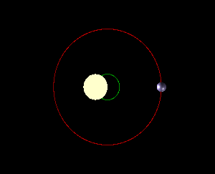
The Doppler Effect
Stars do this but why…?
Shared center of mass

Slide 19
The Doppler Effect
Stars do this but why…? One reason is:
Shared center of mass
This wobble means that the star is very slightly moving towards us, then away from us, over and over.

Slide 20
The Doppler Effect
We can observe this
Shifting back and forth slightly

Slide 21
The Doppler Effect
We can observe this
We can calculate the stars radial velocity–how fast it is moving toward or away from us at any given moment.
Shifting back and forth slightly
Measuring this shift

Slide 22
The Doppler Effect
We can observe this
We can calculate the stars radial velocity–how fast it is moving toward or away from us at any given moment.
A way to detect exoplanets!
Shifting back and forth slightly
Measuring this shift

Slide 23
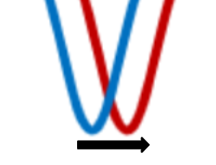
Problem?
Only works when we pinpoint the exact position of a spectral line
The measurement depends on tracking tiny shifts in this position

Slide 24
Problem?
But what if our telescope is on the ground?

Slide 25
Problem?
Sun
But what if our telescope is on the ground?
Atmosphere
CO2
H2O
Telescope on Earth

Slide 26
Problem?
Sun
But what if our telescope is on the ground?
Atmosphere
Absorbs light
CO2
H2O
Telescope on Earth

Slide 27
Problem?
Sun
But what if our telescope is on the ground?
Atmosphere
Absorbs light
CO2
Telluric lines
H2O
Telescope on Earth

Slide 28
What are we trying to model and answer?
How does differing location of telluric contamination impact a spectral line?

Slide 29
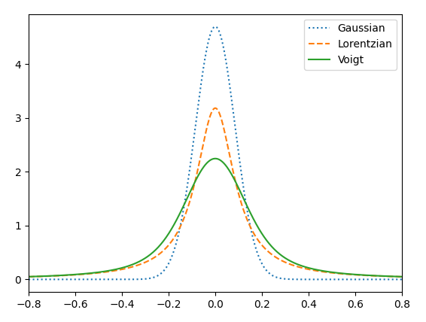
Voigt Profile
Spectral line shape
Finding the center point over time to observe the shift

Slide 30
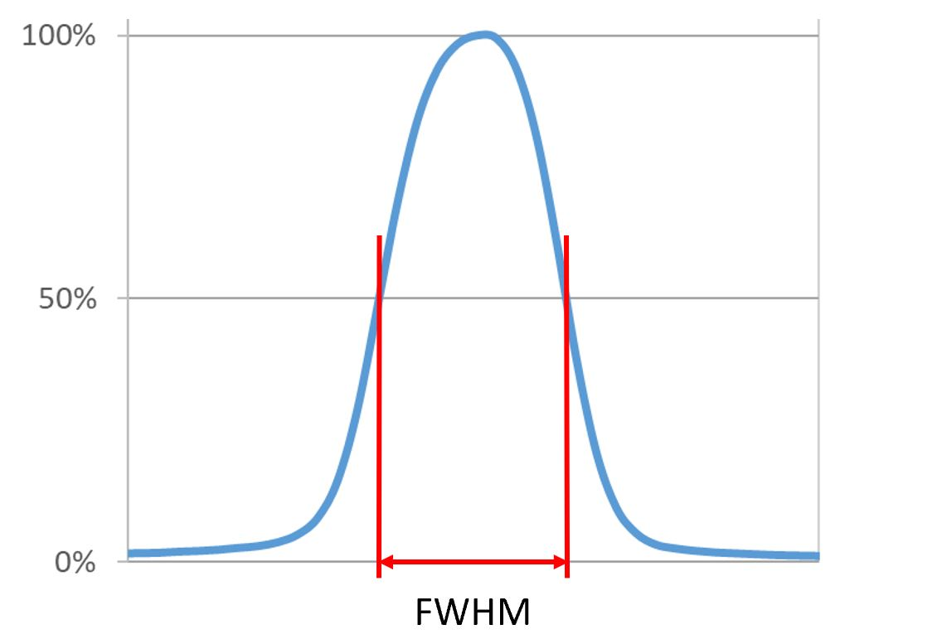
Full-Width-Half-Maximum method

Slide 31
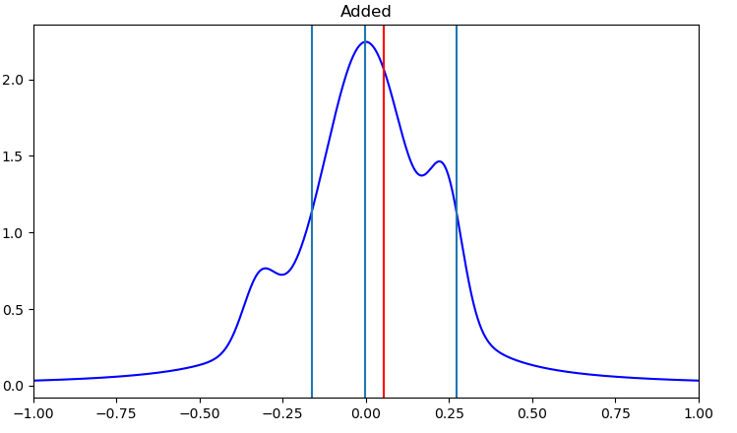
Center point
Full-Width-Half-Maximum method
Voigt profile with contamination

Slide 32
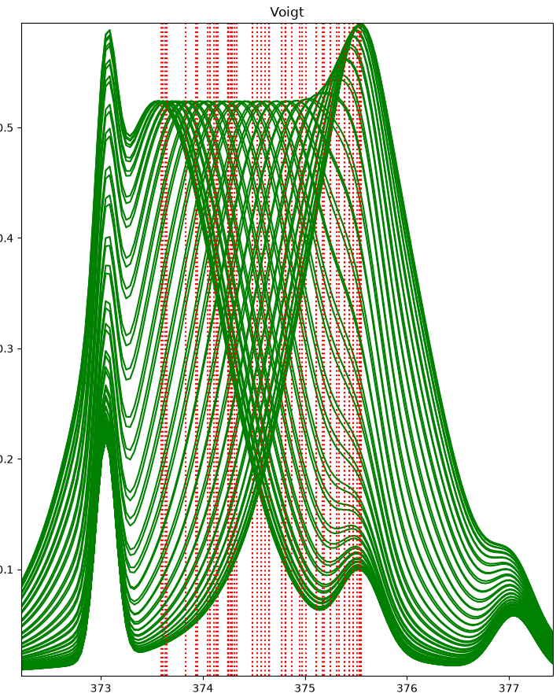
Shifting the Voigt profile
The Voigt profile combining with telluric lines
Line that finds the center point
Wavelength (nm)

Slide 33
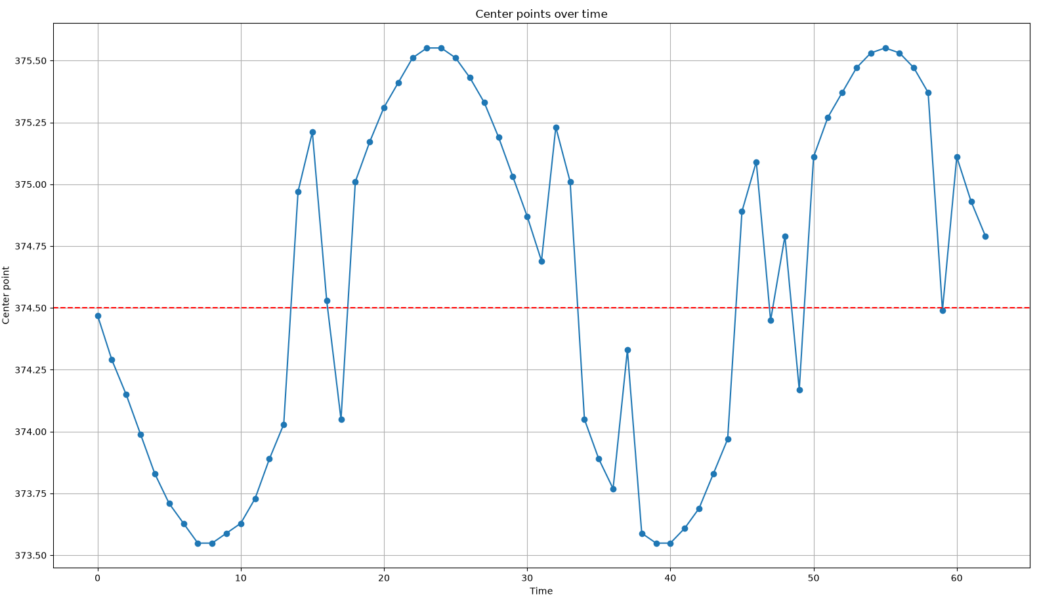
Center points over time–calculated
Telluric contamination at 3 locations
Two same intensity and one less intense
Results #1
Wavelength reference of neutral iron line–374.55 nm
Wavelength (nm)

Slide 34
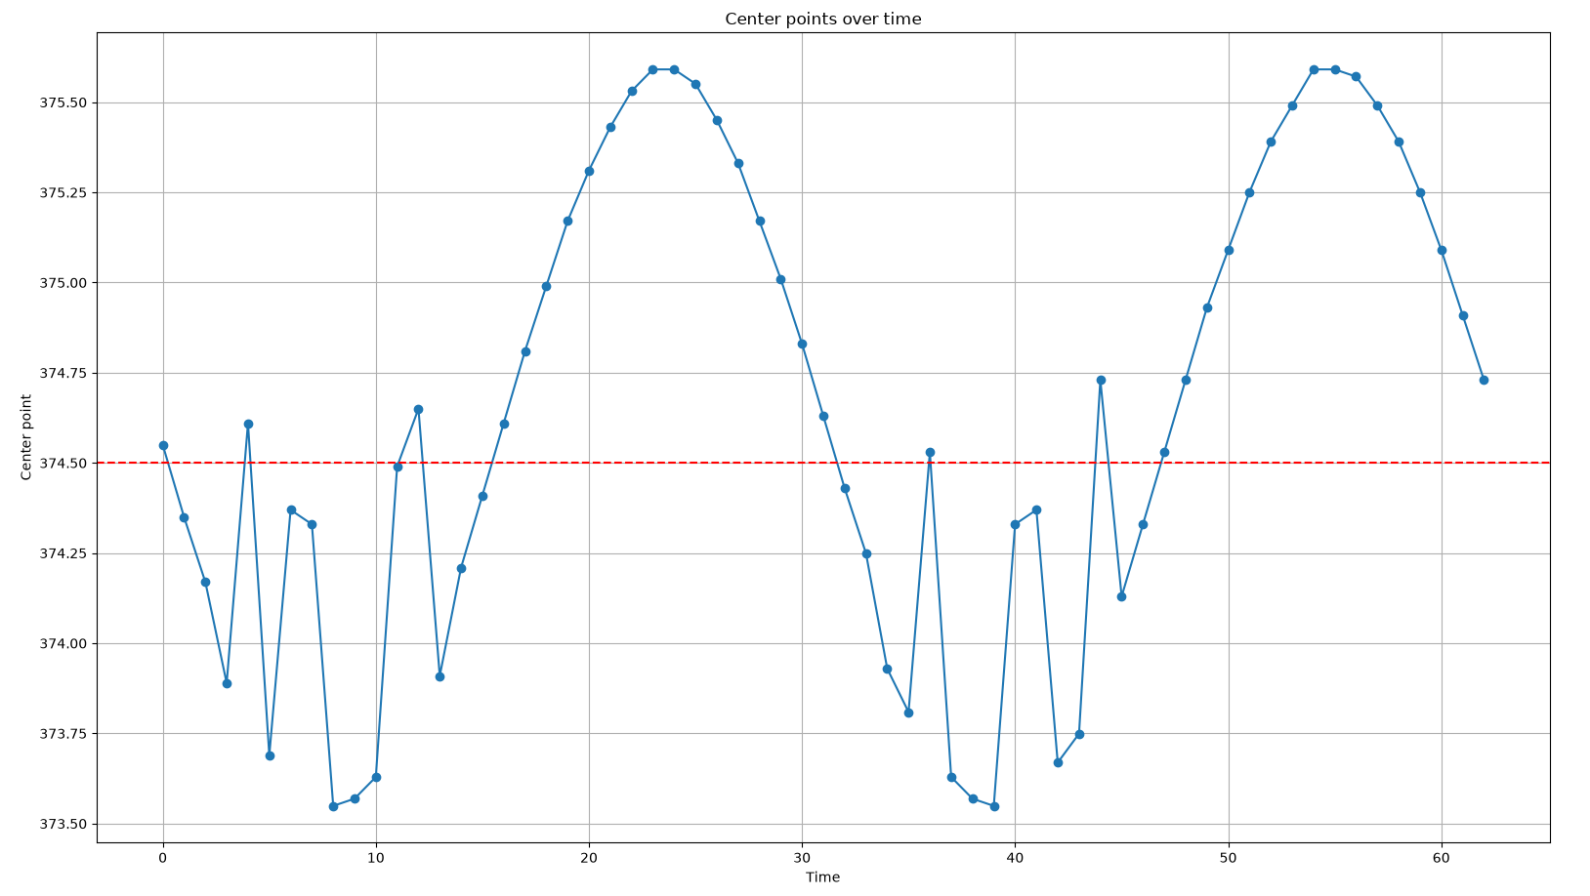
Center points over time–calculated
Telluric contamination at 2 locations
Two similar intensity
Results #2
Wavelength (nm)
Extremely distorted

Slide 35
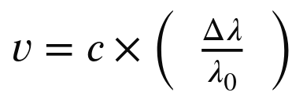
Radial Velocity shift

Slide 36
Radial Velocity shift
Radial velocity shift

Slide 37
Radial Velocity shift
Speed of light m/s
Radial velocity shift

Slide 38
Change in wavelength
Observed - Rest
Radial Velocity shift
Rest wavelength
Speed of light m/s
Radial velocity shift

Slide 39
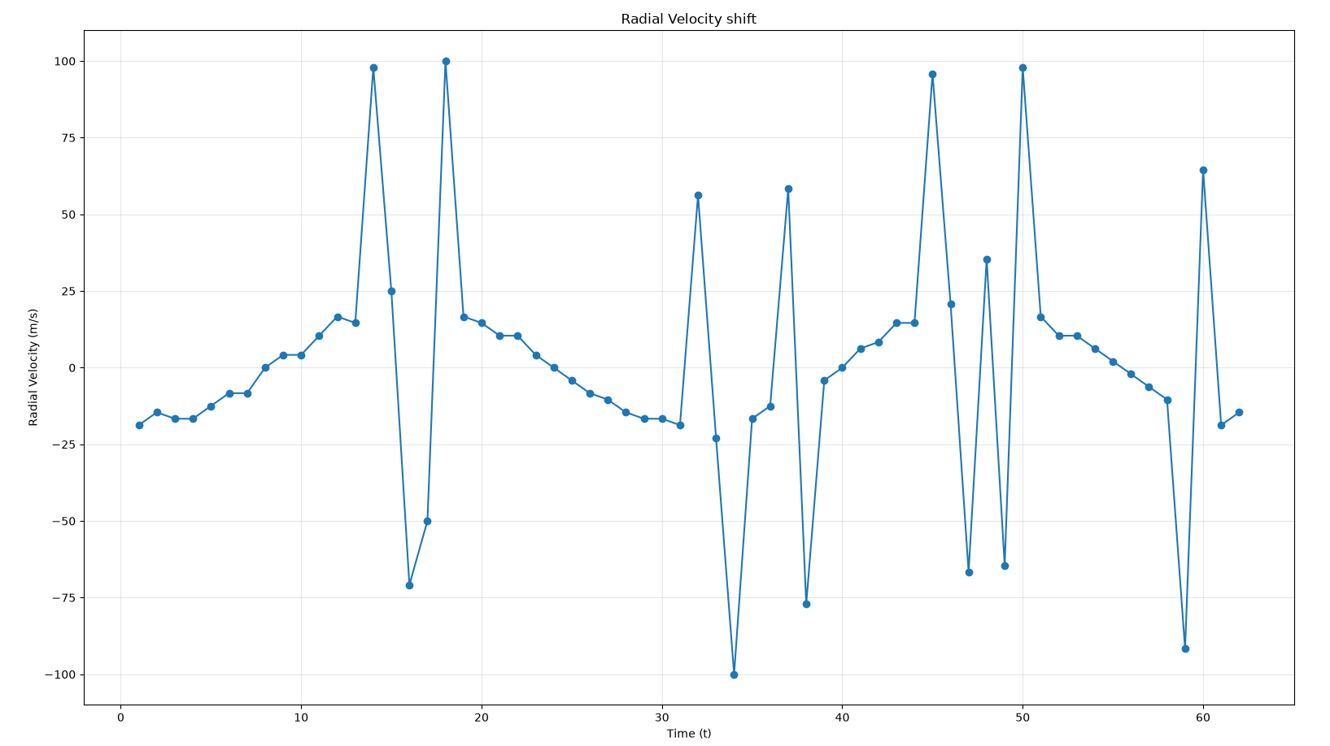
Radial Velocity shift over time
Results #1

Slide 40
Radial Velocity shift over time
Results #1
Radial velocity shift jumps

Slide 41
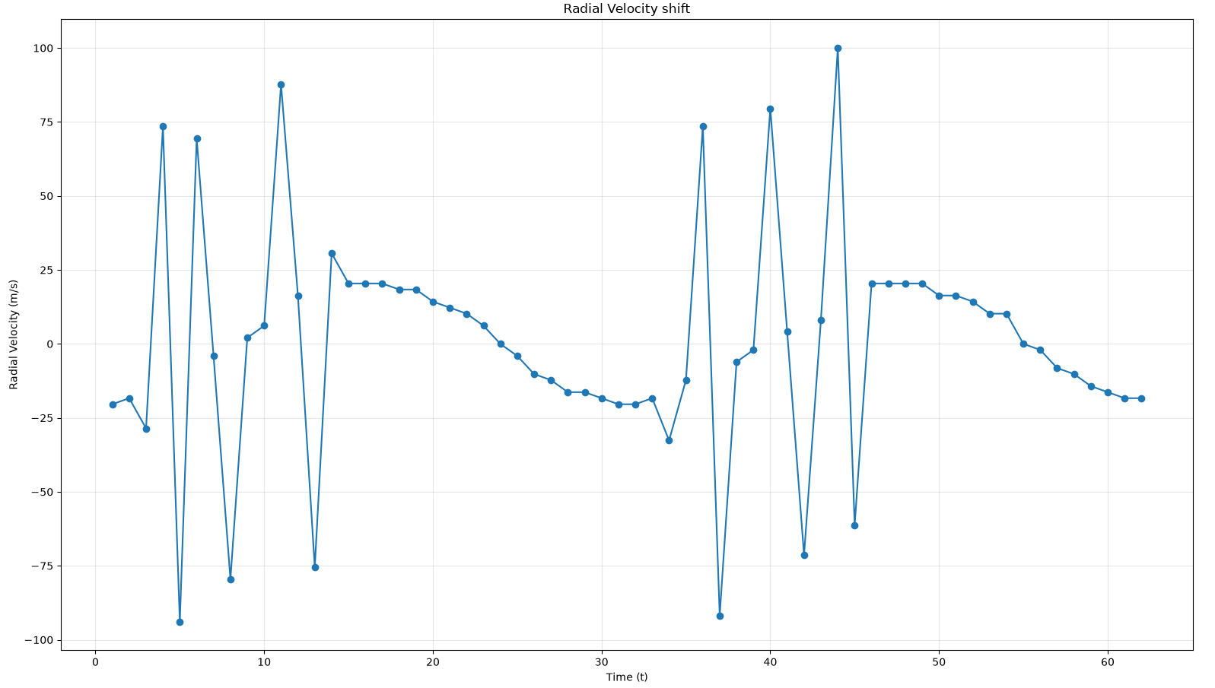
Radial Velocity shift over time
Results #1

Slide 42
Radial Velocity shift over time
Results #1
More intense and frequent jumps

Slide 43
Final results–what can we take away from this?

Slide 44
Why is this important to observe?
Because Radial velocity shift calculations will be impacted, and observing these calculations we miss that there is an exoplanet orbiting a star. Because the data is too skewed
Solar activity can also impact data, it is important to differentiate telluric contamination from solar activity
Programs to remove telluric contamination

Slide 45
Future work
Modeling low level noise
Fitting a Voigt profile to model data to find center point
More systematic analysis of telluric contamination

Slide 46
Thank you

