Slide 1
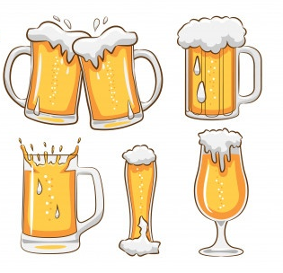
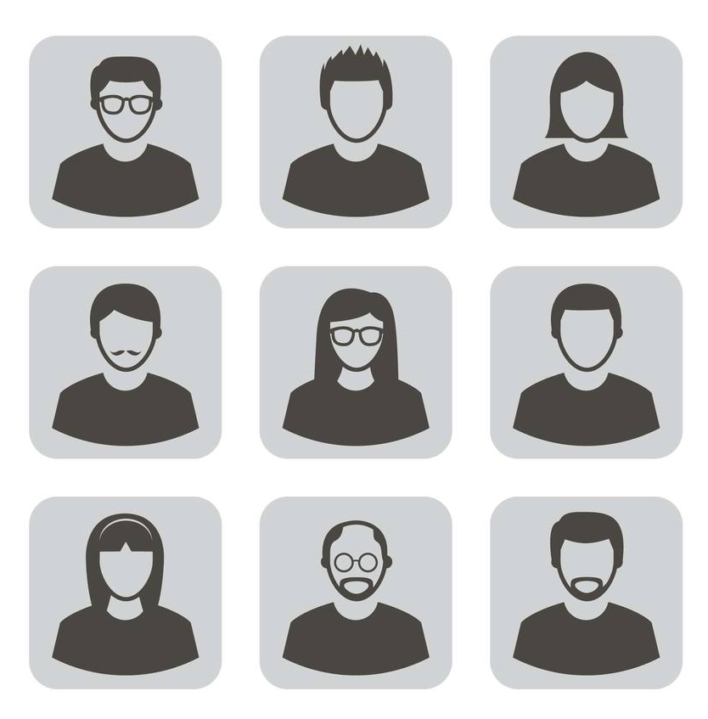
1,586,266 reviews
66,051 beers
33,387 reviewers
156,338,903
beer-to-beer review scores

Slide 2


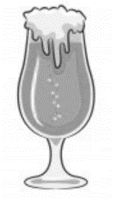


Based on your preference…
4.96
3.63
4.76
2.27

