Slide 1
Social Vulnerability Across Philadelphia County
Meltem Odabaş, 17 July 2025.
Note: Find analysis code is available at
https://github.com/meltemod/social-vulnerabilities/tree/main

Slide 2
Objective
Research question:
“Where are communities most burdened by overlapping social vulnerabilities in Philadelphia County?”
Data:
Demographic and socioeconomic variables derived from the CDC/ATSDR’s social vulnerability index for Philadelphia county at tract-level

Slide 3
Methodology
For comparison across census tracts, the demographics and social vulnerability variables are converted to percentages in population.
To calculate the share of the population aged 25 and older with a high school diploma, I approximated that 70% of each tract’s total population falls within the 25+ age group.
perc_belowpov150 = 100 * `Ppl Below 150% Poverty` / Population
perc_bipoc = 100 * `BIPOC Residents` / Population

Slide 4
Methodology (cont’d)
The three vulnerability variables,
Share of households with no vehicle
Share of population aged 25 and over without a high school diploma
Share of overcrowded housing units
are used to measure vulnerabilities related to transportation, education, and housing, respectively.
A composite vulnerability index is used to generate a map by taking the min-max normalized average of these three variables, weighted equally.

Slide 5
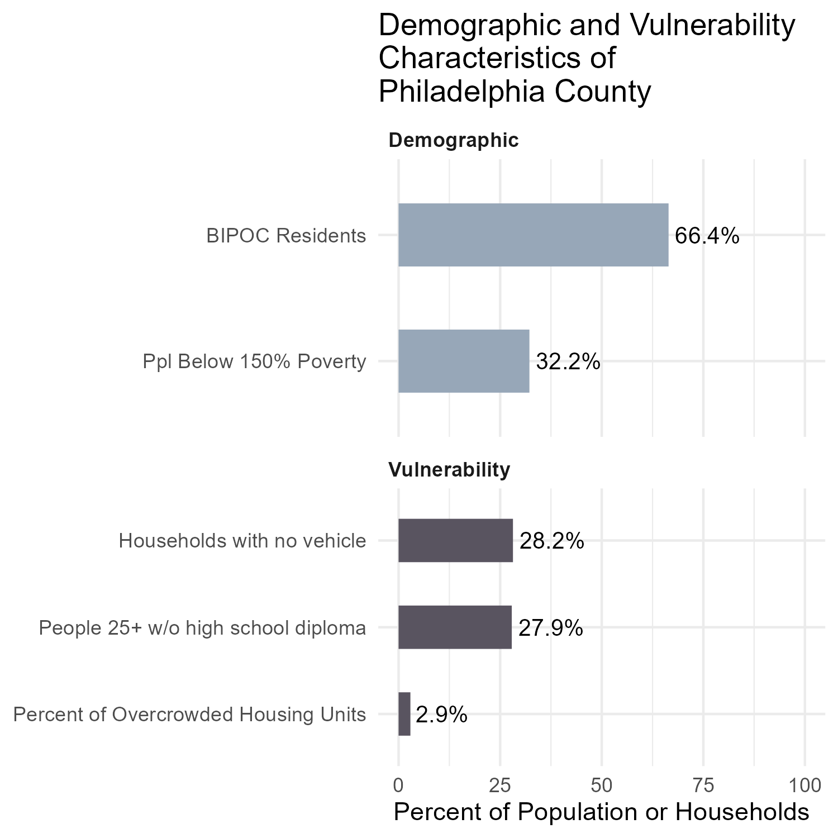
FINDINGS
In Philadelphia County, two-thirds of residents are BIPOC, and one-third live below 150% of the poverty line.
On average, 3% of housing units are overcrowded, 28% oh households lack a vehicle, and 28% of adults (25+) have no high school diploma.

Slide 6
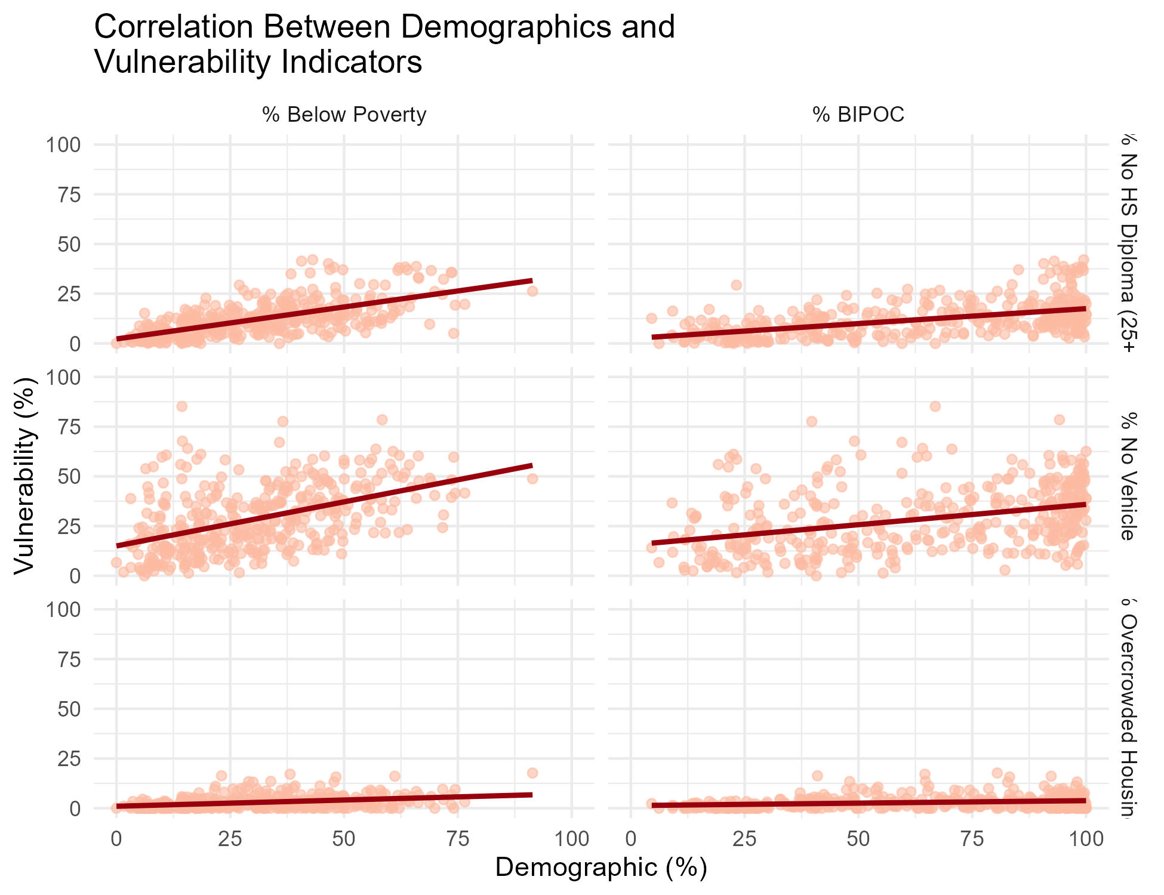
Disadvantage in marginalized communities
Across Philadelphia tracts, the share of households without vehicles and the share of residents without a high school diploma both increase in areas with higher % BIPOC or poverty rates — suggesting compounding disadvantage in already marginalized communities.

Slide 7
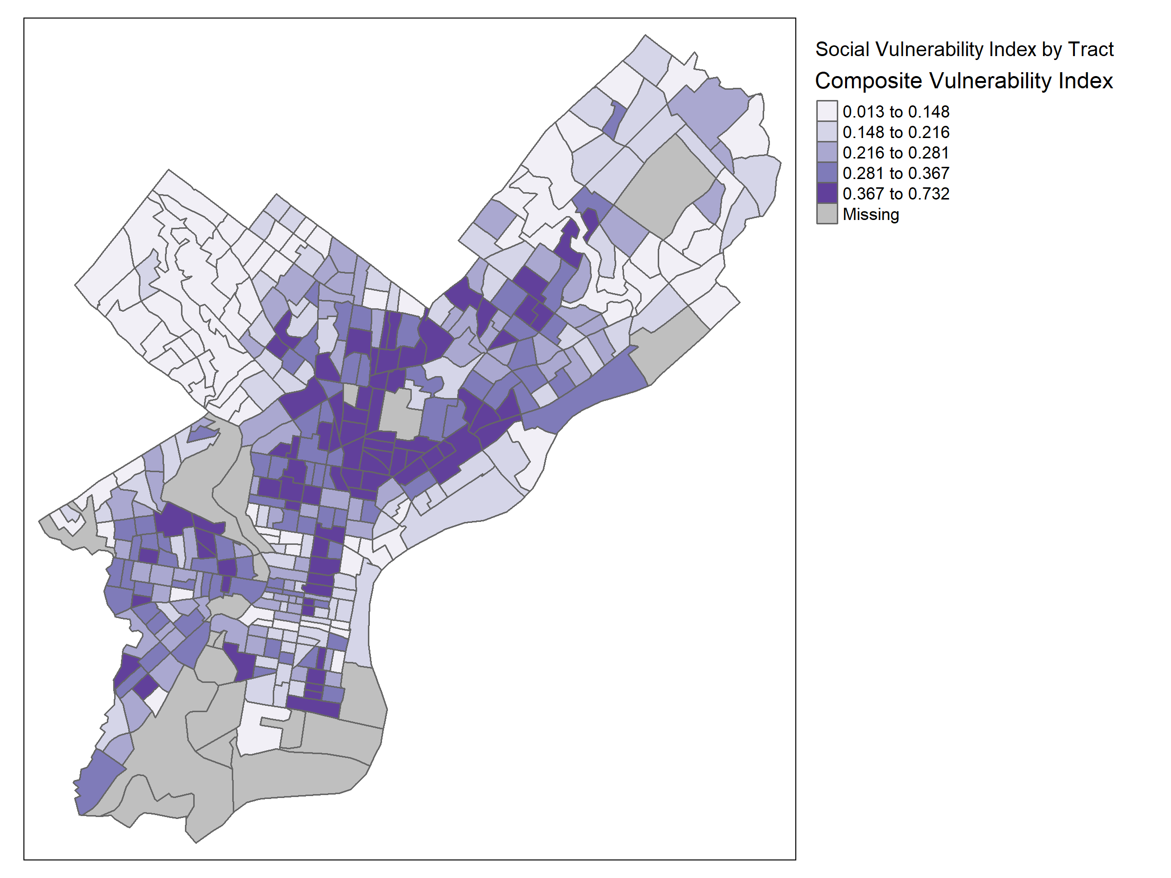
This map shows social vulnerability in Philadelphia based on lack of a vehicle, low education, and overcrowded housing.
Highest vulnerability appears in North, West, and Southwest Philadelphia.
Lowest vulnerability is in Center City, Northwest, and parts of the Northeast.
Highlighted areas need support in transportation, education, and housing combined.

Slide 8

Policy Opportunities
Transportation Equity → Expand affordable transit in areas with high rates of households without vehicles.
Integrated Support → Combine housing, education, and workforce programs in highly vulnerable tracts.
Place-Based Investment → Use the index to guide funding to neighborhoods with greatest need.

Slide 9
LIMITATIONS AND NEXT STEPS
Limitations
Used approximated 25+ population for education variable
Some indicators are proxies (e.g. overcrowding for housing insecurity)
ACS has data sampling variability at tract level
Next Steps
Add intervention and outcome data
Explore change over time (e.g. DiD models)
Validate index with local partners

Slide 10
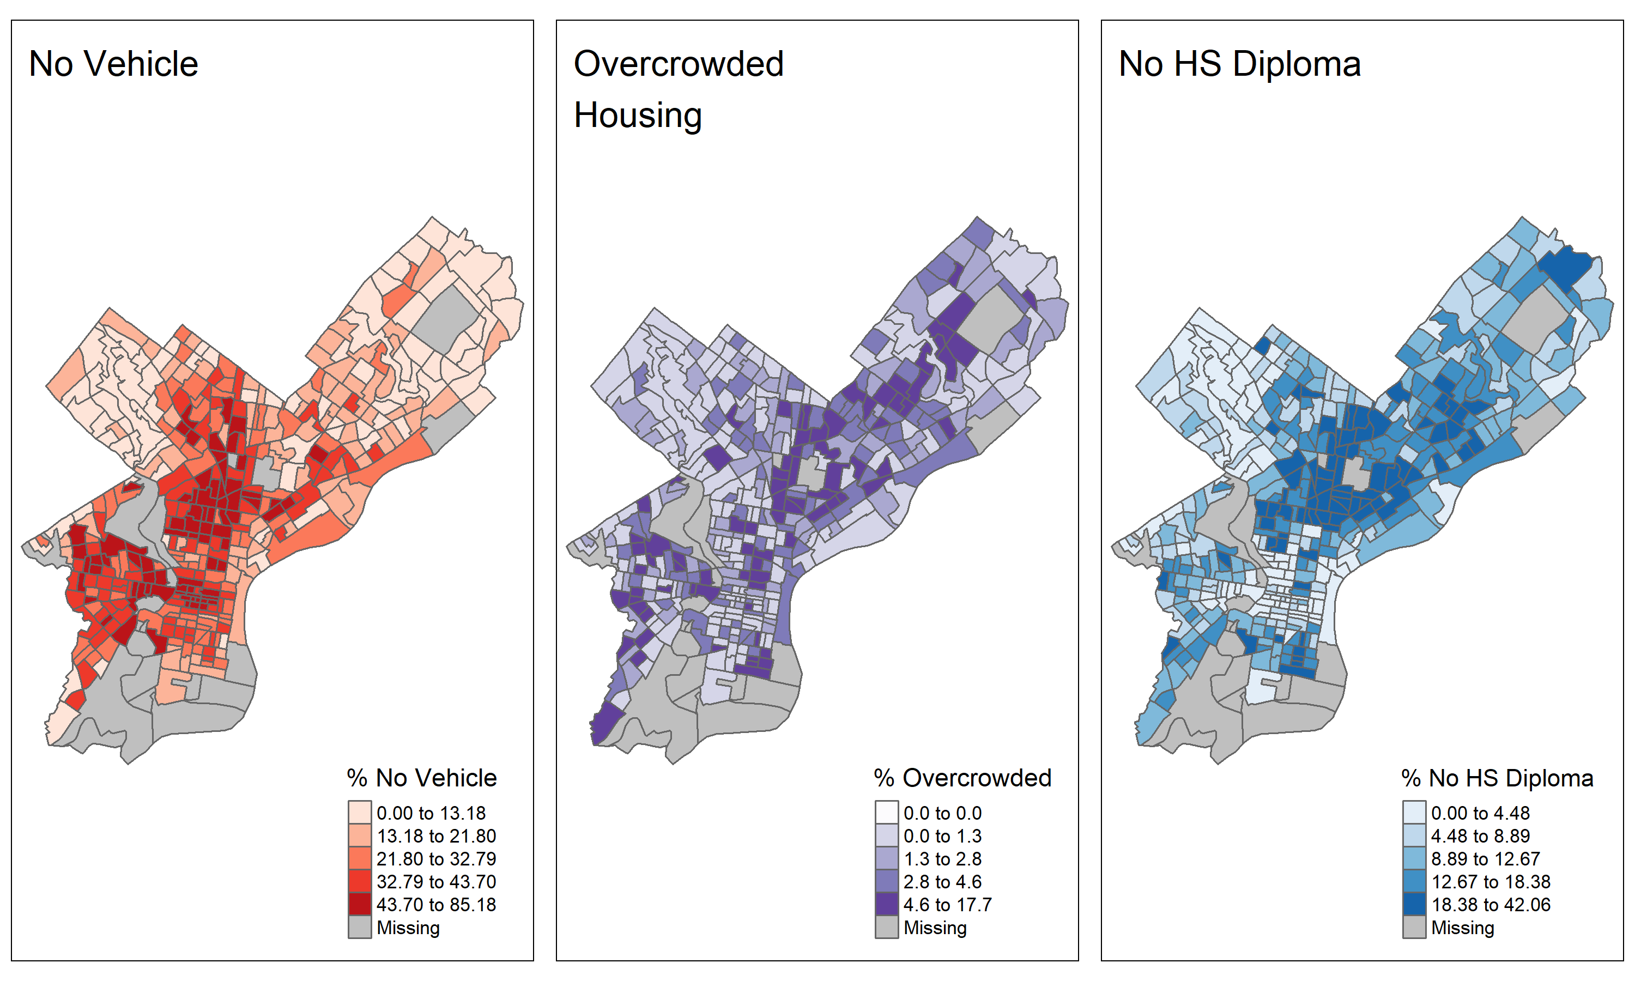
Appendix: A more detailed look at the vulnerabilities across Philadelphia County

