Slide 1
Company Name
RateCard
Smart Rate Card
Management for
Modern Teams
₱700,452
PROJECTED ARR
Annual Billing Projection
Active • 1 Project
Streamline employee billing rates, client portfolios, and project financials — all in one intelligent platform.
Powered by Mel Catuiran

Slide 2






Product Overview
Everything you need to manage rates, projects, and billing — in one place.
Dashboard
Projects
RateCard Creator
Real-time revenue metrics, MRR, ARR, and project contribution ledger.
Manage client initiatives, track team size and progress status.
Build precise rate cards with PH comp & benefits auto-calculation.
Clients
Employees
Reports
Maintain business partner profiles, billing contacts, and portfolios.
Hire and manage staff with default monthly billing rates per role.
Aggregate analytics: project costs, deployment data, and CSV export.

Slide 3
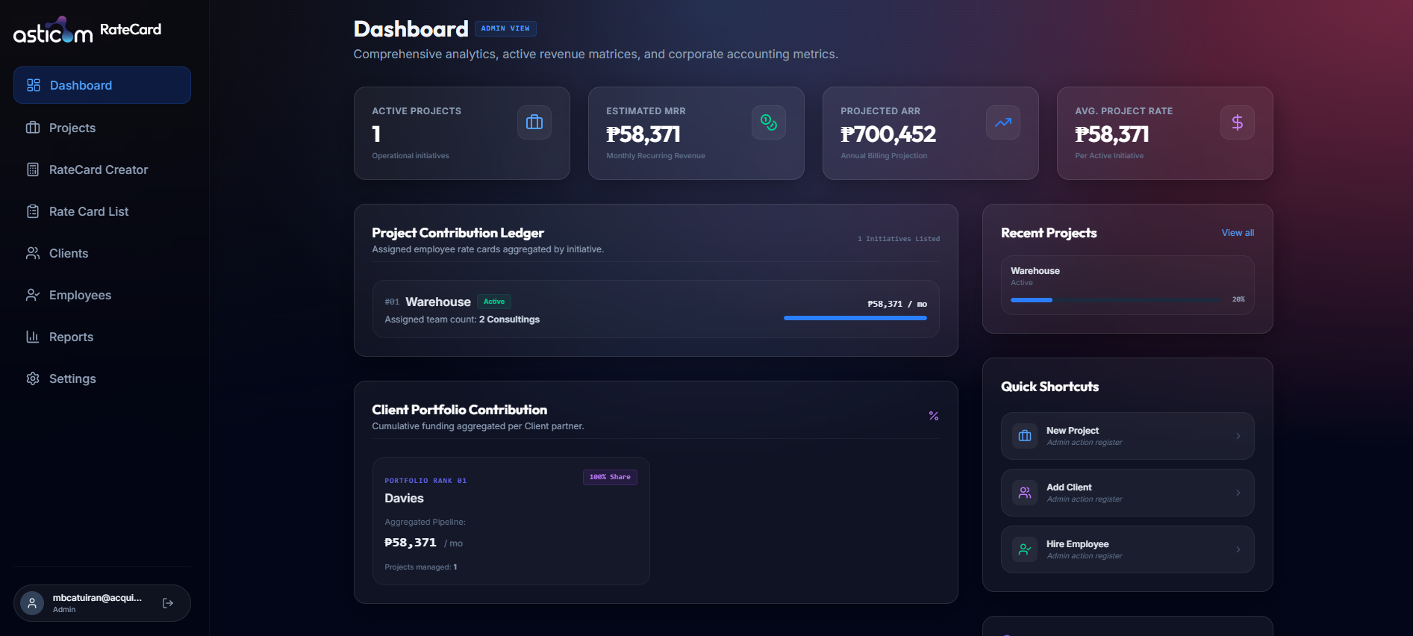

ANALYTICS HUB
Executive
Dashboard
Admin View · Real-Time Revenue Metrics
A centralized command center displaying live MRR, ARR, and average project billing rates. Instantly assess financial health across your entire portfolio.
Active Projects count & MRR/ARR projections
Project Contribution Ledger by initiative
Client Portfolio share breakdown
Quick shortcuts: New Project, Add Client, Hire

Slide 4
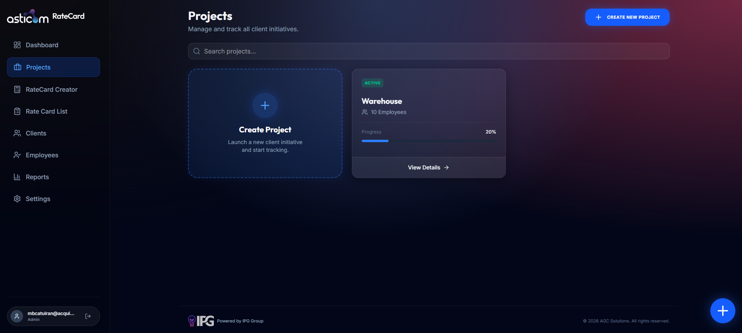
PROJECT MANAGEMENT
Projects &
Initiatives
Track Client Engagements from Start to Finish
Create and manage client initiatives with team assignments, progress tracking, and status monitoring. Each project links employees and rate cards for instant billing visibility.
Create new client projects in seconds
Assign team members and track headcount
Visual progress bar per initiative (% complete)
Active / Inactive status management

Slide 5
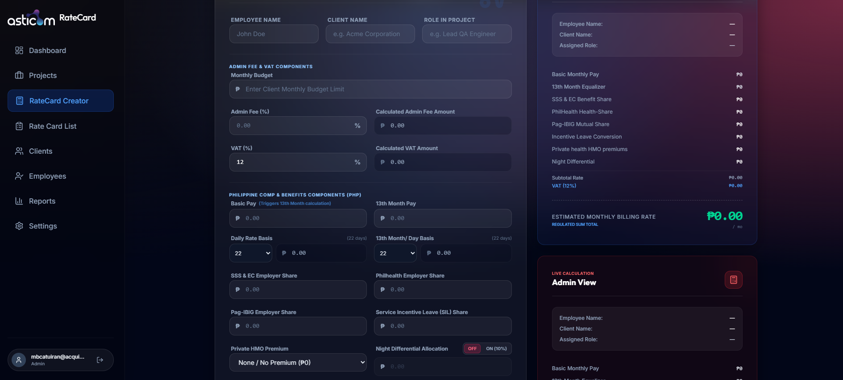
RATE CALCULATION ENGINE
RateCard
Creator
Philippine Compensation & Benefits Auto-Calculator
Input basic pay and the system automatically computes 13th month, SSS, PhilHealth, Pag-IBIG, SIL, HMO, night differential, admin fees, and VAT — generating a precise monthly billing rate.
PH statutory benefits auto-populated
Admin fee (%) and VAT (12%) built-in
Night differential toggle (10%)
Live Admin View and Client View side-by-side

Slide 6
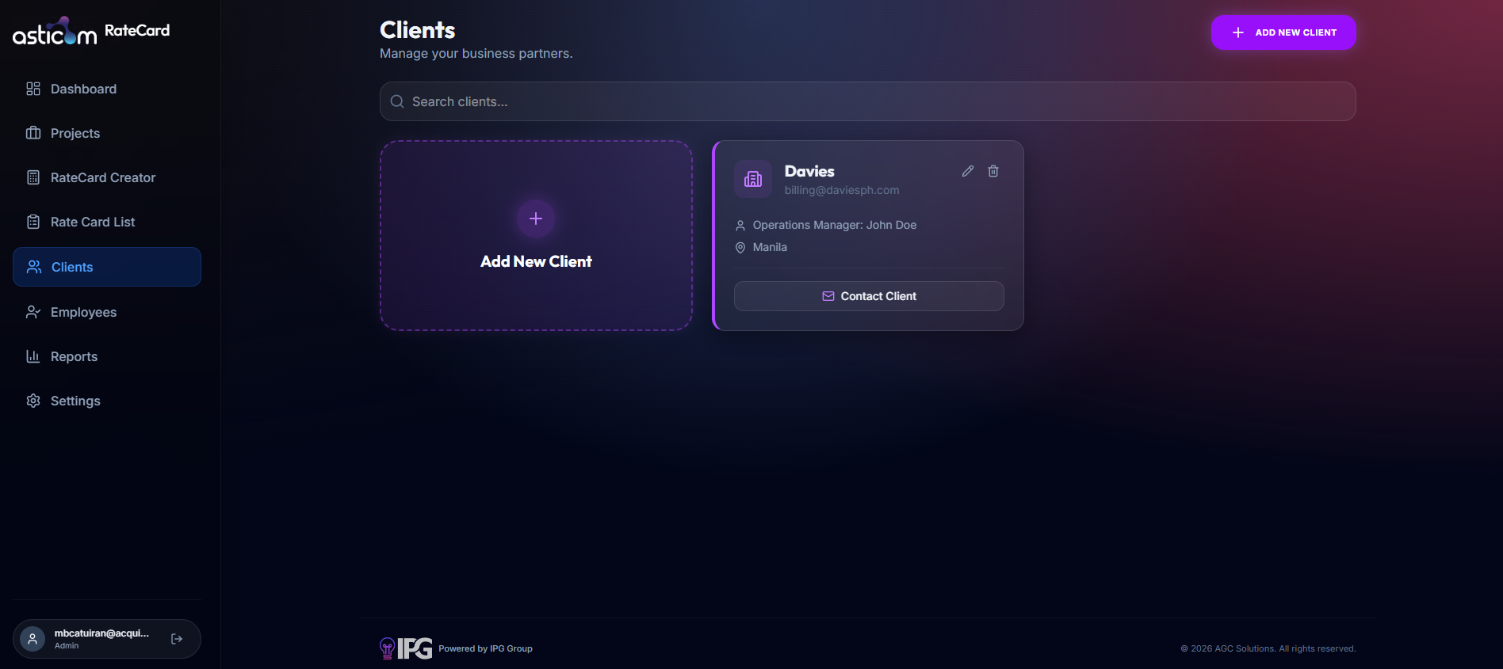
CLIENT MANAGEMENT
Client
Portfolio
Manage Your Business Partners with Ease
Maintain a structured directory of client organizations complete with billing contact emails, operations manager details, and location data. Contact clients directly from the platform.
Add and edit client profiles
Billing email and operations manager fields
One-click Contact Client email action
Client-linked to projects for full traceability

Slide 7
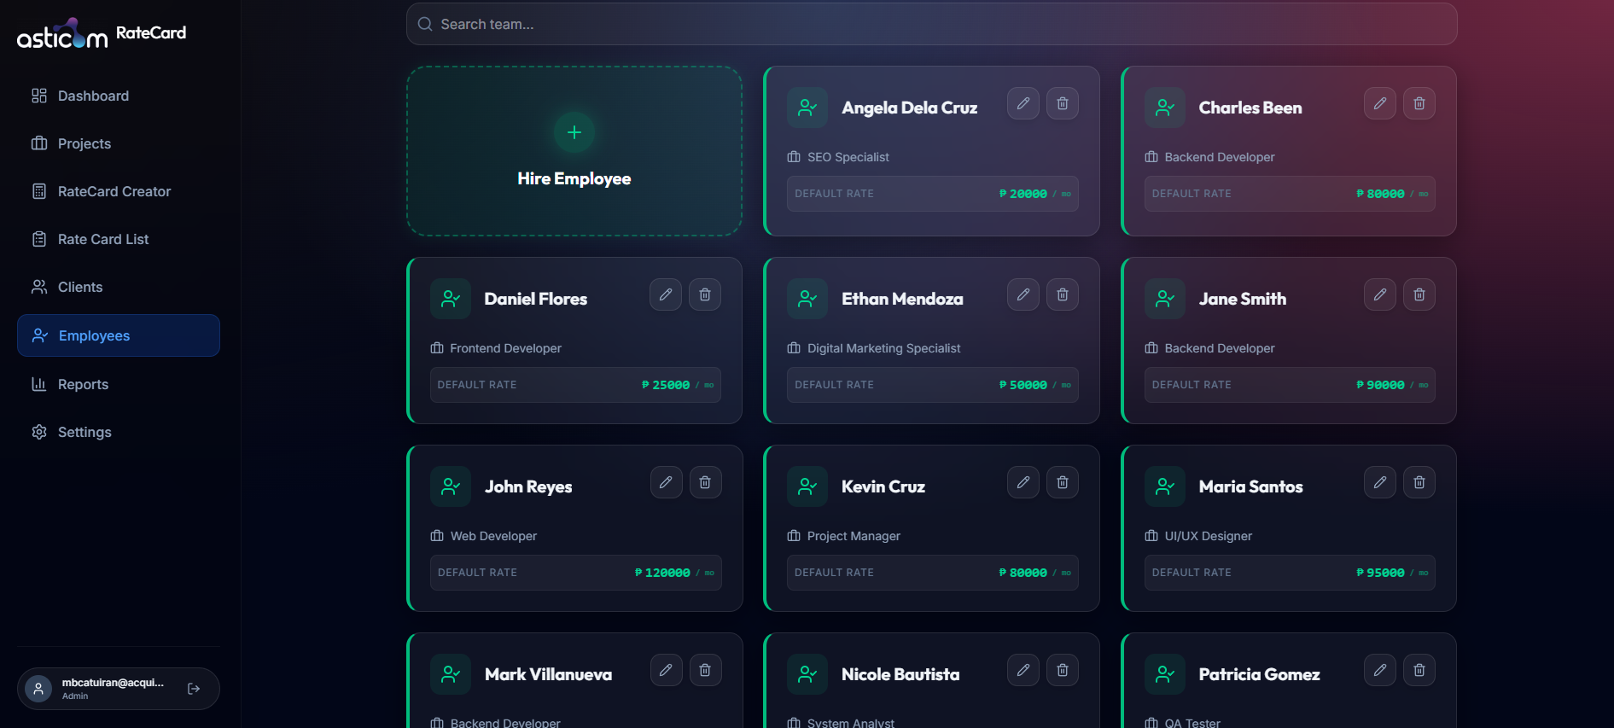
TEAM DIRECTORY
Employee
Registry
Centralized Staff & Default Rate Management
Maintain a searchable roster of all employees with their roles and default monthly billing rates. Hire new team members and edit or remove existing records from a single interface.
Employee cards with role and default rate
Hire Employee workflow integrated
Search team members instantly
Rates feed directly into RateCard Creator

Slide 8
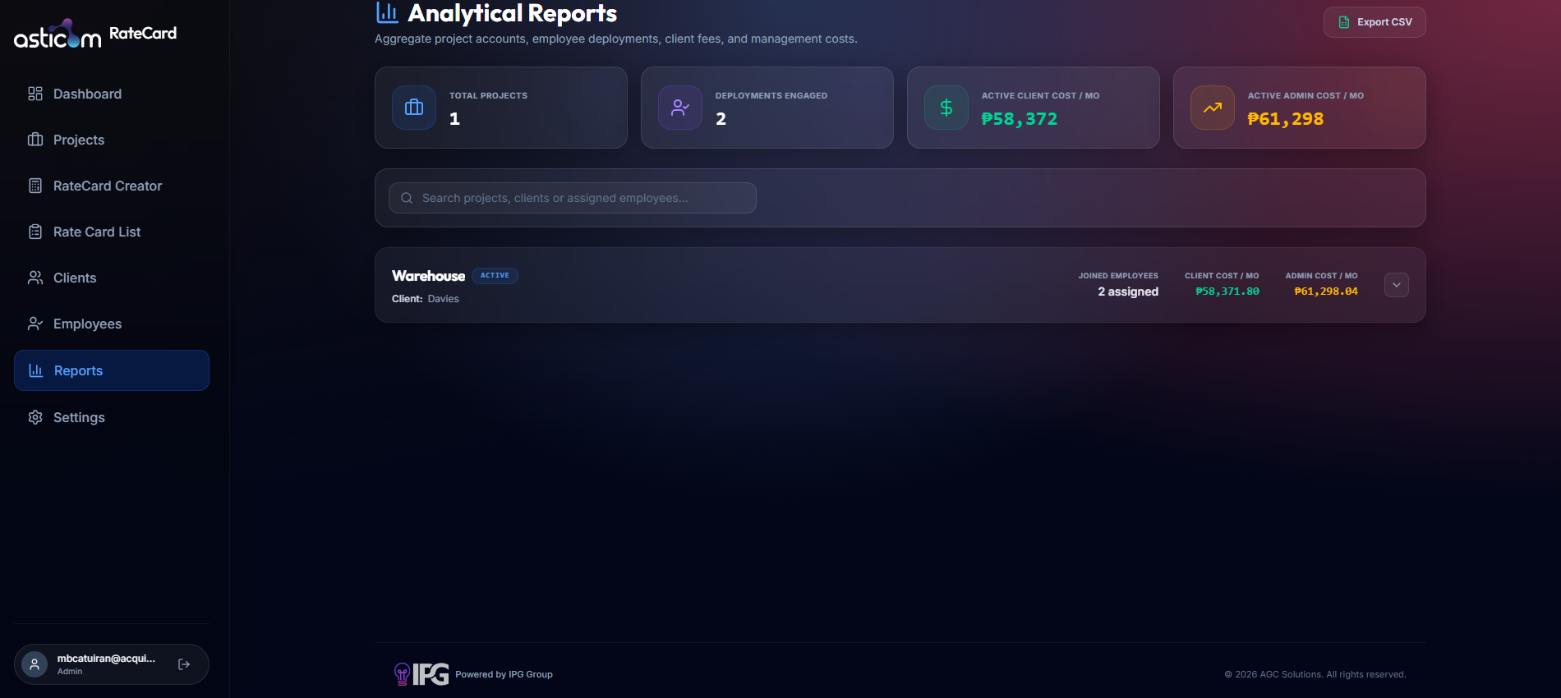
ANALYTICAL REPORTS
Reports &
Analytics
Aggregate Cost Intelligence Across All Projects
The Analytical Reports module aggregates project accounts, employee deployments, client fees, and management costs into one exportable dashboard — giving leadership total financial visibility.
Total projects, deployments & cost summaries
Client cost vs. Admin cost per month
Per-project breakdown with employee count
Export data to CSV with one click

Slide 9
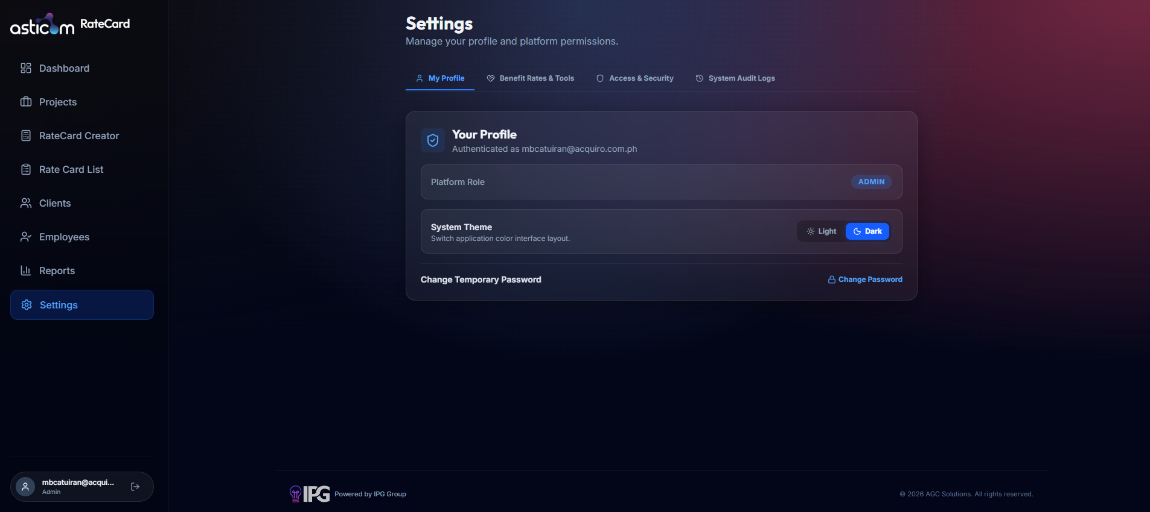

PLATFORM SETTINGS
Settings &
Security
Profile, Permissions, and System Control
Admins manage their profile, configure benefit rates and tools, control access & security, and review system audit logs — all in a tabbed settings panel with Light/Dark theme support.
My Profile with platform role display
Benefit Rates & Tools configuration
Access & Security controls
System Audit Logs for accountability

Slide 10


Why RateCard?
Built for Philippine outsourcing and consulting teams that bill clients monthly.
PH Compliance Built-In
Role-Based Access Control
SSS, PhilHealth, Pag-IBIG, SIL, 13th month — auto-calculated every time, no spreadsheets needed.
Admin-level permissions ensure only the right people see sensitive rate and billing information.
Full Billing Transparency
End-to-End Workflow
Separate Client View and Admin View for every rate card — share only what's appropriate with clients.
From hiring an employee to generating a rate card and assigning them to a project — one seamless flow.

Slide 11
Get Started with
RateCard
Simplify your rate card management. Ensure PH compliance. Bill clients with confidence.
Powered by Mel Catuiran

