Slide 1

iPro Time
6,000+
Digital Time-Keeping
for Over 6,000
In-Store Promodisers
Promodisers Tracked
82%
Compliance Rate
1,250
Replacing paper-based timekeeping with a secure, real-time, compliance-driven platform — reducing income loss, administrative burden, and contract uncertainty.
Total Headcount
Powered by Mel Catuiran

Slide 2




The Problem We're Solving
Paper-Based Timekeeping
Income Loss from Unmanned Areas
Over 6,000 promodisers rely on manual, paper logs — creating data gaps, errors, and zero real-time visibility into attendance and duty hours.
Without accurate deployment tracking, vendor areas go unmanned without detection — leading to lost sales opportunities and unfulfilled space contracts.
High Administrative Burden
Uncertain Contract Compliance
Store Operations Officers manually reconcile timesheets, follow up absences, and validate vendor compliance — consuming hours of key staff time daily.
Supplier agreements require guaranteed promodiser presence. Paper records cannot reliably prove fulfillment, exposing Metro to contractual disputes.

Slide 3










iPro Time — The Solution
A unified web platform that digitizes promodiser time-keeping across all Metro stores, giving operations teams real-time visibility, automated compliance tracking, and instant incident management.
Dashboard
Promodisers
Metro Calendar
User Management
Vendor Management
Live headcount, compliance rate & scorecard
Manage all promodiser profiles & statuses
Global schedule view across all stores
Create & manage platform user accounts
Assign and track vendor representatives
Store Management
Role Management
Incident Reports
Reports
Bulletins
Register and manage all Metro store locations
Define access levels and permissions
File and notify vendors of violations instantly
Daily time records, compliance scorecards & CSV
Broadcast announcements to all vendors

Slide 4
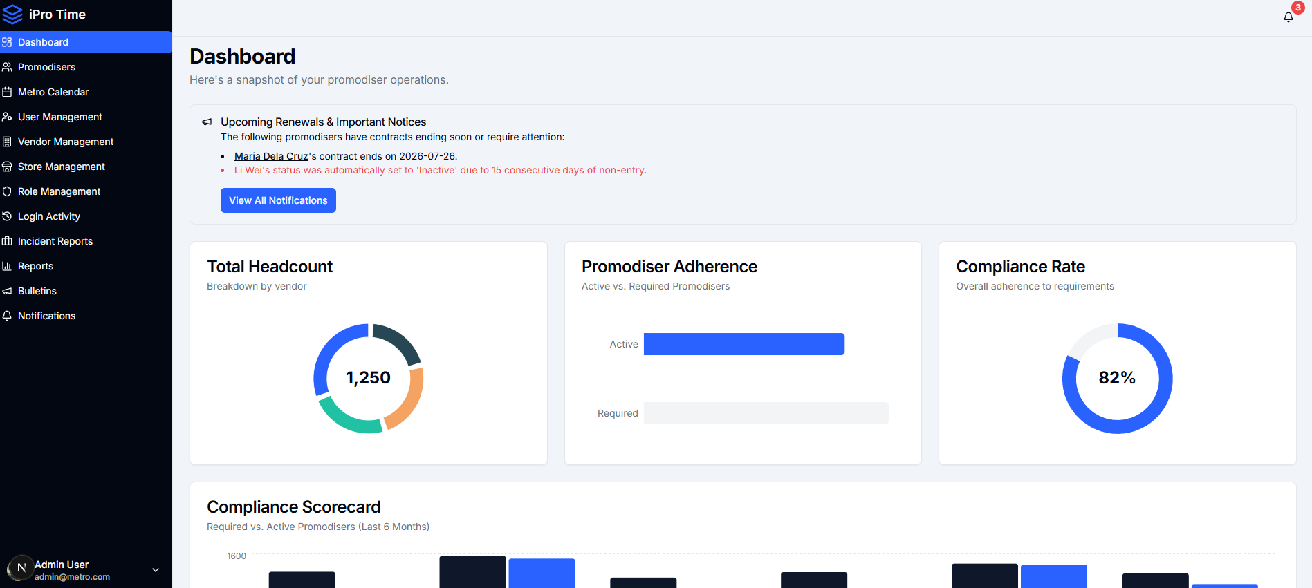

Dashboard
OPERATIONS HUB
Real-Time Snapshot of Promodiser Operations
The Dashboard gives Store Operations Officers an instant overview of total headcount, promodiser adherence vs. required counts, compliance rate, and upcoming contract renewals — all in one place.
Total headcount breakdown by vendor
Promodiser Adherence: Active vs. Required
Compliance Rate gauge (currently 82%)
Upcoming renewals & inactivity alerts

Slide 5
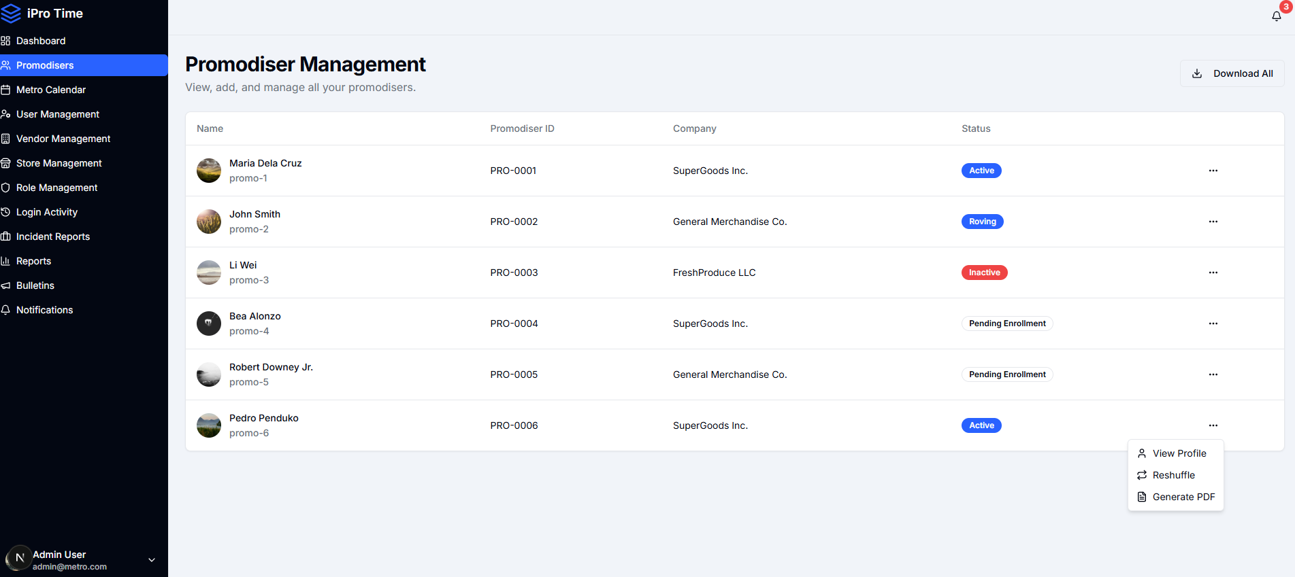
Promodiser Management
WORKFORCE REGISTRY
Centralized Directory of All In-Store Promodisers
Every promodiser is registered with a unique ID, company affiliation, and real-time status. Admins can view profiles, trigger reshuffles, or generate PDF dossiers — all from one interface.
Unique Promodiser IDs (PRO-XXXX)
Status tracking: Active, Roving, Inactive, Pending
Auto-inactivation after 15 days non-entry
View Profile, Reshuffle, and Generate PDF actions

Slide 6
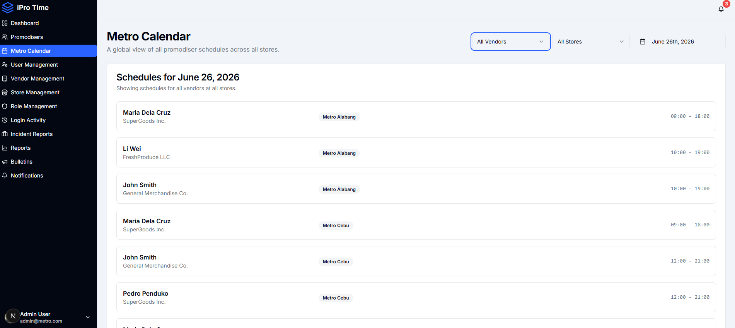
Metro Calendar
SCHEDULE OVERVIEW
Global Promodiser Schedule Across All Stores
A centralized daily calendar showing every promodiser's assigned store and shift hours. Filterable by vendor and store, giving managers instant visibility into deployment coverage gaps.
Date-by-date view of all promodiser schedules
Filter by vendor and store location
Shift time ranges displayed per promodiser
Spot coverage gaps before they cause income loss

Slide 7
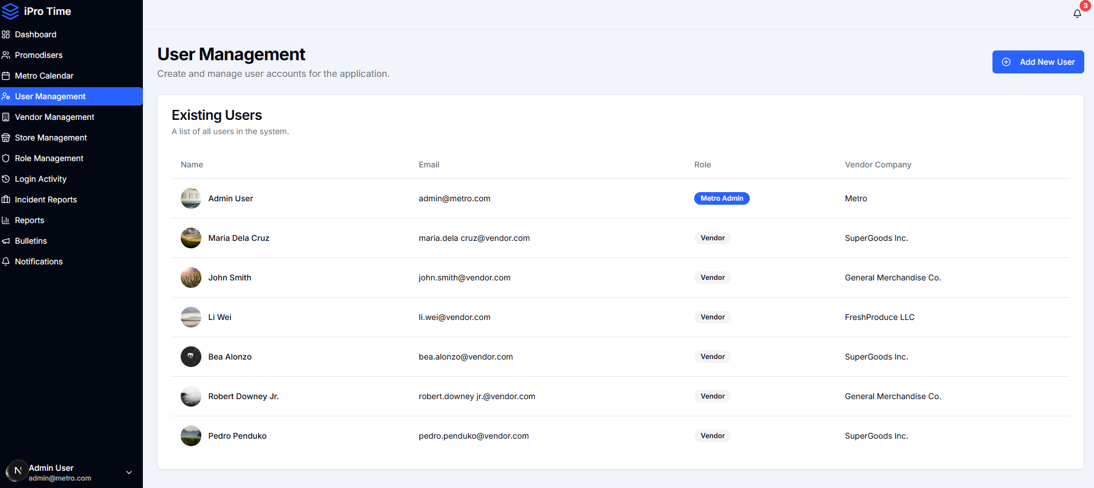
User Management
ACCESS CONTROL
Platform User Accounts & Role Assignment
Admins create and manage all accounts in the system — from Metro Admin to Vendor users. Each user is linked to a vendor company, ensuring data segmentation and proper access scoping.
Add new users with role and vendor assignment
Metro Admin vs. Vendor role distinction
Email-based login for all user types
Full list view with vendor company linkage

Slide 8
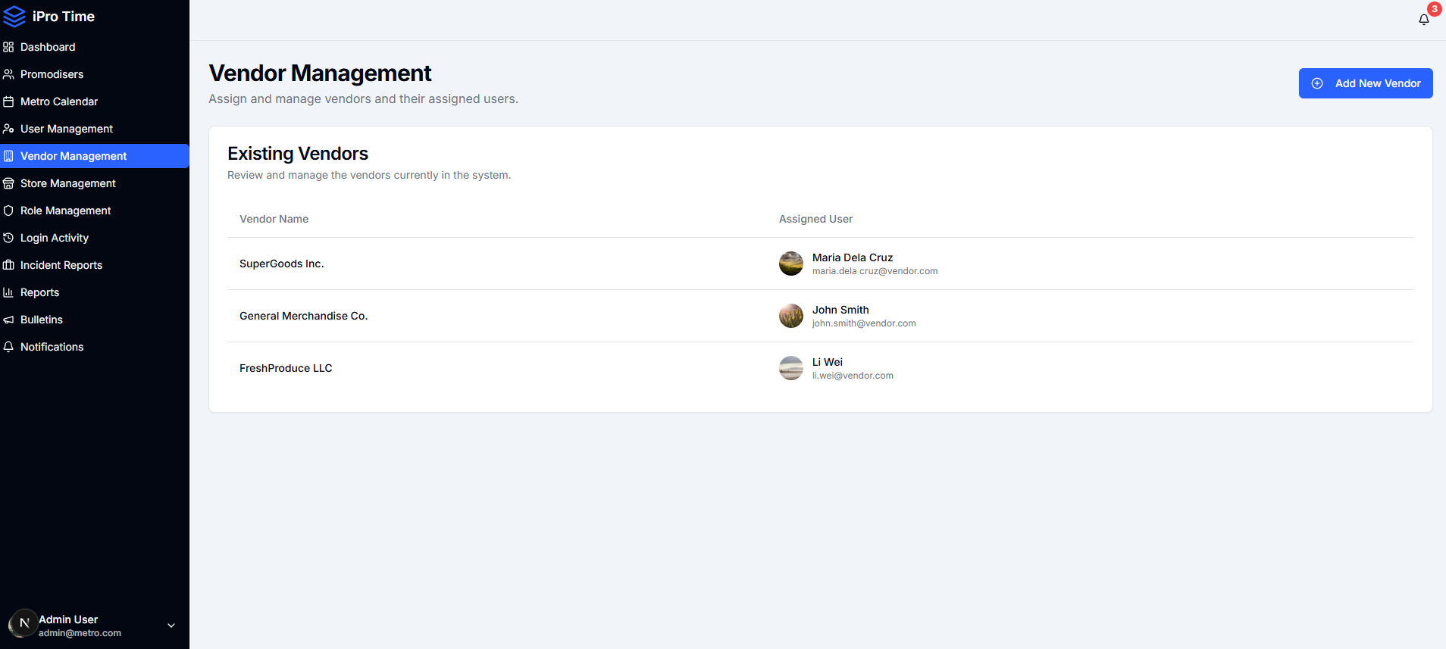
Vendor Management
SUPPLIER DIRECTORY
Manage Suppliers and Their Assigned Contacts
All vendor companies supplying promodisers are registered here with their assigned user contacts. This enables precise accountability — incidents, schedules, and bulletins are all vendor-scoped.
Register and manage all vendor companies
Assign dedicated vendor user accounts
Foundation for compliance reporting per vendor
Supports multi-vendor, multi-store deployments

Slide 9
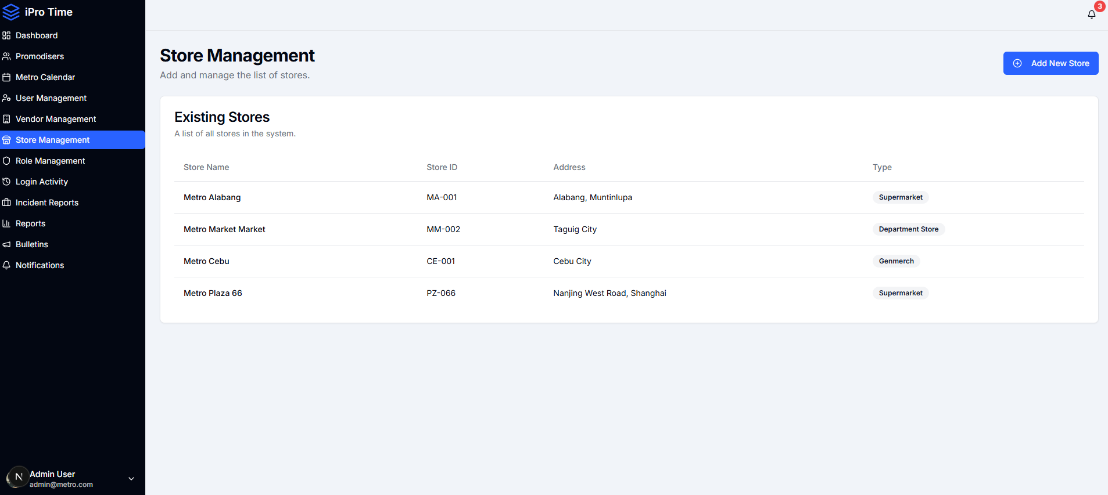
Store Management
LOCATION REGISTRY
Register and Track All Metro Store Locations
Every Metro branch is registered with a store ID, address, and store type (Supermarket, Department Store, Genmerch). This anchors all scheduling, compliance, and reporting to a specific location.
Unique Store IDs (MA-001, MM-002, etc.)
Store type classification per branch
Multi-city coverage across Philippines & abroad
Foundation for store-level compliance reporting

Slide 10
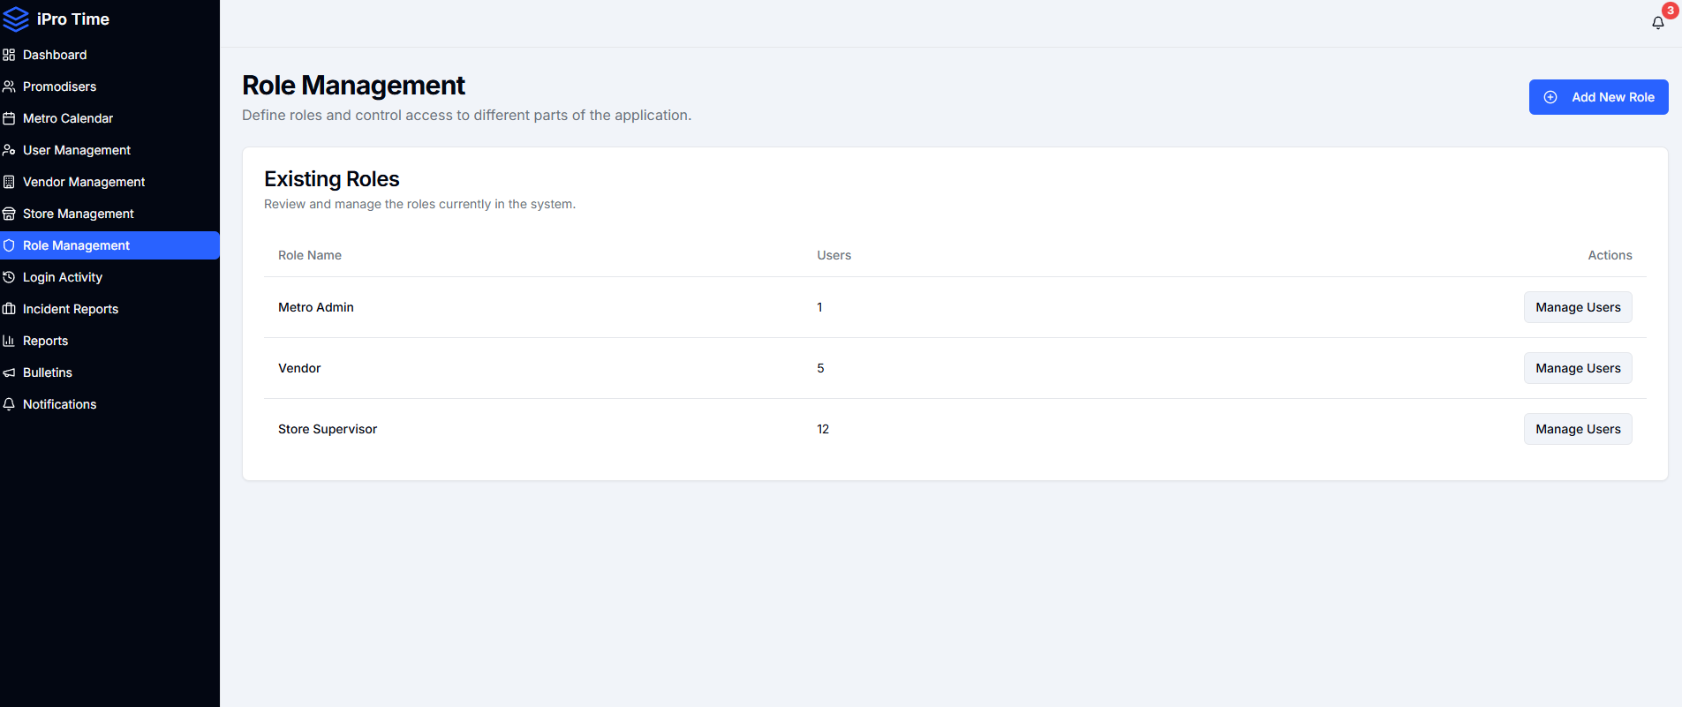
Role Management
PERMISSIONS
Define Roles and Control System Access
Three-tier role structure — Metro Admin, Vendor, and Store Supervisor — ensures each user sees only what they need. Roles can be expanded and users assigned or reassigned at any time.
Metro Admin: full platform control
Vendor: scoped to own promodisers & reports
Store Supervisor: store-level visibility
Manage Users action per role

Slide 11
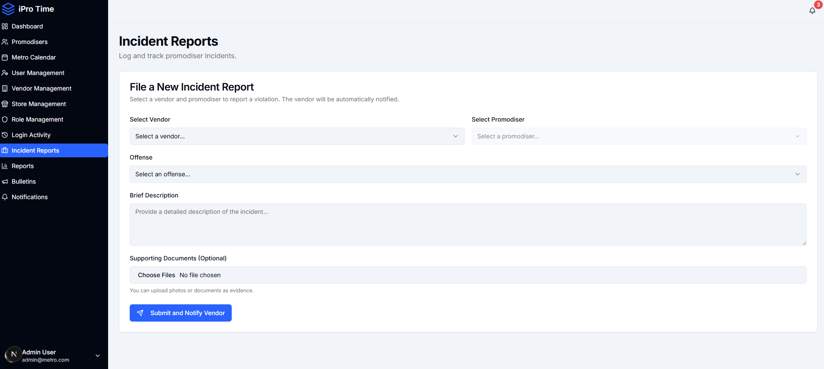
Incident Reports
COMPLIANCE ENFORCEMENT
Log Violations and Auto-Notify Vendors Instantly
When a promodiser commits an offense, admins file an incident report selecting the vendor, promodiser, offense type, and description. The platform automatically notifies the vendor — no manual email required.
Select vendor and promodiser from dropdowns
Categorized offense selection
Detailed description and evidence upload
One-click Submit & Notify Vendor

Slide 12
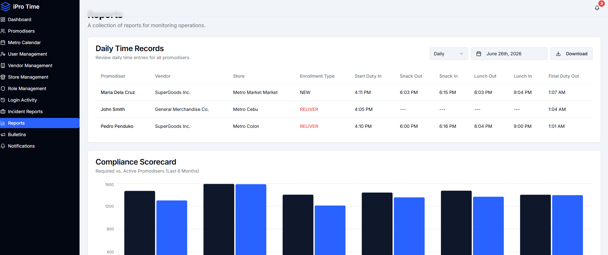
Reports
ANALYTICS & AUDIT
Daily Time Records and 6-Month Compliance Scorecard
The Reports module provides downloadable daily duty logs per promodiser — including snack/lunch breaks and final duty-out times — alongside a 6-month compliance scorecard comparing required vs. active promodisers per branch.
Daily Time Records with full duty timeline
Enrollment type flagging (NEW / RELIVER)
6-Month Compliance Scorecard bar chart
Download reports to CSV

Slide 13
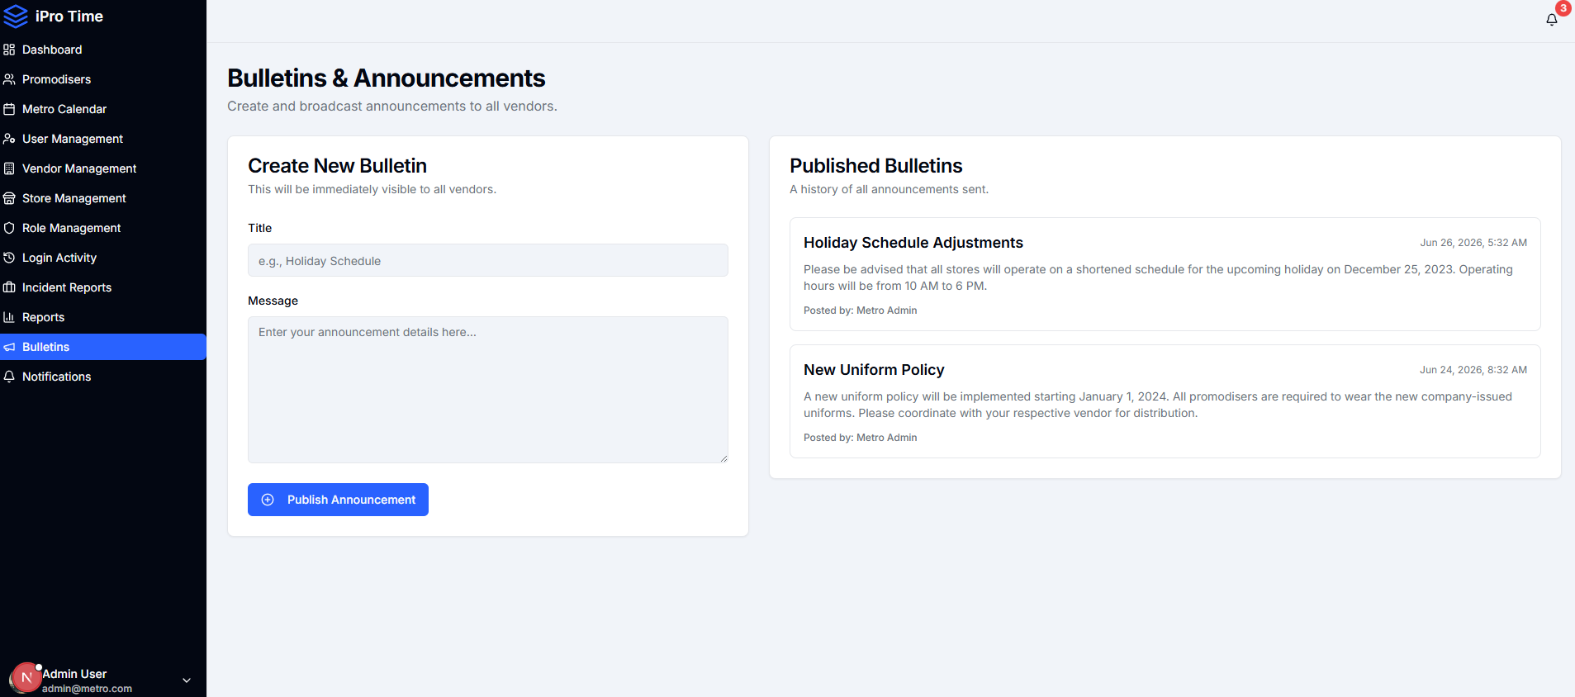
Bulletins & Announcements
COMMUNICATIONS
Broadcast Policy Updates to All Vendors Instantly
Metro Admins compose and publish announcements — policy changes, holiday schedules, uniform updates — that are immediately visible to all vendor users. A published history is maintained for reference.
Create new bulletins with title and message
Immediately visible to all vendor accounts
Published bulletin history with timestamps
Posted by Metro Admin for accountability

Slide 14

Key Benefits & Expected Outcomes
Real-Time Visibility
Reduced Income Loss
Verified Contract Compliance
Operations Officers see live headcount, duty status, and attendance data instantly — no waiting for paper reports.
Unmanned areas are flagged immediately. Deployment gaps are visible before they translate into lost vendor floor revenue.
Digital duty records provide irrefutable proof of promodiser presence — protecting Metro in supplier contract disputes.
Lower Admin Burden
Scalable to 6,000+ Promodisers
Fast Incident Response
Auto-inactivation, automated incident notifications, and downloadable reports eliminate manual reconciliation work.
Multi-vendor, multi-store, multi-role architecture designed to scale across all Metro branches nationwide.
Vendors are automatically notified of violations the moment an incident is filed — no delays, no missed follow-ups.

Slide 15
From Paper to Platform.
iPro Time digitizes promodiser time-keeping for over 6,000 in-store staff across Metro Retail — ensuring contract compliance, reducing administrative burden, and eliminating income loss from unmonitored deployments.
✓ Secure & Accurate
✓ Real-Time Tracking
✓ Contract-Ready Reports
Powered by Mel Catuiran

