Slide 1
DevOps

Slide 2
What is Devops?
DevOps is a culture which promotes collaboration between Development and Operations Team to deploy code to production faster in an automated & repeatable way. The word 'DevOps' is a combination of two words 'development' and 'operations.’
DevOps helps to increases an organization's speed to deliver applications and services. It allows organizations to serve their customers better and compete more strongly in the market.
In simple words, DevOps can be defined as an alignment of development(Development + Testers) and IT operations with better communication and collaboration.

Slide 3
Why is DevOps is Needed?
Before DevOps, the development and operation team worked in complete isolation.
Testing and Deployment were isolated activities done after design-build. Hence they consumed more time than actual build cycles.
Without using DevOps, team members are spending a large amount of their time in testing, deploying, and designing instead of building the project.
Manual code deployment leads to human errors in production
Coding & operation teams have their separate timelines and are not in synch causing further delays.

Slide 4
How is DevOps different from traditional IT
Old Process
Devops
After placing an order for new servers, the Development team works on testing. The Operations team works on extensive paperwork as required in enterprises to deploy the infrastructure.
Projection about failover, redundancy, data center locations, and storage requirements are skewed as no inputs are available from developers who have deep knowledge of the application.
Operations team has no clue on the progress of the Development team. Operations team develop a monitoring plan as per their understanding.
Before go-live, the load testing crashes the application. The release is delayed.
After placing an order for new servers Development and Operations team work together on the paperwork to set-up the new servers. This results in better visibility of infrastructure requirement.
Projection about failover, redundancy, disaster recovery, data center locations, and storage requirements are pretty accurate due to the inputs from the developers.
In DevOps, the Operations team is completely aware of the progress the developers are making. Operations team interact with developers and jointly develop a monitoring plan that caters to the IT and business needs. They also use advance Application Performance Monitoring (APM) Tools.
Before go-live, the load testing makes the application a bit slow. The development team quickly fixes the bottlenecks. The application is released on time.

Slide 5
Why is Devops used?
DevOps allows Agile Development Teams to implement Continuous Integration and Continuous Delivery. This helps the teams to launch products faster into the market.
Other Important reasons are:
Predictability: DevOps offers significantly lower failure rate of new releases.
Reproducibility: Version everything so that earlier version can be restored anytime.
Maintainability: Effortless process of recovery in the event of a new release crashing or disabling the current system.
Time to market: DevOps reduces the time to market up to 50% through streamlined software delivery. This is particularly the case for digital and mobile applications.
Greater Quality: DevOps helps the team to provide improved quality of application development as it incorporates infrastructure issues.
Reduced Risk: DevOps incorporates security aspects in the software delivery lifecycle. It helps in reduction of defects across the lifecycle.
Resiliency: The Operational state of the software system is more stable, secure, and changes are auditable.
Cost Efficiency: DevOps offers cost efficiency in the software development process which is always an aspiration of IT companies' management.
Breaks larger code base into small pieces: DevOps is based on the agile programming method. Therefore, it allows breaking larger code bases into smaller and manageable chunks.

Slide 6
Continues DevOps life-cycle
DevOps is deep integration between development and operations. Understanding DevOps is not possible without knowing DevOps lifecycle.
Development: In this DevOps stage the development of software takes place constantly. In this phase, the entire development process is separated into small development cycles. This benefits DevOps team to speed up software development and delivery process.
Testing: QA team use tools like Selenium to identify and fix bugs in the new piece of code.
Integration: In this stage, new functionality is integrated with the prevailing code, and testing takes place. Continuous development is only possible due to continuous integration and testing.
Deployment: In this phase, the deployment process takes place continuously. It is performed in such a manner that any changes made any time in the code, should not affect the functioning of high traffic website.
Monitoring: In this phase, operation team will take care of the inappropriate system behavior or bugs which are found in production.
When to use Devops?
DevOps should be used for large distributed applications such as eCommerce sites or applications hosted on a cloud platform.
It should not be used in a mission-critical application like bank, power and other sensitive data sites. Such applications need strict access controls on the production environment, a detailed change management policy, access control policy to the data centers.

Slide 7
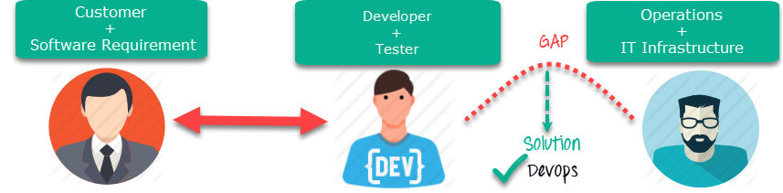
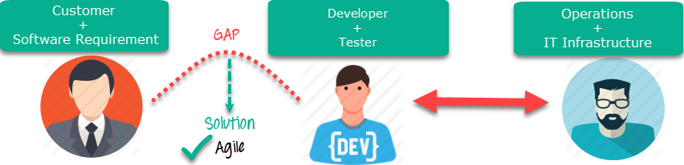
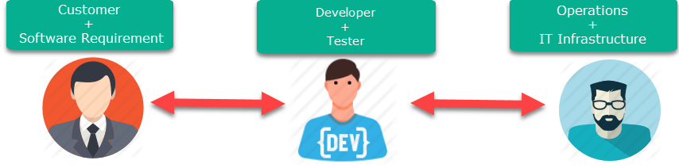
Devops vs Agile vs Traditional IT

Slide 8
Agile
Devops
Emphasize breaking down barriers between developers and management.
Addresses gap between customer requirements and development teams.
Focuses more on functional and non-functional readiness.
Agile development pertains mainly to the way development is thought out by the company.
Agile development manages on "sprints. It means that the time table is much shorter (less than a month) and several features are to be produced and released in that period.
Agile development puts a huge emphasis on training all team members to have varieties of similar and equal skills. So that, when something goes wrong, any team member can get assistance from any member in the absence of the team leader.
DevOps is about software deployment and operation teams.
Addresses the gap between development and Operation team.
It focuses operational and business readiness.
DevOps emphases on deploying software in the most reliable and safest ways which aren't necessarily always the fastest.
DevOps strives for consolidated deadlines and benchmarks with major releases, rather than smaller and more frequent ones.
DevOps, likes to divide and conquer, spreading the skill set between the development and operation teams. It also maintains consistent communication.

Slide 9
Devops Principles
There six principles which are essential when adopting DevOps:
Customer-Centric Action: DevOps team must take customer-centric action for that they should constantly invest in products and services.
End-To-End Responsibility: The DevOps team need to provide performance support until they become end-of-life. This enhances the level of responsibility and the quality of the products engineered.
Continuous Improvement: DevOps culture focuses on continuous improvement to minimize waste. It continuously speeds up the improvement of product or services offered.
Automate everything: Automation is a vital principle of DevOps process. This is not only for the software development but also for the entire infrastructure landscape.
Work as one team: In the DevOps culture role of the designer, developer, and tester are already defined. All they needed to do is work as one team with complete collaboration.
Monitor and test everything: It is very important for DevOps team to have a robust monitoring and testing procedures.

Slide 10
Roles and responsibilities of a Devops engineer
A DevOps Engineer is an IT professional who works with software developers, system operators, and other production IT staff to administer code releases. DevOps should have hard as well as soft skills to communicate and collaborate with development, testing, and operations teams.
DevOps approach needs frequent, incremental changes to code versions, which means frequent deployment and testing regimens
DevOps engineer will work with development team staff to tackle the coding and scripting needed to connect elements of code, like libraries or software development kits.
Roles and Skills:
Able to perform system troubleshooting and problem-solving across platform and application domains.
Manage project effectively through open, standards-based platforms.
Increase project visibility thought traceability.
Improve quality and reduce development cost with collaboration.
Analyze, design and evaluate automation scripts & systems.
Ensuring critical resolution of system issues by using the best cloud security solutions services.
DevOps engineer should have the soft skill of problem-solver and quick-learner.

Slide 11
Future of Devops
They are lots of Change likely to happens in the DevOps world some most prominent are:
Organizations are shifting in their needs to weeks and months instead of years.
We will see soon that DevOps engineers have more access and control of the end user than any other person in the enterprise.
DevOps is becoming a valued skill for IT people. DevOps and continuous delivery are here to stay. Therefore companies need to change as they have no choice but to evolve. However, the mainstreaming the notion of DevOps will take 5 to 10 years.

Slide 12
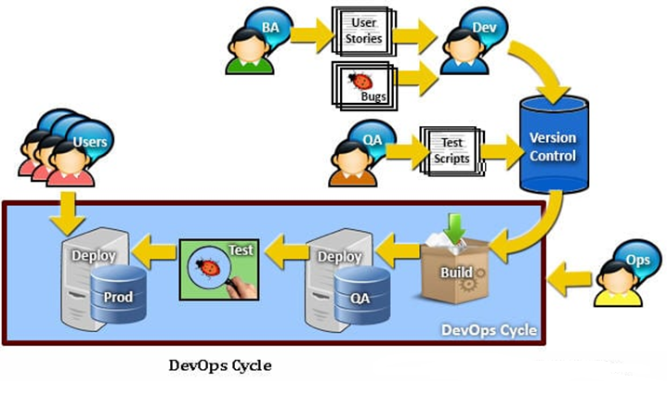
Devops Cycle

Slide 13
Changed role of QA in Devops
Traditionally, QA would get a build which is deployed in their designated environment and QA would then commence their functional & regression testing. The build would ideally sit with the QA for a couple of days before the QA sign-off on the build.
QA change in DevOps:
QA are required to align their efforts in the DevOps cycle.
They have to make sure that all their test cases are automated and achieve near 100% code coverage.
They need to make sure that their environments are standardized and the deployment on their QA boxes are automated.
All their pre-testing tasks, cleanups, post-testing tasks, etc. are automated and aligned with the Continuous Integration cycle.

Slide 14
Questions??

