Slide 1
Campaign and Adviser Performance Optimization Analysis
Prepared by: Melvin Ngure

Slide 2
Executive Summary
Objective: To analyze campaign effectiveness and adviser performance.
Key Focus Areas:
Campaign performance (e.g., conversion and interest rates).
Adviser contribution to customer acquisition.
ROI and financial efficiency metrics.
Outcome: Insights and strategies to maximize conversions and improve ROI.

Slide 3
Methodology
Data Preparation
Analysis Techniques:
Tools Used:
Removed duplicates
Handled missing values
Calculated derived metrics
Descriptive statistics and correlation analysis
Visualization of trends using bar charts, heat maps, and scatter plots
ROI and cost efficiency calculations.
Python, Excel, Power BI, Jupyter Notebook.

Slide 4
Key Findings – Campaign Effectiveness
High Rate of Unprofitable Campaigns: With over 60% of campaigns generating a negative net profit, the current marketing strategy is not effectively translating spend into conversions and profitability.

Slide 5
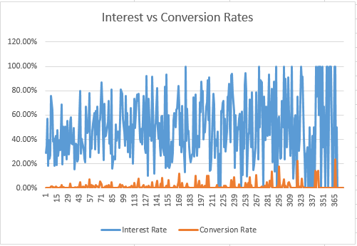
Key Findings – Campaign Effectiveness
Conversion Variability: Some campaigns showed high interest rates but low conversion rates, indicating that while they attract interest, they struggle to convert leads into customers. This suggests potential issues in messaging alignment or follow-up processes within these campaigns.

Slide 6
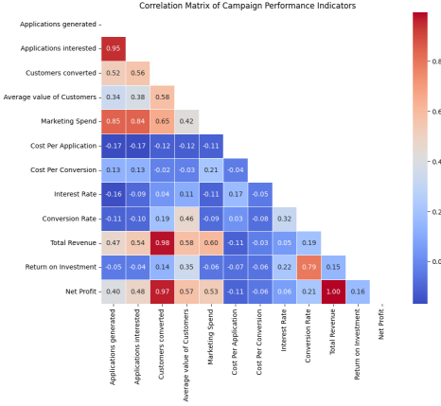
Key Findings – Campaign Effectiveness
Marketing Spend Impact: High marketing spend correlates with high conversion rates. However, a campaign such as Campaign 366 with a low marketing spend of € 5.05 had the highest conversion rate of 23.33%, suggests that strategic spending in targeted campaigns can outperform high-expenditure campaigns with broader reach.

Slide 7
Advisers’ Performance
Low Mean Conversion Rate: The average conversion rate of 0.006025 (or 0.6%) indicates that, on average, advisers convert a very small percentage of their leads. This low baseline may suggest several factors, such as:
Possible misalignment between campaign targets and audience expectations.
Potential challenges in the conversion process, such as lead quality or adviser approach.
High Variability: With a standard deviation of 0.007806, there’s considerable spread in individual adviser performance relative to the mean. Since this standard deviation is larger than the mean, it indicates:
Significant differences among advisers in terms of conversion effectiveness.
The presence of both high and low performers, where some advisers are likely converting far more effectively than others.

Slide 8
Key Drivers of Success
High Correlation Between Applications and Conversions: Analysis revealed a strong positive correlation of 0.52 between the number of applications generated and the number of customers converted, suggesting that campaigns generating more applications have a higher chance of conversion success
Low Correlation Between Marketing Spend and Conversions: The weak correlation of -0.09 between marketing spend and customer conversions indicates that simply increasing budget allocation does not guarantee higher conversion rates, highlighting the importance of targeted and strategic marketing approaches.
Cost Efficiency and Return on Marketing Spend (ROMS): Campaigns with high ROMS delivered strong conversion results while maintaining budget efficiency. This indicates that these campaigns were able to attract and convert customers with minimal expenditure, serving as benchmarks for efficient budget allocation.

Slide 9
Recommendations
Focus on High-Converting Campaigns: Reallocate resources towards campaigns that consistently show high conversion rates. By investing in top-performing campaigns, the organization can maximize conversions while maintaining cost efficiency.
Adjust Messaging for Low-Conversion Campaigns: For campaigns with high interest but low conversions, conduct A/B testing to refine messaging and better align with customer needs. This could involve altering the campaign’s value proposition, visuals, or targeting criteria to improve lead-to-customer conversion rates.
Strategic Budgeting Based on ROMS: Prioritize budget allocation to campaigns with high ROMS, as these deliver a better return on each dollar spent. Campaigns with high conversion rates but moderate spend levels should be considered as primary candidates for additional funding.

Slide 10
Recommendations
Limit Spending on Low-Yield Campaigns: For campaigns with low ROMS, consider reducing budget allocation or re-evaluating campaign strategies. Reallocate these funds to support campaigns that generate more efficient customer conversions.
Segmentation: With more data, we would be able to segment the audience based on demographics, preferences, and past engagement to ensure that campaigns are relevant to specific groups. This can help tailor messages and increase interest rates by focusing on well-defined audience subsets
Targeted Campaigns: For each segment, develop targeted campaigns that address specific needs or interests. A more personalized approach may enhance relevance and improve both interest and conversion rates.

Slide 11
Recommendations
Training Opportunities: Advisers with below-average conversion rates indicate possible gaps in skills or engagement techniques. Adviser Y, for example, had one of the lowest conversion rates despite handling a substantial number of applications, pointing to a potential need for targeted training or support.
Targeted Performance Enhancement: Focus on subtle improvements in conversion techniques rather than extensive overhauls. Training sessions could involve fine-tuning specific skills, such as objection handling, personalized customer engagement, or improving product knowledge to increase overall effectiveness slightly.
Peer Learning and Coaching: Encourage advisers to share their approaches in a collaborative setting, leveraging the team’s overall consistency to implement small yet effective performance adjustments. This can foster an environment of continuous learning where advisers can adopt proven, minor refinements to boost conversion rates across the board.

Slide 12

Conclusion
By implementing recommendations herein this document, the company can:
Increase Customer Acquisition: More efficient and targeted campaigns coupled with improved advisor performance can lead to a higher number of converted customers.
Improve ROI on Marketing: Refining campaigns and allocating resources strategically can improve the return on marketing investment.
Enhance Advisor Productivity: Training and coaching initiatives can lead to increased advisor productivity and customer satisfaction.
Gain a Competitive Advantage: Optimized marketing and operational processes can give the company a competitive edge by acquiring more customers and improving customer lifetime value.

Slide 13
Any Questions?

