Slide 1
REGRESSION
-QUESTIONS

Slide 2

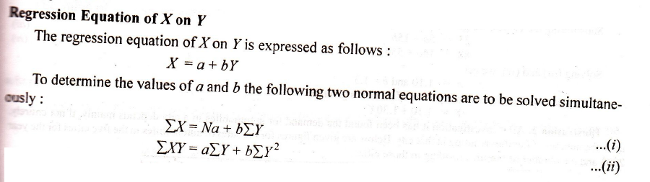

Slide 3



Slide 4
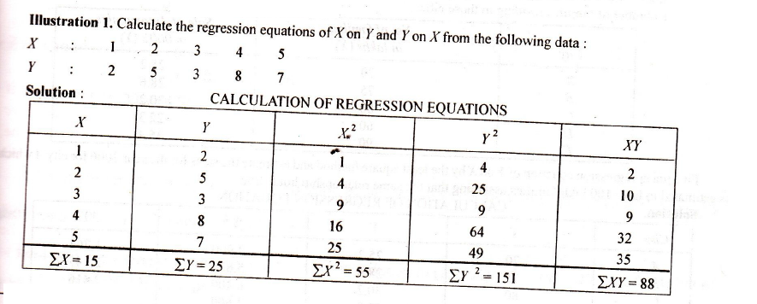

Slide 5
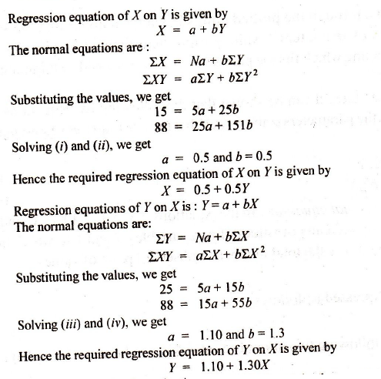

Slide 6
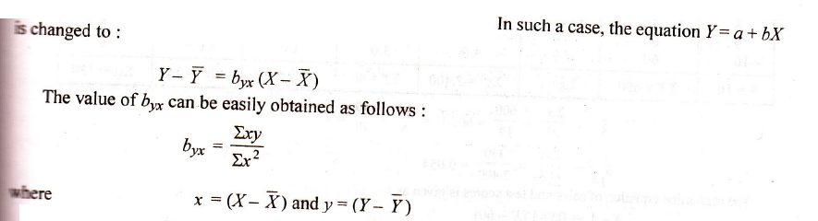
TAKING DEVIATIONS FROM ARITHMETIC MEAN

Slide 7
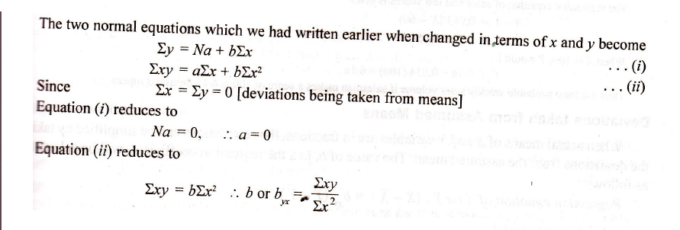

Slide 8
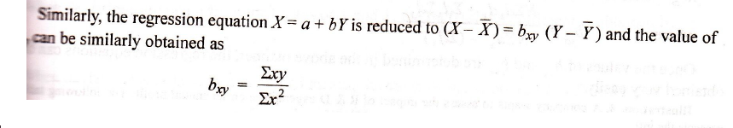

Slide 9
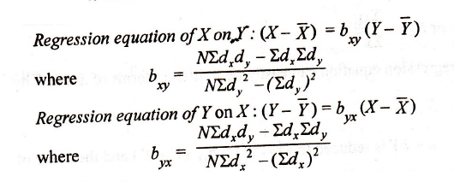
TAKING DEVIATIONS FROM ASSUMED MEAN

Slide 10
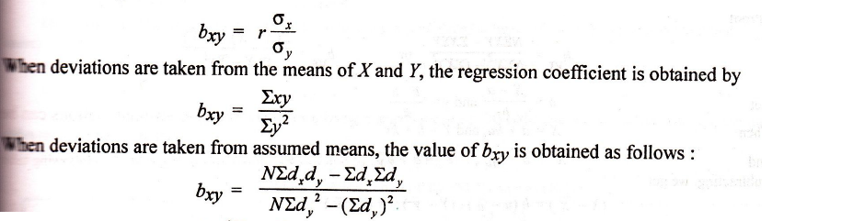
REGRESSION COEFFICIENTS
Regression coefficient of x on y

Slide 11
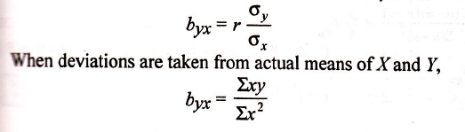
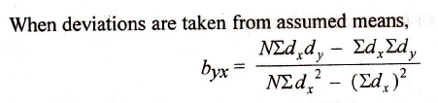
Regression Coefficient of y on x

Slide 12
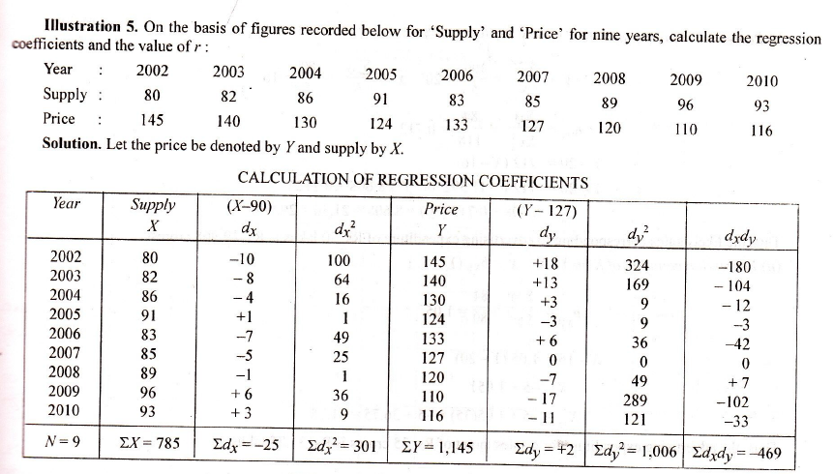

Slide 13
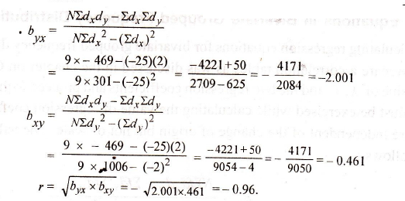

Slide 14
