Slide 1
Computer Science / Informatics And Programming II
INFO 1182 / CS 1182
Using C#

Slide 2
Introduction (Me)
Jonathan “Jon” Holmes
holmjona@isu.edu
BA 541
282-3215
Office Hours:
Tues & Thurs 1:00 – 2:00 PM (and by appointment)

Slide 3
Course Objectives
Basic Concepts of object-oriented design
Be familiar with object-oriented programming (OOP)
Abstraction
Encapsulation
Inheritance
Polymorphism
Association
Aggregation
Composition
Programming experience in C#
Requirements gathering and design

Slide 4
Required Materials
Text: (Required)
C# 6.0 and the .NET 4.6 Framework
ISBN: 9781118833032
Access to Windows-Based Computer for assignments
Personal Computer
ISU Labs
Limited
Access to Moodle
Assignments retrieved and turned in here.

Slide 5
Moodle
http://elearn.isu.edu/moodle/
Syllabus
Forums
Announcements
Help
Open for anyone to answer
Notes and demonstrations
Assignment submission and solutions
Grades for assignments

Slide 6
Needed Software
Free on DreamSpark
Visual Studio
2015 Enterprise
Not 2013, 2012, etc.
No Professional, Express, or Community Versions
Windows
10
Virtual Machine or Dual Boot on Macs and Linux
TAs can help with troubleshooting installations

Slide 7
First Assignment
Exercise 1
C# Form Application
Similar to 1181 Assignments
Exercise 2
No Code
Design based

Slide 8
Project Deliverables
Deliverable
1
Deliverable
2
Deliverable
3
Deliverable
4
Etc.
…
Seven (7) in all
Build on previous deliverable
Solution will be posted
May use it for your next assignment
Cite it!! (Full Disclosure)

Slide 9
Exams
Exam 1, Exam2, and Final
3x5 Note card
Poky and IF
Take in respective classes
Online
Take in class
Provide special times
Arrange with approved proctor
No Retakes
Final is Comprehensive
Score >= 60% to get a C- or better in course

Slide 10
Grades
They are what you earn
I am fair!
What I do for one, I must do for all.
Do not ask for favors

Slide 11
Help and Assistance
Help Forum on Moodle
Faculty
Email
Include CS/INFO 1182 in subject line
Get help as needed - not solutions!
If not sure, ASK!

Slide 12
Tutors
We provide them
Engineering Lounge (Poky)
CHE 206 (IF)
Do not go to TRiO
Use our tutors!
Others hurt more than they help
Do not go with a blank project

Slide 13
Outline (by Week)
Not set in stone; this can change!
WPF Applications
Objects - Abstraction
Encapsulation
Inheritance
Interfaces and Abstract Classes
Exam 1
Aggregation and Composition
Collections

Slide 14
Outline (by Week) cont.
Generics and LINQ
Exam 2
Polymorphism
Threading and Parallel Processing
File and Exception Handling
Web Development and ASP.Net
Databases (or Mobile) and C#
Final Exam (May 4th – 10:00AM)
Not set in stone; this can change!
Except this; this is set!

Slide 15
Grading
Assignments - 45%
Class participation - 5%
Exams - Midterm and Final - 50%
Pen and Paper
Exam Grade Limits Final Grade:
Must pass exams with an average of 60% or better in order to get a C- in the course
Department policy

Slide 16
Expectations (Mine)
1181-level programming experience =>
Attendance
Learning
Reading
Academic Honesty
Participation
Respect
Do your best
Ask Questions
No bad questions
Laptops
Variables
Iterations
Methods
Basic I/O
Casting
Arrays
Simple objects

Slide 17
Academic Honesty
Academic dishonesty includes, but is not limited to:
Cheating on examination
Plagiarism
Collusion

Slide 18
Academic Honesty - Definitions
Cheating on an examination includes:
Copying from another’s paper, any means of communication with another during an examination, giving aid to or receiving aid from another during an examination;
Using any material during an examination that is unauthorized by the proctor;
Taking or attempting to take an examination for another student or allowing another student to take or attempt to take an examination for oneself.
Using, obtaining, or attempting to obtain by any means the whole or any part of an unadministered examination.
Talking to anyone other than the professor during an exam.

Slide 19
Academic Honesty - Definitions
Plagiarism is the unacknowledged incorporation of another’s work into work which the student oﬀers for credit.
Collusion is the unauthorized collaboration of another in preparing work that a student oﬀers for credit.
Other types of academic dishonesty include using other student’s content from the labs or students’ disk, etc.
Performing any act designed to give unfair advantage to a student or the attempt to commit such acts is considered cheating.

Slide 20
Academic Honesty - Clarification
The use of the source code of another person’s program, even temporarily, is considered plagiarism.
Copying material from a source without attributing (citing) the source.
Allowing another person to use your source code, even temporarily, is considered collusion.

Slide 21
Academic Honesty - Acceptable
In this class, the speciﬁc exceptions given below are not considered scholastically dishonest acts:
Discussion of the algorithm and general programming techniques used to solve a problem
Giving and receiving aid in debugging
Discussion and comparison of program output

Slide 22
Academic Honesty – Short Version
Everything you do needs to be YOU.
Not grading anyone else.
Better to submit some code than code that is not yours.

Slide 23
Cite it
If you use any code or do anything outside of yourself, Cite it.
If you ask for help, Cite it.
If you discuss your code, Cite it.
If you Google it, Cite it, with links!

Slide 24
Expectations (Yours)
Weekly Content
Notes
PowerPoints
Not a small amount of homework
Assignments Due via Moodle?

Slide 25
If you miss class?
Your responsibility
Classmates
Notes online
Book
Ask specific questions
Will not repeat lecture.

Slide 26




Getting Started
Add Picture to Moodle
Install Visual Studio
2015 Enterprise
Do Cheating Quiz on Moodle
Take as many times as you need.
Start on 1st Assignment (Due Jan. 19th)
See if you learned what you needed in 1181

Slide 27

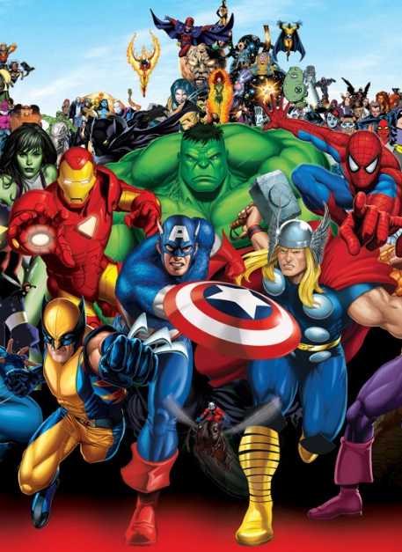
Add a Picture to Moodle
Profile picture that is identifiable as you.

Slide 28


Introductions (You)
Your Name
Preferred name?
Major
Experience
If you were a superhero, what would be your superpower?

Slide 29


