Slide 1
Inheritance
Reusing Code

Slide 2
Extend Class Functionality
Inheritance extends functionality of an existing class
Create a new class that derives from the existing class
Derived class inherits properties and behavior of base class
Implements an “Is-A” relationship for code

Slide 3
Terminology
Inherits from
Base Class
Inherits to
Derived Class

Slide 4
Inheritance Diagram
Base Class and Derived Class Diagram
Base Class
SuperClass
Parent Class
Derived Class
SubClass
Child Class

Slide 5
Inheritance Relationship Example
Person class contains common or general information about all people. This is the base class.
Employee class contains more specialized information about people who are employees. This is a derived class of the person class
Student class contains more specialized information about people who are students. This is a derived class of the person class

Slide 6
"Is-a" Relationship
This is a diagram of the base class (Person) and the two derived classes:
We say that a Employee "Is a" Person and a Student "Is a" Person
Person
Employee
Student

Slide 7
Can go deeper
Person
Employee
Student
Manager
Supervisor
ForeignStudent

Slide 8
Base Class Data
The Person class contains information that is common to all persons:
private String _FirstName;
private String _LastName;
private DateTime _BirthDate;
Every person has a first name, last name and birth date
This private data cannot be seen by derived classes

Slide 9
Sharing Data with Inheritance
To allows Data to be available to derived classes, use the access modifier protected.
protected String _FirstName;
protected String _LastName;
protected DateTime _BirthDate;
Use only when you need access to local values that are hidden from the public.

Slide 10
Base Class Properties (or accessors and mutators)
The base class should provide either properties or accessors and mutators to work with the base class data. These are inherited by derived classes.

Slide 11
Base Class Constructors
Base class should provide default and overloaded constructors to initialize instance data
public Person(string fName, string lName, DateTime bDay) {
FirstName = fName;
LastName = lName;
BirthDate = bDay;
}
Constructors are not inherited by derived classes

Slide 12
Base Class Member Methods
Base class can provide member methods that are common to all people
An example might be a method to send a message to an person
A derived class would inherit all public member methods in the base class

Slide 13
Employee Derived Class
The Employee class is a derived class of the Person base class.
This is coded by using the ":" symbol as shown here in the derived class definition:
class Employee : Person
This indicates that the Employee class will inherit public properties and methods from the Person class (not the constructors)

Slide 14
Employee Class Data
Employees have and employee id, daily hours and an days worked
The instance data for the Employee class is as follows:
private int _IDNumber;
private int _DaysWorked;
private double _DailyHours;

Slide 15
Employee Properties
The Employee class provides properties or accessors and mutators for the data in that class

Slide 16
Employee Member Methods
The Employee class provides a member method to calculate and return the number of hours committed each week.
public double getWeeklyHours() {
return _DaysWorked * _DailyHours;
}

Slide 17
Base Class Constructor Executes First
When an object of Employee class is instantiated using a default constructor, the base class default constructor is executed before the derived class constructor on Person
If an overloaded constructor is used to instantiate a Employee object the derived class code can explicitly call the base class overloaded constructor on Person

Slide 18
Employee Default Constructor
public Employee(){
_DaysWorked= 0;
_DailyHours= 0.0;
}
An instantiation of a Employee using this constructor will cause the base class default constructor to be executed first.

Slide 19
Employee Overloaded Constructor
public Employee(int idNumber, string fName, string lName, int daysWorked, double dailyHours, DateTime bDay):base(fName, lName, bDay){
_IDNumber = idNumber;
_DaysWorked = daysWorked;
_DailyHours = dailyHours;
}
This will pass the fName, lName, and bDay arguments to the Person overloaded constructor that will be executed before the code in this constructor
This calls the base class overloaded constructor

Slide 20
Student Data
Students are people where their work is there classes.
The instance data and property for this data is:
private int _CreditLoad; // Instance data
public int CreditLoad{ // Property
get { return _CreditLoad; }
set {
if (value > 0)
_CreditLoad = value;
}
}

Slide 21
Student Member Method
The member method to calculate the weekly hours a student needs to dedicate has the same name as the Employee method. The calculation is different
public int getWeeklyHours(){
return CreditLoad * 3;
}

Slide 22
Student Overloaded Constructor
Like the Employee overloaded constructor, this constructor passes data to the base class constructor
public Student(string fName, string lName, DateTime bDay, int credits) :base(fName,lName,bDay){
CreditLoad = credits;
}

Slide 23
Using Employee Derived Class
Derived class can use properties and methods from both the base class and the derived class
// Create a Employee object using the default constructor
Employee myEmployee = new Employee();
// Use base class properties
myEmployee.FirstName = “Sue";
myEmployee.LastName = “Storm";
myEmployee.BirthDate = new DateTime(3,4,1966);
// Use derived class properties
myEmployee.DailyHours = 8.0;
myEmployee.DaysWorked = 5;
// Use derived class method
double weeklyHours = myEmployee.getWeeklyHours();

Slide 24
Using Student Derived Class
Objects of both derived classes can use the base class public properties and member methods plus their own
// Create object using the overloaded constructor in derived class
// data for base class is passed to the base class overloaded constructor
Student myStudent = new Student(“Susan", “Storms", new DateTime(5,15,1944), 13);
// Call the derived class member method
double weeklyHours = myStudent.getWeeklyHours();

Slide 25
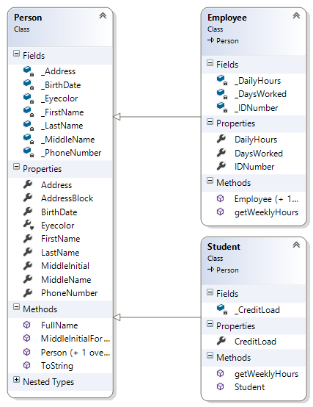
Class Diagram

Slide 26
Code Reusability
Inheritance
Leads to
Code Reusability
&&
Less Redundant Code

Slide 27
Using Abstract Classes
Abstract class cannot be instantiated
Normally used as the base class in an inheritance hierarchy
This provides a template for all derived classes
Derived classes of an abstract class that can be instantiated are called concrete classes

Slide 28
Abstract Classes
Use the keyword abstract
public abstract class Person{
…
}

Slide 29
Abstract Methods
Use the keyword abstract
Must be overridden by derived classes
Must be in an abstract class
public abstract int getAge();

Slide 30
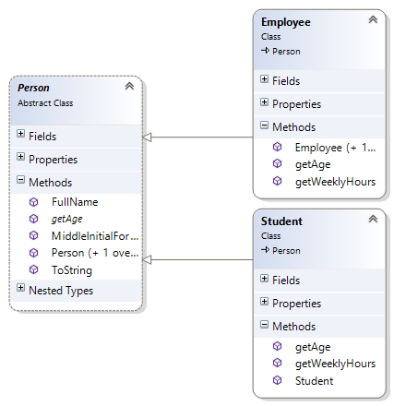
Class Diagram

Slide 31
Interfaces
Specify what operations can be performed - not how they are implemented
Think of interfaces as a “Template”
Assign a common functionality to possibly unrelated classes
Classes that implement the same interface respond to the same method calls (polymorphism)
Similar to abstract classes but classes do not need to be related in an "is-a" relationship
Allows “multiple inheritance”

Slide 32
Implementation
Methods declared must be implemented by the class that implements the interface
Cannot contain fields (class variables);
public interface IPayable {
double getWeeklyWage();
double getBiWeeklyHours();
}

Slide 33
Using
class Employee:Person, IPayable {
double _Wage;
… // other code
public double getWeeklyWage() {
return getWeeklyHours() * _Wage;
}
public double getBiWeeklyHours() {
return getWeeklyHours()*2;
}
}

Slide 34
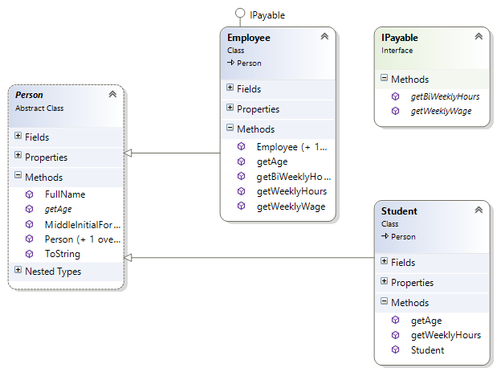
Class Diagram

Slide 35
Interfaces Cannot Be Instantiated
Cannot instantiate objects of the Interface type
Can use Interface as a reference type
IPayable myEmp = new Employee();

Slide 36
Copying Data
Shallow Copy
Copies references to the data to the new object
Deep Copy
Copies values of the data to the new object

Slide 37
Shallow Copy
Stack
Heap
a
b
#A4
#A4
63
12
83
50
26
#A4
b = a

Slide 38
Deep Copy
Stack
Heap
a
b
#A4
#A4
63
12
83
50
26
#F7
#F7
63
12
83
50
26

