Slide 1
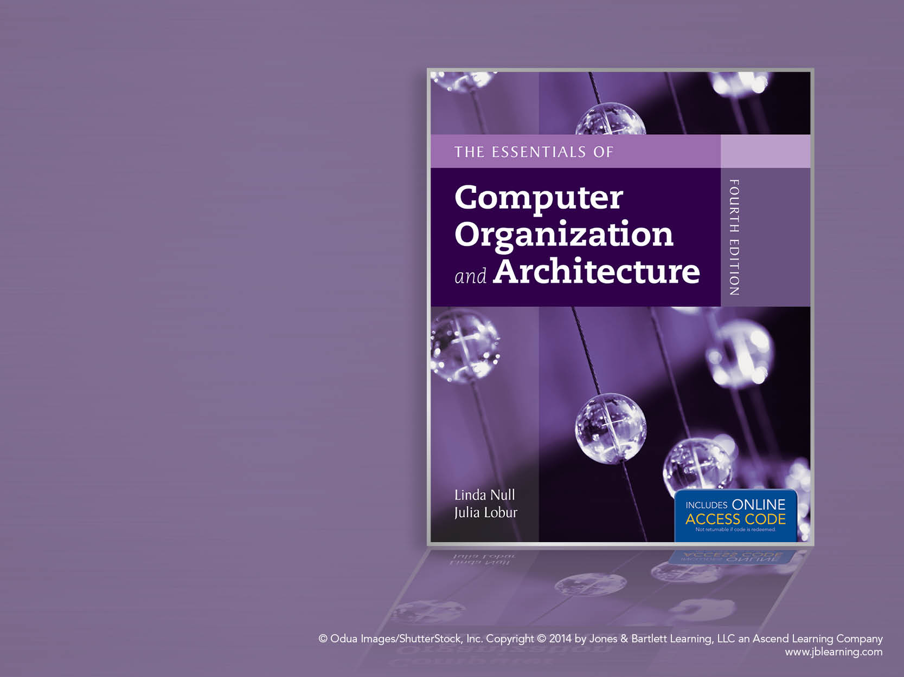
Chapter 1
Introduction

Slide 2
Chapter 1 Objectives
Understand units of measure common to computer systems.
Appreciate the evolution of computers.
Understand the computer as a layered system.
Be able to explain the von Neumann architecture and the function of basic computer components.

Slide 3
1.1 Overview
Why study computer organization / architecture?
Design better programs, including system software such as compilers, operating systems, and device drivers.
Optimize program behavior.
Evaluate (benchmark) computer system performance.
Understand time, space, and price tradeoffs.

Slide 4
1.1 Overview
Computer organization/Architecture
Physical aspects of computer systems.
E.g., How does a computer work?
Logical aspects of system implementation as seen by the programmer.
E.g., instruction sets, instruction formats, data types, addressing modes.
How do I design a computer?

Slide 5
1.2 Computer Components
There is no clear distinction between matters related to computer organization and matters relevant to computer architecture.
Principle of Equivalence of Hardware and Software:
Any task done by software can also be done using hardware, and any operation performed directly by hardware can be done using software.*
* Assuming speed is not a concern.

Slide 6
1.2 Computer Components
At the most basic level, a computer is a device consisting of three pieces:
A processor to interpret and execute programs
A memory to store both data and programs
A mechanism for transferring data to and from the outside world.

Slide 7
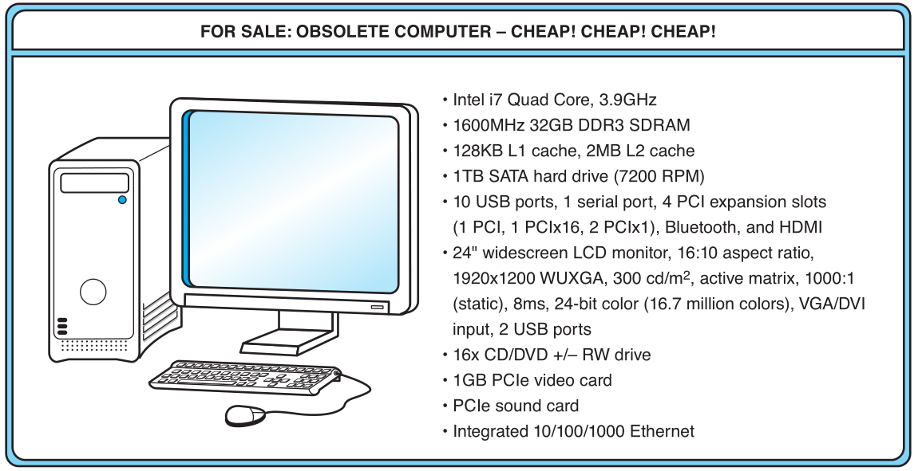
1.3 An Example System
Consider this advertisement:
GHz??
L1 Cache??
GB??
PCI??
USB??
What does it all mean??

Slide 8
1.3 An Example System
Measures of capacity and speed:
Kilo- (K) = 1 thousand = 10³ and 2¹⁰
Mega- (M) = 1 million = 10⁶ and 2²⁰
Giga- (G) = 1 billion = 10⁹ and 2³⁰
Tera- (T) = 1 trillion = 10¹² and 2⁴⁰
Peta- (P) = 1 quadrillion = 10¹⁵ and 2⁵⁰
Exa- (E) = 1 quintillion = 10¹⁸ and 2⁶⁰
Zetta- (Z) = 1 sextillion = 10²¹ and 2⁷⁰
Yotta- (Y) = 1 septillion = 10²⁴ and 2⁸⁰
Whether a metric refers to a power of ten or a power of two typically depends upon what is being measured.

Slide 9
1.3 An Example System
Hertz = clock cycles per second (frequency)
1MHz = 1,000,000Hz
Processor speeds are measured in MHz or GHz.
Byte = a unit of storage
1KB = 2¹⁰ = 1024 Bytes
1MB = 2²⁰ = 1,048,576 Bytes
1GB = 2³⁰ = 1,099,511,627,776 Bytes
Main memory (RAM) is measured in GB
Disk storage is measured in GB for small systems, TB (2⁴⁰) for large systems.

Slide 10
1.3 An Example System
Measures of time and space:
Milli- (m) = 1 thousandth = 10 ⁻³
Micro- (μ) = 1 millionth = 10 ⁻⁶
Nano- (n) = 1 billionth = 10 ⁻⁹
Pico- (p) = 1 trillionth = 10 ⁻¹²
Femto- (f) = 1 quadrillionth = 10 ⁻¹⁵
Atto- (a) = 1 quintillionth = 10 ⁻¹⁸
Zepto- (z) = 1 sextillionth = 10 ⁻²¹
Yocto- (y) = 1 septillionth = 10 ⁻²⁴

Slide 11
1.3 An Example System
Millisecond = 1 thousandth of a second
Hard disk drive access times are often 10 to 20 milliseconds.
Nanosecond = 1 billionth of a second
Main memory access times are often 50 to 70 nanoseconds.
Micron (micrometer) = 1 millionth of a meter
Circuits on computer chips are measured in microns.

Slide 12
1.3 An Example System
We note that cycle time is the reciprocal of clock frequency.
A bus operating at 133MHz has a cycle time of 7.52 nanoseconds:
133,000,000 cycles/second = 7.52ns/cycle
Now back to the advertisement ...

Slide 13
1.3 An Example System
The microprocessor is the “brain” of the system. It executes program instructions. This one is an Intel i7 running at 3.9GHz.

Slide 14
1.3 An Example System
Computers with large main memory capacity can run larger programs with greater speed than computers having small memories.
RAM is an acronym for random access memory. Random access means that memory contents can be accessed directly if you know its location.
Cache is a type of temporary memory that can be accessed faster than RAM.

Slide 15
1.3 An Example System
This system has 32GB of (fast) synchronous dynamic RAM (SDRAM) . . .
… and two levels of cache memory, the level 1 (L1) cache is smaller and (probably) faster than the L2 cache. Note that these cache sizes are measured in KB and MB.

Slide 16
1.3 An Example System
Hard disk capacity determines the amount of data and size of programs you can store.
This one can store 1TB. 7200 RPM is the rotational speed of the disk. Generally, the faster a disk rotates, the faster it can deliver data to RAM. (There are many other factors involved.)

Slide 17
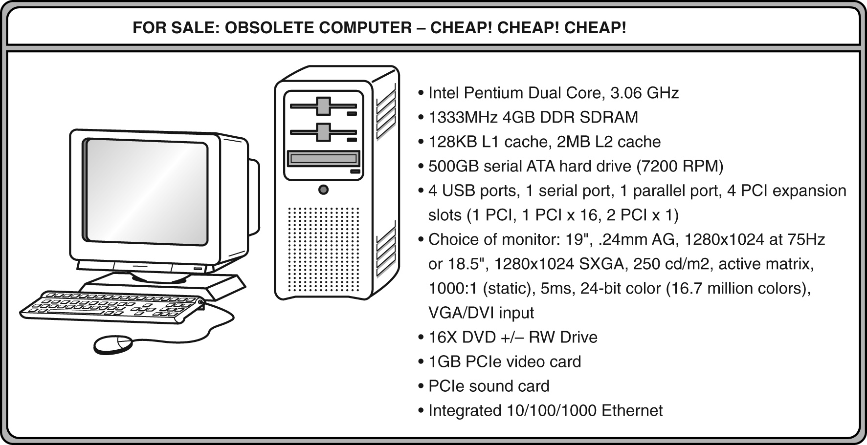
1.3 An Example System
ATA stands for advanced technology attachment, which describes how the hard disk interfaces with (or connects to) other system components.
A DVD can store about 4.7GB of data. This drive supports rewritable DVDs, +/-RW, that can be written to many times.. 16x describes its speed.

Slide 18
1.3 An Example System
Ports allow movement of data between a system and its external devices.
This system has ten ports.

Slide 19
1.3 An Example System
Serial ports send data as a series of pulses along one or two data lines.
Parallel ports send data as a single pulse along at least eight data lines.
USB, Universal Serial Bus, is an intelligent serial interface that is self-configuring. (It supports “plug and play.”)

Slide 20
1.3 An Example System
System buses can be augmented by dedicated I/O buses. PCI, peripheral component interface, is one such bus.
This system has two PCIe (PCI express) devices: a video card and a sound card.

Slide 21
1.3 An Example System
Active matrix technology uses one transistor per picture element (pixel). The resolution of a monitor determines the amount of text and graphics that the monitor can display.
Super VGA (SVGA) tells us this monitor has a resolution of 1280 × 1024 pixels.
The video card contains memory and programs that support the monitor.

Slide 22
1.3 An Example System
Throughout the remainder of the book you will see how these components work and how they interact with software to make complete computer systems.
This statement raises two important questions:
What assurance do we have that computer components will operate as we expect?
And what assurance do we have that computer components will operate together?

Slide 23
1.4 Standards Organizations
There are many organizations that set computer hardware standards-- to include the interoperability of computer components.
Throughout this book, and in your career, you will encounter many of them.
Some of the most important standards-setting groups are . . .

Slide 24
1.4 Standards Organizations
The Institute of Electrical and Electronic Engineers (IEEE)
Promotes the interests of the worldwide electrical engineering community.
Establishes standards for computer components, data representation, and signaling protocols, among many other things.

Slide 25
1.4 Standards Organizations
The International Telecommunications Union (ITU)
Concerns itself with the interoperability of telecommunications systems, including data communications and telephony.
National groups establish standards within their respective countries:
The American National Standards Institute (ANSI)
The British Standards Institution (BSI)

Slide 26
1.4 Standards Organizations
The International Organization for Standardization (ISO)
Establishes worldwide standards for everything from screw threads to photographic film.
Is influential in formulating standards for computer hardware and software, including their methods of manufacture.
Note: ISO is not an acronym. ISO comes from the Greek,
isos, meaning “equal.”

Slide 27
1.5 Historical Development
To fully appreciate the computers of today, it is helpful to understand how things got the way they are.
The evolution of computing machinery has taken place over several centuries.
In modern times computer evolution is usually classified into four generations according to the salient technology of the era.
We note that many of the following dates are approximate.

Slide 28
1.5 Historical Development
Generation Zero: Mechanical Calculating Machines (1642 - 1945)
Calculating Clock - Wilhelm Schickard (1592 - 1635).
Pascaline - Blaise Pascal (1623 - 1662).
Difference Engine - Charles Babbage (1791 - 1871), also designed but never built the Analytical Engine.
Punched card tabulating machines - Herman Hollerith (1860 - 1929).
Hollerith cards were commonly used for computer input well into the 1970s.

Slide 29
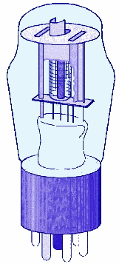
1.5 Historical Development
The First Generation: Vacuum Tube Computers (1945 - 1953)
Atanasoff Berry Computer (1937 - 1938) solved systems of linear equations.
John Atanasoff and Clifford Berry of Iowa State University.

Slide 30
1.5 Historical Development
The First Generation: Vacuum Tube Computers (1945 - 1953)
Electronic Numerical Integrator and Computer (ENIAC)
John Mauchly and J. Presper Eckert
University of Pennsylvania, 1946
The ENIAC was the first general-purpose computer.

Slide 31
1.5 Historical Development
The First Generation: Vacuum Tube Computers (1945 - 1953)
The IBM 650 first mass-produced computer. (1955)
It was phased out in 1969.
Other major computer manufacturers of this period include UNIVAC, Engineering Research Associates (ERA), and Computer Research Corporation (CRC).
UNIVAC and ERA were bought by Remington Rand, the ancestor of the Unisys Corporation.
CRC was bought by the Underwood (typewriter) Corporation, which left the computer business.

Slide 32
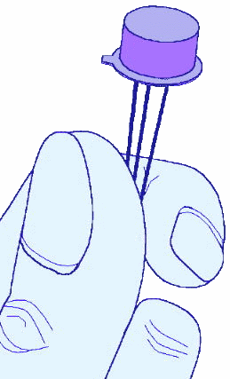
1.5 Historical Development
The Second Generation: Transistorized Computers (1954 - 1965)
IBM 7094 (scientific) and 1401 (business)
Digital Equipment Corporation (DEC) PDP-1
Univac 1100
Control Data Corporation 1604.
. . . and many others.
These systems had few architectural similarities.

Slide 33
1.5 Historical Development
The Third Generation: Integrated Circuit Computers (1965 - 1980)
IBM 360
DEC PDP-8 and PDP-11
Cray-1 supercomputer
. . . and many others.
By this time, IBM had gained overwhelming dominance in the industry.
Computer manufacturers of this era were characterized as IBM and the BUNCH (Burroughs, Unisys, NCR, Control Data, and Honeywell).

Slide 34
1.5 Historical Development
The Fourth Generation: VLSI Computers (1980 - ????)
Very large scale integrated circuits (VLSI) have more than 10,000 components per chip.
Enabled the creation of microprocessors.
The first was the 4-bit Intel 4004.
Later versions, such as the 8080, 8086, and 8088 spawned the idea of “personal computing.”

Slide 35
1.5 Historical Development
Moore’s Law (1965)
Gordon Moore, Intel founder
“The density of transistors in an integrated circuit will double every year.”
Contemporary version:
“The density of silicon chips doubles every 18 months.”
But this “law” cannot hold forever ...

Slide 36
1.5 Historical Development
Rock’s Law
Arthur Rock, Intel financier
“The cost of capital equipment to build semiconductors will double every four years.”
In 1968, a new chip plant cost about $12,000.
At the time, $12,000 would buy a nice home in the suburbs.
An executive earning $12,000 per year was “making a very comfortable living.”

Slide 37
1.5 Historical Development
Rock’s Law
In 2012, a chip plants under construction cost well over $5 billion.
For Moore’s Law to hold, Rock’s Law must fall, or vice versa. But no one can say which will give out first.
$5 billion is more than the gross domestic product of some small countries, including Barbados, Mauritania, and Rwanda.

Slide 38
1.6 The Computer Level Hierarchy
Computers consist of many things besides chips.
Before a computer can do anything worthwhile, it must also use software.
Writing complex programs requires a “divide and conquer” approach, where each program module solves a smaller problem.
Complex computer systems employ a similar technique through a series of virtual machine layers.

Slide 39
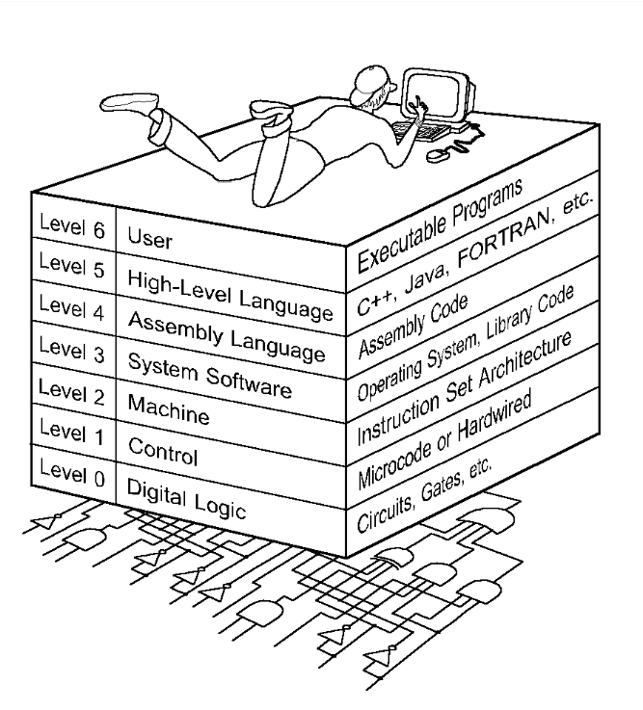
1.6 The Computer Level Hierarchy
Each virtual machine layer is an abstraction of the level below it.
The machines at each level execute their own particular instructions, calling upon machines at lower levels to perform tasks as required.
Computer circuits ultimately carry out the work.

Slide 40
1.6 The Computer Level Hierarchy
Level 6: The User Level
Program execution and user interface level.
The level with which we are most familiar.
Level 5: High-Level Language Level
The level with which we interact when we write programs in languages such as C, Pascal, Lisp, and Java.

Slide 41
1.6 The Computer Level Hierarchy
Level 4: Assembly Language Level
Acts upon assembly language produced from Level 5, as well as instructions programmed directly at this level.
Level 3: System Software Level
Controls executing processes on the system.
Protects system resources.
Assembly language instructions often pass through Level 3 without modification.

Slide 42
1.6 The Computer Level Hierarchy
Level 2: Machine Level
Also known as the Instruction Set Architecture (ISA) Level.
Consists of instructions that are particular to the architecture of the machine.
Programs written in machine language need no compilers, interpreters, or assemblers.

Slide 43
1.6 The Computer Level Hierarchy
Level 1: Control Level
A control unit decodes and executes instructions and moves data through the system.
Control units can be microprogrammed or hardwired.
A microprogram is a program written in a low-level language that is implemented by the hardware.
Hardwired control units consist of hardware that directly executes machine instructions.

Slide 44
1.6 The Computer Level Hierarchy
Level 0: Digital Logic Level
This level is where we find digital circuits (the chips).
Digital circuits consist of gates and wires.
These components implement the mathematical logic of all other levels.

Slide 45
1.7 Computing as a Service: Cloud Computing
The ultimate aim of every computer system is to deliver functionality to its users.
Computer users typically do not care about terabytes of storage and gigahertz of processor speed.
Many companies outsource their data centers to third-party specialists, who agree to provide computing services for a fee.
These arrangements are managed through service-level agreements (SLAs).

Slide 46
1.7 Computing as a Service: Cloud Computing
Rather than pay a third party to run a company-owned data center, another approach is to buy computing services from someone else’s data center and connect to it via the Internet.
This is the idea behind a collection of service models known as Cloud computing.
The “Cloud” is a visual metaphor traditionally used for the Internet. It is even more apt tor service-defined computing.

Slide 47
1.7 Computing as a Service: Cloud Computing
More Cloud computing models:
Software as a Service, or SaaS. The consumer of this service buy application services
Well-known examples include Gmail, Dropbox, GoToMeeting, and Netflix.
Platform as a Service, or PaaS. Provides server hardware, operating systems, database services, security components, and backup and recovery services.
Well-known PaaS providers include Google App Engine and Microsoft Windows Azure Cloud Services.

Slide 48
1.7 Computing as a Service: Cloud Computing
The general term, Cloud computing, consists of several models:
Infrastructure as a Service (IaaS) provides only server hardware, secure network access to the servers, and backup and recovery services. The customer is responsible for all system software including the operating system and databases.
Well-known IaaS platforms include Amazon EC2, Google Compute Engine, Microsoft Azure Services Platform, Rackspace, and HP Cloud.

Slide 49
1.7 Computing as a Service: Cloud Computing
More Cloud computing models:
Infrastructure as a Service (IaaS) provides only server hardware, secure network access to the servers, and backup and recovery services. The customer is responsible for all system software including the operating system and databases.
Well-known IaaS platforms include Amazon EC2, Google Compute Engine, Microsoft Azure Services Platform, Rackspace, and HP Cloud.
Cloud storage is a limited type of IaaS that includes services such as Dropbox, Google Drive, and Amazon.com’s Cloud Drive.

Slide 50
1.7 Computing as a Service: Cloud Computing
Cloud computing relies on the concept of elasticity where resources can be added and removed as needed.
You pay for only what you use.
Virtualization is an enabler of elasticity.
Instead of having a physical machine, you have a “logical” machine that may span several physical machines, or occupy only part of a single physical machine.

Slide 51
1.8 The von Neumann Model
On the ENIAC, all programming was done at the digital logic level.
Programming the computer involved moving plugs and wires.
A different hardware configuration was needed to solve every unique problem type.
Configuring the ENIAC to solve a “simple” problem required many days labor by skilled technicians.

Slide 52
1.8 The von Neumann Model
Inventors of the ENIAC, John Mauchley and J. Presper Eckert, conceived of a computer that could store instructions in memory.
The invention of this idea has since been ascribed to a mathematician, John von Neumann, who was a contemporary of Mauchley and Eckert.
Stored-program computers have become known as von Neumann Architecture systems.

Slide 53
1.8 The von Neumann Model
Today’s stored-program computers have the following characteristics:
Three hardware systems:
A central processing unit (CPU)
A main memory system
An I/O system
The capacity to carry out sequential instruction processing.
A single data path between the CPU and main memory.
This single path is known as the von Neumann bottleneck.

Slide 54
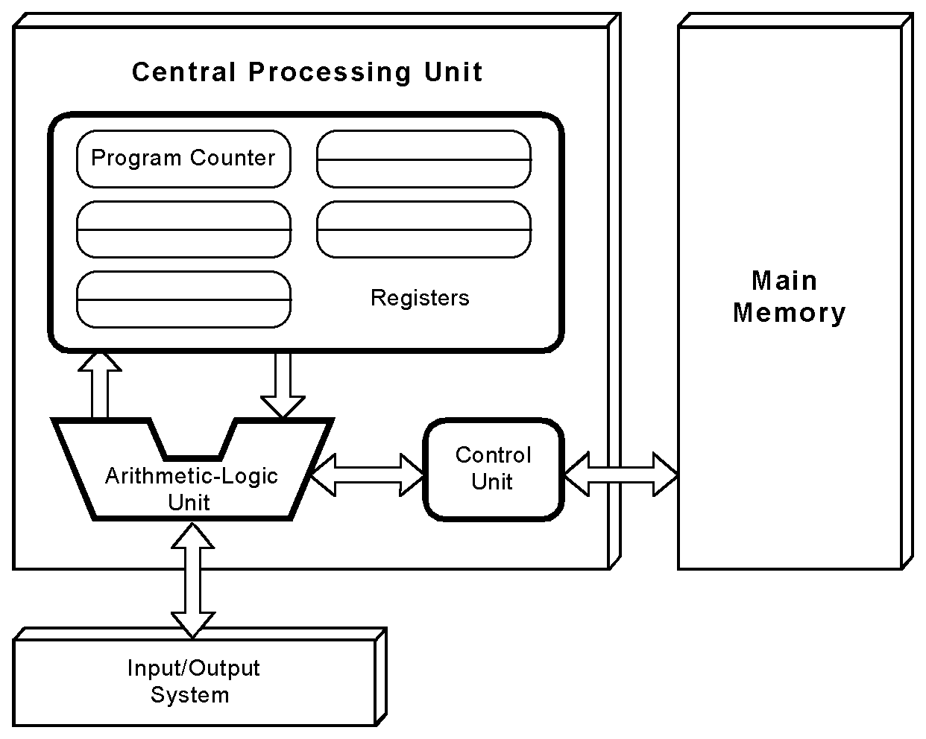
1.8 The von Neumann Model
This is a general depiction of a von Neumann system:
These computers employ a fetch-decode-execute cycle to run programs as follows . . .

Slide 55
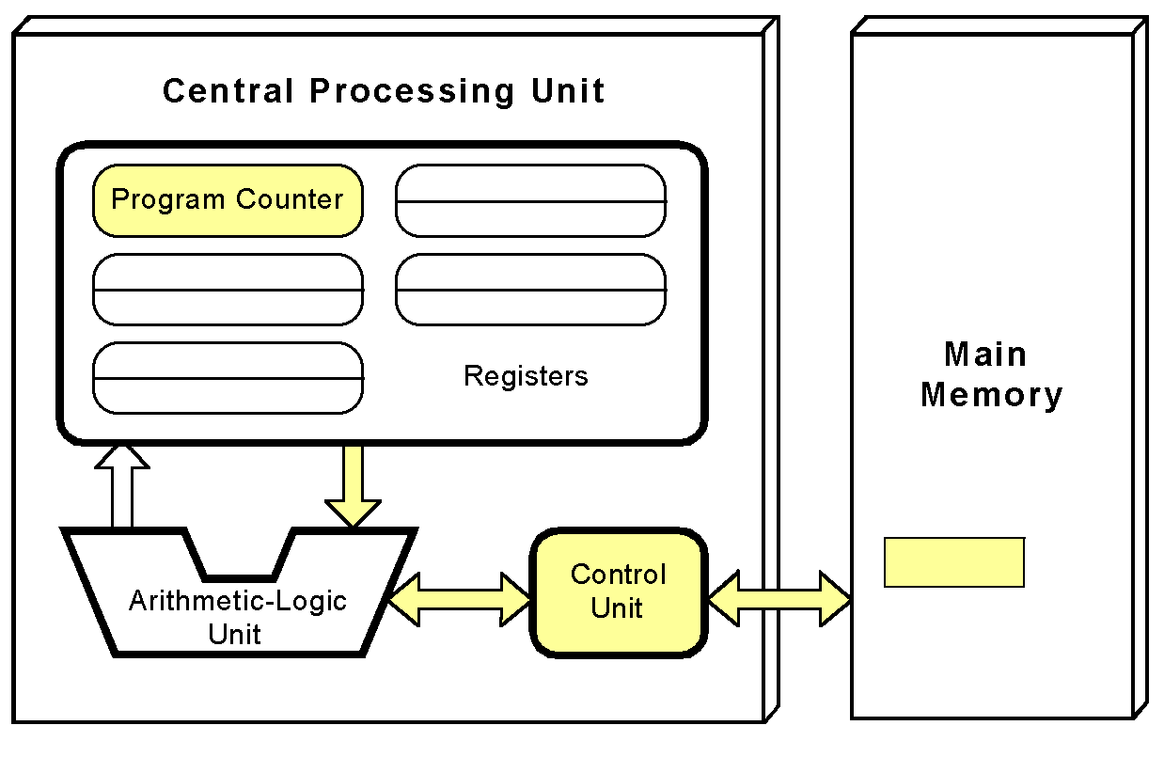
1.8 The von Neumann Model
The control unit fetches the next instruction from memory using the program counter to determine where the instruction is located.

Slide 56
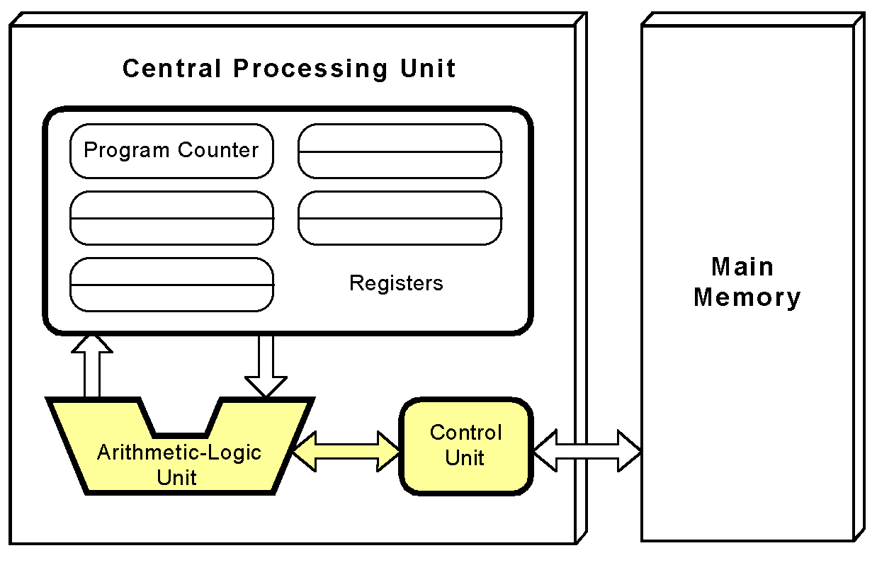
1.8 The von Neumann Model
The instruction is decoded into a language that the ALU can understand.

Slide 57
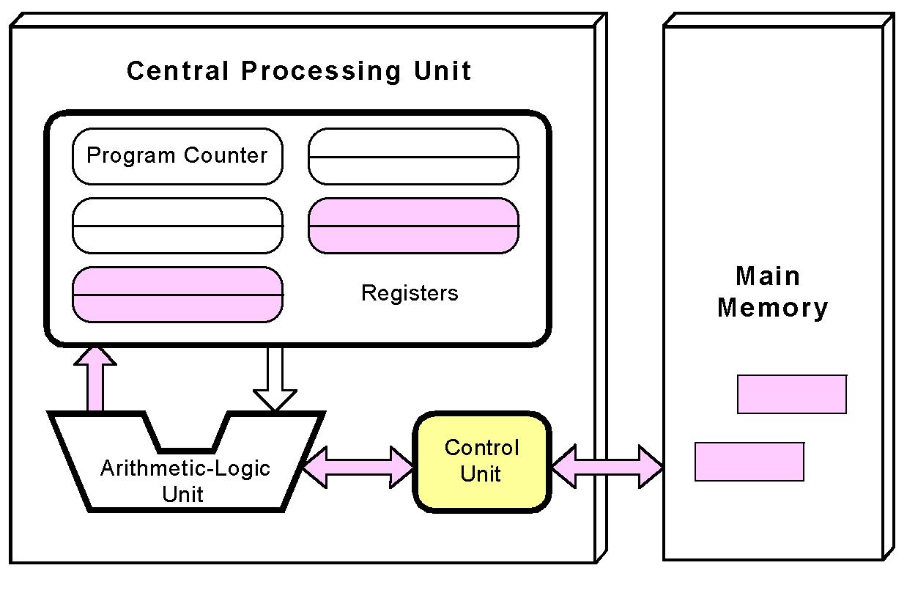
1.8 The von Neumann Model
Any data operands required to execute the instruction are fetched from memory and placed into registers within the CPU.

Slide 58
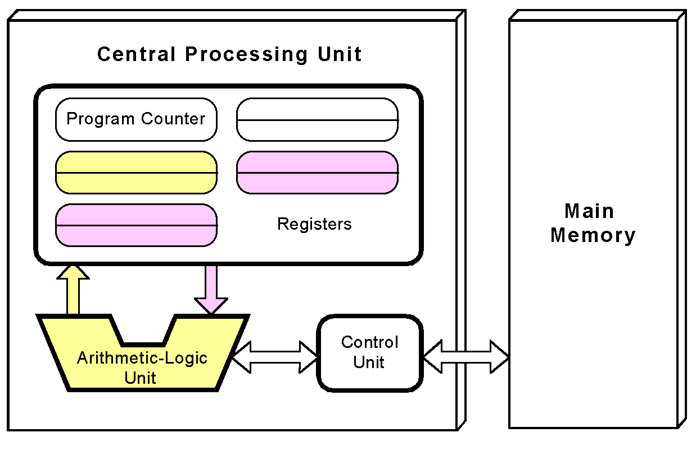
1.8 The von Neumann Model
The ALU executes the instruction and places results in registers or memory.

Slide 59
1.9 Non-von Neumann Models
Conventional stored-program computers have undergone many incremental improvements over the years.
These improvements include adding specialized buses, floating-point units, and cache memories, to name only a few.
But enormous improvements in computational power require departure from the classic von Neumann architecture.
Adding processors is one approach.

Slide 60
1.9 Non-von Neumann Models
Some of today’s systems have separate buses for data and instructions.
Called a Harvard architecture
Other non-von Neumann systems provide special-purpose processors to offload work from the main CPU.
More radical departures include dataflow computing, quantum computing, cellular automata, and parallel computing.

Slide 61
1.10 Parallel Computing
In the late 1960s, high-performance computer systems were equipped with dual processors to increase computational throughput.
In the 1970s supercomputer systems were introduced with 32 processors.
Supercomputers with 1,000 processors were built in the 1980s.
In 1999, IBM announced its Blue Gene system containing over 1 million processors.

Slide 62
1.10 Parallel Computing
Parallel processing allows a computer to simultaneously work on subparts of a problem.
Multicore processors have two or more processor cores sharing a single die.
Each core has its own ALU and set of registers, but all processors share memory and other resources.
“Dual core” differs from “dual processor.”
Dual-processor machines, for example, have two processors, but each processor plugs into the motherboard separately.

Slide 63
1.10 Parallel Computing
Multi-core systems provide the ability to multitask
E.g., browse the Web while burning a CD
Multithreaded applications spread mini-processes, threads, across one or more processors for increased throughput.
New programming languages are necessary to fully exploit multiprocessor power.

Slide 64
1.11 Parallelism: Enabler of Machine Intelligence
The quest for machine intelligence has been ongoing for over 300 years.
The 20th Century witnessed the first machines that could beat human grandmasters at chess when Deep Blue beat Garry Kasparov in 1997.
But the machine and the algorithm relied on a brute force solution, although impressive, hardly “intelligent” by any measure.

Slide 65
1.11 Parallelism: Enabler of Machine Intelligence
Any definition of true machine “intelligence” would [at least] have to include the ability to acquire new knowledge independent of direct human intervention, and the ability to solve problems using incomplete and perhaps contradictory information.
This is precisely what IBM achieved when it build the machine named Watson. [balderdash – dvb]
Watson proved this when it beat two human Jeopardy ! champions on February 16, 2011.

Slide 66
1.11 Parallelism: Enabler of Machine Intelligence
Watson had a massively parallel architecture dubbed DeepQA (Deep Question and Answer).
The system relied on 90 IBM POWER 750 servers.
Each server was equipped with four POWER7 processors, and each POWER7 processor had eight cores, giving a total of 2880 processor cores.
While playing Jeopardy!, each core had access to 16TB of main memory and 4TB of storage.

Slide 67
1.11 Parallelism: Enabler of Machine Intelligence
Watson's technology has been put to work in treating cancer.
Commercial products based on Watson technology, including “Interactive Care Insights for Oncology” and “Interactive Care Reviewer,” are now available.
Watson is also becoming more compact: Watson can now be run on a single POWER 750 server.
Watson has surely given us a glimpse into the future of computing.

Slide 68
Conclusion
This chapter has given you an overview of the subject of computer architecture.
You should now be sufficiently familiar with general system structure to guide your studies throughout the remainder of this course.
Subsequent chapters will explore many of these topics in great detail.

