Slide 1
Converting Bases

Slide 2
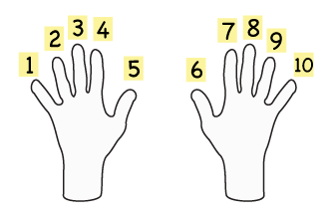
Understanding Numbers
What is a number?
We use the decimal system.
Origin: 1600–10; < Medieval Latin decimālis of tenths, equivalent to Latin decim ( a ) tenth (derivative of decem ten) + -ālis -al
Our decimal system is based off of the number 10.

Slide 3
Defining Bases
Decimal is base- 10
Binary is base- 2
Octal is base- 8
Hexadecimal is base- 16
Number with a subscript of base.
Therefore 8172 in base-10 is written:
8172₁₀

Slide 4
Range
Min value to Max value
Based on Positions
Base - 1
Decimal
1 digit 0-9

Slide 5
What is in a number
How do we interpret the number 8172₁₀?
Break it out into the places
8172₁₀ = 8000+100+70+2
Each place increases by a factor of 10.

Slide 6
Simple math
Solve these:
Number | 1000s | 100s | 10s | 1s
8172 | 8 | 1 | 7 | 2
4567
1040
1900
3247
832

Slide 7
Simple Math Solved
Number | 1000s | 100s | 10s | 1s
8172 | 8 | 1 | 7 | 2
4567 | 4 | 5 | 6 | 7
1040 | 1 | 0 | 4 | 0
1900 | 1 | 9 | 0 | 0
3247 | 3 | 2 | 4 | 7
832 | 0 | 8 | 3 | 2

Slide 8
What is the power?
 | 1 | = | 10⁽ ⁾
 | 10 | = | 10⁽ ⁾
 | 100 | = | 10⁽ ⁾
 | 1000 | = | 10⁽ ⁾

Slide 9
What is the power?
 | 1 | = | 10⁽ ⁾
 | 10 | = | 10⁽ ⁾
 | 100 | = | 10⁽ ⁾
 | 1000 | = | 10⁽ ⁾

Slide 10
This is the power
 | 1 | = | 10⁰
 | 10 | = | 10¹
 | 100 | = | 10²
 | 1000 | = | 10³

Slide 11
Rewrite the table with powers
Number | 1000s | 100s | 10s | 1s
8172 | 8 | 1 | 7 | 2
Number | 10³ | 10² | 10¹ | 10⁰
8172 | 8 | 1 | 7 | 2
=
Number | 1000 | 100 | 10 | 1
 | 10³ | 10² | 10¹ | 10⁰
8172 | 8 | 1 | 7 | 2

Slide 12
Max values
What is the largest number we can get from this table (4 digits)?
What Range of numbers does this table support?
Number | 1000 | 100 | 10 | 1
 | 10³ | 10² | 10¹ | 10⁰

Slide 13
Max values
What is the largest number we can get from this 4 digit table?
What Range of numbers does this table support?
Decimal | 1000 | 100 | 10 | 1
 | 10³ | 10² | 10¹ | 10⁰
9(1000)
9(100)
9(10)
+ 9(1)
-------
9999
9 9 9 9
Range is : 0 – 9999 (10⁴ or 10,000 numbers)

Slide 14
Any base is possible
Just take the base and raise it to the position from the right (starting with 0)
B^{P}
B = Base
P = Position (from right)
B⁷ | B⁶ | B⁵ | B⁴ | B³ | B² | B¹ | B⁰
B⁷ | B⁶ | B⁵ | B⁴ | B³ | B² | B¹ | B⁰

Slide 15

How Penguins count

Slide 16
Computers are binary
Computer (currently) only understand two states.
Bicycle
Bi(-)Cycle
Bi(wheeled) Cycle
Two wheeled Cycle
Binary
Bi = Two

Slide 17
Binary
Computer Binary
Two Parts
On – Off
20 v
ON
Threshold
OFF
0 v
Time

Slide 18
Decimal to Binary
Decimal uses 10 digits
0, 1, 2, 3, 4, 5, 6, 7, 8 ,9
Binary uses 2 digits
0, 1
Number | 8 | 4 | 2 | 1
 | 2³ | 2² | 2¹ | 2⁰

Slide 19
Convert Decimal to Binary
Number₁₀
0
1
2
3
4
5
6
7
Write the powers across the top
Start at the left and divide
Use the remainder in each column from left to right

Slide 20
Convert Decimal to Binary
Number₁₀ | 4 | 2 | 1
 | 2² | 2¹ | 2⁰
0 | 0 | 0 | 0
1 | 0 | 0 | 1
2 | 0 | 1 | 0
3 | 0 | 1 | 1
4 | 1 | 0 | 0
5 | 1 | 0 | 1
6 | 1 | 1 | 0
7 | 1 | 1 | 1
Convert
3₁₀ to Binary

Slide 21
Binary numbers
Number₁₀
 | 2³ | 2² | 2¹ | 2⁰
7
3
11
14
0
9
6
5
10
Solve these
Remember
0, 1

Slide 22
Binary numbers
Number₁₀ | 8 | 4 | 2 | 1
 | 2³ | 2² | 2¹ | 2⁰
7 | 0 | 1 | 1 | 1
3 | 0 | 0 | 1 | 1
11 | 1 | 0 | 1 | 1
14 | 1 | 1 | 1 | 0
0 | 0 | 0 | 0 | 0
9 | 1 | 0 | 0 | 1
6 | 0 | 1 | 1 | 0
5 | 0 | 1 | 0 | 1
10 | 1 | 0 | 1 | 0
Solve these
Remember
0, 1

Slide 23
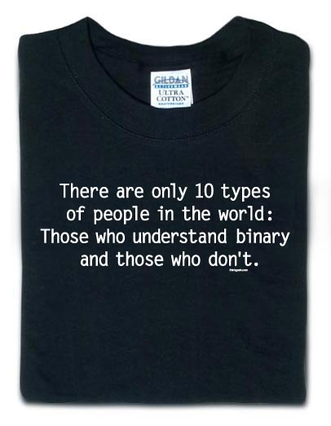
This should now make sense
http://www.thinkgeek.com/product/5aa9/

Slide 24
How big is a 16 bit number?
Number | 32768 | 16384 | 8192 | 4096 | 2048 | 1024 | 512 | 256 | 128 | 64 | 32 | 16 | 8 | 4 | 2 | 1
 | 2¹⁵ | 2¹⁴ | 2¹³ | 2¹² | 2¹¹ | 2¹⁰ | 2⁹ | 2⁸ | 2⁷ | 2⁶ | 2⁵ | 2⁴ | 2³ | 2² | 2¹ | 2⁰
65535
1 1 1 1 1 1 1 1 1 1 1 1 1 1 1 1
2¹⁵+2¹⁴+2¹³+2¹²+2¹¹+2¹⁰+2⁹+2⁸+2⁷+2⁶+2⁵+2⁴+2³+2²+2¹+2⁰=
65535
2^{n}-1 (n=number of bits)

Slide 25
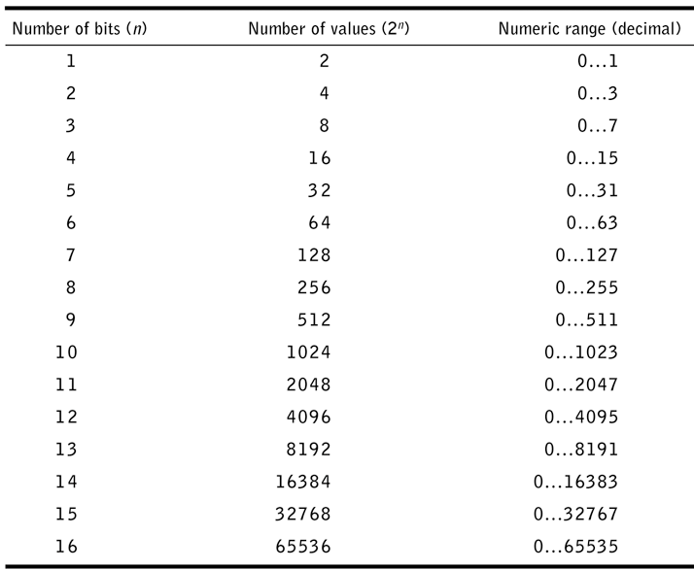
Bit Counts

Slide 26

Larger than Decimal Units
You use them more than you realize.
Rulers and Yard sticks are non decimal units.
1 foot = 12 inches
Clocks are non decimal
1 hour = 60 minutes
Not 10 So
Not Decimal

Slide 27
Solve these
60 in. = ft. in.
36 in. = ft. in.
87 in. = ft. in.
125 in. = ft. in.
96 in. = ft. in.
54 in. = ft. in.
120 in. = ft. in.
144 in. = ft. in.

Slide 28
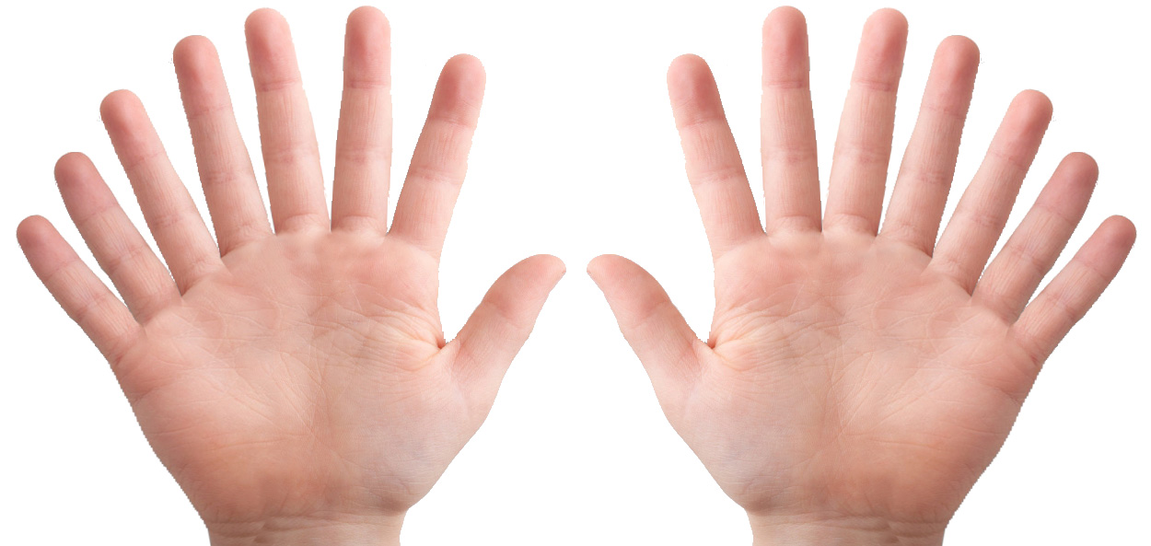
Counting with Hex

Slide 29
Hexadecimal
Decimal uses 10 digits
0, 1, 2, 3, 4, 5, 6, 7, 8 ,9
Binary uses 2 digits
0, 1
Hexadecimal uses 16 digits
0, 1, 2, 3, 4, 5, 6, 7, 8 , 9, A, B, C, D, E, F
Sometimes written 0x(Number)
0xA123
0x193F
Number | 4096 | 256 | 16 | 1
 | 16³ | 16² | 16¹ | 16⁰

Slide 30
Hexing some numbers
Number₁₀
 | 16³ | 16² | 16¹ | 16⁰
26
255
256
7985
4096
12
3657
5287
Solve these
Remember
0, 1, 2, 3, 4, 5, 6, 7, 8 , 9, A, B, C, D, E, F

Slide 31
Hexing some numbers
Number₁₀ | 4096 | 256 | 16 | 1
 | 16³ | 16² | 16¹ | 16⁰
26 | 0 | 0 | 1 | A
255 | 0 | 0 | F | F
256 | 0 | 1 | 0 | 0
7985 | 1 | F | 3 | 1
4096 | 1 | 0 | 0 | 0
12 | 0 | 0 | 0 | C
3657 | 0 | E | 4 | 9
5287 | 1 | 4 | A | 7
Solve these
Remember
0, 1, 2, 3, 4, 5, 6, 7, 8 , 9, A, B, C, D, E, F

Slide 32

How to count with out pinkies

Slide 33
Octal
Decimal uses 10 digits
0, 1, 2, 3, 4, 5, 6, 7, 8 ,9
Binary uses 2 digits
0, 1
Hexadecimal uses 16 digits
0, 1, 2, 3, 4, 5, 6, 7, 8 , 9, A, B, C, D, E, F
Octal uses 8 digits
0, 1, 2, 3, 4, 5, 6, 7
Number | 512 | 64 | 8 | 1
 | 8³ | 8² | 8¹ | 8⁰

Slide 34
Octal numbers
Number₁₀
 | 8³ | 8² | 8¹ | 8⁰
26
255
256
912
345
46
63
512
Solve these
Remember
0, 1, 2, 3, 4, 5, 6, 7

Slide 35
Octal numbers (solved)
Number₁₀ | 512 | 64 | 8 | 1
 | 8³ | 8² | 8¹ | 8⁰
26 | 0 | 0 | 3 | 2
255 | 0 | 3 | 7 | 7
256 | 0 | 4 | 0 | 0
912 | 1 | 6 | 2 | 0
345 | 0 | 5 | 3 | 1
46 | 0 | 0 | 5 | 6
63 | 0 | 0 | 7 | 7
512 | 1 | 0 | 0 | 0
Solve these
Remember
0, 1, 2, 3, 4, 5, 6, 7

Slide 36
Convert these numbers to decimal
101₂
101₈
101₁₀
101₁₆
10011₂
56₁₆
111110₂
752₈
F2₁₆
100110₂
2A₁₆
110011₂

Slide 37
Uncommon bases to decimal
81₉
101₁₂
101₇
22₃
53₆

Slide 38
Another one!
There are 10 kinds of people in the world, those who understand trinary , those who don’t, and those who thought this was in binary.

Slide 39
Homework Assignment
Worth 10 points (Max)
To make sure you know base numbering
You can work together, but remember the tests are individual work.
Extra Credit takes extra effort
fractional benefit
do it to challenge yourself.

