Slide 1

From Data to Decisions: Wellness Trends for Bellabeat
Melvin Mathew
University of South Florida
08/20/2025

Slide 2
Business Task
Analyze smart device (Fitbit) usage data to uncover user activity, sleep, and calorie trends.
Apply findings to Bellabeat’s products (Leaf, Time, Spring, Bellabeat app).
Provide data-driven marketing recommendations to improve customer engagement.

Slide 3
Data Sources
Public Fitbit Fitness Tracker dataset (30 users, collected via Amazon Mechanical Turk, April–May 2016).
Files analyzed:
daily_activity_merged.csv
daily_calories_merged.csv
daily_steps_merged.csv
sleep_day_merged.csv
weight_log_info_merged.csv

Slide 4
Data cleaning process
Standardized column names (snake_case).
Converted date/time formats → consistent activity_date.
Removed duplicates & null values.
Merged tables into one daily_master dataset (steps, calories, activity minutes, sleep, weight/BMI).
Verified number of unique users and date ranges.

Slide 5
Analysis Summary
Steps & Calories: Strong positive relationship → more steps = more calories burned.
Sedentary Time: Users spend high % of day sedentary, with fewer “very active” minutes.
Sleep: Sleep data is incomplete but shows variability in total sleep time.
Weekday Trends: Steps generally higher on weekdays than weekends.

Slide 6
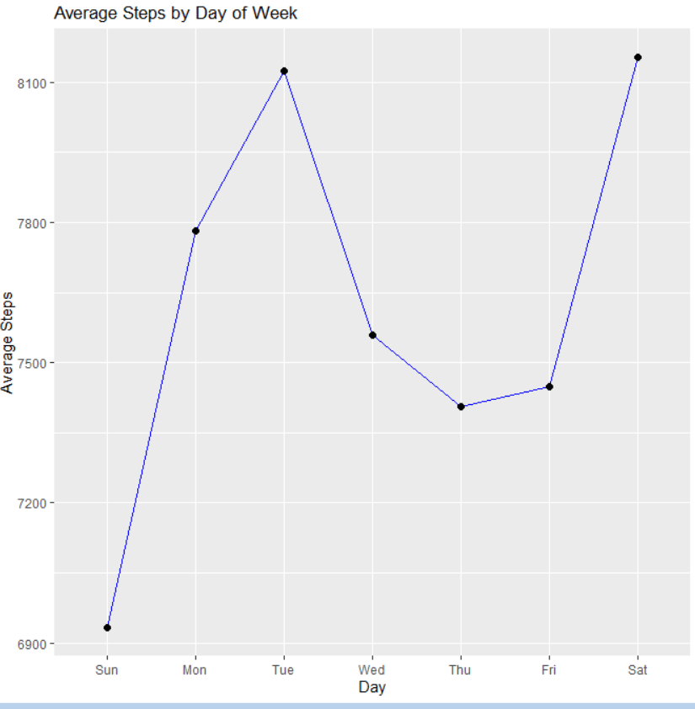
Average Steps by Weekday
Weekday activity levels are generally higher than weekends.
Users show more consistency in steps during workdays.

Slide 7
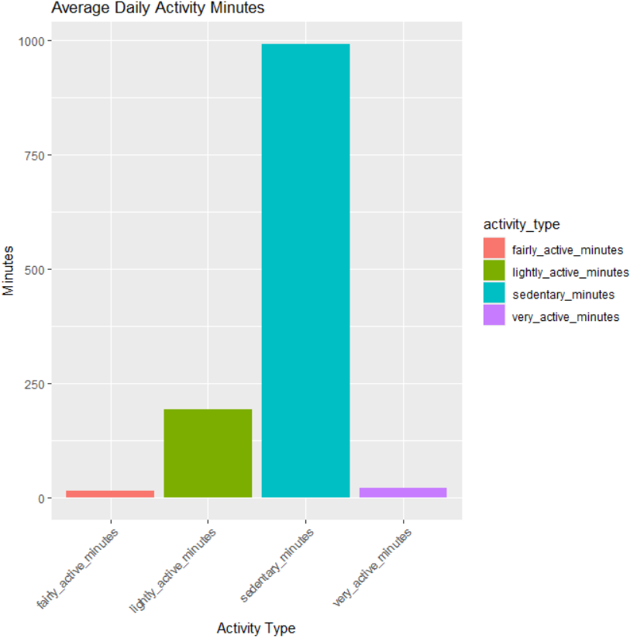
Activity Breakdown
Sedentary minutes dominate daily activity.
Lightly active minutes are common; very active minutes are low.

Slide 8
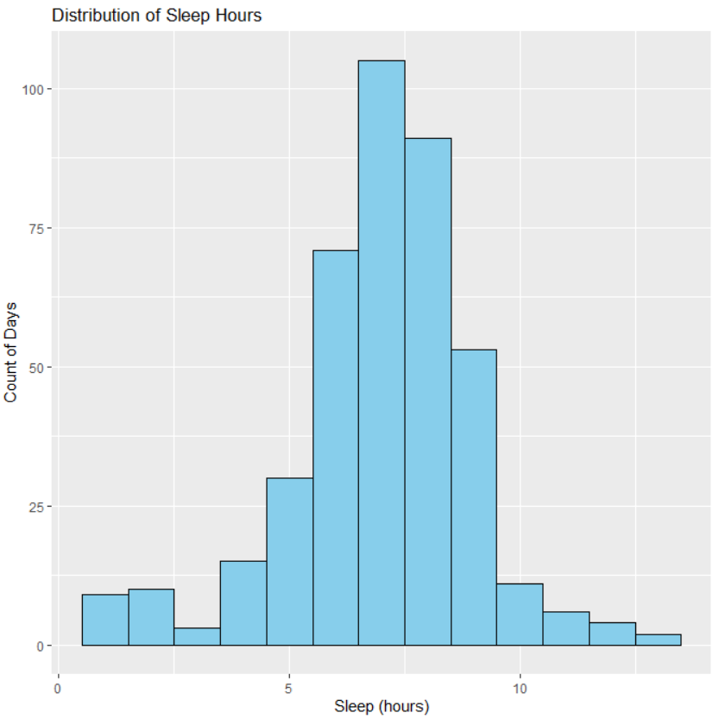
Sleep Distribution
Users’ sleep patterns vary widely across the dataset.
Some users average 7–8 hours, others show much less or missing data.

Slide 9
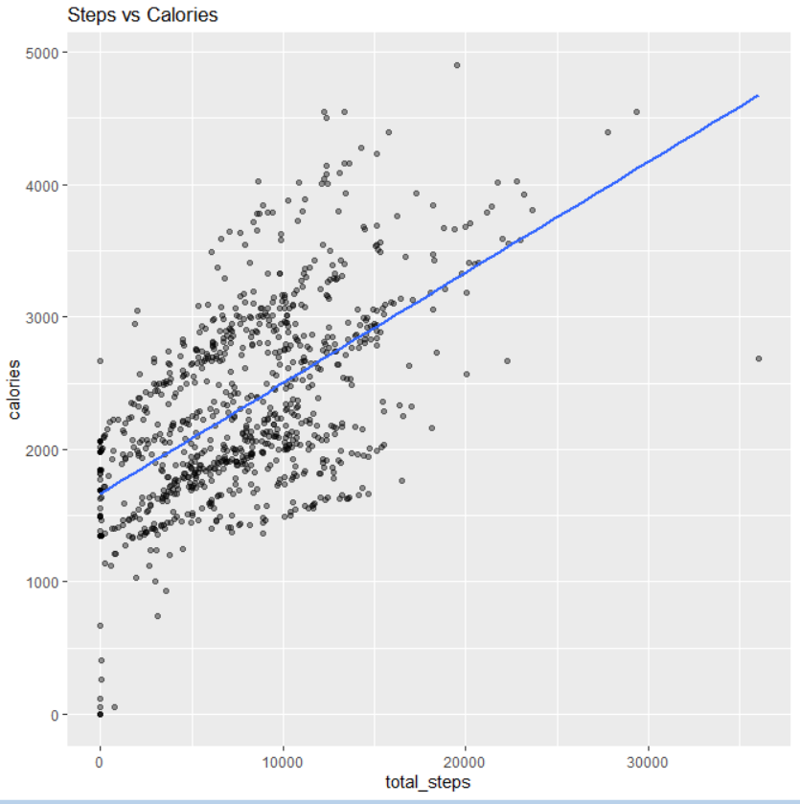
Scatter plot: Steps vs Calories
Clear upward trend.
Sedentary users (<5,000 steps/day) still burn ~1,800–2,000 calories baseline.
Highly active users (>10,000 steps/day) burn significantly more calories.

Slide 10

Recommendations Bellabeat marketing strategy:
Promote Activity Streaks – encourage users to reach daily step goals (gamification, challenges).
Target Sedentary Users – in-app nudges for micro-workouts, reminders to move.
Weekend Campaigns – highlight fun weekend activities for users with lower activity on Saturdays/Sundays.
Sleep Insights – market Bellabeat’s sleep-tracking features; promote bedtime reminders.
Hydration + Recovery – link sedentary breaks to Spring water bottle reminders.

Slide 11
Closing
Smart device data reveals clear links between activity, calories, and health habits.
Bellabeat can leverage these insights to enhance user engagement and product adoption.

