Slide 1

From Data to Decisions: Wellness Trends for Bellabeat
Melvin Mathew
University of South Florida
08/20/2025

Slide 2
Business Task
Analyze smart device (Fitbit) usage data to uncover user activity, sleep, and calorie trends.
Apply findings to Bellabeat’s products (Leaf, Time, Spring, Bellabeat app).
Provide data-driven marketing recommendations to improve customer engagement.

Slide 3
Data Sources
Public Fitbit Fitness Tracker dataset (30 users, collected via Amazon Mechanical Turk, April–May 2016).
Files analyzed:
daily_activity_merged.csv
daily_calories_merged.csv
daily_steps_merged.csv
sleep_day_merged.csv
weight_log_info_merged.csv

Slide 4
Data cleaning process
Standardized column names (snake_case).
Converted date/time formats → consistent activity_date.
Removed duplicates & null values.
Merged tables into one daily_master dataset (steps, calories, activity minutes, sleep, weight/BMI).
Verified number of unique users and date ranges.

Slide 5
Analysis Summary
Steps & Calories: Strong positive relationship → more steps = more calories burned.
Sedentary Time: Users spend high % of day sedentary, with fewer “very active” minutes.
Sleep: Sleep data is incomplete but shows variability in total sleep time.
Weekday Trends: Steps generally higher on weekdays than weekends.

Slide 6
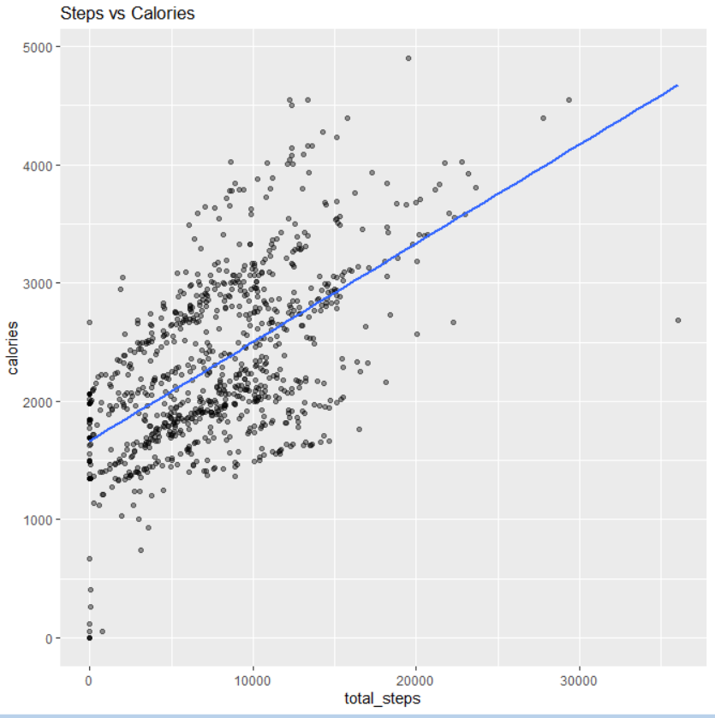
Scatter plot: Steps vs Calories
Clear upward trend.
Sedentary users (<5,000 steps/day) still burn ~1,800–2,000 calories baseline.
Highly active users (>10,000 steps/day) burn significantly more calories.

Slide 7

Recommendations Bellabeat marketing strategy:
Promote Activity Streaks – encourage users to reach daily step goals (gamification, challenges).
Target Sedentary Users – in-app nudges for micro-workouts, reminders to move.
Weekend Campaigns – highlight fun weekend activities for users with lower activity on Saturdays/Sundays.
Sleep Insights – market Bellabeat’s sleep-tracking features; promote bedtime reminders.
Hydration + Recovery – link sedentary breaks to Spring water bottle reminders.

Slide 8
Closing
Smart device data reveals clear links between activity, calories, and health habits.
Bellabeat can leverage these insights to enhance user engagement and product adoption.

