Slide 1

UNIX Eye-Opener Workshop 2008
Download slides at
http://www.comp.nus.edu.sg/~chungwk/Downloads.html
Notes:
Consider Changing the title to:
"Appreciating Unix".
"Use share".
slow down , too many 'yah' , need more experince in hands-on

Slide 2


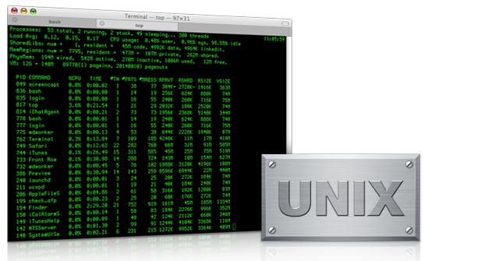
Have you used UNIX before?
  Which OS did Apple choose when it needed a stable OS layer for its Mac OSX?
  Which OS made the biggest impact to the online lives as you know it today?
Notes:
Use as ice-breaking slide
Unix is not alien to you.
You're using it, but it's just that
What do they have in common?
Why will these folks, arguably the best IT minds in the world, use an OS designed in the 1970?
These services run on Unix.
Apple choose BSD.
Yahoo is runing on BSD.
Google is running on BSD.
These are unix variations.

Slide 3

Objectives
  Appreciate the importance and usefulness of UNIX
  Set up your own Website in UNIX
  Be prepared for SoC modules (CS1101, CS1102, CS2102, CS2281, ...)
Notes:
What you bring home today

Slide 4
Overview
  Huh? What's Unix?
  Demo
  UNIX basics
  Hands-on: homepage setup

Slide 5

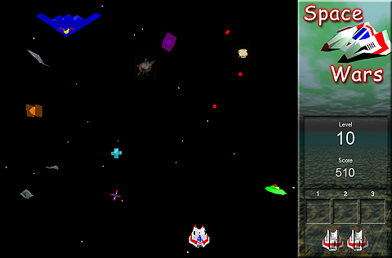





What is UNIX? - Origins
Way back in the 1970s...
Ken Thompson (left) & Dennis Ritchie (right)
from AT&T Bell Labs
Unix was created.
Other variations of UNIX surfaced...
Interested to know more? Read this
Notes:
Have you ever think of writing an OS to play your warcraft / DoTA?
To what extent would you go to get your Starcraft running?
Back then in 1970s, these 2 guys went to extent of writing an OS just to play Space Wars
A computer operating system originally developed in 1969 by a group of AT&T employees at Bell Labs including Ken Thompson, Dennis Ritchie and Douglas McIlroy.
Thanks to these computer scientists (and some others from AT&T Bell Labs) from 1970s, we get UNIX.
The story of Operating Environments and Operating Systems.
Microsoft Windows is just one portion of the story...
UNIX forms the other portion.
Computing undergrads must know the full story.

Slide 6
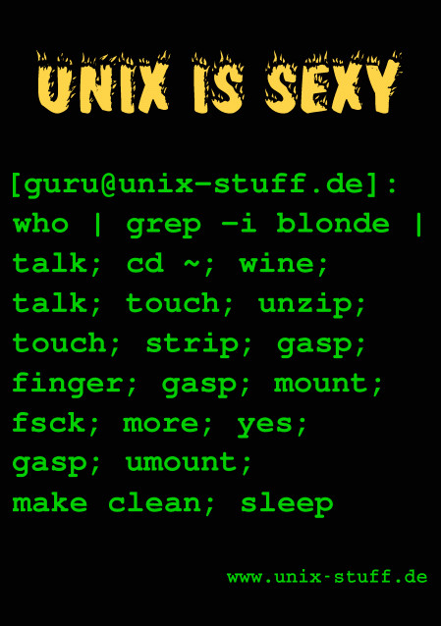
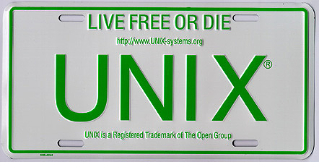
What is UNIX?
A portable, multi-tasking & multi-user Operating Environment:
  Portable: different architectures from embedded devices, your laptop, servers, systems with 100+ CPU... and PS3
  Multi-tasking: tens of thousands programs running concurrently
  Multi-user: hundreds of users using the system at the same time
Notes:
objective:
build on their familiarity wiith windows. unix can do what winodws can do, but on a bigger scale.
* Portable: Most embedded systems run on UNIX. Can run on embedded chips to thousands of CPUs
* Multi-tasking: on machine can run several thousands programs while Window will crash with a few hundreds of programs
* Multi-user:
For Windows, you can have many accounts on one machine. But only one person can log in at the same time (because the GUI limits it to one person).
But for Unix, we are talking about the possibility of hundreds of people logging in at the same time.

Slide 7
Overview
  Huh? What's Unix
  Demo - what's interesting?
  UNIX basics
  Hands-on: homepage setup

Slide 8
Just imagine if one day...
Your CEO announces:
  Company is changing name from "Windoze" to "UsefulNix"
  TOMORROW!
Your "small part":
  Update the company website* to reflect that!
Can you deliver this in time?
*: About 20,000 html files.

Slide 9
Demo (1/2)
- UNIX vs. Window
  Task 1 : Open a file. Find occurrences of "Windoze".
    Windows: use Ctrl-F at any text editor.
    UNIX: grep -l Windoze fileName
  Task 2 : Find all files in folder A containing "html".
    Windows: Arggghhhh!!! Open all files and check?
    UNIX: find A -type f | xargs grep -l Windoze
Notes:
take note: create own file , with line breaks ,

Slide 10
Demo (2/2)
- UNIX vs. Window
  Task 3 : Open a file. Replace "Windoze" by "UsefulNIX"
    Windows: Use Ctrl + H at any text editor
    UNIX: perl -pi -e 's/Windoze/UsefulNIX/g' fileName
  Task 4 : Find all files in folder A with "html", and replace by "UsefulNIX"
    Windows: haizzz....
    UNIX: find A -type f | xargs grep -l Windoze | xargs perl -pi -e 's/Windoze/UsefulNIX/g'
See how powerful UNIX is ^^ & the idea of "achieving complex tasks through small toys“
Let's learn UNIX !!!

Slide 11
Now picture the following day...
Your are sitting in your office, sipping coffee....
Webpage transformation is done, all 20,000 pages.
Knowing Unix, it's not that hard to imagine!

Slide 12
Overview
  Huh? What's Unix
  Demo
  UNIX Basics
    SOC accounts
    Connecting to UNIX servers
    File directories
    bash shell
    UNIX tips
    UNIX text editor
  Hands-on: homepage setup

Slide 13
Why SOC accounts ?
– SOC student privileges
  Free server to host your work (~2GB)‏
  Access to SoC-only services: printing quota, download free MSDN software, …
  More importantly, assist your study at SoC (wait until school starts ^^)‏

Slide 14
Creating SOC accounts
  Logon to this website using your NUSNET id and password:
  https://mysoc.nus.edu.sg/~newacct
  Read through the user-agreement and make sure you understand the obligations.
  Choose your own username. (5-8 characters and must be formed from your name)‏
    Warning: Only alphanumeric characters allowed. You may also use your NUSNET id (even though you really hate it).
    Take Note: user name is permanent. You cannot change it later.
  Type in your new password (twice).
  Submit your application.
Notes:
no dots
default naming conventions for user name.
logical stop here. status check. make sure soc account created.
getent passwd username

Slide 15
Connecting to UNIX server (1/4)‏
  Double click on the “SSH Client” shortcut.
  Click on “Quick Connect”.
  Type sunfire.comp.nus.edu.sg in the “Host name” box. (Yellow)‏
  Type your username in the “User Name” box.(Highlighted Red)‏
  Click “Connect”.
  Key in your password and enter. (Note: Password is case-sensitive.)‏

Slide 16
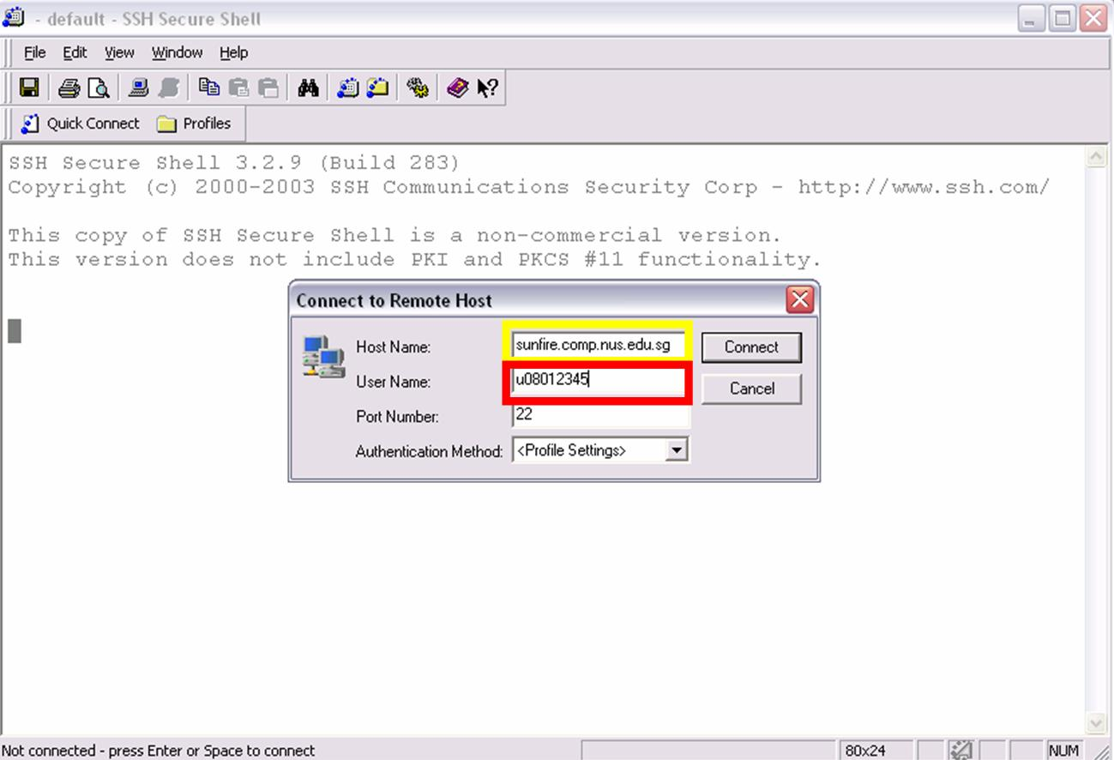
Connecting to UNIX server (2/4)‏
Unix ID
sunfire.comp.nus.edu.sg
username
You can choose 'yes' when prompted whether you want to save RSA key

Slide 17
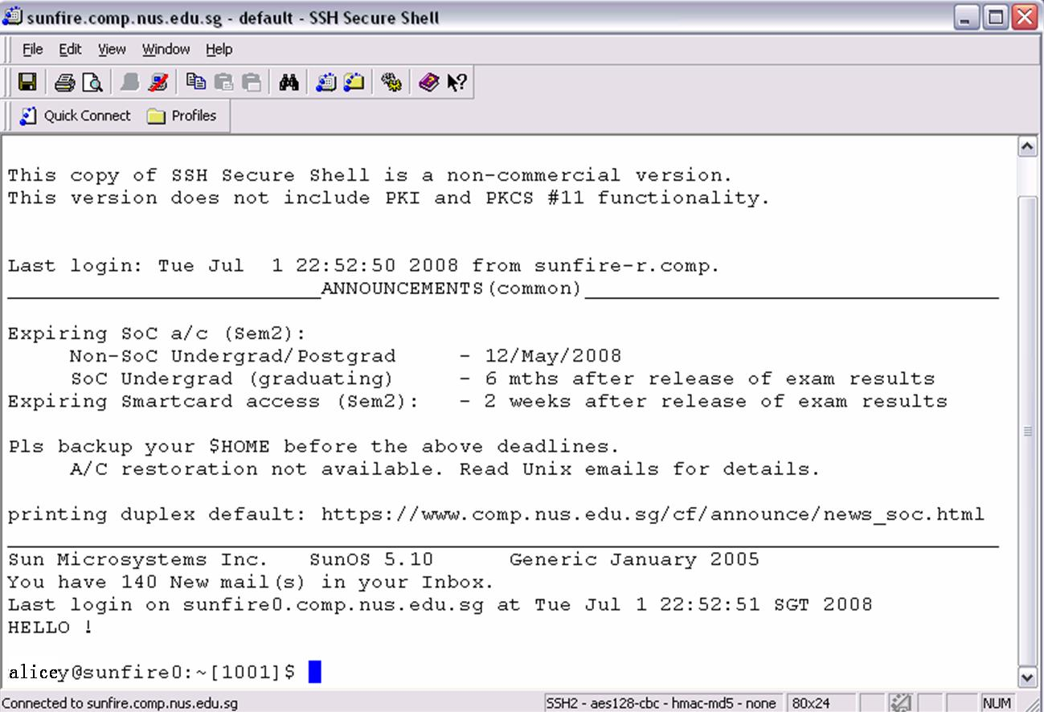
Connecting to UNIX server (3/4)‏
  Upon successful login, you will see:

Slide 18
Connecting to UNIX server (4/4)‏
  Connect using sunfire.comp.nus.edu.sg
  Connection is allowed within campus, from any major local ISP, or using NUS or SOC VPN.
  Remember to log out from your UNIX session after use, by typing logout or exit.
  You can try logging in from other countries, but good luck...
Notes:
make sure everyone can log in out

Slide 19
Getting started
Get the materials that are needed for this workshop.
[bash~]$ cd
[bash~]$ /tmp/WorkshopScript.sh
[bash~]$ ls
See that there's a file called CoolStuff.sh
[bash~]$ chmod u+x CoolStuff.sh
[bash~]$ CoolStuff.sh
[bash~]$ ls
See that there's a folder called ‘ws2008'.

Slide 20
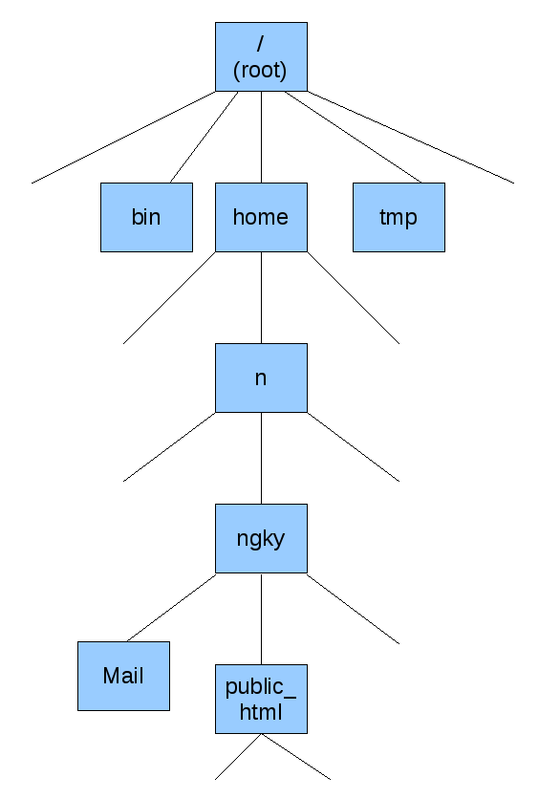
File directories
In Windows :
C:\Documents and Settings\ngky\
In Unix:
/home/n/ngky
Directories in Unix are just like your folders in Windows
Notes:
explain home directory -
a directory that is your home.

Slide 21
Let's do this!
[bash~]$ echo ~
[bash~]$ pwd
[bash~]$ cd ..
[bash~]$ pwd
[bash~]$ ls
[bash~]$ cd
[bash~]$ pwd
[bash~]$ cd /
[bash~]$ ls
[bash~]$ pwd
[bash~]$ cd
[bash~]$ mkdir public_html
[bash~]$ ls
Notes:
1 minute exercise to understand file directory.
purpose of this hands on is to let them get used to directory structure and try out some unix cmds
explain ~. it's the left button beside the #1.
you'll need to press [shift].
cd [blank] will go to home direcory
clear screens between each demo.
enlarge font.
pull the bottom of the screen to mid level cos back row cannot see.

Slide 22
Let's do this!
cd change directory
echo display information
ls list directory contents
mkdir create directory / folder
rmdir delete directory / folder
pwd print working / current directory
. current directory
.. parent / previous directory
~ represents your home directory
example: /home/n/ngky
Notes:
1 minute exercise to understand file directory.
purpose of this hands on is to let them get used to directory structure and try out some unix cmds
explain ~. it's the left button beside the #1.
you'll need to press [shift].
cd [blank] will go to home direcory
clear screens between each demo.
enlarge font.
pull the bottom of the screen to mid level cos back row cannot see.

Slide 23
bash Shell
  Bash-shell shortcut
    tab: auto-complete command, or file name
    tab twice: all available commands
  man: the manual for Unix commands
    space: down one page
    b: back one page
    q: exit
try: man man, man joe, man emacs, man ssh
More tips, read this.
Notes:
In Windows, you use mouse to click here and there.
In sunfire, you use keyboard and execute commands.
shell is a program that executes other programs

Slide 24
Let's do this ! (1/2)‏
[bash~]$ cd
[bash~]$ date
[bash~]$ cal
[bash~]$ pusage
[bash~]$ who
[bash~]$ bc
7+7 [enter]
7^999 [enter]
quit
[bash~]$ ls
[bash~]$ wget http://nus.edu.sg
[bash~]$ ls
[bash~]$ less index.html
(press space to read next page, 'b' to read previous page, 'j' to read next line, 'k' to read previous line, 'q' to quit)
[bash~]$ mv ./index.html ~public_html/nus.html
[bash~]$ cd ~/public_html ; ls -l
[bash~]$ history
Notes:
1 minute exercise to explore bash.
let them ask questions
emphasize [tab] when doing renaming. start with wg[ tab]

Slide 25
Let's do this ! (2/2)‏
Summary of the commands used on the previous slide:
  date: show the current date
  pusage: show your print quota available
  cal: show the calendar of the month
  ls: list files
  history: show recently typed commands
  who: who's currently online
  bc: Unix's version of Calculator!
  mv: rename files or move files to different folders
Notes:
5 minutes let them explore.
let them ask questions
emphaisze the reason why these cmds are small and simple , cos we can piece them together to achieve wonders, fantastic results, like what we've seen when we find and replace.

Slide 26
UNIX tips
  lpr: use SOC printers with command line
lpr -Pdmdts filename.txt
    -P: option to specify the printer name. (e.g. dmdts: SOC line printer)‏
  at: schedule a task to run a specified time
[bash~]$ at now+1min
at> date > ~/testing
at> ^D
More tips: Read this.

Slide 27
UNIX Text editor
  Joe is simple, easy to learn and use.
  Another simple editor: nano
  Advanced: vim, emacs
(there are tutorials available in sunfire for the above advanced editors. just type vimtutor or emacs and the tutorial will be shown)‏
  Why use UNIX text editors?
Notes:
Why use vim and emacs when I've joe?
It's up to your preferences actually.
Some people fall in love at first sight with the editor they use.
It's good to know more, no harm. Maybe it'll help you in scripting in the future.
Why use UNIX editors?
simply to edit files on Unix!
You choose different editors for different reasons. Since you are using unix, must as well learn to use unix editors.

Slide 28
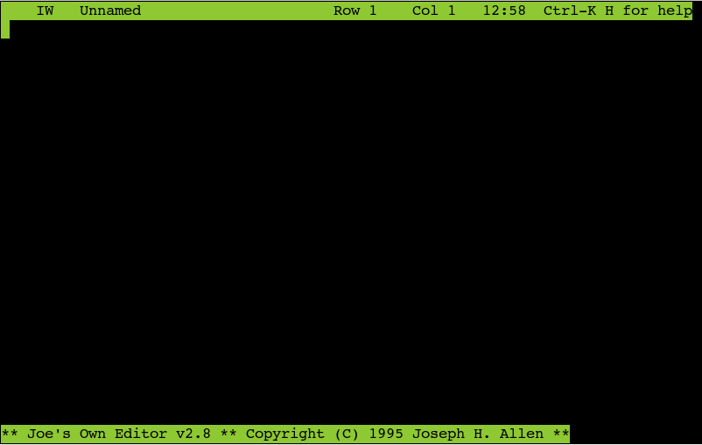
UNIX Text editor - Hey Joe!
  Who is Joe?
In your shell, type in "joe", or "/usr/local/bin/joe".
Notes:
Who is Joe?
a very friendly & easy to use text editor.
your friend in this introductory session.

Slide 29
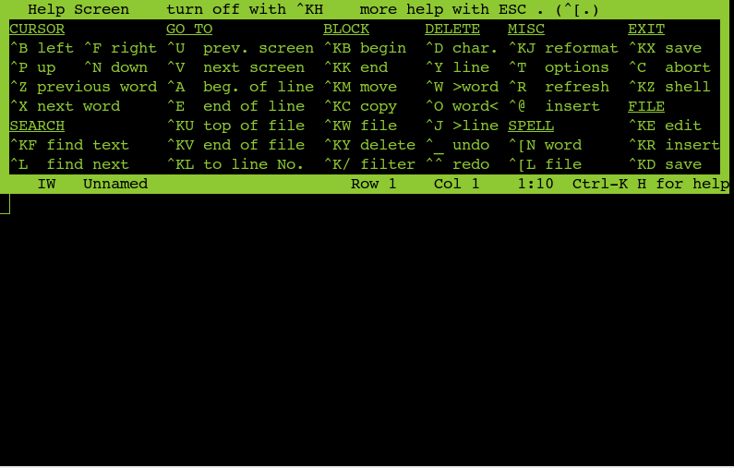
UNIX Text editor - Hey Joe!
Don't fret upon seeing that screen !
press and hold Ctrl, then press K once, then press H once.
Notes:
also let them play with joe. give them some time.
Don't fret upon seeing this screen. Help is on the way!
press and hold Ctrl, then press K once, then press H once.
Joe provides a nice permanent reference manual on the top part of the terminal. How nice!

Slide 30
Let's do this !
  press and hold Ctrl, press K once, press R once
  name of file to insert:
    ~/ws2008/webpage
    Then press [enter].
  when you are done, save and exit joe. (press and hold Ctrl, press K once, press X once)‏
    Name of file to save: ~public_html/index.html

Slide 31
Overview
  Huh? What's Unix
  Demo - let's gain the interest
  UNIX basics
  Hands-on: homepage setup

Slide 32
Hands-on - homepage setup
Goal: make your own home page accessible through www.comp.nus.edu.sg/~<your_user_name>.
General Steps:
  Create a public_html directory
  Create a file index.html as a homepage.
  Store index.html in the public_html directory
  Set file permissions

Slide 33
Hands-on - index.html
Let's edit our index.html using joe.
[bash~]$ cd ~/public_html
[bash~]$ joe index.html
To save your file,
Press and Hold Ctrl, 'K' once and 'X' once.
Note: This time, you do not need to specify the filename.
Notes:
automated.

Slide 34
Hands-on - public_html
Use your browser, point to this URL:
http://www.comp.nus.edu.sg/~ngky
What do you see?
General Steps:
  Create a public_html directory
  Create a file index.html as a homepage.
  Store index.html in the public_html directory
  Set file permissions
Notes:
Now, we need to put index.html into the public_html folder. Use this command:
mv ~/index.html ~/public_html/
Use your browser, point to this URL:
www.comp.nus.edu.sg/~<yourUnixID>
What do you see?
403 Forbidden !!
We missed out something important!
mv and renmame are the same within the file system.

Slide 35
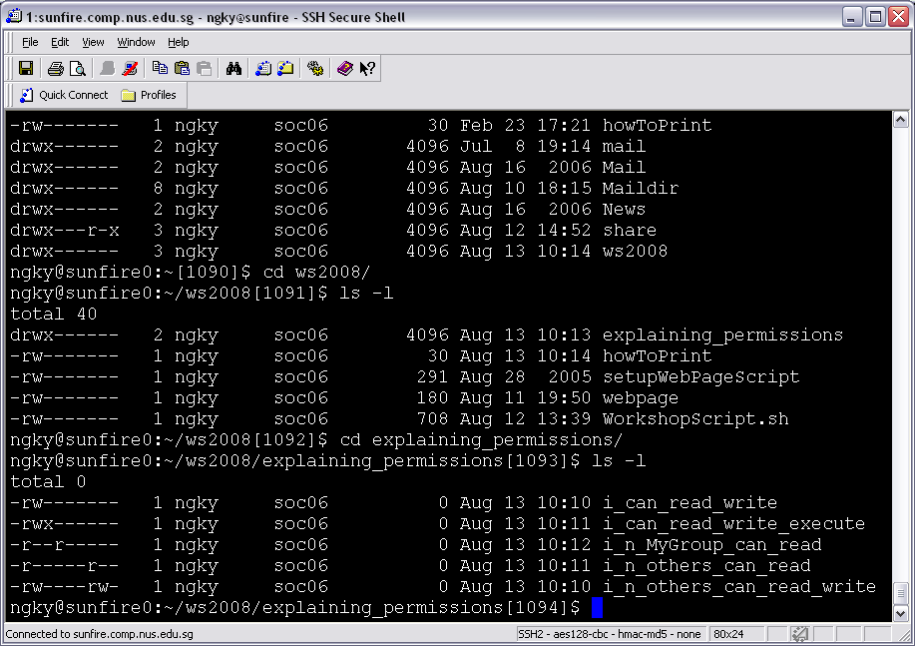
Hands-on - file permission
  Files have permissions attributes. Owners can do anything to their files while others usually have limited permissions.
d : directory
u : user
g : group
o : others
r : read
w : write
x : execute
Notes:
Logon to sunfire
cd public_html # this is where all your webpages sit
create a file called index.html #This is where the web server will first look for your page
Fill it with contents and save
Ensure that the access modes are correct. For security reasons, the webserver runs as a third party so you need to give it access
chmod a+rx ~/public_html
chmod a+r ~/public_html/index.html

Slide 36
Hands-on - file permission
Let's set the permissions of public_html and index.html so that other people can access the public directory and view the file respectively.
[bash~]$ cd
[bash~]$ ls -l
[bash~]$ chmod o+x public_html
[bash~]$ ls -l
[bash~]$ cd public_html
[bash~]$ chmod o+r index.html
[bash~]$ chmod o+r nus.html
[bash~]$ ls -l
Now try to load your webpage again :)‏
Notes:
Logon to sunfire
cd public_html # this is where all your webpages sit
create a file called index.html #This is where the web server will first look for your page
Fill it with contents and save
Ensure that the access modes are correct. For security reasons, the webserver runs as a third party so you need to give it access
chmod a+rx ~/public_html
chmod a+r ~/public_html/index.html
remember to do chmod to remove own permission

Slide 37
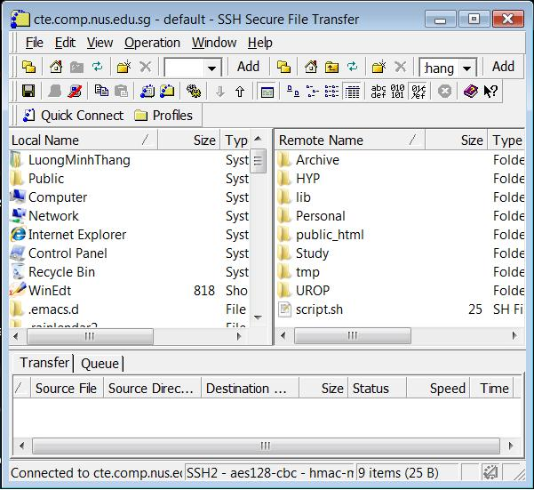
Hands-on - upload files
  simply drag and drop files using SSH to add more contents to your homepage :)‏
Notes:
What if you've already created many html files in your laptop, using dreamweaver?
You can use the SSH FTP transfer client to upload your files into the public_html folder.

Slide 38
Contact Us !
student-helpers@comp.nus.edu.sg
Where to get SSH -for Windows users?
http://www.filewatcher.com/m/SSHSecureShellClient-3.2.9.exe.5517312.0.0.html
Where to get SSH -for Mac / Linux / Unix users ?
You don't need to install anything. Inside your 'Terminal', type:
ssh username@sunfire.comp.nus.edu.sg
Answer 'yes' to the RSA encryption question, type in your password, and you are done!
Useful Sites
http://linuxhelp.blogspot.com/2005/08/bash-shell-shortcuts.html
http://fosswire.com/2007/08/02/unixlinux-command-cheat-sheet/

Slide 39
Reference
  Unix workshop – Freshmen orientation 2007
  SoC account - http://www.comp.nus.edu.sg/cf-pub/soc-account.html
  X Window System - http://en.wikipedia.org/wiki/X_Window_System
  CJ Fearnley's slides on UNIX and Linux, http://www.cjfearnley.com/UNIX-Linux-Basics.2005.01.ppt

Slide 40
Now, time for some fun...
Wanna watch Star Wars on sunfire?
telnet towel.blinkenlights.nl

