Slide 1
Please ...
Silence your handphone, pager and other electronic devices
Refrain from talking on your phone and chatting during the lesson
Pay attention and only do things that you are told to do
Notes:
Flash this slide prior to starting the lesson proper

Slide 2
UNIX Familiarization Course
< Your Name >

Slide 3
Before starting…
Can everyone hear me?
Does everyone have a terminal?
Does everyone have both your account slips?
Who has no experience with using computers?
Ok… let’s start!
Notes:
- Ask the assistants to pay more attention to the so called weaker people

Slide 4
Agenda
Course Objective
Conduct of the course
Course Detail

Slide 5
Course Objective
To provide the freshmen with an introduction to Unix servers and other resources SoC (and NUS) has provided for them
This course will focus solely on the Unix aspect due to time constraints
Notes:
Elaborate on the 2nd part, ask them to pay attention and restrain themselves from typing away as the course is under way. Instructors are not liable to help them correct fatal problems that happens if it is not taught during the lesson

Slide 6
Course Conduct
For every lesson, we will give a/an:
  Explanation of the basic ideas
  CAUTION!
  Step-by-Step Walkthrough

Slide 7
Course Details
1. NUS & SoC Facilities
2. UNIX Fundamentals
3. Login
4. Unix Files & Directories
5. Editors
6. Mail
7. BBS
8. More UNIX commands
9. Other Resources

Slide 8
Lesson 1
NUS & SoC Facilities

Slide 9
NUS Account (1)
NUS account and password
  isc***** (5 digits) [Note: replace “isc” with your faculty’s code if you are not from SoC]
  [password]
NUS Email
  isc*****@nus.edu.sg

Slide 10
NUS Account (2)
Important!
You belong to NUSSTU Domain
  NUSSTU (NUS STUdent)
  NUSSTF (NUS STaFf)

Slide 11
SoC Account (3)
SoC account and password
  userid (max. 8 characters)
  password
SoC Email
  userid@comp.nus.edu.sg

Slide 12
SoC Resources
200 MB disk quota
150MB email quota
Dot-matrix printer quota
Laser printer quota
Daily file backups
etc…

Slide 13
CAUTION!
Do not share your account/password
  Report any irregularities to the machine room (helpdesk@comp.nus.edu.sg)
Change your password regularly
Do not attempt to hack anything
  Every network/server activity is logged and monitored
  Read the AUP you signed!
  Police Record → Expulsion from NUS
Notes:
- AUP: Acceptable Use Policy

Slide 14
Login to NUSNET-IV (1)
The Windows NT Workstations here are connected to NUSNET-III (NUS Facility)
Need to use your isc***** account to login

Slide 15
Login to NUSNET-IV (2)
Step 1: Press CTRL-ALT-DEL
Step 2: Type your username (isc*****)
Step 3: Type your password
Step 4: Select NUSSTU domain
Note:
Make sure the NUSSTU domain is selected

Slide 16
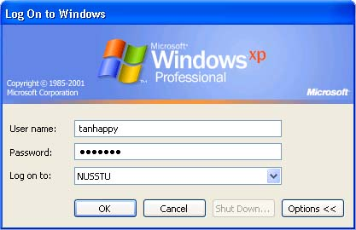
Login to NUSNET-IV (3)
isc12345

Slide 17
Lesson 2
UNIX Fundamentals

Slide 18
UNIX Fundamentals
UNIX Server
Running Programs on Unix
General UNIX Command

Slide 19

UNIX Server (1)
A UNIX server is a shared machine
It handles hundreds of users and thousands of programs…
UNIX sunfire servers
Notes:
- on Unix servers, there’s no privacy, people can see what you are doing almost all the time.

Slide 20
UNIX Server (2)
To gain access, you “login”
After login, you can do many things
  Write programs
  Check email
  Read BBS
  etc…
To exit, you “logout”
Notes:
- To use the server, the basic idea is… to login.. Then run your programs and logout after you are done

Slide 21
Running Programs on UNIX
Similar to DOS programs
Run a program by executing a command on the command prompt
Arguments are added when you want the command to behave differently
Notes:
- However, DOS programs cannot multitask

Slide 22
General UNIX Command
Simple command
cmd
Command with 1 argument called “a”
cmd –a
Same command with extra argument called “b”
cmd -ab

Slide 23
CAUTION!
Find out before you try out commands especially new commands
UNIX commands are case-sensitive!
  “ABC” is not the same as “abc” or “AbC”
You cannot UNDO a command on the UNIX server

Slide 24
Lesson 3
Login

Slide 25
Login Walkthrough
Start the ssh client
Connect to sunfire sf3
Enter your SoC UNIX userid
Enter your password
Command prompt

Slide 26
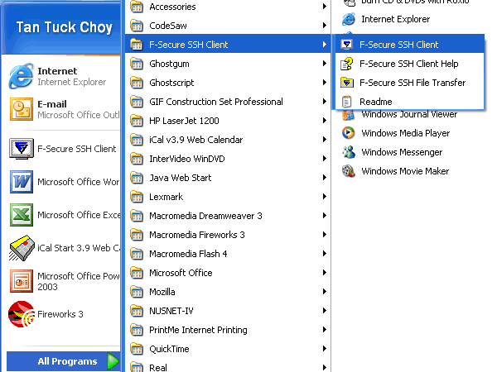
Startup the ssh client

Slide 27
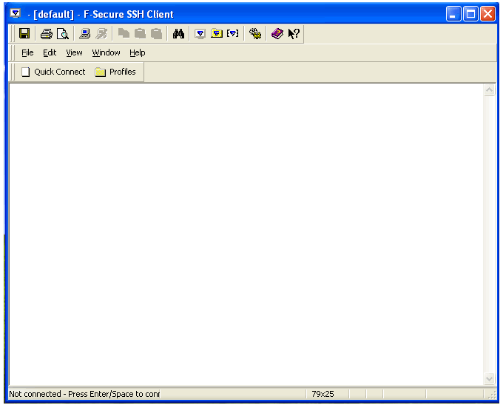
Login to SoC UNIX account (1)

Slide 28
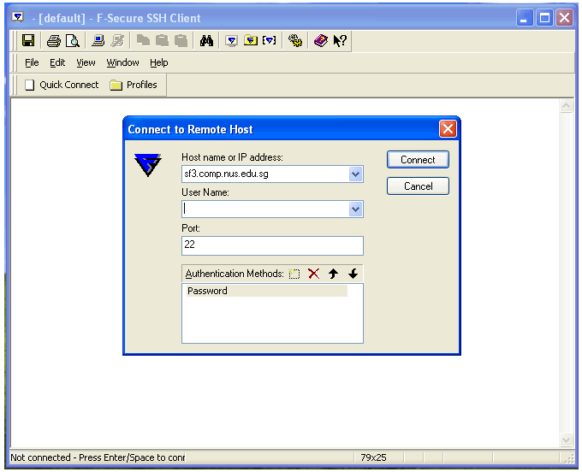
Login to SoC UNIX account (2)

Slide 29
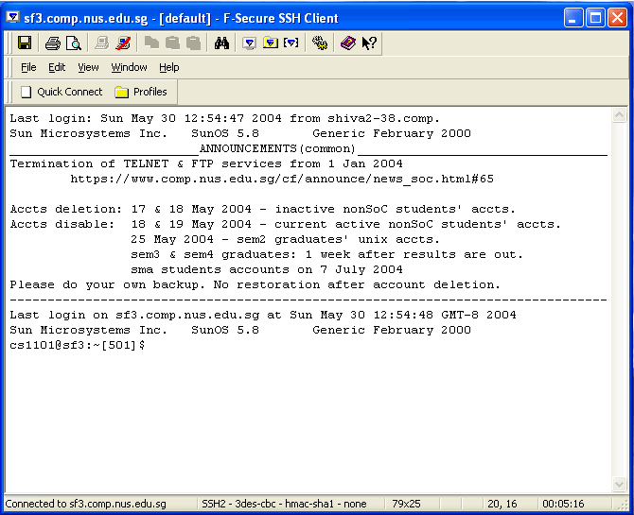
Login to SoC UNIX account (3)
Command prompt
Message of the Day (MOTD)

Slide 30
Lesson 4
UNIX Files & Directories

Slide 31
UNIX Files & Directories
UNIX Directories
Directory Content Listing
Directory Manipulation
  Directory Navigation
  Directory Creation
  Directory Deletion
  File/Directory Deletion

Slide 32
UNIX Directories (1)
You are given a disk quota (40MB)
SoC provides back-ups on a daily basis
Organize your stuff properly

Slide 33
UNIX Directories (2)
Tree Structure
home directory
work
mail
jokes
cs1101
cs1104
tutorial 1
Notes:
- Currently, you only have your home directory and nothing else

Slide 34
UNIX Directories (3)
Directory Content Listing
Directory Manipulation

Slide 35
Directory Content Listing (1)
What do I have in my directory?
Walkthrough example using “ls” (file list)

Slide 36
Directory Content Listing (2)
Simple command
ls
ls –a
ls –l –a
ls –la
Notes:
ls (simplest list command)
ls –a (list hidden files also)
ls –l –a (list file attributes)
ls –la (same as above)

Slide 37
Directory Manipulation
Walkthrough:
  How do I create a directory?
  How do I change to another directory?
  How do I delete a directory?
  File/Directory deletion

Slide 38
Directory Creation
To create a sub-directory called “mystuff”
mkdir mystuff

Slide 39
Directory Navigation (1)
Change current directory to “mystuff”
cd mystuff
ls -la

Slide 40
Directory Navigation (2)
To go back to your home directory
cd ..
cd
cd ~
cd $HOME
Notes:
- cd .. actually mans to go ONE level up from the current directory

Slide 41
Directory Deletion
You can only delete directories that are empty using the following command
rmdir mystuff

Slide 42
File/Directory Deletion
To delete a file
rm <filename>
To delete a non-empty directory
rm –r <sub-directory>

Slide 43
CAUTION!
Never execute these commands (unless you know what you are doing)
rm –fr ~
rm –fr $HOME
Notes:
- prompt audience to have a volunteer to explain what it means

Slide 44
Lesson 5
Editor:
pico

Slide 45
Editor: pico
What is pico?
Using pico

Slide 46
What is pico?
pico is:
  a text editor
  easy to use
  more user-friendly than the other editors
  used as basic editor in pine and BBS
However, pico lacks many advanced features

Slide 47
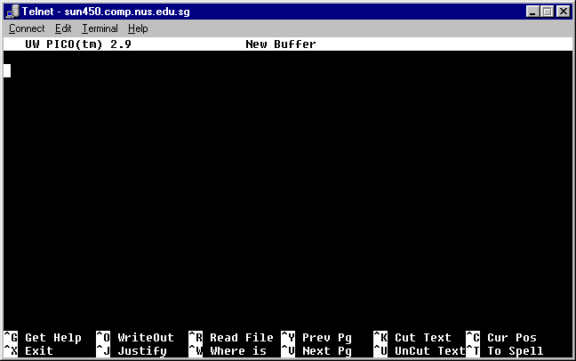
pico screenshot

Slide 48
Using pico
Walkthrough
  Creating a new file
  Editing it
  Deleting a line
  Cut-n-Paste
  Saving it
  Exiting pico

Slide 49
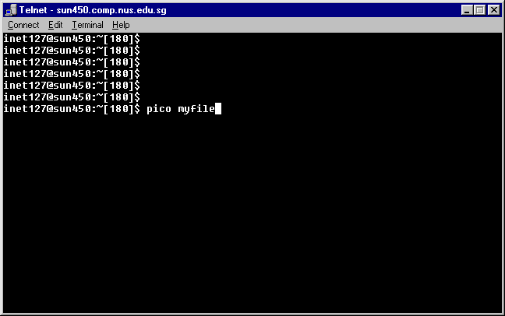
Creating a new file (1)

Slide 50
Creating a new file (2)

Slide 51
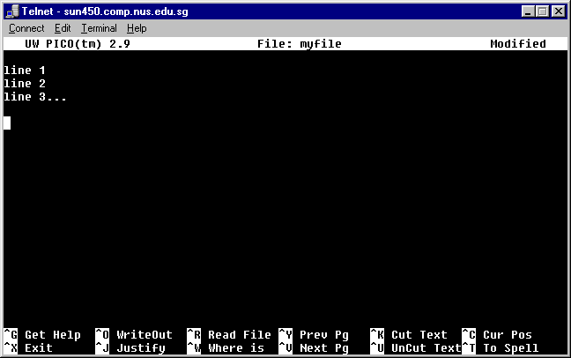
Editing it

Slide 52
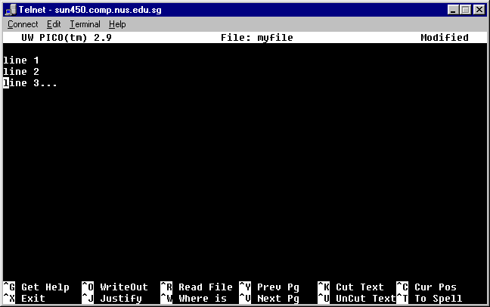
Deleting a line: ctrl-k (1)

Slide 53
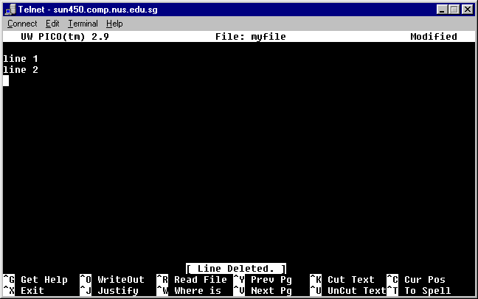
Deleting a line: ctrl-k (2)

Slide 54
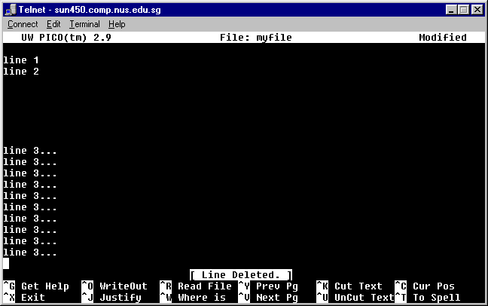
Cut-n-Paste: ctrl-u

Slide 55
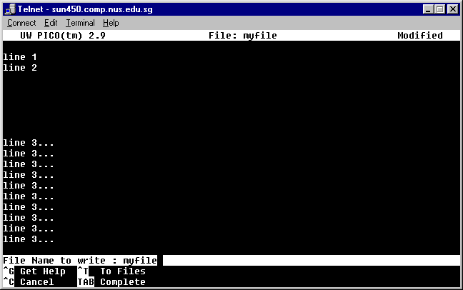
Saving it: ctrl-o

Slide 56
Before exiting pico.
Make more changes to the file

Slide 57
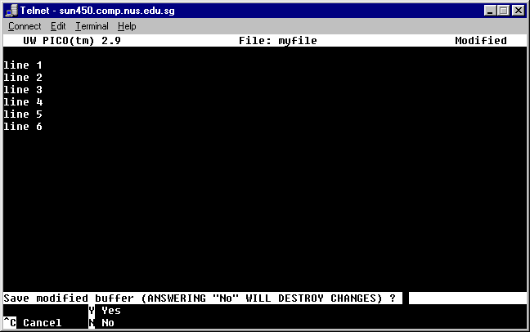
Exiting pico: ctrl-x (1)

Slide 58
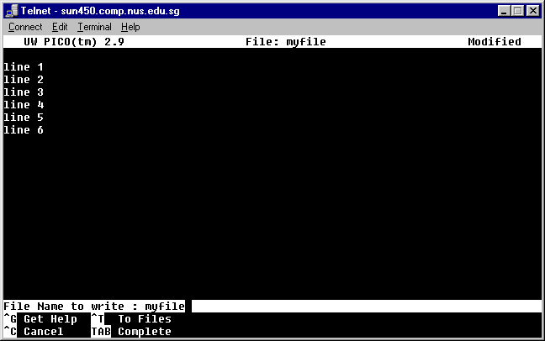
Exiting pico (2)

Slide 59
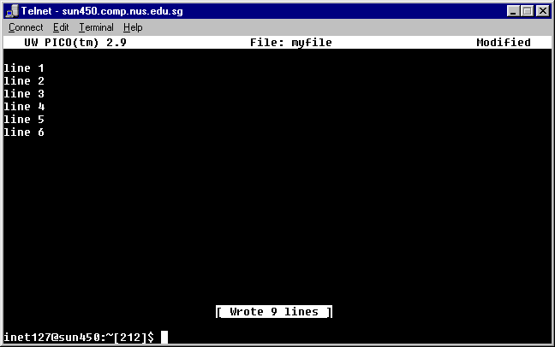
Exiting pico (3)

Slide 60
Lesson 6
Mail:
pine

Slide 61
Mail: pine
What is pine?
Using pine

Slide 62
What is pine?
pine is the default email client for SoC on UNIX servers
You use pine to:
  Read emails
  Compose emails
  Delete emails
  Store emails

Slide 63
Using pine
Walkthrough on:
  Starting pine and authenticating
  Reading emails
  Composing emails
  Replying emails
  Forwarding emails
  Deleting emails
  Undeleting emails
  Storing emails

Slide 64
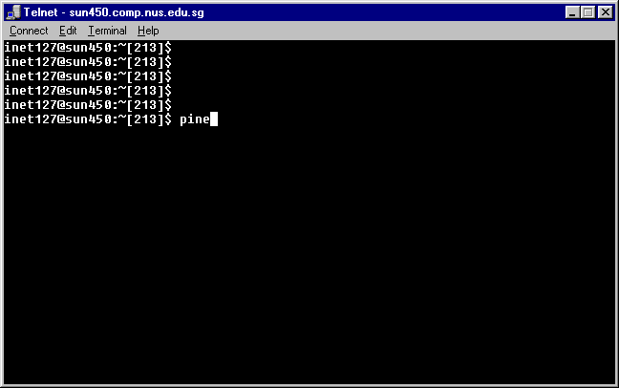
Starting pine and authenticating (1)

Slide 65
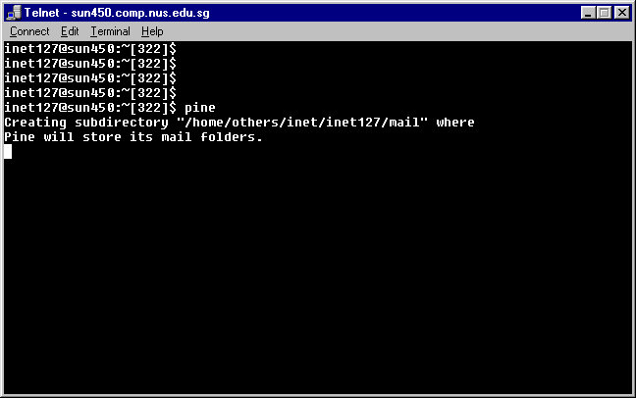
Starting pine and authenticating (2)

Slide 66
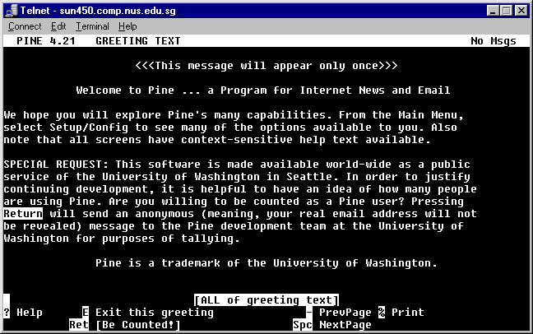
Starting pine and authenticating (3)

Slide 67
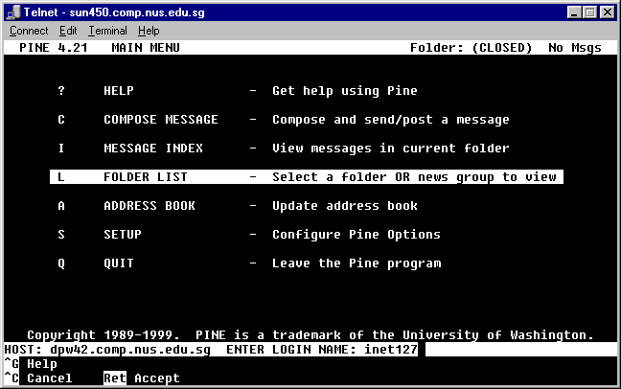
Starting pine and authenticating (4)

Slide 68
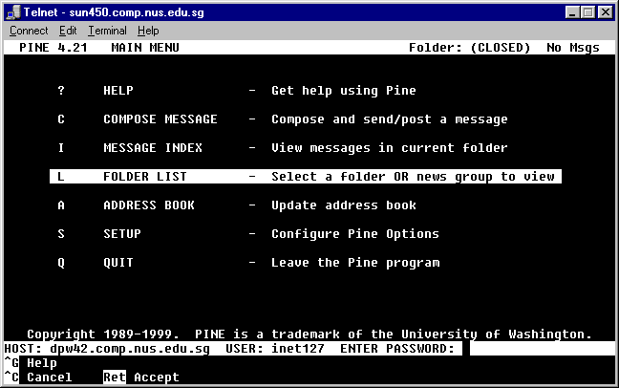
Starting pine and authenticating (5)

Slide 69
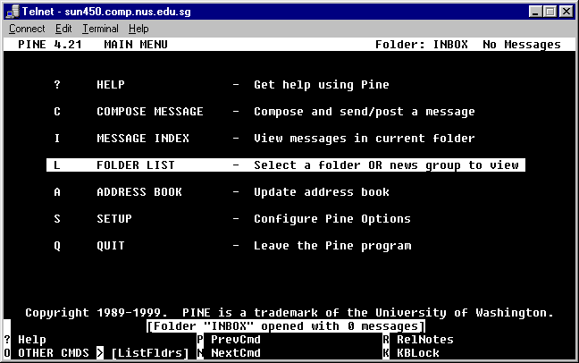
Starting pine and authenticating (6)

Slide 70
Exchanging userids
Please get the userid of ONE person around you

Slide 71
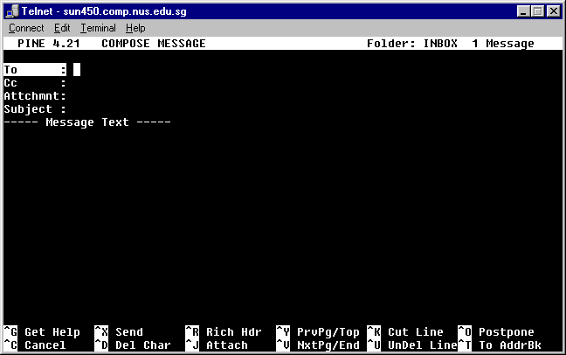
Composing emails (1)

Slide 72
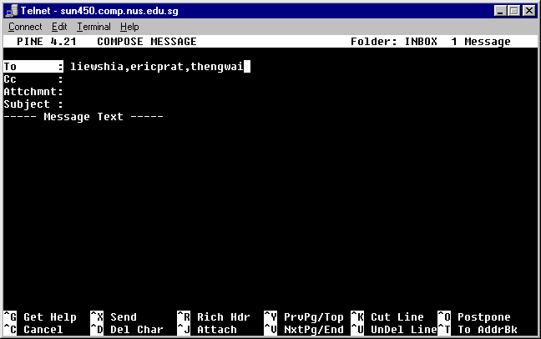
Composing emails (2)
Notes:
- for SoC accounts, there is no need to type in the full email address, ie the @comp.nus.edu.sg extension is not needed. Pine will automatically expand the addresses.

Slide 73
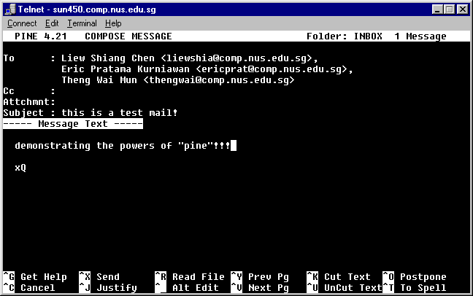
Composing emails (3)

Slide 74
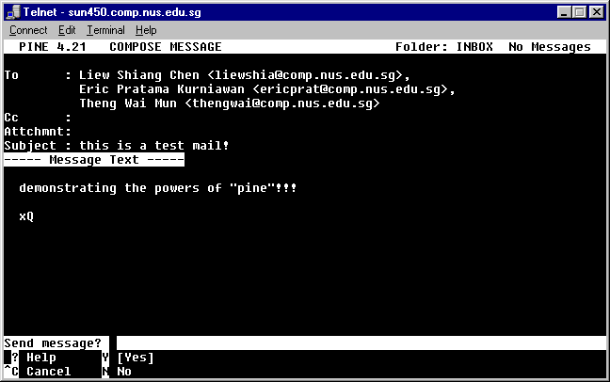
Composing emails (4)

Slide 75
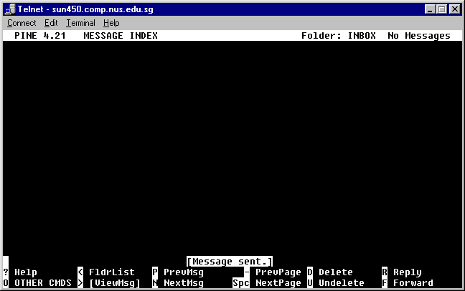
Composing emails (5)

Slide 76
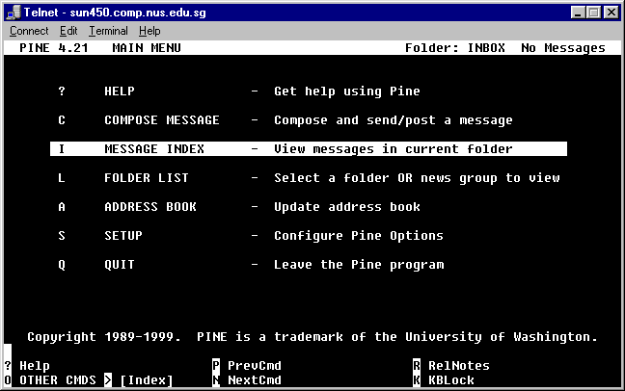
Reading emails (1)

Slide 77
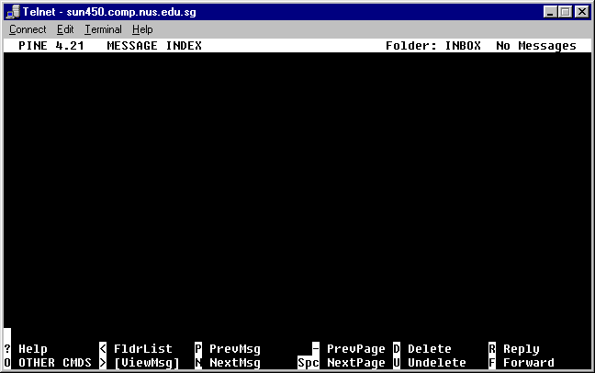
Reading emails (2)

Slide 78
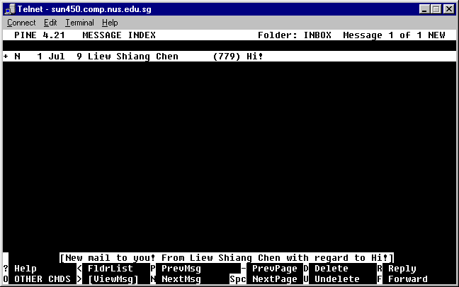
Reading emails (3)

Slide 79
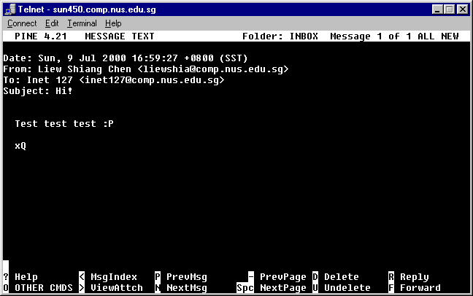
Reading emails (4)

Slide 80
Replying emails: r
To reply:
  Press “r” at the mail you want to reply
  Write your reply as in the “Compose” step
  Press control-x to send

Slide 81
Forwarding emails: f
To forward:
  Press “f” at the mail you want to reply
  Add any comments you have in the “Compose” step
  Press control-x to send

Slide 82
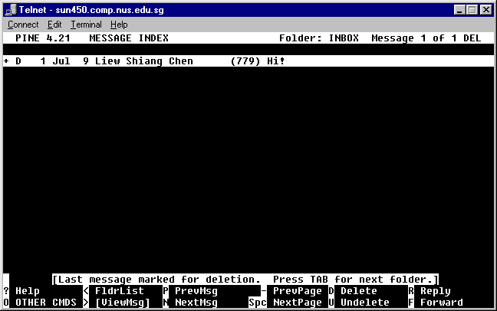
Deleting emails - d

Slide 83
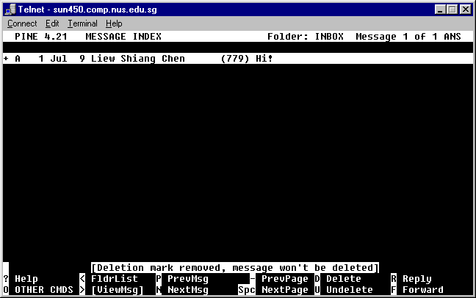
Undeleting emails - u

Slide 84
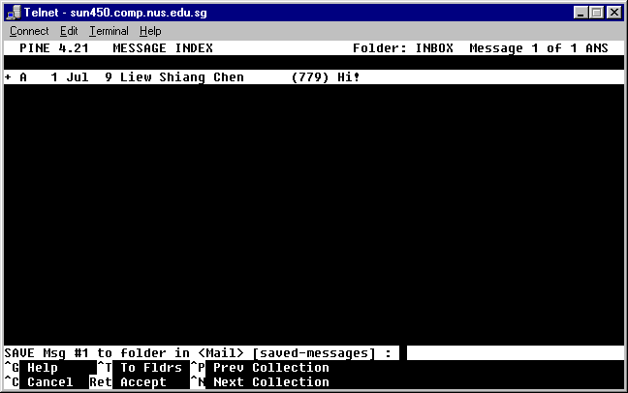
Storing emails (1)

Slide 85
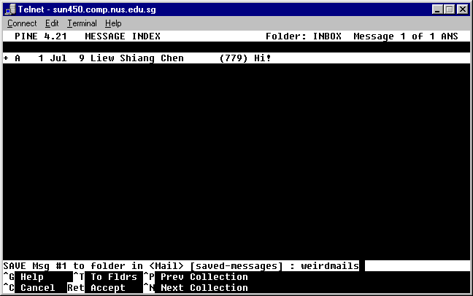
Storing emails (2)

Slide 86
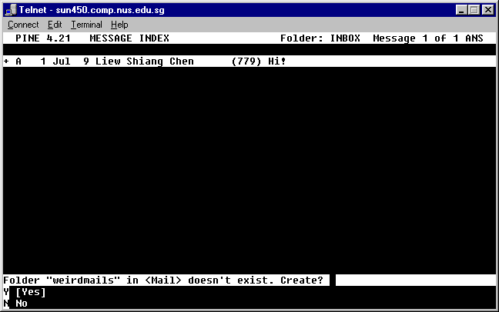
Storing emails (3)

Slide 87
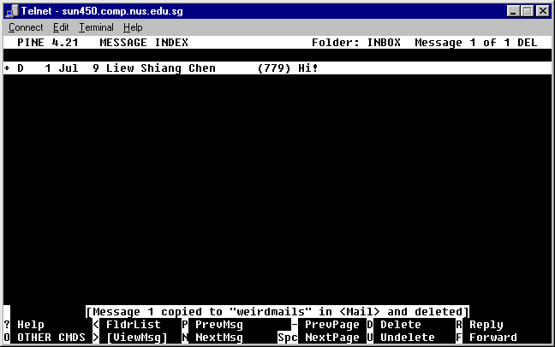
Storing emails (4)

Slide 88
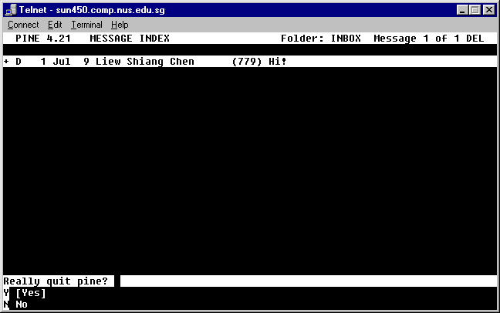
Storing emails (5)

Slide 89
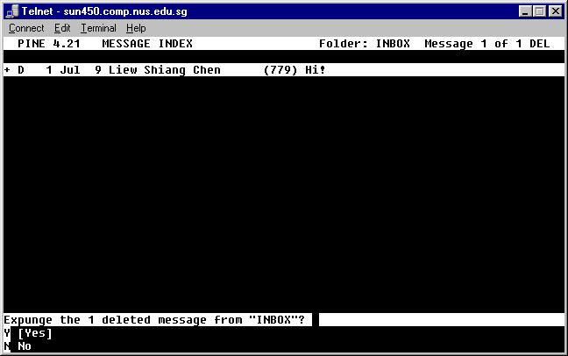
Storing emails (6)

Slide 90
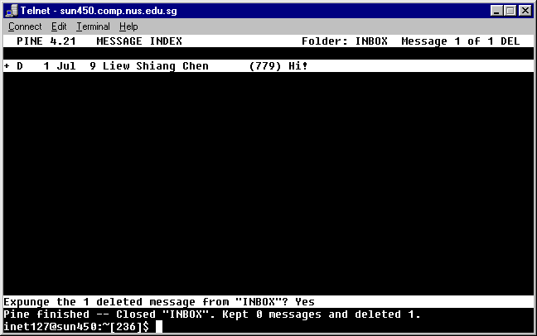
Storing emails (7)

Slide 91
Lesson 7
BBS

Slide 92
BBS
What is a BBS?
SoC BBS
Using bbs

Slide 93
What is a BBS?
BBS stands for Bulletin Board System
BBS is:
  a hierarchically organized group of folders
  where you can exchange views and comments online
  where you can buy/sell stuff
  meet people of similar interests

Slide 94
SoC BBS
SoC provides an internal BBS for all current undergraduates and alumni
Only people who are taking modules in SoC (including CFM) can access it

Slide 95
Using BBS
Walkthrough on:
  Configuring bbs
  Starting up bbs
  Rules & Regulations
  Posting in SoC.test
  Deleting articles
  Following-up

Slide 96
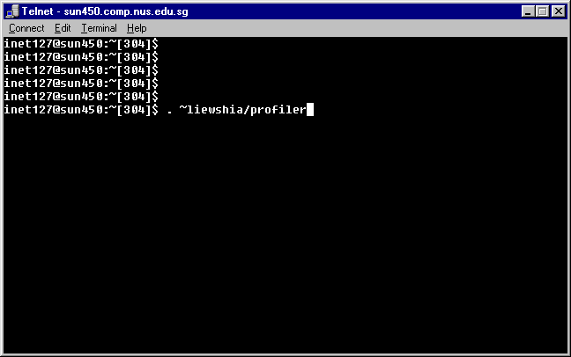
Configuring bbs (1)

Slide 97
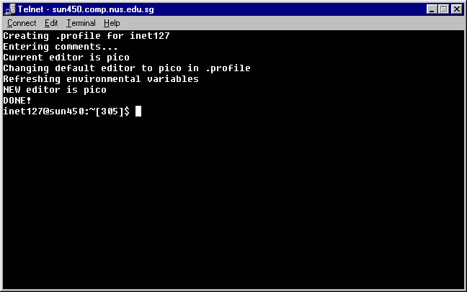
Configuring bbs (2)

Slide 98
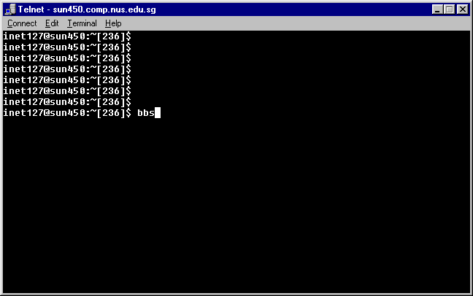
Starting up bbs (1)

Slide 99
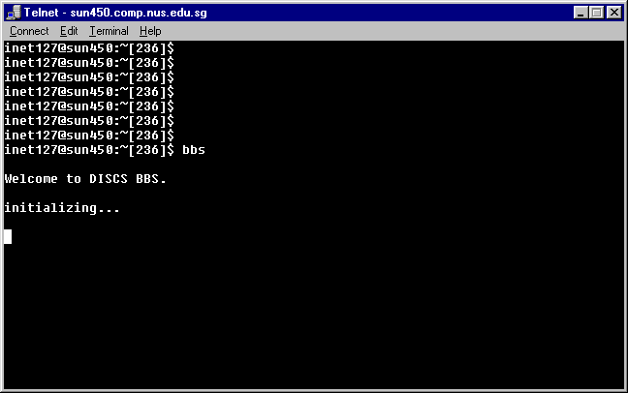
Starting up bbs (2)

Slide 100
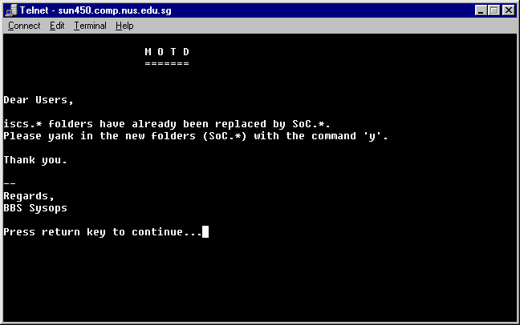
Starting up bbs (3)

Slide 101
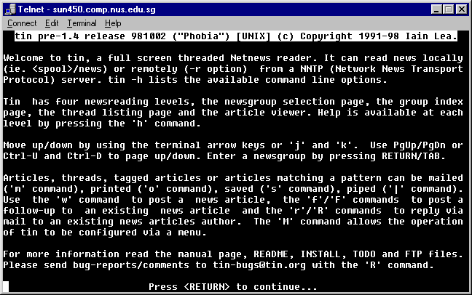
Starting up bbs (4)

Slide 102
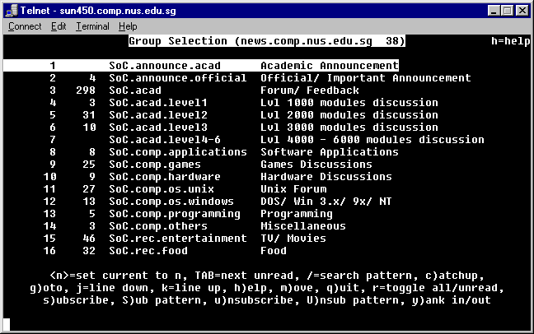
Starting up bbs (5)

Slide 103
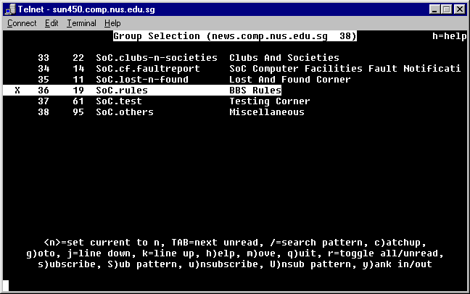
Rules & Regulations (1)

Slide 104
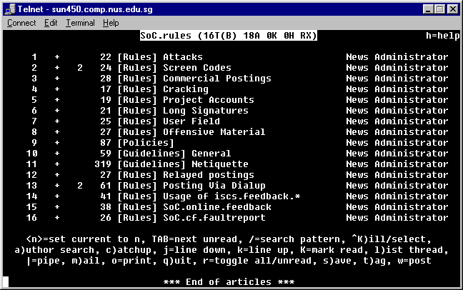
Rules & Regulations (2)

Slide 105
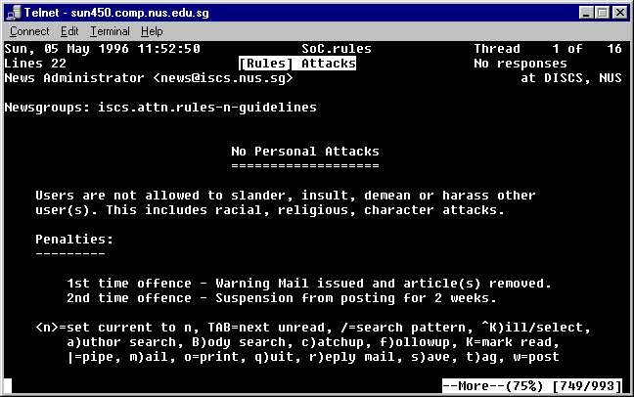
Reading Articles

Slide 106
CAUTION!
Before attempting any serious posting in any other folders than SoC.test, please read through ALL the rules.

Slide 107
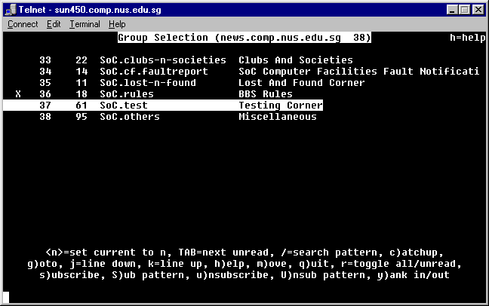
Posting in SoC.test (1)

Slide 108

Posting in SoC.test (2)

Slide 109

Posting in SoC.test: w (3)

Slide 110

Posting in SoC.test (4)

Slide 111

Posting in SoC.test: ctrl-x (5)

Slide 112

Posting in SoC.test (6)

Slide 113

Posting in SoC.test: p (7)

Slide 114

Posting in SoC.test (8)

Slide 115

Posting in SoC.test (9)

Slide 116

Posting in SoC.test (10)

Slide 117

Posting in SoC.test (11)

Slide 118

Deleting articles: shift-d (1)

Slide 119

Deleting articles (2)

Slide 120

Deleting articles (3)

Slide 121
Article follow up: f
Same for posting
Find the article you want to follow up
Press “f” to follow up with the original content
Exit and Post

Slide 122
Article replying (email): r
Same for posting
Find the article you want to follow up
Press “r” to reply via email to the author

Slide 123
Lesson 8
More UNIX commands

Slide 124
More UNIX commands
yppasswd
cp
mv
man
date
cat
less
quota
pusage

Slide 125
yppasswd (no arguments)
To change your password, use
  yppasswd

Slide 126
cp <file1> <file2>
cp is “copy” on UNIX
To make a duplicate of a file named “myfile” to “ourfile”:
cp myfile ourfile
Think of it as “copy myfile to ourfile”

Slide 127
mv <file1> <file2>
mv is “move” on UNIX
To rename a file from “myfile” to “ourfile”, do a
mv myfile ourfile
Think of it as “move myfile to ourfile”
“myfile” will no longer exist

Slide 128
man <command>
man stands for “manual (page)”
Use man to find out more about Unix commands:
man ls
man less
man man

Slide 129
date
date will print out the current date and time on the system

Slide 130
cat
Use cat to print out the content of a file
cat <filename>

Slide 131
less
less is a pager
Use it to browse a file if you do not want to edit it
less <filename>
Press spacebar to go down
Press w to go up
Press q to quit

Slide 132
quota
Use quota to check how much diskspace is left
quota

Slide 133
pusage
pusage stands for “paper usage”
Use it to find out how much paper quota you have left
pusage

Slide 134
Lesson 9
Other Resources

Slide 135
Other Resources
man
man nuslib
http://helpdesk.nus.edu.sg/
http://www.comp.nus.edu.sg/cf/
http://www.comp.nus.edu.sg/students/

Slide 136
That’s IT!
Remember to “logout”

