Slide 1
UNIX Workshop
Freshmen Orientation 2007

Slide 2
Before we begin…
Does everybody have a computer?
Does everybody have your account slips?

Slide 3

Let’s start!
to
School of Computing
(SoC)!

Slide 4
Introduction
Objectives:
Logging in and out of UNIX.
Understanding UNIX file structure.
Using basic UNIX commands.
Using an editor to edit text.
Using an email software to read and send emails.
Creating a web page.
Other utilities, such as file transfer between your UNIX account and the local disk.

Slide 5
NUSNET and SoC accounts
Every NUS student is given an NUSNET account (accout slip given at matriculation).
  Username (example): u0701234
  Email address: u0701234@nus.edu.sg
  Note: You belong to the NUSSTU (NUS students) domain.
In addition to the above, every SoC student has an SoC UNIX account.
  Username (example): johnlee (5 - 8 characters)
  Email address: johnlee@comp.nus.edu.sg
Use only these official email addresses when you email NUS staff.

Slide 6
Login to NUSNET
Press CTRL-ALT-DEL
Type your username (example: u0701234)
Type your password (note: password is case-sensitive)
Select NUSSTU domain
Note: Make sure the NUSSTU domain is selected.

Slide 7
What is UNIX?
Developed in 1960s.
A multi-user multi-tasking operating system (OS).
UNIX OS comprises 4 parts: the kernel, the shell, commands and utilities and file structures (files and directories).

Slide 8
Creating your SoC UNIX account
(Skip this if you have already created your SoC UNIX account earlier.)
Refer to this website for instructions:
https://www.comp.nus.edu.sg/cf/unix/socaccount.html
Disk quote in your SoC account: 500Mbytes.

Slide 9
Connecting to UNIX server (1/4)
Double click on the “SSH Client” shortcut.
Click on “Quick Connect”.
Type sf3.comp.nus.edu.sg (or sunfire.comp.nus.edu.sg) in the “Host name” box.
Type your username in the “User Name” box.
Click “Connect”.
Key in your password and enter. (Note: Password is case-sensitive.)

Slide 10
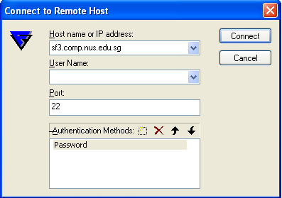
Connecting to UNIX server (2/4)

Slide 11
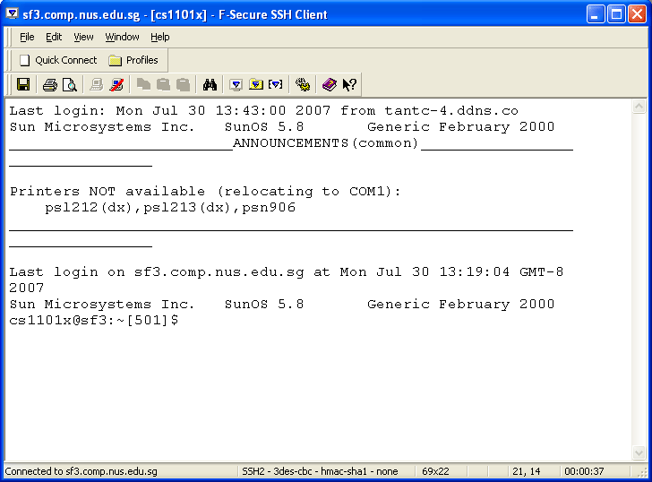
Connecting to UNIX server (3/4)
Upon successful login, you will see:

Slide 12
Connecting to UNIX server (4/4)
In campus, use sf3.comp.nus.edu.sg or sunfire.comp.nus.edu.sg
From home through Singapore ISPs without activating VPN, use
  sunfire-r.comp.nus.edu.sg
Remember to log out from your UNIX session after use, by typing logout or exit.

Slide 13
Files and directories in UNIX (1/2)
The directory system supports a multilevel hierarchy. Files and directories have access protection. Files and directories are accessed through pathnames. Removable file systems are also supported.
All data in UNIX are organised into files. All files are organised into directories.
These directories are organised into a tree-like structure called the file system.

Slide 14
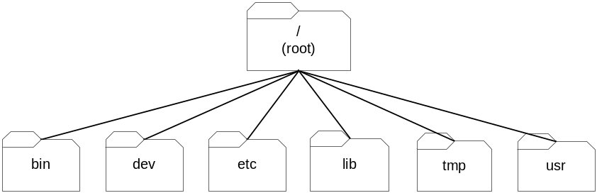
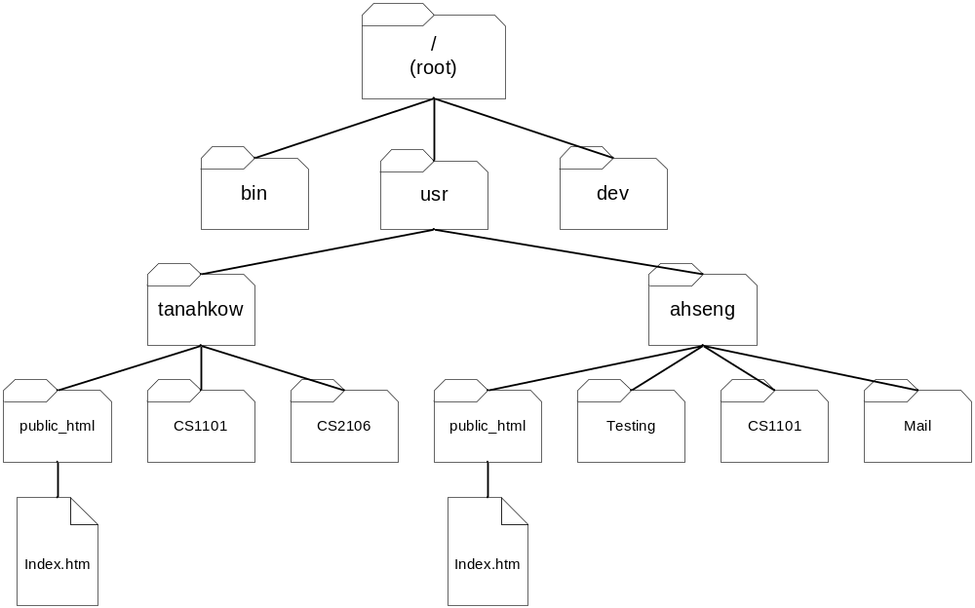
Files and directories in UNIX (2/2)
Top-level organisation of the UNIX file system:
These directories are in turn organised hierarchically. For example, the usr directory may have its own subdirectories:

Slide 15
Files in UNIX
Every file has a name. A filename is composed of 1 to 14 characters, and is case-sensitive. To avoid confusion, choose only characters from the following list for your filenames: letters [A-Z, a-z], digits [0-9], underscore [_], period [.], comma [,].
The root directory uses the symbol /. No other directory or file may use this symbol.
Like children of one parent, no two files in the same directory may have the same name. Files in different directories, like children of different parents, may have the same name.

Slide 16
Some Useful UNIX Commands
The following is a list of commands that provide information. Note that all UNIX commands are case-sensitive.
whoami Show your username.
date Show the server date/time.
cal Show the calendar of current month.
pusage Show your print quota available.
pwd Show the current working directory you are in.
who Show a list of logged on users.
man command Show manual page about the command (example: man who)

Slide 17
Special characters & their meanings
The following is a list of special characters.
(.) dot current directory
(..) dot dot parent of current directory
(/) slash root directory (when appears as the first character; separator when appears between directory names)
(~) tilde short-hand for your home directory

Slide 18
Command format
Most UNIX commands has this format
  command [options] [arguments]
Example: ls –l folder1
  “ls” is a UNIX command
  “-l” is one of the many options available for the “ls” command. An option is usually preceded by a dash symbol (-). There can be many options for a command. (Eg: man ls)
  “folder1” is the argument to the “ls” command. Depending on the command, it may expect zero, one or more arguments.
  There should be at least one space between a command and its option, between an option and argument, and between arguments.

Slide 19
Commands for Files and Directories
cd <dest> Change working directory
ls [options…] <name> List the content of a directory
mkdir <name> Create a new directory
rmdir [options] directory… Delete directory(ies)
cp [options] <src> <dest> Copy file(s)
mv [options] <src> <dest> Move file(s)
rm [options] file… Delete file(s)
chmod [options] [mode] file Change access permission of a file/directory.

Slide 20
Commands to display file contents
cat [options] file… Concatenate and display file
less [options] file… Display content of a file one screen at a time.
head [-n] file Display the first n lines (default: 10 lines) of the file
tail [-n] file Display the last n lines of the file

Slide 21
Task 1 (Work in pair) (1/3)
Make sure you are in your home directory. (Type “cd” to get to your home directory. Use “pwd” to check.)
Change directory to /home/l/lujunche/workshop (or ~lujunche/workshop)
Copy sample1 and sample2 to your home directory.
Create a new directory called workshop under your home directory.
Create 3 sub-directories called folder1, folder2 and folder3 respectively in your newly created workshop directory.
Move sample1 to folder1, and sample2 to folder2.

Slide 22
Task 1 (Work in pair) (2/3)
Use a display commands (cat and less) to view sample1 and note the differences.
Change directory to workshop.
Delete the directory folder2. (Note: you need to delete all files in a directory before you can delete the directory.)
Use chmod to allow your partner to access your sample1. Example: chmod go+r sample1 would allow students in the same group as well as others to read your sample1.
Try accessing your partner’s sample1 by copying it to your folder3.
Rename (use the mv command) sample1 to mytext.

Slide 23
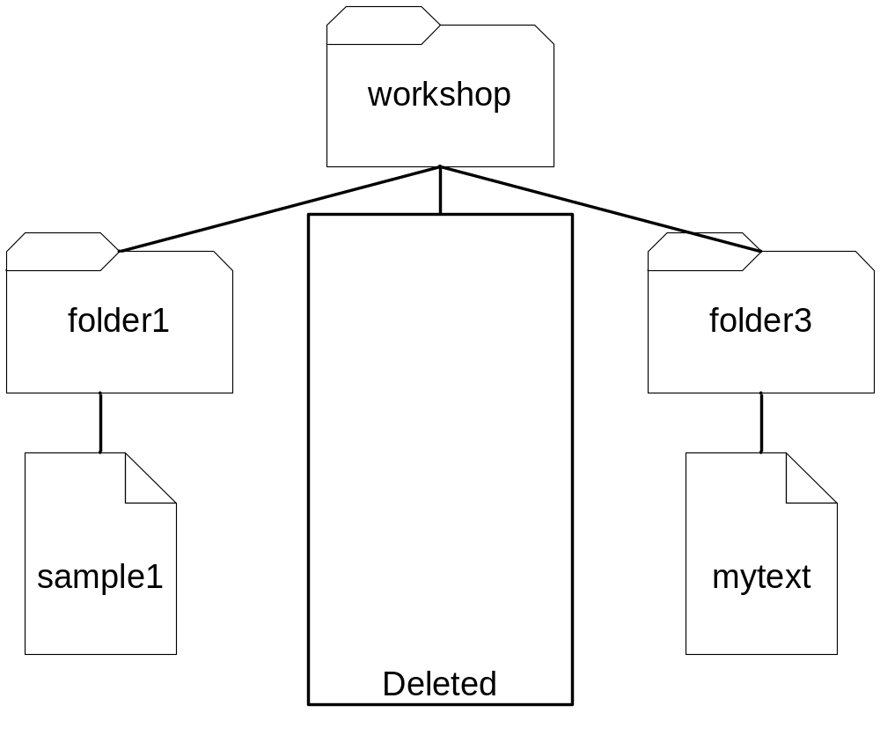
Task 1 (Work in pair) (3/3)
The final product is shown below.

Slide 24
Task 2: Using pico editor (1/2)
Change directory to your folder3 directory (cd ~/workshop/folder3)
To use the pico editor, type pico followed by the name of the file. Example: pico index.htm
You will see a blank editor screen, with a menu of pico commands at the bottom. Refer to the notes on the list of pico commands. For example, ^X (to exit) means pressing CTRL-X.
Type in the text according to the screen in the next slide. This is an HTML file which will be your web page.
Type CTRL-X to save the file and exit from pico.
You may use pico to modify the content of the file whenever you like.

Slide 25
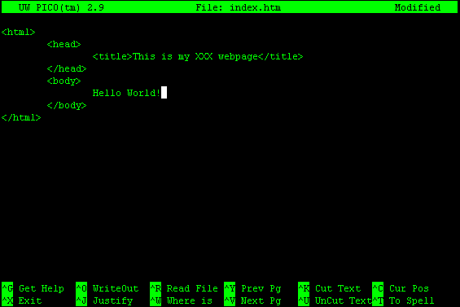
Task 2: Using pico editor (2/2)

Slide 26
Using pine to read/send emails (1/4)
pine = Program for Internet News and Email
To use pine, just type pine (this can be done in any directory; it doesn’t depend on which directory you are in) and the following screen will be shown (see next slide).

Slide 27
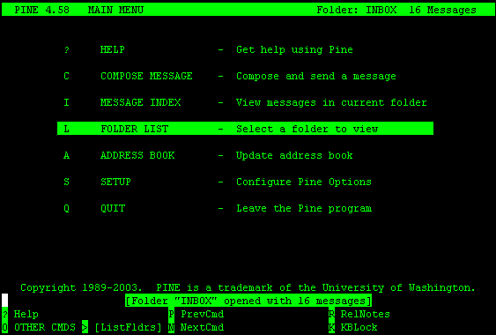
Using pine to read/send emails (2/4)

Slide 28
Using pine to read/send emails (3/4)
To check your email messages, go to Folder List (just press enter since you are already at Folder List), then choose INBOX.
To send an email, go to Compose Message (use the arrow key, or type “C”).
  To send to someone at comp.nus.edu.sg, you may just enter his/her username (eg: wengheng) and it will fill the full email address (eg: wengheng@comp.nus.edu.sg) by itself.
  To send to someone elsewhere, you need to provide the complete email address (eg: bobby@yahoo.com.sg)
  Remember to send email to staff using only your official email addresses (@comp.nus.edu.sg or @nus.edu.sg)

Slide 29
Using pine to read/send emails (4/4)
If you wish to automatically direct incoming emails sent to your comp.nus.edu.sg address to another mailbox, you may do this:
  Go to your home directory (type cd)
  Create a special file called .forward (note the dot in front of the filename; it must be present). How to create it? You may use the pico editor (pico .forward).
  Type the target email address into your .forward file. For example: sassy@hotmail.com.sg
  Exit from the editor to complete the process. From now on, any email that is sent to your SoC UNIX account will be automatically forwarded to the above target email address.

Slide 30
Task 3: Send an email
Send a greeting email message to the SoC email address of your partner.
Check to make sure that you have received your partner’s email.
Create an email with attachment and send it to your partner.
Check that you have received your partner’s email with attachment.

Slide 31
Task 4: Creating your web page
Create a directory public_html in your home directory. (Type cd to go to your home directory, then mkdir public_html)
Copy the file index.htm in your folder3 directory (created in Task 2) to this public_html directory:
cp folder3/index.htm public_html
In your home directory, set the permission settings:
  chmod 711 .
  chmod 711 public_html
  Chmod 744 public_html/index.htm
Use a web browser (example: Internet Explorer) to check whether your web page works. Your URL is http://www.comp.nus.edu.sg/~username

Slide 32
Task 5: Using SSH File Transfer (1/2)
You can transfer files from your local harddisk to your UNIX account, and vice-versa.
Use SSH Secure File Transfer Client: click on the SSH window.
A window (see next slide) will show up.

Slide 33
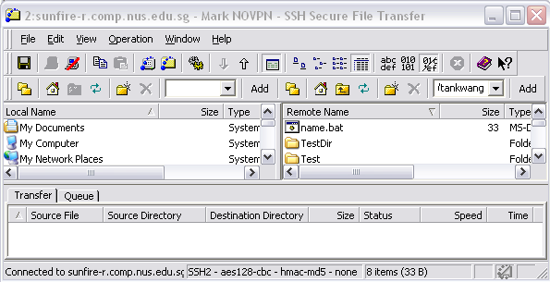
Task 5: Using SSH File Transfer (2/2)

Slide 34
Other Facilities (1/3)
Listing of all computing facilities
  https://www.comp.nus.edu.sg/cf/
Intranet portal for web services
  https://mysoc.nus.edu.sg/
SoC Network
  https://noc.comp.nus.edu.sg/

Slide 35
Other Facilities (2/3)
Printing (/cf/printing/index.html)
  50 A4/month
  300 dot matrix/month
Connecting to SoC Network
  https://noc.comp.nus.edu.sg/docs/netstart
SAMBA service (cf/samba/index.html)
  Access your home directory from Windows via \\stusambahost\unix_username

Slide 36
Other Facilities (3/3)
Tembusu cluster (cf/tembusu/intro.html)
  Linux cluster for grid/distributed computing
Solaris Zones
  web service playground, supports Apache, MySQL, PHP, CGI, JSP and J2EE
  Apply from https://mysoc.nus.edu.sg/~eform/forms/form1.php
  Details at
  https://mysoc.nus.edu.sg/~wiki/index.php/One_Zone_per_User

Slide 37
The End
THANK YOU!
(Do read the notes to find out more.)

