Slide 1
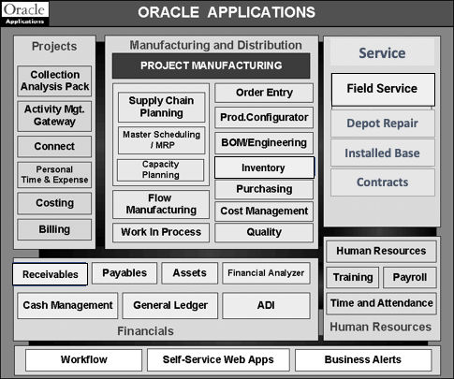
Instructions: Research three modules that would lead to process improvement / elimination of defects and include an explanation of why that capability would solve
the business problem identified in Task #2.
Business Problem Statement identified in Task #2: Lack of inter- and intra-communication
Field Service Module:
This module will automatically and reliably dispatch field technicians to service calls in remote locations. It will correctly document the tasks to be accomplished. It will also eliminate guesswork surrounding qualification, availability, and geographic relevance of the field service technicians.
Inventory Management Module:
This module will promptly display the availability of specific parts, and seamlessly place orders to replenish any inventory gaps. It will also keep track of customers’ past order history, and thus the age of the various installed parts would easily be ascertained. RMA direct receipt is also an added advantage.
Receivables Module:
This module will streamline invoicing, receipt, and customer deduction processing. It will record customer details, and thereby eliminate erroneous deliveries. It will also ensure improved cash flow, increased fiscal efficiencies, and optimize customer relationships.
Circle the modules you have selected on this diagram

