Slide 1

GE VENTILATOR FLUCTUATING DEMAND

Slide 2





AGENDA
Executive Summary
Data Analysis
Value Stream Map Findings
Current & Future Challenges
Summary/Next Steps

Slide 3
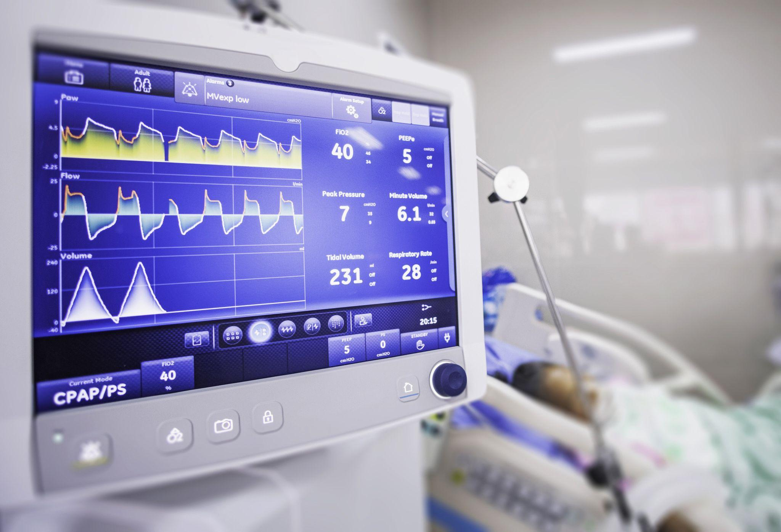
EXECUTIVE SUMMARY
Problem : Ventilator demand in surge, but
ventilator supply constant
Reason : Unexpected emergence of the
fatal COVID-19 pandemic
Solution : Identifying and addressing bottlenecks
in the production process

Slide 4
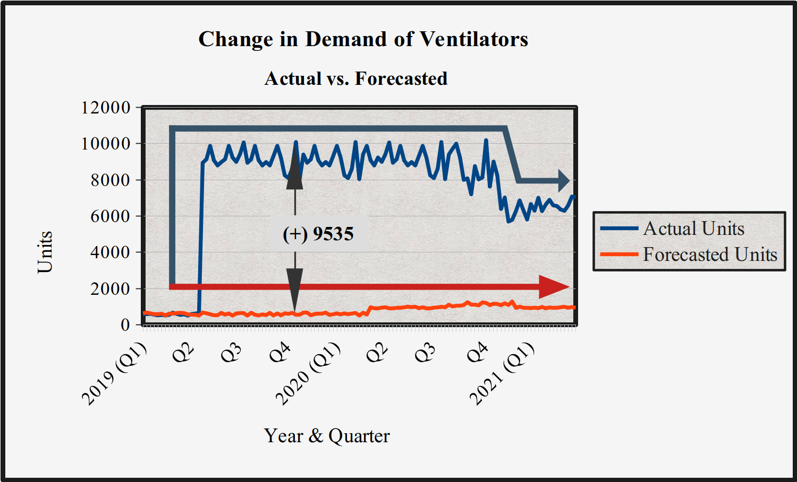
DATA ANALYSIS
IQM and SD of Actual data :
8406.9 & 752.05
IQM and SD of Forecasted data :
766.9 & 148.6
Difference in the two averages :
7639.9

Slide 5
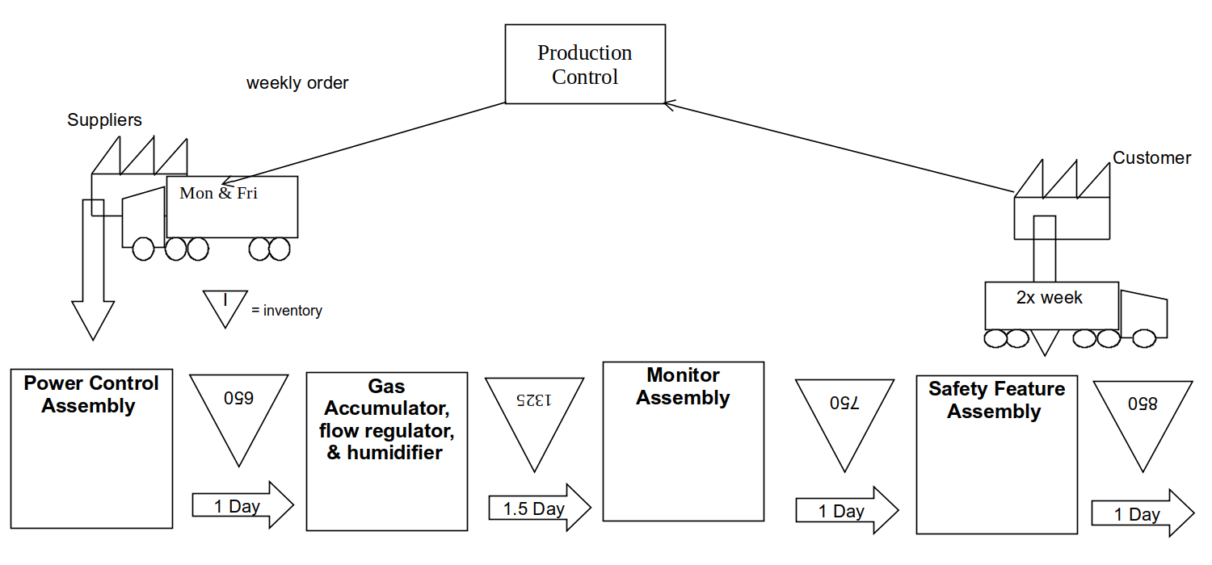
VALUE STREAM MAP FINDINGS
Bottlenecks are similar at all four inventories, with the largest one being at the second inventory.
No inventory management or scheduling system exists.
Takt time of 314.53 seconds
is less than the total process cycle time (CT/VA) of 351 seconds.
Delivery is either stagnant,
or untimely.
5
3
1
4
2

Slide 6
CURRENT & FUTURE CHALLENGES
People
Process
Technology
Pandemic (demand) forecasting
Logistics congestion
Change in engineering and manufacturing standards
Government restrictions and regulations
Composite and cost-effective materials
Raw materials and intermediate goods scarcity
Talent acquisition,
HR management, and
skills development
Quality assurance
Provisional solutions for scalability

Slide 7




NEXT STEPS
Build and maintain a rapport with public health officials and hospitals.
Maintain and periodically rotate a buffer stock (JIC). Implement the FIFO and Heijunka models (JIT) on the main inventories to avoid pile-ups.
Implement the Kanban scheduling and supermarket management systems.
Be prepared to reliably rent additional equipment, & hire temporary personnel at a moment’s notice.

