Slide 1

CBT25C: Expenses
CBT25: Creating Authorizations
Notes:
Welcome to “CBT25: Creating Authorizations.” This series of courses is designed to explore the process of creating trip-by-trip authorizations in E2 Solutions.
This tutorial – “CBT25C: Expenses” – is the third in the series, and will discuss the authorization’s Expenses page.

Slide 2
Authorization Workflow
Basic Information – Establish basic authorization information
Reservation – Make online flight, rail, hotel, and rental car reservations; associate existing reservations with the authorization; or retrieve reservations made by a TMC
Site Details – Select trip per diem locations and provide travel details
Expenses – Review, add, and update estimated expenses for the trip
Accounting – Select the accounts to fund the trip
Travel Policy – Select justifications for any out-of-policy details
Summary – Review authorization details
Notes:
Let’s review the authorization workflow defined within the first tutorial.
Once your travel details have been established and/or verified, E2 Solutions continues through the workflow to the Expenses page. This tutorial covers that step:
Using the Expenses page to review, add, and update estimated expenses for the trip.
Step 1 in the workflow was covered in the CBT25A: Introduction & Getting Started tutorial, while steps 2 and 3 were covered in CBT25B: Reservations & Site Details. All remaining steps will be covered in subsequent tutorials for the Creating Authorizations course.

Slide 3
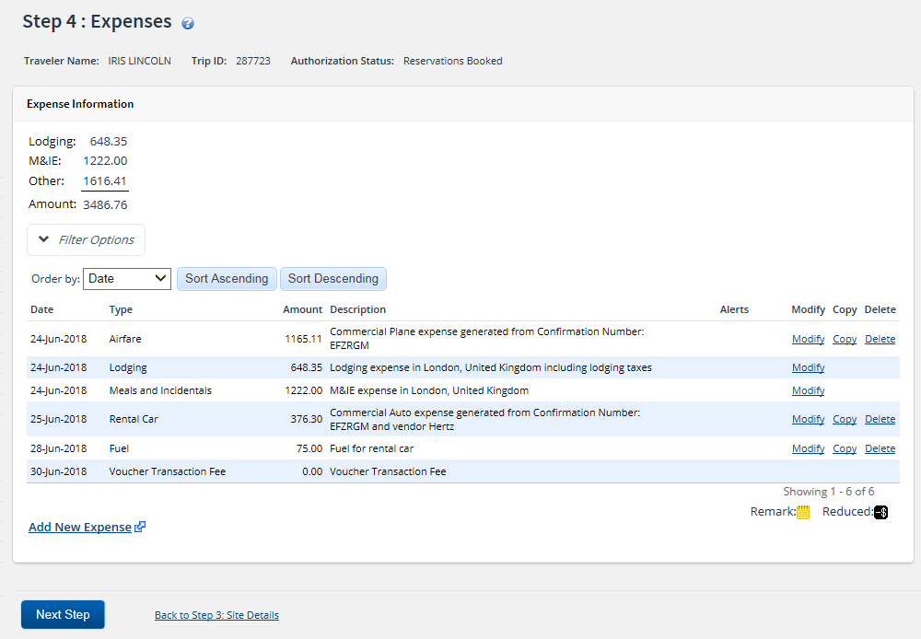
Estimated Expenses
Based on reservation/ per diem site location
​Review expense details
Verify reimbursement type selection
Modify as needed
Add additional expenses
Notes:
Estimated expenses, including airfare, rail, lodging, and rental car expenses, may be automatically generated on the Expenses page, based on your associated reservation. If you do not have a reservation, the Expenses page will still populate with estimated lodging, meals, and incidental expenses, based on the per diem rates for the sites selected for the trip.
When the Expenses page displays:
Review the details of the estimated expenses already displayed on the page, specifically verifying the reimbursement type for lodging and meals and incidentals (M&IE), and making any changes as needed.
Add any additional estimated expenses you anticipate incurring for the trip.

Slide 4
Reimbursement Types - Standard
Per Diem
Actual
Reduced
No Expenses
Notes:
You can specify the type of reimbursement to receive for lodging, meals, and incidental expenses during the Expenses step of the authorization workflow. The selected reimbursement type controls the maximum amount that can be entered for these expenses.
The reimbursement types available to you are controlled by your agency’s travel policy. Click through the buttons to learn more about the standard reimbursement types you may encounter.

Slide 5
Reimbursement Types: Per Diem
Daily payment, up to a specific limit
Based on TDY location
Variable per diem
Notes:
Per diem is a daily payment used to reimburse the traveler. When the Per Diem reimbursement type is selected, the lodging and meals and incidental expenses (M&IE) amounts allowed are based on per diem rate tables for the corresponding day and TDY site location. Typically, your expense may not exceed the per diem rate, unless allowed by your travel policy up to a set percentage.
Variable per diem rates may be configured by your workgroup based on the trip days or the type of travel. For example, E2 calculates M&IE per diem for your first and last days of travel at 75% of the full amount, as required by the FTR.

Slide 6
Reimbursement Types: Actual
Actual trip expenses
Cannot exceed travel policy limitations
Notes:
The Actual reimbursement type allows you to claim actual trip expenses, rather than be limited to per diem rates. When selected, you may enter the actual lodging and meals and incidental expenses (M&IE) you estimate incurring for the corresponding day. The allowed amount may exceed the per diem rate, but may not exceed any limitations defined by your travel policy.

Slide 7
Reimbursement Types: Reduced
Lower than the standard per diem rate
Notes:
The Reduced reimbursement type allows you to reduce the reimbursement amount to a specific rate. When selected, the allowed amount must be less than the per diem rate.

Slide 8
Reimbursement Types: No Expenses
No incurred expenses for the day
Notes:
The No Expenses reimbursement type allows you to indicate no lodging and/or meals and incidental expenses (M&IE) will be incurred for the corresponding day. When selected, E2 Solutions automatically updates any allowed amounts to $0.00.

Slide 9
Reimbursement Types - JTR
EUM
GMR/PMR
Occasional Meals
Notes:
Additional reimbursement types may be available for JTR travelers for meals and incidental expenses (M&IE). Click through the buttons to learn more about these reimbursement types.

Slide 10
Reimbursement Types: EUM
Essential unit messing (EUM)
Meals provided
Amount reduced to incidentals
Notes:
When essential unit messing (EUM) has been established, the government provides meals to the traveler, and meals and incidental expenses (M&IE) should be reduced to only the applicable incidental expenses.
When EUM is selected as the reimbursement type, the allowed amount defaults to the incidental per diem rate for the corresponding day, and the Breakfast Provided, Lunch Provided, and Dinner Provided check boxes are checked.

Slide 11
Reimbursement Types: GMR/PMR
Government meal rate (GMR)
Standard meal rate
Meals provided
Proportional meal rate (PMR)
Only some meals provided; itemize unprovided
Average of GMR and locality rate
From GMR or EUM
Notes:
The government meal rate (GMR) is a standard meal rate charged to JTR travelers receiving an allowance for subsistence, the subsistence portion of per diem, or permission to eat in DoD dining facilities.
When the GMR/PMR reimbursement type is selected, the allowed amount defaults to the GMR amount plus the incidental per diem rate for the corresponding day, and the Breakfast Provided, Lunch Provided, and Dinner Provided check boxes are checked.
The proportional meal rate (PMR) is the rate used when only one or two government meals are available or provided at no cost to the traveler. The PMR is the average of the GMR and the site’s per diem meal rate, rounded up to the nearest whole dollar.
PMR may be utilized for reimbursement when either EUM or GMR/PMR is selected as the reimbursement type. If one or more of the Meal Provided check boxes are cleared, the allowed amount for the corresponding day defaults to the PMR plus the incidental per diem rate. You will need to itemize any unprovided meal expenses on the voucher to be properly reimbursed.

Slide 12
Reimbursement Types: Occasional Meals
Itemized expenses
Cannot exceed PMR
No incidentals allowed
Notes:
Occasional meals are itemized meal expenses that cannot exceed the proportional meal rate (PMR) for the corresponding date and travel site. When the Occasional Meals reimbursement type is selected, the allowed amount is automatically calculated by E2, based on the PMR, and the No Incidentals check box is checked and disabled.

Slide 13
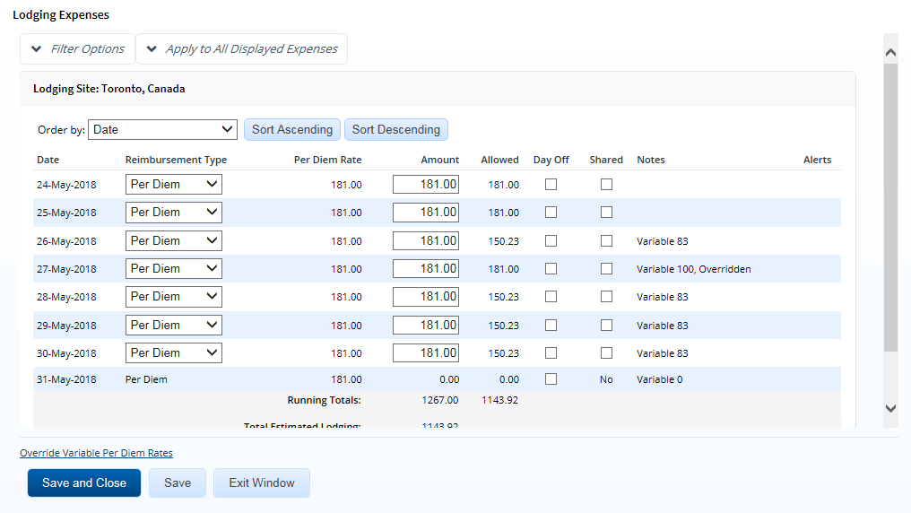
Lodging Expenses
Lodging Expenses window
Site
Reimbursement type
Amount, Allowed, Estimated Tax
Day Off
Shared
Notes:
Click the Modify link for a Lodging expense on the Expenses page to display the Lodging Expenses window.
The following information in the Lodging Expenses window should be reviewed and, if necessary, modified for each day of lodging.
If your trip includes multiple locations, a Site field displays near the top of the window. Select the site for which you want to view or maintain lodging expenses from the drop-down list.
Select the appropriate reimbursement type for the corresponding day from the Reimbursement Type drop-down list.
Review the Amount and Allowed fields for each line item, making changes as needed.
Enter your estimated lodging tax in the Estimated Tax field. It is important to note, lodging tax is authorized for reimbursement for CONUS travel only. Lodging taxes are considered a separate expense and are not included in the lodging rates for sites within the continental U.S., as well as U.S. areas outside the continental U.S. Alternatively, per diem lodging rates for foreign sites include lodging taxes, and therefore the Estimated Tax field is unnecessary and will not display.
Select the Day Off check box, if applicable, for any day that should be identified as an official day off. Official days off do not qualify for lodging or meals and incidental expenses, and your estimated expenses will be reduced accordingly.
Select the Shared check box, if applicable, for any day where you will be sharing lodging. If checked, verify the estimated lodging amount for that day is for your portion only.
Be sure to click the Save or Save and Close button when you are finished to save any changes you might have made and update the corresponding Lodging expense on the Expenses page.

Slide 14
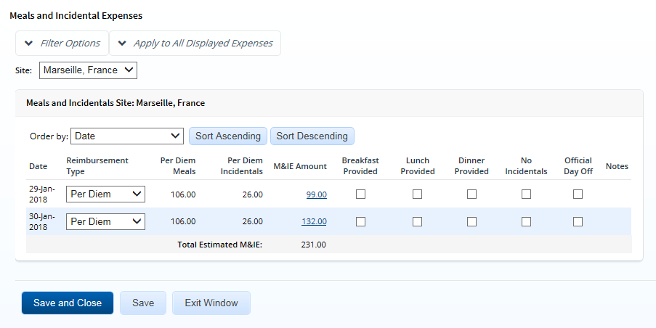
Meals & Incidental Expenses
Meals and Incidental Expenses window
Site
Reimbursement type
Breakfast, Lunch, Dinner Provided
No Incidentals
Official Day Off
Notes:
Click the Modify link for a Meals and Incidentals expense on the Expenses page to display the Meals and Incidental Expenses window.
The following information in the Meals and Incidental Expenses window should be reviewed and, if necessary, modified for each day of M&IE.
If your trip includes multiple locations, a Site field displays near the top of the window. Select the site for which you want to view or maintain meals and incidental expenses (M&IE) from the drop-down list.
Select the appropriate reimbursement type for the corresponding day from the Reimbursement Type drop-down list.
If applicable, select the Breakfast, Lunch, or Dinner Provided check box for any meal that will be provided on a particular day. Identifying a meal as provided will deduct the amount for that meal from the day’s allowed M&IE amount.
Select the No Incidentals check box, if applicable, to indicate no incidental expenses are required for the corresponding day. When checked, the daily incidental amount will be deducted from the day’s allowed M&IE amount.
Select the Official Day Off check box, if applicable, for any day that should be identified as an official day off. Official days off do not qualify for lodging or M&IE, and your estimated expenses will be reduced accordingly.
Be sure to click the Save or Save and Close button when you are finished to save any changes you might have made and update the corresponding Meals and Incidentals expense on the Expenses page.

Slide 15
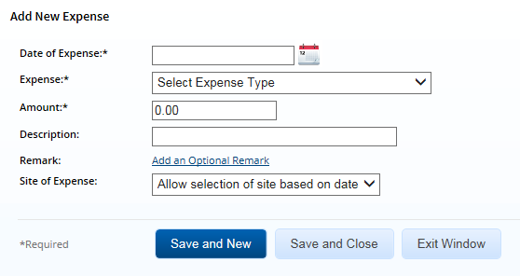
Other Estimated Expenses
Add New Expense link > Add New Expense window
Date of Expense
Expense
Amount
Description
Save and New vs. Save and Close
Notes:
Transportation and other estimated trip expenses (i.e., those that are not lodging, meals, or incidental expenses) can also be added and maintained via the authorization’s Expenses page.
The Add New Expense window displays when you click the Add New Expense link. Select or enter information in the following fields to create a record for a new expense.
Enter the date the expense will be incurred in the Date of Expense field, or click the calendar icon to select a date from the drop-down calendar.
Select the type of expense you are adding from the Expense drop-down list.
Enter the estimated amount of the expense in the Amount field.
If desired, enter a description of the expense in the Description field.
When you are finished with your entries, click the Save and New button to save the expense and clear the fields in the Add New Expense window, allowing you to add another expense to the authorization. Clicking the Save and Close button saves the expense and closes the Add New Expense window, returning you to the Expenses page.

Slide 16
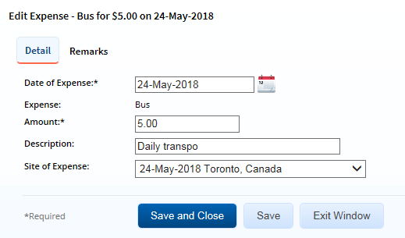
Edit Expenses
T&O expense > Modify link > Edit Expense window
Notes:
Click the Modify link for a transportation or other (T&O) expense listed on the Expenses page to display the Edit Expense window, which allows you to edit the details of that expense. The window displays the same fields as the Add New Expense window, although some values may be read only.

Slide 17
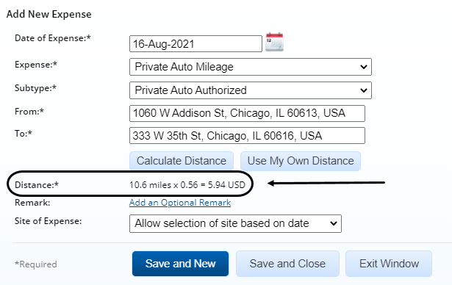
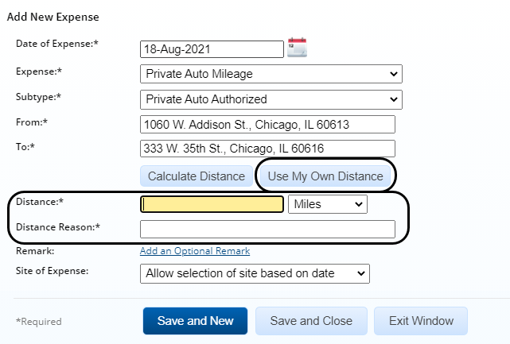
Private Transportation Expense
Private Auto Mileage or Private Motorcycle Mileage
Auto subtype
From, To > Calculate Distance button > Distance
Manually enter > Use My Own Distance button
Distance
Distance Reason
Notes:
You can add an expense for the use of a privately owned vehicle (POV) — such as a car, truck, or motorcycle — in the Add New Expense window. When you select Private Auto Mileage or Private Motorcycle Mileage from the Expense drop-down list, additional fields and buttons are added to the window that allow you to calculate the distance traveled and the reimbursable amount.
If you selected Private Auto Mileage, select an option from the Subtype drop-down list (i.e., Government Auto Available or Private Auto Authorized) to determine the mileage rate used for the expense.
Enter your starting and ending locations in the From and To fields. You may enter a full address, street address, city, state or province, country, or zip or postal code; be as specific as possible. When your entries are complete, click the Calculate Distance button to automatically calculate the distance between your two locations. E2 displays the result, as well as the calculated expense amount, in the Distance field.
You can manually enter your mileage, if necessary, by clicking the Use My Own Distance button. Enter the distance between your locations in the Distance field, and then enter the reason you chose not to use a system-calculated distance in the Distance Reason field.
When you are finished with your expense entries, always be sure to click one of the Save buttons to save your expense.

Slide 18
Estimate TMC Fee
Fee charged by TMC for reservations; displays on invoice
Add via Add New Expense
Contact TMC or manager to estimate amount
Notes:
A TMC fee is a fee assessed by your travel management center (TMC) when processing and ticketing your reservation. The fee varies based on the complexity of the reservation and the involvement by the TMC, but it is typically included on the invoice sent to you by your TMC (based on your agency’s ticketing agreement).
If you made a reservation for your trip, you should add an estimate of the TMC fee to the authorization via the Add New Expense window, just as you would when adding any other estimated miscellaneous expense.
It is important to note, however, that due to the variable nature of the TMC fee and the fact E2 Solutions is utilized by multiple agencies, the E2 application cannot provide you with an estimated amount for your TMC fee. (The same is true for the help resources created to support E2 Solutions.) If you do not have access to your invoice and/or the actual amount charged by the TMC, contact your TMC, manager, or other agency personnel for more information on the actual fees assessed or help in determining the best amount to estimate.

Slide 19
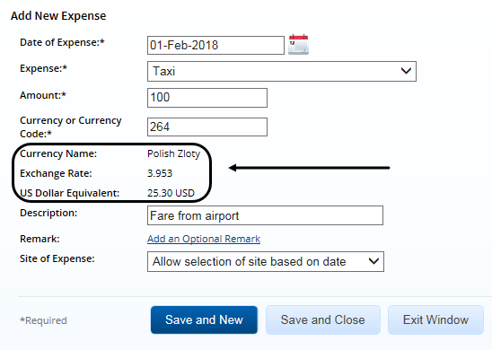
Estimated Expenses in Foreign Currency
Currency or Currency Code field
Add New Expense/ Edit Expense
Lodging Expenses
Apply to All Displayed Expenses
Notes:
If your trip includes a site that is outside the United States, you may be allowed to enter your estimated lodging and T&O (i.e., transportation and other) expenses in the foreign currency.
A Currency or Currency Code field displays for the expense in the Add New Expense and Edit Expense windows. Enter the estimated expense amount, as it would be in the foreign currency, in the Amount field. Once the amount has been entered, enter the first few characters of the currency name, country name, or currency code in the Currency or Currency Code field, pause, and then select the correct currency from the list. For example, if you enter EUR, you will see a list of currency codes for all countries that use the Euro. The Currency Name, Exchange Rate, and US Dollar Equivalent fields will be automatically updated based on your selection.
In the Lodging Expenses window, click the Apply to All Displayed Expenses tab to access the Currency or Currency Code field. Enter/select the appropriate currency code, and then click the Apply to Displayed button to apply the currency code to each day of lodging in the Lodging Expenses data grid.
Be sure to click the Save and Close button in both windows to save your changes before returning to the Expenses page.

Slide 20
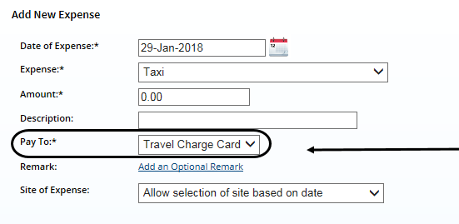
Entering “Pay To” Information
Method of reimbursement = Pay To drop-down list
Options controlled by expense type and travel policy
Agency Billed, Travel Charge Card, Traveler
Notes:
Your workgroup may require you to select the method of reimbursement — or “pay to” — for your estimated expenses. “Pay to” selections should be reviewed for all estimated expenses, including lodging expenses for each day and site, meals and incidental expenses (M&IE) for each day and site, and all additional estimated expenses.
To change the method of reimbursement, select an option from the Pay To drop-down list. Depending on the expense type and your group’s travel policy, options available in the drop-down list may be Agency Billed, Travel Charge Card, and Traveler.

