Slide 1

Arch Lab
Warm Up
Chenlu Miao 09/2022
Notes:
大家早上好，欢迎大家来到kg的体系结构课
我是今年的助教缪晨露
希望这一学期能够给大家做体系实验提供一点帮助。
今天的主要内容是给大家讲一下warmup和第一个体系实验

Slide 2
Overview
Lab Sessions
Vivado
Verilog Warmup
Verilog Event-Driven Simulation
Notes:
我主要想讲的一些内容
体系实验的概览，vivado，一些常用的verilog语法，还有verilog的event-driven simulation

Slide 3
Lab Sessions
Notes:
首先介绍一下这一学期体系实验要做的内容

Slide 4
Lab Sessions
Lab 01
Implement a 5-staged pipelined CPU with forwarding and predicted-not-taken to support RV32I instructions.
Lab 02
Implement handling of interrupt and exception on the pipelined CPU from Lab 01.
Lab 03
Implement a two-way associative cache through simulation.
Lab 04
Incorporate the two-way associative cache from Lab 03 to the pipelined CPU from Lab 02.
Lab 05
Extend the pipelined CPU from Lab 02 to support multi-cycle operations, out-of-order execution, and hazard detection
Lab 06
Extend the pipelined CPU from Lab 05 to support dynamic scheduling such as Scoreboarding or Tomasulo.
Notes:
一共有6个实验
第一个实验实现一个5步流水的cpu, 支持RISCV 32位基础整数指令集, 并且支持forwarding和predict-not-taken
第二个实验是在实验一的基础上实现中断和异常
第三个和第四个实验是实现一个cache, 然后将cache接入实验2的cpu
实验5是实现乱序执行的cpu
实验6支持scoreboarding
每个实验我们都是提供一份代码的，然后大家进行补充，这个代码是王总辉老师他们提供的
我听说你们前四个实验在计组都做过了，所以应该难度不大
然后我们的实验是两人一组 自由组队 可以solo

Slide 5
Vivado
Notes:
ok, 然后讲一下vivado

Slide 6
Vivado
New vivado users ? → click this
Vivado 2020.2 and higher versions
Our Board → xc7k325tffg676-2L
Notes:
我感觉大家上过计组应该对vivado的使用比较熟悉了。如果还不熟悉vivado的使用的，可以看看计组实验对vivado使用的介绍，这个链接
大家做实验的实验选板子要选这个型号，这个可能和计组是不一样的
好像大家很多是2017版本的vivado, 我不确定行不行，但去年用的基本都是2020.2
大家先试试2017行不行，不行的话在升到2020，如果有同学解决这个问题可以在群里分享一下经验

Slide 7
Verilog Warmup
Notes:
实验中我们使用的是verilog语言，但如果你想用chisel，也可以

Slide 8
Verilog Warmup
variable
vector
assignment
always block
if-else
case
ROM & RAM
Verilog Practice in HDLBits: https://hdlbits.01xz.net/wiki/Main_Page
Notes:
在实验过程中，根据以往经验，大家经常会因为verilog语法而在实现过程中出现问题。比如最常见的问题就是阻塞赋值和非阻塞赋值的错误使用，导致仿真和上板跑的结果不一样
如果不熟悉verilog的，推荐大家去做一下hdlbits里面的verilog练习，应该不会花太长时间，但是对你熟悉verilog很有帮助
我在这里介绍很小一部分我认为比较重要的verilog语法。

Slide 9
Verilog – Variable
wire: Physically a wire. Can not "hold" value. Must be continuously assigned.
reg : Not necessarily a register. Can "hold" value. Can be conditionaly assigned.
Verilog: wire vs. reg → https://inst.eecs.berkeley.edu/~cs150/Documents/Nets.pdf
Notes:
首先是变量，verilog里面有两种类型的变量，一种是wire一种是reg。
wire物理上就是电路中的一条连线，不能hold值
reg是可以保存值的

Slide 10
Verilog – Vector
Concatenation
input [15:0] in;
output [23:0] out;
//left
assign {out[7:0], out[15:8]} = in;
//right
assign out[15:0] = {in[7:0], in[15:8]};
assign out = {in[7:0], in[15:8]};
Notes:
然后是vector, vector既可以是wire构成的，也可以是reg构成的
vector有一些比较常用的操作，比如拼接, 可以用大括号将vector拼接起来，比如这个out[7:0]构成了新的vector的高位，out[15:8]构成了新的vector的低位

Slide 11
Verilog – Vector
Concatenation
Reverse
module top_module(
input [7:0] in,
output [7:0] out
);
// assign out[7:0] = in[0:7]; wrong
assign out = {in[0], in[1], in[2], in[3], in[4], in[5], in[6], in[7]};
endmodule
Notes:
vector reverse
不能直接去反转一个vector, 像这个out[7:0] = in[0:7]是错误的写法
你可以用拼接的方法去reverse一个vector

Slide 12
Verilog – Vector
Concatenation
Reverse
Replication
{num{vector}}
This replicates vector by num times. num must be a constant
{5{1'b1}} // 5'b11111 (or 5'd31 or 5'h1f)
{2{a,b,c}} // The same as {a,b,c,a,b,c}
{3'd5, {2{3'd6}}} // 9'b101_110_110
Notes:
vector replication
这个非常常用，可以将一个vector复制n份，比如你想将一个1扩展到5位

Slide 13
Verilog – Vector
Concatenation
Reverse
Replication
Reduction
& a[3:0] // AND: a[3]&a[2]&a[1]&a[0]. Equivalent to (a[3:0] == 4'hf)
| b[3:0] // OR: b[3]|b[2]|b[1]|b[0]. Equivalent to (b[3:0] != 4'h0)
^ c[2:0] // XOR: c[2]^c[1]^c[0]
Notes:
vector reduction， 这个中文好像叫递减运算
你想对一个vector里面的每一位与起来，或起来，异或起来的话，不需要每一位每一位写过去，直接用这个reduction operator

Slide 14
Verilog – Assignment
Continuous assignment (assign x = y;)
Procedural blocking assignment (x = y;)
Procedural non-blocking assignment (x <= y;)
Notes:
然后是赋值
verilog常用有三种类型的赋值，连续赋值，阻塞赋值和非阻塞赋值

Slide 15
Verilog – Assignment
Continuous assignment
Example:
wire x;
assign x = y;
Requirements:
Can only be used when not inside a procedure ("always block")
The left-hand-side of an assign statement must be a net type (e.g., wire)
Notes:
连续赋值就是assign x = y；这个形式
什么情况应该使用连续赋值呢，首先不能出现在过程块中，比如always block，其次assign语句的左侧必须为wire，不能是reg

Slide 16
Verilog – Assignment
Procedural blocking assignment
Example:
reg x;
always @(*) x = y;
Requirements:
Can only be used inside a procedure.
The left-hand-side of a procedural assignment (in an always block) must be a variable type (e.g., reg)
Notes:
然后是阻塞赋值，阻塞赋值是=号
阻塞赋值只能被用在过程语句中，比如always block, initial。在always语句中，最好只在alway @(*)中使用
在使用阻塞赋值的时候，左侧必须为reg类型

Slide 17
Verilog – Assignment
Procedural non-blocking assignment
Example:
reg x;
always @(posedge clk) x <= y;
Requirements:
Can only be used inside a procedure.
The left-hand-side of a procedural assignment (in an always block) must be a variable type (e.g., reg)
Notes:
相对于阻塞赋值，还有非阻塞赋值，一个<=号
和阻塞赋值一样，非阻塞赋值只能被用在always initial这种过程语句中，左侧必须为reg类型。
但和阻塞赋值不同的是，在always语句中，最好只在alway @(clk)中使用

Slide 18
Verilog – Always Block
Combinational: always @(*)
Clocked: always @(posedge clk)
Notes:
always block
我们主要用的有两种类型，一种是组合的，always@(*)
一种是时钟的, always @(posedge clk)

Slide 19
Verilog – Always Block
reg [3:0] out;
always @(*) begin
if(sel1)
out = in1[3:0];
else if(sel2)
out = in2[3:0];
Combinational: always @(*)
Equivalent to assign statements
Procedural blocks have a richer set of statements (e.g., if-then, case) …
else if(sel3)
out = in3[3:0];
else
out = 4'b0;
end
wire [3:0] out;
assign out = ({4{sel1}} & in1[3:0])
| ({4{sel2}} & in2[3:0])
| ({4{sel3}} & in3[3:0]);
Notes:
always @(*)是一种组合逻辑，和assign语句是等价的
但是always @*中可以使用更丰富的语句，比如可以使用if-else, case语句
如果想要描述一些复杂的组合逻辑，使用always @(*)
这里给了一个多路选择器的例子，你用always @*以及if else语句得到的效果和下面的连续赋值语句的效果是等效的

Slide 20
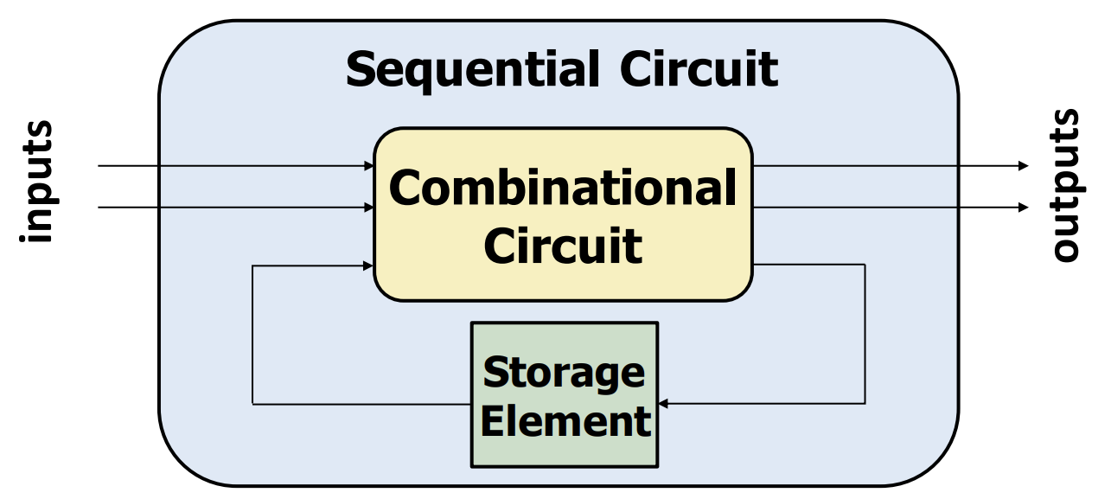
Verilog – Always Block
reg [2:0] q;
always @(posedge clk) begin
if(reset) q <= 0;
else begin
q <= q + 1;
end
end
Combinational: always @(*)
Clocked: always @(posedge clk)
Notes:
第二种是always @(posedge clk)语句
这主要是用来描述时序逻辑的

Slide 21
Verilog – Always Block
Combinational: always @(*)
Clocked: always @(posedge clk)
⚠️ Always use
blocking assignment in combinational logic always @(*)
non-blocking assignment in sequential logic always @(posedge clk).
Notes:
为了避免出错
最好在always @(*)是使用阻塞赋值
在always @(posedge clk)中使用非阻塞赋值

Slide 22
Verilog – if-else
👍 Prefer
if(sel1)
out = in1[3:0];
else if(sel2)
out = in2[3:0];
else if(sel3)
out = in3[3:0];
else
out = 4'b0;
assign out = sel1 ? in1[3:0] :
sel2 ? in2[3:0] :
sel3 ? in3[3:0] :
4'b0;
assign out = ({4{sel1}} & in1[3:0])
| ({4{sel2}} & in2[3:0])
| ({4{sel3}} & in3[3:0]);
Notes:
接下来看一下if-else
左边是if-else语句
但是if else语句其实有很多问题
if else语句的问题是：
不能传播不定态，比如sel1是一个什么xxx值，if语句会选择out=4’b0, 仍然是一个正常的输出，看不出selection1出现了不定态
会产生优先级选择电路而不是并行选择电路， if优先级最高，else优先级最低，会影响生成电路的面积和时序。if else使用不当还有可能使电路中产生不必要的锁存器，比如你不写else语句
如果是组合逻辑，更建议使用assign语句 右边是对应的assign语句电路
上面的assign语句使用了选择运算符，能解决传播不定态的问题，但是生成优先级电路
下面的assign语句，能解决传播不定态的问题，且生成并行电路

Slide 23
Verilog – case
always @(*) begin // This is a combinational circuit
case (in)
1'b1: begin
out = 1'b1; // begin-end if >1 statement
end
1'b0: out = 1'b0;
default: out = 1'bx;
endcase
end
Notes:
case语句以关键字case开始，以endcase结束，两者成对出现
-case语句中每个条目只执行一条语句，如要在一个条目下进行多个赋值，需要将多条语句放在begin/end关键字之间
case语句和if-else语句有同样的问题：不能传播不定态，会生成优先级选择电路

Slide 24
Verilog – ROM & RAM
initial begin
$readmemh("rom.hex", mem);
end
assign rd_data = mem[addr];
endmodule
module ROM (
input [ 6:0] addr,
output [31:0] rd_data
);
reg [31:0] mem[127:0];
⚠️ Put rom.hex in xxx\sim_1\behav\xsim dir
or use absolute path
Notes:
最后是ROM和RAM的写法
可能大家计组里面是生成IP做的
我们这里就是这样一份代码，通过readmemh将rom.hex以16进制从文件中读入
要注意一下，如果仿真的时候找不到rom, ram文件，需要将他们放到这个目录，或者在代码中使用绝对路径

Slide 25
Verilog – Event-Driven Simulation
Notes:
最后，讲一下verilog的仿真机制
我个人觉得always block中阻塞赋值，非阻塞赋值的使用还是很难理解的。如果能够搞清楚verilog的仿真机制的话在写代码的时候应该会有些帮助

Slide 26
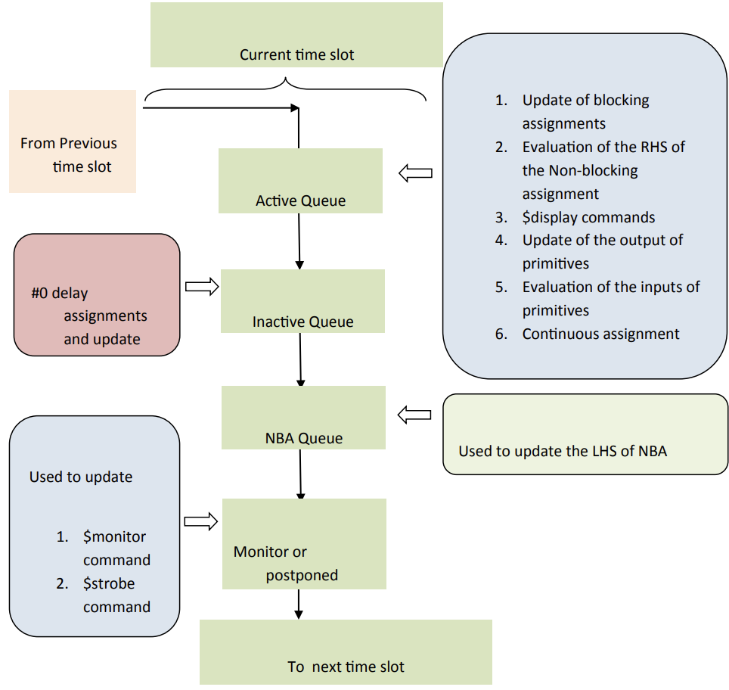
Verilog – Stratified Event Queue
Active Queue: Most of the Verilog events are scheduled in the active event queue. These events can be scheduled in any order and evaluated or updated in any order. The active queue is used to update the blocking assignments, continuous assignments, evaluation of RHS of the non-blocking assignments (LHS of NBA is not updated in the active queue), $display commands and to update the primitives.
Inactive Queue: The #0delay assignments are updated in the inactive queue. Use of #0 delays in the Verilog is not good practice, and it unnecessarily complicates the event scheduling and ordering. Most of the times the designer uses the #0 delay assignments to fool the simulator to avoid the race around conditions.
IEEE Standard for Verilog Hardware Description Language 158~162
Notes:
verilog做仿真的模型是一个事件驱动模型
做simulation的时候，当一些条件发生的时候，会执行一系列的事件，比如执行一段verilog代码，更新一些对象的值，这些事件会被放到一个一个队列中
verilog仿真有分层事件队列这样一个概念
分了4个事件队列，active, inactive, nonblocking assign update queue, monitor queue
这几个队列中事件的执行是有先后顺序的

Slide 27
Verilog – Stratified Event Queue
while (there are events) {
if (no active events) {
if (there are inactive events) {
activate all inactive events;
} else if (there are nonblocking assign update events) {
activate all nonblocking assign update events;
} else if (there are monitor events) {
activate all monitor events;
} else {
advance T to the next event time;
activate all inactive events for time T;
}
}
E = any active event;
if (E is an update event) {
update the modified object;
add evaluation events for sensitive processes to event queue;
} else { /* shall be an evaluation event */
evaluate the process;
add update events to the event queue;
}
}
Notes:
这个就是verilog事件队列的执行伪代码
如果有active event, 就执行active event
active event执行完了，接下来是inactive event, 把inactive event放到active queue, 开始执行
inactive event执行完了，执行nonblocking assign update events
…
这些队列都执行完了就到下一个time slot，再次开始执行active queue

Slide 28
Verilog – Stratified Event Queue
Active Queue: Most of the Verilog events are scheduled in the active event queue. These events can be scheduled in any order and evaluated or updated in any order. The active queue is used to update the blocking assignments, continuous assignments, evaluation of RHS of the non-blocking assignments (LHS of NBA is not updated in the active queue), $display commands and to update the primitives.
Inactive Queue: The #0delay assignments are updated in the inactive queue. Use of #0 delays in the Verilog is not good practice, and it unnecessarily complicates the event scheduling and ordering. Most of the times the designer uses the #0 delay assignments to fool the simulator to avoid the race around conditions.
Notes:
最主要的我们关注两个队列，一个是active queue, 一个是onblocking assignment queue
active queue，基本上的事件都会被放到active queue。就是这个框里的内容，比如更新阻塞赋值，对非阻塞赋值右侧进行evaluation，连续赋值什么的

Slide 29
Verilog – Stratified Event Queue
NBA (Non-Blocking Assign Update) Queue: The LHS of the non-blocking assignments updates in this queue.
Monitor events: It is used to evaluate and update the $monitor and $strobe commands. The updates of all the variables are during the current simulation time.
Notes:
还有一个要重点关注的一个是nonblocking assign update queue
非阻塞赋值左值的更新事件是放在这个队列里面的

Slide 30
Verilog – Stratified Event Queue
Active Queue:
always @(*)
f = a & b;
always @(*)
f = a | b;
execute in any order!
f = ?
Notes:
我们来看一些例子
这里有两个always语句，他们都会放在active queue里面，因为调度时会以任意顺序调度这两个always block, 所以我们不能确定f的值是什么
这个写法是有问题的

Slide 31
Verilog – Stratified Event Queue
Active Queue:
always @(*)
begin
f = a & b;
f = a | b;
end
execute in order!
f = a & b
f = a | b
Notes:
第二个例子，一个always block, 两个阻塞赋值语句，在一个block中是按顺序执行的，
这两个阻塞赋值是按顺序执行的, f最终的值就是a | b

Slide 32
Verilog – Stratified Event Queue
always @(posedge clk)
f <= a & b;
Active Queue: RHS Evaluation
Notes:
再来看一下非阻塞赋值
非阻塞赋值的右边的值的计算是放在active queue里面的

Slide 33
Verilog – Stratified Event Queue
always @(posedge clk)
f <= a & b;
NBA Queue: LHS Update
Notes:
而左值的更新事件是放在nba queue里面的

Slide 34
Verilog – Stratified Event Queue
wire A_in, B_in, C_in;
reg A_out, B_out, C_out;
always @( posedge clk )
A_out = A_in;
assign B_in = A_out + 1;
always @( posedge clk )
B_out = B_in;
assign C_in = B_out + 1;
always @( posedge clk )
C_out = C_in;
A
B
C
+1
+1
https://cseweb.ucsd.edu/classes/sp09/cse141L/Slides/02-Verilog2.pdf
Notes:
接下来是一个复杂一点的例子
这个电路希望实现的效果是时钟上升沿，C=B+1, B=A+1,A=输入的这样一个逻辑
这很明显是一个时序电路，因为你当前的值和上一个时钟的值有关系，那其实我们可以确定的是应该使用always @(posedge clk)和非阻塞赋值
那 如果使用阻塞赋值会出现什么问题呢

Slide 35
Verilog – Stratified Event Queue
wire A_in, B_in, C_in;
reg A_out, B_out, C_out;
always @( posedge clk )
A_out = A_in;
assign B_in = A_out + 1;
always @( posedge clk )
B_out = B_in;
assign C_in = B_out + 1;
always @( posedge clk )
C_out = C_in;
Active Event Queue
A
1
On clock edge all those events which are sensitive to the clock are added to the active event queue in any order!
B
2
C
Notes:
时钟上升沿来了后，上升沿触发的时间以任意顺序被加到active queue

Slide 36
Verilog – Stratified Event Queue
wire A_in, B_in, C_in;
reg A_out, B_out, C_out;
always @( posedge clk )
A_out = A_in;
assign B_in = A_out + 1;
always @( posedge clk )
B_out = B_in;
assign C_in = B_out + 1;
always @( posedge clk )
C_out = C_in;
Active Event Queue
A
A
1
On clock edge all those events which are sensitive to the clock are added to the active event queue in any order!
B
2
C

Slide 37
Verilog – Stratified Event Queue
wire A_in, B_in, C_in;
reg A_out, B_out, C_out;
always @( posedge clk )
A_out = A_in;
assign B_in = A_out + 1;
always @( posedge clk )
B_out = B_in;
assign C_in = B_out + 1;
always @( posedge clk )
C_out = C_in;
Active Event Queue
B
A
A
1
B
2
C

Slide 38
Verilog – Stratified Event Queue
wire A_in, B_in, C_in;
reg A_out, B_out, C_out;
always @( posedge clk )
A_out = A_in;
assign B_in = A_out + 1;
always @( posedge clk )
B_out = B_in;
assign C_in = B_out + 1;
always @( posedge clk )
C_out = C_in;
Active Event Queue
C
B
A
A
1
B
2
C

Slide 39
Verilog – Stratified Event Queue
wire A_in, B_in, C_in;
reg A_out, B_out, C_out;
always @( posedge clk )
A_out = A_in;
assign B_in = A_out + 1;
always @( posedge clk )
B_out = B_in;
assign C_in = B_out + 1;
always @( posedge clk )
C_out = C_in;
Active Event Queue
1
C
B
A
1
B
A evaluates and as a consequence 1 is added to the event queue
2
C
Notes:
A block计算完了，更新A_out的值，这个时候1号块，也就是B_in =A_out+1这个语句，因为A_out更新被加入active queue

Slide 40
Verilog – Stratified Event Queue
wire A_in, B_in, C_in;
reg A_out, B_out, C_out;
always @( posedge clk )
A_out = A_in;
assign B_in = A_out + 1;
always @( posedge clk )
B_out = B_in;
assign C_in = B_out + 1;
always @( posedge clk )
C_out = C_in;
Active Event Queue
2
1
C
A
1
B
Event queue is emptied before we go to next clock cycle
2
C
Notes:
然后一直执行

Slide 41
Verilog – Stratified Event Queue
wire A_in, B_in, C_in;
reg A_out, B_out, C_out;
always @( posedge clk )
A_out = A_in;
assign B_in = A_out + 1;
always @( posedge clk )
B_out = B_in;
assign C_in = B_out + 1;
always @( posedge clk )
C_out = C_in;
A
B
C
+1
+1
+1
+1
Notes:
所以其实这个代码生成的是下面这个电路
而不是我们想要的上面这个电路
三个always block执行完了之后，再去执行了这两个assign语句，大错特错

Slide 42
Verilog – Stratified Event Queue
wire A_in, B_in, C_in;
reg A_out, B_out, C_out;
always @( posedge clk )
A_out <= A_in;
assign B_in = A_out + 1;
always @( posedge clk )
B_out <= B_in;
assign C_in = B_out + 1;
always @( posedge clk )
C_out <= C_in;
Active Event Queue
CR
BR
AR
A
2
1
1
B
Non Blocking Queue
2
CL
BL
AL
C
Notes:
再来看一下使用非阻塞赋值的效果
A,B,C右侧的evaluation放在active queue里面，
左侧的更新放在NBA queue里面
不过个人觉得这里1号块和2号块放的位置有问题, 应该在A_out, B_out更新后执行

Slide 43
Verilog – Stratified Event Queue
wire A_in, B_in, C_in;
reg A_out, B_out, C_out;
always @( posedge clk )
A_out <= A_in;
assign B_in = A_out + 1;
always @( posedge clk )
B_out <= B_in;
assign C_in = B_out + 1;
always @( posedge clk )
C_out <= C_in;
Active Event Queue
A
1
B
Non Blocking Queue
2
CL
BL
AL
C

Slide 44
Verilog – Stratified Event Queue
wire A_in, B_in, C_in;
reg A_out, B_out, C_out;
always @( posedge clk )
A_out <= A_in;
assign B_in = A_out + 1;
always @( posedge clk )
B_out <= B_in;
assign C_in = B_out + 1;
always @( posedge clk )
C_out <= C_in;
Active Event Queue
CL
BL
AL
A
1
B
Non Blocking Queue
2
C
Notes:
个人觉得A_L执行完了之后执行1号块

Slide 45
Verilog – Stratified Event Queue
wire A_in, B_in, C_in;
reg A_out, B_out, C_out;
always @( posedge clk )
A_out <= A_in;
assign B_in = A_out + 1;
always @( posedge clk )
B_out <= B_in;
assign C_in = B_out + 1;
always @( posedge clk )
C_out <= C_in;
A
B
C
+1
+1
https://cseweb.ucsd.edu/classes/sp09/cse141L/Slides/02-Verilog2.pdf

Slide 46
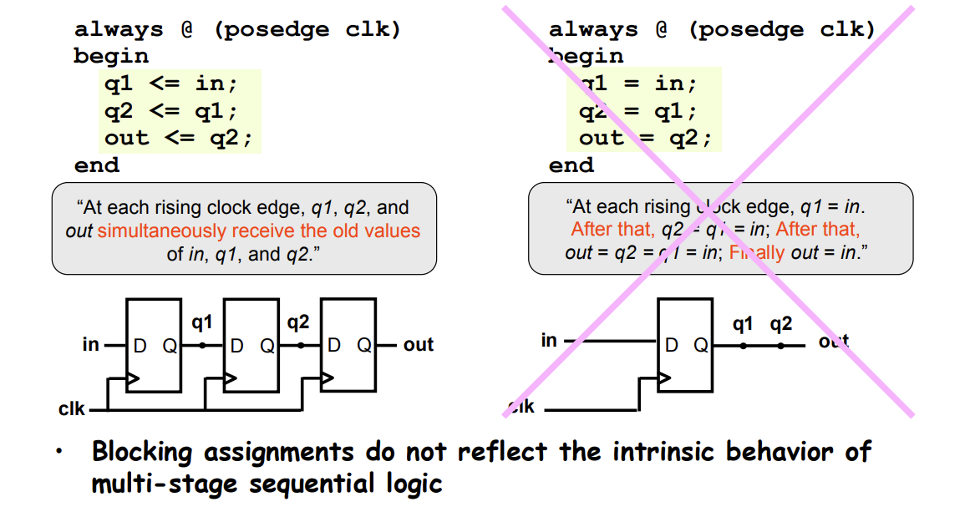
Verilog – Stratified Event Queue
https://courses.csail.mit.edu/6.111/f2007/handouts/L06.pdf
Notes:
前面我们讨论的是仿真，然后对应到生成电路的话
时序电路非阻塞赋值其实在电路中会生成触发器
就是左图的效果
如果使用阻塞复制的话，就不会生成这样的电路

Slide 47
References
Verilog General Guide
https://safari.ethz.ch/digitaltechnik/spring2021/lib/exe/fetch.php?media=onur-digitaldesign_comparch-2021-lecture7-hdl-verilog-afterlecture.pdf
https://safari.ethz.ch/digitaltechnik/spring2021/lib/exe/fetch.php?media=onur-digitaldesign_comparch-2021-lecture6-sequential-logic-updated-beforelecture.pdf
HDLBits
从仿真器的角度理解Verilog语言
RISC-V CPU处理器设计
Digital Logic Design Using Verilog Coding and RTL Synthesis Second Edition
https://cseweb.ucsd.edu/classes/sp09/cse141L/Slides/02-Verilog2.pdf
https://electronics.stackexchange.com/questions/443641/why-we-need-non-blocking-assignments-in-verilog
https://courses.csail.mit.edu/6.111/f2007/handouts/L06.pdf
IEEE Standard for Verilog Hardware Description Language

