Slide 1

Arch Lab6
Dynamically Scheduled Pipelines using Scoreboarding
Chenlu Miao 12/2022
Notes:
大家好，今天讲一下实验6的内容
实验5实现了多周期操作的流水线
实验6我们会实现Scoreboarding进行动态调度

Slide 2
Tasks
Redesign the pipelines with IF/IS/RO/FU/WB stages and supporting multicycle operations.
Design of a scoreboard and integrate it to CPU.

Slide 3
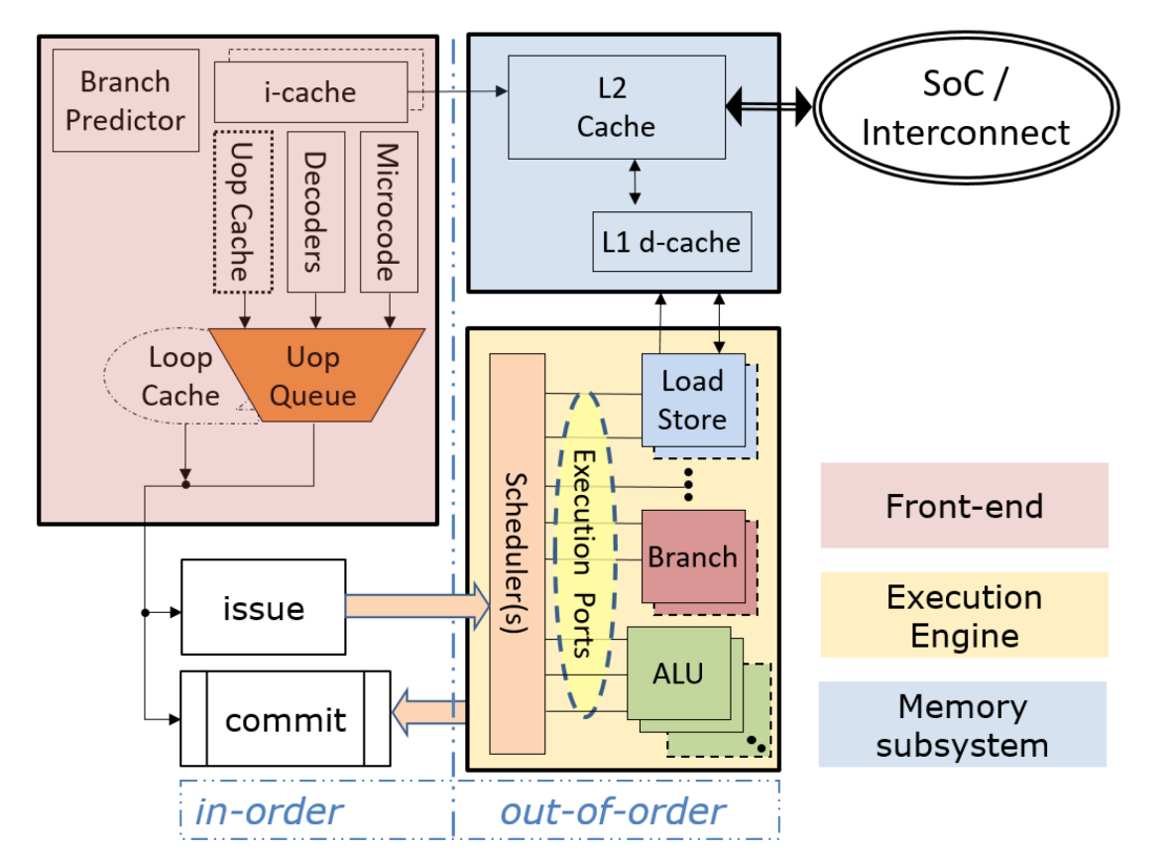
Processor Core Microarchitecture
https://dl.acm.org/doi/pdf/10.1145/3369383
Notes:
这是一个现代处理器core的结构
这个core分成三个部分，红色的这个front-end, 黄色的这块back-end的execution engine, 蓝色的这块是memory subsystem
前端供指, execution engine执行，memory subsystem访存
指令顺序发射，乱序执行

Slide 4
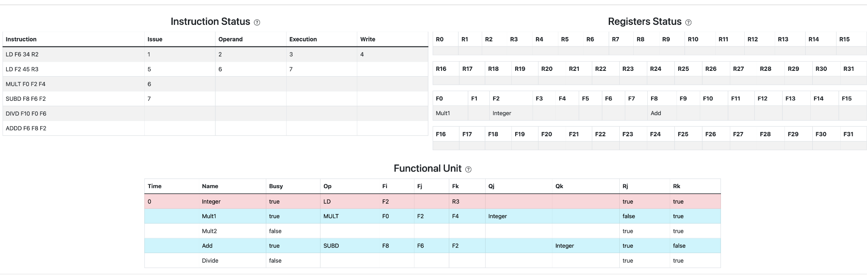
Scoreboard Overview
https://jasonren0403.github.io/scoreboard/
Notes:
我们这个实验实现的乱序执行使用的是Scoreboarding
上课应该讲的比较仔细了，就不展开讲了
这是往上找的一个scoreboarding的可视化程序，可以参考一下

Slide 5
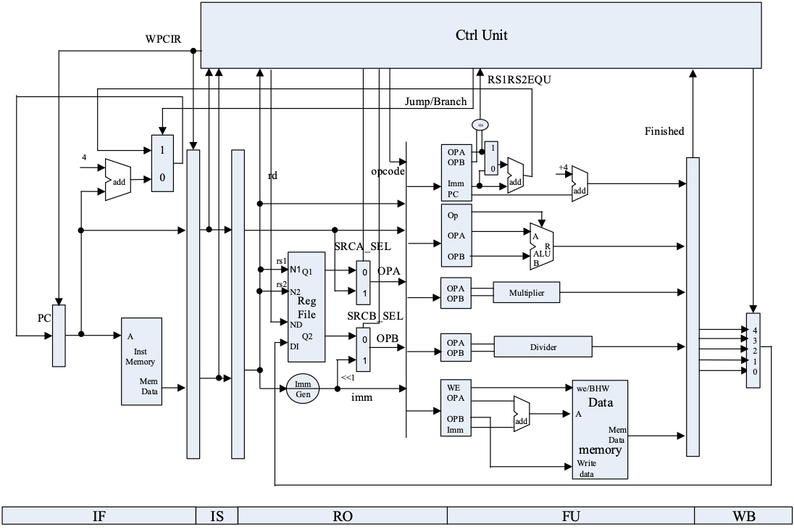
Architecture
Overview
Notes:
这是整个系统的结构图
和实验5很相似
这个流水线中分成了5个stage, IF/IS/RO/FU/WB
IF阶段取指令，IS阶段发射, RO阶段读取操作数, FU阶段进行计算，最后writeback

Slide 6
Architecture Overview – IF
// IF
assign PC_EN_IF = IS_EN | FU_jump_finish & is_jump_FU;
REG32 REG_PC(.clk(debug_clk),.rst(rst),.CE(PC_EN_IF),.D(next_PC_IF),.Q(PC_IF));
add_32 add_IF(.a(PC_IF),.b(32'd4),.c(PC_4_IF));
MUX2T1_32 mux_IF(.I0(PC_4_IF),.I1(PC_jump_FU),.s(FU_jump_finish & is_jump_FU),.o(next_PC_IF));
ROM_D inst_rom(.a(PC_IF[8:2]),.spo(inst_IF));
Notes:
然后来看每个pipeline stage
和实验5区别不大

Slide 7
Architecture Overview – IS
//Issue
REG_IF_IS reg_IF_IS(.clk(debug_clk),.rst(rst),.EN(IS_EN),
.flush(1'b0),.PCOUT(PC_IF),.IR(inst_IF),
.IR_IS(inst_IS),.PCurrent_IS(PC_IS));
ImmGen imm_gen(.ImmSel(ImmSel_ctrl),.inst_field(inst_IS),.Imm_out(Imm_out_IS));
CtrlUnit ctrl(.clk(debug_clk),.rst(rst),.PC(PC_IS),.inst(inst_IS),.imm(Imm_out_IS), .ALU_done(FU_ALU_finish),.MEM_done(FU_mem_finish),.MUL_done(FU_mul_finish),.DIV_done(FU_div_finish),.JUMP_done(FU_jump_finish),.is_jump(is_jump_FU),
.IS_en(IS_EN),.ImmSel(ImmSel_ctrl),.ALU_en(FU_ALU_EN),
.MEM_en(FU_mem_EN),.MUL_en(FU_mul_EN),.DIV_en(FU_div_EN),.JUMP_en(FU_jump_EN),
.PC_ctrl(PC_ctrl),.imm_ctrl(imm_ctrl),.rs1_ctrl(rs1_addr_ctrl),.rs2_ctrl(rs2_addr_ctrl), .JUMP_op(Jump_ctrl),.ALU_op(ALUControl_ctrl),.ALU_use_PC(ALUSrcA_ctrl),.ALU_use_imm(ALUSrcB_ctrl),
.MEM_we(mem_w_ctrl),.MEM_bhw(bhw_ctrl),.MUL_op(),.DIV_op(),
.write_sel(DatatoReg_ctrl),.reg_write(RegWrite_ctrl),.rd_ctrl(rd_ctrl)
);
Notes:
ID阶段也是

Slide 8
Architecture Overview – RO
// RO
Regs register(.clk(debug_clk),.rst(rst),
.R_addr_A(rs1_addr_ctrl),.rdata_A(rs1_data_RO),
.R_addr_B(rs2_addr_ctrl),.rdata_B(rs2_data_RO),
.L_S(RegWrite_ctrl),.Wt_addr(rd_ctrl),.Wt_data(wt_data_WB),
.Debug_addr(debug_addr[4:0]),.Debug_regs(debug_regs));
MUX2T1_32 mux_imm_ALU_RO_A(.I0(rs1_data_RO),.I1(PC_ctrl),.s(ALUSrcA_ctrl),.o(ALUA_RO));
MUX2T1_32 mux_imm_ALU_RO_B(.I0(rs2_data_RO),.I1(imm_ctrl),.s(ALUSrcB_ctrl),.o(ALUB_RO));
Notes:
RO阶段读取操作数

Slide 9
Architecture Overview – FU
// FU
FU_ALU alu(...);
FU_mem mem(...);
FU_mul mu(...);
FU_div du(...);
FU_jump ju(...);
Notes:
然后FU

Slide 10
Architecture Overview – WB
// WB
REG32 reg_WB_ALU(.clk(debug_clk),.rst(rst),.CE(FU_ALU_finish),.D(ALUout_FU),.Q(ALUout_WB));
REG32 reg_WB_mem(.clk(debug_clk),.rst(rst),.CE(FU_mem_finish),.D(mem_data_FU),.Q(mem_data_WB));
REG32 reg_WB_mul(.clk(debug_clk),.rst(rst),.CE(FU_mul_finish),.D(mulres_FU),.Q(mulres_WB));
REG32 reg_WB_div(.clk(debug_clk),.rst(rst),.CE(FU_div_finish),.D(divres_FU),.Q(divres_WB));
REG32 reg_WB_jump(.clk(debug_clk),.rst(rst),.CE(FU_jump_finish),.D(PC_wb_FU),.Q(PC_wb_WB));
MUX8T1_32 mux_DtR(.s(DatatoReg_ctrl),.I0(ALUout_WB),.I1(mem_data_WB),.I2(mulres_WB),.I3(divres_WB),
.I4(PC_wb_WB),.I5(32'd0),.I6(32'd0),.I7(32'd0),.o(wt_data_WB));
Notes:
最后write back

Slide 11
Ctrl Unit
Notes:
上面这些pipeline stage看起来和实验5都差不多，
最主要的区别在于Ctrl Unit的控制逻辑

Slide 12
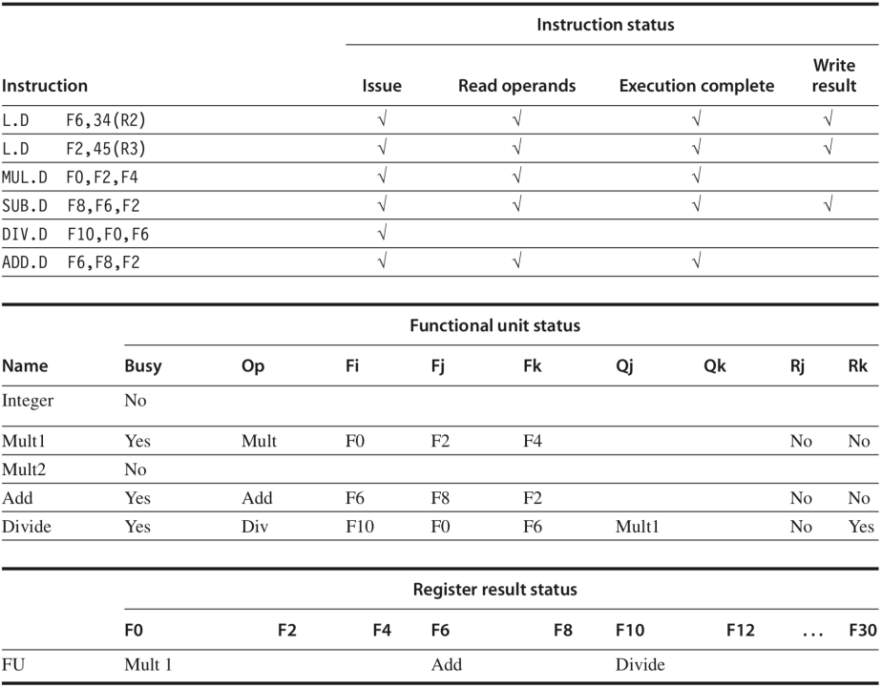
Ctrl Unit
Notes:
Scoreboarding算法里面需要这三张表，这三张表在Control Unit里面是怎么处理的呢
那第一张表你可以根据指令所处的流水线阶段知道目前指令执行的状态
我们需要增加一下第二张表和第三张表的支持

Slide 13
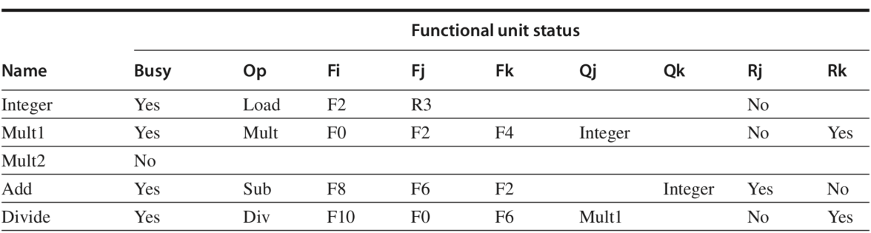
Ctrl Unit – Function Unit Status
Busy – Indicate whether the unit is busy or not.
Op – Operation to perform in the unit (e.g., addr or subtract).
Fi – Destination register.
Fj, Fk – Source-register numbers.
Qj, Qk – Functional units producing source registers Fj, Fk
Rj, Rk – Flags indicating when Fj, Fk are ready and not yet read. Set to No after operands.
+ FU_DONE
Notes:
先来看一下这个Function Unit Status, 记录Function unit的状态
在原有9个field的基础上加了FU_DONE这个field, 记录指令是否执行完成

Slide 14
Ctrl Unit – Function Unit Status
// function unit
`define FU_BLANK 3'd0
`define FU_ALU 3'd1
`define FU_MEM 3'd2
`define FU_MUL 3'd3
`define FU_DIV 3'd4
`define FU_JUMP 3'd5
// bits in FUS
`define BUSY 0
`define OP_L 1
`define OP_H 5
`define DST_L 6
`define DST_H 10
`define SRC1_L 11
`define SRC1_H 15
`define SRC2_L 16
`define SRC2_H 20
`define FU1_L 21
`define FU1_H 23
`define FU2_L 24
`define FU2_H 26
`define RDY1 27
`define RDY2 28
`define FU_DONE 29
Busy – Indicate whether the unit is busy or not.
Op – Operation to perform in the unit
Fi – Destination register.
Fj, Fk – Source-register numbers.
Qj, Qk – Functional units producing source registers Fj, Fk
Rj, Rk – Flags indicating when Fj, Fk are ready and not yet read. Set to No after operands.
+ FU_DONE
reg[31:0] FUS[1:5];
e.g. FUS[`FU_MEM][`SRC1_H:`SRC1_L]
Notes:
这个Function Unit Status在代码里面这样表示的
1:5这个指示了哪一个function unit
这32位指示了FUS里面存的信息，比如第0位是Busy, 1-5记录Op

Slide 15
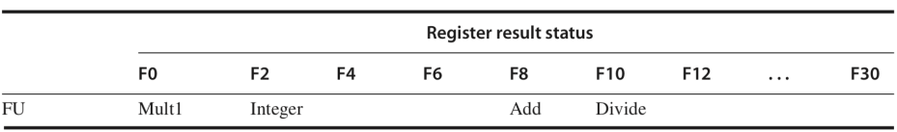
Ctrl Unit – Register Result Status
// function unit
`define FU_BLANK 3'd0
`define FU_ALU 3'd1
`define FU_MEM 3'd2
`define FU_MUL 3'd3
`define FU_DIV 3'd4
`define FU_JUMP 3'd5
Indicates which functional unit will write each register, if an active instruction has the register as its destination. This field is set to blank whenever there are no pending instructions that will write that register.
// records which FU will write corresponding reg at WB
reg[2:0] RRS[0:31];
Notes:
然后第二个是Register Result Status这张表，记录寄存器会被哪一个Function unit写
32个寄存器，然后每一个可能对应这些function unit

Slide 16
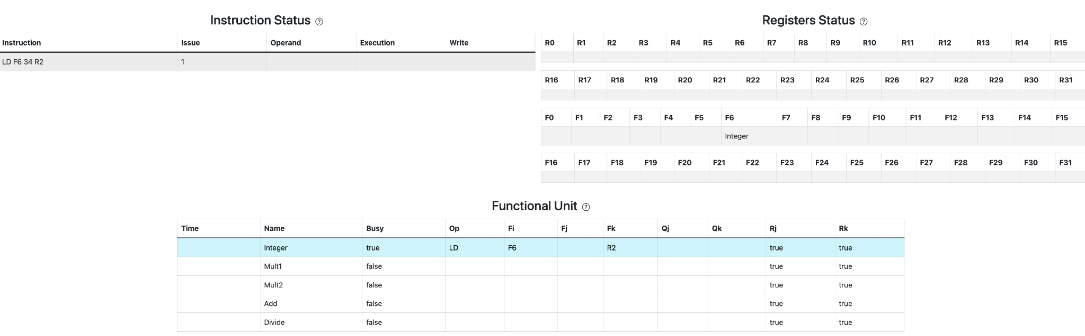
ISSUE
Notes:
讲完了上述三张表的存储实现之后，我们来看scoreboard的工作过程
首先ISSUE,
如果指令对应的功能部件空闲，且指令没有WAW冒险，就可以发射

Slide 17
ISSUE
// IS
if (RO_en) begin
// not busy, no WAW, write info to FUS and RRS
if (|dst)
RRS[dst] <= use_FU;
FUS[use_FU][`BUSY] <= 1'b1;
FUS[use_FU][`OP_H:`OP_L] <= ...
FUS[use_FU][`DST_H:`DST_L] <= ...
FUS[use_FU][`SRC1_H:`SRC1_L] <= ...
FUS[use_FU][`SRC2_H:`SRC2_L] <= ...
FUS[use_FU][`FU1_H:`FU1_L] <= ...
FUS[use_FU][`FU2_H:`FU2_L] <= ...
FUS[use_FU][`RDY1] <= ...
FUS[use_FU][`RDY2] <= ...
FUS[use_FU][`FU_DONE] <= ...
IMM[use_FU] <= imm;
PCR[use_FU] <= PC;
end
// normal stall: structural hazard or WAW
assign normal_stall = ...;
assign IS_en = IS_flush | ~normal_stall & ~ctrl_stall;
assign RO_en = ~IS_flush & ~normal_stall & ~ctrl_stall;
always @ (posedge clk or posedge rst) begin
if (rst) begin
ctrl_stall <= 0;
end
else begin
// IS
if (RO_en & (use_FU == `FU_JUMP)) begin
ctrl_stall <= 1;
end
else if (JUMP_done) begin
ctrl_stall <= 0;
end
end
end
Notes:
对应到代码里
normal_stall检测strural hazard， 看有没有空闲的功能部件和WAW
然后这里还会有control hazard的一些逻辑，如果遇到branch类型的指令，会stall 后面的指令要等branch执行完了才能issue
右边代码 如果能issue的话，代码里面会设置FUS和RRS

Slide 18
Read Operands
// JUMP
if (FUS[`FU_JUMP][`RDY1] & FUS[`FU_JUMP][`RDY2]) begin
ALU_en = 1'b0;
MEM_en = 1'b0;
MUL_en = 1'b0;
DIV_en = 1'b0;
JUMP_en = 1'b1;
JUMP_op = FUS[`FU_JUMP][`OP_H:`OP_L];
rs1_ctrl = FUS[`FU_JUMP][`SRC1_H:`SRC1_L];
rs2_ctrl = FUS[`FU_JUMP][`SRC2_H:`SRC2_L];
PC_ctrl = PCR[`FU_JUMP];
imm_ctrl = IMM[`FU_JUMP];
end
// ALU
...
// MEM
...
// MUL
…
// DIV
Notes:
Read Operands阶段读取操作数
了解当前指令需要哪些寄存器的数值、该数值是否准备好、如果数值没有准备好的话数值正在哪个功能部件进行运算。如果数值没有准备好（这是为了解决RAW冒险），那么指令就无法读取数据。
如果寄存器都可以读取，那么对应的寄存器数值会被存进操作数寄存器中

Slide 19
Read Operands
// RO
if (FUS[`FU_JUMP][`RDY1] & FUS[`FU_JUMP][`RDY2]) begin
// JUMP
FUS[`FU_JUMP][`RDY1] <= 1'b0;
FUS[`FU_JUMP][`RDY2] <= 1'b0;
end
else if (...) begin //fill sth. here.
// ALU
... //fill sth. here.
end
else if (..) begin //fill sth. here.
// MEM
... //fill sth. here.
end
else if (...) begin //fill sth. here.
// MUL
... //fill sth. here.
end
else if (..) begin //fill sth. here.
// DIV
... //fill sth. here.
end
Notes:
读完会把RDY设为0

Slide 20
Execute
// EX
FUS[`FU_ALU][`FU_DONE] <= ... //fill sth. here
... //fill sth. here
Notes:
然后开始执行
这里他会track function unit执行完了没有，执行完了就设置这个FU_DONE

Slide 21
Write Back
// WB
if (FUS[`FU_JUMP][`FU_DONE] & JUMP_WAR) begin
FUS[`FU_JUMP] <= 32'b0;
RRS[FUS[`FU_JUMP][`DST_H:`DST_L]] <= 3'b0;
// ensure RAW
...
end
// ALU
...; //fill sth. here
// MEM
...; //fill sth. here
// MUL
...; //fill sth. here
// DIV
...; //fill sth. here
// WB
always @ (*) begin
write_sel = 0;
reg_write = 0;
rd_ctrl = 0;
if (FUS[`FU_JUMP][`FU_DONE] & JUMP_WAR) begin
write_sel = 3'd4;
reg_write = 1'b1;
rd_ctrl = FUS[`FU_JUMP][`DST_H:`DST_L];
end
else if (FUS[`FU_ALU][`FU_DONE] & ALU_WAR) begin
write_sel = 3'd0;
reg_write = 1'b1;
rd_ctrl = FUS[`FU_ALU][`DST_H:`DST_L];
end
...
end
Notes:
执行完了之后要写回
写回的时候要注意WAR冒险，需要观察所有Rj、Rk，如果相关寄存器的RDY是true，那就说明有指令要读当前要写入的寄存器，那就要先等前序指令读完寄存器再写回
如果没有WAR冒险，则可以写回寄存器，然后看FUS里面有没有别的指令在等待自己的值，给他们设置为Ready
然后清理FUS和RRS，这条指令就算是执行完了

Slide 22
ROM
NO. | Instruction | Addr. | Label | ASM | Comment
0 | 00000013 | 0 | __start: | addi x0, x0, 0
1 | 00402103 | 4 |  | lw x2, 4(x0)
2 | 00802203 | 8 |  | lw x4, 8(x0) | Structural Hazard
3 | 004100b3 | C |  | add x1, x2, x4
4 | fff08093 | 10 |  | addi x1, x1, -1 | WAW
5 | 00c02283 | 14 |  | lw x5, 12(x0)
6 | 01002303 | 18 |  | lw x6, 16(x0)
7 | 01402383 | 1C |  | lw x7, 20(x0)
8 | 402200b3 | 20 |  | sub x1,x4,x2
9 | ffd50093 | 24 |  | addi x1,x10,-3
10 | 00520c63 | 28 |  | beq x4,x5,label0
11 | 00420a63 | 2C |  | beq x4,x4,label0
12 | 00000013 | 30 |  | addi x0,x0,0
13 | 00000013 | 34 |  | addi x0,x0,0
14 | 00000013 | 38 |  | addi x0,x0,0
Notes:
这里给出了仿真rom.hex里面的指令

Slide 23
ROM
NO. | Instruction | Addr. | Label | ASM | Comment
15 | 00000013 | 3C |  | addi x0,x0,0
16 | 000040b7 | 40 | label0: | lui x1,4
17 | 00c000ef | 44 |  | jal x1,12
18 | 00000013 | 48 |  | addi x0,x0,0
19 | 00000013 | 4C |  | addi x0,x0,0
20 | ffff0097 | 50 |  | auipc x1, 0xffff0
21 | 0223c433 | 54 |  | div x8, x7, x2
22 | 025204b3 | 58 |  | mul x9, x4, x5 | St. Ha./RAW/WAW
23 | 022404b3 | 5C |  | mul x9, x8, x2 | WAR
24 | 00400113 | 60 |  | addi x2, x0, 4
25 | 000000e7 | 64 |  | jalr x1,0(x0)
26 | 00000013 | 68 |  | addi x0,x0,0
27 | 00000013 | 6C |  | addi x0,x0,0
Notes:
这里给出了仿真rom.hex里面的指令

Slide 24
RAM
NO. | Data | Addr.
0 | 000080BF | 0
1 | 00000008 | 4
2 | 00000010 | 8
3 | 00000014 | C
4 | FFFF0000 | 10
5 | 0FFF0000 | 14
6 | FF000F0F | 18
7 | F0F0F0F0 | 1C
8 | 00000000 | 20
9 | 00000000 | 24
10 | 00000000 | 28
11 | 00000000 | 2C
12 | 00000000 | 30
13 | 00000000 | 34
14 | 00000000 | 38
15 | 00000000 | 3C
NO. | Instruction | Addr.
16 | 00000000 | 40
17 | 00000000 | 44
18 | 00000000 | 48
19 | 00000000 | 4C
20 | A3000000 | 50
21 | 27000000 | 54
22 | 79000000 | 58
23 | 15100000 | 5C
24 | 00000000 | 60
25 | 00000000 | 64
26 | 00000000 | 68
27 | 00000000 | 6C
28 | 00000000 | 70
29 | 00000000 | 74
30 | 00000000 | 78
31 | 00000000 | 7C
Notes:
这里是ram里面的数据

Slide 25
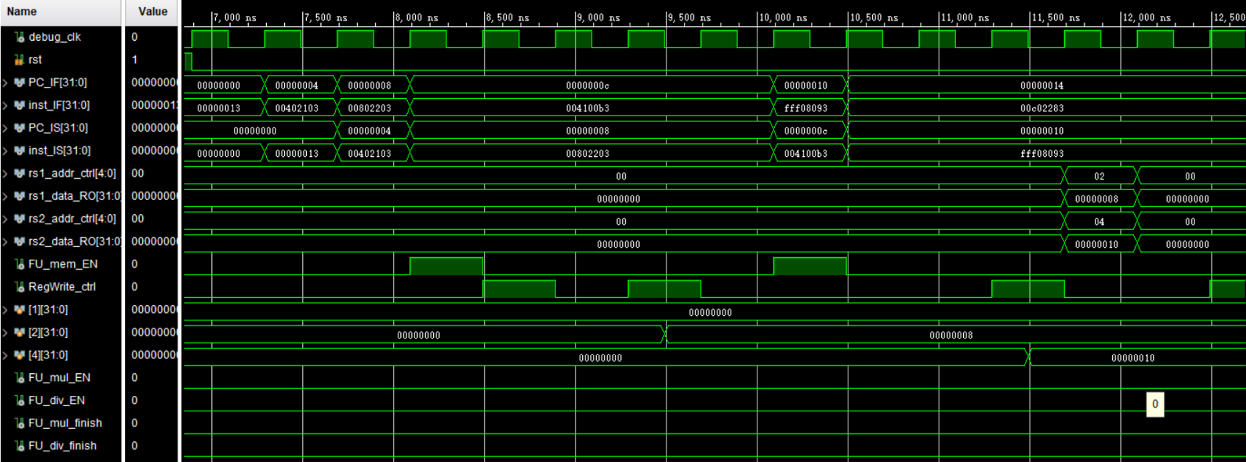
Simulation

Slide 26
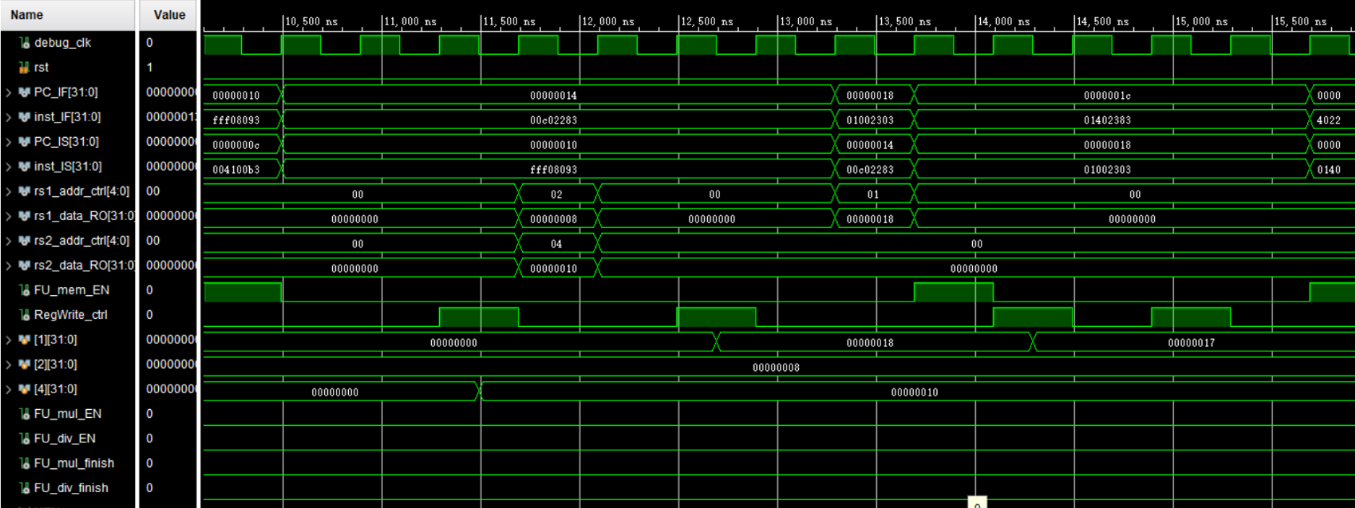
Simulation

Slide 27
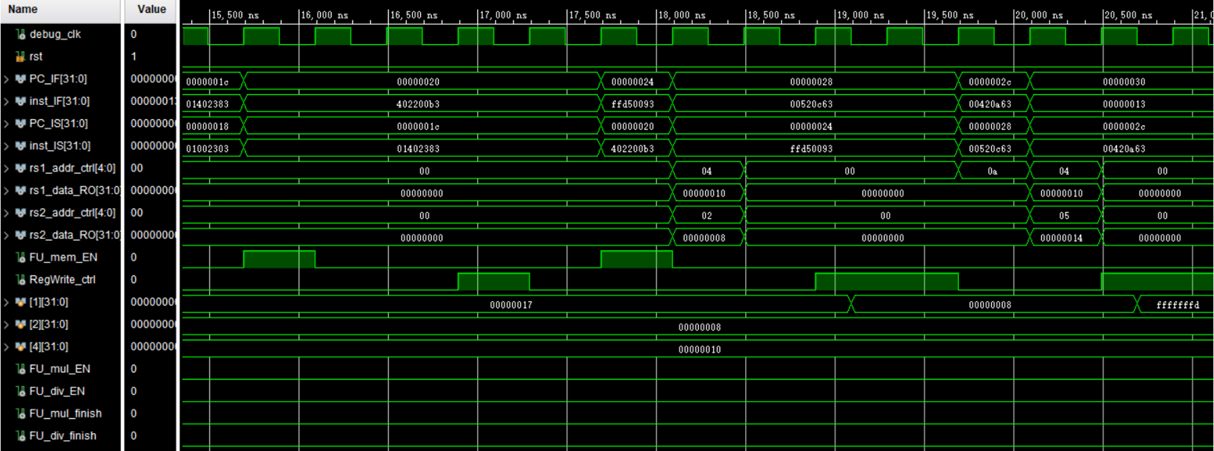
Simulation

Slide 28
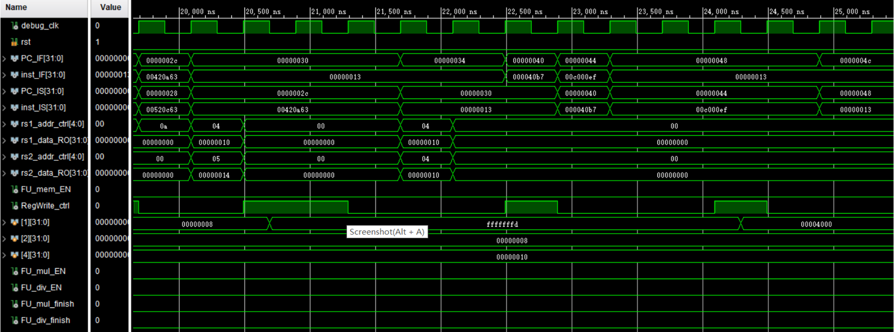
Simulation

Slide 29
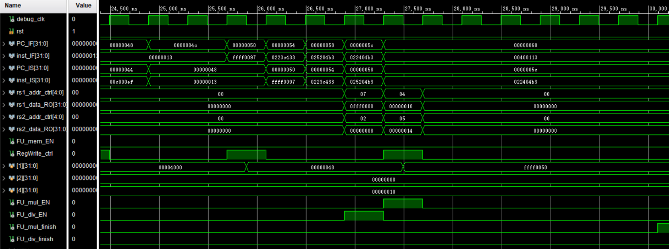
Simulation

Slide 30
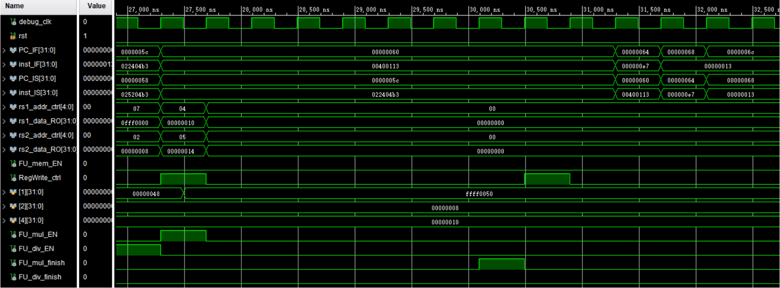
Simulation

Slide 31
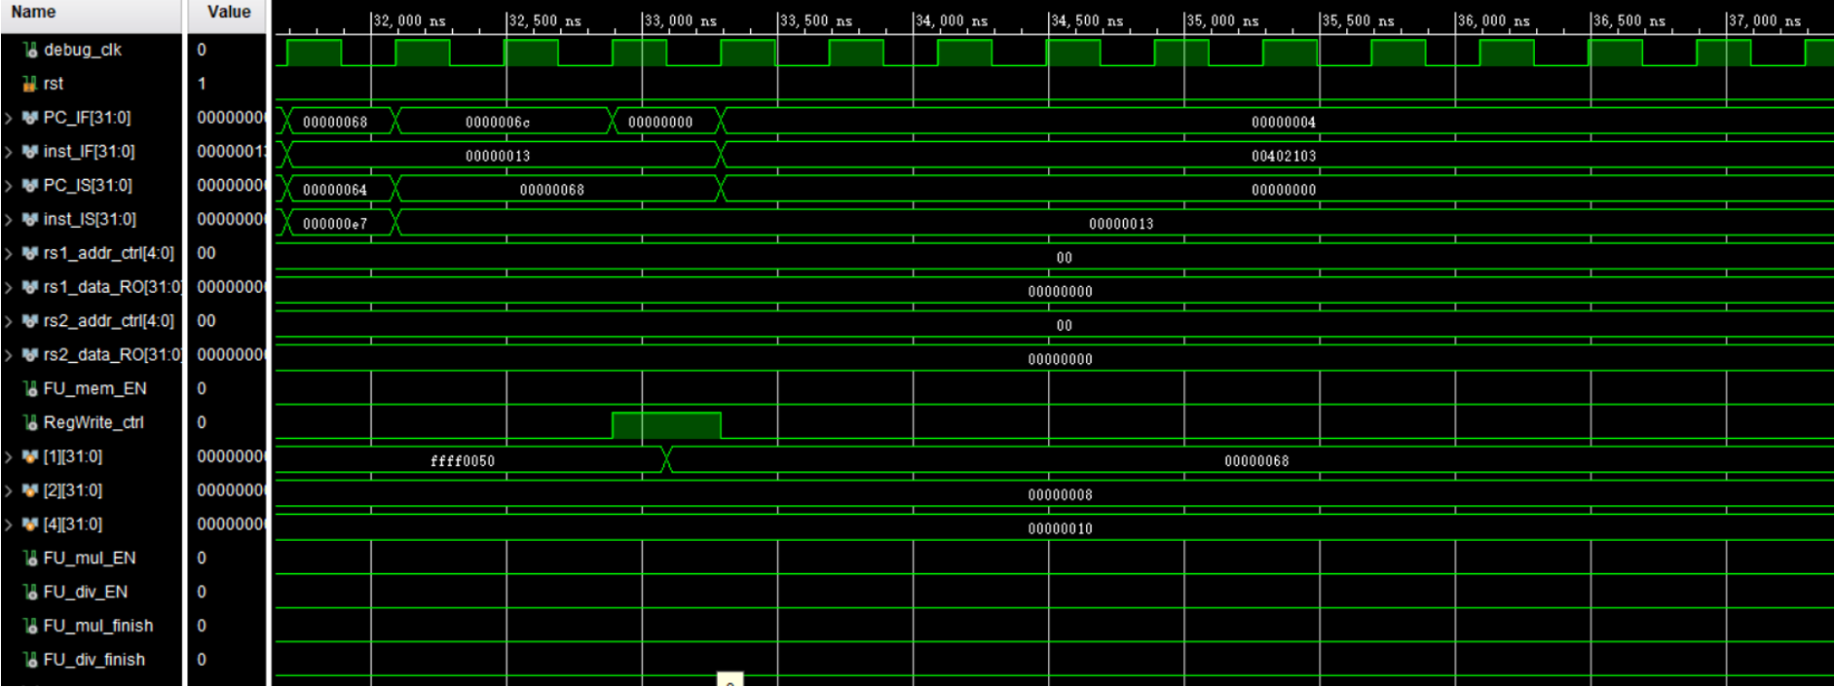
Simulation

Slide 32
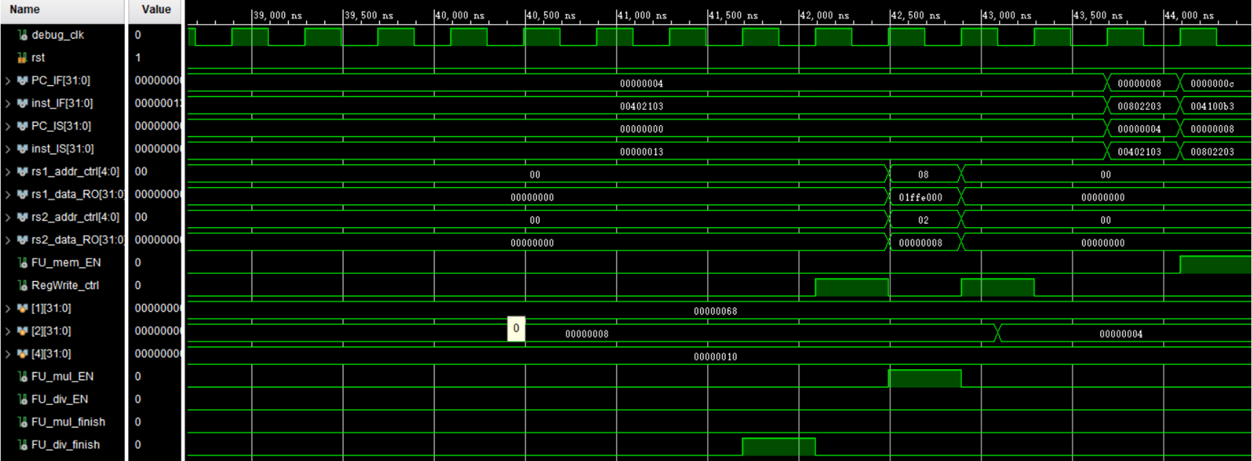
Simulation

Slide 33
References
https://dl.acm.org/doi/pdf/10.1145/3369383
https://zhuanlan.zhihu.com/p/496078836
https://jasonren0403.github.io/scoreboard/

