Slide 1

Computer Architecture ----A Quantitative Approach
陈文智
浙江大学计算机学院
chenwz@zju.edu.cn

Slide 2
Computer Architecture
Chapter 5 Memory - Hierarchy Design
5.1 Introduction
5.2 Review of the ABCs of Caches
5.3 Cache Performance
5.4 Reducing Cache Miss Penalty
5.5 Reducing Miss Rate
5.6 Reducing Cache Miss Penalty or Miss Rate via Parallelism
5.7 Reducing Hit Time
5.8 Main Memory and Organizations for Improving Performance
5.9 Memory Technology
2

Slide 3
5.1 Introduction
Processor-Memory Performance Gap
Memory
C
a
c
h
e
Memory bus
CPU
I/O bus
I/O devices
Registers
Disk
Memory
reference
Register
reference
Cache
reference
Memory
reference
Size: 500B 64KB 512MB 100GB
Speed: 0.25ns 1ns 100ns 5ms
Notes:
Y-axis is performance
X-axis is time
Latency
Cliché:
Not e that x86 didn’t have cache on chip until 1989

Slide 4
Who Cares About the Memory Hierarchy?
CPU-DRAM Gap
1000
µProc
60%/yr.
CPU
“Moore’s Law”
100
Processor-Memory
Performance Gap: (grows 50% / year)
Performance
10
“Less’ Law?”
DRAM
7%/yr.
DRAM
1
1980
1986
1981
1982
1983
1984
1985
1987
1988
1989
1990
1991
1992
1993
1994
1995
1996
1997
1998
1999
2000
1980: no cache in µproc; 1995 2-level cache on chip (1989 first Intel µproc with a cache on chip)
Notes:
Y-axis is performance
X-axis is time
Latency
Cliché:
Not e that x86 didn’t have cache on chip until 1989

Slide 5
Three classes of computers With different concerns in memory hierarchy
Desktop computers:
Are primarily running one application for single user
Are concerned more with average latency from the memory hierarchy.
Server computers:
May typically have hundreds of users running potentially dozens of applications simultaneously.
Are concerned about memory bandwidth.
Embedded computers:
Real-time applications.
Worst-case performance vs Best case performance
Are concerned more about power and battery life.
Hardware vs software
Running single app & use simple OS
The protection role of the memory hierarchy is often diminished.
Main memory is very small
often no disk storage
Notes:
1st generation
Latency 1/2
but Clock rate 3X and IPC is 3X
Now move to other 1/2 of industry

Slide 6
Enhance speed of memory
Component character of hardware:
Smaller hardware is faster and more expensive
Bigger memories are lower and cheaper
The goal:
There are speed of smallest memory and capacity of biggest memory
To provide cost almost as low as the cheapest level of memory and speed almost as fast as the fastest level.
Notes:
1st generation
Latency 1/2
but Clock rate 3X and IPC is 3X
Now move to other 1/2 of industry

Slide 7
The method enhance speed of memory
By taking advantage of the principle of locality:
most programs do not access all code or data uniformly
Temporal Locality (Locality in Time):
If an item is referenced, the same item will tend to be referenced again soon
Keep most recently accessed data items closer to the processor
Spatial Locality (Locality in Space):
If an item is referenced, nearby items will tend to be referenced soon
Move recently accessed groups of contiguous words(block) closer to processor.
The method
Hierarchies bases on memories of different speeds and size
The more closely CPU the level is, the faster the one is.
The more closely CPU the level is, the smaller the one is.
The more closely CPU the level is, the more expensive one is.
Notes:
1st generation
Latency 1/2
but Clock rate 3X and IPC is 3X
Now move to other 1/2 of industry

Slide 8
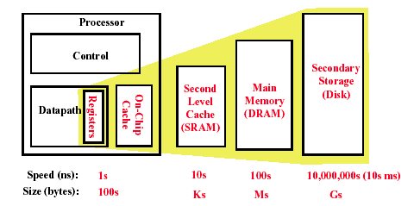
Memory Hierarchy of a Modern Computer System
By taking advantage of the principle of locality:
. Present the user with as much memory as is available in the cheapest technology.
. Provide access at the speed offered by the fastest technology.
Notes:
1st generation
Latency 1/2
but Clock rate 3X and IPC is 3X
Now move to other 1/2 of industry

Slide 9
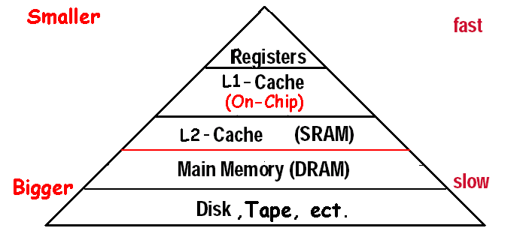
What is a cache?
Small, fast storage used to improve average access time to slow memory.
In computer architecture, almost everything is a cache!
Registers “a cache” on variables – software managed
First-level cache a cache on second-level cache
Second-level cache a cache on memory
Memory a cache on disk (virtual memory)
TLB a cache on page table
Branch-prediction a cache on prediction information?

Slide 10
5.2 Review of the ABCs of Caches
36 terms of Cache
Cache | full associative | write allocate
Virtual memory | dirty bit | unified cache
Memory stall cycles | block | block offset
misses per instruction | direct mapped | write back
Valid bit | data cache | locality
Block address | hit time | address trace
Write through | cache miss | set
Instruction cache | page fault | miss rate
random replacememt | index field | cache hit
Average memory access time | page | tag field
n-way set associative | no-write allocate | miss penalty
Least-recently used | write buffer | write stall

Slide 11
Four Questions for Memory Hierarchy Designers
Caching is a general concept used in processors, operating systems, file systems, and applications.
There are Four Questions for Memory Hierarchy Designers
Q1: Where can a block be placed in the upper level? (Block placement)
Fully Associative, Set Associative, Direct Mapped
Q2: How is a block found if it is in the upper level? (Block identification)
Tag/Block
Q3: Which block should be replaced on a miss? (Block replacement)
Random, LRU,FIFO
Q4: What happens on a write? (Write strategy)
Write Back or Write Through (with Write Buffer)

Slide 12
Q1: Block Placement
Direct mapped
Block can only go in one place in the cache
Usually address MOD Number of blocks in cache
Fully associative
Block can go anywhere in cache.
Set associative
Block can go in one of a set of places in the cache.
A set is a group of blocks in the cache.
Block address MOD Number of sets in the cache
If sets have n blocks, the cache is said to be n-way set associative.
Note that direct mapped is the same as 1-way set associative, and fully associative is m-way set-associative (for a cache with m blocks).

Slide 13
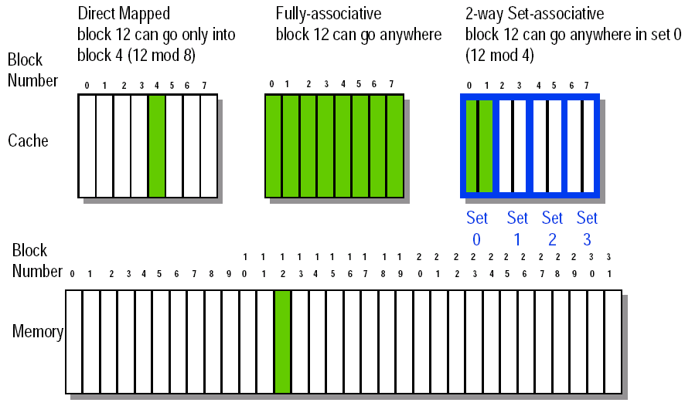
Figure5.4 8-32 Block Placement

Slide 14
Q2: Block Identification
Every block has an address tag that stores the main memory address of the data stored in the block.
When checking the cache, the processor will compare the requested memory address to the cache tag -- if the two are equal, then there is a cache hit and the data is present in the cache
Often, each cache block also has a valid bit that tells if the contents of the cache block are valid

Slide 15
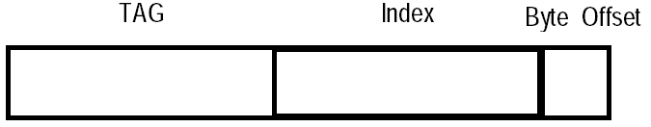
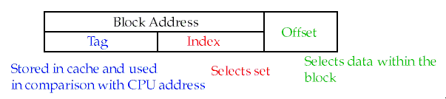
The Format of the Physical Address
The Index field selects
The set, in case of a set-associative cache
The block, in case of a direct-mapped cache
Has as many bits as log2(#sets) for set-associative caches, or log2(#blocks) for direct-mapped caches
The Byte Offset field selects
The byte within the block
Has as many bits as log2(size of block)
The Tag is used to find the matching block within a set or in the cache
Has as many bits as Address_size – Index_size – Byte_Offset_Size

Slide 16
The Format of the Physical Address
The Index field selects
The set, in case of a set-associative cache
The block, in case of a direct-mapped cache
Has as many bits as log2(#sets) for set-associative caches, or log2(#blocks) for direct-mapped caches
The Byte Offset field selects
The byte within the block
Has as many bits as log2(size of block)
The Tag is used to find the matching block within a set or in the cache
Has as many bits as Address_size – Index_size – Byte_Offset_Size

Slide 17
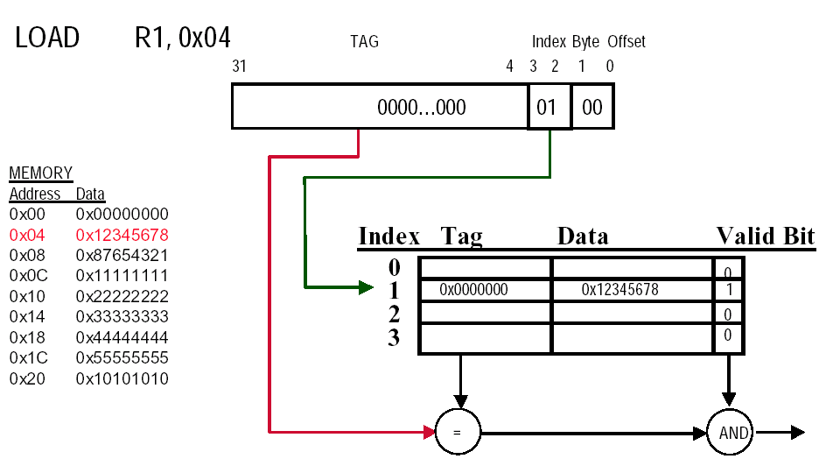
Direct-mapped Cache Example (1-word Blocks)

Slide 18
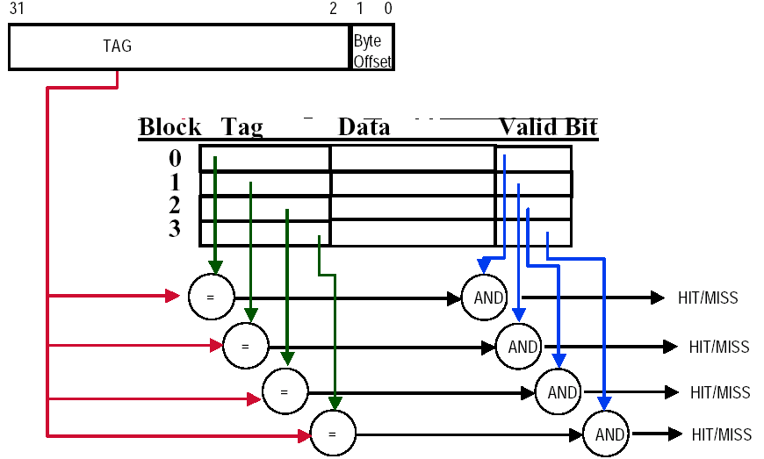
Fully-Associative Cache example (1-word Blocks)
Assume cache has 4 blocks

Slide 19
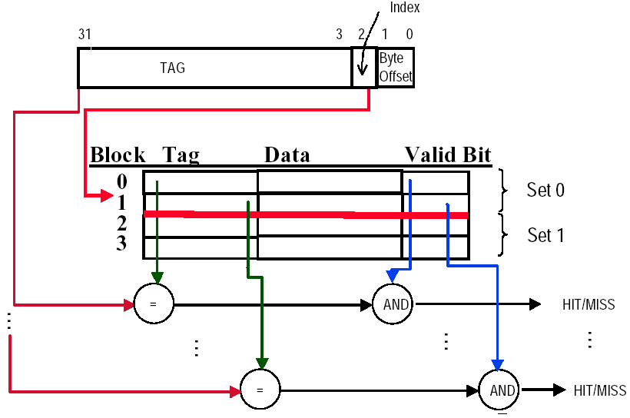
2-Way Set-Associative Cache
Assume cache has 4 blocks and each block is 1 word
2 blocks per set, hence 2 sets per cache

Slide 20
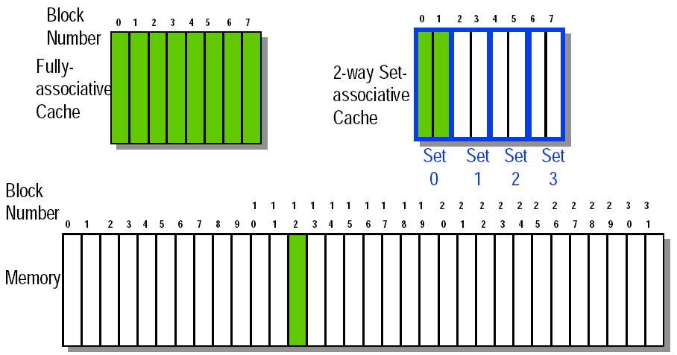
Q3: Block Replacement
In a direct-mapped cache, there is only one block that can be replaced
In set-associative and fully-associative caches, there are N blocks (where N is the degree of associativity

Slide 21
Strategy of block Replacement
Several different replacement policies can be used
Random replacement - randomly pick any block
Easy to implement in hardware, just requires a random number generator
Spreads allocation uniformly across cache
May evict a block that is about to be accessed
Least-recently used (LRU) - pick the block in the set which was least recently accessed
Assumed more recently accessed blocks more likely to be referenced again
This requires extra bits in the cache to keep track of accesses.
First in,first out(FIFO)-Choose a block from the set which was first came into the cache

Slide 22
Q4: Write Strategy
When data is written into the cache (on a store), is the data also written to main memory?
If the data is written to memory, the cache is called a write-through cache
Can always discard cached data - most up-to-date data is in memory
Cache control bit: only a valid bit
memory (or other processors) always have latest data
If the data is NOT written to memory, the cache is called a write-back cache
Can’t just discard cached data - may have to write it back to memory
Cache control bits: both valid and dirty bits
much lower bandwidth, since data often overwritten multiple times
Write-through adv: Read misses don't result in writes, memory hierarchy is consistent and it is simple to implement.
Write back adv: Writes occur at speed of cache and main memory bandwidth is smaller when multiple writes occur to the same block.

Slide 23
Write stall
Write stall ---When the CPU must wait for writes to complete during write through
Write buffers
A small cache that can hold a few values waiting to go to main memory.
To avoid stalling on writes, many CPUs use a write buffer.
This buffer helps when writes are clustered.
It does not entirely eliminate stalls since it is possible for the buffer to fill if the burst is larger than the buffer.

Slide 24
Write buffers
CPU
in out
Write Buffer
write
buffer
DRAM
(or lower mem)

Slide 25
Write misses
Write misses
If a miss occurs on a write (the block is not present), there are two options.
Write allocate
The block is loaded into the cache on a miss before anything else occurs.
Write around (no write allocate)
The block is only written to main memory
It is not stored in the cache.
In general, write-back caches use write-allocate , and write-through caches use write-around .

Slide 26
Example
Assume a fully associative write-back cache with many cache entries that starts empty. Below is a sequence of five memory operations(the address is in square brackets):
1 write Mem[100];
2 write Mem[100];
3 Read Mem[200];
4 write Mem[200];
5 write Mem[100];
What are the number of hits and misses when using no-write allocate versus write allocate?
Answer :
for no-write allocate misses: 1,2,3,5
hit: 4
for write allocate misses: 1,3
hit: 2,4,5

Slide 27
Split vs. unified caches
Unified cache
All memory requests go through a single cache.
This requires less hardware, but also has lower performance
Split I & D cache
A separate cache is used for instructions and data.
This uses additional hardware, though there are some simplifications (the I cache is read-only).
Proc
Proc
Unified
Cache-1
I-Cache-1
Proc
D-Cache-1
Unified
Cache-2
Unified
Cache-2

Slide 28
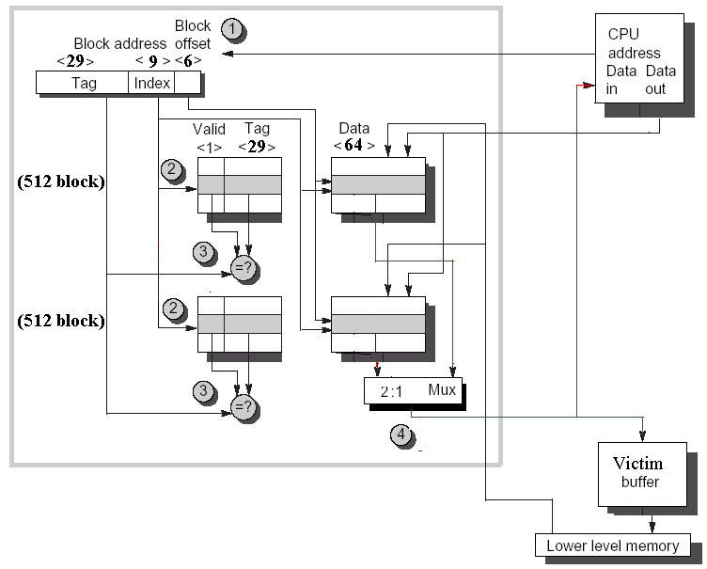
An example :the Alpha 21264 data cache

Slide 29
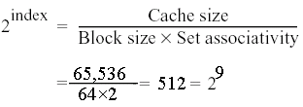
An example :the Alpha 21264 data cache
Step1 Cache is divided into 2 fields: the 38 bit block address and the 6-bit block offset(64=2⁶and 38+6=44).
Step2 Index selection ,Be reading the two tags from cache.
Step4 If one tag does match, CPU loads the proper data from the cache, else from main memory.
The 21264 allows 3 clock cycles for these four steps, so the instructions in the following 2 clock cycles would wait if they tried to use the result of the load.
Step3 the two tags are compared and the winner is selected. Tag contains valid bit, else the results of the comparison are ignored.

Slide 30
5.3 Cache performance
Memory System Performance
CPU Execution time
CPU Execution time = (CPU clock cycles + Memory stall cycles)×Clock cycle time
CPI_{Execution} includes ALU and Memory instructions

Slide 31
Average Memory Access Time
Average Memory Access Time
Whole accesses time
Average Memory Access Time＝
All memory accesses in program
Accesses time on hitting+ Accesses time on miss
＝
All memory accesses in program
＝ Hit time + (Miss Rate × Miss Penalty)

Slide 32
Example1: Impact on Performance
Suppose a processor executes at
Clock Rate = 200 MHz (5 ns per cycle), Ideal (no misses) CPI = 1.1
50% arith/logic, 30% ld/st, 20% control
Suppose that 10% of memory operations get 50 cycle miss penalty
Suppose that 1% of instructions get same miss penalty
What is the CPUtime and the AMAT ?
Answer:CPI = ideal CPI + average stalls per instruction = 1.1(cycles/ins) + [ 0.30 (DataMops/ins) x 0.10 (miss/DataMop) x 50 (cycle/miss)] + [ 1 (InstMop/ins) x 0.01 (miss/InstMop) x 50 (cycle/miss)] = (1.1 + 1.5 + .5) cycle/ins = 3.1
AMAT=(1/1.3)x[1+0.01x50]+(0.3/1.3)x[1+0.1x50]=2.54

Slide 33
Example2: Impact on Performance
Assume (p395): Ideal CPI=1 (no misses)
L/S’s structure . 50% of instructions are data accesses
Miss penalty is 25 clock cycles
Miss rate is 2%
How faster would the computer be if all instructions were cache hits?
Answer: first compute the performance for always hits:
CPU_{execution time} =(CPU clock cycles+memory stall cycles)×clock cycle
=(IC ×CPI+0) ×Clock cycle
=IC ×1.0 ×clock cycle
Now for the computer with the real cache,first compute memory stall cycles:

Slide 34
Example2: Impact on Performance
The total performance is thus:
CPU execution time cache =(IC ×1.0+IC ×0.75) ×Clock cycle
=1.75 ×IC ×Clock cycle
The performance ratio is the inverse of the execution times
CPU execution time _{cache} 1.75 ×IC ×Clock cycle
CPU execution time 1.0 × IC ×clock cycle
＝1.75
The computer with no cache misses is 1.75 time faster.

Slide 35
Example3-1: Impact on Performance
Assume(406) : unified caches: 32K unified cache
Split cache: 16K D-cache and 16K I-cache
36% of the instructions are data transfer instructions
A hit takes 1 colck cycle
The miss penalty is 100 clock cycles
A load/store take 1 extra clock cycle on a unified cache
Write-through with a write-buffer
and ignore stalls due to the write buffer
What is the miss rate in each case?
What is the average memory access time in each case?
Answer : first let’s convert misses per 1000 instructions into miss rate.
From Figure 5.8 The unified miss rate needs to account for instruction and data accesses:
Misses
43.3/1000
1000Instruction
/1000
Miss rate _{32KB unified}＝
＝0.0318
Miss rate=
1.00+0.36
Memoryaccesses
Instructions

Slide 36
Example3-1: Impact on Performance
Since every instruction access has exactly one memory access to fetch the instruction, according to Figure 5.8 the instruction cache miss rate is
Since 36% of the instructions are data transfers, according to Figure 5.8 the data miss rate is
3.82/1000
Miss rate _{16KB instruction}＝
＝0.004
1.0
40.9/1000
Miss rate _{16KB data}＝
＝0.114
0.36
Basing on Figure 2.32 on page 138 there is 74% instruction references in split cache. The average miss rate for the split cache is:
(74%×0.004)+(26% × 0.114)=0.0324
Thus ,a 32KB unified cache has a slightly lower effective miss rate than two 16KB caches.
Misses
1000Instruction
/1000
Miss rate=
Memoryaccesses
Instructions

Slide 37
Example3-2: Impact on Performance
The average memory access time can be divided into instruction and data accesses:
Therefore,the time for each organization is
Average memory access time_{split}
=74%×(1+0.004×100)+ 26%×(1+0.114×100)
=(74%×1.38)+(26%×12.36)=1.023+3.214=4.24
Hence, this split cache in this example—which offer two memory ports per clock cycle, thereby avoiding the structural hazard—have a better average memory access time than the single-ported unified cache despite having a worse effective miss rate.
Average memory access time_{unified}
=74%×(1+0.0318×100)+ 26%×(1+1+0.0318×100)
=(74%×4.18)+(26%×5.18)=3.096+1.348=4.44

Slide 38
Example4: Impact on Performance
Assume(408): in-order execution computer, such as the Ultra SPARC Ⅲ.
Miss penalty: 100 clock cycles
Miss rate : 2%
Memory references Per instruction: 1.5
Average cache misses per 1000 instructions: 30
CPI ＝1.0(ignoring memory stalls)
What is the impact on performance when behavior of the cache is included (Calclate the impact using both misses per instruction and miss rate.)?
Answer : The performance, including cache misses, is

Slide 39
Example4: Impact on Performance
CPU time _{with cache} ＝
＝IC×(1.0+(30/1000×100)) × Clock cycle time
＝IC × 4.00 × Clock cycle time
Now caculating performance using miss rate:
CPU time _{with cache} ＝
＝IC×(1.0+(1.5×2%×100)) × Clock cycle time
＝IC × 4.00 × Clock cycle time
The clock cycles time and instruction count are the same, with or without a cache. Thus, CPU time increases fourfold, with CPI from 1.00 a “perfect cache” to 4.00 with a cache that can miss.
Without any memory hierarchy at all the CPI would increase again to 1.0+100×1.5 or 151—factor of almost 40 time longer than a system with a cache.

Slide 40
Example5: Impact on Performance
Assume(p409): CPI=2(perfect cache) clock cycle time＝1.0 ns
MPI(memory reference per instruction)＝1.5
Size of both caches is 64K and size of both block is 64 bytes
One cache is direct mapped and other is two-way set associative. the former has miss rate of 1.4%, the latter has miss rate 1.0%
The selection multiplexor forces CPU clock cycle time to be stretched 1.25 times
Miss penalty is 75ns,and hit time is 1 clock cycle
What is the impact of two diffect cache organizations on performance of CPU (first,calculate the average memory access time and then CPU performance.)?
Answer : Average memory access time is
Average memory access time＝Hit time+Miss rate×miss penalty
Thus, the time for each organization is
Average memory access time_{1-way}＝1.0+(0.014 ×75)＝2.05 ns
Average memory access time_{2-way}＝1.0×1.25 +(0.01 ×75)＝2.00 ns

Slide 41
Example5: Impact on Performance
The average memory access time is better for the 2-way set-associative cache.
CPU performance is
Substituting 75 ns for (miss penalty×Clock cycle time), the performance of each cache organization is
CPU time_{1-way}＝IC×(2×1.0+(1.5 ×0.014 ×75))＝3.58 ×IC
CPU time_{2-way}＝IC×(2×1.0×1.25+(1.5 ×0.010 ×75))＝3.63 ×IC
Relative performance is
In contrast to the results of average memory access time, the direct-mapped lesds to slighly better average performance. Since CPU time is our bottom-line evaluation.

Slide 42
How to Improve
Hence, we organize 17 cache optimizations into four categories:
1.Reduce the miss penalty--5
——multilevel caches, critical word first, read miss before write miss, merging write buffers, and victim caches
2. Reduce the miss rate--5
——larger block size, large cache size, higher associativity, way prediction and pseudo associativity, and compiler optimizations
3. Reduce the miss penalty and miss rate via parallelism
——non-blocking caches, hardware prefetching, and compiler prefetching
4. Reduce the time to hit in the cache.--4
——small and simple caches, avoiding address translation, pipelined cache access, and trace caches

Slide 43
5.4 Reducing Cache miss penalty Be continued
1.Reduce the miss penalty ——5
2. Reduce the miss rate
3. Reduce the miss penalty and miss rate via parallelism
4. Reduce the time to hit in the cache.

Slide 44

THANK YOU
THANK YOU

