Slide 1
Appendix C Basic pipeline concepts and implementation

Slide 2
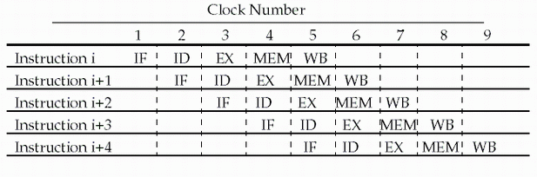
Pipelining RISC-V instruction set
Since there are five separate stages, we can have a pipeline in which one instruction is in each stage.
CPI is decreased to 1, since one instruction will be issued (or finished) each cycle.
During any cycle, one instruction is present in each stage.
Ideally, performance is increased five fold !

Slide 3
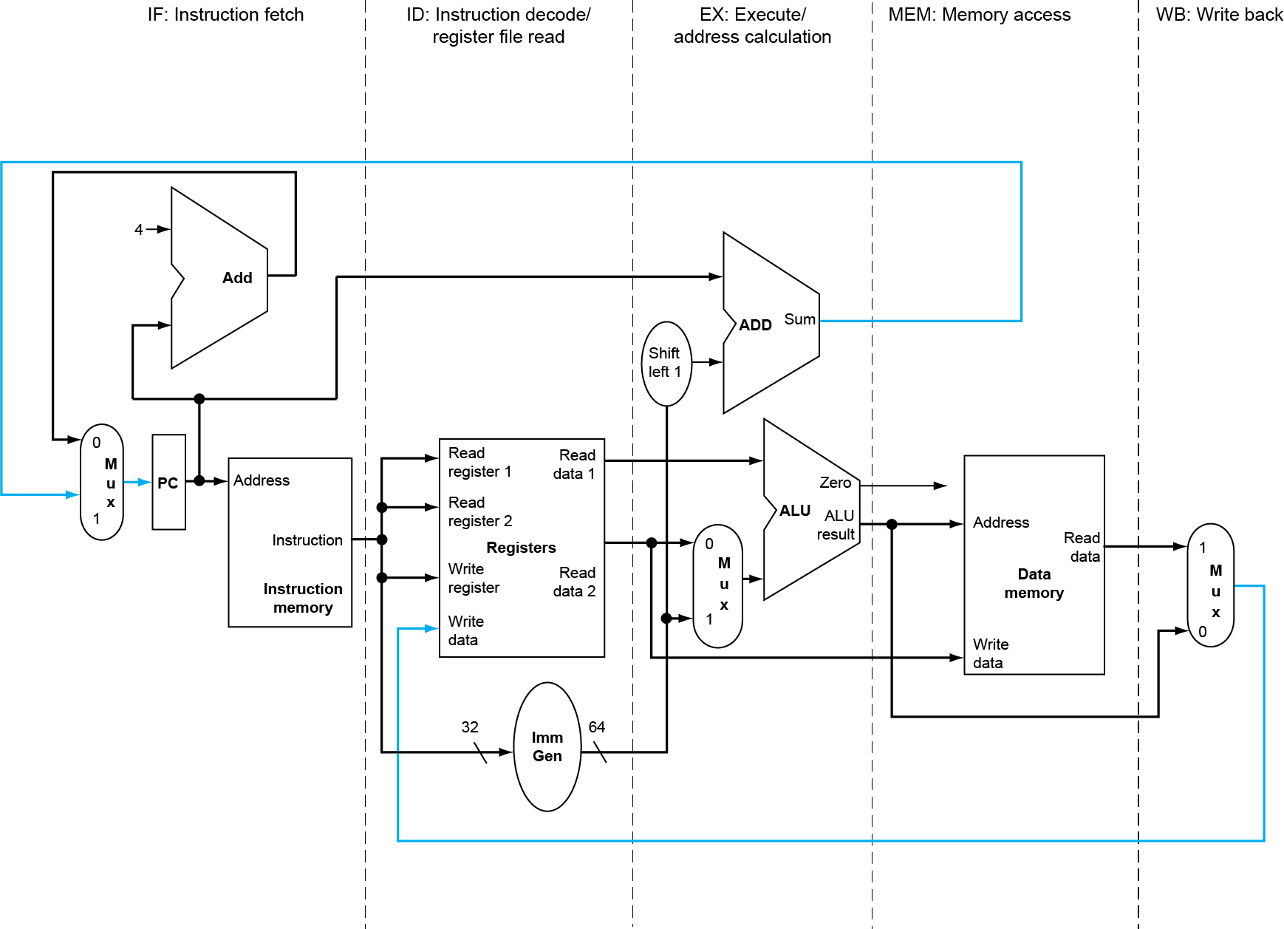
Pipelined Datapath and Control
MEM
Right-to-left flow leads to hazards
WB

Slide 4
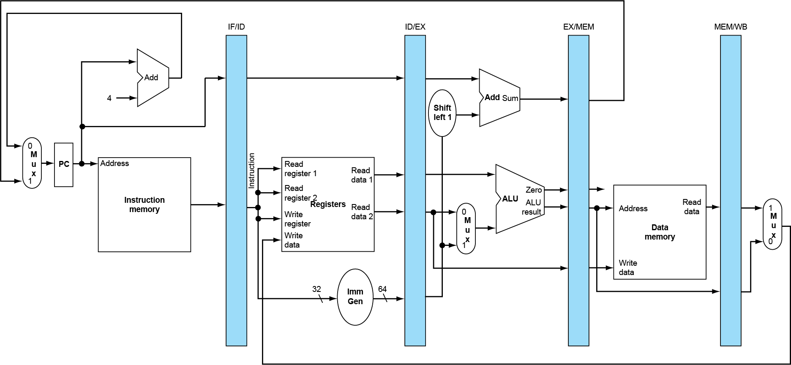
Five stage pipeline
Need registers (or latch) between stages
To hold information produced in previous cycle

Slide 5
Pipeline Hazards
Taxonomy of Hazards
Structural hazards
These are conflicts over hardware resources.
Data hazards
Instruction depends on result of prior computation which is not ready (computed or stored) yet
Control hazards
branch condition and the branch PC are not available in time to fetch an instruction on the next clock

Slide 6
How to solve the structural hazard
Multiple accesses to memory
Split instruction and data memory / multiple memory port / instruction buffer
Memory bandwidth need to be imporved by 5 folds.
Multiple accesses to the register file
Double bump
Not fully pipelined functional units
Fully pipeline the functional unit
Using multiple functional unites
Real machine often with structural hazards.

Slide 7
Summary of Structural hazard
Taxonomy of Hazards
Structural hazards
These are conflicts over hardware resources.
OK, maybe add extra hardware resources;
or full pipelined the functional units;
otherwise still have to stall
Allow machine with Structural hazard, since it happens not so often
Data hazards
Instruction depends on result of prior computation which is not ready (computed or stored) yet
Control hazards
branch condition and the branch PC are not available in time to fetch an instruction on the next clock

Slide 8
Data hazard
Data hazards occur when the pipeline changes the order of read/write accesses to operands (Violation of data dependence) ycomparing with that in sequential executing, .
Let’s see an Example
DADD R1, R1, R3
DSUB R4, R1, R5
AND R6, R1, R7
OR R8, R1, R9
XOR R10, R1, R11

Slide 9
Coping with data hazards:example

Slide 10
Data hazard
Basic structure
An instruction in flight wants to use a data value that’s not “done” yet
“Done” means “it’s been computed” and “it’s located where I would normally expect to go look in the pipe hardware to find it”
Basic cause
You are used to assuming a purely sequential model of instruction execution
Instruction N finishes before instruction N+k, for k >= 1
There are dependencies now between “nearby” instructions (“near” in sequential order of fetch from memory)
Consequence+
Data hazards -- instructions want data values that are not done yet, or not in the right place yet

Slide 11
Somecases “Double Bump” can do !

Slide 12
The simplest way to solve data hazard: stall
Proposed solution
Don’t let them overlap like this…?
Mechanics
Don’t let the instruction flow through the pipe
In particular, don’t let it WRITE any bits anywhere in the pipe hardware that represents REAL CPU state (e.g., register file, memory)
Let the instruction wait until the hazard resolved.
Name for this operation: PIPELINE STALL

Slide 13
How do we stall ? Insert nop by compiler
Bubble
Bubble
Bubble
Bubble
Bubble
Bubble
Bubble
Bubble
Bubble

Slide 14
How do we stall? Add hardware Interlock !
Add extra hardware to detect stall situations
Watches the instruction field bits
Looks for “read versus write” conflicts in particular pipe stages
Basically, a bunch of careful “case logic”
Add extra hardware to push bubbles thru pipe
Actually, relatively easy
Can just let the instruction you want to stall GO FORWARD through the pipe…
…but, TURN OFF the bits that allow any results to get written into the machine state
So, the instruction “executes” (it does the work), but doesn’t “save”

Slide 15
Interlock: insert stalls
Bubble
Bubble
Empty slots in the
pipe called bubbles;
means no real
instruction work
getting saved here
How the interlock is implementated ?

Slide 16
How the Interlock functions?
The Interlock can simulate the NOP:
Once it is detected need to add a stall, then
Clear the ID/EX.IR to be the instruction of NOP.
disable the write signal: “wreg, wmem”.
Keep IF/ID. IR unchanged for one more clock cycle.
Disable the write signal: “WritePC, WriteIR”.

Slide 17
How to Stall ? Add a stall control logic !
PC IF/ID ID/EX EX/MEM MEM/WB
M.Inst
D.Inst
E.Inst
F.Inst
Bubble
Bubble
Branch
Branch
Wreg
Wreg
Rd
Rd
Stall control logic
Rs
Rt
stall
To produce a stall signal. If stall ==1 then
Use stall to disable writing PC write and IF/ID latch.
Push a bubble into next stage.
Bubble = 1 and disable control signal Wreg and Wmem.
Puch a nop forward into ID/EX

Slide 18
How to stall (when data hazard )?
Are the stalls the same for
Data hazard / control hazard ?
If stall == 0 //stop the latter ones
then PC ← new PC; IF/ID.IR ← IF.IR
IF/ID.NPC ← PC + 4
If stall == 1 // push bubble forward
then ID/EX.nop ←1 else ID/EX.nop ←0
When initial
ID/EX.nop ←0, EX/MEM.nop ← 0, Mem.WB.nop ←0

Slide 19
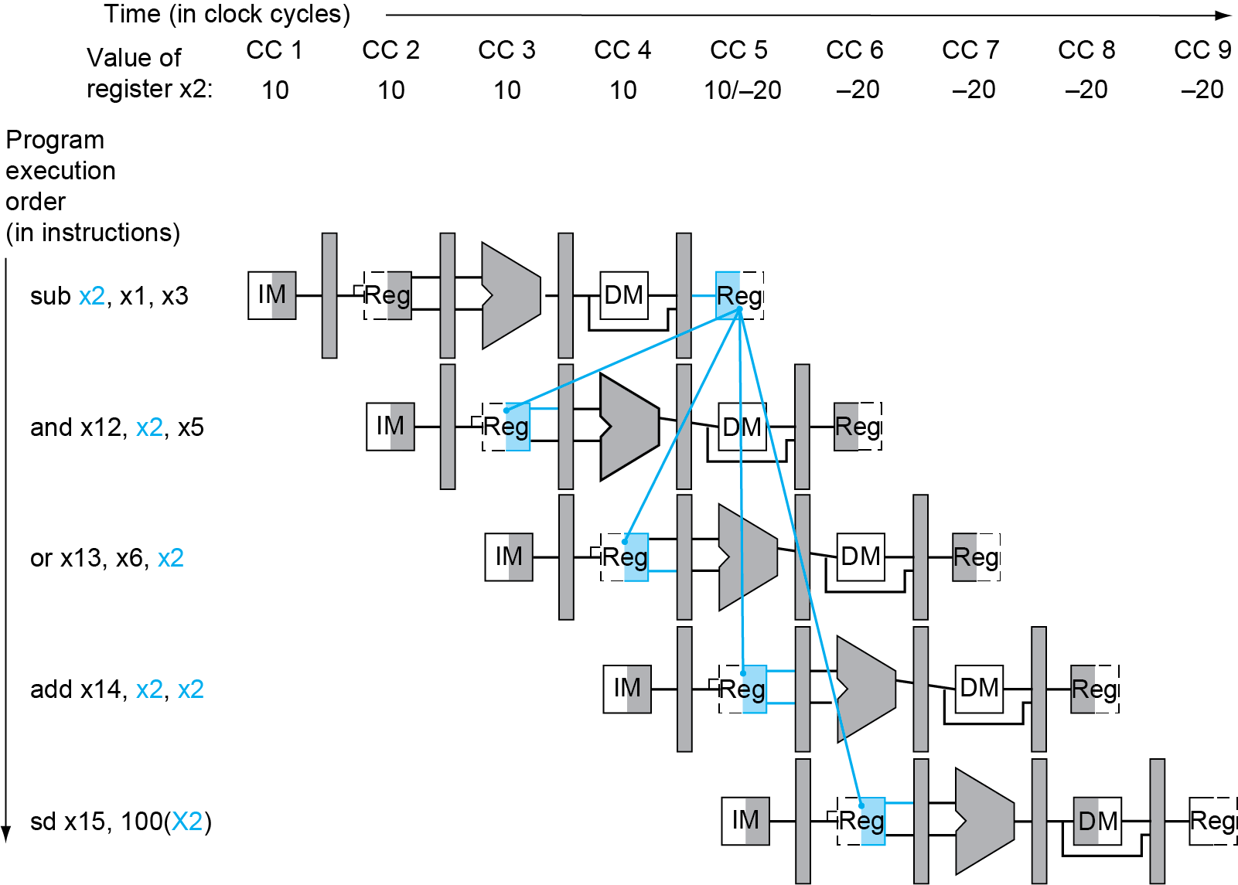
Solve the data hazard by Forwarding
Data Dependence
I2 RAW on I1
I3 RAW on I1
I4 RAW on I1
I5 RAW on I1
Data Hazard
I2 RAW hazard with I1
I3 RAW hazard with I1
RAW hazard，but no stall
using double bump
No RAW hazard

Slide 20
Hardware Change for Forwarding
NextPC
ID/EX
EX/MEM
MEM/WR
Registers
mux
ALU
Data
Memory
mux
mux
Immediate
Source → sink
EX/Mem.ALUoutput → ALU input
MEM/WB.ALUoutput → ALU input
MEM/WB.LMD → ALU input
When to use the red. Blue
purple forwording path ?

Slide 21
When to use the forwarding path ?
EX/Mem.ALUoutput → ALU input
The previous instruction in EX/MEM is ALU
The instruction in ID/EX has Rs1 or Rs2 source register
EX/MEM.Rd == ID/EX.Rs1 or EX/MEM.Rd ==ID/EX.Rs2
MEM/WB.ALUoutput → ALU input
The previous instruction in MEM/WB is ALU
The instruction in ID/EX has Rs1 or Rs2 source register
MEM/WB.Rd == ID/EX.Rs1 or MEM/WB.Rd == IF/ID.Rs2
MEM/WB.LMD → ALU input
The previous instruction in MEM/WB is Load
The instruction in ID/EX has Rs1 or Rs2 source register
MEM/WB.Rd == ID/EX.Rs1 or MEM/WB.Rd == ID/EX.Rs2

Slide 22
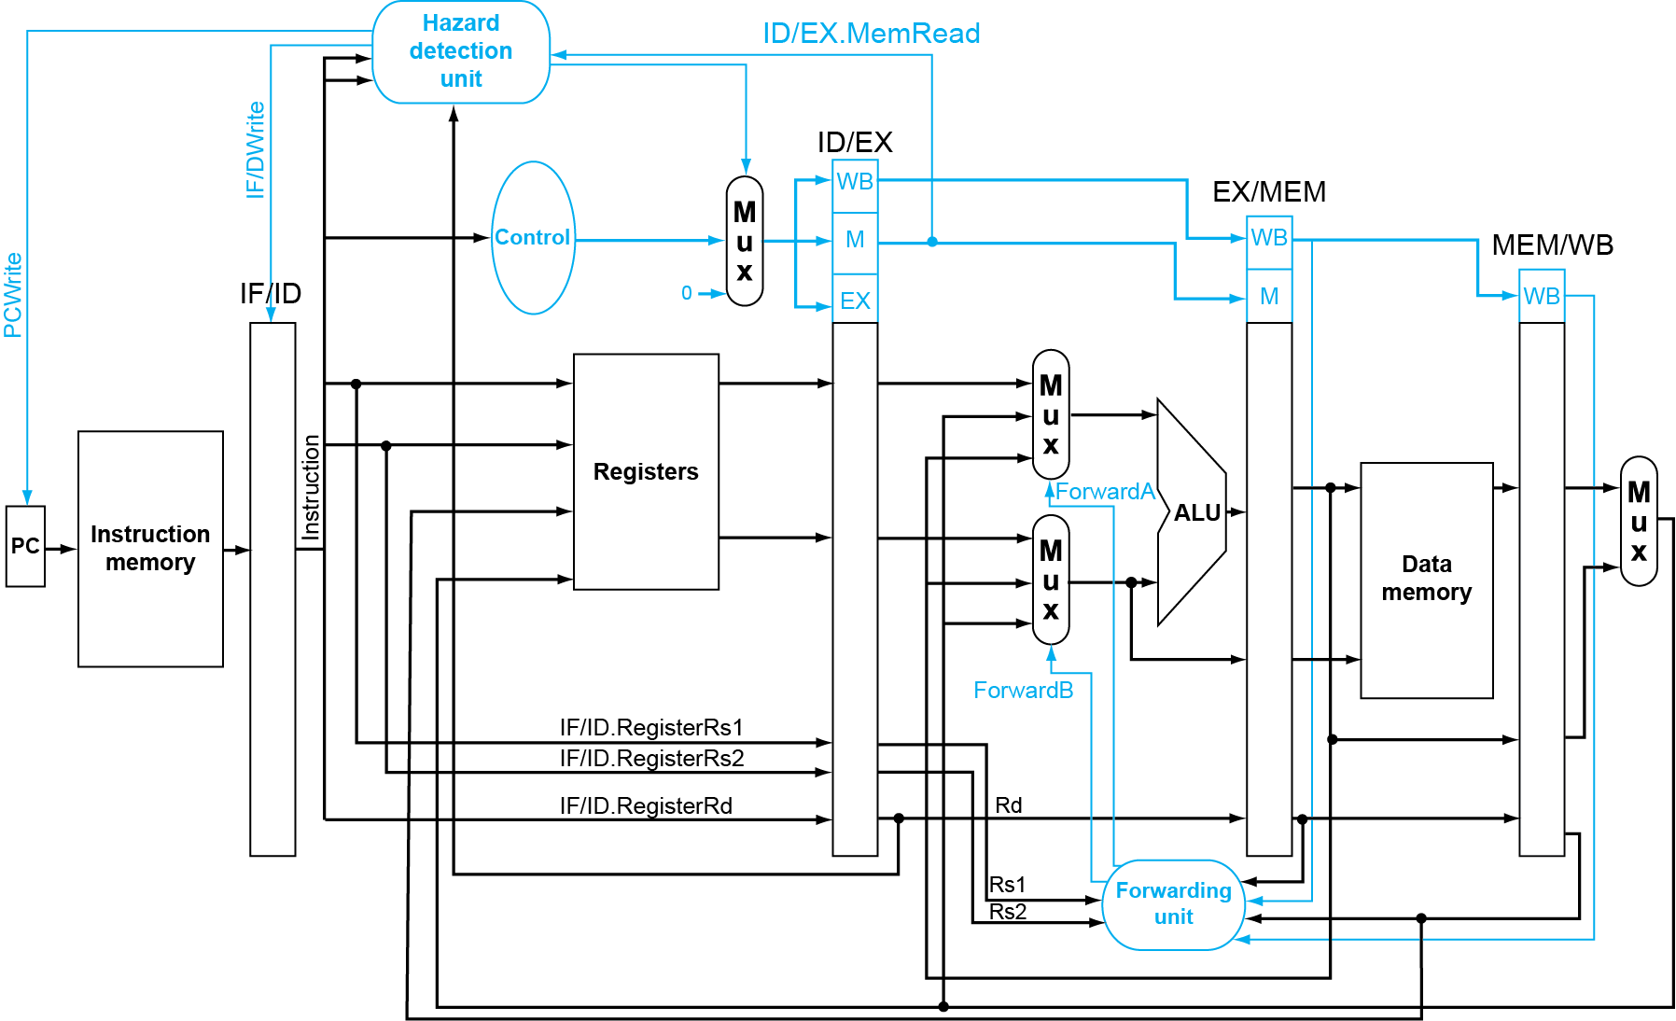
Forwarding at EX stage

Slide 23
Fowarding can only solve some problems
ADD x6, x28, x29
SUB x30, x6, x14
ADD x6, x28, x29
AND x14, x5, x7
SUB x30, x6, x14
/ LW x6, 4(x10)

Slide 24
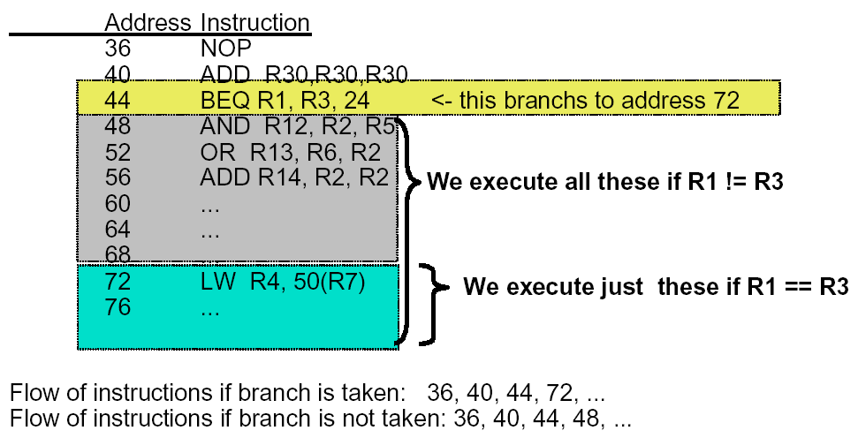
Control hazard Example: Branches
R3, 24

Slide 25
Recall: Basic Pipelined Datapath

Slide 26
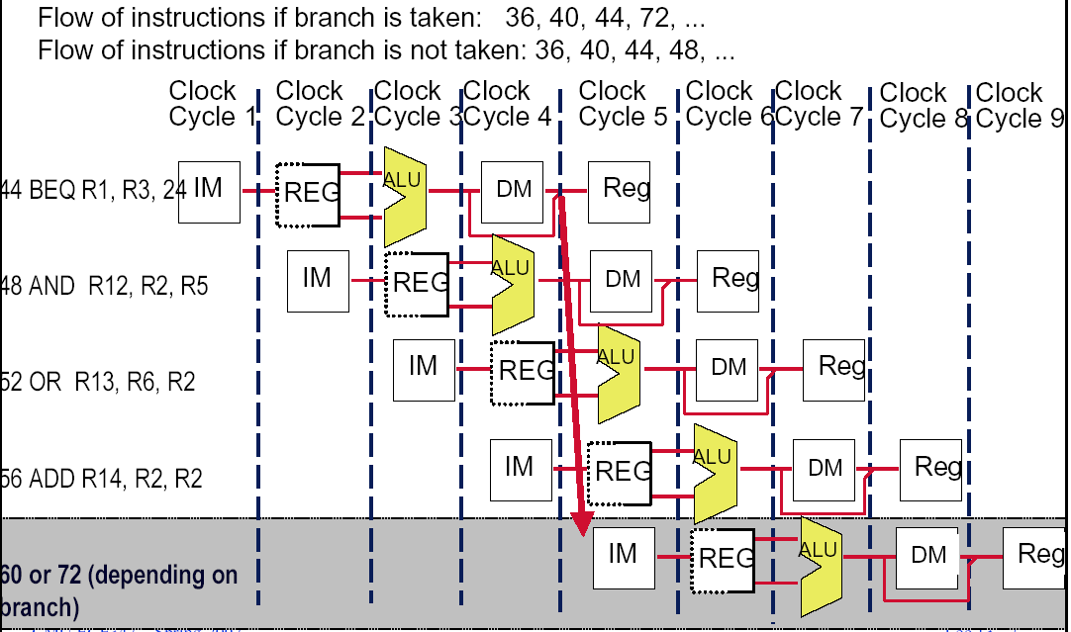
Control hazard

Slide 27
Dealing with the control hazard
Four simple solutions
Stall
Prediction
Predict-untaken: treat every branch as not taken
Predict-taken: treat every branch as taken
Delayed branch ( omit)
Note:
Fixed hardware
Compile time scheme using knowledge of hardware scheme and of branch behavior

Slide 28
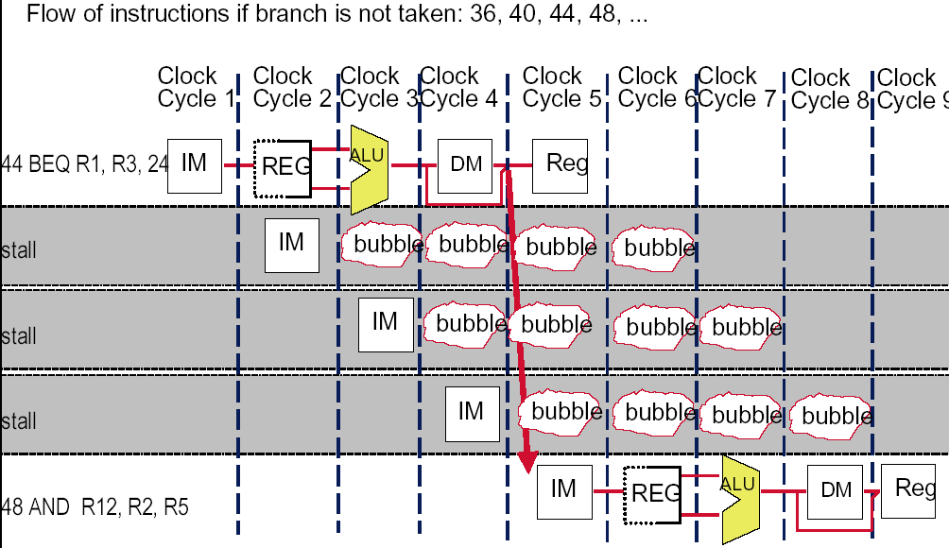
Recall: solve the hazard by inserting stalls
48 or 72
24

Slide 29
Flushing the pipeline
Simplest hardware:
Holding or deleting any instruction after branch until the branch destination is know.
Penalty is fixed.
Can not be reduced by software.
Implementation. Note difference with data hazard stall
Stop the later instruction: keep PC unchanged
Nop → IF/ID.IR clear the wrong instruction fetched
Nop → ID/EX.IR push a bubble forward

Slide 30
Stalls greatly hurt the performance
Problem:
With a 30% branch frequency and an ideal CPI of 1, how much the performace is by inserting stalls ?
Answer:
CPI = 1+30%×３＝1.9
this simple solution achieves only about half of the ideal performance.

Slide 31
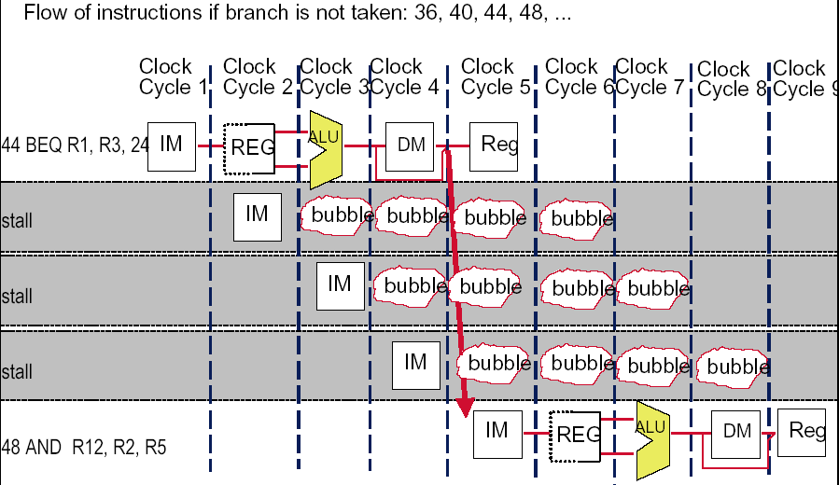
Always Stall Hurts the Not- taken case
24

Slide 32
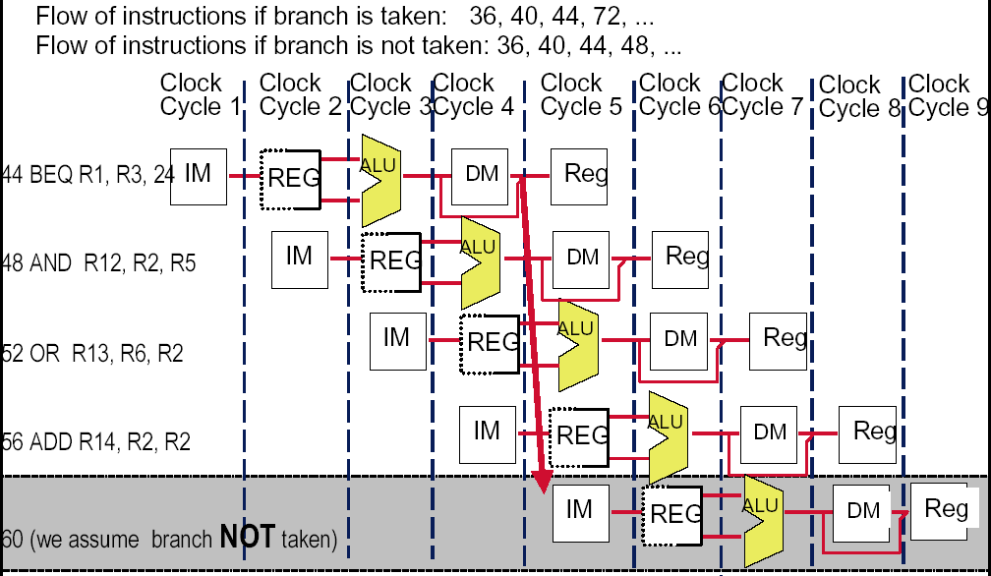
How about assume Branch Not Taken

Slide 33
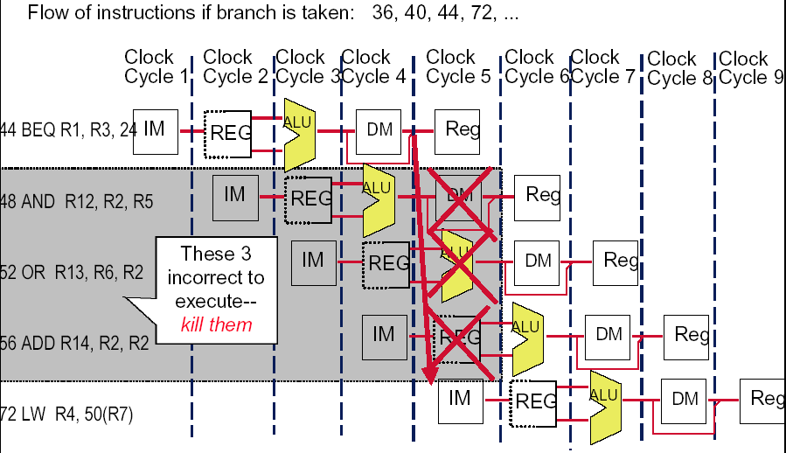
How to do with the branch taken ?
24

Slide 34
Predict –not-taken
Hardware:
Treat every branch as not taken (or as the formal instruction)
When branch is not taken, the fetched instruction just continues to flow on. No stall at all.
If the branch is taken, then restart the fetch at the branch target, which cause 3 stall.(should turn the fetched instruction into a no-op)
Perf = 1+ br% ( not taken% * 0 + take%* 3 )
Compiler:
Can improve the performance by coding the most frequent case in the untaken path.

Slide 35
Implementation of predict-not-taken
When the branch is not taken, run as the branch is an ALU.
When the branch is taken， then
Change the PC to the branch target ( turn to the right direction)
Kill the wrong instructions have been predicted to execute.
Nop→IF/ID
Nop→ID/EX
Nop→EX/MEM

Slide 36
Move the Branch Computation Forward

Slide 37
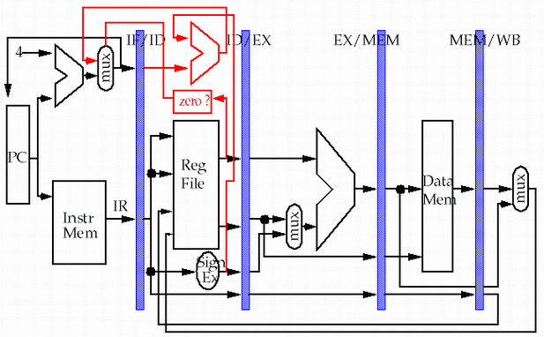
Move the Branch Computation more Forward
store
load

Slide 38
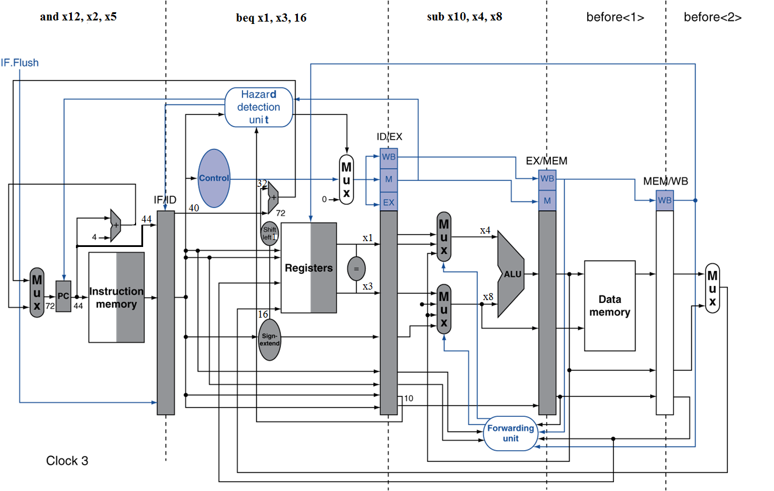
Example: Branch Taken

Slide 39
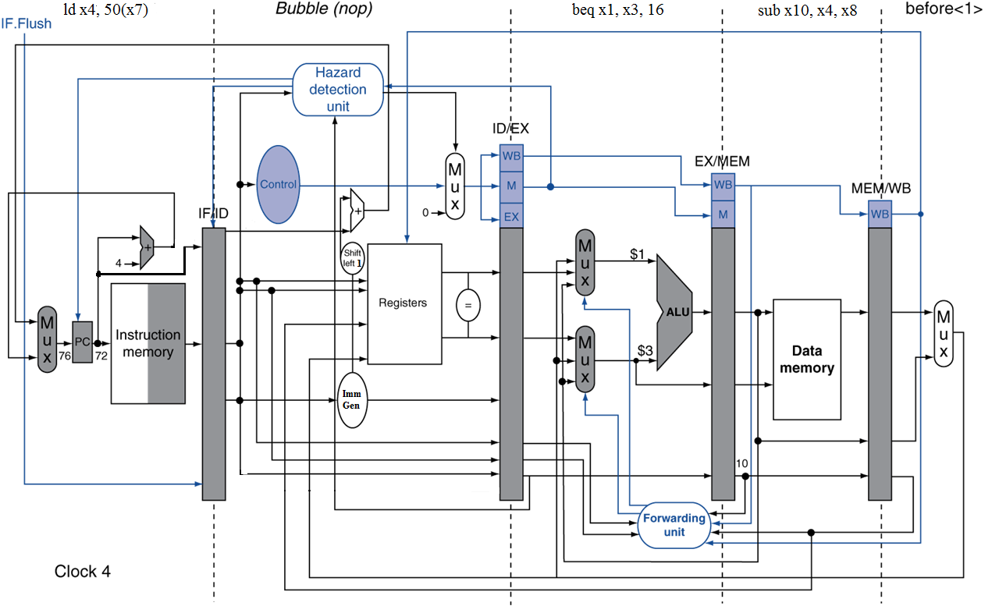
Example: Branch Taken
What’s the possible problem ?

Slide 40
Data Hazards for Branches
If a comparison register is a destination of preceding ALU instruction or 2nd preceding load instruction
Need 1 stall cycle
ld x1, addr
IF
ID
EX
MEM
WB
add x4, x5, x6
IF
ID
EX
MEM
WB
beq stalled
IF
ID
beq x1, x4, target
ID
EX
MEM
WB

Slide 41
Data Hazards for Branches
If a comparison register is a destination of immediately preceding load instruction
Need 2 stall cycles
ld x1, addr
IF
ID
EX
MEM
WB
beq stalled
IF
ID
beq stalled
ID
beq x1, x0, target
ID
EX
MEM
WB

Slide 42
Can the stalls on the previous page be reduced ?
Yes. Move the forwarding path from EX stage to ID stage.
though at the cost of Clock cycle time be increased.
Please note:
the positions of the sources /sinks of the forwarding paths.
Question: When the purple forwarding path will be needed ?

Slide 43
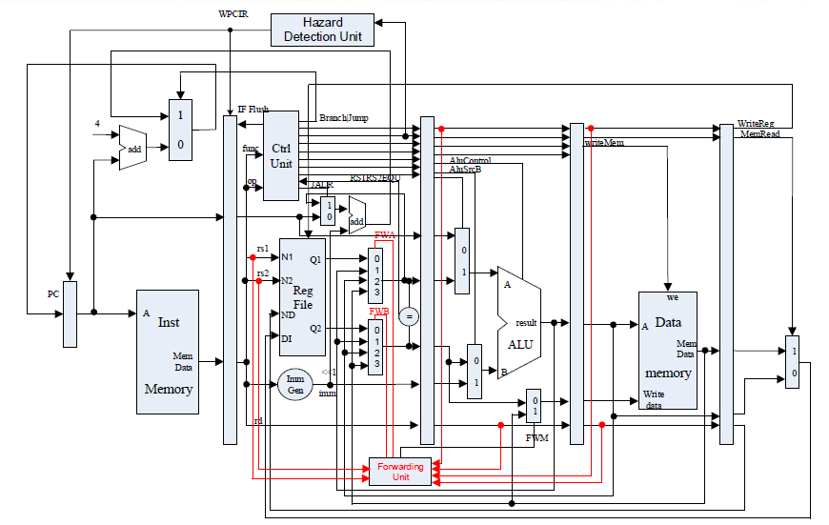
Fowarding paths in Lab1

