Slide 1
Ch2-2 How to improve the performance of Memory hierarchy

Slide 2
2.2 Memory Technology and Optimizations
Performance metrics
Latency is concern of cache
Bandwidth is concern of multiprocessors and I/O
Access time
Time between read request and when desired word arrives
Cycle time
Minimum time between unrelated requests to memory
SRAM memory has low latency, use for cache
Organize DRAM chips into many banks for high bandwidth, use for main memory

Slide 3
Memory Technology
SRAM
Requires low power to retain bit
Requires 6 transistors/bit
DRAM
Must be re-written after being read
Must also be periodically refeshed
Every ~ 8 ms (roughly 5% of time)
Each row can be refreshed simultaneously
One transistor/bit
Address lines are multiplexed:
Upper half of address: row access strobe (RAS)
Lower half of address: column access strobe (CAS)

Slide 4
DRAM logical organization (64 Mbit) 这个不大对,改成256
Data in
Column Decoder
D
14
…
Sense
Amps & I/O
Data out
Address buffer
Q
Memory
Array
(16,384×16,384)
A0…A1
3
Bit Line
…
Row Decoder
Storage
Cell
Word Line
Square root of bits per RAS/CAS
Notes:
64*2^20/8byte 2^22 byte
4byte一个word
应该是2^28bit 256Mbit
16384=2^14
先找到行地址，然后再送列地址

Slide 5
DRAM Read Timing
Every DRAM access begins at:
The assertion of the RAS_L
2 ways to read: early or late v. CAS
RAS_L
CAS_L
WE_L
OE_L
A
256K x 8
DRAM
D
9
8
DRAM Read Cycle Time
RAS_L
CAS_L
A
Row Address
Col Address
Junk
Row Address
Col Address
Junk
WE_L
OE_L
D
High Z
Junk
Data Out
High Z
Data Out
Read Access
Time
Output Enable
Delay
Early Read Cycle: OE_L asserted before CAS_L
Late Read Cycle: OE_L asserted after CAS_L
Notes:
Similar to DRAM write, DRAM read can also be a Early read or a Late read.
In the Early Read Cycle, Output Enable is asserted before CAS is asserted so the data lines will contain valid data one Read access time after the CAS line has gone low.
In the Late Read cycle, Output Enable is asserted after CAS is asserted so the data will not be available on the data lines until one read access time after OE is asserted.
Once again, notice that the RAS line has to remain asserted during the entire time. The DRAM read cycle time is defined as the time between the two RAS pulse.
Notice that the DRAM read cycle time is much longer than the read access time.
Q: RAS & CAS at same time? Yes, both must be low
+2 = 65 min. (Y:45)

Slide 6
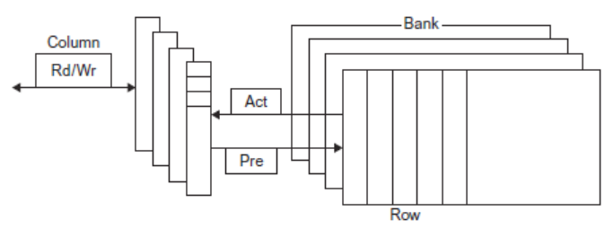
Internal Organization of DRAM

Slide 7
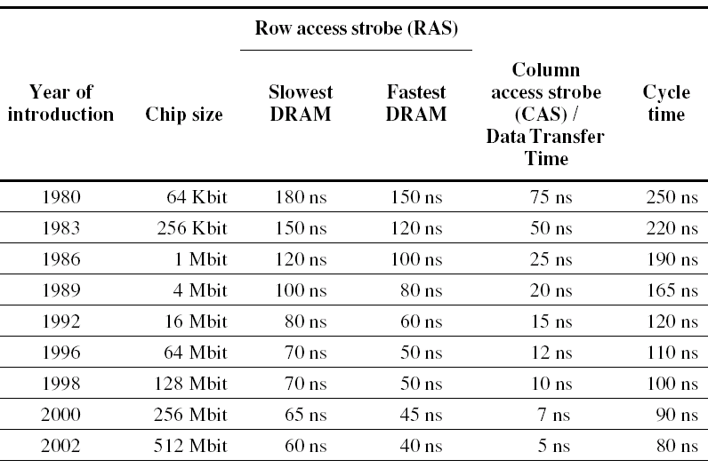
Times of fast and slow DRAMs with each generation.

Slide 8
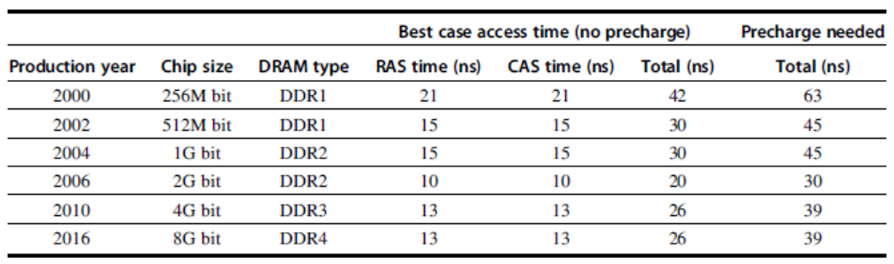
Memory Optimizations
Notes:
行选通 列选通

Slide 9
Memory Technology
Amdahl:
Memory capacity should grow linearly with processor speed
Unfortunately, memory capacity and speed has not kept pace with processors
Some optimizations:
Multiple accesses to same row
Synchronous DRAM 异步访问握手过程很耗时
Added clock to DRAM interface
Burst mode with critical word first
Wider interfaces 一次拿更多word
Double data rate (DDR) 工作频率提高
Multiple banks on each DRAM device

Slide 10
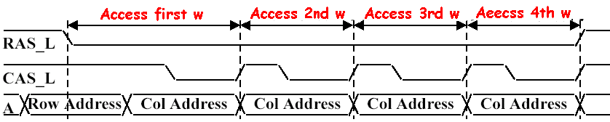
1st Improving DRAM Performance Fast Page Mode DRAM (FPM)
Timing signals that allow repeated accesses to the row buffer (page) without another row access time
Such a buffer comes naturally, as each array will buffer 1024 to 2048 bits for each access.
Page: All bits on the same ROW (Spatial Locality)
Don’t need to wait for wordline to recharge
Toggle CAS with new column address
Notes:
把行称为page

Slide 11
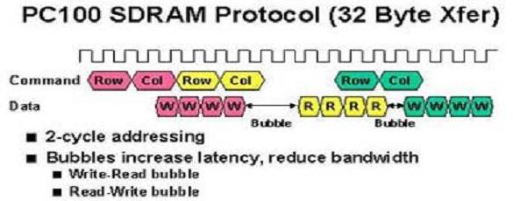
2nd Improving DRAM Performance Synchronous DRAM
conventional DRAMs have an asynchronous interface to the memory controller, and hence every transfer involves overhead to synchronize with the controller.
The solution was to add a clock signal to the DRAM interface, so that the repeated transfers would not bear that overhead.
Data output is in bursts w/ each element clocked

Slide 12
3rd Improving DRAM Performance DDR--Double data rate
On both the rising edge and falling edge of the DRAM clock signal, DRAM innovation to increase bandwidth is to transfer data,
thereby doubling the peak data rate.
2.5V
1.8v
1.5v

Slide 13
DDR--Double data rate
DDR:
DDR2
Lower power (2.5 V -> 1.8 V)
Higher clock rates (266 MHz, 333 MHz, 400 MHz)
DDR3
1.5 V
800 MHz
DDR4
1-1.2 V
1333 MHz
GDDR5 is graphics memory based on DDR3

Slide 14
4rd Improving DRAM Performance New DRAM Interface: RAMBUS (RDRAM)
a type of synchronous dynamic RAM, designed by the Rambus Corporation.
Each chip has interleaved memory and a high speed interface.
Protocol based RAM w/ narrow (16-bit) bus
High clock rate (400 Mhz), but long latency
Pipelined operation
Multiple arrays w/ data transferred on both edges of clock
The first generation RAMBUS interface dropped RAS/CAS, replacing it with a bus that allows other accesses over the bus between the sending of the address and return of the data. It is typically called RDRAM.
The second generation RAMBUS interface include a separate row- and column-command buses instead of the conventional multiplexing; and a much more sophisticated controller on chip. Because of the separation of data, row, and column buses, three transactions can be performed simultaneously. called Direct RDRAM or DRDRAM
Notes:
interleaved memory 多个bank，可以流水线

Slide 15
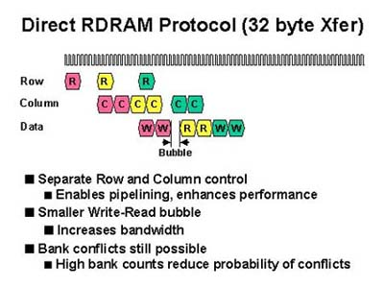
RDRAM Timing

Slide 16
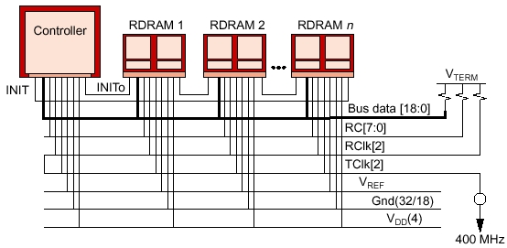
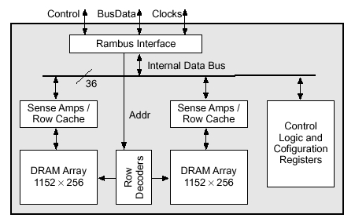
RAMBUS (RDRAM)
RDRAM Memory System
RAMBUS Bank

Slide 17
Comparing RAMBUS and DDR SDRAM
Since the most computers use memory in DIMM packages, which are typically at least 64-bits wide, the DIMM memory bandwidth is closer to what RAMBUS provides than you might expect when just comparing DRAM chips.
Caution that performance of cache are based in part on latency to the first byte and in part on the bandwidth to deliver the rest of the bytes in the block.
Although these innovations help with the latter case, none help with latency.
Amdahl’s Law reminds us of the limits of accelerating one piece of the problem while ignoring another part.

Slide 18
Memory Optimizations
Reducing power in SDRAMs:
Lower voltage
Low power mode (ignores clock, continues to refresh)
Graphics memory:
Achieve 2-5 X bandwidth per DRAM vs. DDR3
Wider interfaces (32 vs. 16 bit)
Higher clock rate
Possible because they are attached via soldering instead of socketted DIMM modules

Slide 19
Summery
Memory organization
Wider memory
Simple interleaved memory
Independent memory banks
Avoiding Memory Bank Conflicts
Memory chip
Fast Page Mode DRAM
Synchronize DRAM
Double Date Rate
RDRAM

Slide 20
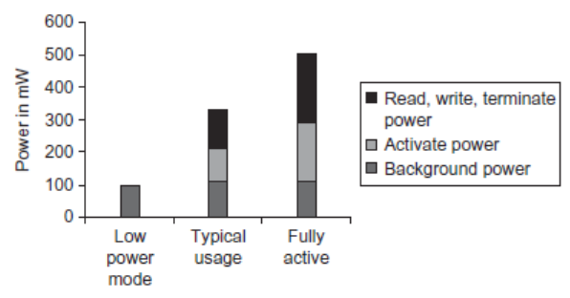
Memory Power Consumption

Slide 21
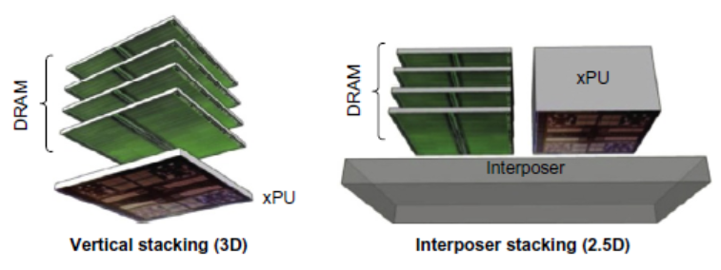
Stacked/Embedded DRAMs
Stacked DRAMs in same package as processor
High Bandwidth Memory (HBM)

Slide 22
Flash Memory
Type of EEPROM
Types: NAND (denser) and NOR (faster)
NAND Flash:
Reads are sequential, reads entire page (.5 to 4 KiB)
25 us for first byte, 40 MiB/s for subsequent bytes
SDRAM: 40 ns for first byte, 4.8 GB/s for subsequent bytes
2 KiB transfer: 75 uS vs 500 ns for SDRAM, 150X slower
300 to 500X faster than magnetic disk

Slide 23
NAND Flash Memory
Must be erased (in blocks) before being overwritten
Nonvolatile, can use as little as zero power
Limited number of write cycles (~100,000)
$2/GiB, compared to $20-40/GiB for SDRAM and $0.09 GiB for magnetic disk
Phase-Change（相变）/Memrister Memory
Possibly 10X improvement in write performance and 2X improvement in read performance

Slide 24
Memory Dependability
Memory is susceptible to cosmic rays
Soft errors: dynamic errors
Detected and fixed by error correcting codes (ECC)
Hard errors: permanent errors
Use spare rows to replace defective rows
Chipkill: a RAID-like error recovery technique

Slide 25
How to Improve Cache Performance?
AMAT = HitTime + MissRate×MissPenalty
Reduce hit time(4)
Small and simple first-level caches, Way prediction
avoiding address translation, Trace cache
Increase bandwidth(3)
Pipelined caches, multibanked caches, non-blocking caches
Reduce miss penalty(5)
multilevel caches, read miss prior to writes,
Critical word first, merging write buffers, and victim caches
Reduce miss rate(4)
larger block size, large cache size, higher associativity
Compiler optimizations
Reduce miss penalty or miss rate via parallelization (1)
Hardware or compiler prefetching

Slide 26
1st Hit Time Reduction Technique: Small and Simple Caches
Using small and Direct-mapped cache
The less hardware that is necessary to implement a cache, the shorter the critical path through the hardware.
Direct-mapped is faster than set associative for both reads and writes.
Fitting the cache on the chip with the CPU is also very important for fast access times.

Slide 27
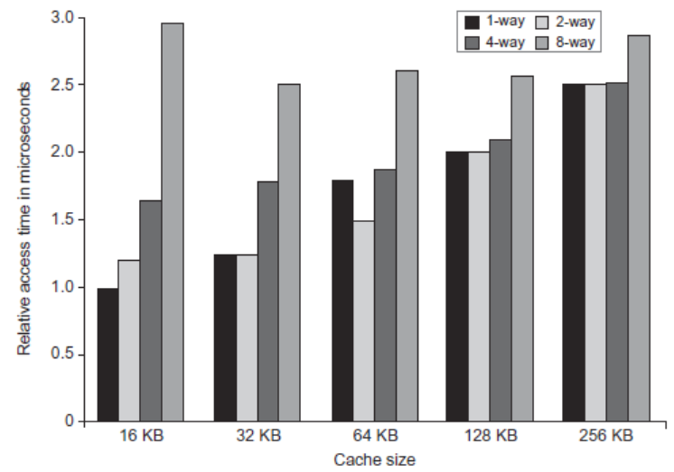
L1 Size and Associativity
Access time vs. size and associativity

Slide 28
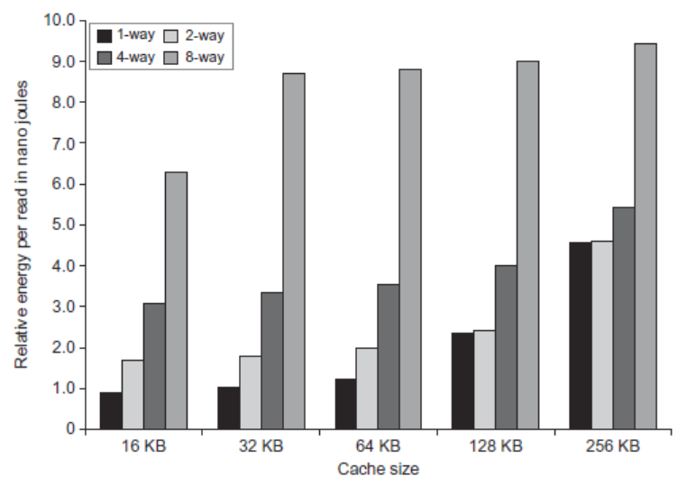
L1 Size and Associativity
Energy per read vs. size and associativity

Slide 29
2nd Hit Time Reduction Technique: Way Prediction
To improve hit time, predict the way to pre-set mux
Mis-prediction gives longer hit time
Prediction accuracy
> 90% for two-way
> 80% for four-way
I-cache has better accuracy than D-cache
First used on MIPS R10000 in mid-90s
Used on ARM Cortex-A8
Extend to predict block as well
“Way selection”
Increases mis-prediction penalty

Slide 30
2nd Hit Time Reduction Technique: Way Prediction
Way Prediction (Pentium 4 )
Extra bits are kept in the cache to predict the way,or block within set of the next cache access.
If the predictor is correct, the instruction cache latency is 1 clock clock cycle.
If not,it tries the other block, changes the way predictor, and has a latency of 1 extra clock cycles.
Simulation using SPEC95 suggested set prediction accuracy is excess of 85%, so way prediction saves pipeline stage in more than 85% of the instruction fetches.

Slide 31
3rd Hit Time Reduction Technique: Avoiding Address Translation during Indexing of the Cache
Trans-
lation
Main
Memory
VA
PA
miss
Cache
CPU
hit
data
Page table is a large data structure in memory
TWO memory accesses for every load, store, or instruction fetch!!!
Virtually addressed cache?
synonym problem
Cache the address translations?

Slide 32
TLBs
A way to speed up translation is to use a special cache of recently used page table entries -- this has many names, but the most frequently used is Translation Lookaside Buffer or TLB
Virtual Address Physical Address Dirty Ref Valid Access
Really just a cache on the page table mappings
TLB access time comparable to cache access time
(much less than main memory access time)

Slide 33
Translation Look-Aside Buffers
Just like any other cache, the TLB can be organized as fully associative, set associative, or direct mapped
TLBs are usually small, typically not more than 128 - 256 entries even on high end machines. This permits fully associative lookup on these machines. Most mid-range machines use small n-way set associative organizations.
hit
VA
PA
miss
TLB
Lookup
Cache
Main
Memory
CPU
Translation
with a TLB
miss
hit
Trans-
lation
data
1/2 t
t
20 t

Slide 34
Fast hits by Avoiding Address Translation
CPU
CPU
CPU
VA
VA
VA
VA
Tags
$
PA
Tags
$
TB
TB
VA
PA
PA
L2 $
$
TB
MEM
PA
PA
MEM
MEM
Virtual indexed, Physically tagged
Overlap $ access
with VA translation:
requires $ index to
remain invariant
across translation
Conventional
Organization
Virtually Addressed Cache
Translate only on miss
Synonym Problem

Slide 35
Virtual Addressed Cache
Any Problems ?
Send virtual address to cache? Called Virtually Addressed Cache or
just Virtual Cache (vs. Physical Cache)
Every time process is switched logically must flush the cache; otherwise get false hits
Cost is time to flush + “compulsory” misses from empty cache
Add process identifier tag that identifies process as well as address within process: can’t get a hit if wrong process

Slide 36
Virtual cache

Slide 37
Dealing with aliases
Dealing with aliases (synonyms); Two different virtual addresses map to same physical address
NO aliasing! What are the implications?
HW antialiasing: guarantees every cache block has unique address
verify on miss (rather than on every hit)
cache set size <= page size ?
what if it gets larger?
How can SW simplify the problem? (called page coloring)
I/O must interact with cache, so need virtual address

Slide 38
Aliases problem with Virtual cache
If the index and offset bits of two aliases are forced to be
the same, than the aliases address will map to the same block in cache.

Slide 39
Overlap address translation and cache access (Virtual indexed, physically tagged)
Any limitation ?

Slide 40
What’s the limitation?
IF it’s direct map cache, then
Cache size = 2^{index} * 2^{blockoffset} <= 2 ^{pageoffset}
How to solve this problem?
Use higher association. Say it’s a 4 way, then cache size can reach 4 times 2^{pageoffset} with change nothing in index or tag or offset.

Slide 41
Example: Virtual indexed, physically tagged cache
Virtual address wide = 43 bits, Memory physical address wide = 38 bits, Page size = 8KB.
Cache capacity =16KB. If a virtually indexed and physically tagged cache is used.
And the cache is 2-way associative write back cache with 32 byte block size.
index block offset
VA
VPN: 30bits 8bits 5bits
VPN PPN
=
V D 30 bits 25 bits
Cache
=
0
V D 25 bits 256 bits
=
bank0
=
TLB
PPN：25bits
255
=
0
V D 25 bits 256 bits
bank1
255
=

Slide 42
4th Hit Time Reduction Technique: Trace caches
Find a dynamic sequence of instructions including taken branches to load into a cache block.
The block determined by CPU instead of by memory layout.
Complicated address mapping mechanism

Slide 43
Why Trace Cache ?
Bring N instructions per cycle
No I-cache misses
No prediction miss
No packet breaks !
Because branch in each 5 instruction, so cache can only provide a packet in one cycle.

Slide 44
What’s Trace ?
Trace: dynamic instruction sequence
When instructions ( operations ) retire from the pipeline, pack the instruction segments into TRACE, and store them in the TRACE cache, including the branch instructions.
Though branch instruction may go a different target, but most times the next operation sequential will just be the same as the last sequential. ( locality )

Slide 45
Whose propose ?
Peleg Weiser (1994) in Intel corporation
Patel / Patt ( 1996)
Rotenberg / J. Smith (1996)
Paper: ISCA’98

Slide 46
Trace in CPU

Slide 47
Instruction segment

Slide 48
Pentium 4: trace cache, 12 instr./per cycle

Slide 49
How to Improve Cache Performance?
AMAT = HitTime + MissRate×MissPenalty
Reduce hit time(4)
Small and simple first-level caches, Way prediction
avoiding address translation, Trace cache
Increase bandwidth(3)
Pipelined caches, multibanked caches, non-blocking caches
Reduce miss penalty(5)
multilevel caches, read miss prior to writes,
Critical word first, merging write buffers, and victim caches
Reduce miss rate(4)
larger block size, large cache size, higher associativity
Compiler optimizations
Reduce miss penalty or miss rate via parallelization (1)
Hardware or compiler prefetching

Slide 50
Pipelined Caches
Pipeline cache access to improve bandwidth
Examples:
Pentium: 1 cycle
Pentium Pro – Pentium III: 2 cycles
Pentium 4 – Core i7: 4 cycles
Increases branch mis-prediction penalty
Makes it easier to increase associativity

Slide 51
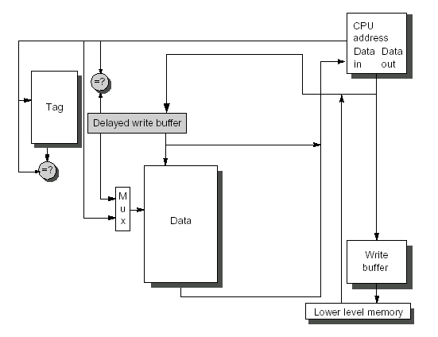
1st Increasing cache bandwidth: Pipelined Caches
Hit in multiple cycles,
giving fast clock cycle time

Slide 52
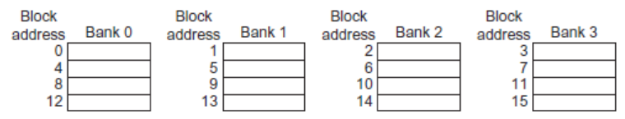
2nd Increasing cache bandwidth: Multibanked Caches
Organize cache as independent banks to support simultaneous access
ARM Cortex-A8 supports 1-4 banks for L2
Intel i7 supports 4 banks for L1 and 8 banks for L2
Banking works best when accesses naturally spread themselves across banks ⇒ mapping of addresses to banks affects behavior of memory system
Interleave banks according to block address,Simple mapping that works well is “sequential interleaving”

Slide 53
Single banked two bank two bank two bank
consecutive interleaving group interleaving

Slide 54
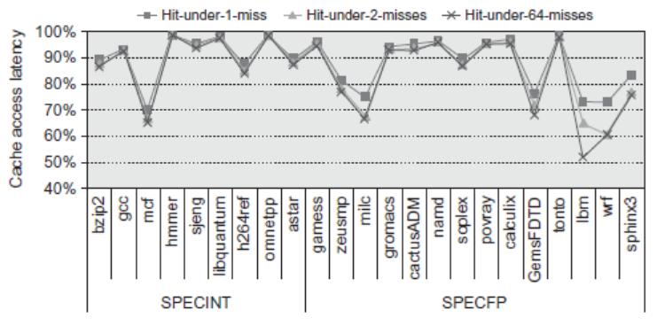
3rd Increasing cache bandwidth: Nonblocking Caches
Allow hits before previous misses complete
“Hit under miss” ， “Hit under multiple miss”
L2 must support this
In general, processors can hide L1 miss penalty but not L2 miss penalty
Nonblocking, in conjunction with out-of-order execution, can allow the CPU to continue executing instructions after a data cache miss.

Slide 55
Nonblocking cache
假设要执行下面一段程序：
1 Reg1:=LoadMem(A);
2 Reg2:=LoadMem(B);
3 Reg3:=Reg1 + Reg2;
当执行第一行时，cpu发现地址A不在cache中，就需要去内存读。但读内存的时间是很长的，此时CPU也不会闲着，就去执行了第二行。然后发现B也不在cache中。那么此时cache会怎么做呢？
(a). cache阻塞，等着先把A读进来，然后再去读B。这种叫做Blocking Cache
(b). cache同时去内存读B，最终B和A一起进入Cache。这种叫做Non-Blocking Cache

Slide 56
How to Improve Cache Performance?
AMAT = HitTime + MissRate×MissPenalty
Reduce hit time(4)
Small and simple first-level caches, Way prediction
avoiding address translation, Trace cache
Increase bandwidth(3)
Pipelined caches, multibanked caches, non-blocking caches
Reduce miss penalty(5)
multilevel caches, read miss prior to writes,
Critical word first, merging write buffers, and victim caches
Reduce miss rate(4)
larger block size, large cache size, higher associativity
Compiler optimizations
Reduce miss penalty or miss rate via parallelization (1)
Hardware or compiler prefetching

Slide 57
1st Miss Penalty Reduction Technique: Multilevel Caches
This method focuses on the interface between the cache and main memory.
Add an second-level cache between main memory and a small, fast first-level cache, to make the cache fast and large.
The smaller first-level cache is fast enough to match the clock cycle time of the fast CPU and to fit on the chip with the CPU, thereby lessening the hits time.
The second-level cache can be large enough to capture many memory accesses that would go to main memory, thereby lessening the effective miss penalty.

Slide 58
Parameter about Multilevel cache
The performance of a two-level cache is calculated in a similar way to the performance for a single level cache.
L2 Equations
AMAT = Hit Time_{L1} + Miss Rate_{L1} x Miss Penalty_{L1}
Miss Penalty_{L1} = Hit Time_{L2} + Miss Rate_{L2} x Miss Penalty_{L2}
AMAT = Hit Time_{L1} +
Miss Rate_{L1} x (Hit Time_{L2} + Miss Rate_{L2} * Miss Penalty_{L2})
So the miss penalty for level 1 is calculated using the hit time, miss rate, and miss penalty for the level 2 cache.

Slide 59
Two conceptions for two-level cache
Definitions:
Local miss rate— misses in this cache divided by the total number of memory accesses to this cache (Miss rate_{L2})
Global miss rate—misses in this cache divided by the total number of memory accesses generated by the CPU
Using the terms above, the global miss for the first-level cache is stall just Miss rate_{L1}, but for the second-level cache it is :

Slide 60
2nd Miss Penalty Reduction Technique: Giving Priority to Read Misses over Writes
If a system has a write buffer, writes can be delayed to come after reads.
The system must, however, be careful to check the write buffer to see if the value being read is about to be written.

Slide 61
Write buffer
Write-back want buffer to hold displaced blocks
Read miss replacing dirty block
Normal: Write dirty block to memory, and then do the read
Instead copy the dirty block to a write buffer, then do the read, and then do the write
CPU stall less since restarts as soon as do read
Write-through want write buffers => RAW conflicts with main memory reads on cache misses
If simply wait for write buffer to empty, might increase read miss penalty (old MIPS 1000 by 50% )
Check write buffer contents before read; if no conflicts, let the memory access continue

Slide 62
3nd Miss Penalty Reduction Technique: Critical Word First & Early Restart
Don’t wait for full block to be loaded before restarting CPU
Critical Word First—Request the missed word first from memory and send it to the CPU as soon as it arrives; let the CPU continue execution while filling the rest of the words in the block. Also called wrapped fetch and requested word first
Early restart—As soon as the requested word of the block arrives, send it to the CPU and let the CPU continue execution
Generally useful only in large blocks,
Spatial locality => tend to want next sequential word, so not clear if benefit by early restart

Slide 63
Example: Critical Word First
Assume:
cache block＝64-byte
L2: take 11 CLK to get the critical 8 bytes,(AMD Athlon)
and then 2 CLK per 8 byte to fetch the rest of the
block
There will be no other accesses to rest of the block
Calculate the average miss penalty for critical word first.
Then assuming the following instructions read data sequentially 8 bytes at a time from the rest of the block
Compare the times with and without critical word first.

Slide 64
4th Miss Penalty Reduction Technique: Merging write Buffer
One word writes replaces with multiword writes, and it improves buffers’s efficiency.
In write-through ,When write misses if the buffer contains other modified blocks,the addresses can be checked to see if the address of this new data matches the address of a valid write buffer entry.If so,the new data are combined with that entry.
The optimization also reduces stalls due to the write buffer being full.

Slide 65
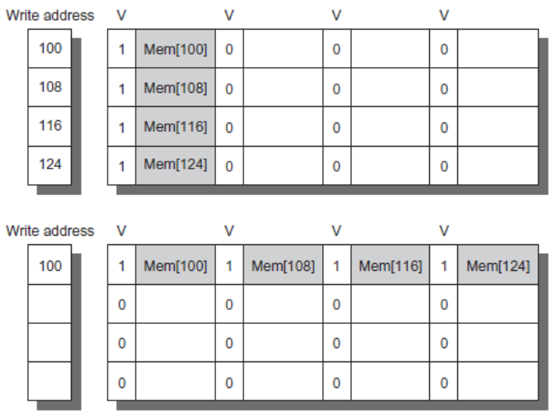
Merging Write Buffer
When storing to a block that is already pending in the write buffer, update write buffer
Reduces stalls due to full write buffer
Do not apply to I/O addresses
No write buffering
Write buffering

Slide 66
5th Miss Penalty Reduction Technique: Victim Caches
A victim cache is a small (usually, but not necessarily) fully-associative cache that holds a few of the most recently replaced blocks or victims from the main cache.
This cache is checked on a miss data before going to next lower-level memory(main memory).
to see if they have the desired item
If found, the victim block and the cache block are swapped.
The AMD Athlon has a victim caches (write buffer for write back blocks ) with 8 entries.

Slide 67
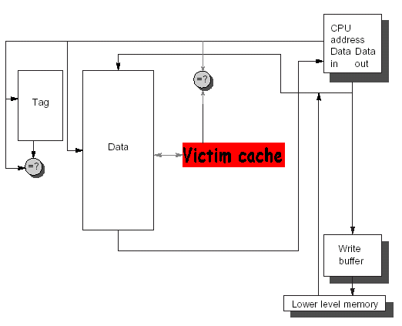
The Victim Cache

Slide 68
How to combine victim Cache ?
How to combine fast hit time of direct mapped yet still avoid conflict misses?
Add buffer to place data discarded from cache
Jouppi [1990]: 4-entry victim cache removed 20% to 95% of conflicts for a 4 KB direct mapped data cache
Used in Alpha, HP machines
TAGS
DATA
Tag and Comparator
One Cache line of Data
Tag and Comparator
One Cache line of Data
Tag and Comparator
One Cache line of Data
Tag and Comparator
One Cache line of Data
To Next Lower Level In
Hierarchy

Slide 69
How to Improve Cache Performance?
AMAT = HitTime + MissRate×MissPenalty
Reduce hit time(4)
Small and simple first-level caches, Way prediction
avoiding address translation, Trace cache
Increase bandwidth(3)
Pipelined caches, multibanked caches, non-blocking caches
Reduce miss penalty(5)
multilevel caches, read miss prior to writes,
Critical word first, merging write buffers, and victim caches
Reduce miss rate(4)
larger block size, large cache size, higher associativity
Compiler optimizations
Reduce miss penalty or miss rate via parallelization (1)
Hardware or compiler prefetching

Slide 70
Where misses come from?
Classifying Misses: 3 Cs
Compulsory—The first access to a block is not in the cache, so the block must be brought into the cache. Also called cold start misses or first reference misses. (Misses in even an Infinite Cache)
Capacity—If the cache cannot contain all the blocks needed during execution of a program, capacity misses will occur due to blocks being discarded and later retrieved. (Misses in Fully Associative Size X Cache)
Conflict—If block-placement strategy is set associative or direct mapped, conflict misses (in addition to compulsory & capacity misses) will occur because a block can be discarded and later retrieved if too many blocks map to its set. Also called collision misses or interference misses. (Misses in N-way Associative, Size X Cache)
4th “C”:
Coherence - Misses caused by cache coherence.
Notes:
Intuitive Model by Mark Hill

Slide 71
3Cs Absolute Miss Rate (SPEC92)

Slide 72
3Cs Relative Miss Rate
Flaws: for fixed block size
Good: insight => invention

Slide 73
Reducing Cache Miss Rate
To reduce cache miss rate, we have to eliminate some of the misses due to the three C's.
We cannot reduce capacity misses much except by making the cache larger.
We can, however, reduce the conflict misses and compulsory misses in several ways:

Slide 74
Cache Organization?
Assume total cache size not changed:
What happens if:
Change Block Size:
Change Associativity:
3) Change Compiler:
Which of 3Cs is obviously affected?
Notes:
Ask which affected?
Block size
1) Compulsory
2) More subtle, will change mapping

Slide 75
1st Miss Rate Reduction Technique: Larger Block Size (fixed size&assoc)
Larger blocks decrease the compulsory miss rate by taking advantage of spatial locality.
Drawback--curve is U-shaped
However, they may increase the miss penalty by requiring more data to be fetched per miss.
In addition, they will almost certainly increase conflict misses since fewer blocks can be stored in the cache.
And maybe even capacity misses in small caches
Trade-off
Trying to minimize both the miss rate and the miss penalty.
The selection of block size depends on both the latency and bandwidth of lower-level memory

Slide 76
Miss Rate relates Block size
Block size | Cache size
 | 4K | 16K | 64K | 256K
16 | 8.57% | 3.94% | 2.04% | 1.09%
32 | 7.24% | 2.87% | 1.35% | 0.70%
64 | 7.00% | 2.64% | 1.06% | 0.51%
128 | 7.78% | 2.77% | 1.02% | 0.49%
256 | 9.51% | 3.29% | 1.15% | 0.49%

Slide 77
Performance curve is U-shaped
Reduced
compulsory
misses
Increased
Conflict
Misses
What else drives up block size?

Slide 78
Example: Larger Block Size (C-26)
Assume: memory takes 80 clock cycles of overhead and then delivers 16 bytes every 2 cycles.
1 clock cycle hit time independent of block size.
Which block size has the smallest AMAT for each size in Fig.5.17 ?
Answer:
AMAT_{16-byte block, 4KB} = 1+(8.57%*82)=8.027
AMAT_{256-byte block}, _{256KB}= 1+(0.49%*112)=1.549

Slide 79
2nd Miss Rate Reduction Technique: Larger Caches
Cache Size
rule of thumb: 2 x size => 25% cut in miss rate
What does it reduce ?

Slide 80
Pro. Vs. cons for large caches
Pro.
Reduce capacity misses
Con.
Longer hit time, Higher cost, AMAT curve is U-shaped
Popular in off-chip caches
Block size | Miss penalty | Cache size
 |  | 4K | 16K | 64K | 256K
16 | 82 | 8.027 | 4.231 | 2.673 | 1.894
32 | 84 | 7.082 | 3.411 | 2.134 | 1.588
64 | 88 | 7.160 | 3.323 | 1.933 | 1.449
128 | 96 | 8.469 | 3.659 | 1.979 | 1.470
256 | 112 | 11.651 | 4.685 | 2.288 | 1.549

Slide 81
3rd Miss Rate Reduction Technique: Higher Associativity
Conflict misses can be a problem for caches with low associativity (especially direct-mapped).
With higher associativity decreasing Conflict misses to improve miss rate
cache rule of thumb
2:1 rule of thumb a direct-mapped cache of size N has the same miss rate as a 2-way set-associative cache of size N/2.
Eight-way set associative is for practical purposes as effective in reducing misses for these sized cache as fully associative.

Slide 82
Associativity
2:1 rule of thumb
Conflict

Slide 83
Associativity vs Cycle Time
Beware: Execution time is only final measure!
Why is cycle time tied to hit time?
Will Clock Cycle time increase?
Hill [1988] suggested hit time for 2-way vs. 1-way external cache +10%, internal + 2%
suggested big and dumb caches

Slide 84
AMAT vs. Miss Rate (P430)
Example: assume CCT = 1.36 for 2-way, 1.44 for 4-way, 1.52 for 8-way vs. CCT direct mapped
Cache Size Associativity
(KB) 1-way 2-way 4-way 8-way
4 3.44 3.25 3.22 3.28
8 2.69 2.58 2.55 2.62
16 2.33 2.40 2.46 2.53
32 2.06 2.30 2.37 2.45
64 1.92 2.24 2.18 2.25
128 1.52 1.84 1.92 2.00
256 1.32 1.66 1.74 1.82
512 1.20 1.55 1.59 1.66
(Red means A.M.A.T. not improved by more associativity)

Slide 85
4th Miss Rate Reduction Technique: Compiler Optimizations
The techniques reduces miss rates without any hardware changes and reorders instruction sequence with compiler.
Instructions
Reorder procedures in memory so as to reduce conflict misses
Profiling to look at conflicts(using tools they developed)
Data
Merging Arrays: improve spatial locality by single array of compound elements vs. 2 arrays
Loop Interchange: change nesting of loops to access data in order stored in memory
Loop Fusion: Combine 2 independent loops that have same looping and some variables overlap
Blocking: Improve temporal locality by accessing “blocks” of data repeatedly vs. going down whole columns or rows

Slide 86
Merging Arrays
Combining independent matrices into a single compound array.
Improving spatial locality
Example
/*before*/
Int val[SIZE];
Int key[SIZE];
/*after*/
Struct merge{
int val;
int key;
}
Struct merge merged_array[SIZE]

Slide 87
b. Loop Interchange
By switching the order in which loops execute, misses can be reduced due to improvements in spatial locality.
/* Before */
for (k = 0; k < 100; k = k+1)
for (j = 0; j < 100; j = j+1)
for (i = 0; i < 5000; i = i+1)
x[i][j] = 2 * x[i][j];
/* After */
for (k = 0; k < 100; k = k+1)
for (i = 0; i < 5000; i = i+1)
for (j = 0; j < 100; j = j+1)
x[i][j] = 2 * x[i][j];
Sequential accesses instead of striding through memory every 100 words;

Slide 88
c. Loop fusion
By fusion the code into a single loop, the data that are fetched into the cache can be used repeatedly before being swapped out.
Imporving the temporal locality
Example:
/*before*/ /*after*/
For (i=0; i<N; i=i+1) For (i=0; i<N; i=i+1)
For (i=0; j<N; j=i+1) For (j=0; j<N; j=i+1)
a[i][j]=1/b[i][j]*c[i][j]; {
For (i=0; i<N; i=i+1)
a[i][j]=1/b[i][j]*c[i][j];
For (j=0; j<N; j=j+1) d[i][j]=a[i][j]*c[i][j];
d[i][j]=a[i][j]*c[i][j]; }

Slide 89
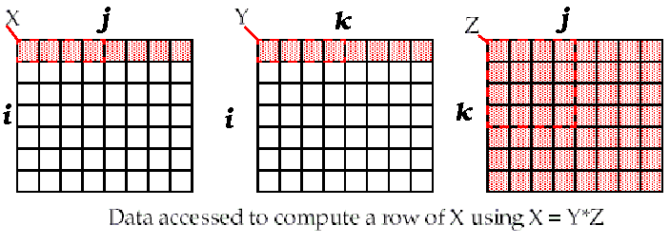
d. Unoptimized Matrix Multiplication
/* Before */
for (i = 0; i < N; i = i+1)
for (j = 0; j < N; j = j+1)
{r = 0;
for (k = 0; k < N; k = k+1)
r = r + y[i][k]*z[k][j];
x[i][j] = r;
};
Two Inner Loops:
Write N elements of 1 row of X[ ]
Read N elements of 1 row of Y[ ] repeatedly
Read all NxN elements of Z[ ]
Capacity Misses a function of N & Cache Size:
2N³ + N² => (assuming no conflict; otherwise …)
Idea: compute on BxB submatrix that fits
x[1][j]
y[1][k]
z[k][j]
((N+N)N+N)N=2N³ + N²
Accessed For N³ operations

Slide 90
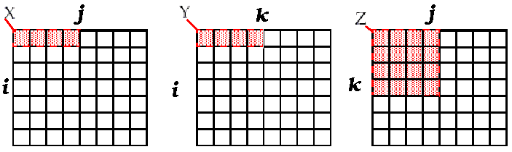
Blocking optimized Matrix Multiplication
Matrix multiplication is
performed by multiplying the
submatrices first.
/* After */
for (jj = 0; jj < N; jj = jj+B)
for (kk = 0; kk < N; kk = kk+B)
for (i = 0; i < N; i = i+1)
for (j = jj; j < min(jj+B-1,N); j = j+1)
{r = 0;
for (k = kk; k < min(kk+B-1,N); k = k+1)
r = r + y[i][k]*z[k][j];
x[i][j] = x[i][j] + r;
};
Y benefits from spatial locality
Z benefits from temporal locality
Capacity Misses from 2N³ + N² to N³/B+2N²
BN
BN
B×B
B called Blocking Factor
(BN+BN)+B²)×(N/B)²=2N³/B + N²
Accessed For N³ operations

Slide 91
Reducing Conflict Misses by Blocking
Conflict misses in caches not FA vs. Blocking size
Lam et al [1991] a blocking factor of 24 had a fifth the misses vs. 48 despite both fit in cache

Slide 92
Summary of Compiler Optimizations to Reduce Cache Misses (by hand)

Slide 93
5th Miss Rate Reduction Technique: Way Prediction and Pseudo-Associative Cache
Using two Technique reduces conflict misses and yet maintains hit speed of direct-mapped cache
Predictive bit - Pseudo-Associative
Way Prediction (Alpha 21264 )
Extra bits are kept in the cache to predict the way,or block within set of the next cache access.
If the predictor is correct, the instruction cache latency is 1 clock clock cycle.
If not,it tries the other block, changes the way predictor, and has a latency of 3 clock cycles.
Simulation using SPEC95 suggested set prediction accuracy is excess of 85%, so way prediction saves pipeline stage in more than 85% of the instruction fetches.

Slide 94
Pseudo-Associative Cache (column associative)
How to combine fast hit time of Direct Mapped and have the lower conflict misses of 2-way SA cache?
Divide cache: on a miss, check other half of cache to see if there, if so have a pseudo-hit (slow hit)
Drawback: CPU pipeline is hard if hit takes 1 or 2 cycles
Better for caches not tied directly to processor (L2)
Used in MIPS R1000 L2 cache, similar in UltraSPARC
Hit Time
Pseudo Hit Time
Miss Penalty
Time

Slide 95
Pseudo-Associative Cache

Slide 96
How to Improve Cache Performance?
AMAT = HitTime + MissRate×MissPenalty
Reduce hit time(4)
Small and simple first-level caches, Way prediction
avoiding address translation, Trace cache
Increase bandwidth(3)
Pipelined caches, multibanked caches, non-blocking caches
Reduce miss penalty(5)
multilevel caches, read miss prior to writes,
Critical word first, merging write buffers, and victim caches
Reduce miss rate(4)
larger block size, large cache size, higher associativity
Compiler optimizations
Reduce miss penalty or miss rate via parallelization (1)
Hardware or compiler prefetching
Using HBM to extend the memory hierarchy

Slide 97
1st Miss Penalty/Rate Reduction Technique: Hardware Prefetching of Inst.and data
The act of getting data from memory before it is actually needed by the CPU.
This reduces compulsory misses by retrieving the data before it is requested.
Of course, this may increase other misses by removing useful blocks from the cache.
Thus, many caches hold prefetched blocks in a special buffer until they are actually needed.
E.g., Instruction Prefetching
Alpha 21064 fetches 2 blocks on a miss
Extra block placed in “stream buffer”
On miss check stream buffer
Prefetching relies on having extra memory bandwidth that can be used without penalty

Slide 98
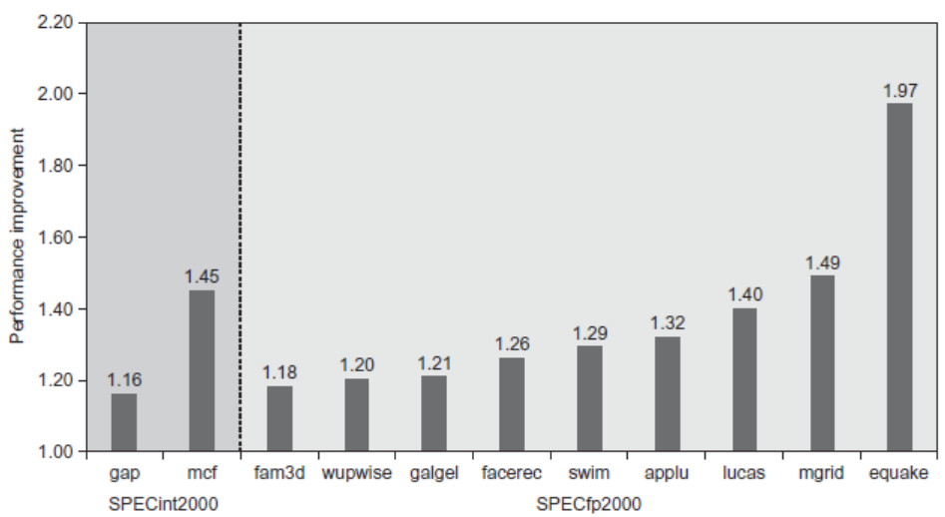
Hardware Prefetching
Fetch two blocks on miss (include next sequential block)
Pentium 4 Pre-fetching

Slide 99
2nd Miss Penalty/Rate Reduction Technique: Compiler-controlled prefetch
The compiler inserts prefetch instructions before the data is needed
Non-faulting: prefetch doesn’t cause exceptions, a form of speculative execution
Combine with loop unrolling and software pipelining
Register Prefetch (HP PA-RISC loads)
Binding prefetch: Requests load directly into register.
Must be correct address and register!
Cache Prefetch (MIPS IV, PowerPC, SPARC v. 9)
Non-Binding prefetch: Load into cache.
Can be incorrect. Faults?
Issuing Prefetch Instructions takes time
Is cost of prefetch issues < savings in reduced misses ?
Higher superscalar reduces difficulty of issue bandwidth

Slide 100
Example: Compiler-controlled prefetch
for( i=0; i <3; i = i +1)
for( j=0; j<100; j=j+1) 7 cycles/iteration
a[i][j] = b[j][0] * b[j+1][0];
16B/block， 8B/element， 2elements/block
A[i][j]: 3*100 the even value of j will miss,
the odd values will hit, total 150 misses
B[i][j]：101*3 the same elements are accessed for each iteration of i
j=0 B[0][0]、B[1][0] 2
j=1 B[1][0]、B[2][0] 1
total 2+99=101 misses
Performance: 300 * 7 + 251 *100 = 27200

Slide 101
Example cont.: Compiler-controlled prefetch
For (j=0; j<100; j=j+1){ 9 cycles / iteration
Prefetch(b[j+7][0]);
prefetch(a[0][j+7]);
a[0][j]=b[j][0]*b [j+1][0];}; 7 misses for b
4 misses for a
For (I=1; I<3; I=I+1) 8 cycles / iteration
For (j=0; j<100; j=j+1){
prefetch(a[i][j+7]);
a[i][j]=b[j][0]*b [j+1][0];};4 misses for a[1][j]
4 misses for a[2][j]
Total: 19 misses
save 232 cache misses at the price of 400 prefetch instructions.
Performance: 100 * 9 + 200* 8 + 19 *100 = 4400 cycles

Slide 102
Use HBM to Extend Hierarchy
HBM： High Bandwidth Memory
Build massive L4 cache (128 MiB to 1GiB) using DRAMs
Smaller blocks require substantial huge tag storage
Problems for Large block size
unneed contents, inefficient transferring
More conflict and consistency misses
One approach (L-H):
Each SDRAM row is a block index
Each row contains set of tags and 29 data segments
29-set associative
Hit requires a CAS
block size: 64B/4KB; Block number:2²⁴/2¹⁸ ; 16M/256K

Slide 103
Use HBM to Extend Hierarchy
Another approach (Alloy cache):
Mold tag and data together
Use direct mapped
Both schemes require two DRAM accesses for misses
Two solutions:
Use map to keep track of blocks
Predict likely misses

Slide 104
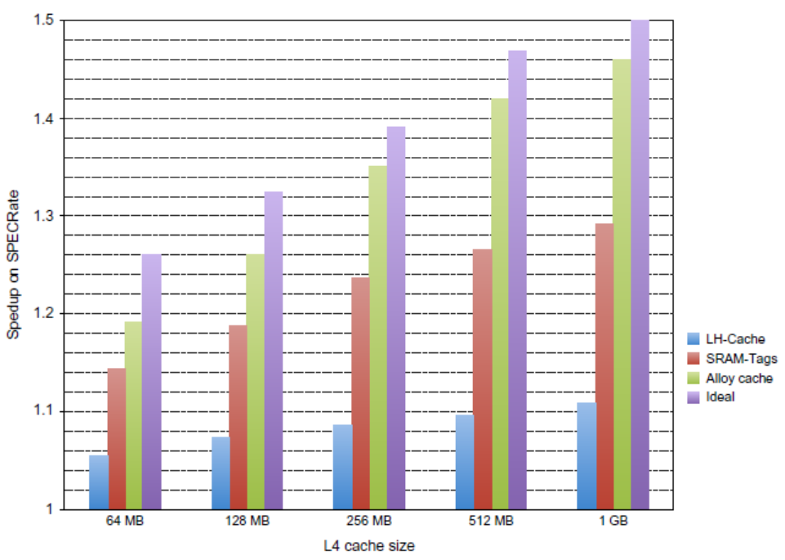
Use HBM to Extend Hierarchy

Slide 105
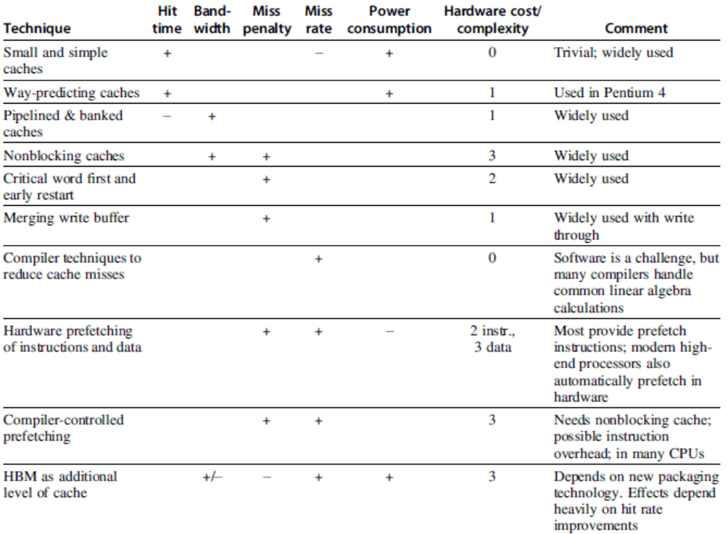
Summary

Slide 106
Example: Alpha 21264 Memory Hierarchy
The 21264 is an out-of-order execution processor
fetches up to 4 instructions per clock cycle and executes up to 6 instructions per clock cycle.
virtual address
48-bit virtual address and a 44-bit physical address
/ 43-bit virtual address and 41-bit physical;
In either case, Alpha halves the physical address space, with the lower half for memory addresses and the upper half for I/O addresses.
when the Alpha is turned on.
Hardware on the chip loads the instruction cache serially from an external PROM. (16K instructions)
The same serial interface (and PROM) also loads configuration information that specifies L2 cache speed/timing, system port speed/timing, and much other information necessary

Slide 107
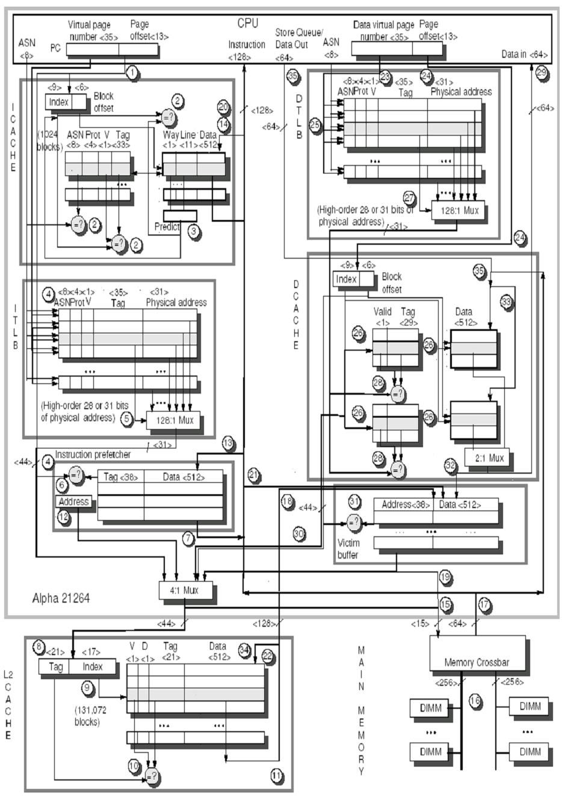

Slide 108
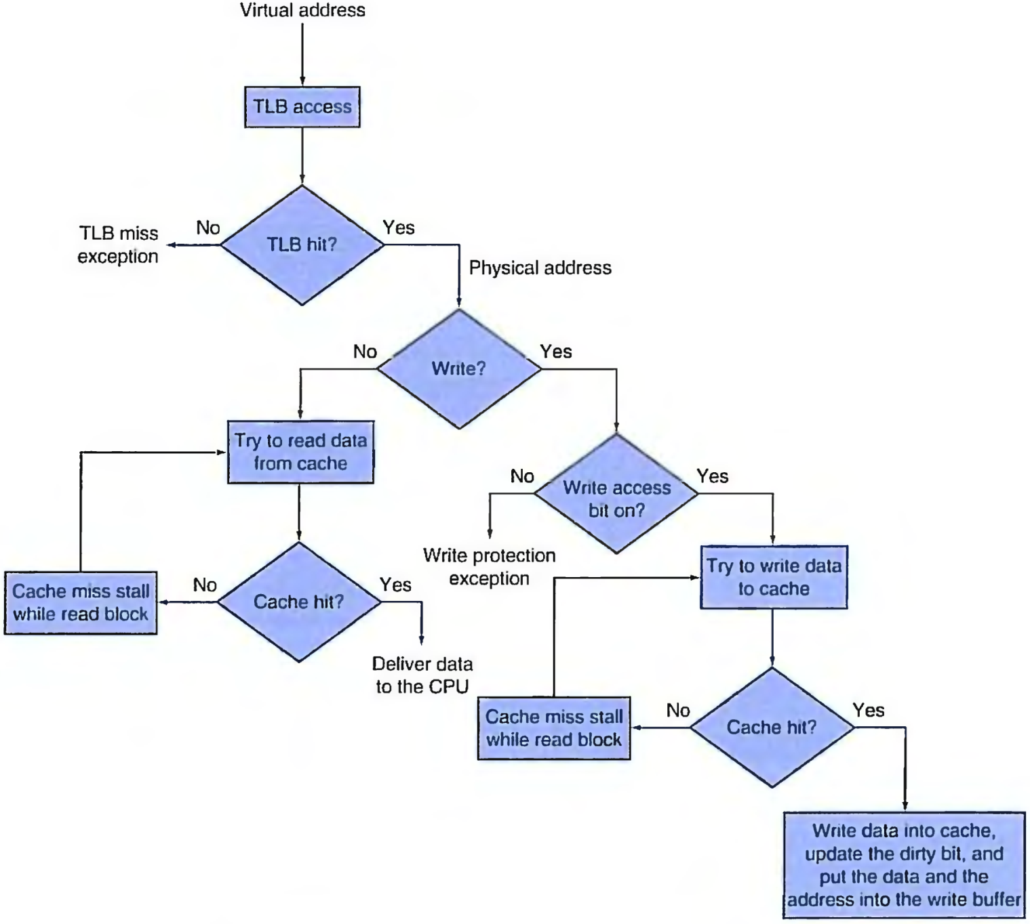
Important concept： Cache
Cache / Memory
L1 cache / L2 cache / L3 cache
Memory / Disk
TLB / page table

Slide 109
Virtual Memory and Virtual Machines
Protection via virtual memory
Keeps processes in their own memory space
Role of architecture
Provide user mode and supervisor mode
Protect certain aspects of CPU state
Provide mechanisms for switching between user mode and supervisor mode
Provide mechanisms to limit memory accesses
Provide TLB to translate addresses

Slide 110
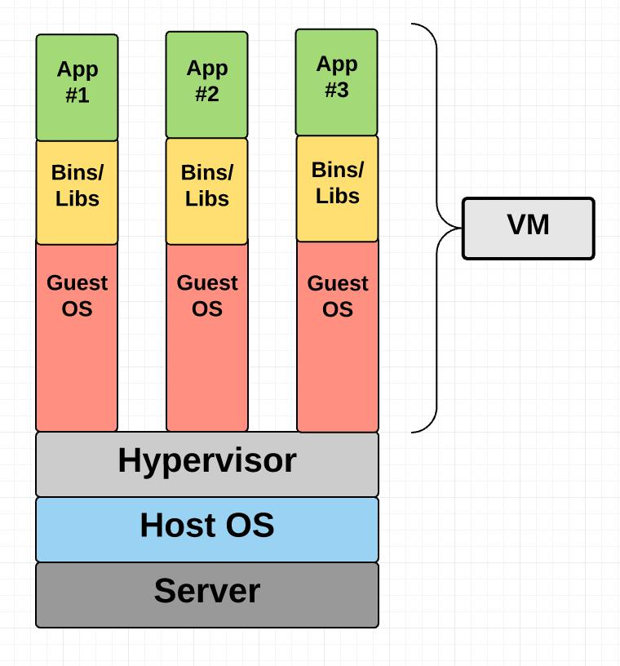
Virtual machine
An efficient, isolated duplicate of the real machine.
VMM （virtual machine monitor）
Provide an environment for programs， which is essentially identical with the original machine.
Programs run in this environment show at worst only minor decrease in speed.
VMM is in complete control of system resources.

Slide 111
Protection via Virtual Machines
Supports isolation and security
Sharing a computer among many unrelated users
Enabled by raw speed of processors, making the overhead more acceptable
Allows different ISAs and operating systems to be presented to user programs
“System Virtual Machines” ( at binary instruction set architecture)
SVM software is called “virtual machine monitor” or “hypervisor”
Individual virtual machines run under the monitor are called “guest VMs”

Slide 112
Requirements of VMM
Guest software should:
Behave on as if running on native hardware
Not be able to change allocation of real system resources
VMM should be able to “context switch” guests
Hardware must allow:
System and use processor modes
Privileged subset of instructions for allocating system resources

Slide 113
Impact of VMs on Virtual Memory
Each guest OS maintains its own set of page tables
VMM adds a level of memory between physical and virtual memory called “real memory”
VMM maintains shadow page table that maps guest virtual addresses to physical addresses
Requires VMM to detect guest’s changes to its own page table
Occurs naturally if accessing the page table pointer is a privileged operation

Slide 114
Extending the ISA for Virtualization
Objectives:
Avoid flushing TLB
Use nested page tables instead of shadow page tables
Allow devices to use DMA to move data
Allow guest OS’s to handle device interrupts
For security: allow programs to manage encrypted portions of code and data

Slide 115
Fallacies and Pitfalls
Predicting cache performance of one program from another
Simulating enough instructions to get accurate performance measures of the memory hierarchy
Not deliverying high memory bandwidth in a cache-based system

Slide 116
End.

