Slide 1
Ch3-- ILP & its exploration
Ch3-1
Instruction Level Parallelism
Basic Compiler Techniques
for Exposing ILP
Dynamic scheduling--Scoreboard
3.1, 3.2, App C7

Slide 2
What is Instruction-Level Parallelism ?
Instruction-level parallelism
The potential overlap among instructions
Basic Block ILP is quite small
Basic Block: a straight-line code sequence with no branches in except to the entry and no branches out except at the exit
average dynamic branch frequency 15% to 25% => 4 to 7 instructions execute between a pair of branches
Plus instructions in BB likely to depend on each other

Slide 3
Recall from Pipelining Review
When exploiting instruction-level parallelism, goal is to maximize CPI
Pipeline CPI = Ideal pipeline CPI + Structural Stalls + Data Hazard Stalls + Control Stalls
Ideal pipeline CPI: measure of the maximum performance attainable by the implementation
Structural hazards: HW cannot support this combination of instructions
Data hazards: Instruction depends on result of prior instruction still in the pipeline
Control hazards: Caused by delay between the fetching of instructions and decisions about changes in control flow (branches and jumps)

Slide 4
How to exploit ILP？
there are two main approaches:
Hardware-based dynamic approaches
Used in server and desktop processors
Not used as extensively in PMP processors
Compiler-based static approaches
Not as successful outside of scientific applications

Slide 5
Chapter 3
ILP: Concepts and Challenge
Basic compiler Techniques for exposing ILP
Overcoming Data Hazards with Dynamic Scheduling
Reducing Branch Costs with Dynamic Branch Prediction
Hardware-based Speculation
Exploiting ILP with Multiple Issue & Static Scheduling
Exploiting ILP with Dynamic scheduling, Multiple issue, & speculation
Advanced Techniques for instruction Delivery and speculation
Multithreading: exploiting TLP improve uniprocessor throughput

Slide 6
Ideas to Reduce Stalls
ChC
Ch3
ChH

Slide 7
Instruction-Level Parallelism (ILP)
To obtain substantial performance enhancements, we must exploit ILP across multiple basic blocks
Simplest: loop-level parallelism to exploit parallelism among iterations of a loop
Vector & GPU is one way
If not vector, then either dynamic via branch prediction or static via loop unrolling by compiler

Slide 8
Data Dependence & hazard
Dependencies are a property of programs, presence of dependence indicates potential for a hazard,
Pipeline organization determines if dependence is detected and if it causes a stall, actual hazard and length of any stall is a property of the pipeline
Data dependence conveys:
Possibility of a hazard ( register & memory location)
Order in which results must be calculated
Upper bound on exploitable instruction level parallelism
Dependencies that flow through memory locations are difficult to detect
Notes:
存储单元的操作一样会有相关性，并且更难判断
编译的时候地址不一定明确知道，很多是在运行的时候才会算出来，所以存储单元的相关性是比寄存器更难判断
两个地址相等：有关 要动态判断

Slide 9
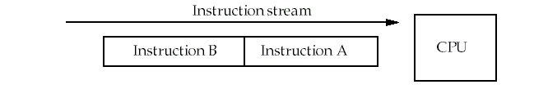
Recall: Types of data hazards
Consider two instructions, A and B. A occurs before B.
RAW( Read after write) true dependence
Instruction A writes Rx，instruction B reads Rx
WAW(Write after write) output dependence
Instruction A writes Rx，instruction B writes Rx
WAR( Write after read) anti-denpendence
Instruction A reads Rx，instruction B writes Rx
Hazards are named according to the ordering that MUST be preserved by the pipeline

Slide 10
True Data Dependence and Hazards
True Data Dependence:
Instr_{J} is data dependent on Instr_{I} Instr_{J} tries to read operand before Instr_{I} writes it
or Instr_{J} is data dependent on Instr_{K} which is dependent on Instr_{I}
Caused by a “True Dependence” (compiler term)
If true dependence caused a hazard in the pipeline, called a Read After Write (RAW) hazard
I: add r1,r2,r3
J: sub r4,r1,r3

Slide 11
Name Dependence 1:Anti-dependence
Name dependence: when 2 instructions use same register or memory location, called a name, but no flow of data between the instructions associated with that name;
Instr_{J} writes operand before Instr_{I} reads it called an “anti-dependence” by compiler writers. This results from reuse of the name “r1”
If anti-dependence caused a hazard in the pipeline, called a Write After Read (WAR) hazard
I: sub r4,r1,r3
J: add r1,r2,r3
K: mul r6,r1,r7

Slide 12
Name Dependence 2: Output dependence
Instr_{J} writes operand before Instr_{I} writes it.
Called an “output dependence” by compiler writers This also results from the reuse of name “r1”
If anti-dependence caused a hazard in the pipeline, called a Write After Write (WAW) hazard
I: sub r1,r4,r3
J: add r1,r2,r3
K: mul r6,r1,r7

Slide 13
Name Dependence
Two instructions use the same name but no flow of information
Not a true data dependence, but is a problem when reordering instructions
Antidependence: instruction j writes a register or memory location that instruction i reads
Initial ordering (i before j) must be preserved
Output dependence: instruction i and instruction j write the same register or memory location
Ordering must be preserved

Slide 14
ILP and Data Hazards
HW/SW must preserve program order: order instructions would execute in if executed sequentially 1 at a time as determined by original source program
HW/SW goal: exploit parallelism by preserving program order only where it affects the outcome of the program
Instructions involved in a name dependence can execute simultaneously if name used in instructions is changed so instructions do not conflict
Register renaming resolves name dependence for registers
Either by compiler or by HW

Slide 15
Control Dependencies
Every instruction is control dependent on some set of branches, and, in general, these control dependencies must be preserved to preserve program order
if p1 {
S1;
};
if p2 {
S2;
}
S1 is control dependent on p1, and S2 is control dependent on p2 but not on p1.

Slide 16
Control Dependence Ignored
Control dependence need not be preserved
willing to execute instructions that should not have been executed, thereby violating the control dependences, if can do so without affecting correctness of the program
Instead, 2 properties critical to program correctness are exception behavior and data flow

Slide 17
Examples
Example 1:
add x1,x2,x3
beq x4,x0,L
sub x1,x1,x6
L: …
or x7,x1,x8
Example 2:
add x1,x2,x3
beq x12,x0,skip
sub x4,x5,x6
add x5,x4,x9
skip:
or x7,x8,x9
or instruction dependent on add and sub
Assume x4 isn’t used after skip
Possible to move sub before the branch

Slide 18
Exception Behavior
Preserving exception behavior
=> any changes in instruction execution order must not change how exceptions are raised in program
(=> no new exceptions)
Example: DADDU R2,R3,R4 BEQZ R2,L1 LW R1,0(R2) L1: ……
Problem with moving LW before BEQZ?
Notes:
ld指令容易出现异常，访存地址不对，越界，缺页中断
条件不成立才能ld，提前到前面的话异常行为会变化
转移指令后面的ld指令不能乱动！

Slide 19
A short summary
ILP
The potential overlap among instructions
Reduce stalls from
Structural hazards
Data hazards
Control hazards
To keep the program correctness, we should
Preserving Data flow
Preserving exception behavior

Slide 20
Lecture for ILP: Software approaches
Basic Compiler Technique for Exposing ILP
Loop unrolling
Static Branch Prediction
Static multiple Issue: VLIW
Advanced Compilor Support for Exposing and Exploiting ILP
Software pipelining
Global Code scheduling
Hardware Support for Exposing More Parallelism at compile time
Conditional or Predicated instructions
Compiler speculation with hardware support

Slide 21
FP Loop: Where are the Hazards?
Loop: LD F0,0(R1) ;F0=vector element
ADDD F4,F0,F2 ;add scalar from F2
SD 0(R1),F4 ;store result
SUBI R1,R1,8 ;decrement pointer 8B (DW)
BNEZ R1,Loop ;branch R1!=zero
NOP ;delayed branch slot
Instruction Instruction Execution Latency producing result using result in cycles in cycles
FP ALU op Another FP ALU op 4 3
FP ALU op Store double 3 2
Load double FP ALU op 1 1
Load double Store double 1 0
Integer op Integer op 1 0
Where are the stalls?

Slide 22
Specification for the latency
ALU F1, -,- : IF ID FD FD FD FD WB
ALU -, F1,-: IF ID s s s FD FD FD FD WB
ALU: IF ID FD FD FD FD WB
SW: IF ID s s EX DM
LW F1, - : IF ID EX DM WB
SW: F1, 8(R1): IF ID EX DM WB
MEM/WB.LDMR --→DM input port
Notes:
FD是什么

Slide 23
Reducing stalls from scheduling in BB and delayed branch
Loop: LD F0, 0(R1)
ADDD F4, F0, F2
SD 0(R1), F4
SUBI R1, R1, #8
BNEZ R1, Loop
F D X M W
F D s A₁ A₂ A₃ A₄ W
F s D s s X M W
F s s D X M W
F s D X M W
10 CC F F
Loop: LD F0, 0(R1)
SUBI R1, R1,#8
ADDD F4, F0, F2
BNEZ R1, Loop
SD +8(R1), F4
F D X M W
F D X M W
F DA₁A₂A₃A₄W
F D X M W
F D s X M W
6 CC F s D X M W

Slide 24
Unroll Loop Four Times (straightforward way)
1 cycle stall
1 Loop: LD F0,0(R1)
2 ADDD F4,F0,F2
3 SD 0(R1),F4 ;drop SUBI & BNEZ
4 LD F6,-8(R1)
5 ADDD F8,F6,F2
6 SD -8(R1),F8 ;drop SUBI & BNEZ
7 LD F10,-16(R1)
8 ADDD F12,F10,F2
9 SD -16(R1),F12
10 LD F14,-24(R1)
11 ADDD F16,F14,F2
12 SUBI R1,R1,#32 ;alter to 4*8
13 SD +8(R1),F16
14 BNEZ R1,LOOP
NOP
14 + 3 x (1+2) +1 +1 +1= 26 clock cycles, or 6.5 per iteration
Assumes R1 is multiple of 4
Rewrite loop to minimize stalls?
2 cycles stall
1 cycle stall
1 cycle stall(waiting for F16
1 cycle control stall

Slide 25
Unrolled Loop That Minimizes Stalls
1 Loop: LD F0,0(R1)
2 LD F6,-8(R1)
3 LD F10,-16(R1)
4 LD F14,-24(R1)
5 ADDD F4,F0,F2
6 ADDD F8,F6,F2
7 ADDD F12,F10,F2
8 ADDD F16,F14,F2
9 SD 0(R1),F4
10 SD -8(R1),F8
11 SUBI R1,R1,#32
12 SD +16(R1),F12
13 BNEZ R1,LOOP
14 SD 8(R1),F16 ; 8-32 = -24
14 clock cycles, or 3.5 per iteration
What assumptions made when moved code?
OK to move store past SUBI even though changes register
OK to move loads before stores: get right data?
When is it safe for compiler to do such changes?

Slide 26
Ideas to Reduce Stalls
ChC
Ch3
ChH

Slide 27
Why Dynamic Scheduling ?
Example1 :
DIVD F0,F2,F4 ADDD F10,F0,F8 SUBD F12,F8,F14
Example2: Structure Hazard
DIVD F2,F2,F4
ADDD F10,F0,F8 ; FP ADDer unpipelined
ADDD F12, F0,F4
MULD F16, F14, F4
Problem: instruction (SUBD, MULD) stalled
due to irrelevent forward instructions.

Slide 28
HW Schemes: Dynamic scheduling
Key idea: Allow instructions behind stall to proceed. Rearrange order of instructions to reduce stalls while maintaining data flow
Enables out-of-order execution and allows out-of-order completion
Will distinguish when an instruction begins execution and when it completes execution; between 2 times, the instruction is in execution
In a dynamically scheduled pipeline, all instructions pass through issue stage in order (in-order issue)

Slide 29
Adv. Of Dynamic Scheduling
Handles cases when dependences unknown at compile time
(e.g., because they may involve a memory reference)
It simplifies the compiler, Compiler doesn’t need to have knowledge of microarchitecture
Allows code that compiled for one pipeline to run efficiently on a different pipeline
Hardware speculation, a technique with significant performance advantages, that builds on dynamic scheduling

Slide 30
Dynamic Scheduling Step 1
Simple pipeline had 1 stage to check both structural and data hazards: Instruction Decode (ID), also called Instruction Issue
Split the ID pipe stage of simple 5-stage pipeline into 2 stages:
Issue—Decode instructions, check for structural hazards
Read operands—Wait until no data hazards, then read operands

Slide 31
Dynamic Scheduling with a Scoreboard
Scoreboarding
Named after CDC6600 scoreboard
Allowing instructions to execute out of order when there are sufficient resources and no data dependences.
In-order issue
Out-of order completion
Executing an instruction as early as possible

Slide 32
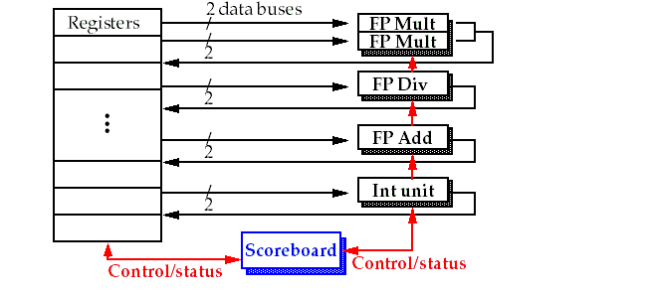
Basic structure of a pipelined processor with a scoreboard

Slide 33

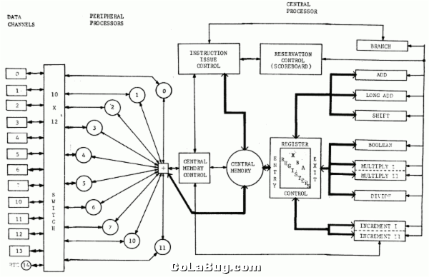
CDC6600 –First Supercomputer top1 1964-1969

Slide 34
The pipeline stages with scoreboard
The Five stages: IF, ID, EX, MEM, WB
IF: the same for all instructions
ID: split into two stages: issue and read operands
EX: no change
MEM: omitted for only concentrating on the FP operations
WB: no change
So, the stages are: IF, IS, RO, EX,WB.
Another way to lookat missing MEM ?

Slide 35
Pipeline supports multiple outstanding FP operations
EX
MEM
M1
M2
M3
M4
M5
M6
M7
WB
IF
ID
A1
A2
A3
A4
DIV

Slide 36
Scoreboard Pipeline stage description
Issue: a instruction is issued when
The functional unit is available and
No other active instruction has the same destination register.
Avoid strutural hazard and WAW hazard
Read Operands (RO)
The read operation is delayed until both the operands are available.
This means that no previously issued but ncompleted instruction has the operand as its destination.
This resolves RAW hazards dynamically
Execution (EX)
Notify the scoreboard when completed so the functional unit can be reused.
Write result (WB)
The scoreboard checks for WAR hazards and stalls the completing instruction if necessary.
Notes:
这一张总结的非常好
RO RAW
WB WAR

Slide 37
The scoreboard algorithm
Scoreboard-takes full responsibility for instruction issue and execution
Create the dependence records
Decide when to fetch the operand
Decide when to enter execution
Decide when the result can be written into the register file
Three data structure
Instruction status:
which of the four steps the instruction is in
Functional unit status: buzy,op,Fi, Fj,Fk,Qj,Qk ,Rj,Rk
Register result status:
which functional unit will write that register
Notes:
Fi、Fj、Fk 代表源操作数和目的操作数（Fi 为源，Fj、Fk 为目的）。
Qj、Qk 代表源操作数来自哪个部件
R是ready，R1为源操作数1是否可用
如果没有ready，他在哪里算？
比如等F4，那F4是在等谁 会把这个谁，也就是操作部件，写在Q里面，等算完了才会改变R的状态
以前的register只有value，现在还有状态status，表示可用or不可用，如果不可用，谁在生产这个值？

Slide 38
Example: Instruction status
LD F6, 34(R2)
LD F2, 45(R3)
MULTD F0, F2, F4
SUBD F8, F6, F2
DIVD F10, F0, F6
ADDD F6, F8, F2
Notes:
F2不可用，所以第三条只能发射（没有结构竞争，没有写写竞争），但是一个源操作数不可用
Add无法发射，因为减法已经把加法器给占用了

Slide 39
Scoreboard Example
Clock cycle counter

Slide 40
Scoreboard Cycle 1
Clock cycle counter
Notes:
现在第一条指令可以发射 Rj为yes代表R2是可以用的
这条指令的目的寄存器F6在等INT部件
根据表原来的值判断，在这个cycle结束的时候进行更新

Slide 41
Scoreboard Cycle 2
Clock cycle counter
Notes:
这一拍进行ro，需要看rj和rk是否可用
这里r变成了no，读过之后要变成no 这是为什么
这里第二条不能发射，因为结构竞争

Slide 42
Scoreboard Cycle 3
Clock cycle counter
Notes:
第三拍的时候看一下只有一条指令处于RO（就是cycle2结束的那个表格）
这一拍开始执行，整数部件开始运作
第二条指令不能发射，因为结构竞争

Slide 43
Scoreboard Cycle 4
Clock cycle counter
Notes:
在访存，ex 有两拍

Slide 44
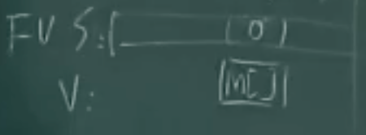
Scoreboard Cycle 5
Clock cycle counter
Notes:
这里reg的写法稍微简单了
其实是有一个status和一个value
这个表格是在这一拍结束的时候两个红色的地方变了，这样下一拍load就可以is

Slide 45
Scoreboard Cycle 6
Clock cycle counter
Notes:
红色的就是第六排结束的时候，就是下一个时钟沿到来的时候要写进去的

Slide 46
Scoreboard Cycle 7
Notes:
源操作数是F2，会去读F2的状态，把F2状态赋给Rj 0代表可用
R是一个二值逻辑，Q是FU的编号
把reg result status里的东西直接写到Q R里面去

Slide 47
Scoreboard Cycle 8
Clock cycle counter
Notes:
Mul一看两个源操作数一个no一个yes，就不能读

Slide 48
Scoreboard Cycle 9
Clock cycle counter

Slide 49
Example: Function unit status and Register status

Slide 50
Scoreboard Cycle 10
Clock cycle counter
Notes:
写完以后寄存器状态才会变化 写完以后操作部件不忙了，去表格里查Q把等于INT的变成0，把R变成yes

Slide 51
Scoreboard Cycle 11
Clock cycle counter
Notes:
No no表示都读过了

Slide 52
Scoreboard Cycle 12

Slide 53
Scoreboard Cycle 15
Notes:
15的时候减法写结果
这个时候还不能发射add，因为15拍开始的时候要看14拍的表格

Slide 54
Scoreboard Cycle 16

Slide 55
Scoreboard Cycle 17

Slide 56
Scoreboard Cycle 18

Slide 57
Scoreboard Cycle 19
Notes:
注意到在这之后，最后一条 ADD 指令必须等到 DIV 指令 RO 之后才能 WB（否则会修改 F6）。

Slide 58
Examples: Dynamic Scheduling
Dynamic scheduling implies:
Out-of-order execution
Out-of-order completion
Example 1:
fdiv.d f0,f2,f4
fadd.d f10,f0,f8
fsub.d f12,f8,f14
fsub.d is not dependent, issue before fadd.d
Example 2:
fdiv.d f0,f2,f4
fmul.d f6,f0,f8
fadd.d f0,f10,f14
fadd.d is not dependent, but the antidependence makes it impossible to issue earlier without register renaming
Notes:
在刚刚的scoreboar里面加法是会发射出去的，但是f0不可用会等在操作部件里
E2里面后两条会有war竞争 加法必须等到乘法把f0读掉才能写 war的延时是很长的

Slide 59
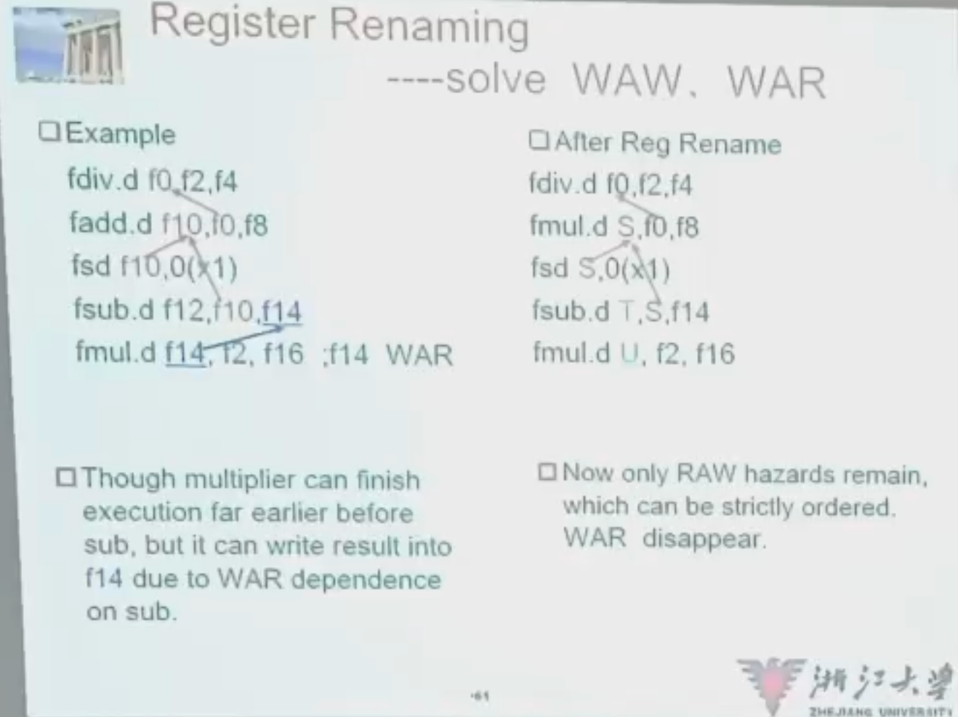
Register Renaming
Example 3:
fdiv.d f0,f2,f4
fadd.d f6,f0,f8
fsd f6,0(x1)
fsub.d f8,f10,f14
fmul.d f6,f10,f8
antidependence
antidependence

Slide 60
Register Renaming
Example 3:
fdiv.d f0,f2,f4
fadd.d S,f0,f8
fsd S,0(x1)
fsub.d T,f10,f14
fmul.d f6,f10,T
Now only RAW hazards remain, which can be strictly ordered

Slide 61
Limitations of Scoreboard-1
ILP
If we can't find independent instructions to execute, scoreboard (or any dynamic scheduling scheme for that matter) helps very little.
Size of the "issued" queue
This determines how far ahead the CPU can look for instructions to execute in parallel.
It's called the window.
For now, we assume that a window can not span a branch.
In other words, the window includes instructions only within basic blocks.

Slide 62
Limitations of Scoreboard-2
Number, types, and speed of the functional units
This determines how often a structural hazard results in stall.
The presence of anti-dependences and output dependences
WAR and WAW hazards limit the scoreboard more than RAW hazards, lead to WAR and WAW stalls.
RAW hazards are problems for any technique.
But WAR and WAW hazards can be solved in ways other than scoreboards.

Slide 63
Scoreboard vs. Tomasulo
特点
Multiple multiplier, etc. Funcs
Issue in order, Complete OOO
IF→ Issue, Ro
4 stages pipeline
Scoreboare centralized control
缺点
Stall when WAW, WAR
Fewer Func, unpipelined
Issue in order, Complete OOO
FP op. queue, Reservation station, LD/ST buffer, CDB
Reg. Rename→No WAW, WAR
Reduce structural hazard
RAW detection decentralized—reservation
CDB→ forwarding path

