Slide 1
Ch3-3 ILP: Branch Prediction & Hardware-based speculation
Notes:
基于硬件的猜测执行

Slide 2
Review
Structural Hazard
Separate/replicate function unit, fully-pipelined function units
Data Hazard
RAW: double-bump, forwarding path, simple compiler scheduling
WAR, WAW: implicit register renaming
Control Hazard
Resolve branch asap, Flushing, Predict-not-taken, Predict-taken, Delayed-Branch

Slide 3
Control Hazard (example P_{A-25})
Flushing: stall until the branch is resolved.
Stall X cycles if delay slots=x
Predict-not-taken:
Hardware takes all branches as not-taken, compiler need to put frequent case in the not-taken branch
Stall 0 cycles if not-taken, stall X cycles if taken
Predict-taken:
Hardware takes all branches as taken, can go forward only when get the branch target . Compiler need to put frequent case in the taken branch
Stall y cycles waiting for branch target; stall X cycles if not taken.
Delayed Branch:

Slide 4
Static branch prediction
Stall for control hazards
= f (branch frequency, prediction accuracy, misprediction penalty )
Predict according to statistics: (predict taken)
Mispredition: 9% ~ 59%, average 34%

Slide 5
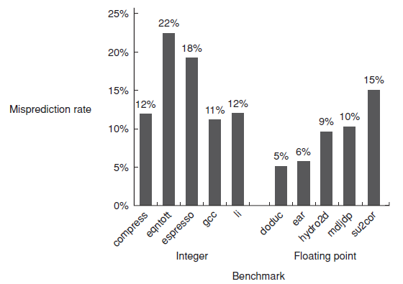
Predict based on profile information
Average misprediction rate 9% for FP programs,
Average misprediction rate 15% for integer programs

Slide 6
Dynamic Hardware Prediction --reducing branch costs
1-bit Branch-Prediction Buffer
2-bit Branch-Prediction Buffer
Correlating Branch Prediction Buffer
Tournament Branch Predictor
Branch Target Buffer
Integrated Instruction Fetch Units
Return Address Predictors
Notes:
每一条指令记录了上一次跳转的结果

Slide 7
1-bit Branch-Prediction Buffer
Performance = ƒ(accuracy, cost of misprediction)
Branch History Table: Lower bits of PC address index table of 1-bit values
Says whether or not branch taken last time
No address check (saves HW, but may not be right branch)
Problem: in a loop, 1-bit BHT will cause 2 mispredictions (avg 2/n iterations before exit):
Only (n-2)/n accuracy even if loop (n-1)/n of the time
0111……1110111… …1110111……1110111…
Notes:
从0变1,1变0会出错
想象对于每一条指令，都有一个bit记录上一次跳转的结果，上一次跳转，猜测这一次跳转
最理想情况是每一条转移指令都有这样的bit
像是敏感的人去炒股
N次循环，n-1是taken，一次是un 一个循环要错两次

Slide 8
2-bit Branch-Prediction Buffer
Solution: 2-bit scheme where change prediction only if get misprediction twice:
(Jim Smith, 1981, A study of branch prediction strategies)
Red: stop, not taken
Blue: go, taken
Adds hysteresis to decision making process
01111111……111110111111…1110111111
T
NT
Predict Taken
Predict Taken
T
T
NT
NT
Predict Not
Taken
Predict Not
Taken
T
NT
Notes:
对自己的猜测保持信心，出错两次才改变猜测方向
和初始状态设置有关系
循环最多错一次

Slide 9
An alternative 2-bit predictor
It can be implemented using a 2-bit counter
T
NT
Predict Taken
Surely
Predict Taken
T
T
NT
NT
Predict Not
Taken
Predict Not
Taken surely
T
NT

Slide 10
Generalize the 2-bit predictor to n-bit predictor
N-bit counter ( 0<x<2^{n}-1)
Predict taken X >= 2^{n-1}
Predict untaken X < 2^{n-1}
Counter + 1 when a taken branch
Counter – 1 when a not taken branch
Most system rely on 2-bit predictor rather than n-bit predictor.

Slide 11
Accuracy of the 2-bit predictor
4096 entries, 2-bit predictor
SPEC89
Accuracy : 99%~82%
Misprediction: 1%~18%

Slide 12
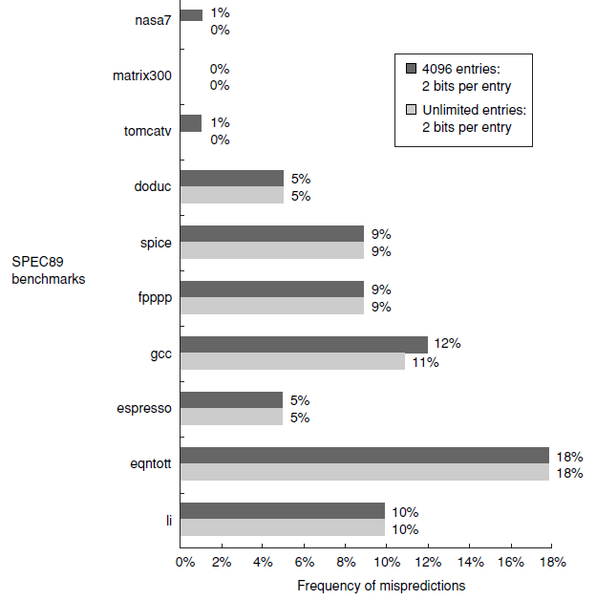
How about unlimited entries ?

Slide 13
How to improve accuracy ?
Analysize the branch behavior
IF ( aa == 2)
aa = 0;
IF ( bb == 2)
bb = 0;
IF (aa == bb ) {
……
}
SUBI R3, R1, #2
BNEZ R3, L1 ; br.b1 (aa!=2)
ADD R1, R0, R0 ; aa==0
L1: SUBI F3, R2, #2
BNEZ R3, L2 ; br.b2 (bb!=2)
ADD R2, R0, R0 ; bb==0
L2: SUB R3, R1, R2; R3=aa-bb
BEQZ R3, L3 ; br.b3 (aa==bb)
Notes:
不只是依赖于自己的历史，而是和别的指令有关系

Slide 14
Conclusion from the example
B3 branch depends on b1 and b2. B3 is taken only when both b1 and b2 is untaken.
It’s impossible to predict B3 correctly only depending on its previous behavior.
A branch’s behavior not only rely on it’s previous behavior but also on recent behavior of other branches.

Slide 15
Let’s check an example
If (d==0)
d=1;
if (d==1){
…...
}
Assume Reg[R1] = d
BNEZ R1, L1 ; br b1, (d!=0)
DADDIU R1, R0, #1 ; d==0, so d=1
L1: DADDIU R3, R1, #-1 ;
BNEZ R3, L2 ; br b2, (d!=1)
……
L2:

Slide 16
Feature of the code:
d的 初值 | d==0? | B1 | 在b2以前的d值 | d==1? | b2
0 | Yes | Not taken | 1 | Yes | Not taken
1 | No | Taken | 1 | Yes | Not taken
2 | No | Taken | 2 | no | Taken
Conclusion: b2 will be not taken if b1 is not taken
So, we can get accurate prediction if using correlate predictor.

Slide 17
Always mispredict if using one-bit predictor
d=? | b1预测 | b1动作 | 新的b1预测 | b2预测 | b2动作 | 新的b2预测
2 | NT | T | T | NT | T | T
0 | T | NT | NT | T | NT | NT
2 | NT | T | T | NT | T | T
0 | T | NT | NT | T | NT | NT
预测与实际动作 预测与实际动作
总是相反 总是相反
Notes:
每条指令有自己的预测
因为没有关联考虑这两条指令

Slide 18
Correlating predictor
Correlating predictor is composed of two parts ( two bits ):
1st bit: prediction for previous br. is NT，
2nd bit: prediction for previous br. Is T
Four combinations
预测 组合 | 上一次Br为NT,预测本次位(看第一位) | 上一次Br为T,预测本次为(看第二位)
NT/NT | NT | NT
NT/ T | NT | T
T /NT | T | NT
T / T | T | T
Note, previous Br might be a different br.
Notes:
• 最近一次执行的分支与要预测的分支可能不是同一条指令
要考虑相关跳转指令的结果
根据上一个指令是跳还是不跳分别用一个转移预测期

Slide 19
Prediction with correlating predictor (1,1) with initial value =NT/NT.
粗体字表示本次预测
预测出错 b1动作与b2预测值选用关系
预测正确 b2动作与b1预测值选用关系
新预测值
粗体字表示本次预测
预测出错 b1动作与b2预测值选用关系
预测正确 b2动作与b1预测值选用关系
新预测值
Notes:
还是一位预测器，只是no的时候用前面的预测值，t的时候用后面的
记为（1，1）预测器，即根据最近一次分支的行为来选择一对1-bit预测器中的一个。 • 更一般的表示为（m, n)，即根据最近的m个分支，从2m个分支预测器中选择预测器，每个预测器的位数为n

Slide 20
Correlating Branches prediction buffer
Idea: taken/not taken of recently executed branches is related to behavior of next branch (as well as the history of that branch behavior)
Then behavior of recent branches selects between, say, 4 predictions of next branch, updating just that prediction
(2,2) predictor: 2-bit global, 2-bit local
Branch address (4 bits)
2-bits per branch local predictors
Prediction
2-bit global
branch history
(01 = not taken then taken)

Slide 21
4.Correlating Branches prediction buffer
Assume branch history with branch i in blue box.
0 0 0 0 0 1 1 1 0 0 0 0 0 1 1 1 0 0 0 0 0 1 1 1
Predict: v v x
v v x v v v
00
00
00
01
00
00
11
Branch i
01
6次
3次
Branch history
11

Slide 22
(m, n) predictor
m: previous m branch instruction
2^{m}

Slide 23
Comparision of 2-bit predictors

Slide 24
Accuracy analysis
Mispredict because either:
Wrong guess for the branch
Got branch history of wrong branch when index the table.
Notes:
大循环 PC后面是一样的但是前面不一样 大循环和小循环用了同一个转移预测器
行为不一样，把预测器改掉了 互相干扰

Slide 25
4、Tournament Predictors
Motivation for correlating branch predictors is 2-bit predictor failed on important branches; by adding global information, performance improved
Tournament predictors: use 2 predictors, 1 based on global information and 1 based on local information, and combine with a selector
Hopes to select right predictor for right branch

Slide 26
Tournament Predictor in Alpha 21264
4K 2-bit counters to choose from among a global predictor and a local predictor
Global predictor also has 4K entries and is indexed by the history of the last 12 branches; each entry in the global predictor is a standard 2-bit predictor
12-bit pattern: ith bit 0 => ith prior branch not taken; ith bit 1 => ith prior branch taken;
00,10,11
00,01,11
1
4K × 2 bits
2
Use 1
Use 2
3
10
01
01
10
.
.
01
.
Use 1
Use 2
10
12
00,11
00,11

Slide 27
T-Predictor in Alpha 21264 （cont.)
Local predictor consists of a 2-level predictor:
Top level a local history table consisting of 1024 10-bit entries; each 10-bit entry corresponds to the most recent 10 branch outcomes for the entry. 10-bit history allows patterns 10 branches to be discovered and predicted.
Next level Selected entry from the local history table is used to index a table of 1K entries consisting a 3-bit saturating counters, which provide the local prediction
Total size: 4K*2 + 4K*2 + 1K*10 + 1K*3 = 29K bits! (~180,000 transistors)
1K × 10 bits
1K × 3 bits

Slide 28
% of predictions from local predictor in Tournament Prediction Scheme
0%
20%
40%
60%
80%
100%
nasa7
98%
matrix300
100%
tomcatv
94%
doduc
90%
spice
55%
fpppp
76%
gcc
72%
espresso
63%
eqntott
37%
li
69%

Slide 29
Accuracy of Branch Prediction
99%
tomcatv
99%
100%
95%
doduc
84%
97%
86%
fpppp
82%
Profile-based
98%
2-bit counter
88%
Tournament
li
77%
98%
86%
espresso
82%
96%
88%
gcc
70%
94%
fig 3.40
0%
20%
40%
60%
80%
100%
Profile: branch profile from last execution (static in that is encoded in instruction, but profile)

Slide 30
Accuracy v. Size (SPEC89)
10%
9%
8%
Local - 2 bit counters
7%
6%
Conditional branch misprediction rate
5%
Correlating - (2,2) scheme
4%
3%
Tournament
2%
1%
0%
0
8
16
24
32
40
48
56
64
72
80
88
96
104
112
120
128
Total predictor size (Kbits)

Slide 31
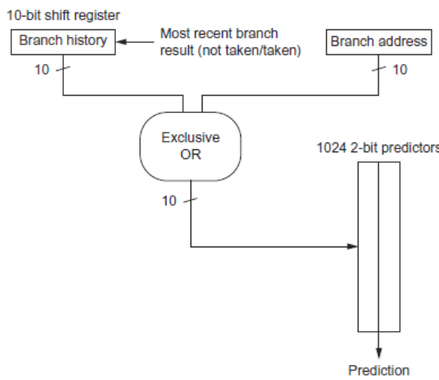
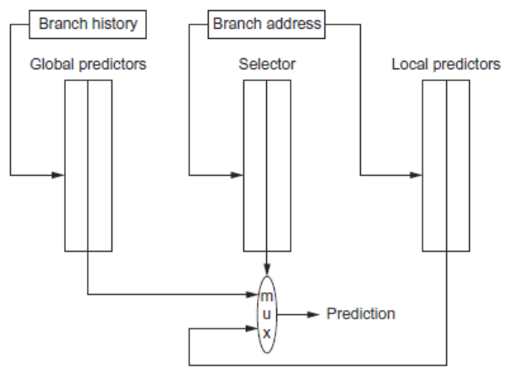
Other Branch Prediction
gshare
tournament

Slide 32
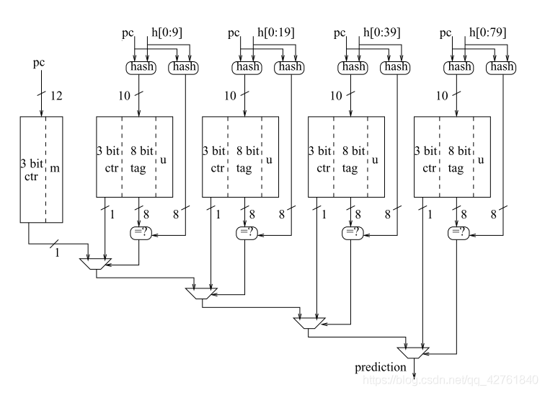
PPM（Prediction by Partial Matching）
Michaud Pierre 2005
A PPM-like, Tag-based Predictor.
J. Instr. Level Parallelism 7 (2005)
第一届CBP取得了第五名的成绩
Notes:
由部分PC直接索引的3-bits饱和计数器，充当本地预测器。与一般的饱和计数器不同，附带了一个m位(meta-predictor 代表全局预测器的有效性)。右边的四个部分是四个类似Gshare的预测器，把本地PC和全局分支历史通过Hash结合到一起。其中心思想在于构造一个竞争预测器以本地的预测作为基础，而使用带有全局分支信息的多个作用条件更强的预测器作为辅助，辅助预测器适用的作用条件越强，其预测的上下文越具体，其预测在和其他预测器竞争时可信度越高。这样就在进入和脱离特定上下文时减少了惯性，而在上下文具有典型的特征时作出准确的预测。在预测时，PC和不同长度的全局分支历史通过索引Hash(此处是带折叠的XOR)得到索引值，而后得到饱和计数器ctr值，8-bit的tag值和u(useful 代表记录的有效性)值，同时PC和不同长度的全局分支历史通过校验Hash(随便起的名字，是图上右边的hash函数，用于校验的hash函数和用于索引的函数是不同的)得到8-bit校验值，比较该值和查找表中的tag值，如果两者相同则控制底部的Mux选择Mux右边输入(ctr高位的输出)，如该不同则选择Mux左边输入的值(前一级传入输出)。这样预测器则总会选择tag和Hash输出命中的具有最长全局分支历史的预测器的预测结果，如果tag一个都没命中，则选择本地预测器结果。

Slide 33
Tagged Hybrid Predictors
Need to have predictor for each branch and history
Problem: this implies huge tables
Solution:
Use hash tables, whose hash value is based on branch address and branch history
Longer histories may lead to increased chance of hash collision, so use multiple tables with increasingly shorter histories

Slide 34
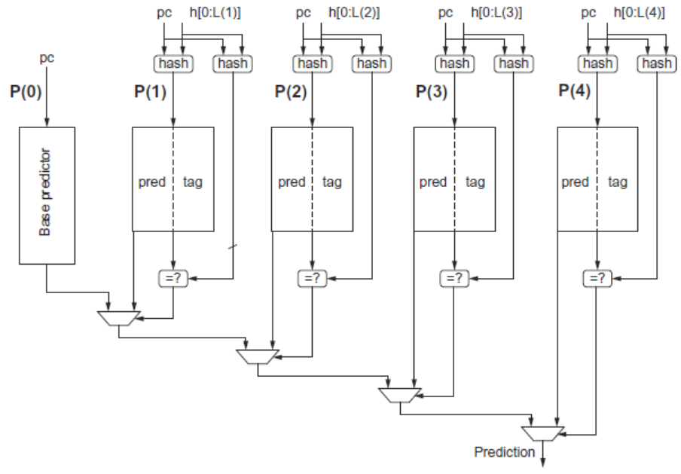
TAGE(TAgged GEometric history length branch prediction:

Slide 35
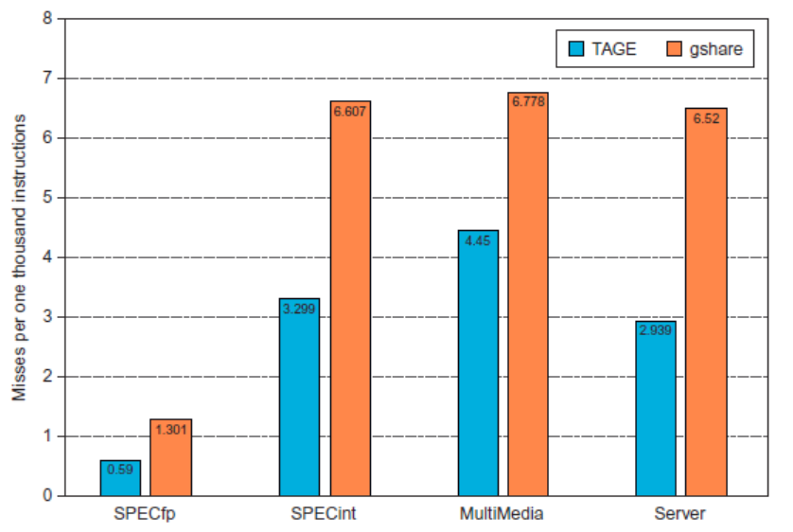
Tagged Hybrid Predictors

Slide 36
5. Branch Target Buffer
Branch Target Buffer (Branch Target Cache):
Address of branch index to get prediction AND branch address (if taken)
Note: must check for branch match now, since can’t use wrong branch address
Branch PC
Predicted PC
PC of instruction
FETCH
=?
Yes: instruction is branch and use predicted PC as next PC
Extra
prediction state
bits
No: branch not
predicted, proceed normally
(Next PC = PC+4)
Notes:
把上一次跳转的pc值给记录下来

Slide 37
Branch Target “Cache”
Branch Target cache - Only predicted taken branches
“Cache” - Content Addressable Memory (CAM) or Associative Memory (see figure)
Use a big Branch History Table & a small Branch Target Cache
Branch PC
Predicted PC
PC
=?
Prediction state
bits (optional)
Yes: predicted taken branch found
No: not found

Slide 38
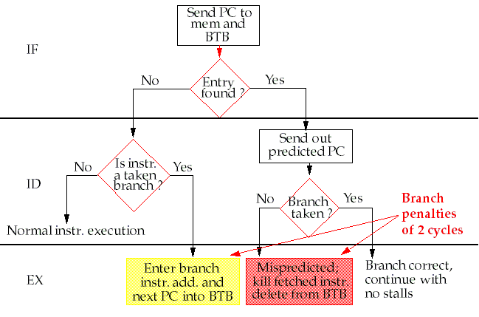
Steps in handling an instruction with a Branch-Target Buffer

Slide 39
Variations of Branch Target Buffer
Instead of storing just the branch address, the BTB can store the actual instruction as well.
Storing both the branch address and the actual instruction in the buffer
Very big branch Target buffer to cache addresses or instructions from multiple paths, ex, the predicted and unpredicted direction

Slide 40
6. Integrated Instruction Fetch Units
Increasing the number of instructions executed per clock, instruction fetch will become an significant bottleneck.
Integrated instruction fetch unit:
Integrated branch prediction
Instruction prefetch
(see P438 hardward prefetch &
P483 ex. Instruction prefetcher )
Instruction memory access and buffering

Slide 41
7、Return Address Predictors
Technique for predicting indirect jumps, whoes destination address varies at run time.
Register Indirect branch hard to predict address
SPEC89: procedure return account for 85% of the indirect jumps.
Branch-target buffer doesn’t work well for procedure return

Slide 42
Return Addresses Buffer
Since stack discipline for procedures, save return address in small buffer that acts like a stack:
Caches the most recent return addresses.
Push return address into stack at a call;
pop an address off at a return
SPEC benchmark shows a stack with 8-16 entries works quite well. (fig-3.22)

Slide 43
Dynamic Branch Prediction Summary
Prediction becoming important part of scalar execution
Branch History Table: 2 bits for loop accuracy
Correlation: Recently executed branches correlated with next branch.
Either different branches
Or different executions of same branches
Tournament Predictor: more resources to competitive solutions and pick between them
Tagged Hybrid Predictors: have predictor for each branch and history
Branch Target Buffer: include branch address & prediction
Predicated Execution can reduce number of branches, number of mispredicted branches
Return address stack for prediction of indirect jump

Slide 44
Chapter3 ILP Hardware Based Speculation

Slide 45
Tomasulo Drawbacks
Complexity
delays of 360/91, MIPS 10000, Alpha 21264, IBM PPC 620 in CA:AQA 2/e, but not in silicon!
Many associative stores (CDB) at high speed, Performance limited by Common Data Bus
Non-precise interrupts!
We will address this later
Partially overlapped basic blocks
integer units get ahead, beyond FP operation
the successor basic block can not start execution until the branch is resolved, in spite of that it can be issued.
Notes:
We talked about Tomasulo algorithm and found that it gets better performance than scoreboard, but it’s not good enough for ILP exploration.
In spite of Non-precise interrupts, it can only provide partially overlapped basic blocks, which means
1) Next basic block can be issued before a branch is resolved.
2) Integer instructions in successor basic block can go ahead beyond the FP operations in previous block.
But it requires that a branch is resolved before actually executing any instruction in the successor basic block.

Slide 46
Hardward-based Speculation
Speculating on the outcome of branches and executing the program as if the predictions were correct.
Need to handle the situation where the speculation is incorrect.
Key ideas:
Dynamic branch prediction to choose which instruction to execute
Speculation to allow the execution of instructions before the control dependences are resolved.
Dynamic scheduling to deal with the scheduling of different combinations of basic blocks.
Data flow execution:
Operations execute as soon as their operands are available.
Notes:
We talked about using dynamic branch predictor to increase predict accuracy, so that we can decrease the stalls due to control hazards.
We can go further. Get the predicted Instruction Address by combining the predictor with target PC avoiding Target address calculation.
Even further by combining the branch target instruction buffer with predictor, so that we can get the instruction avoiding memory access.
How about take a further step to execute the instructions in the predicted basic block ?
That’s the basic motivation of speculation !
branch prediction + speculatively execution + Dynamic scheduling
1) Using dynamic branch predictor to select which instructions to execute speculatively.
2) Speculation to execute the predicted instruction before a branch is resolved, with the ability to undo the effects of a wrong guess instruction sequence.
3) Schedule the instructions dynamically to deal with different combination of basic blocks.
So it’s a Data flow execution ignoring the control dependences between the instructions.

Slide 47
Hardware-Based Speculation
Execute instructions along predicted execution paths but only commit the results if prediction was correct
Instruction commit: allowing an instruction to update the register file when instruction is no longer speculative
Need an additional piece of hardware to prevent any irrevocable action until an instruction commits
I.e. updating state or taking an executionb

Slide 48
Speculative execution based on Tomasulo's algorithm
Separate the process of completing execution and the bypassing of results among instructions from instruction commit (reg file or memory update).
Allows other (speculative) instructions to execute, but no results are committed until we know the instruction is no longer speculative.
Allow instructions to execute out of order but force them to commit in order, which helps with handling exceptions properly.
Notes:
It needs to be able to undo the effects of the speculated instruction sequence, so that we should separate the bypassing results and the actual completion of an instruction.
So that we can allow the instructions to execute and bypass its results to other instructions which is required to execute speculatively, at the same time allow a instruction to update the register file or memory only when it is assured that the instruction is no longer speculative.
We call the stage of updating register file or memory “instruction commit”. And instruction commit should be kept in order so that we can undo the effects. So the instructions, speculative or not speculative are executed out of order and can have the execution results out of order, but instructions will be committed in order.
We need additional buffer to store the results that finish executing but not ready for commitment.

Slide 49
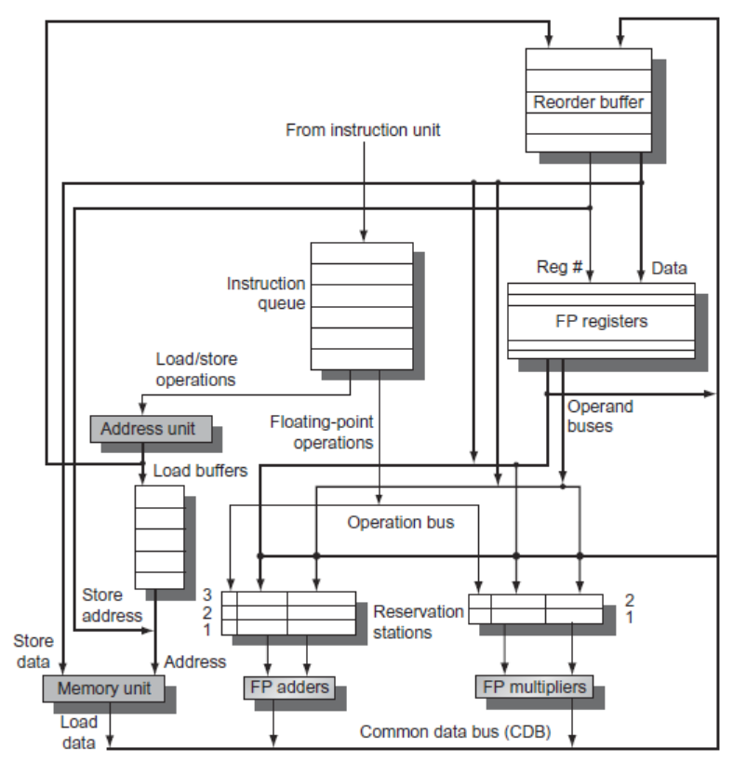
Extend Tomasulo’s Algorithm to handle speculation
Notes:
The reorder buffer takes the responsibility of reservation stations in Tomasulo algorithm, and more.
Works as cyclic FIFO queue to enable in-order commitment.
Buffer the results between the time finishing executing and the time instruction commits for normal instructions and speculative instructions.
Provide extra registers as a source of instruction operands, enable implicit register renaming.
Also act as store buffer.
We still need the reservation stations to buffer the operations between issue and execution. The only difference is that we tag the results using reorder buffer number.

Slide 50
Review: Tomasulo Algorithm
From Intruction unit
From Mem
FP Op
Queue
FP Registers
Load Buffers
Load1
Load2
Load3
Load4
Load5
Load6
Store
Buffers
Add1
Add2
Add3
Mult1
Mult2
Reservation
Stations
To Mem
FP adders
FP multipliers
Common Data Bus (CDB)

Slide 51
Difference from Tomasulo Algorithm
Reorder Buffer is added
Eliminate store buffer (Mem write is ordered in Reorder buffer)
Register renaming is done via reorder buffer instead of reservation station
Reservation only for storing opcodes and operands during the instruction flying between issue and execution.
ROB hold the instruction results and supply operands in the interval between completion of instruction execution and instruction commit.

Slide 52
Entry of ROB
Instruction type
Destination field
Value field
Ready field
Exception vector
Notes:
Instruction type: ALU, LD, ST, Branch,
Destination field: Register number for ALU, LD
Memory address for ST
Value: hold the results between finishing execution
and waiting for commits.
Ready: result is ready or not.

Slide 53
4 Steps of Speculative Tomasulo Algorithm
1. Issue—get instruction from FP Op Queue
If reservation station and reorder buffer slot free, issue instr & send operands & reorder buffer no. for destination (this stage sometimes called “dispatch”) , update control entries “in use”.
2.Execution—operate on operands (EX)
When both operands ready then execute; if not ready, watch CDB for result; when both in reservation station, execute; checks RAW
3.Write result—finish execution (WB)
Write on Common Data Bus to all awaiting FUs & reorder buffer; mark the reservation station available.
4.Commit—update register with reorder result
When instruction at head of reorder buffer & result present, update register with result (or store to memory) and remove instr from reorder buffer. Mispredicted branch flushes reorder buffer (sometimes called “graduation”)

Slide 54
What to do when commit ?
when an instruction reaches the head of ROB and its result is present in the buffer, then
For non-Branch instruction
Update the register with the result
Remove the instruction from ROB
When it’s a STORE, update the memory instead of Reg.
For a mispredicted branch
ROB is flushed and execution is restarted at the correct successor of the branch
For a right-predicted branch
End of branch instruction.

Slide 55
Tomasulo With Reorder buffer:
2 clock cycles for pipelined memory access
Reorder Buffer
Done?
FP Op
Queue
ROB7
ROB6
ROB5
ROB4
ROB3
ROB2
ROB1
Newest
LD F6,34(R2)
LD F2,45(R3)
MULD F0,F2,F4
SUBD F8,F2,F6
DIVD F10,F0,F6
ADDD F6,F8,F2
LD F6,34(R2)
Oldest
F6
LD F6,34(R2)
N
Registers
Busy, ROB No. Value
To
Memory
Dest
Dest
from
Memory
Dest
Reservation
Stations
1 34+R2
FP adders
FP multipliers
Notes:
Resolve RAW memory conflict? (address in memory buffers)
Integer unit executes in parallel

Slide 56
Tomasulo With Reorder buffer:
Done?
FP Op
Queue
ROB7
ROB6
ROB5
ROB4
ROB3
ROB2
ROB1
Newest
Reorder Buffer
LD F6,34(R2)
LD F2,45(R3)
MULD F0,F2,F4
SUBD F8,F2,F6
DIVD F10,F0,F6
ADDD F6,F8,F2
F2
LD F2,45(R3)
N
Oldest
F6
LD F6,34(R2)
N
Registers
To
Memory
Dest
Dest
from
Memory
Dest
Reservation
Stations
1 34+R2
2 45+R3
FP adders
FP multipliers
Notes:
Resolve RAW memory conflict? (address in memory buffers)
Integer unit executes in parallel

Slide 57
Tomasulo With Reorder buffer:
Done?
FP Op
Queue
ROB7
ROB6
ROB5
ROB4
ROB3
ROB2
ROB1
Newest
Reorder Buffer
F0
MULD F0,F2,F4
N
LD F6,34(R2)
LD F2,45(R3)
MULD F0,F2,F4
SUBD F8,F2,F6
DIVD F10,F0,F6
ADDD F6,F8,F2
F2
LD F2,45(R3)
N
Oldest
F6
LD F6,34(R2)
N
Registers
To
Memory
Dest
Dest
from
Memory
3 MULD ROB2,R(F4)
Dest
Reservation
Stations
1 34+R2
2 45+R3
FP adders
FP multipliers
Notes:
Resolve RAW memory conflict? (address in memory buffers)
Integer unit executes in parallel

Slide 58
Tomasulo With Reorder buffer:
Note: The first LD will finish memeory access next cycle
Done?
FP Op
Queue
ROB7
ROB6
ROB5
ROB4
ROB3
ROB2
ROB1
Newest
N
N
Reorder Buffer
F8
SUBD F8,F2,F6
N
F0
MULD F0,F2,F4
N
LD F6,34(R2)
LD F2,45(R3)
MULD F0,F2,F4
SUBD F8,F2,F6
DIVD F10,F0,F6
ADDD F6,F8,F2
F2
LD F2,45(R3)
N
Oldest
F6
LD F6,34(R2)
N
Registers
To
Memory
Dest
Dest
from
Memory
4 SUBD ROB2,ROB1
3 MULD ROB2,R(F4)
Dest
Reservation
Stations
1 34+R2
2 45+R3
FP adders
FP multipliers
Notes:
Resolve RAW memory conflict? (address in memory buffers)
Integer unit executes in parallel

Slide 59
Tomasulo With Reorder buffer:
Note: The 2nd LD will finish memeory access next cycle
Done?
FP Op
Queue
ROB7
ROB6
ROB5
ROB4
ROB3
ROB2
ROB1
Newest
N
F10
DIVD F10,F0,F6
N
Reorder Buffer
F8
SUBD F8,F2,F6
N
F0
MULD F0,F2,F4
N
LD F6,34(R2)
LD F2,45(R3)
MULD F0,F2,F4
SUBD F8,F2,F6
DIVD F10,F0,F6
ADDD F6,F8,F2
F2
LD F2,45(R3)
N
Oldest
F6
M[34+R2]
LD F6,34(R2)
Y
Registers
To
Memory
Dest
Dest
from
Memory
4 SUBD ROB2,M[34+R2]
3 MULD ROB2,R(F4)
5 DIVD ROB3,M[34+R2]
Dest
Reservation
Stations
1 34+R2
2 45+R3
FP adders
FP multipliers
Notes:
Resolve RAW memory conflict? (address in memory buffers)
Integer unit executes in parallel

Slide 60
Tomasulo With Reorder buffer:
Done?
FP Op
Queue
ROB7
ROB6
ROB5
ROB4
ROB3
ROB2
ROB1
Newest
F6
ADDD F6,F8,F2
N
F10
DIVD F10,F0,F6
N
Reorder Buffer
F8
SUBD F8,F2,F6
N
F0
MULD F0,F2,F4
N
LD F6,34(R2)
LD F2,45(R3)
MULD F0,F2,F4
SUBD F8,F2,F6
DIVD F10,F0,F6
ADDD F6,F8,F2
F2
M[45+R3]
LD F2,45(R3)
Y
Oldest
F6
M[34+R2]
LD F6,34(R2)
Y
Registers
To
Memory
Dest
Dest
from
Memory
4 SUBD M[45+R3],M[34+R2]
6 ADDD ROB4, M[45+R3]
3 MULD M[45+R3],R(F4)
5 DIVD ROB3,M[34+R2]
Dest
Reservation
Stations
1 34+R2
2 45+R3
FP adders
FP multipliers
Notes:
Resolve RAW memory conflict? (address in memory buffers)
Integer unit executes in parallel

Slide 61
Tomasulo With Reorder buffer:
Done?
FP Op
Queue
ROB7
ROB6
ROB5
ROB4
ROB3
ROB2
ROB1
Newest
F6
ADDD F6,F8,F2
N
F10
DIVD F10,F0,F6
N
Reorder Buffer
F8
V[1]
SUBD F8,F2,F6
Y
F0
MULD F0,F2,F4
N
LD F6,34(R2)
LD F2,45(R3)
MULD F0,F2,F4
SUBD F8,F2,F6
DIVD F10,F0,F6
ADDD F6,F8,F2
F2
M[45+R3]
LD F2,45(R3)
Y
Oldest
F6
M[34+R2]
LD F6,34(R2)
Y
Registers
To
Memory
Dest
Dest
from
Memory
6 ADDD V[1], M[45+R3]
3 MULD M[45+R3],R(F4)
5 DIVD ROB3,M[34+R2]
Dest
Reservation
Stations
FP adders
FP multipliers
Notes:
Resolve RAW memory conflict? (address in memory buffers)
Integer unit executes in parallel

Slide 62
Speculation performance
Overlapped basic block
Is there any new problems ?
Pay attention to the memory accessing

Slide 63
Tomasulo With Reorder buffer:
Done?
FP Op
Queue
ROB7
ROB6
ROB5
ROB4
ROB3
ROB2
ROB1
Newest
Reorder Buffer
Oldest
F0
LD F0,10(R2)
N
Registers
To
Memory
Dest
Dest
from
Memory
Dest
Reservation
Stations
1 10+R2
FP adders
FP multipliers
Notes:
Resolve RAW memory conflict? (address in memory buffers)
Integer unit executes in parallel

Slide 64
Tomasulo With Reorder buffer:
Done?
FP Op
Queue
ROB7
ROB6
ROB5
ROB4
ROB3
ROB2
ROB1
Newest
Reorder Buffer
F10
ADDD F10,F4,F0
N
Oldest
F0
LD F0,10(R2)
N
Registers
To
Memory
Dest
Dest
from
Memory
2 ADDD R(F4),ROB1
Dest
Reservation
Stations
1 10+R2
FP adders
FP multipliers
Notes:
Resolve RAW memory conflict? (address in memory buffers)
Integer unit executes in parallel

Slide 65
Tomasulo With Reorder buffer:
Done?
FP Op
Queue
ROB7
ROB6
ROB5
ROB4
ROB3
ROB2
ROB1
Newest
Reorder Buffer
F2
DIVD F2,F10,F6
N
F10
ADDD F10,F4,F0
N
Oldest
F0
LD F0,10(R2)
N
Registers
To
Memory
Dest
Dest
from
Memory
2 ADDD R(F4),ROB1
3 DIVD ROB2,R(F6)
Dest
Reservation
Stations
1 10+R2
FP adders
FP multipliers
Notes:
Resolve RAW memory conflict? (address in memory buffers)
Integer unit executes in parallel

Slide 66
Tomasulo With Reorder buffer:
Done?
FP Op
Queue
ROB7
ROB6
ROB5
ROB4
ROB3
ROB2
ROB1
Newest
F0
ADDD F0,F4,F6
N
F4
LD F4,0(R3)
N
Reorder Buffer
--
BNE F2,<…>
N
F2
DIVD F2,F10,F6
N
F10
ADDD F10,F4,F0
N
Oldest
F0
LD F0,10(R2)
N
Registers
To
Memory
Dest
Dest
from
Memory
2 ADDD R(F4),ROB1
6 ADDD ROB5, R(F6)
3 DIVD ROB2,R(F6)
Dest
Reservation
Stations
1 10+R2
5 0+R3
FP adders
FP multipliers
Notes:
Resolve RAW memory conflict? (address in memory buffers)
Integer unit executes in parallel

Slide 67
Tomasulo With Reorder buffer:
Done?
FP Op
Queue
--
ROB5
ST 0(R3),F4
N
ROB7
ROB6
ROB5
ROB4
ROB3
ROB2
ROB1
Newest
F0
ADDD F0,F4,F6
N
F4
LD F4,0(R3)
N
Reorder Buffer
--
BNE F2,<…>
N
F2
DIVD F2,F10,F6
N
F10
ADDD F10,F4,F0
N
Oldest
F0
LD F0,10(R2)
N
Registers
To
Memory
Dest
Dest
from
Memory
2 ADDD R(F4),ROB1
6 ADDD ROB5, R(F6)
3 DIVD ROB2,R(F6)
Dest
Reservation
Stations
1 10+R2
6 0+R3
FP adders
FP multipliers
Notes:
Resolve RAW memory conflict? (address in memory buffers)
Integer unit executes in parallel

Slide 68
Tomasulo With Reorder buffer:
Done?
FP Op
Queue
--
M[10]
ST 0(R3),F4
Y
ROB7
ROB6
ROB5
ROB4
ROB3
ROB2
ROB1
Newest
F0
ADDD F0,F4,F6
N
F4
M[10]
LD F4,0(R3)
Y
Reorder Buffer
--
BNE F2,<…>
N
F2
DIVD F2,F10,F6
N
F10
ADDD F10,F4,F0
N
Oldest
F0
LD F0,10(R2)
N
Registers
To
Memory
Dest
Dest
from
Memory
2 ADDD R(F4),ROB1
6 ADDD M[10],R(F6)
3 DIVD ROB2,R(F6)
Dest
Reservation
Stations
1 10+R2
FP adders
FP multipliers
Notes:
Resolve RAW memory conflict? (address in memory buffers)
Integer unit executes in parallel

Slide 69
Tomasulo With Reorder buffer:
Done?
FP Op
Queue
--
M[10]
ST 0(R3),F4
Y
ROB7
ROB6
ROB5
ROB4
ROB3
ROB2
ROB1
Newest
F0
<val2>
ADDD F0,F4,F6
Ex
F4
M[10]
LD F4,0(R3)
Y
Reorder Buffer
--
BNE F2,<…>
N
F2
DIVD F2,F10,F6
N
F10
ADDD F10,F4,F0
N
Oldest
F0
LD F0,10(R2)
N
Registers
To
Memory
Dest
Dest
from
Memory
2 ADDD R(F4),ROB1
3 DIVD ROB2,R(F6)
Dest
Reservation
Stations
1 10+R2
FP adders
FP multipliers
Notes:
Resolve RAW memory conflict? (address in memory buffers)
Integer unit executes in parallel

Slide 70
Tomasulo With Reorder buffer:
Done?
FP Op
Queue
--
M[10]
ST 0(R3),F4
Y
ROB7
ROB6
ROB5
ROB4
ROB3
ROB2
ROB1
Newest
F0
<val2>
ADDD F0,F4,F6
Ex
F4
M[10]
LD F4,0(R3)
Y
Reorder Buffer
--
BNE F2,<…>
N
F2
DIVD F2,F10,F6
N
F10
ADDD F10,F4,F0
N
Oldest
What about memory
hazards???
F0
LD F0,10(R2)
N
Registers
To
Memory
Dest
Dest
from
Memory
2 ADDD R(F4),ROB1
3 DIVD ROB2,R(F6)
Dest
Reservation
Stations
1 10+R2
FP adders
FP multipliers
Notes:
Resolve RAW memory conflict? (address in memory buffers)
Integer unit executes in parallel

Slide 71
new problem--memory disambiguation
Question: Given a load that follows a store in program order, are the two related?
(Alternatively: is there a RAW hazard between the store and the load)? Eg: ST 0(R2), R5 LD R4, 0(R3)
Can we go ahead and start the load early?
Store address could be delayed for a long time by some calculation that leads to R2 (divide?).
We might want to issue/begin execution of both operations in same cycle.

Slide 72
Tomasulo With Reorder buffer:
Done?
FP Op
Queue
ROB7
ROB6
ROB5
ROB4
ROB3
ROB2
ROB1
Newest
Reorder Buffer
Oldest
-
ST R5,0(R2)
N
Registers
To
Memory
Dest
Dest
from
Memory
Dest
Reservation
Stations
FP adders
FP multipliers
Notes:
Resolve RAW memory conflict? (address in memory buffers)
Integer unit executes in parallel

Slide 73
Tomasulo With Reorder buffer:
Done?
FP Op
Queue
ROB7
ROB6
ROB5
ROB4
ROB3
ROB2
ROB1
Newest
Reorder Buffer
F10
ADDD F10,F4,F0
N
Oldest
-
ST R5,0(R2)
N
Registers
To
Memory
Dest
Dest
from
Memory
2 ADDD R(F4),R（F0)
Dest
Reservation
Stations
FP adders
FP multipliers
Notes:
Resolve RAW memory conflict? (address in memory buffers)
Integer unit executes in parallel

Slide 74
Tomasulo With Reorder buffer:
Done?
FP Op
Queue
ROB7
ROB6
ROB5
ROB4
ROB3
ROB2
ROB1
Newest
Reorder Buffer
F2
DIVD F2,F10,F6
N
F10
ADDD F10,F4,F0
N
Oldest
-
ST R5,0(R2)
N
Registers
To
Memory
Dest
Dest
from
Memory
2 ADDD R(F4),R(F0)
3 DIVD ROB2,R(F6)
Dest
Reservation
Stations
FP adders
FP multipliers
Notes:
Resolve RAW memory conflict? (address in memory buffers)
Integer unit executes in parallel

Slide 75
Tomasulo With Reorder buffer:
Done?
FP Op
Queue
ROB7
ROB6
ROB5
ROB4
ROB3
ROB2
ROB1
Newest
F0
ADDD F0,F4,F6
N
F4
LD F4,0(R3)
N
Reorder Buffer
--
BNE F2,<…>
N
F2
DIVD F2,F10,F6
N
F10
ADDD F10,F4,F0
N
Oldest
-
ST R5,0(R2)
N
Registers
To
Memory
Dest
Dest
from
Memory
2 ADDD R(F4), ROB?
6 ADDD ROB5, R(F6)
3 DIVD ROB2,R(F6)
Dest
Reservation
Stations
4 0+R3
FP adders
FP multipliers
Notes:
Resolve RAW memory conflict? (address in memory buffers)
Integer unit executes in parallel

Slide 76
Tomasulo With Reorder buffer:
Done?
FP Op
Queue
--
ROB5
ST 0(R3),F4
N
ROB7
ROB6
ROB5
ROB4
ROB3
ROB2
ROB1
Newest
F0
ADDD F0,F4,F6
N
F4
LD F4,0(R3)
N
Reorder Buffer
--
BNE F2,<…>
N
F2
DIVD F2,F10,F6
N
F10
ADDD F10,F4,F0
N
Oldest
F0
ST R5,0(R2)
N
Registers
To
Memory
Dest
Dest
from
Memory
2 ADDD R(F4),R(F0)
6 ADDD ROB5, R(F6)
3 DIVD ROB2,R(F6)
Dest
Reservation
Stations
4 0+R3
FP adders
FP multipliers
Notes:
Resolve RAW memory conflict? (address in memory buffers)
Integer unit executes in parallel

Slide 77
Tomasulo With Reorder buffer:
Done?
FP Op
Queue
--
M[10]
ST 0(R3),F4
Y
ROB7
ROB6
ROB5
ROB4
ROB3
ROB2
ROB1
Newest
F0
ADDD F0,F4,F6
N
F4
M[10]
LD F4,0(R3)
Y
Reorder Buffer
--
BNE F2,<…>
N
F2
DIVD F2,F10,F6
N
F10
ADDD F10,F4,F0
N
Oldest
F0
ST R5,0(R2)
N
Registers
To
Memory
Dest
Dest
from
Memory
2 ADDD R(F4), ROB?
6 ADDD M[10],R(F6)
3 DIVD ROB2,R(F6)
Dest
Reservation
Stations
4 0+R3
FP adders
FP multipliers
Notes:
Resolve RAW memory conflict? (address in memory buffers)
Integer unit executes in parallel

Slide 78
Tomasulo With Reorder buffer:
Done?
FP Op
Queue
--
M[10]
ST 0(R3),F4
Y
ROB7
ROB6
ROB5
ROB4
ROB3
ROB2
ROB1
Newest
F0
<val2>
ADDD F0,F4,F6
Ex
F4
M[10]
LD F4,0(R3)
Y
Reorder Buffer
--
BNE F2,<…>
N
F2
DIVD F2,F10,F6
N
F10
ADDD F10,F4,F0
N
Oldest
F0
ST R5,0(R2)
N
Registers
To
Memory
Dest
Dest
from
Memory
2 ADDD R(F4), ROB?
3 DIVD ROB2,R(F6)
Dest
Reservation
Stations
4 0+R3
FP adders
FP multipliers
Notes:
Resolve RAW memory conflict? (address in memory buffers)
Integer unit executes in parallel

Slide 79
Tomasulo With Reorder buffer:
Done?
FP Op
Queue
--
M[10]
ST 0(R3),F4
Y
ROB7
ROB6
ROB5
ROB4
ROB3
ROB2
ROB1
Newest
F0
<val2>
ADDD F0,F4,F6
Ex
F4
M[10]
LD F4,0(R3)
Y
Reorder Buffer
--
BNE F2,<…>
N
F2
DIVD F2,F10,F6
N
F10
ADDD F10,F4,F0
N
Oldest
What if 0(R3)=0(R2)
F0
ST R5,0(R2)
N
Registers
To
Memory
Dest
Dest
from
Memory
2 ADDD R(F4), ROB?
3 DIVD ROB2,R(F6)
Dest
Reservation
Stations
4 0+R3
FP adders
FP multipliers
Notes:
Resolve RAW memory conflict? (address in memory buffers)
Integer unit executes in parallel

Slide 80
Memory Disambiguation: Sorting out RAW Hazards in memory
Question: Given a load that follows a store in program order, are the two related?
(Alternatively: is there a RAW hazard between the store and the load)? Eg: ST 0(R2), R5 LD R6, 0(R3)
Can we go ahead and start the load early?
Store address could be delayed for a long time by some calculation that leads to R2 (divide?).
We might want to issue/begin execution of both operations in same cycle.
Today: Answer is that we are not allowed to start load until we know that address 0(R2) ≠ 0(R3)

Slide 81
Hardware Support for Memory Disambiguation
Need buffer to keep track of all outstanding stores to memory, in program order.
Keep track of address (when becomes available) and value (when becomes available)
FIFO ordering: will retire stores from this buffer in program order
When issuing a load, record current head of store queue (know which stores are ahead of you).

Slide 82
Hardware Support for Memory Disambiguation(2)
When have address for load, check store queue:
If any store prior to load is waiting for its address, stall load.
If load address matches earlier store address (associative lookup), then we have a memory-induced RAW hazard:
store value available ⇒ return value
store value not available ⇒ return ROB number of source
Otherwise, send out request to memory
Actual stores commit in order, so no worry about WAR/WAW hazards through memory.

Slide 83
Memory Disambiguation:
Done?
FP Op
Queue
ROB7
ROB6
ROB5
ROB4
ROB3
ROB2
ROB1
Newest
Reorder Buffer
F4
LD F4, 10(R3)
N
--
ST 10(R3), F5
N
F0
LD F0,32(R2)
N
Oldest
--
<val 1>
ST 0(R3), F4
Y
Registers
To
Memory
Dest
Dest
from
Memory
Dest
Reservation
Stations
2 32+R2
4 ROB3
FP adders
FP multipliers
Notes:
Resolve RAW memory conflict? (address in memory buffers)
Integer unit executes in parallel

Slide 84
HW support for precise interrupts
Need HW buffer for results of uncommitted instructions: reorder buffer
3 fields: instr, destination, value
Use reorder buffer number instead of reservation station when execution completes
Supplies operands between execution complete & commit
(Reorder buffer can be operand source => more registers like RS)
Once instruction commits, result is put into register
As a result, easy to undo speculated instructions on mispredicted branches or exceptions
Reorder
Buffer
FP
Op
Queue
FP Regs
Res Stations
Res Stations
FP Adder
FP Adder

Slide 85
 | 记分牌 | Tomasulo | 带投机的Tomasulo
主要 思想 | 动态调度、按序发射、乱序 执行、乱序完成、集中控制。 | 动态调度、按序发射、乱序 执行、乱序完成分散控制。 增加RS（保留站）,CDB。 | 转移预测, 动态调度、投机执行、 按序完成。在RS基础上再增加ROB(reorder buffer)。
解决 何种 竞争 | RAW数据竞争。 WAW,WAR时stall | 解决数据竞争,避免WW,WAR 竞争;允许硬件支持的循环展 开，不局限于程序基本块。 | 解决数据竞争,避免WW,WAR 竞争;从数据竞争扩充到控制竞争。通过 预测减少控制竞争stall。
指 令 节 拍 | ISSUE：停顿于结构竞争和WAW竞争。 RO：等待两个操作数就绪,动态解决RAW。 EX：和普通流水线一样。 WB：停顿于WAR竞争。 | ISSUE：仅停顿于结构竞争（RS部件）。 EX：利用保留站（RS）进行换名，解决了WAW和WAR问题（即名字相关）。 WB：回写。 | ISSUE：仅停顿于结构竞争（RS部件和ROB部件）。 EX：等待操作数就绪，执行。 WB：结果写到ROB，其它指令可以引用该临时结果，但不更新寄存器。 COMMIT：保证按序完成，保证精确中断。
关键 部件 | 记分牌、集中控制、指令状 态、功能部件状态、寄存器 结果状态。 | CDB(通用数据总线)：执行结果通过CDB传递，及时。 RS(保留站)：换名功能以及暂存临时数据。 | ROB(REORDER BUFFER)重构序缓冲器： 对移到顶部的指令进行判断。。。ROB 负责寄存器重命名、暂存执行后和交付 前的结果、
其它 | 从静态调度到动态调度的过 渡算法。 | 一旦指令将临时结果放在保留站，则其它后续的指令都能立即在寄存器组中看见这个结果。 | 某指令将临时结果放在ROB后，其它指 令并不能从寄存器组中看到这个结果 （也就是说，寄存器组的值并没有更 新），而是等待该指令提交（commit） 后，寄存器组才更新。

Slide 86
ARM处理器体系结构
ARM流水线的执行顺序：
取指令（Fetch）：从存储器读取指令；
译码（Decode）：译码以鉴别它是属于哪一条指令；
执行（Execute）：将操作数进行组合以得到结果或存储器地址；
缓冲/数据（Buffer/data）：如果需要，则访问存储器以存储数据；
回写：（Write-back）：将结果写回到寄存器组中；

Slide 87
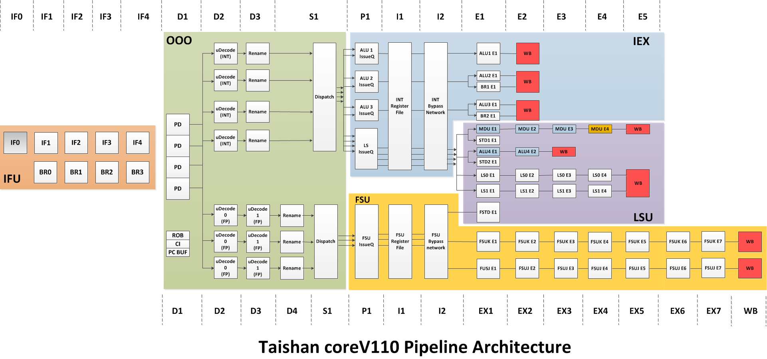
基于ARMv8的鲲鹏流水线技术

Slide 88
基于ARMv8的鲲鹏流水线技术
Branch预测和取指流水线解耦设计，取指流水线每拍最多可提供32Bytes指令供译码，分支预测流水线可以不受取指流水停顿影响，超前进行预测处理；
定浮点流水线分开设计，解除定浮点相互反压，每拍可为后端执行部件提供4条整型微指令及3条浮点微指令；
整型运算单元支持每拍4条ALU运算（含2条跳转）及1条乘除运算；
浮点及SIMD运算单元支持每拍2条ARM Neon 128bits 浮点及SIMD运算；
访存单元支持每拍2条读或写访存操作，读操作最快4拍完成，每拍访存带宽为2x128bits读及1x128bits写；

