Slide 1
Change3-4 Multiple-issue ----SuperScalar & VLIW

Slide 2
Review – explore ILP via Hardware approaches
Basic 5-stage pipeline
Extended to pipeline supporting FP operations
Scoreboard
Tomasulo Algorithm
Branch predictor
Hardware-based Speculation
Explicit register renaming

Slide 3
Review:
achieve an ideal CPI = 1 !
Forwarding
Reduce potential data hazard stalls.
Delayed branch
Reduce control stalls with simple branch scheduling
Dynamic scheduling
Scoreboard:
reduce data stalls from true data dependence
Tomasulo:
Eliminate data stalls from WAR & WAW data dependences via renaming
Reduce data hazard stalls via out-of-order execution
Branch predictor
Reduce control stalls
Hardware-based speculation
Branch predictor + dynamic scheduling + speculation

Slide 4
Getting CPI < 1 Multiple Issue Processors:
Vector Processing: Explicit coding of independent loops as operations on large vectors of numbers
Multimedia instructions being added to many processors
Superscalar: varying number of instructions/cycle (1 to 8), scheduled by compiler or by HW (Tomasulo)
IBM PowerPC, Sun UltraSparc, DEC Alpha, Pentium III/4
(Very) Long Instruction Words (V)LIW: fixed number of instructions (4-16) scheduled by the compiler; put ops into wide templates (TBD)
Intel Architecture-64 (IA-64) 64-bit address
Renamed: “Explicitly Parallel Instruction Computer (EPIC)”
Anticipated success of multiple instructions lead to Instructions Per Clock cycle (IPC) vs. CPI

Slide 5
Explore ILP via Multiple-issue
Goal:
Allow multiple instructions to issue in a clock cycle. Getting CPI < 1:
Approach
Static Superscalar
Dynamic Superscalar
Speculative Superscalar
VLIW/LIW
EPIC( IA-64)
Notes:
EPIC: Explicit Parallel Instruction Computing

Slide 6
Comparison
 | Issue Structure | Hazard Detection | Scheduling | Characteristic | examples
Superscalar (static) | Dynamic | Hardware | Static | In-order execution | Sun UltraSPARCII
Superscalar (dynamic) | Dynamic | Hardware | Dynamic | Some out-or-order exec. | IBM Power2
Superscalar (speculative) | Dynamic | Hardware | Dynamic With speculation | Out-of-order exec. With speculation | Pentium III/4 MIPS R10K, Alpha 21264
VLIW/ LIW | Static | Software | Static | No hazards in issue packets | Trimedia, i860
EPIC | Mostly static | Mostly software | Mostly static | Explicit dependences marked by compiler | Itanium
Notes:
EPIC: Explicit parallel instruction computer
proposed by HP and Intel when create IA-64 architecture.

Slide 7
Superscalar
the processor tries to issue more than one instruction (varying number 1-8 ) per cycle so as to keep all of the functional units busy.
Statically scheduled
using compiler techniques
In-order execution
Dynamically scheduled
using techniques based on Tomasulo’s algorithm
Out-of-order execution

Slide 8
Statically Scheduled Superscalar
Instruction issue in order
All pipeline hazards are checked for at issue time. May issue 0~8 instructions per Clockcycle.
Issue packet: the instruction group received from the fetch unit that potentially issue in one clock cycle.
Issue stage is split and pipelined:
Decide how many instructions from the packet can issue simultaneously (within packet )
Detect hazards among the selected instructions and those that have already been issued.(between packet)

Slide 9
An example of dual-issue pipeline

Slide 10
Ex. Superscalar MIPS
2 instructions, 1 FP & 1 anything
– Fetch 64-bits/clock cycle; Int on left, FP on right
– Can only issue 2nd instruction if 1st instruction issues
– More ports for FP registers to do FP load & FP op in a pair
1 cycle load delay expands to 3 instructions in Superscalar
instruction in right half can’t use it, nor instructions in next slot
Branch delay for a taken branch becomes either two or three instructions

Slide 11
Superscalar MIPS pipeline in operation

Slide 12
Multiple Issues
issue packet: group of instructions from fetch unit that could potentially issue in 1 clock
If instruction causes structural hazard or a data hazard either due to earlier instruction in execution or to earlier instruction in issue packet, then instruction does not issue
0 to N instruction issues per clock cycle, for N-issue
Performing issue checks in 1 cycle could limit clock cycle time: O(n²-n) comparisons
=> issue stage usually split and pipelined
1st stage decides how many instructions from within this packet can issue, 2nd stage examines hazards among selected instructions and those already been issued
=> higher branch penalties => prediction accuracy important

Slide 13
Multiple Issue Challenges
While Integer/FP split is simple for the HW, get CPI of 0.5 only for programs with:
Exactly 50% FP operations AND No hazards
If more instructions issue at same time, greater difficulty of decode and issue:
Even 2-scalar => examine 2 opcodes, 6 register specifiers, & decide if 1 or 2 instructions can issue; (N-issue ~O(N²-N) comparisons)
Register file: need 2*N reads and 1*N writes/cycle

Slide 14
Multiple Issue Challenges(cont.)
Rename logic: must be able to rename same register multiple times in one cycle! For instance, consider 4-way issue:
add r1, r2, r3 add p11, p4, p7 sub r4, r1, r2 ⇒ sub p22, p11, p4 lw r1, 4(r4) lw p23, 4(p22) add r5, r1, r2 add p12, p23, p4
Imagine doing this transformation in a single cycle!
Result buses: Need to complete multiple instructions/cycle
So, need multiple buses with associated matching logic at every reservation station.
Or, need multiple forwarding paths

Slide 15
Dynamically Scheduled Superscalar
Potentially overcome the issue restrictions.
Two different approaches to issue multiple instructions per clock:
Pipeline: Run this step in half a clock cycle, so that two instructions can be processed in one clock cycle.
Widen issue logic: Build the logic necessary to handle two instructions at once, including any possible dependences between the instructions.
Both: Modern superscalar processors often include both pipeline and widen the issue logic.

Slide 16
Example
Assumptions:
1 FP and 1 integer operation per CC. even if they are dependent.
One interger function unit for ALU and address calculations
Separate function unit for evaluating branch condition
Single issue for branches, but perfect prediction.
No speculation: all instr. following a branch are delay until branch resolved.
Loop: L.D F0, 0(R1)
ADD.D F4, F0, F2
S.D F4, 0(R1)
DADDIU R1, R1, #-8
BNE R1,R2, Loop
Function Latency:
1 cycle for integer ALU
2 cycles for load
3 cycles for FP add.

Slide 17
Operation on a dual-issue version of Tomasulo pipeline
One memory unit, one interger pipeline, one FP adder
Structure hazard
No speculation
Structure hazard
Structure hazard
Integer function unit ➔bottleneck

Slide 18
Separate FU for ALU op and Address Calculation
A second CDB is needed !

Slide 19
Multiple Issue with Speculation
A speculative processor can be extended to multiple issue.
Need to handle multiple instruction commits per clock cycle.
Example:
Loop: LD R2, 0(R1)
ADDI R2, R2, #1
SD R2, 0(R1)
ADDI R1, R1, #4
BNE R2, R3, Loop

Slide 20
Assumptions
Separate integer function units for
Effective address calculation
ALU operations
Branch condition evaluation

Slide 21
Dual-issue without speculation

Slide 22
Dual-issue with speculation

Slide 23
Explore ILP via Software approaches
Basic Compiler Technique for Exposing ILP
Loop unrolling
Static Branch Prediction
Static multiple Issue: VLIW
Advanced Compilor Support for Exposing and Exploiting ILP
Software pipelining
Global Code scheduling
Hardware Support for Exposing More Parallelism at compile time
Conditional or Predicated instructions
Compiler speculation with hardware support

Slide 24
Review: Static Branch Prediction
Simplest: Predict taken
average misprediction rate = untaken branch frequency, which for the SPEC programs is 34%.
Unfortunately, the misprediction rate ranges from not very accurate (59%) to highly accurate (9%)
Predict on the basis of branch direction?
choosing backward-going branches to be taken (loop)
forward-going branches to be not taken (if)
SPEC programs, however, most forward-going branches are taken => predict taken is better
Predict branches on the basis of profile information collected from earlier runs
Misprediction varies from 5% to 22%

Slide 25
Example:
For ( i=1000; i>0; i=i-1 )
x[i] = x[i] + s;
Notes:
Let check the example to see
What compiler can do to increase the amount of available ILP by transforming loops.

Slide 26
First: Translate into MIPS code
Loop: LD F0,0(R1) ;F0=vector element
ADDD F4,F0,F2 ;add scalar from F2
SD 0(R1),F4 ;store result
SUBI R1,R1,8 ;decrement pointer 8B (DW)
BNEZ R1,R2,Loop ;branch if R1 != R2
NOP ;delayed branch slot
Instruction Instruction Latency producing result using result in cycles
FP ALU op Another FP ALU op 3
FP ALU op Store double 2
Load double FP ALU op 1
Load double Store double 0
Integer op Integer op 0

Slide 27
Where are the Hazards?
Loop: LD F0, 0(R1)
ADDD F4, F0, F2
SD 0(R1), F4
SUBI R1, R1, #8
BNE R1,R2 Loop
1 Loop: L.D F0,0(R1)
2 stall
3 ADD.D F4,F0,F2
4 stall
5 stall
6 S.D 0(R1),F4
7 DSUBUI R1,R1,8
8 stall
9 BNEZ R1,R2,Loop
10 stall
F D X M W
F D s A₁ A₂ A₃ A₄ W
F s D s s X M W
F s s D X M W
F s D X M W
10 CC F F

Slide 28
Reducing stalls from scheduling in Basic and delayed branch
Loop: LD F0, 0(R1)
SUBI R1, R1,#8
ADDD F4, F0, F2
BNEZ R1,R2 Loop
SD +8(R1), F4
Loop: LD F0, 0(R1)
ADDD F4, F0, F2
SD 0(R1), F4
SUBI R1, R1, #8
BNEZ R1,R2, Loop
F D X M W
F D s A₁ A₂ A₃ A₄ W
F s D s s X M W
F s s D X M W
F s D X M W
10 CC F F
F D X M W
F D X M W
F DA₁A₂A₃A₄W
F D X M W
F D s X M W
F s D X M W
6 CC

Slide 29
Unrolled Loop That Minimizes Stalls
1 Loop: LD F0,0(R1)
2 LD F6,-8(R1)
3 LD F10,-16(R1)
4 LD F14,-24(R1)
5 ADDD F4,F0,F2
6 ADDD F8,F6,F2
7 ADDD F12,F10,F2
8 ADDD F16,F14,F2
9 SD 0(R1),F4
10 SD -8(R1),F8
11 SUBI R1,R1,#32
12 SD +16(R1),F12
13 BNEZ R1,LOOP
14 SD 8(R1),F16 ; 8-32 = -24
14 clock cycles, or 3.5 per iteration
What assumptions made when moved code?
OK to move store past SUBI even though changes register
OK to move loads before stores: get right data?
When is it safe for compiler to do such changes?

Slide 30
Compiler Perspectives on Code Movement
Compiler concerned about dependencies in program
Whether or not a HW hazard depends on pipeline
Try to schedule to avoid hazards that cause performance losses
(True) Data dependencies (RAW if a hazard for HW)
Instruction i produces a result used by instruction j, or
Instruction j is data dependent on instruction k, and instruction k is data dependent on instruction i.
If dependent, can’t execute in parallel
Easy to determine for registers (fixed names)
Hard for memory (“memory disambiguation”) problem:
Does 100(R4) = 20(R6)?
From different loop iterations, does 20(R6) = 20(R6)?

Slide 31
Compiler Perspectives on Code Movement
Our example required compiler to know that if R1 doesn’t change then: 0(R1) ≠ -8(R1) ≠ -16(R1) ≠ -24(R1)
There were no dependencies between some loads and stores so they could be moved by each other

Slide 32
Unrolled Loop Detail
Do not usually know upper bound of loop
Suppose it is n, and we would like to unroll the loop to make k copies of the body
Instead of a single unrolled loop, we generate a pair of consecutive loops:
1st executes (n mod k) times and has a body that is the original loop
2nd is the unrolled body surrounded by an outer loop that iterates (n/k) times
For large values of n, most of the execution time will be spent in the unrolled loop

Slide 33
Steps Compiler Performed to Unroll
Check OK to move the S.D after DSUBUI and BNEZ, and find amount to adjust S.D offset
Determine unrolling the loop would be useful by finding that the loop iterations were independent
Rename registers to avoid name dependencies
Eliminate extra test and branch instructions and adjust the loop termination and iteration code
Determine loads and stores in unrolled loop can be interchanged by observing that the loads and stores from different iterations are independent
requires analyzing memory addresses and finding that they do not refer to the same address.
Schedule the code, preserving any dependences needed to yield same result as the original code

Slide 34
Not good enough due to limitations
Amount of overhead amortized with each unroll
Overhead: 2/6 → 2/14=1/ 7 → 2/26=1/13
2/iteration 2/4 iteration 2/8 iteration
Result in growth of code size
Potential shortfall in registers.
What about branch but not loop ?

Slide 35
Using Loop unrolling and scheduling with static Multiple Issue
Integer Instruction | FP instruction | Clock cycle
Loop: L.D F0, 0(R1) |  | 1
L.D F0, -8(R1) |  | 2
L.D F0, -16(R1) | ADD.D F4, F0. F2 | 3
L.D F0, -24(R1) | ADD.D F8, F6. F2 | 4
L.D F0, -32(R1) | ADD.D F12, F10. F2 | 5
S.D F4, 0(R1) | ADD.D F16, F14. F2 | 6
S.D F8, -8(R1) | ADD.D F20, F18. F2 | 7
S.D F12,-16(R1) |  | 8
DADDUI R1, R1, #-40 |  | 9
S.D F16, 16(R1) |  | 10
BNE R1, R2, Loop |  | 11
S.D F20, 8(R1) |  | 12

Slide 36
Static Multiple issue: VLIW
VLIW: Very Long Instruction Word
Each “instruction” has explicit coding for multiple operations
In EPIC, grouping called a “packet”
In Transmeta, grouping called a “molecule” (with “atoms” as ops)
Tradeoff instruction space for simple decoding
The long instruction word has room for many operations
By definition, all the operations the compiler puts in the long instruction word are independent => execute in parallel
E.g., 2 integer operations, 2 FP ops, 2 Memory refs, 1 branch
16 to 24 bits per field => 7*16 or 112 bits to 7*24 or 168 bits wide
Need compiling technique that schedules across several branches

Slide 37
Loop Unrolling in VLIW
Memory Memory FP FP Int. op/ Clock reference 1 reference 2 operation 1 op. 2 branch
LD F0,0(R1) LD F6,-8(R1) 1
LD F10,-16(R1) LD F14,-24(R1) 2
LD F18,-32(R1) LD F22,-40(R1) ADDD F4,F0,F2 ADDD F8,F6,F2 3
LD F26,-48(R1) ADDD F12,F10,F2 ADDD F16,F14,F2 4
ADDD F20,F18,F2 ADDD F24,F22,F2 5
SD 0(R1),F4 SD -8(R1),F8 ADDD F28,F26,F2 6
SD -16(R1),F12 SD -24(R1),F16 7
SD -32(R1),F20 SD -40(R1),F24 SUBI R1,R1,#48 8
SD -0(R1),F28 BNEZ R1,LOOP 9
Unrolled 7 times to avoid delays
7 results in 9 clocks, or 1.3 clocks per iteration (1.8X)
Average: 2.5 ops per clock, 50% efficiency
Note: Need more registers in VLIW (15 vs. 6 in SS)

Slide 38
Problems for VLIW
Technical problems
Increase in code size
Loop unrolling—statically finding parallelism
Unused function slots
Limitations of lockstep operation
A stall in any function unit may cause the entire processor to stall
Logistical problem
Binary code compatibility
Major challenge for all multiple-issue processors
Exploit large amounts of ILP

Slide 39
Advanced Compiler Support for Exploiting ILP (section 4.4 in 3rd edition) （appendix H in 6th edition）
Detecting and Enhancing Loop-level Parallelism
Eliminating Dependent Computations
Software pipelining: Symbolic loop unrolling
Global Code Scheduling
Trace Scheduling: focus on Critical path
Superblocks

Slide 40
Dynamic Scheduling, Multiple Issue, and Speculation
Modern microarchitectures:
Dynamic scheduling + multiple issue + speculation
Two approaches:
Assign reservation stations and update pipeline control table in half clock cycles
Only supports 2 instructions/clock
Design logic to handle any possible dependencies between the instructions
Issue logic is the bottleneck in dynamically scheduled superscalars

Slide 41
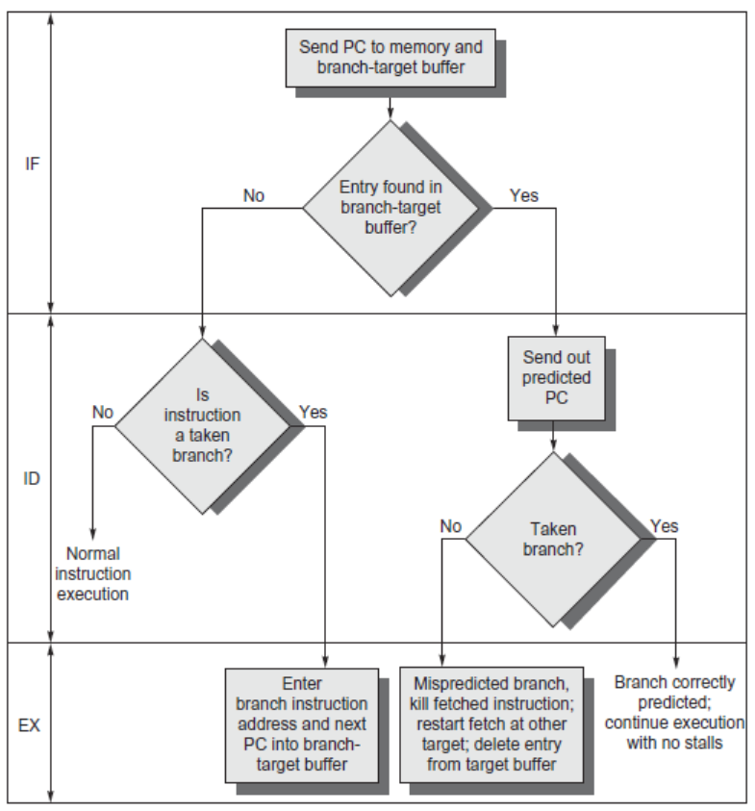
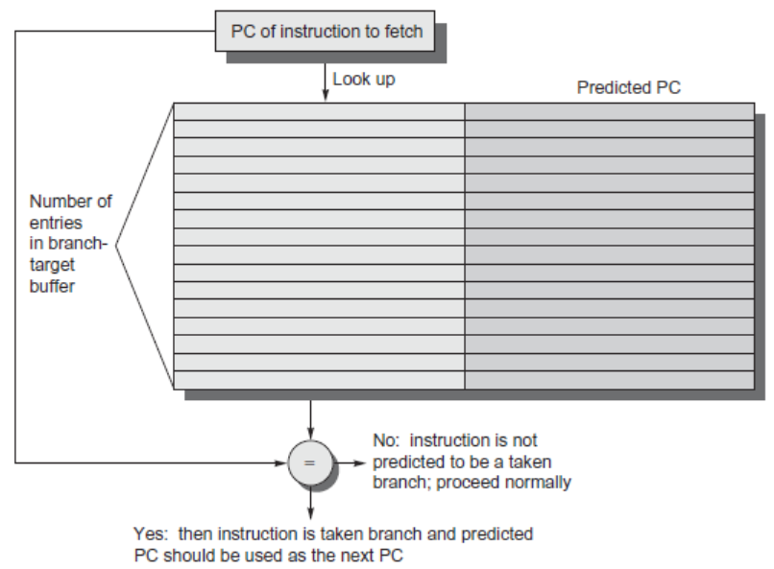
Branch-Target Buffer
Need high instruction bandwidth
Branch-Target buffers
Next PC prediction buffer, indexed by current PC

Slide 42
Branch Folding
Optimization:
Larger branch-target buffer
Add target instruction into buffer to deal with longer decoding time required by larger buffer
“Branch folding”
combines branch instructions with predicted instructions. This technique can be implemented using an instruction queue, which buffers prefetched instructions. 、
PARK, Sang, Hyun, YU, Sungwook, & CHO, et al. (2005). Speculative branch folding for pipelined processors(computer systems). ICE transactions on information and systems.

Slide 43
Return Address Predictor
Most unconditional branches come from function returns
The same procedure can be called from multiple sites
Causes the buffer to potentially forget about the return address from previous calls
Create return address buffer organized as a stack

Slide 44
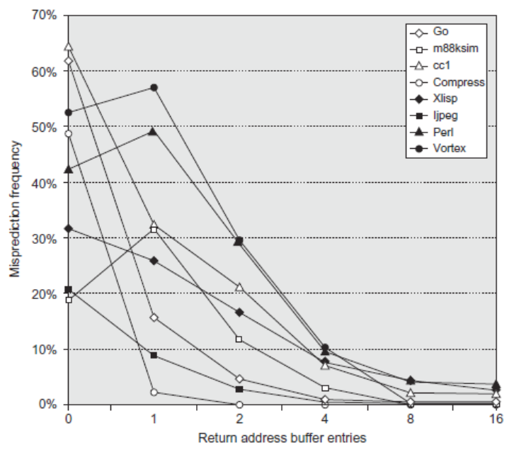
Return Address Predictor

Slide 45
Integrated Instruction Fetch Unit
Design monolithic unit that performs:
Branch prediction
Instruction prefetch
Fetch ahead
Instruction memory access and buffering
Deal with crossing cache lines

Slide 46
Register Renaming
Register renaming vs. reorder buffers
Instead of virtual registers from reservation stations and reorder buffer, create a single register pool
Contains visible registers and virtual registers
Use hardware-based map to rename registers during issue
WAW and WAR hazards are avoided
Speculation recovery occurs by copying during commit
Still need a ROB-like queue to update table in order
Simplifies commit:
Record that mapping between architectural register and physical register is no longer speculative
Free up physical register used to hold older value
In other words: SWAP physical registers on commit
Physical register de-allocation is more difficult
Simple approach: deallocate virtual register when next instruction writes to its mapped architecturally-visibly register

Slide 47
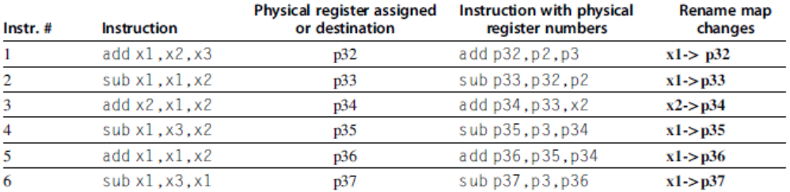
Integrated Issue and Renaming
Combining instruction issue with register renaming:
Issue logic pre-reserves enough physical registers for the bundle
Issue logic finds dependencies within bundle, maps registers as necessary
Issue logic finds dependencies between current bundle and already in-flight bundles, maps registers as necessary

Slide 48
How Much?
How much to speculate
Mis-speculation degrades performance and power relative to no speculation
May cause additional misses (cache, TLB)
Prevent speculative code from causing higher costing misses (e.g. L2)
Speculating through multiple branches
Complicates speculation recovery
Speculation and energy efficiency
Note: speculation is only energy efficient when it significantly improves performance

Slide 49
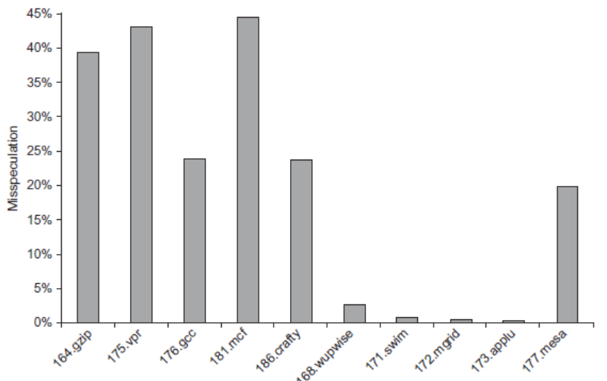
How Much?
integer

Slide 50
Energy Efficiency
Value prediction
Uses:
Loads that load from a constant pool
Instruction that produces a value from a small set of values
Not incorporated into modern processors
Similar idea--address aliasing prediction--is used on some processors to determine if two stores or a load and a store reference the same address to allow for reordering

Slide 51
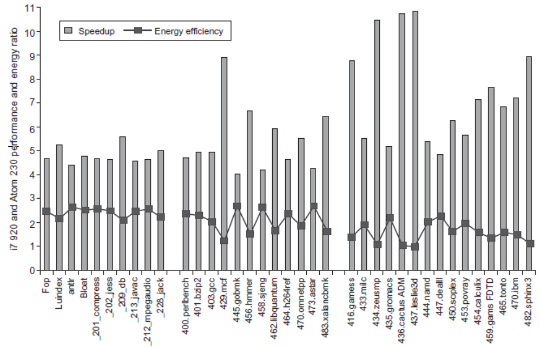
Fallacies and Pitfalls
It is easy to predict the performance/energy efficiency of two different versions of the same ISA if we hold the technology constant

Slide 52
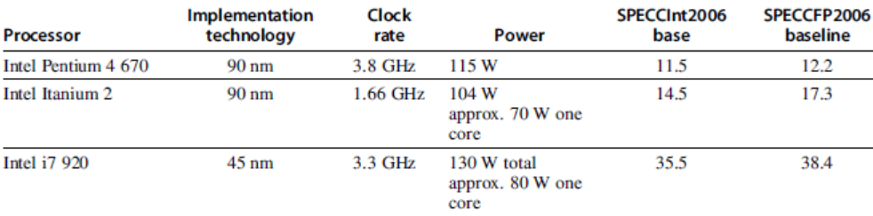
Fallacies and Pitfalls
Processors with lower CPIs / faster clock rates will also be faster
Pentium 4 had higher clock, lower CPI
Itanium had same CPI, lower clock

Slide 53
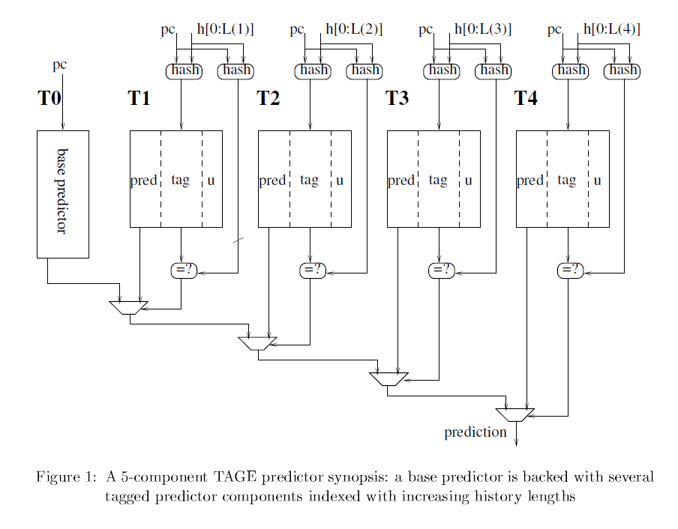
Fallacies and Pitfalls
Sometimes bigger and dumber is better
Pentium 4 and Itanium were advanced designs, but could not achieve their peak instruction throughput because of relatively small caches as compared to i7
And sometimes smarter is better than bigger and dumber
TAGE branch predictor outperforms gshare with less stored predictions

Slide 54
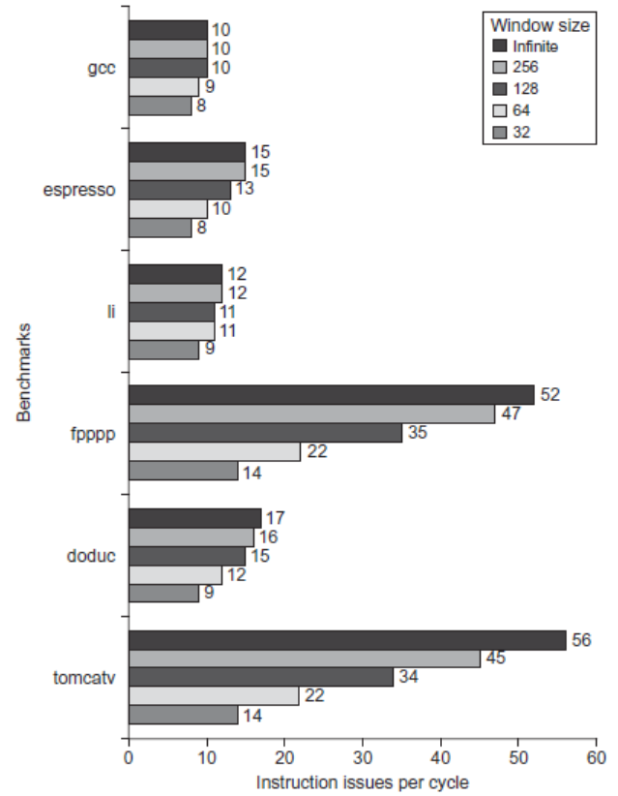
Fallacies and Pitfalls
Believing that there are large amounts of ILP available, if only we had the right techniques

Slide 55
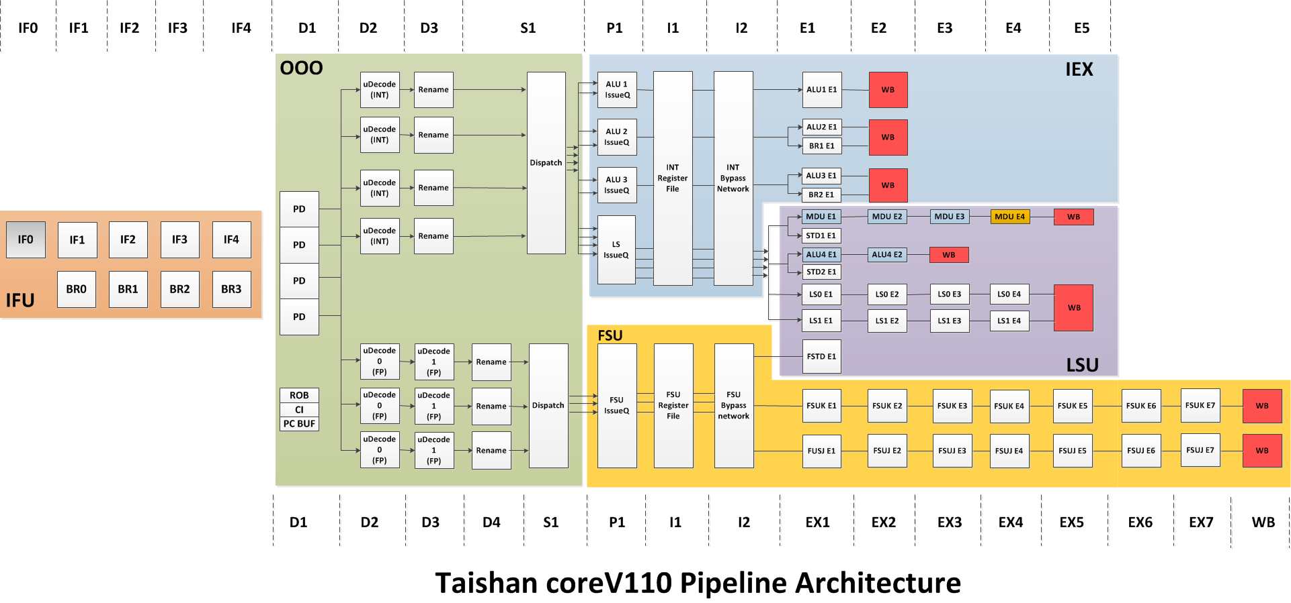
基于ARMv8的鲲鹏流水线技术

Slide 56
基于ARMv8的鲲鹏流水线技术
Branch预测和取指流水线解耦设计，取指流水线每拍最多可提供32Bytes指令供译码，分支预测流水线可以不受取指流水停顿影响，超前进行预测处理；
定浮点流水线分开设计，解除定浮点相互反压，每拍可为后端执行部件提供4条整型微指令及3条浮点微指令；
整型运算单元支持每拍4条ALU运算（含2条跳转）及1条乘除运算；
浮点及SIMD运算单元支持每拍2条ARM Neon 128bits 浮点及SIMD运算；
访存单元支持每拍2条读或写访存操作，读操作最快4拍完成，每拍访存带宽为2x128bits读及1x128bits写；

Slide 57
Dynamic Scheduling in P6 (Pentium Pro, II, III)
Q: How pipeline 1 to 17 byte 80x86 instructions?
P6 doesn’t pipeline 80x86 instructions
P6 decode unit translates the Intel instructions into 72-bit micro-operations (~ MIPS)
Sends micro-operations to reorder buffer & reservation stations
Many instructions translate to 1 to 4 micro-operations
Complex 80x86 instructions are executed by a conventional microprogram (8K x 72 bits) that issues long sequences of micro-operations
14 clocks in total pipeline (~ 3 state machines)

Slide 58
Dynamic Scheduling in P6
Parameter 80x86 microops
Max. instructions issued/clock 3 6
Max. instr. complete exec./clock 5
Max. instr. commited/clock 3
Window (Instrs in reorder buffer) 40
Number of reservations stations 20
Number of rename registers 40
No. integer functional units (FUs) 2 No. floating point FUs 1 No. SIMD Fl. Pt. FUs 1 No. memory Fus 1 load + 1 store

Slide 59
P6 Pipeline
14 clocks in total (~3 state machines)
8 stages are used for in-order instruction fetch, decode, and issue
Takes 1 clock cycle to determine length of 80x86 instructions + 2 more to create the micro-operations (uops)
3 stages are used for out-of-order execution in one of 5 separate functional units
3 stages are used for instruction commit
Reserv. Station
Reorder Buffer
Instr Fetch 16B /clk
16B
Instr Decode 3 Instr /clk
6 uops
Execu- tion units (5)
Gradu- ation
3 uops /clk
Renaming 3 uops /clk

Slide 60
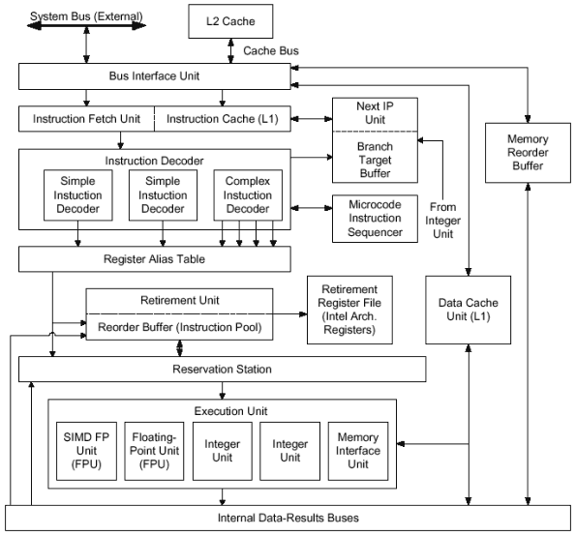
P6 Block Diagram
IP = PC
From: http://www.digit-life.com/articles/pentium4/

Slide 61
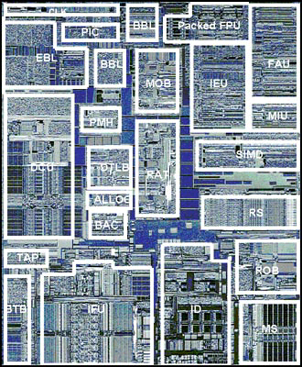
Pentium III Die Photo
EBL/BBL - Bus logic, Front, Back
MOB - Memory Order Buffer
Packed FPU - MMX Fl. Pt. (SSE)
IEU - Integer Execution Unit
FAU - Fl. Pt. Arithmetic Unit
MIU - Memory Interface Unit
DCU - Data Cache Unit
PMH - Page Miss Handler
DTLB - Data TLB
BAC - Branch Address Calculator
RAT - Register Alias Table
SIMD - Packed Fl. Pt.
RS - Reservation Station
BTB - Branch Target Buffer
IFU - Instruction Fetch Unit (+I$)
ID - Instruction Decode
ROB - Reorder Buffer
MS - Micro-instruction Sequencer
1st Pentium III, Katmai: 9.5 M transistors, 12.3 * 10.4 mm in 0.25-mi. with 5 layers of aluminum
Notes:
From http://www.tomshardware.com/cpu/99q3/990810/
Statistics
0.25 micron 5-layer metal CMOS process technology
9.5M transistors
10.2 x 12.1 mm die size (excluding the etch ring)
3-way superscalar out-of-order execution micro-architecture
70 new streaming SIMD instructions:
Comprehensive set of new SIMD-FP instruction set
Additional SIMD-integer MMX Technology instructions
New memory streaming instructions (for FP & integer data types)
Bottom left quadrant
Logic for the front-end of the pipeline resides here.
IFU
Instruction Fetch Unit. Instruction fetch logic and a 16K Byte 4-way set-associative level one
instruction cache resides in this block. Instruction data from the IFU is then forwarded to the ID.
BTB
Branch Target Buffer. This block is responsible for dynamic branch prediction based on the
history of past branch decisions paths.
BAC
Branch Address Calculator. Static branch prediction is performed here to handle the BTB miss
case.
TAP
Testability Access Port. Various testability and debug mechanisms reside within this block.
Bottom right quadrant
Instruction decode, scheduling, dispatch, and retirement functionality is contained within this
quadrant.
ID
Instruction Decoder. This unit is capable of decoding up to 3 instructions per cycle.
MS
Micro-instruction Sequencer. This holds the microcode ROM and sequencer for more complex
instruction flows. The microcode update functionality is also located here.
RS
Reservation Station. Micro-instructions and source data are held here for scheduling and dispatch
to the execution ports. Dispatch can happen out-of-order and is dependent on source data
availability and an available execution port.
ROB
Re-Order Buffer. This supports a 40-entry physical register file that holds temporary write-back
results that can complete out of order. These results are then committed to a separate
architectural register file during in-order retirement.
Top right quadrant
This primarily consists of the execution datapath for the Pentium® III processor.
SIMD
SIMD integer execution unit for MMX Technology instructions.
MIU
Memory Interface Unit. This is responsible for data conversion and formatting for floating point
data types.
IEU
Integer Execution Unit. This is responsible for ALU functionality of scalar integer instructions.
Address calculations for memory referencing instructions are also performed here along with
target address calculations for jump related instructions.
FAU
Floating point Arithmetic Unit. This performs floating point related calculations for both existing
scalar instructions along with support for some of the new SIMD-FP instructions.
PFAU
Packed Floating point Arithmetic Unit. This contains arithmetic execution data-path functionality
for SIMD-FP specific instructions.
Top left quadrant
Functionality in this quadrant is split into assorted functions including bus interface related
functionality, data cache access, and allocation.
ALLOC
Allocator. Allocation of various resources such as ROB, MOB, and RS entries is performed here
prior to micro-instruction dispatch by the RS.
RAT
Register Alias Table. During resource allocation the renaming of logical to physical registers is
performed here.
MOB
Memory Order Buffer. Acts as a separate schedule and dispatch engine for data loads and
stores. Also temporarily holds the state of outstanding loads and stores from dispatch until
completion.
DTLB
Data Translation Look-aside Buffer. Performs the translation from linear addresses to physical
address required for support of virtual memory.
PMH
Page Miss Handler. Hardware engine for performing a page table walk in the event of a TLB
miss.
DCU
Data Cache Unit. Contains the non-blocking 16K Byte 4-way set-associative level one data cache
along with associated fill and write back buffering.
BBL
Back-side Bus Logic. Logic for interface to the back-side bus for accesses to the external unified
level two processor cache.
EBL
External Bus Logic. Logic for interface to the external front-side bus.
PIC
Programmable Interrupt Controller. Local interrupt controller logic for multi-processor interrupt
distribution and boot-up communication.

Slide 62
END

