Slide 1
Chapter3 Advanced compiler techniques for exploring ILP
In Appendix H， 6th edition

Slide 2
Score board/ Tomasulo中 WB、Issue是并行执行的
WB中： 写CDB，清空对应ReservationStation，目的RegS置为可用
Issue中： 可以发射，修改ReservationStation，
目的RegS置为对应ReservationStation编号
可以并行，否则每一条指令WB周期后都多一个cycle清空周期
怎么实现： Issue与WB要修改同一编号ReservationStation（行），则做Issue修改，而不做清空。
若Issue的目的RegS与WB的RegS相同，则只做目的RegS置为对应
ReservationStation编号，而不再做WB的“目的RegS置为可用”

Slide 3
Dynamic scheduling理论与是实现的区别
Scoreboard中三张表、Tomasulo的Reservation中的值都是存在寄存器中，对应2个值：当前值、时钟上升沿之后的新值
理论上作业时，某一个cycle下表值或Reservation中的值
填的一般是指在该cycle执行结束后得到的新值
（TPA验收看到的值—还未写入寄存器）
但在硬件实现时，
该cycle执行结束后得到的新值 要在下个cycle
上升沿后才会被写入寄存器，才会被看到
（延后一拍才能看到对应寄存器中的值）

Slide 4
Tomasulo算法实现注意点
WAW问题：
Reg的2nd Write 会覆盖Reg的1st write 但1st Write CDB的操作还是要预约，因为第一条指令的操作结果还要forwarding到需要该值的ResStation里（如下面例子中的Mul的ResStation）。
LW F2, D1(Rx) F2的S会变成LoadB1
MUL F4，F2，。。
LW F2， D2(Ry) issue时， F2的S会变成LoadB2

Slide 5
Why software pipeling ?
1 LD F0, 0(R1)
2 stall
3 ADDD F4, F0, F2
4 stall
5 stall
6 SD 0(R1), F4
7 SUBI R1, R1, #4
8 stall
9 BNEZ R1, LOOP
10 stall
1 LD F0, 0(R1)
2 ADDD F4, F0, F2
3 SD 0(R1), F4
4 SUBI R1, R1, #4
5 BNEZ R1, LOOP
Loop Parallelism lost !

Slide 6
Software Pipelining
Observation: if iterations from loops are independent, then can get more ILP by taking instructions from different iterations
Software pipelining: reorganizes loops so that each iteration is made from instructions chosen from different iterations of the original loop (­ Tomasulo in SW)

Slide 7
Software Pipelining Example
Before: Unrolled 3 times
1 LD F0,0(R1)
2 ADDD F4,F0,F2
3 SD 0(R1),F4
4 LD F6,-8(R1)
5 ADDD F8,F6,F2
6 SD -8(R1),F8
7 LD F10,-16(R1)
8 ADDD F12,F10,F2
9 SD -16(R1),F12
10 SUBI R1,R1,#24
11 BNEZ R1,LOOP
After: Software Pipelined
1 SD 0(R1),F4 ; Stores M[i]
2 ADDD F4,F0,F2 ; Adds to M[i-1]
3 LD F0,-16(R1); Loads M[i-2]
4 SUBI R1,R1,#8
5 BNEZ R1,LOOP
SW Pipeline
overlapped ops
Time
Loop Unrolled
Symbolic Loop Unrolling
Maximize result-use distance
Less code space than unrolling
Fill & drain pipe only once per loop vs. once per each unrolled iteration in loop unrolling
Time
5 cycles per iteration

Slide 8
Code after reorganized
1 LD F0,0(R1)
1 ADDD F4,F0,F2 start-up
2 LD F0, -8(R1)
Loop: 1 SD 0(R1),F4 ; Stores M[i]
2 ADDD F4,F0,F2 ; Adds to M[i-1]
3 LD F0,-16(R1); Loads M[i-2]
4 SUBI R1,R1,#8
5 BNEZ R1,LOOP
2 SD -8(R1), F4
1 ADDD F4,F0,F2 clear-up
1 SD -16(R1), F4

Slide 9
Software Pipelining with loop unrolling in VLIW
Memory Memory FP FP Int. op/ Clock
reference 1 reference 2 operation 1 op. 2 branch
LD F0,-48(R1) ST 0(R1),F4 ADDD F4,F0,F2 1
LD F6,-56(R1) ST -8(R1),F8 ADDD F8,F6,F2 SUBI R1,R1,#24 2
LD F10,-40(R1) ST 8(R1),F12 ADDD F12,F10,F2 BNEZ R1,LOOP 3
Software pipelined across 9 iterations of original loop
In each iteration of above loop, we:
Store to m,m-8,m-16 (iterations I-3,I-2,I-1)
Compute for m-24,m-32,m-40 (iterations I,I+1,I+2)
Load from m-48,m-56,m-64 (iterations I+3,I+4,I+5)
9 results in 9 cycles, or 1 clock per iteration
Average: 3.3 ops per clock, 66% efficiency
Note: Need less registers for software pipelining
(only using 7 registers here, was using 15)

Slide 10
Global code motion
The loop unrolling and software pipelining work well with straight forward loop.
What about a loop with internal control flow ?
Global code scheduling : Effective scheduling of a loop body with internal control flow by moving instructions across branches.

Slide 11
Trace Scheduling
Parallelism across IF branches vs. LOOP branches
Two steps:
Trace Selection
Find likely sequence of basic blocks (trace) of (statically
predicted or profile predicted) long sequence of straight-line code
Trace Compaction
Squeeze trace into few VLIW instructions
Need bookkeeping code in case prediction is wrong
This is a form of compiler-generated speculation
Compiler must generate “fixup” code to handle cases
in which trace is not the taken branch
Needs extra registers: undoes bad guess by discarding
Subtle compiler bugs mean wrong answer vs. poorer performance; no hardware interlocks

Slide 12
Example of Trace Scheduling

Slide 13
Example

Slide 15
Superblock
A form of extended basic block that are restricted to have a single entry point but allow multiple exits.
Easier to compact a superblock than a trace.

Slide 16
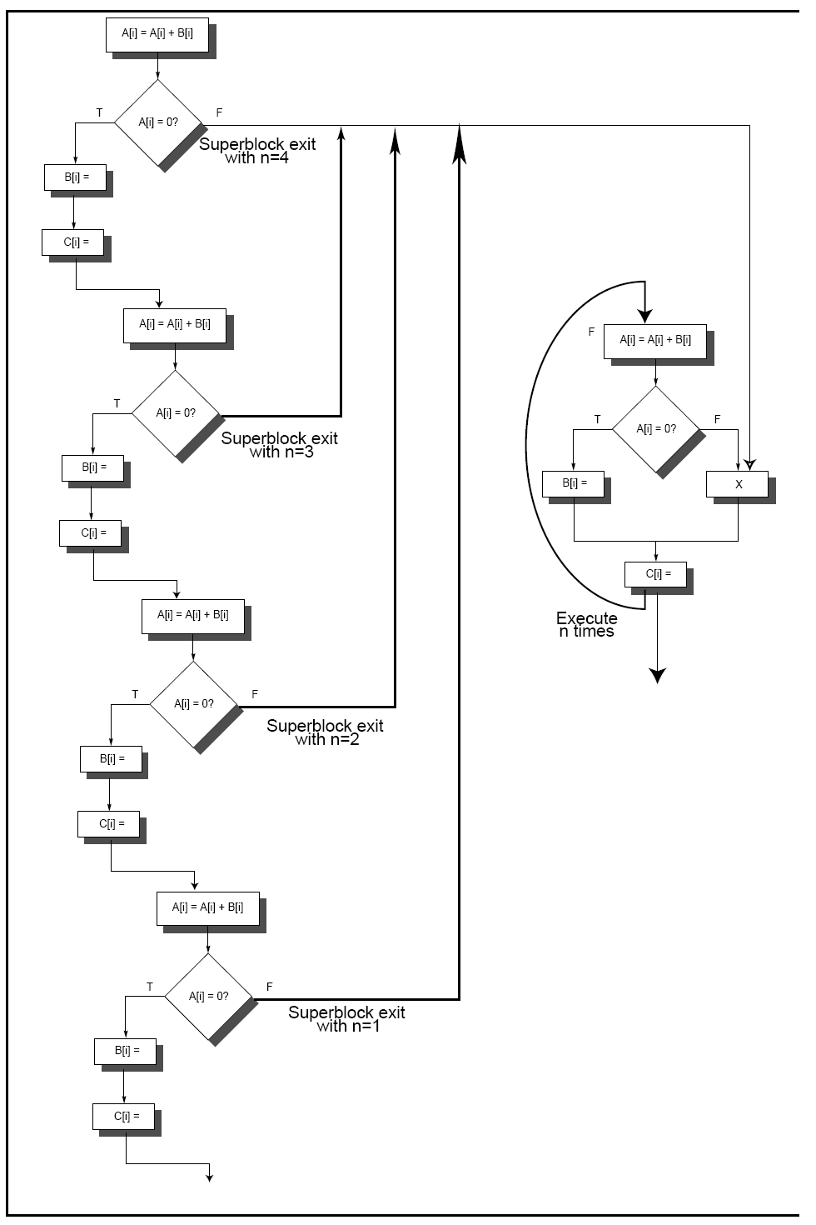

Slide 17
Hardware Support for Expoilting ILP at compile time
Conditional Instruction (predicated instruction)
A conditional instruction refers to a condition which is evaluated as part of the instruction execution,
Example:
If (A==0) {S=T} BNEZ R1, L CMOV R2,R3, R1
ADDU R2, R3, R0
L: ……
the CPU always executes the instruction but writes the result only if the condition is met.
A conditional branch changes a control dependence into a data dependence.

Slide 18
Example: improving scheduloing performance using Conditional Inst.
1st inst.
2nd inst
LW R1, 40(R2) ADD R3, R4, R5
ADD R6,R3, R7
BEQZ R10, L
LW R8, 0(R10)
LW R9, 0(R8)

Slide 19
Using conditional instruction
LMC Rx, D(Ry), Rz
Load Rx, D(Ry) if Rz != 0
Nop if Rz == 0

Slide 20
Conditional instructions in real computer

Slide 21
hyper block: --super block + prediction
No branch ,No prediction No throw away ,But an extra source code field.

Slide 22
Block-Structure
Basic idea:
Block substitute instruction as atomic unit running in computer.
One block is always executed in whole or entirely, but not just half or part of it.
Additional mechanism need to solve the exception that happens in the middle of the basic block.
If the intermediate result of the basic block is not used by other blocks, then we can use linkage within the block but not the register (that is used by the software) to connect the producer and consumer, which can save space and power.

Slide 23
Block-Structure
Block is produced by a compiler as trace cache segment.
If an exception happens at the middle of the block, then all the block work have done will be throw away and go to another block.
The hardware can find more concurrency in one block.

Slide 24
Block-structure: Example

