Slide 1

Computer Architecture ----A Quantitative Approach
陈文智
浙江大学计算机学院
chenwz@zju.edu.cn

Slide 2
5.4 Reducing Cache miss penalty
1.Reduce the miss penalty
2. Reduce the miss rate
3. Reduce the miss penalty and miss rate via parallelism
4. Reduce the time to hit in the cache.

Slide 3
First Miss Penalty Reduction Technique:
Multilevel Caches
This method focuses on the interface between the cache and main memory.
We can add an second-level cache between main memory and a small, fast first-level cache.
This helps satisfy the desire to make the cache fast and large.
The first –level cache allows:
The smaller first-level cache is fast enough to match the clock cycle time of the fast CPU and to fit on the chip with the CPU, thereby lessening the hits time.
The second-level cache allows:
The larger second-level can be large enough to capture many memory accesses that would go to main memory, thereby lessening the effective miss penalty.

Slide 4
Parameter about Multilevel cache
The performance of a two-level cache is calculated in a similar way to the performance for a single level cache.
L2 Equations
AMAT = Hit Time_{L1} + Miss Rate_{L1} x Miss Penalty_{L1}
Miss Penalty_{L1} = Hit Time_{L2} + Miss Rate_{L2} x Miss Penalty_{L2}
AMAT = Hit Time_{L1} +
Miss Rate_{L1} x (Hit Time_{L2} + Miss Rate_{L2} x Miss Penalty_{L2})
Definitions:
Local miss rate— misses in this cache divided by the total number of memory accesses to this cache (Miss rate_{L2})
Global miss rate—misses in this cache divided by the total number of memory accesses generated by the CPU
Global Miss Rate is what matters

Slide 5
Parameter about Multilevel cache
So the miss penalty for level 1 is calculated using the hit time, miss rate, and miss penalty for the level 2 cache.
The performance of a two-level cache is calculated in a similar way to the performance for a single level cache.
L2 Equations
AMAT = Hit Time_{L1} + Miss Rate_{L1} x Miss Penalty_{L1}
Miss Penalty_{L1} = Hit Time_{L2} + Miss Rate_{L2} x Miss Penalty_{L2}
AMAT = Hit Time_{L1} +
Miss Rate_{L1} x (Hit Time_{L2} + Miss Rate_{L2} x Miss Penalty_{L2})
Definitions:
Local miss rate— misses in this cache divided by the total number of memory accesses to this cache (Miss rate_{L2})
Global miss rate—misses in this cache divided by the total number of memory accesses generated by the CPU
Global Miss Rate is what matters

Slide 6
Parameter about Multilevel cache
Using the terms above, the global miss for the first-level cache is still just Miss rate_{L1}, but for the second-level cache it is :

Slide 7
Memory stall per instruction
This local miss rate is large for second-level caches before the first-level cache skims the cream of the memory accesses. This is why the global miss rate is more useful measure: It indicates what fraction of the memory accesses that leave the CPU go all the way to memory.
Here is a place where the misses per instruction metric shines. Instead of confusion about local or global miss rates, we just expand memory stalls per instruction to add the impact of a second-level cache:
Average memory stalls per instruction
＝Misses per instruction_{L1} x Hit time_{L2}
+ Misses per instruction_{L2} x Miss penalty_{L2}

Slide 8
Example7: Multilevel cache
Assume(p414):
L1 cache: Misses: 40 misses/1000 memory
Hit time: 1 clock cycles
Memory references per instruction: 1.5
L2 cache: 20 misses
Miss penalty: 100 clock cycles
Hit time: 10 clock cycles
What is the average memory access time and average stall cycles per instruction (Ignore the impact write) ?
Answer: Calculating Miss rate for local and global.
AMAT＝Hit time_{L1}+Miss rate_{L1}×(Hit time_{L2}+Miss rate_{L2}×Miss penalty_{L2} )
＝1+4% ×(10+50% ×100)＝1+4% ×60＝3.4 clock cycle

Slide 9
Example7: Multilevel cache
Misses number Per 1000 instructions:
L1(global): 1.5 × 4% ×1000＝60
L2(global): 1.5 × 2% ×1000＝30
Form average memory stalls per instruction for distributed uniformly:
Form average memory stalls per instruction
＝Misses per instruction_{L1(global)} ×Hit time_{L2}+Misses per instruction_{L2(global)}
×Miss penalty_{L2}＝(60/1000) ×10+(30/1000) ×100
＝0.060 ×10+0.030 ×100＝3.6 clock cycles
if we subtract the L1 hit time from AMAT and then multiply by the average number of memory references per instruction,we get the same average memory stalls per instruction:
(3.4-1.0) ×1.5＝2.4 ×1.5＝3.6 clock cycles

Slide 10
Example8: Multilevel cache
Assume(p714): Hit time_{L2} for direct mapped = 10 clock cycles.
Hit time_{L2} for two-way set = 10.1 clock cycles.
Local miss rate_{L2} for direct mapped = 25%.
Local miss rate_{L2} for two-way set associative =20%.
Miss penalty_{L2} = 100 clock cycles.
What is the impact of second-level cache associativity on its miss penalty?
Answer: For a direct-mapped L2 cache, L1 cache miss penalty is :
Miss penalty_{1-wayL1}＝10＋25%×100=35.0 clock cycles
Adding the cost of associativity increases the hit cost only 0.1 clock cycles, making the new L1 cache miss penalty
Miss penalty_{2-wayL1}=10.1＋20%×100=30.1 clock cycles

Slide 11
Example8: Multilevel cache
In reality, L2 cache are almost always synchronized with the L1 cache and CPU. Accordingly, the L2 hit time must be an integral number of clock cycles. If we are lucky,we shave the second-level hit time to 10 cycles;if not,we round up to 11 cycles. Either choice is an improvement over the direct-mapped L2 cache:
Miss penalty_{2-way L1}＝10＋20%×100＝30.0 clock cycles
Miss penalty_{2-way L1}＝11 ＋20%×100＝31.0 clock cycles
Now we can reduce the miss penalty by reducing the miss rate of the second-level cache

Slide 12
Second Miss Penalty Reduction Technique:
Critical Word First and Early Restart
Don’t wait for full block to be loaded before restarting CPU
Critical Word First—Request the missed word first from memory and send it to the CPU as soon as it arrives; let the CPU continue execution while filling the rest of the words in the block. Also called wrapped fetch and requested word first
Early restart—As soon as the requested word of the block arrives, send it to the CPU and let the CPU continue execution
Generally useful only in large blocks,
Spatial locality => tend to want next sequential word, so not clear if benefit by early restart
block

Slide 13
Example9: Critical Word First
Assume(p419): cache block＝64-byte
L2: take 11 CLK to get the critical 8 bytes, (AMD Athlon)
and then 2 CLK per 8 byte to fetch the rest of the block
There will be no other accesses to rest of the block
Calculate the average miss penalty for critical word first.
Then assuming the following instructions read data sequentially 8 bytes at a time from the rest of the block
Compare the times with and without critical word first.
Answer:
The average miss penalty is 11 clock cycles for critical word first.
The Athlon can issue 2 loads per clock, which is faster the L2 cache can supply data. Thus, for the CPU to sequentially read a full cache block it would take:
11+(8-1) ×2＝25 clock cycle
Without for critical word first, it would take 25 clock cycles to load the block, and then 8/2 or 4 clocks to issue the loadd, giving 29 clock cycles total

Slide 14
Third Miss Penalty Reduction Technique:
Giving Priority to Read Misses over Writes
If a system has a write buffer, writes can be delayed to come after reads.
The system must, however, be careful to check the write buffer to see if the value being read is about to be written.

Slide 15
Third Miss Penalty Reduction Technique:
Write-back want buffer to hold displaced blocks
Read miss replacing dirty block
Normal: Write dirty block to memory, and then do the read
Instead copy the dirty block to a write buffer, then do the read, and then do the write
CPU stall less since restarts as soon as do read
Write-through w/ write buffers => RAW conflicts with main memory reads on cache misses
If simply wait for write buffer to empty, might increase read miss penalty (old MIPS 1000 by 50% )
Check write buffer contents before read; if no conflicts, let the memory access continue

Slide 16
Example10: Giving Priority to Read Misses over Writes
Assume: Code sequence following:
SW R3, 512(R0) ; M[512]←R3 (cache index 0)
LW R1, 1024(R0) ; R1←M[1024] (cache index 0)
LW R2, 512(R0) ; R2←M[512] (cache index 0)
Direct-mapped, write-through cache that maps 512 and 1024 to the same block, and a four-word write buffer
Will the value in R2 always be equal to the value in R3?
Answer: There is a read-after-write data hazard in memory.
Let’s follow a cache access to see the danger.
The data in R3 are placed into the write buffer after the store.
The following load uses the same cache index and is therefore a miss.
The second load instruction tries to put the value in location 512 into register R2; this also results in a miss.
If the write buffer hasn’t completed writing to location 512 in memory, the read of location 512 will put the old, wrong value into the cache block, and then into R2. Without proper precautions,
R3 would not be equal to R2!

Slide 17
Fourth Miss Penalty Reduction Technique:
Merging write Buffer
One word writes replaces with multiword writes, and it improves buffers’s efficiency.
In write-through , if the buffer contains other modified blocks,the addresses can be checked to see if the address of this new data matches the address of a valid write buffer entry.If so,the new data are combined with that entry.
The optimization also reduces stalls due to the write buffer being full.

Slide 18
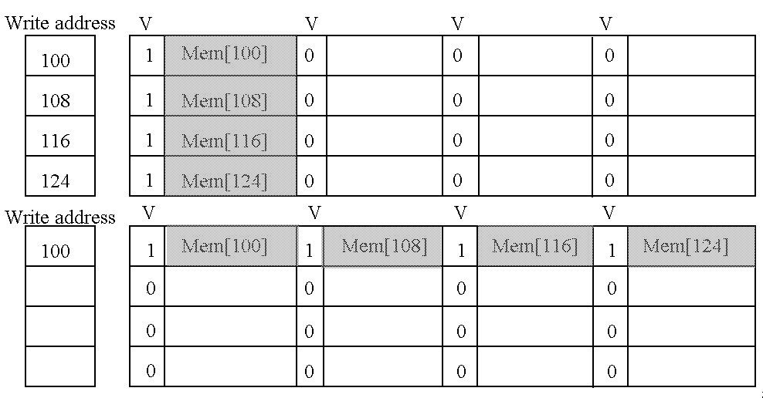
Fourth Miss Penalty Reduction Technique:

Slide 19
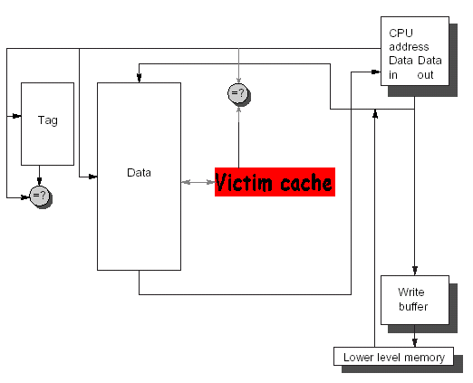
Fifth Miss Penalty Reduction Technique:
Victim Caches
A victim cache is a small (usually, but not necessarily) fully-associative cache that holds a few of the most recently replaced blocks or victims from the main cache.
This cache is checked on a miss data before going to next lower-level memory(main memory).
to see if they have the desired
If found, the victim block and the cache block are swapped.
The AMD Athlon has a victim caches with 8 entries.

Slide 20
How to combine victim Cache
How to combine fast hit time of direct mapped yet still avoid conflict misses?
Add buffer to place data discarded from cache
Jouppi [1990]: 4-entry victim cache removed 20% to 95% of conflicts for a 4 KB direct mapped data cache
Used in Alpha, HP machines
TAGS
DATA
Tag and Comparator
One Cache line of Data
Tag and Comparator
One Cache line of Data
Tag and Comparator
One Cache line of Data
Tag and Comparator
One Cache line of Data
To Next Lower Level In
Hierarchy

Slide 21
Summary: Miss Penalty Reduction
1. Reduce penalty via Multilevel Caches
2. Reduce penalty via Critical Word First
3. Reduce penalty via Read Misses over Writes
4. Reducing penalty via Merging write Buffer
5. Reducing penalty via Victim Caches

Slide 22
5.5 Reducing miss rate
1.Reduce the miss penalty
2. Reduce the miss rate
3. Reduce the miss penalty and miss rate via parallelism
4. Reduce the time to hit in the cache.

Slide 23
Where do misses come from?
Classifying Misses: 3 Cs
Compulsory—The first access to a block is not in the cache, so the block must be brought into the cache. Also called cold start misses or first reference misses. (Misses in even an Infinite Cache)
Capacity—If the cache cannot contain all the blocks needed during execution of a program, capacity misses will occur due to blocks being discarded and later retrieved. (Misses in Fully Associative Size X Cache)
Conflict—If block-placement strategy is set associative or direct mapped, conflict misses (in addition to compulsory & capacity misses) will occur because a block can be discarded and later retrieved if too many blocks map to its set. Also called collision misses or interference misses. (Misses in N-way Associative, Size X Cache)
4th “C”:
Coherence - Misses caused by cache coherence.
Notes:
Intuitive Model by Mark Hill

Slide 24
3Cs Absolute Miss Rate (SPEC92)
Conflict

Slide 25
3Cs Relative Miss Rate
Conflict
Flaws: for fixed block size
Good: insight => invention

Slide 26
Reducing Cache Miss Rate
To reduce cache miss rate, we have to eliminate some of the misses due to the three C's.
We cannot reduce capacity misses much except by making the cache larger.
We can, however, reduce the conflict misses and compulsory misses in several ways:

Slide 27
Cache Organization?
Assume total cache size not changed.
What happens if:
Change Block Size
Change Associativity
Change Compiler
Which of 3Cs is obviously affected?
Notes:
Ask which affected?
Block size
1) Compulsory
2) More subtle, will change mapping

Slide 28
First Miss Rate Reduction Technique
Larger Block Size (fixed size&assoc)
Larger blocks decrease the compulsory miss rate by taking advantage of spatial locality.
Drawback: curve is U-shaped
However, they may increase the miss penalty by requiring more data to be fetched per miss.
In addition, they will almost certainly increase conflict misses since fewer blocks can be stored in the cache.
And maybe even capacity misses in small caches
Trade-off
Trying to minimize both the miss rate and the miss penalty.
The selection of block size depends on both the latency and bandwidth of lower-level memory

Slide 29
First Miss Rate Reduction Technique
Block size | Cache size
 | 1K | 4K | 16K | 64K | 256K
16 | 15.05% | 8.57% | 3.94% | 2.04% | 1.09%
32 | 13.34% | 7.24% | 2.87% | 1.35% | 0.70%
64 | 13.76% | 7.00% | 2.64% | 1.06% | 0.51%
128 | 16.64% | 7.78% | 2.77% | 1.02% | 0.49%
256 | 22.01% | 9.51% | 3.29% | 1.15% | 0.49%

Slide 30
The performance curve is U-shaped
25%
20%
1K
15%
Miss Rate
10%
4K
5%
16K
64K
256K
0%
Reduced
compulsory
misses
16
32
64
128
256
Block Size (bytes)
Increased
Conflict
Misses
What else drives up block size?

Slide 31
Example11: Larger Block Size
Assume: actual miss rates shows in the table
Block size | Cache size
 | 1K | 4K | 16K | 64K | 256K
16 | 15.05% | 8.57% | 3.94% | 2.04% | 1.09%
32 | 13.34% | 7.24% | 2.87% | 1.35% | 0.70%
64 | 13.76% | 7.00% | 2.64% | 1.06% | 0.51%
128 | 16.64% | 7.78% | 2.77% | 1.02% | 0.49%
256 | 22.01% | 9.51% | 3.29% | 1.15% | 0.49%
Hit time: 1CLK independent of block size
Memory system overhead: 80 CLK
Delivering time: 16 bytes/2 CLK
Which block size has the smallest average memory access time for each cache size in above table?
This equals that it can supply 16 bytes in 82 CLK, 32 bytes in 84 CLK and so on.

Slide 32
Example11: Larger Block Size-2
Answer: Average memory access time is:
Average memory access time＝Hit time + Miss rate×Miss penalty
16-byte block in 1KB cache is
Average memory access time＝1 + (15.05% ×82)＝13.314 CLK
256-byte block in 256KB cache is
Average memory access time＝1 + (0.49% ×112)＝1.549 CLK
All average memory access times are calculated showing in following table
Block size | Miss penalty | Cache size
 |  | 4K | 16K | 64K | 256K
16 | 82 | 8.027 | 4.231 | 2.673 | 1.894
32 | 84 | 7.082 | 3.411 | 2.134 | 1.588
64 | 88 | 7.160 | 3.323 | 1.933 | 1.449
128 | 96 | 8.469 | 3.659 | 1.979 | 1.470
256 | 112 | 11.651 | 4.685 | 2.288 | 1.549

Slide 33
Second Miss Rate Reduction Technique
Cache Size
Larger Caches
Old rule of thumb: 2 x size => 25% cut in miss rate
What does it reduce?

Slide 34
Drawback
Longer hit time.
Higher cost.

Slide 35
Huge Caches => Working Sets
fic
Data traf
First working set
Capacity-generated traf
fic
(including conflicts)
Second working set
Other capacity-independent communication
Inher
ent communication
Cold-start (compulsory) traf
fic
Replication capacity (cache size)
Example LU Decomposition
from NAS Parallel Benchmarks

Slide 36
Third Miss Rate Reduction Technique:
Higher Associativity
Conflict misses can be a problem for caches with low associativity (especially direct-mapped).
With higher associativity decreasing Conflict misses to improve miss rate
Cache rule of thumb
2:1 rule of thumb a direct-mapped cache of size N has the same miss rate as a 2-way set-associative cache of size N/2.
Eight-way set associative is for practical purposes as effective in reducing misses for these sized cache as fully associative.

Slide 37
Associativity
Conflict

Slide 38
Associativity vs Cycle Time
Beware: Execution time is only final measure!
Why is cycle time tied to hit time?
Will Clock Cycle time increase?
Hill [1988] suggested hit time for 2-way vs. 1-way external cache +10%, internal + 2%
suggested big and dumb caches
Effective cycle time of assoc
pzrbski ISCA

Slide 39
Example12: Higher Associativity
Assume:
Clock Cycle time_{2-way} = 1.36×Clock Cycle time_{1-way}
Clock Cycle time_{4-way} = 1.44×Clock Cycle time_{1-way}
Clock Cycle time_{8-way} = 1.52×Clock Cycle time_{1-way}
Hit time: 1 CLK
Miss penalty_{direct-mapped}: 25 CLK
L2 cache that never misses, and that the penalty need not rounded to integral number of clock cycle
Using Figure 5.14(p424) for miss rates, which cache sizes each of these three statements true?
Average memory access time_{8-way}< Average memory access time_{4-way}
Average memory access time_{4-way}< Average memory access time_{2-way}
Average memory access time_{2-way}< Average memory access time_{1-way}

Slide 40
Example12: Higher Associativity-2
Cache size(KB) | Associativity
 | 1-way | 2-way | 4-way | 8-way
4 | 3.44 | 3.25 | 3.22 | 3.28
8 | 2.69 | 2.58 | 2.55 | 2.62
16 | 2.33 | 2.40 | 2.46 | 2.53
32 | 2.06 | 2.30 | 2.37 | 2.45
64 | 1.92 | 2.24 | 2.18 | 2.25
128 | 1.52 | 1.84 | 1.92 | 2.00
256 | 1.32 | 1.66 | 1.74 | 1.82
512 | 1.20 | 1.55 | 1.59 | 1.66
(Red means A.M.A.T. not improved by more associativity)

Slide 41
Fourth Miss Rate Reduction Technique:
Way Prediction and Pseudo-Associative Cache
Using two Technique reduces conflict misses and yet maintains hit speed of direct-mapped cache
Predictive bit
Pseudo-Associative
Way Prediction
Extra bits are kept in the cache to predict the way, or block within the set of the next cache access.
The Alpha 21264 user uses way prediction in its two-way set-associative instruction cache.
If the predictor is correct, the instruction cache latency is 1 clock cycle.
If not, it tries the other block, changes the way predictor, and has a latency of 3 clock cycles.
Simulation using SPEC95 suggested set prediction accuracy is excess of 85%, so way prediction saves pipeline stage in more than 85% of the instruction fetches.

Slide 42
Pseudo-Associative Cache (column associative)
How to combine fast hit time of Direct Mapped and have the lower conflict misses of 2-way SA cache?
Divide cache: on a miss, check other half of cache to see if there, if so have a pseudo-hit (slow hit)
Drawback: CPU pipeline is hard if hit takes 1 or 2 cycles
Better for caches not tied directly to processor (L2)
Used in MIPS R1000 L2 cache, similar in UltraSPARC
Hit Time
Pseudo Hit Time
Miss Penalty
Time

Slide 43
Fifth Miss Rate Reduction Technique:
Compiler Optimizations
The techniques reduces miss rates without any hardware changes and reorders instruction sequence with compiler.
Instructions
Reorder procedures in memory so as to reduce conflict misses
Profiling to look at conflicts(using tools they developed)
Data
Merging Arrays: improve spatial locality by single array of compound elements vs. 2 arrays
Loop Interchange: change nesting of loops to access data in order stored in memory
Loop Fusion: Combine 2 independent loops that have same looping and some variables overlap
Blocking: Improve temporal locality by accessing “blocks” of data repeatedly vs. going down whole columns or rows

Slide 44
①Loop Interchange
By switching the order in which loops execute, misses can be reduced due to improvements in spatial locality.
/* Before */
for (k = 0; k < 100; k = k+1)
for (j = 0; j < 100; j = j+1)
for (i = 0; i < 5000; i = i+1)
x[i][j] = 2 * x[i][j];
/* After */
for (k = 0; k < 100; k = k+1)
for (i = 0; i < 5000; i = i+1)
for (j = 0; j < 100; j = j+1)
x[i][j] = 2 * x[i][j];
Sequential accesses instead of striding through memory every 100 words;

Slide 45
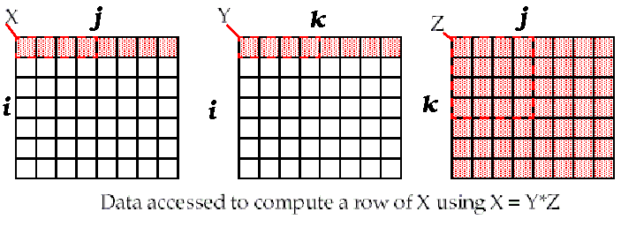
② Unoptimized Matrix Multiplication
/* Before */
for (i = 0; i < N; i = i+1)
for (j = 0; j < N; j = j+1)
{r = 0;
for (k = 0; k < N; k = k+1)
r = r + y[i][k]*z[k][j];
x[i][j] = r;
};
Two Inner Loops:
Write N elements of 1 row of X[ ]
Read N elements of 1 row of Y[ ] repeatedly
Read all NxN elements of Z[ ]
Capacity Misses a function of N & Cache Size:
2N³ + N² => (assuming no conflict; otherwise …)
Idea: compute on BxB submatrix that fits
x[1][j]
y[1][k]
z[k][j]
((N+N)N+N)N=2N³ + N²
Accessed For N³ operations

Slide 46
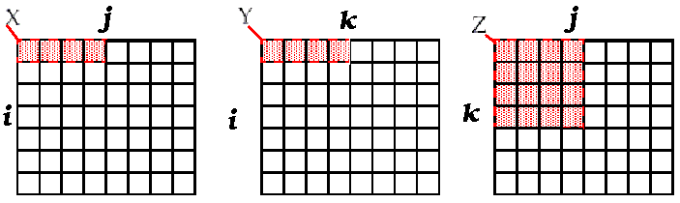
Blocking optimized Matrix Multiplication
Matrix multiplication is
performed by multiplying the
submatrices first.
/* After */
for (jj = 0; jj < N; jj = jj+B)
for (kk = 0; kk < N; kk = kk+B)
for (i = 0; i < N; i = i+1)
for (j = jj; j < min(jj+B-1,N); j = j+1)
{r = 0;
for (k = kk; k < min(kk+B-1,N); k = k+1)
r = r + y[i][k]*z[k][j];
x[i][j] = x[i][j] + r;
};
Y benefits from spatial locality
Z benefits from temporal locality
Capacity Misses from 2N³ + N² to 2N³/B+N²
BN
BN
B×B
B called Blocking Factor
(BN+BN)+B²)×(N/B)²=2N³/B + N²
Accessed For N³ operations

Slide 47
I→N;J→B;K→B;jj→N/B;KK→N/B; SO
For x[I,J]
N/B * N/B * (N*B)
For y[I,K]
N/B * N/B * (N*B)
For z[K,J]
N/B * N/B * (B*B)

Slide 48
Reducing Conflict Misses by Blocking
Conflict misses in caches not FA vs. Blocking size
Lam et al [1991] a blocking factor of 24 had a fifth the misses vs. 48 despite both fit in cache

Slide 49
③Loop Fusion
/* Before */
for (i = 0; i < N; i = i+1)
for (j = 0; j < N; j = j+1)
a[i][j] = 1/b[i][j] * c[i][j];
for (i = 0; i < N; i = i+1)
for (j = 0; j < N; j = j+1)
d[i][j] = a[i][j] + c[i][j];
/* After */
for (i = 0; i < N; i = i+1)
for (j = 0; j < N; j = j+1)
{ a[i][j] = 1/b[i][j] * c[i][j];
d[i][j] = a[i][j] + c[i][j];
}
2 misses per access to a & c vs. one miss per access; improve spatial locality

Slide 50
④Merging Arrays
/* Before: 2 sequential arrays */
int val[SIZE];
int key[SIZE];
/* After: 1 array of stuctures */
struct merge {
int val;
int key;
};
struct merge merged_array[SIZE];
Reducing conflicts between val & key; improve spatial locality

Slide 51
Summary of Compiler Optimizations to Reduce Cache Misses (by hand)

Slide 52
Summary: Miss Rate Reduction
3 Cs: Compulsory, Capacity, Conflict
1. Larger cache
2. Reduce Misses via Larger Block Size
3. Reduce Misses via Higher Associativity
4. Reducing Misses via Pseudo-Associativity
5. Reducing Misses by Compiler Optimizations

Slide 53
5.6 Reduce Cache Miss Penalty or Miss Rate via Parallelism
1.Reduce the miss penalty
2. Reduce the miss rate
3. Reduce the miss penalty and miss rate via parallelism
4. Reduce the time to hit in the cache.

Slide 54
First Miss Penalty/Rate Reduction Technique:
Nonblocking Caches to Reduce Stalls on Cache Misses
Reducing Miss Penalty
A nonblocking(Lockup-free cache) cache, allows The cache to continues to supply hits while processing read misses ( hit under miss , hit under multiple miss ).
Complex caches can even have multiple outstanding misses ( miss under miss ). It will further lower effective miss penalty
Nonblocking, in conjunction with out-of-order execution, can allow the CPU to continue executing instructions after a data cache miss.

Slide 55
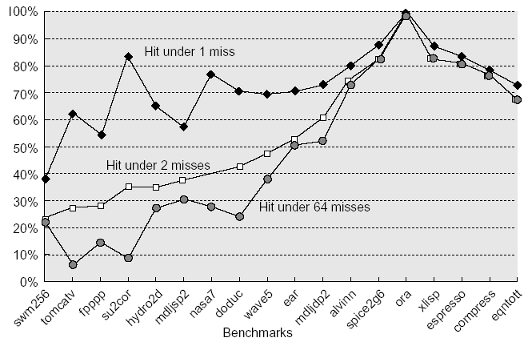
Ratio of the average memory stall time for a blocking cache to hit-under-miss schemes as the number of outstanding misses is varied for 18 SPEC92 programs.
The hit-under-64-misses line allows one miss for every register in the machine.
The first 14 programs are floating-point programs: the average for hit under 1 miss is 76%, for 2 misses is 51%, and for 64 misses is 39%.
Ratio of the average memory stall time
The final four are integer programs, and the three averages are 81%, 78%, and 78%,
These data were collected for an 8-KB direct-mapped data cache with 32-byte blocks and a 16-clock-cycle miss penalty, which today would imply a second-level cache. These data were generated using the VLIW Multiflow Compiler, which scheduled loads away from use [Farkas and Jouppi 1994].

Slide 56
Example13: Nonblocking
Assume: For the cache described in Figure 5.23；
Miss rates for 8KB: 11.4% for fp-DM cache
10.7% for 2-way cache
Miss rates for 8KB: 7.4% for int-DM cache
6.0% for 2-way cache
① which is more important for floating-point programs: 2-way or hit under one miss?
② What about integer programs?
Answer: The numbers for Figure 5.23 were based on a miss penalty of 16 clock cycles. Although this is low for a miss penalty, let’s stick with it for consistency. For floating-point programs the average memory stall times are:
Miss rate_{DM} * Miss penalty = 11.4% ∗ 16 = 1.84
Miss rate_{2-way} * Miss penalty = 10.7% * 16 = 1.71
The memory stalls of two-way are thus 1.71/1.84 or 93% of direct-mapped cache.

Slide 57
Example13: Nonblocking
The caption of Figure 5.23 says hit under one miss reduces the average memory stall time to 76%(<93%) of a blocking cache.
Hence, so for floating-point programs the direct-mapped data cache supporting hit under one miss gives better performance than a two-way set-associative cache that blocks on a miss.
For integer programs the calculation is:
Miss rate_{DM} * Miss penalty = 7.4% * 16 = 1.18
Miss rate_{2-way} * Miss penalty = 6.0% * 16 = 0.96
The memory stalls of two-way are thus 0.96/1.18 or 81% (=81%)of direct-mapped cache.
The caption of Figure 5.23 says hit under one miss reduces the average memory stall time to 81% of a blocking cache, so the two options give about the same performance for integer programs.
One advantage of hit under miss is that it cannot affect the hit time, as associativity can.

Slide 58
Second Miss Penalty/Rate Reduction Technique:
Hardware Prefetching of Instructions and data
Reducing Misses
The act of getting data from memory before it is actually needed by the CPU.
This reduces compulsory misses by retrieving the data before it is requested.
Of course, this may increase other misses by removing useful blocks from the cache.
Thus, many caches hold prefetched blocks in a special buffer until they are actually needed.
E.g., Instruction Prefetching
Alpha 21064 fetches 2 blocks on a miss
Extra block placed in “stream buffer”
On miss check stream buffer
Prefetching relies on having extra memory bandwidth that can be used without penalty

Slide 59
Third Miss Penalty/Rate Reduction Technique:
Compiler-controlled prefetch
Reducing Misses
The compiler inserts prefetch instructions to request the data before they are needed
Data Prefetch Load data into register (HP PA-RISC loads)
Cache Prefetch: load into cache (MIPS IV, PowerPC, SPARC v. 9)
Special prefetching instructions cannot cause faults; a form of speculative execution
Prefetching comes in two flavors:
Binding prefetch: Requests load directly into register.
Must be correct address and register!
Non-Binding prefetch: Load into cache.
Can be incorrect. Faults?
Issuing Prefetch Instructions takes time
Is cost of prefetch issues < savings in reduced misses?
Higher superscalar reduces difficulty of issue bandwidth

Slide 60
Example13: Compiler-controlled prefetch
Assume: cache sizes: 8-KB
blocks sizes: 16-byte
data cache strategy: direct-mapped 、 write- back cache 、 write allocate
The elements of a and b are 8 bytes long since they are double-precision floating-point arrays.
a array: 3 rows and 100 columns
b array: 101 rows and 3 columns
they are not in the cache at the start of the program.
For the code below:
First determine which accesses are likely to cause data cache misses.
Next, insert prefetch instructions to reduce misses.
Finally, calculate the number of prefetch instructions executed and the misses avoided due to prefetching.
for ( i=0; i<3; i=i+1)
for ( j=0; j<100; j=j+1)
a[i][j] = b[j][0] × b[j+1][0]

Slide 61
Example13: Compiler-controlled prefetch-2
Answer: First determine which accesses are likely to cause data cache misses.
16 Byte/block， 8 Byte/element，2 elements/block
Elements of a are written in the order that they are stored in memory, so a will benefit from spatial locality:
The even values of j will miss and the odd values will hit. Since :
A[I][J]: 3×100 accesses will lead to:
Since the accesses are not in the order it is stored. The array b does not benefit from spatial locality. The array b does benefit twice from temporal locality: the same elements are accessed for each iteration of i, and each iteration of j uses the same value of b as the last iteration.
j=0 B[0][0]、B[1][0] 2 accesses first
j=1 B[1][0]、B[2][0] 1 accesses next from j=1 to j=99
2+99=101 misses
for ( i=0; i<3; i=i+1)
for ( j=0; j<100; j=j+1)
a[i][j] = b[j][0] × b[j+1][0]
100
3 * -------- =150 Misses
2
Total misses: 150 + 101 ＝251

Slide 62
Example13: Compiler-controlled prefetch-3
Next, insert prefetch instructions to reduce misses.
This revise code prefetched a[I][7] through a[I][99] and b[7][0] through b[100][0].
for (j = 0; j < 100; j = j+1) {
prefetch(b[j+7][0]);
/* b(j,0) for 7 iterations later */
prefetch(a[0][j+7]);
/* a(0,j) for 7 iterations later */
a[0][j] = b[j][0] * b[j+1][0];};
for (i = 1; i < 3; i = i+1)
for (j = 0; j < 100; j = j+1) {
prefetch(a[i][j+7]);
/* a(i,j) for +7 iterations */
a[i][j] = b[j][0] *b[j+1][0];}
7 misses for elements
b[0][0], b[1][0], …, b[6][0]
Expense 400 prefetch instructions
Total misses 7+4×3＝19
4 misses「7/2] for elements
a[0][0], a[0][2], …, a[0][6]
4 misses「7/2] for elements
a[1][0], a[1][2], …, a[1][6]
4 misses「7/2] for elements
a[2][0], a[2][2], …, a[2][6]

Slide 63
Example13: Compiler-controlled prefetch-3
Expense 400 prefetch instructions
Total misses 7+4×3＝19
Finally, calculate the number of prefetch instructions executed and the misses avoided due to prefetching.
The improving performance of decreased cache misses is: 251－19＝232

Slide 64
Example13: Compiler-controlled prefetch-4
Assume: Here are the key loop times ignoring cache misses:
The original loop takes 7 clock cycles per iteration
The first prefetch loop takes 9 CLK per iteration
The second prefetch loop takes 8 CLK per iteration
A miss takes 100 CLK
How much time it taken that saved in the example?
Answer original doubly nested loop executing without cache miss:
3×100 ×7＝2100
Plus cache miss time
2100 + 251 ×100＝27200 CLK
After prefetch:
First iteration: 100 × 9 + 11 × 100＝2000
Second iteration: 200 × 8 + 8 × 100＝2400
Total time: 2000 + 2400＝4400 CLK

Slide 65
Example13: Compiler-controlled prefetch-4
If we assume that prefetches are completely Overlapped with the rest of the execution, then the prefetch code is faster:
27200
-------- ＝6.2 times
4400

Slide 66
Summary: Reduce Cache Miss Penalty or Miss Rate via Parallelism
1. Reduce Miss penalty via Nonblocking Caches
2. Reduce Misses via Hardware Prefetching
3. Reduce Misses via Compiler-controlled prefetch

Slide 67
5.7 Reducing Hit Time
1.Reduce the miss penalty
2. Reduce the miss rate
3. Reduce the miss penalty and miss rate via parallelism
4. Reduce the time to hit in the cache.

Slide 68
First Hit Time Reduction Technique:
Small and Simple Caches
Using small and Direct-mapped cache
The less hardware that is necessary to implement a cache, the shorter the critical path through the hardware.
Direct-mapped is faster than set associative for both reads and writes.
Fitting the cache on the chip with the CPU is also very important for fast access times.

Slide 69
Second Hit Time Reduction Technique:
Avoiding Address Translation during Indexing of the Cache
The CPU uses virtual addresses that must be mapped to a physical address
The cache may either use virtual or physical addresses.
A cache that indexes by virtual addresses is called a virtual cache , as opposed to a physical cache .
Address translation can be done in parallel with cache access, so penalties for misses are reduced as well.
Avoid address translation during indexing
A virtual cache reduces hit time since a translation from a virtual address to a physical address is not necessary on hits

Slide 70
a virtual address to a physical address
Trans-
lation
Main
Memory
VA
PA
miss
Cache
CPU
hit
data
Page table is a large data structure in memory
Two memory accesses for every load, store, or instruction fetch!
Virtually addressed cache?
synonym problem
Cache the address translations?

Slide 71
TLBs
A way to speed up translation is to use a special cache of recently used page table entries -- this has many names, but the most frequently used is Translation Lookaside Buffer or TLB
Virtual Address Physical Address Dirty Ref Valid Access
Really just a cache on the page table mappings
TLB access time comparable to cache access time
(much less than main memory access time)

Slide 72
Translation Look-Aside Buffers
Just like any other cache, the TLB can be organized as fully associative,
set associative, or direct mapped
TLBs are usually small, typically not more than 128 - 256 entries even on
high end machines. This permits fully associative
lookup on these machines. Most mid-range machines use small
n-way set associative organizations.
hit
VA
PA
miss
TLB
Lookup
Cache
Main
Memory
CPU
miss
hit
Translation
with a TLB
Trans-
lation
data
1/2 t
t
20 t

Slide 73
Fast hits by Avoiding Address Translation
CPU
CPU
CPU
VA
VA
VA
TB
VA
Tags
$
PA
Tags
$
TB
PA
VA
PA
$
TB
L2 $
PA
PA
MEM
MEM
MEM
Overlap $ access
with VA translation:
requires $ index to
remain invariant
across translation
Conventional
Organization
Virtually Addressed Cache
Translate only on miss
Synonym Problem

Slide 74
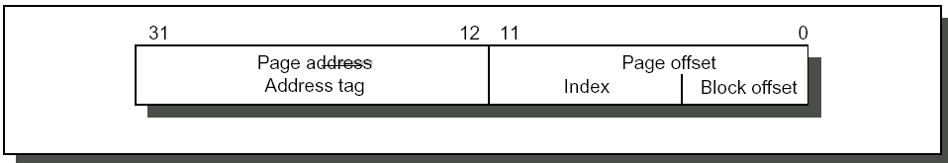
Fast Cache Hits by Avoiding Translation:
Index with Physical Portion of Address
If index is physical part of address, can start tag access in parallel with translation so that can compare to physical tag
Limits cache to page size: what if want bigger caches and uses same trick?
Higher associativity moves barrier to right
Page coloring

Slide 75
Fast hits by Avoiding Address Translation
Send virtual address to cache? Called Virtually Addressed Cache or just Virtual Cache vs. Physical Cache
Every time process is switched logically must flush the cache; otherwise get false hits
Cost is time to flush + “compulsory” misses from empty cache
Add process identifier tag that identifies process as well as address within process: can’t get a hit if wrong process
Dealing with aliases (sometimes called synonyms); Two different virtual addresses map to same physical address
solve by fiat: no aliasing! What are the implications?
HW antialiasing: guarantees every cache block has unique address
verify on miss (rather than on every hit)
cache set size <= page size ?
what if it gets larger?
How can SW simplify the problem? (called page coloring)
I/O must interact with cache, so need virtual address

Slide 76
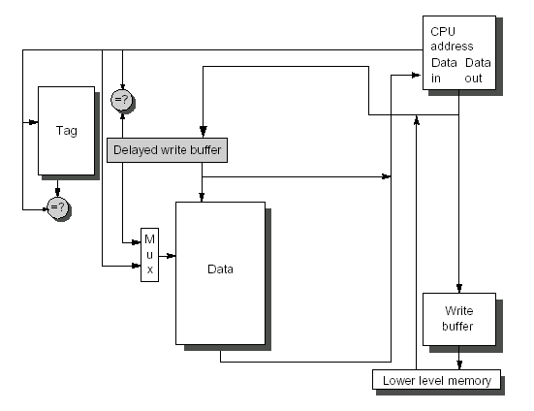
Third Hit Time Reduction Technique:
Pipelined Cache Access
The second stage of the write (cache is updated with new data) occurs during the first stage of the next write.
Write hits take longer than read hits because tag checking is required before the data is written.
Allows tag checking and data writing to occur simultaneously.

Slide 77
Fourth Hit Time Reduction Technique:
Trace caches
Instead of limiting the instructions in a static cache block to spatial locality, a trace cache finds a dynamic sequence of instructions including taken branches to load a cache block.
The cache blocks contains dynamic traces of the executed instructions as determined by CPU rather than containing static sequences of instructions as determined by memory.
The branch prediction is folded into the cache and must be validated alone with this addresses to have a valid fetch.

Slide 78
Summary: Reducing Hit Time
1.Reduce Hit Time via Small and Simple Caches
2.Reduce Hit Time via Avoiding Address Translation during Indexing of the Cache
3. Reduce Hit Time via pipelined Cache Access
4. Reduce Hit Time via Trace caches

Slide 79
Cache Optimization Summary
Technique MP MR HT Complexity
1.Multilevel caches + 2
2.Early Restart & Critical Word 1st + 2
3.Priority to Read Misses + 1
4.Merging write buffer + 1
5.Victim caches + + 2
6.Larger block size - + 0
7.Larger cache size + - 1
8.Higher Associativity + - 1
9.Way-predicting cache and Pseudo-associative caches
+ 2
10.Compiler techniques reduce cache misses + 0
11.Non-Blocking Caches + + 3
12.HW Prefetching of Instr/Data + + 2instr./3data
13.Compiler Controlled Prefetching + + 3
14.Small & Simple Caches - + 0
15.Avoiding Address Translation + 2
16.Pipelined Cache Access + 1
17.Trace cache + 3
miss
penalty
miss rate
parallelism
hit time

Slide 80
5.8 Main Memory and Organizations for Improving Performance
To be continued

Slide 81

THANK YOU
THANK YOU

