Slide 1
Database System
Textbook: Database System Concepts (7th Edition)
Instructor : SUN Jianling(孙建伶) (Professor)
Office:玉泉校区曹光彪楼410室
Email: sunjl@zju.edu.cn
Tel: 13705818519
wechat: sobeksun
Course TA 1 :石宇新（Master Student)
Email: 22321188@zju.edu.cn
Tel: 18567669366
wechat: zjusyx
Course TA 2 : 章潇彬（Master Student)
Email: 15968532522@163.com
Tel: 15968532522
wechat: zzzcjwddmw

Slide 2
Database System
Course Grading Policy（课程成绩评定规则）:
Exercise (作业) 10%
Quiz (测试+讨论) 10%
Lab & Project (实验和大程) 30%
Exam (考试) 50%
(Open two-page notes, handwriting, with student ID & name)

Slide 3
Database System
Course URL:
https://courses.zju.edu.cn/course/80897/content#/
数据库系统 - 学在浙大 (zju.edu.cn)
dingtalk：2025春夏 数据库系统 孙建伶班
WeChat：2025春夏 数据库系统

Slide 4
Database System in CS
AI 、NLP、CV、IR、CG、Multimedia、E-commence、 Numerical Analysis、Software Engine、Embedded System …
Programming Language、Data Structure、Algorithm、Parallel & Distributed Computing
Complier、Database System、Computer Network
Operating System
Computer Organization、Computer Architecture、Assemble
Digital Circuits

Slide 5
Chapter 1: Introduction

Slide 6
Outline
Database Systems
Database Applications
Purpose of Database Systems
View of Data
Data Models
Database Languages
Database Design
Database Engine
Database Users and Administrators
History of Database Systems

Slide 7
Database Systems
Applications built on files vs. built on databases
Database is a collection of interrelated data about a enterprise, which is managed by a DBMS(Database Management System).
The primary goal of a DBMS is to provide a way to store and retrieve database information that is both convenient and eﬃcient.
Management of data involves both deﬁning structures for storage of information and providing mechanisms for the manipulation of information.
The database system must ensure the safety of the information stored, despite system crashes or attempts at unauthorized access.
If data are to be shared among several users, the system must provide concurrency control mechanisms to avoid possible anomalous results.
applications
applications
DBMS
Database Engine
files
database
Notes:
7

Slide 8
Database Applications
Database Applications（数据库应用，数据库应用系统）:
Enterprise Information
Sales: customers, products, purchases
Accounting: payments, receipts, assets
Human Resources: employees, salaries, payroll taxes.
Manufacturing: production, inventory, orders, supply chain
Banking: customers, accounts, loans, credit cards ,transactions
Universities: instructors, students, courses, registration, grades
Airlines: reservations, schedules
Web-based services
Online retailers: order tracking, customized recommendations
Online advertisements
Databases touch all aspects of our lives
Notes:
8

Slide 9
Database Applications
Databases can be very large → Big Data （大数据）
Volume （容量）
Variety （种类）
Velocity （速度）
Value(价值）
Data-driven Artificial Intelligence →AI 2.0 （人工智能 2.0）
GAI: Generative Artificial Intelligence（生成式人工智能）
LLM : Large Language Model （大语言模型）
DeepSeek
豆包
通意千问（Qwen）
文小言
…
Notes:
9

Slide 10
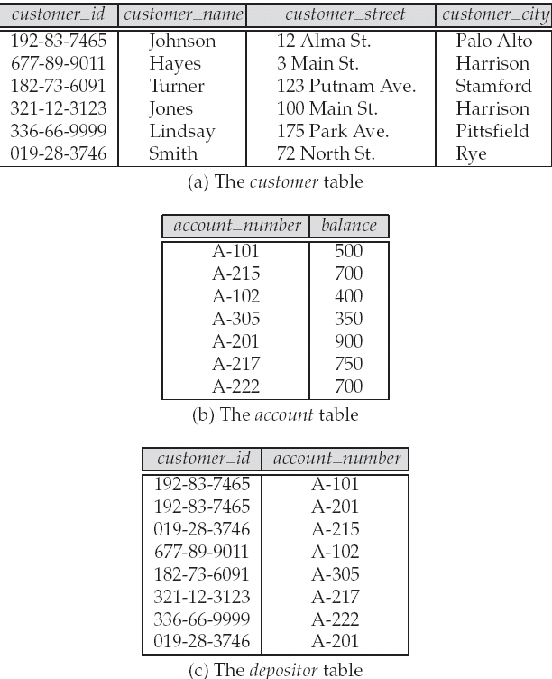
Database Example-Banking
Application program example - Banking
Add customers
Open accounts
Save/Withdraw money
Lend/ Repay loans
Notes:
10

Slide 11
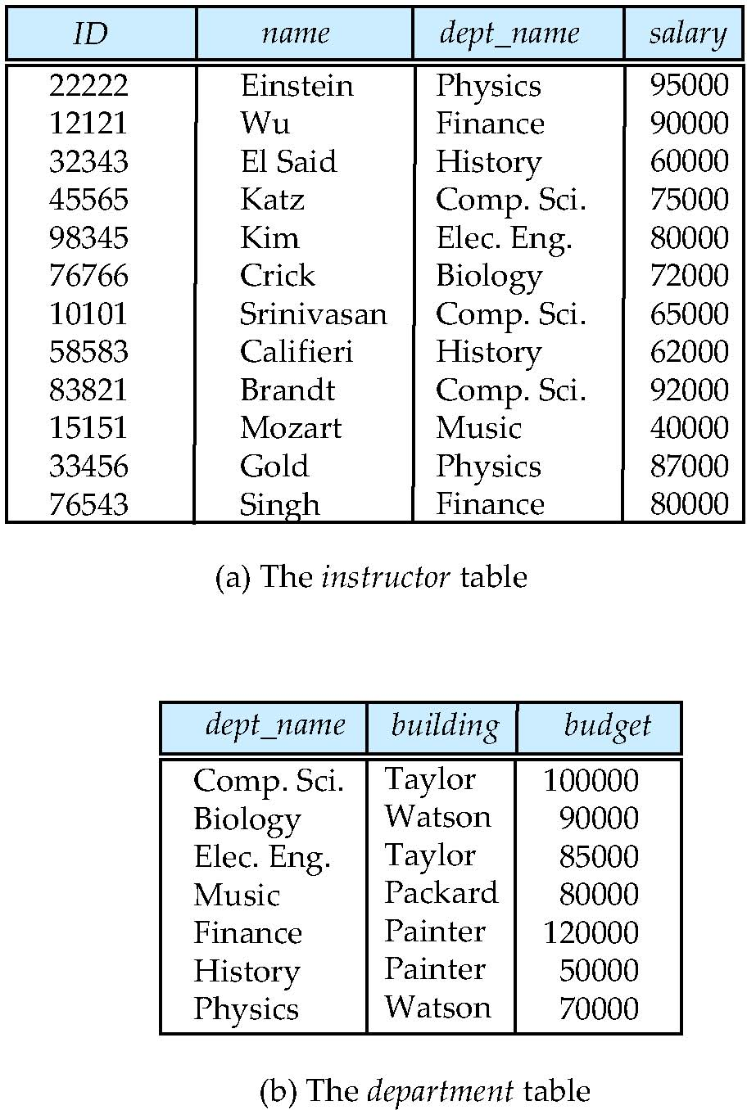
Database Example- University
Application program example - University
Add new students, instructors, and courses
Register students for courses, and generate class rosters
Assign grades to students
compute grade point averages (GPA) and generate transcripts
Notes:
11

Slide 12
Purpose of Database Systems
In the early days, database applications were built directly on top of file systems，which leads to:
Data redundancy（数据冗余） and inconsistency（不一致）
Multiple file formats, duplication of information in different files
Data isolation（数据孤立，数据孤岛） — multiple files and formats
Difficulty in accessing data （存取数据困难）
Need to write a new program to carry out each new task
applications
files
files
Notes:
12

Slide 13
Purpose of Database Systems
Integrity problems（完整性问题）
Integrity constraints become “buried” in program code rather than being stated explicitly(显式的)
Example: “account balance >=1”
Hard to add new constraints or change existing ones
Notes:
13

Slide 14
Purpose of Database Systems
Atomicity problems（原子性问题）
Failures may leave database in an inconsistent state with partial updates carried out
Example: Transfer of funds from one account to another should either complete or not happen at all
50
A：100
B：100
balance - 50
balance + 50
Notes:
14

Slide 15
Purpose of Database Systems
Concurrent access anomalies（并发访问异常）
Concurrent access needed for performance
Uncontrolled concurrent accesses can lead to inconsistencies
Example: Two people reading a balance (say 100) and updating it by saving money (say 50 each) at the same time
T1
T2
read : balance = 100
read: balance = 100
write : balance +50
write : balance + 50
A：100
Notes:
15

Slide 16
Purpose of Database Systems
Security problems（安全性问题）
Hard to provide user access to some, but not all, data
Authentication(认证）
Priviledge （权限）
Audit（审计）
Database systems offer solutions to all the above problems
Notes:
16

Slide 17
Characteristics of Databases
Characteristics of Databases
data persistence(数据持久性)
convenience in accessing data(数据访问便利性)
data integrity （数据完整性）
concurrency control for multiple user(多用户并发控制)
failure recovery（故障恢复）
security control（安全控制）
Notes:
17

Slide 18
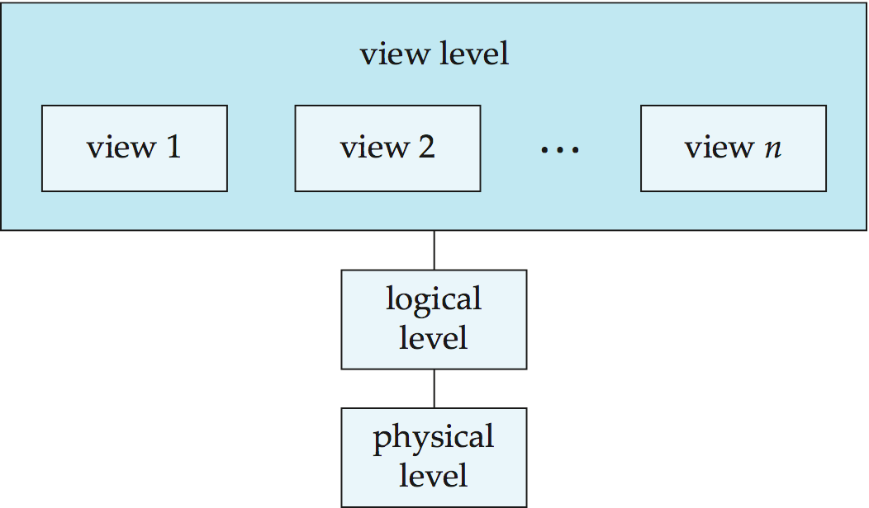
View of Data
Three-level abstraction of databases
view schema
view/logical mapping
logical schema
logical/physical mapping
physical schema
.Hide the complexities
.Enhance the adaptation to changes
Notes:
18

Slide 19
Schema and Instance
Similar to types and variables in programming languages
Schema （模式）– the logical structure of the database
Example: The database consists of information about a set of customers and accounts and the relationship between them
Analogous to type information of a variable in a program
Physical schema（物理模式）: database design at the physical level
Logical schema（逻辑模式）: database design at the logical level
Instance（实例） – the actual content of the database at a particular point in time
Analogous to the value of a variable
Notes:
19

Slide 20
Data Independence
Physical Data Independence（物理数据独立性） – the ability to modify the physical schema without changing the logical schema
Applications depend on the logical schema
In general, the interfaces between the various levels and components should be well defined so that changes in some parts do not seriously influence others.
Logical Data Independence(逻辑数据独立性) – the ability to modify the logical schema without changing the user view schema
Notes:
20

Slide 21
Data Models（数据模型）
A collection of tools for describing
Data (数据)
Data relationships(联系)
Data semantics(语义)
Data constraints(约束)
Relational model(关系模型)
Entity-Relationship(实体-联系) data model
Object-based data models
Object-oriented (面向对象数据模型)
Object-relational(对象-关系模型模型)
Semistructured data model (XML)(半结构化数据模型)
Other older models:
Network model (网状模型)
Hierarchical model(层次模型)
Notes:
21

Slide 22
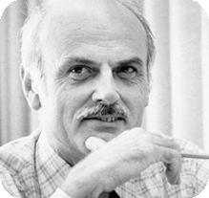
Relational Model
Relational model
Example of tabular data in the relational model
Covered in Chapter 2
Columns / Attributes
(列/属性)
Rows / Tuples
（行/元组）
Ted Codd Turing Award 1981
Notes:
22

Slide 23
Database Languages
Data Definition Language (DDL)
Data Manipulation Language (DML)
SQL Query Language
Application Program Interface （API）
Covered in Part one - Chapters 3, 4, 5
Notes:
23

Slide 24
Data Definition Language (DDL) （数据定义语言）
Specification notation for defining the database schema
Example: create table instructor ( ID char(5), name varchar(20), dept_name varchar(20), salary numeric(8,2))
DDL compiler generates a set of table templates stored in a data dictionary（数据字典）
Data dictionary contains metadata (元数据， i.e., data about data)
Database schema
Integrity constraints（完整性约束）
Primary key (ID uniquely identifies instructors)（主健）
Referential integrity (references constraint in SQL)（参照完整性）
e.g. dept_name value in any instructor tuple must appear in department relation
Authorization（权限）
Notes:
24

Slide 25
Data Manipulation Language (DML) （数据操作语言）
Language for accessing and manipulating the data organized by the appropriate data model
DML also known as query language
Two classes of languages
Procedural（过程式） – user specifies what data is required and how to get those data
Declarative (nonprocedural， 陈述式，非过程式) – user specifies what data is required without specifying how to get those data
SQL is the most widely used query language
Notes:
25

Slide 26
SQL Query Language
SQL: widely used non-procedural language
Example 1: Find the name of the instructor with ID 22222 select name from instructor where instructor.ID = ‘22222’
Example 2: Find the ID and building of instructors in the Physics dept.
select instructor.ID, department.building from instructor, department where instructor.dept_name = department.dept_name and department.dept_name = ‘Physics’
Notes:
26

Slide 27
Database Access from Application Program
Non-procedural query languages such as SQL are not as powerful as a universal Turing machine.
SQL does not support actions such as input from users, output to displays, or communication over the network.
Such computations and actions must be written in a host language, such as C/C++, Java or Python.
Application programs generally access databases through one of
Language extensions to allow embedded SQL
API（Application program interface） (e.g., ODBC/JDBC) which allow SQL queries to be sent to a database
Notes:
27

Slide 28
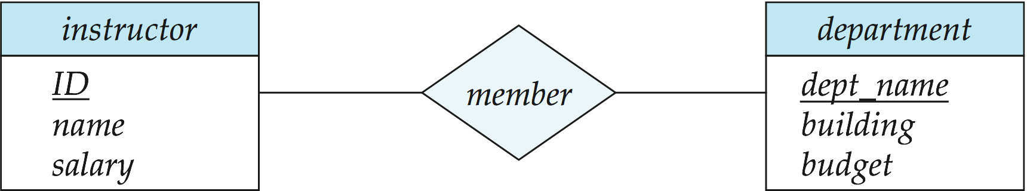
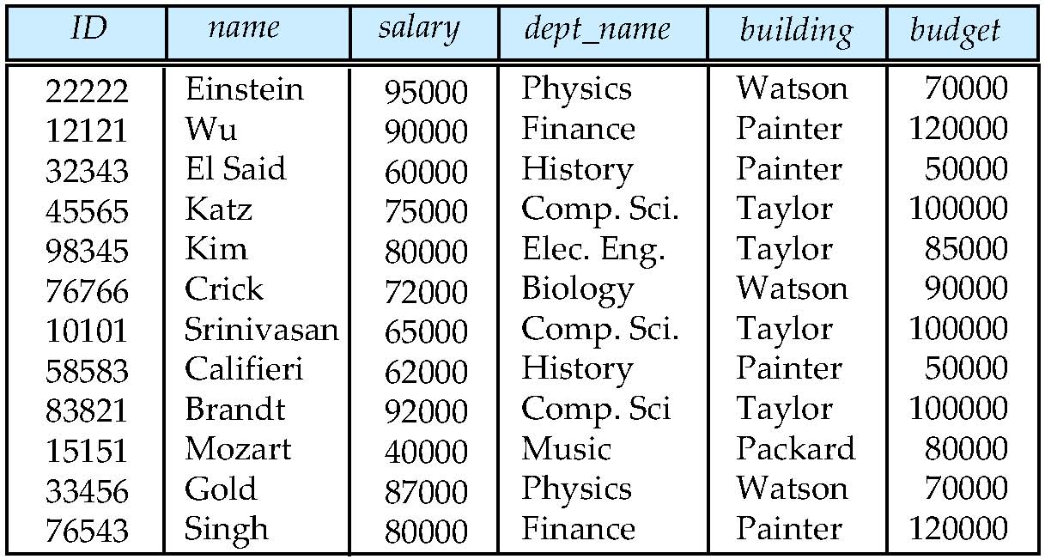
Database Design(数据库设计)
Entity Relationship Model （实体-联系模型）
Models an enterprise as a collection of data entities and relationships
Represented diagrammatically by an entity-relationship diagram.
Normalization Theory（规范化理论）
Formalize what designs are bad, and test for them
Covered in Part Two – Chapter 6 ,7
Is there any problem with this design?
Notes:
28

Slide 29
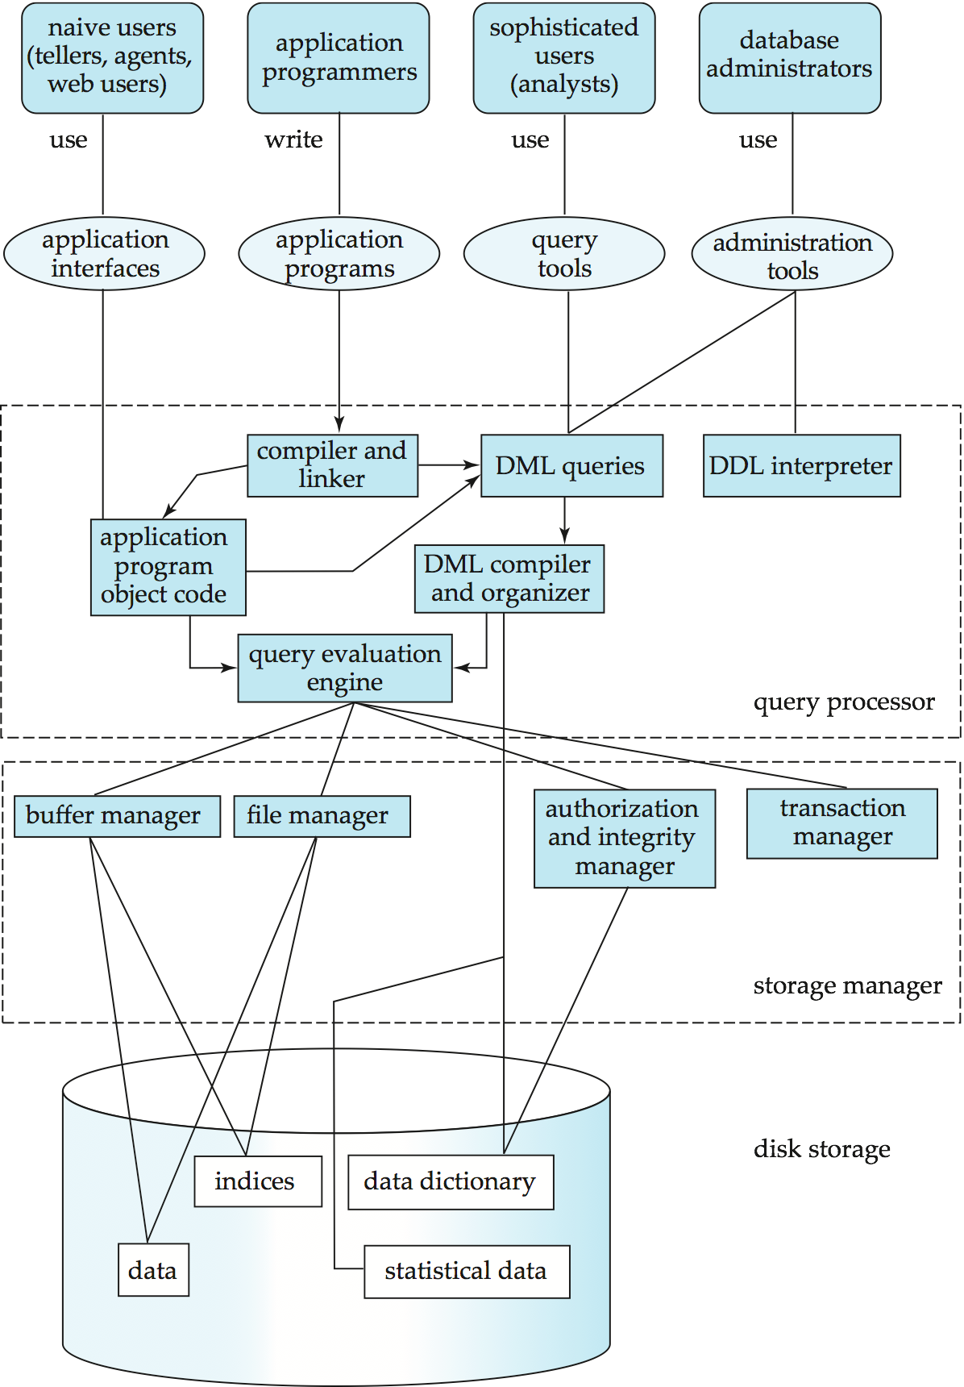
Database Engine(数据库引擎)
A database system(database engine) is partitioned into modules that deal with each of the responsibilities of the overall system.
The functional components of a database system can be divided into
The storage manager
The query processor
The transaction management component.
Notes:
29

Slide 30
Storage Manager
A program module that provides the interface between the low-level data stored in the database and the application programs and queries submitted to the system.
The storage manager is responsible to the following tasks:
Interaction with the OS file manager
Efficient storing, retrieving and updating of data
The storage manager components include:
File manager
Buffer manager
Authorization and integrity manager
Transaction manager
Covered in Part five - Chapters 12 ,13,14
Notes:
30

Slide 31
Storage Manager (Cont.)
The storage manager implements several data structures as part of the physical system implementation:
Data files -- store the database itself
Data dictionary -- stores metadata about the structure of the database, in particular the schema of the database.
Indices -- can provide fast access to data items. A database index provides pointers to those data items that hold a particular value.
Statistical data
Notes:
31

Slide 32
Query Processor
The query processor components include:
DDL interpreter -- interprets DDL statements and records the definitions in the data dictionary.
DML compiler -- translates DML statements in a query language into an evaluation plan consisting of low-level instructions that the query evaluation engine understands.
The DML compiler performs query optimization; that is, it picks the lowest cost evaluation plan from among the various alternatives.
Query evaluation engine -- executes low-level instructions generated by the DML compiler.
Covered in Part six - Chapters 15,16
Notes:
32

Slide 33
Query Processing
1. Parsing and translation
2. Optimization
3. Evaluation
Notes:
33

Slide 34
Transaction Management
A transaction is a collection of operations that performs a single logical function in a database application.
Recover Manager ensures that the database remains in a consistent (correct) state despite system failures (e.g., power failures and operating system crashes) and transaction failures.
Concurrency-control manager controls the interaction among the concurrent transactions, to ensure the consistency of the database.
Covered in Part Seven - Chapters 17,18,19
Notes:
34

Slide 35
Database Users
Naïve users
Banking, Airlines
Sales, Health …
Database application
Application programmer
ODBC, JDBC,
Hibernet …
API
Oracle,SQL Server, DB2,达梦, GaussDB,
PolarDB, OceanBase,
MySQL,PostgreSQL
DBMS
DBA
Data Analyst
Unix/Linux,
Windows,
Mac OS …
OS
Database

Slide 36
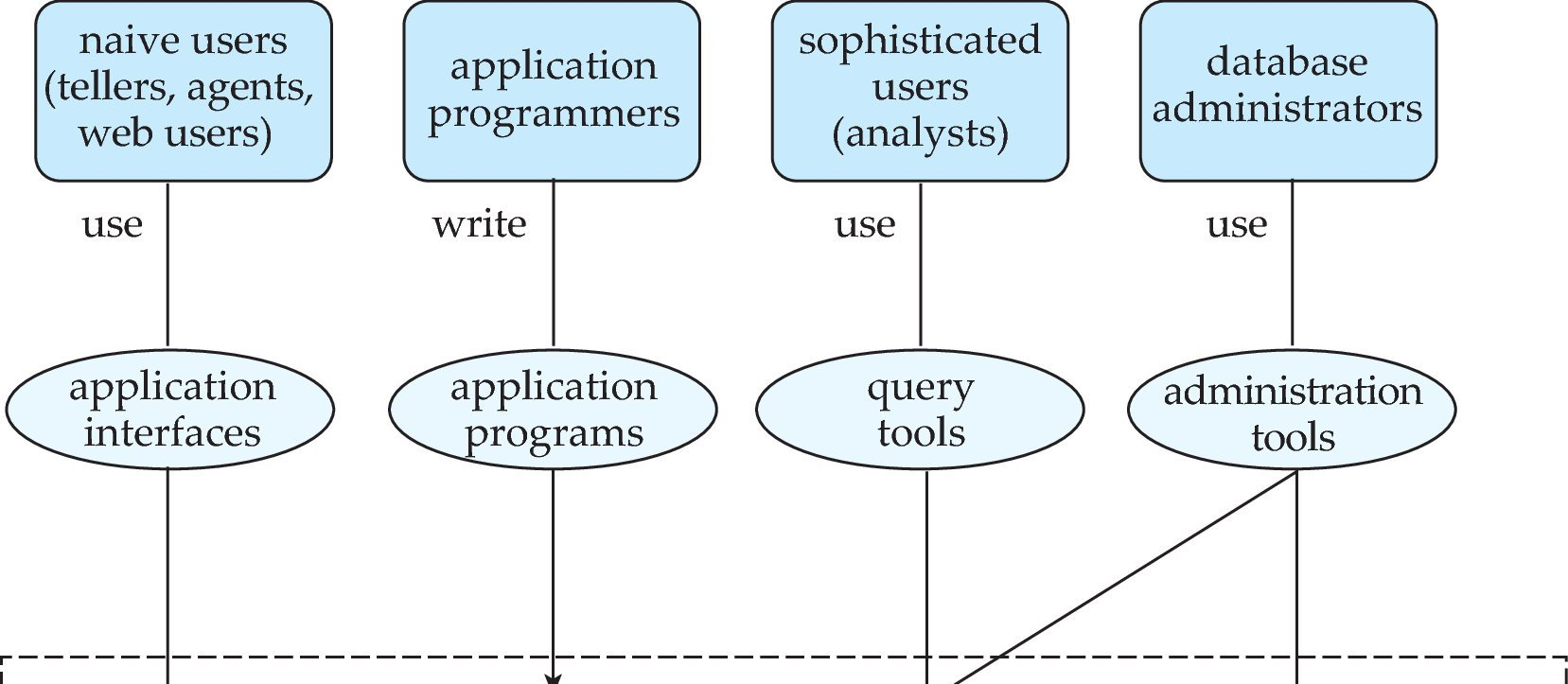
Database Users
Database
Notes:
36

Slide 37
Database Users
Users are differentiated by the way they expect to interact with the system
Application programmers – interact with system through DML calls
Naïve users – invoke one of the permanent application programs that have been written previously
Examples, people accessing database over the web, bank tellers, clerical staff
Database Administrator - Coordinates all the activities of the database system; the database administrator has a good understanding of the enterprise’s information resources and needs.

Slide 38
Database Administrator（DBA）
Database administrator's duties include:
Schema definition
Storage structure and access method definition
Schema and physical organization modification
Granting user authority to access the database
Routine maintenance
Performance Tuning - Monitoring performance and responding to changes in requirements
Periodically backing up the database onto remote servers
Ensuring that enough free disk space is available for normal operations, and upgrading disk space as required

Slide 39
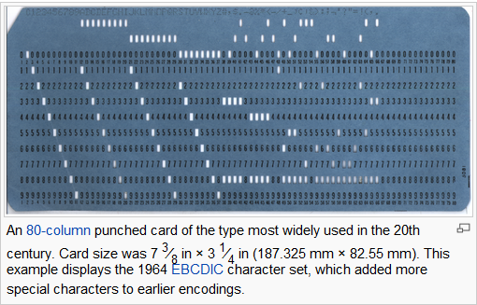

History of Database Systems
1950s and early 1960s:
Data processing using magnetic tapes for storage
Tapes provide only sequential access
Punched cards for input

Slide 40
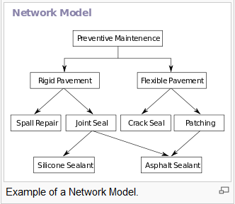
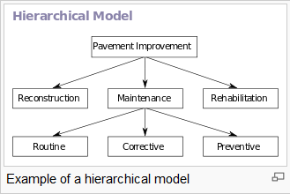
History of Database Systems
1960s :
Hard disks allow direct access to data
Network and hierarchical data models are widely used
IDS（Integrated DataStore), 1961, GE
Charles W. Bachman
IBM IMS(Information Management System), 1968.

Slide 41
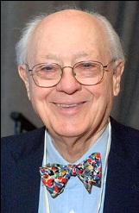
Turing Award:Charles W. Bachman(1924-2017)
IDS（Integrated DataStore), 1961, GE(美国通用电气)
“ father of databases"
1973 ACM Turing Award for his outstanding contribution to database technology

Slide 42
History of Database Systems
1970s:
Business Applications
OLTP (Online Transaction Processing)
Edgar F. Codd defines the relational data model in 1970
IBM Research begins System R prototype(1974, Jim Gray as a key player)
UC Berkeley begins Ingres prototype(1974, leaded by Michael Stonebraker)

Slide 43

Turing Award: Edgar F. Codd (1923-2003)
A Relational Model of Data for Large Shared Data Banks, CACM 1970.
1981 ACM Turing Award
In 2004, SIGMOD renamed its highest prize to the SIGMOD Edgar F. Codd Innovations Award.

Slide 44
History of Database Systems
1980s:
RDBMS implementation
Research relational prototypes evolve into commercial systems
Oracle(1983)
IBM DB2(1983)
Informix(1985)
Sybase(1987)
Postgres (PostgresSQL,1989)
Parallel database systems
Distributed database systems
Object-oriented database systems
Object-relational Database systems
Extended to Engineering Applications

Slide 45


Turing Award: Jim Gray(1944-2007)
IMS、System R、SQL/DS、DB2
《Transaction Processing: Concepts and Techniques》
1998 ACM Turing Award for his seminal contribution to database and transaction processing research and technical leadership in system implementation.
SIGMOD Jim Gray Doctoral Dissertation Award
Disappearance on January 28, 2007 at sea in his sloop Tenacious, during a short solo sailing trip to the Farallon Islands near San Francisco to scatter his mother's ashes.

Slide 46
History of Database Systems
1990s:
Business intelligence(BI)
Large decision support and data-mining applications
Large multi-terabyte data warehouses
OLAP(Online Analytical Processing)
Emergence of Web commerce
The Web changes everything
New workloads – performance, concurrency, availability

Slide 47
History of Database Systems
2000s:
Web Era
Big data
NoSQL
XML and XQuery standards
Automated database administration

Slide 48
History of Database Systems
2000s: NoSQL
A NoSQL(Not Only SQL) database provides a mechanism for storage and retrieval of data that use looser consistency models than traditional relational databases in order to achieve horizontal scaling and higher availability.
NoSQL database systems are useful when working with a huge quantity of data (especially big data) when the data's nature does not require a relational model.
Some NoSQL DBMSs:
MongoDB, Cassandra, HBase

Slide 49
History of Database Systems
2010s:
NewSQL
Cloud database
Autonomous Database (AI powered Database)

Slide 50
History of Database Systems
2010s: NewSQL
NewSQL is a class of modern RDBMSs that seek to provide the same scalable performance of NoSQL systems for OLTP workloads while still maintaining the ACID guarantees of a traditional database system
NewSQL: An Alternative to NoSQL and Old SQL for New OLTP Apps
Some NewSQL DBMSs:
VoltDB, NuoDB, Clustrix, JustOneDB

Slide 51

Turing Award: Michael Stonebraker (1943~ )
2014 ACM Turing Award for his fundamental contributions to the concepts and practices underlying modern database systems.
Stonebraker invented many of the concepts that are used in almost all modern database systems.
Stonebraker brought Relational Database Systems from concept to commercial success, set the research agenda for the multibillion-dollar database field for decades.
Through practical application of his innovative database management technologies and numerous business start-ups, he has continually demonstrated the role of the research university in driving economic development.

Slide 52
History of Database Systems
2010s: Cloud Database
A cloud database is a database that typically runs on a cloud computing platform, access to it is provided as a service.
Characteristics
Scalability
High availability
Resource transparency
Trustiness
Security and privacy
Vendors
Amazon RDS/DynamoDB/SimpleDB
Microsoft Azure SQL Database
Google Aurora
Huawei GaussDB
Aliyun PolarDB
Tencent TDSQL-C/ TencentDB

Slide 53
End of Chapter 1
Notes:
53

