Slide 1
Chapter 2: The Relational Model

Slide 2
Outline
Structure of Relational Databases
Database Schema
Keys
Schema Diagrams
Relational Query Languages
The Relational Algebra
Notes:
1

Slide 3
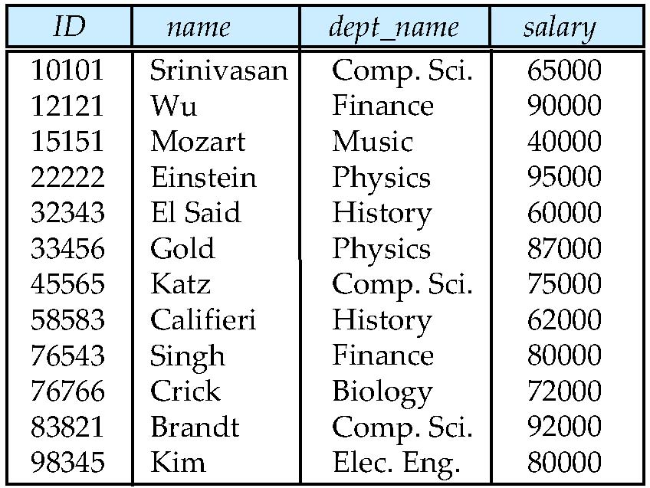
Example of a Relation
attributes
(or columns)
tuples
(or rows)

Slide 4
Basic Structure
Formally, given sets D₁, D₂, …. D_{n} a relation r is a subset of D₁ x D₂ x … x D_{n.} Thus, a relation is a set of n-tuples (a₁, a₂, …, a_{n}) where each a_{i} ∈ D_{i}
Example: If
name = {Wu, Mozart, Gold, Singh, …} /* set of all instructor names */
dept_name = {Music, Physics, Finance, …} /* set of all department names*/
salary = {40000, 80000, 87000,90000 …} /* set of all salary */
Then r = { (Wu, Finance, 90000), (Mozart, Music, 40000), (Gold, Physics, 87000), (Singh, Finance, 80000) } is a relation over
name x dept_name x salary

Slide 5
Relation Schema and Instance
A₁, A₂, …, A_{n} are attributes
R = (A₁, A₂, …, A_{n} ) is a relation schema
Example:
instructor = (ID, name, dept_name, salary)
A relation instance r defined over schema R is denoted by r (R).
The current values a relation are specified by a table
An element t of relation r is called a tuple and is represented by a row in a table
Notes:
1

Slide 6
Attributes
The set of allowed values for each attribute is called the domain（域） of the attribute
Attribute values are (normally) required to be atomic（原子的）; that is, indivisible
The special value null （空值） is a member of every domain
The null value causes complications in the definition of many operations

Slide 7
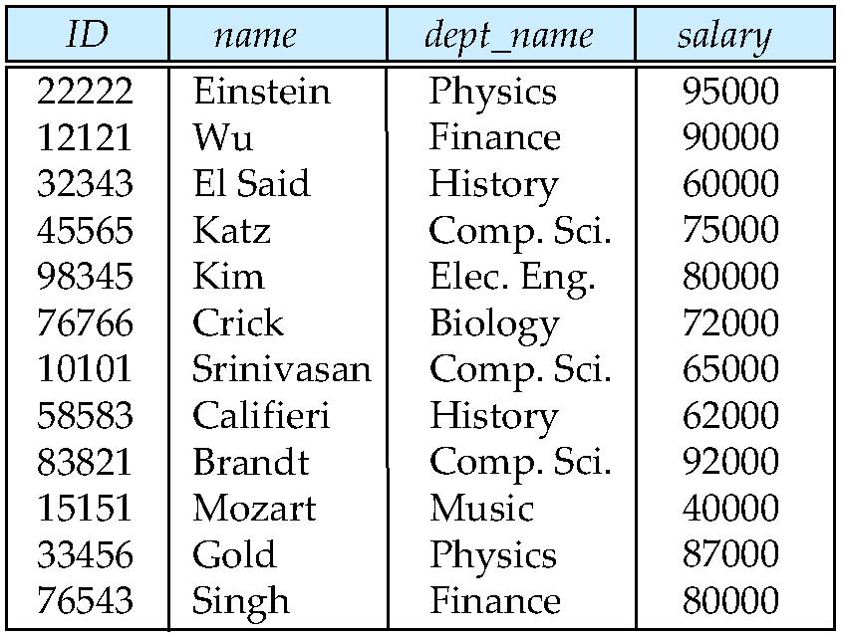
Relations are Unordered
Order of tuples is irrelevant (tuples may be stored in an arbitrary order)
Example: instructor relation with unordered tuples

Slide 8
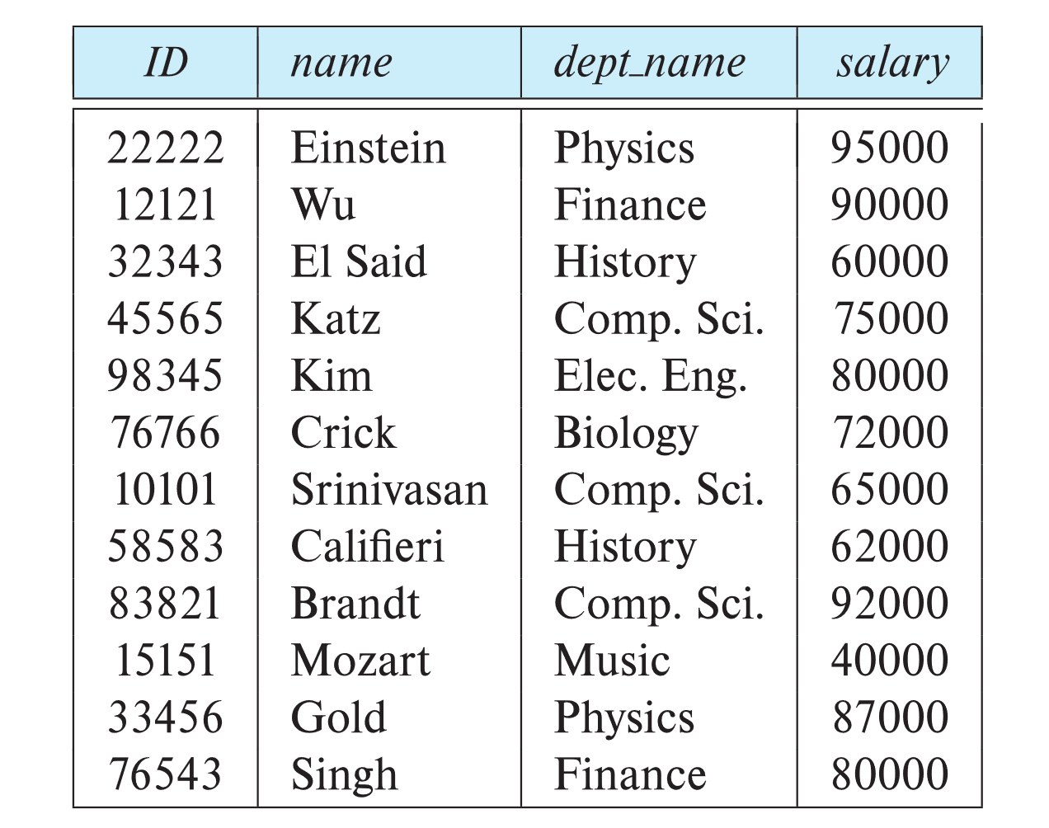
Database Schema
Database schema -- is the logical structure of the database.
Database instance -- is a snapshot of the data in the database at a given instant in time.
Example:
schema: instructor (ID, name, dept_name, salary)
Instance:

Slide 9
Keys
Let K ⊆ R
K is a superkey(超健) of R if values for K are sufficient to identify a unique tuple of each possible relation r(R)
Example: {ID} and {ID,name} are both superkeys of instructor.
Superkey K is a candidate key(候选健) if K is minimal Example: {ID} is a candidate key for Instructor
One of the candidate keys is selected to be the primary key（主键）.

Slide 10
Keys
Foreign key（外键） constraint from attribute(s) A of relation r1 to the primary key B of relation r2 states that on any database instance, the value of A for each tuple in r1 must also be the value of B for some tuple in r2.
Referencing relation : teaching Referenced relation: instructor
Referential integrity(参照完整性) constraint requires that the values appearing in specified attribute(s) A of any tuples in the referencing relation r1 also appear in specified attribute(s) B of at least one tuple in the referenced relation r2.
Referencing relation : section Referenced relation: time-slot
ID
course_id
10101
12121
76766
CS-101
FIN-201
BIO-101
ID
name
dept_name
10101
12121
15151
Srinivasan
Wu
Mozart
Comp. Sci.
Finance
Music
course_id
sec-id
semester
year
time-slot_id
time-slot_id
day
start-time
end-time
CS-101
CS-101
BIO-101
1
2
1
spring
spring
summer
2022
2022
2021
t1
t1
t2
t1
t1
t2
t2
Tue
Fri
Wed
Wed
13:15
8:00
13:15
18:30
15:40
9:35
15:40
20:05

Slide 11
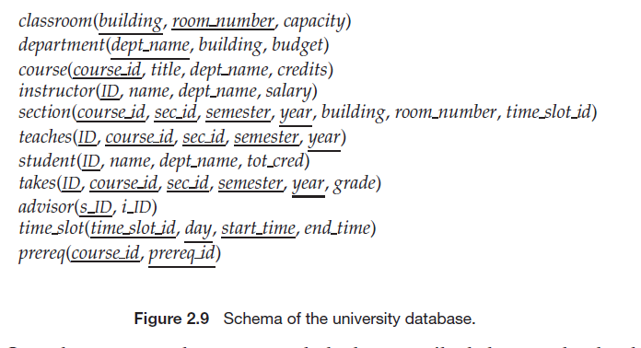
Database
A database consists of multiple relations
Information about an enterprise is broken up into parts

Slide 12
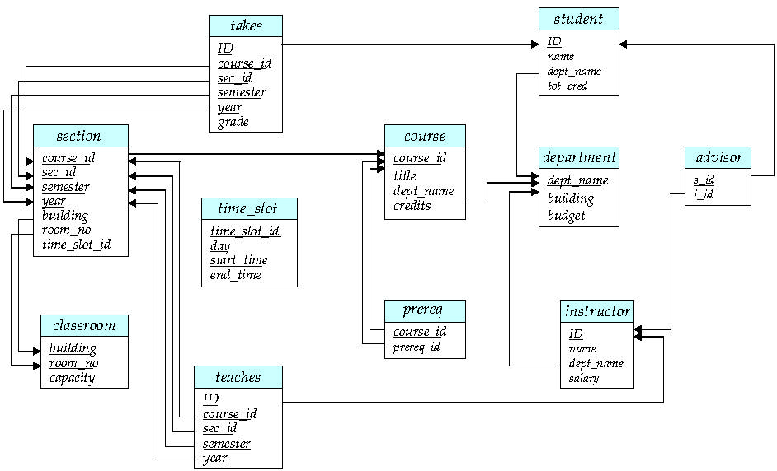
Schema Diagram for University Database
referential
Integrity constraint
foreign-key constraint

Slide 13
Relational Query Languages
Procedural vs.non-procedural, or declarative
“Pure” languages:
Relational algebra(关系代数)
Tuple relational calculus（元组关系演算）
Domain relational calculus（域关系演算）
The above 3 pure languages are equivalent in computing power
We will concentrate on relational algebra
Not Turing-machine equivalent
Consists of 6 basic operations

Slide 14
Relational Algebra
A procedural language consisting of a set of operations that take one or two relations as input and produce a new relation as their result.
Six basic operators
select: σ
project: ∏
union: ∪
set difference: –
Cartesian product(笛卡尔积): x
rename: ρ

Slide 15
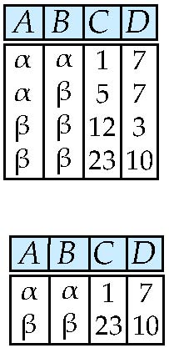
Select Operation – Example
Relation r
σ_{A=B ^ D > 5} (r)

Slide 16
Select Operation
The select operation selects tuples that satisfy a given predicate.
Notation: σ _{p}(r)
p is called the selection predicate
Defined as: σ_{p}(r) = {t | t ∈ r and p(t)}
Where p is a formula in propositional calculus consisting of terms connected by : ∧ (and), ∨ (or), ¬ (not) Each term is one of:
<attribute> op <attribute>
<attribute> op <constant>
where op is one of: =, ≠, >, ≥. <. ≤
Example of selection: σ _{dept_name=“Physics”}(instructor)
σ _{salary >} ₉₀₀₀₀ (instructor)
σ _{dept_name=“Physics” ∧ salary >} ₉₀₀₀₀ (instructor)

Slide 17
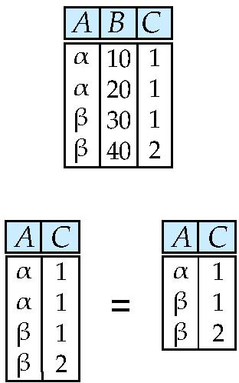
Project Operation – Example
Relation r:
∏_{A,C} (r)

Slide 18
Project Operation
The project operation is a unary operation that returns its argument relation, with certain attributes left out.
Notation:
where A₁, A₂ are attribute names and r is a relation name.
The result is defined as the relation of k columns obtained by erasing the columns that are not listed
Duplicate rows removed from result, since relations are sets
Example: To eliminate the dept_name attribute of instructor ∏_{ID, name, salary} (instructor)

Slide 19
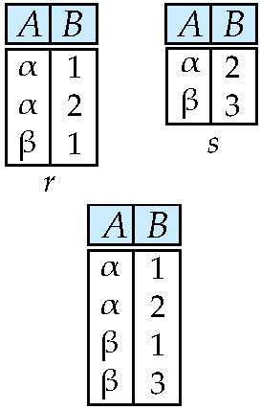
Union Operation – Example
Relations r, s:
r ∪ s:

Slide 20
Union Operation
The union operation allows us to combine two relations
Notation: r ∪ s
Defined as:
r ∪ s = {t | t ∈ r or t ∈ s}
For r ∪ s to be valid.
1. r, s must have the same arity (元数)(same number of attributes)
2. The attribute domains must be compatible (example: 2nd column of r deals with the same type of values as does the 2nd column of s)
Example: to find all courses taught in the Fall 2009 semester, or in the Spring 2010 semester, or in both ∏_{course_id} (σ _{semester=“Fall” Λ year=2009} (section)) ∪ ∏_{course_id} (σ _{semester=“Spring” Λ year=2010} (section))

Slide 21
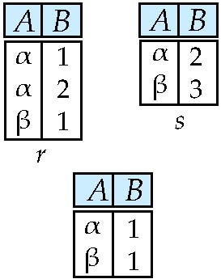
Set difference – Example
Relations r, s:
r – s:

Slide 22
Set Difference Operation
The set-difference operation allows us to find tuples that are in one relation but are not in another.
Notation r – s
Defined as:
r – s = {t | t ∈ r and t ∉ s}
Set differences must be taken between compatible relations.
r and s must have the same arity
attribute domains of r and s must be compatible
Example: to find all courses taught in the Fall 2009 semester, but not in the Spring 2010 semester ∏_{course_id} (σ _{semester=“Fall” Λ year=2009} (section)) − ∏_{course_id} (σ _{semester=“Spring” Λ year=2010} (section))

Slide 23
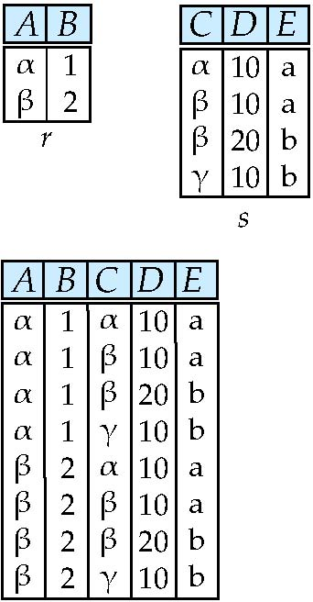
Cartesian-Product Operation – Example
Relations r, s:
r x s:

Slide 24
Cartesian-Product Operation
The Cartesian-product operation (denoted by X) allows us to combine information from any two relations.
Notation r x s
Defined as:
r x s = {t q | t ∈ r and q ∈ s}
Assume that attributes of r(R) and s(S) are disjoint. (That is, R ∩ S = ∅).
If attributes of r(R) and s(S) are not disjoint, then renaming must be used.

Slide 25
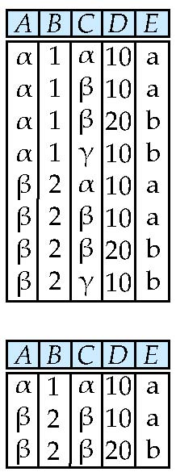
Composition of Operations
Can build expressions using multiple operations
Example: σ_{A=C}(r x s)
r x s
σ_{A=C}(r x s)

Slide 26
Rename Operation
Allows us to name, and therefore to refer to, the results of relational-algebra expressions.
Allows us to refer to a relation by more than one name.
Example:
ρ _{x} (E)
returns the expression E under the name X
If a relational-algebra expression E has arity n, then
returns the result of expression E under the name X, and with the
attributes renamed to A₁ , A₂ , …., A_{n} .

Slide 27
Example Queries
Find the names of all instructors in the Physics department, along with the course_id of all courses they have taught
Query 1 ∏_{instructor.name,course_id} (σ_{dept_name=“Physics”} ( σ _{instructor.ID=teaches.ID} (instructor x teaches)))
Query 2 ∏_{instructor.name,course_id} (σ_{instructor.ID=teaches.ID} ( σ _{dept_name=“Physics”} (instructor) x teaches))

Slide 28
Example Queries
Find the names of all instructors in the Physics department, along with the course_id and title of all courses they have taught
Query ∏instructor.name, course.course_id. course.title (σ_{dept_name=“Physics” Λ} instructor.ID=teaches.ID Λ teaches.course_id=course.course_id (instructor x
teaches x course))

Slide 29
Example Query
Find the largest salary in the university
Step 1: find instructor salaries that are less than some other instructor salary (i.e. not maximum)
using a copy of instructor under a new name d
∏_{instructor.salary} (σ _{instructor.salary < d.salary} (instructor x ρ_{d} (instructor)))
Step 2: Find the largest salary
∏_{salary} (instructor) – ∏_{instructor.salary} (σ _{instructor.salary < d,salary} (instructor x ρ_{d} (instructor)))

Slide 30
Example Query
Find the largest salary in the university
∏_{salary} (instructor) – ∏_{instructor.salary} (σ _{instructor.salary < d.salary} (instructor x ρ_{d} (instructor)))
ID
salary
10101
12121
15151
70000
80000
90000
instrtuctor.ID
instructor.salary
d.ID
d.salary
10101
10101
10101
12121
12121
12121
15151
15151
15151
70000
70000
70000
80000
80000
80000
90000
90000
90000
10101
12121
15151
10101
12121
15151
10101
12121
15151
70000
80000
90000
70000
80000
90000
70000
80000
90000

Slide 31
Formal Definition
A basic expression in the relational algebra consists of either one of the following:
A relation in the database
A constant relation
Let E₁ and E₂ be relational-algebra expressions; the following are all relational-algebra expressions:
E₁ ∪ E₂
E₁ – E₂
E₁ x E₂
σ_{p} (E₁), P is a predicate on attributes in E₁
∏_{s}(E₁), S is a list consisting of some of the attributes in E₁
ρ _{x} (E₁), x is the new name for the result of E₁

Slide 32
Additional Operations
We define additional operations that do not add any power to the
relational algebra, but that simplify common queries.
Set intersection: r ∩ s
Natural join: r s
Semijoin: ⋉_{θ}
Assignment: ←
Outer join : r s, r s, r s
Division Operator: r ÷ s

Slide 33
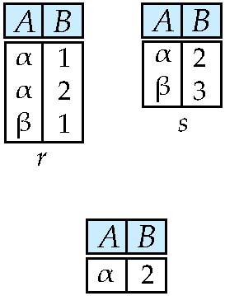
Set-Intersection Operation – Example
Relation r, s:
r ∩ s

Slide 34
Set-Intersection Operation
The set-intersection operation allows us to find tuples that are in both the input relations.
Notation: r ∩ s
Defined as:
r ∩ s = { t | t ∈ r and t ∈ s }
Assume:
r, s have the same arity
attributes of r and s are compatible
Note: r ∩ s = r – (r – s)

Slide 35
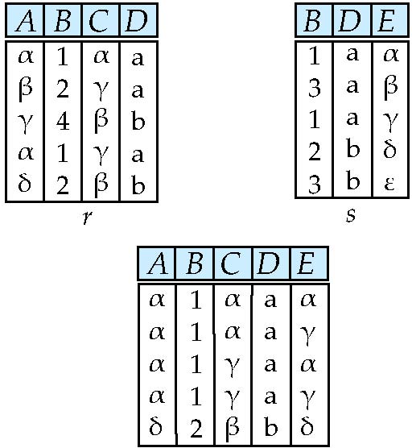
Natural Join – Example
Relations r, s:
r s

Slide 36
Natural-Join Operation
Notation: r s
Let r and s be relations on schemas R and S respectively. Then, r s is a relation on schema R ∪ S obtained as follows:
Consider each pair of tuples t_{r} from r and t_{s} from s.
If t_{r} and t_{s} have the same value on each of the attributes in R ∩ S, add a tuple t to the result, where
t has the same value as t_{r} on r
t has the same value as t_{s} on s
Example:
R = (A, B, C, D)
S = (E, B, D)
Result schema = (A, B, C, D, E)
r s = ∏_{r.A, r.B, r.C, r.D, s.E} (σ_{r.B = s.B ∧ r.D = s.D} (r x s))

Slide 37
Natural Join and Theta Join
Find the names of all instructors in the Comp. Sci. department together with the course titles of all the courses that the instructors teach
∏ _{name, title} (σ _{dept_name=“Comp. Sci.”} (instructor teaches course))
Natural join is associative
(instructor teaches) course is equivalent to instructor (teaches course)
Natural join is commutative
instructor teaches is equivalent to teaches instructor
The theta join operation r _{θ} s is defined as
r _{θ} s = σ_{θ} (r x s)

Slide 38
Outer Join
An extension of the join operation that avoids loss of information.
Computes the join and then adds tuples form one relation that does not match tuples in the other relation to the result of the join.
Uses null values:
null signifies that the value is unknown or does not exist
All comparisons involving null are (roughly speaking) false by definition.
We shall study precise meaning of comparisons with nulls later

Slide 39
Outer Join – Example
instructor teaches
ID
name
dept_name
ID
course_id
10101
12121
15151
Srinivasan
Wu
Mozart
Comp. Sci.
Finance
Music
10101
12121
76766
CS-101
FIN-201
BIO-101
Join instructor teaches
ID
name
dept_name
course_id
10101
12121
Srinivasan
Wu
Comp. Sci.
Finance
CS-101
FIN-201
Left Outer Join
instructor teaches
ID
name
dept_name
course_id
10101
12121
15151
Srinivasan
Wu
Mozart
Comp. Sci.
Finance
Music
CS-101
FIN-201
null

Slide 40
Outer Join – Example
instructor teaches
ID
name
dept_name
ID
course_id
10101
12121
15151
Srinivasan
Wu
Mozart
Comp. Sci.
Finance
Music
10101
12121
76766
CS-101
FIN-201
BIO-101
Right Outer Join
instructor teaches
ID
name
dept_name
course_id
10101
12121
76766
Srinivasan
Wu
null
Comp. Sci.
Finance
null
CS-101
FIN-201
BIO-101
Full Outer Join
instructor teaches
ID
name
dept_name
course_id
10101
12121
15151
76766
Srinivasan
Wu
Mozart
null
Comp. Sci.
Finance
Music
null
CS-101
FIN-201
null
BIO-101

Slide 41
Outer Join using Joins
Outer join can be expressed using basic operations
r s can be written as
(r s) U (r – ∏_{R}(r s) x {(null, …, null)}
r s can be written as
(r s) U {(null, …, null)} x (s – ∏_{s}(r s)
r s can be written as
(r s) U
(r – ∏_{R}(r s) x {(null, …, null)} U
{(null, …, null)} x (s – ∏_{s}(r s)

Slide 42
Semijoin（半连接） Operation
Notation: r ⋉ _{θ} s
Is a subset of r, in which every tuple r_{i} matches at least one truple s_{i} in s under the condition θ.
r ⋉ _{θ} s = ∏_{R} (r _{θ}s)
Semijoin examples:
r s r ⋉ _{r.B=s.B} s s ⋉ _{r.B=s.B} r
A | B | C | D
α | 1 | α | a
β | 2 | γ | a
γ | 4 | β | b
α | 1 | γ | a
δ | 2 | β | b
B | D | E
1 | a | α
3 | a | β
1 | a | γ
2 | b | δ
3 | b | ε
A | B | C | D
α | 1 | α | a
β | 2 | γ | a
α | 1 | γ | a
δ | 2 | β | b
B | D | E
1 | a | α
1 | a | γ
2 | b | δ

Slide 43
Semijoin（半连接） Operation and Nested Query
select name from instructor where exists (select * from teaches where instructor.ID = teaches.ID and teaches.year = 2022)
∏_{name}(instructor ⋉_{instructor.ID=teaches.ID} (σ_{teaches.year=2022} (teaches)))
select name
from instructor where ID in (select teaches.ID from teaches where teaches.year = 2022)

Slide 44
Null Values
Comparisons with null values return the special truth value: unknown
Three-valued logic using the truth value unknown:
OR: (unknown or true) = true, (unknown or false) = unknown (unknown or unknown) = unknown
AND: (true and unknown) = unknown, (false and unknown) = false, (unknown and unknown) = unknown
NOT: (not unknown) = unknown
In SQL “P is unknown” evaluates to true if predicate P evaluates to unknown
Result of select predicate is treated as false if it evaluates to unknown

Slide 45
Assignment Operation
The assignment operation (←) provides a convenient way to express complex queries.
Write query as a sequential program consisting of
a series of assignments
followed by an expression whose value is displayed as a result of the query.
Assignment must always be made to a temporary relation variable.

Slide 46
Division Operation – Example
Relations r, s:
A
B
B
α
α
α
β
γ
δ
δ
δ
∈
∈
β
1
2
3
1
1
1
3
4
6
1
2
1
2
s
r ÷ s:
A
r
α
β

Slide 47
Division Operator
Given relations r(R) and s(S), such that S ⊂ R, r ÷ s is the largest relation t(R-S) such that t x s ⊆ r
E.g. let r(ID, course_id) = ∏_{ID, course_id} (takes ) and s(course_id) = ∏_{course_id} (σ_{dept_name=“Biology”}(course ) then r ÷ s gives us students who have taken all courses in the Biology department
Can write r ÷ s as
temp1 ← ∏_{R-S} (r ) temp2 ← ∏_{R-S} ((temp1 x s ) – ∏_{R-S,S} (r )) result = temp1 – temp2
The result to the right of the ← is assigned to the relation variable on the left of the ←.
May use variable in subsequent expressions.

Slide 48
Another Division Example
Relations r, s:
A
B
C
D
E
D
E
α
α
α
β
β
γ
γ
γ
a
a
a
a
a
a
a
a
α
γ
γ
γ
γ
γ
γ
β
a
a
b
a
b
a
b
b
1
1
1
1
3
1
1
1
a
b
1
1
s
r
r ÷ s:
A
B
C
α
γ
a
a
γ
γ

Slide 49
Extended Relational-Algebra-Operations
Generalized Projection
Aggregate Functions

Slide 50
Generalized Projection
Extends the projection operation by allowing arithmetic functions to be used in the projection list.
E is any relational-algebra expression
Each of F₁, F₂, …, F_{n} are are arithmetic expressions involving constants and attributes in the schema of E.
Given relation instructor(ID, name, dept_name, salary) where salary is annual salary, get the same information but with monthly salary
∏_{ID, name, dept_name, salary/12} (instructor)

Slide 51

Aggregate Functions and Operations
Aggregation function （聚合函数）takes a collection of values and returns a single value as a result.
avg: average value min: minimum value max: maximum value sum: sum of values count: number of values
Aggregate operation in relational algebra
E is any relational-algebra expression
G₁, G₂ …, G_{n} is a list of attributes on which to group (can be empty)
Each F_{i} is an aggregate function
Each A_{i} is an attribute name
Note: Some books/articles use γ instead of (Calligraphic G)

Slide 52
Aggregate Operation – Example
Relation r:
A
B
C
α
α
β
β
α
β
β
β
7
7
3
10
_{sum(c)} (r)
sum(c )
27

Slide 53
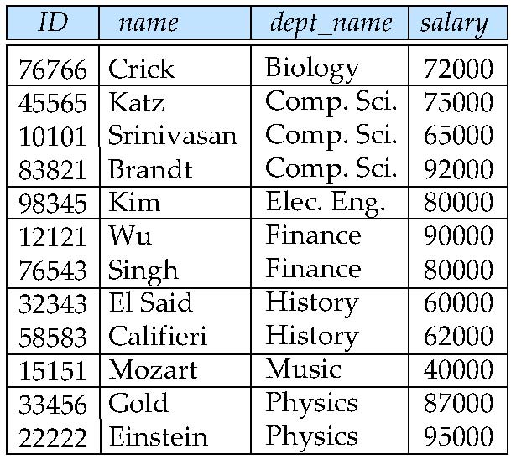
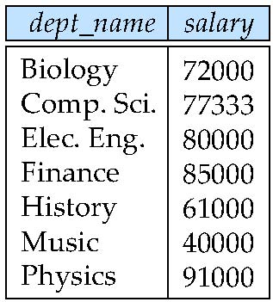
Aggregate Operation – Example
Find the average salary in each department
_{dept_name} _{avg(salary)} (instructor)
avg_salary

Slide 54
Aggregate Functions (Cont.)
Result of aggregation does not have a name
Can use rename operation to give it a name
For convenience, we permit renaming as part of aggregate operation
_{dept_name} _{avg(salary) as avg_sal} (instructor)

Slide 55
Modification of the Database
The content of the database may be modified using the following operations:
Deletion
Insertion
Updating
All these operations can be expressed using the assignment operator

Slide 56
Multiset Relational Algebra
Pure relational algebra removes all duplicates
e.g. after projection
Multiset（多重集） relational algebra retains duplicates, to match SQL semantics
SQL duplicate retention was initially for efficiency, but is now a feature
Multiset relational algebra defined as follows
selection: has as many duplicates of a tuple as in the input, if the tuple satisfies the selection
projection: one tuple per input tuple, even if it is a duplicate
cross product: If there are m copies of t1 in r, and n copies of t2 in s, there are m x n copies of t1.t2 in r x s
set operators
union: m + n copies
intersection: min(m, n) copies
difference: min(0, m – n) copies

Slide 57
SQL and Relational Algebra
select A1, A2, .. An from r1, r2, …, rm where P
is equivalent to the following expression in multiset relational algebra
∏ _{A1, .., An} (σ _{P} (r1 x r2 x .. x rm) )
select A1, A2, sum(A3) from r1, r2, …, rm where P group by A1, A2
is equivalent to the following expression in multiset relational algebra
_{A1, A2} _{sum(A3)} (σ _{P} (r1 x r2 x .. x rm)))

Slide 58
SQL and Relational Algebra
More generally, the non-aggregated attributes in the select clause may be a subset of the group by attributes, in which case the equivalence is as follows: select A1, sum(A3) from r1, r2, …, rm where P group by A1, A2
is equivalent to the following expression in multiset relational algebra
∏ _{A1,sumA3}( _{A1,A2} _{sum(A3)} _{as sumA3}(σ _{P} (r1 x r2 x .. x rm)))

Slide 59
End of Chapter 2
Notes:
59

