Slide 1
Chapter 4: Intermediate SQL

Slide 2
Outline
Joined Relation
SQL Data Types and Schemas
Integrity Constraints
Views
Indexes
Transactions
Authorization
Notes:
1

Slide 3
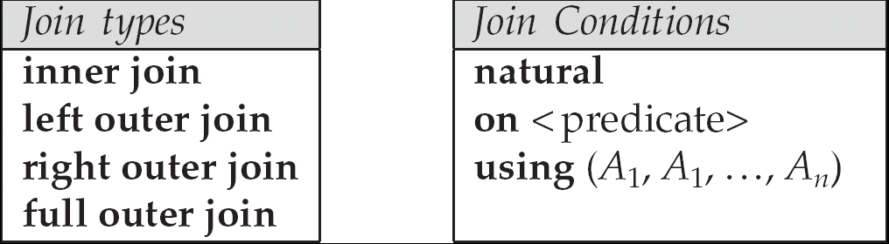
Joined Relations
Join operations take two relations and return as a result another relation.
Join operations are typically used as subquery expressions in the from clause
Join condition – defines which tuples in the two relations match, and what attributes are present in the result of the join.
Join type – defines how tuples in each relation that do not match any tuple in the other relation (based on the join condition) are treated.
自然连接
条件连接
等值连接

Slide 4
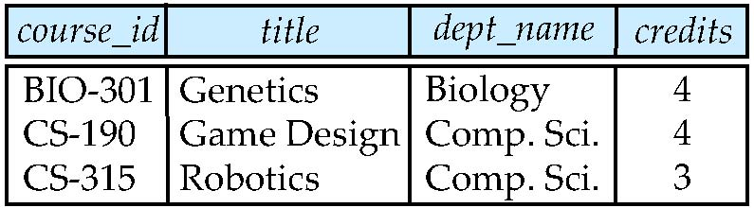
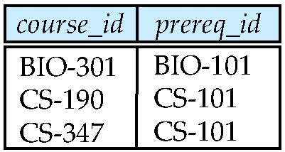
Join operations – Example
Relation course
Relation prereq
Observe that
prereq information is missing for CS-315 and
course information is missing for CS-437

Slide 5
Outer Join
An extension of the join operation that avoids loss of information.
Computes the join and then adds tuples form one relation that does not match tuples in the other relation to the result of the join.
Uses null values.

Slide 6
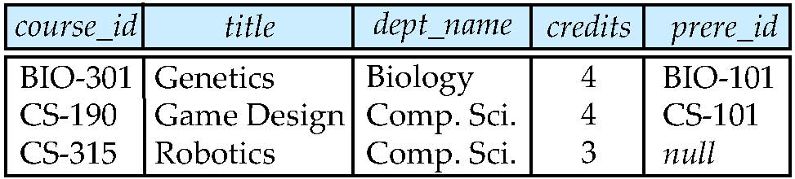
Left Outer Join
course natural left outer join prereq

Slide 7
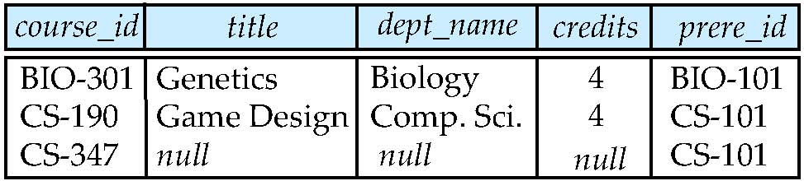
Right Outer Join
course natural right outer join prereq
select count（*）
from course natural right outer join prereq
where prereq_id is null;

Slide 8
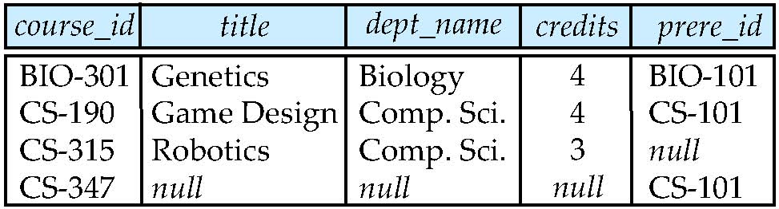
Full Outer Join
course natural full outer join prereq

Slide 9
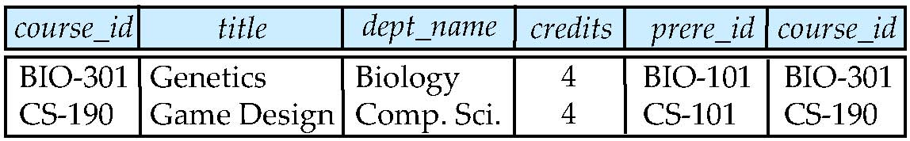
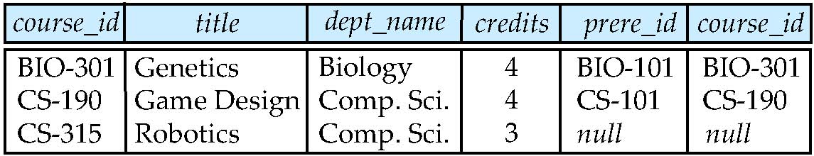
Joined Relations – Examples
course inner join prereq on course.course_id = prereq.course_id
What is the difference between the above, and a natural join?
course left outer join prereq on course.course_id = prereq.course_id

Slide 10
Joined Relations – Examples
course natural right outer join prereq
course full outer join prereq using (course_id)

Slide 11
Built-in Data Types in SQL
date: Dates, containing a (4 digit) year, month and date
Example: date ‘2005-7-27’
time: Time of day, in hours, minutes and seconds.
Example: time ‘09:00:30’ time ‘09:00:30.75’
timestamp: date plus time of day
Example: timestamp ‘2005-7-27 09:00:30.75’
interval: period of time
Example: interval ‘1’ day
Subtracting a date/time/timestamp value from another gives an interval value
Interval values can be added to date/time/timestamp values
date, time functions:
current_date(), current_time()
year(x), month(x), day(x), hour(x), minute(x), second(x)

Slide 12
User-Defined Types
create type construct in SQL creates user-defined type
create type Dollars as numeric (12,2) final
create table department (dept_name varchar (20), building varchar (15), budget Dollars);

Slide 13
Domains
create domain construct in SQL-92 creates user-defined domain types
create domain person_name char(20) not null
Types and domains are similar. Domains can have constraints, such as not null, specified on them.
create domain degree_level varchar(10) constraint degree_level_test check (value in (’Bachelors’, ’Masters’, ’Doctorate’));

Slide 14
Large-Object Types
Large objects (photos, videos, CAD files, etc.) are stored as a large object:
blob: binary large object -- object is a large collection of uninterpreted binary data (whose interpretation is left to an application outside of the database system)
MySQL BLOB datatypes:
TinyBlob ： 0 ~ 255 bytes.
Blob： 0 ~ 64K bytes.
MediumBlob ： 0 ~ 16M bytes.
LargeBlob : 0 ~ 4G bytes.
clob: character large object -- object is a large collection of character data
When a query returns a large object, a pointer is returned rather than the large object itself.

Slide 15
Integrity Constraints
Integrity constraints guard against accidental damage to the database, by ensuring that authorized changes to the database do not result in a loss of data consistency.
A checking account must have a balance greater than $10,000.00
A salary of a bank employee must be at least $4.00 an hour
A customer must have a (non-null) phone number

Slide 16
Integrity Constraints on a Single Relation
not null
primary key
unique
check (P), where P is a predicate
foreign key

Slide 17
Not Null and Unique Constraints
not null
Declare name and budget to be not null
name varchar(20) not null budget numeric(12,2) not null
unique ( A₁, A₂, …, A_{m})
The unique specification states that the attributes A1, A2, … Am form a super key ( × candidate key) .
Candidate keys are permitted to be null (in contrast to primary keys).

Slide 18
The check clause
check (P)
where P is a predicate
Example: ensure that semester is one of fall, winter, spring or summer:
create table section (
course_id varchar (8),
sec_id varchar (8),
semester varchar (6),
year numeric (4,0),
building varchar (15),
room_number varchar (7),
time slot id varchar (4),
primary key (course_id, sec_id, semester, year),
check (semester in (’Fall’, ’Winter’, ’Spring’, ’Summer’)) );

Slide 19
Referential Integrity
Ensures that a value that appears in one relation for a given set of attributes also appears for a certain set of attributes in another relation.
Example: If “Biology” is a department name appearing in one of the tuples in the instructor relation, then there exists a tuple in the department relation for “Biology”.
Let A be a set of attributes. Let R and S be two relations that contain attributes A and where A is the primary key of S. A is said to be a foreign key of R if for any values of A appearing in R these values also appear in S.

Slide 20
Cascading Actions in Referential Integrity
create table course ( course_id char(5) primary key, title varchar(20), dept_name varchar(20) references department )
create table course ( … dept_name varchar(20), foreign key (dept_name) references department on delete cascade on update cascade, . . . )
alternative actions to cascade: set null, set default, restricted

Slide 21
Integrity Constraint Violation During Transactions
create table person ( ID char(10), name char(40), mother char(10), father char(10), primary key (ID), foreign key (father) references person, foreign key (mother) references person);
How to insert a tuple without causing constraint violation ?
insert father and mother of a person before inserting person
OR, set father and mother to null initially, update after inserting all persons (not possible if father and mother attributes declared to be not null)
OR defer constraint checking to transaction end.

Slide 22
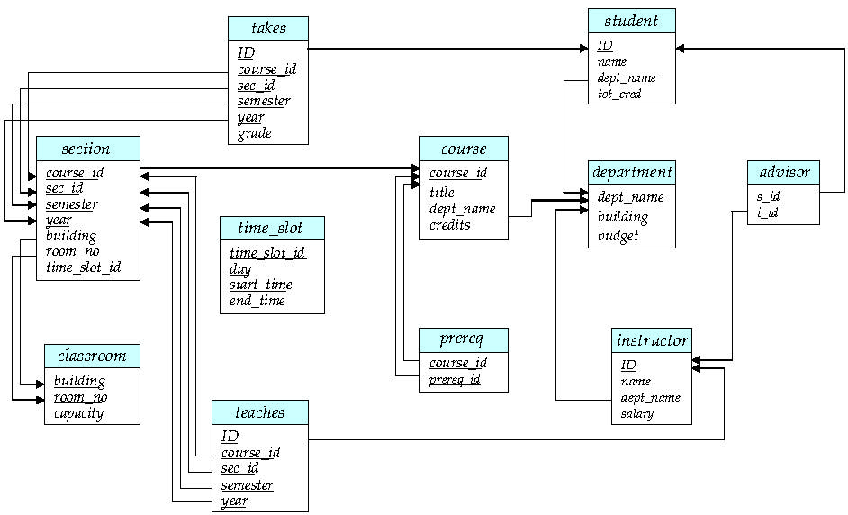
Complex Check Clauses
check (time_slot_id in
(select time_slot_id from time_slot))
Every section has at least one instructor teaching the section.
check ((course_id, sec_id, semester, year) in
(select course_id, sec_id, semester, year from teaches))

Slide 23
Complex Check Clauses
Unfortunately: subquery in check clause not supported by pretty much any database
Alternative: triggers

Slide 24
assertion
create assertion <assertion-name> check <predicate>;
create assertion credits_earned_constraint check
(not exists
(select ID
from student
where tot_cred <> (
select sum(credits)
from takes natural join course
where student.ID=takes.ID
and grade is not null
and grade<>’F’))

Slide 25
Views
A view provides a mechanism to hide certain data from the view of certain users.
Consider a person who needs to know an instructors name and department, but not the salary. This person should see a relation described, in SQL, by select ID, name, dept_name from instructor
Any relation that is not of the conceptual model but is made visible to a user as a “virtual relation” is called a view.

Slide 26
View Definition
A view is defined using the create view statement which has the form
create view v as < query expression >
where <query expression> is any legal SQL expression. The view name is represented by v.
Once a view is defined, the view name can be used to refer to the virtual relation that the view generates.
View definition is not the same as creating a new relation by evaluating the query expression
Rather, a view definition causes the saving of an expression; the expression is substituted into queries using the view.

Slide 27
Example Views
A view of instructors without their salary create view faculty as select ID, name, dept_name from instructor
Find the names of all instructors in the Biology department select name from faculty where dept_name = ‘Biology’
Create a view of department salary totals create view departments_total_salary(dept_name, total_salary) as select dept_name, sum (salary) from instructor group by dept_name;

Slide 28
Views Defined Using Other Views
create view physics_fall_2009 as select course.course_id, sec_id, building, room_number from course, section where course.course_id = section.course_id and course.dept_name = ’Physics’ and section.semester = ’Fall’ and section.year = ’2009’;
create view physics_fall_2009_watson as select course_id, room_number from physics_fall_2009 where building= ’Watson’;

Slide 29
View Expansion
Expand use of a view in another view
create view physics_fall_2009_watson as select course_id, room_number from physics_fall_2009 where building= ’Watson’;
→
create view physics_fall_2009_watson as
(select course_id, room_number
from (select course.course_id, building, room_number
from course, section
where course.course_id = section.course_id
and course.dept_name = ’Physics’
and section.semester = ’Fall’
and section.year = ’2009’)
where building= ’Watson’;

Slide 30
View Expansion
Expand use of a view in a query：
select course_id, room_number from physics_fall_2009 where building= ’Watson’;
→
select course_id, room_number
from (select course.course_id, building, room_number
from course, section
where course.course_id = section.course_id
and course.dept_name = ’Physics’
and section.semester = ’Fall’
and section.year = ’2009’)
where building= ’Watson’;
→
select course_id, room_number
from course, section
where course.course_id = section.course_id
and course.dept_name = ’Physics’
and section.semester = ’Fall’
and section.year = ’2009’
and building= ’Watson’;

Slide 31
Update of a View
Add a new tuple to faculty view which we defined earlier
create view faculty as select ID, name, dept_name from instructor
insert into faculty values (’30765’, ’Green’, ’Music’);
This insertion must be represented by the insertion of the tuple
(’30765’, ’Green’, ’Music’, null)
into the instructor relation
insert into instructor values (’30765’, ’Green’, ’Music’, null);

Slide 32
Some Updates cannot be Translated Uniquely
create view instructor_info as select ID, name, building from instructor, department where instructor.dept_name= department.dept_name;
insert into instructor_info values (’69987’, ’White’, ’Taylor’);
which department, if multiple departments in Taylor?
Most SQL implementations allow updates only on simple views(updatable views)
The from clause has only one database relation.
The select clause contains only attribute names of the relation, and does not have any expressions, aggregates, or distinct specification.
Any attribute not listed in the select clause can be set to null
The query does not have a group by or having clause.

Slide 33
*Materialized Views
Materializing a view: create a physical table containing all the tuples in the result of the query defining the view
If relations used in the query are updated, the materialized view result becomes out of date
Need to maintain the view, by updating the view whenever the underlying relations are updated.
Example:
create materialized view departments_total_salary(dept_name, total_salary) as select dept_name, sum (salary) from instructor group by dept_name;
select dept_name from departments_total_salary where total_salary > (select avg(total_salary) from departments_total_salary );

Slide 34
* View and Logical Data Indepencence
If relation S(a, b, c) is split into two sub relations S1(a,b) and S2(a,c)
How to realize the logical data independence?
1) create table S1 …;
create table S2 …;
2) insert into S1 select a, b from S;
insert into S2 select a, c from S;
3) drop table S;
4) create view S(a,b,c) as select a,b,c from S1 natural join S2;
select * from S where … → select * from S1 natural join S2 where …
insert into S values (1 ,2,3) → insert into S1 values (1, 2);
insert into S2 values (1 ,3);

Slide 35
Indexes
create table student ( ID varchar (5), name varchar (20) not null, dept_name varchar (20), tot_cred numeric (3,0) default 0, primary key (ID) )
create index studentID_index on student(ID)
Indices are data structures used to speed up access to records with specified values for index attributes
e.g. select * from student where ID = ‘12345’
can be executed by using the index to find the required record, without looking at all records of student

Slide 36
Transactions
Unit of work (NONE or ALL)
Atomic transaction
either fully executed or rolled back as if it never occurred
Isolation from concurrent transactions
Transactions begin implicitly
Ended by commit work or rollback work
But default on most databases: each SQL statement commits automatically
Can turn off auto commit for a session (e.g. using API)
In MySQL:
>SET AUTOCOMMIT=0;
In SQL:1999, can use: begin atomic …. end
Not supported on most databases

Slide 37
Transactions
Transaction example :
SET AUTOCOMMIT=0;
UPDATE account SET balance=balance -100 WHERE ano=‘1001’;
UPDATE account SET balance=balance+100 WHERE ano=‘1002’;
COMMIT;
UPDATE account SET balance=balance -200 WHERE ano=‘1003’;
UPDATE account SET balance=balance+200 WHERE ano=‘1004’; COMMIT;
UPDATE account SET balance=balance+balance*2.5%;
COMMIT;

Slide 38

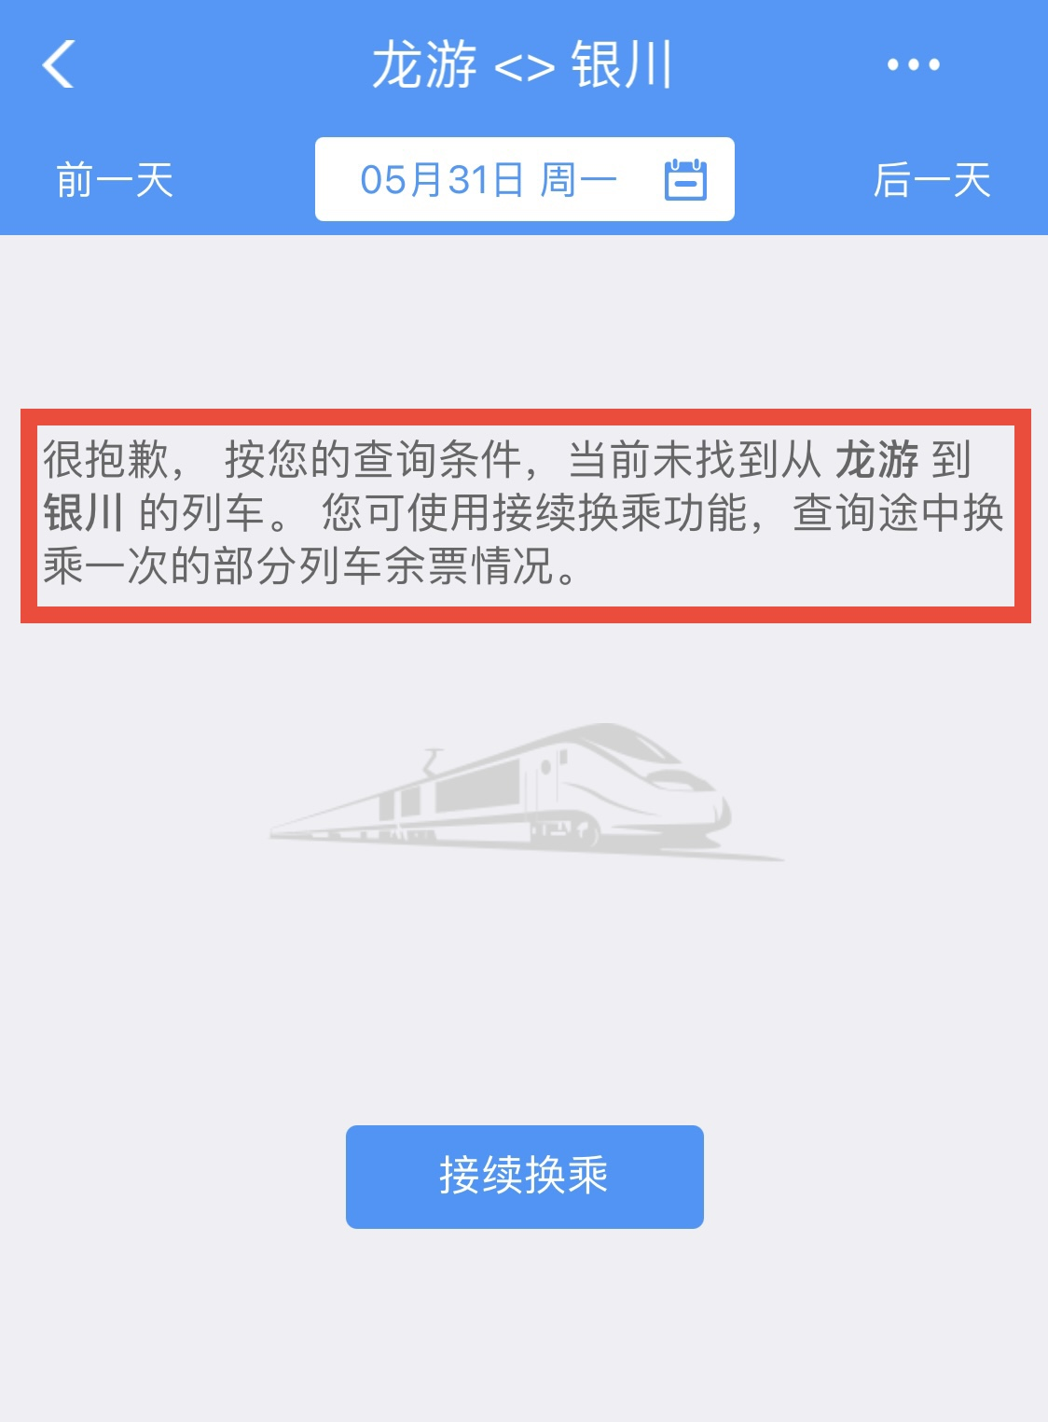
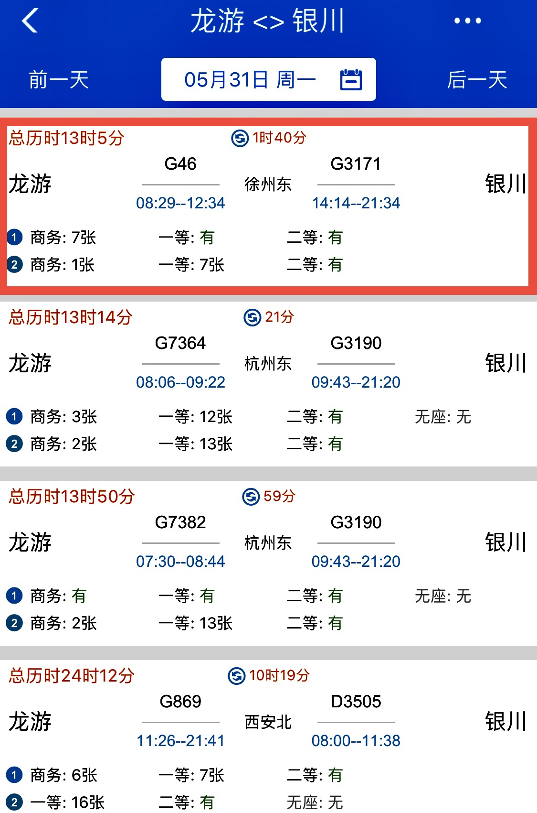
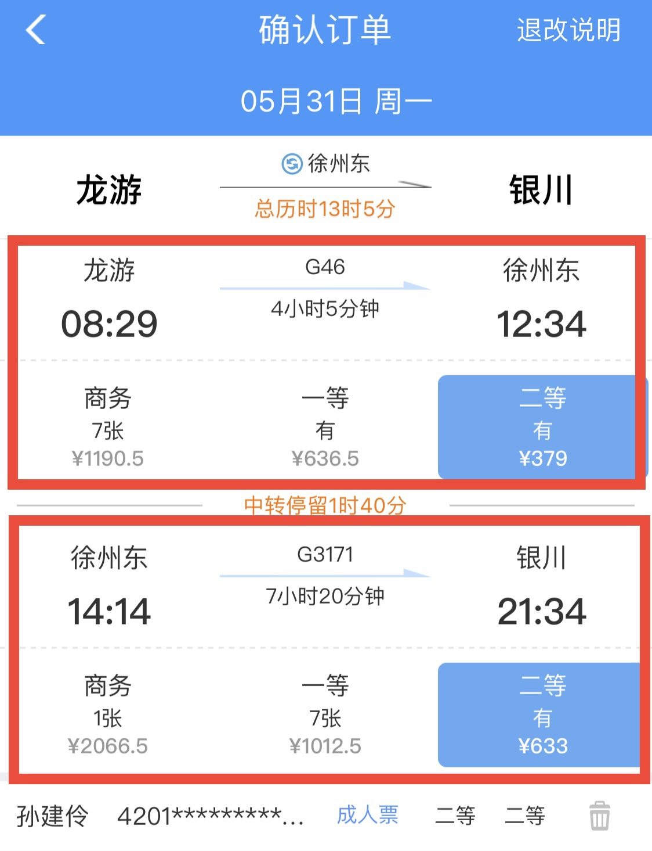
Transaction Examples
Transaction Boundaries
Booking one ticket vs multiple tickets?

Slide 39
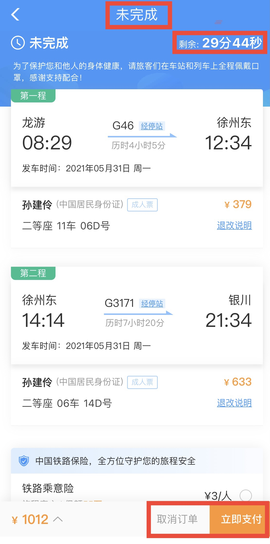
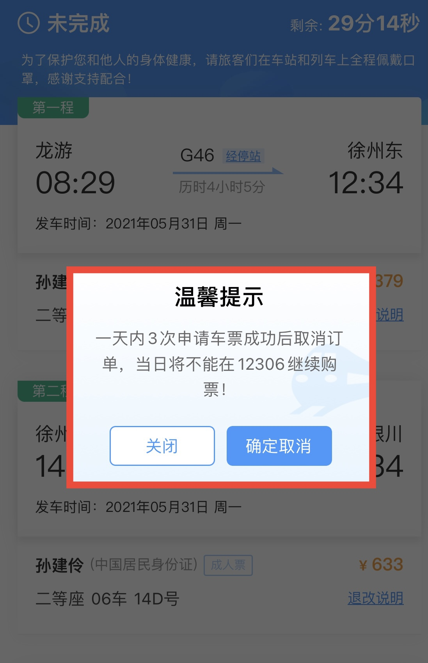
Transaction Examples
Transaction Boundaries
Booking tickets & paying order - combining vs separating ?

Slide 40
ACID Properties
A transaction is a unit of program execution that accesses and possibly updates various data items.To preserve the integrity of data the database system must ensure:
Atomicity. Either all operations of the transaction are properly reflected in the database or none are.
Consistency. Execution of a transaction in isolation preserves the consistency of the database.
Isolation. Although multiple transactions may execute concurrently, each transaction must be unaware of other concurrently executing transactions. Intermediate transaction results must be hidden from other concurrently executed transactions.
That is, for every pair of transactions T_{i} and T_{j}, it appears to T_{i} that either T_{j}, finished execution before T_{i} started, or T_{j} started execution after T_{i} finished.
Durability. After a transaction completes successfully, the changes it has made to the database persist, even if there are system failures.

Slide 41
Authorization(授权)
Enables use of the CREATE VIEW statement.
Forms of authorization on parts of the database:
Select - allows reading, but not modification of data.
Insert - allows insertion of new data, but not modification of existing data.
Update - allows modification, but not deletion of data.
Delete - allows deletion of data.
Forms of authorization to modify the database schema
Resources（MySQL：Create） - allows creation of new relations.
Alteration - allows addition or deletion of attributes in a relation.
Drop - allows deletion of relations.
Index - allows creation and deletion of indices.
Create view（MySQL） – allows creation of views.

Slide 42
Authorization Specification in SQL
The grant statement is used to confer authorization
grant <privilege list> // privilege：权限
on <relation name or view name> to <user list>
<user list> is:
a user-id
public, which allows all valid users the privilege granted
A role (more on this later)
Granting a privilege on a view does not imply granting any privileges on the underlying relations.
The grantor of the privilege must already hold the privilege on the specified item (or be the database administrator).

Slide 43
Privileges in SQL
grant select on instructor to U₁, U₂, U₃
grant select on department to public
grant update (budget) on department to U1,U2
grant all privileges on department to U₁

Slide 44
Revoking Authorization in SQL
The revoke statement is used to revoke authorization.
revoke <privilege list>
on <relation name or view name>
from <user list>
Example:
revoke select on branch from U₁, U₂, U₃
<privilege-list> may be all to revoke all privileges the revokee may hold.
If <revokee-list> includes public, all users lose the privilege except those granted it explicitly.
If the same privilege was granted twice to the same user by different grantees, the user may retain the privilege after the revocation.
All privileges that depend on the privilege being revoked are also revoked.

Slide 45
Roles
create role instructor;
grant instructor to Amit;
Privileges can be granted to roles:
grant select on takes to instructor;
Roles can be granted to users, as well as to other roles
create role teaching_assistant
grant teaching_assistant to instructor;
Instructor inherits all privileges of teaching_assistant
Chain of roles
create role dean;
grant instructor to dean;
grant dean to Satoshi;
role
priv
user

Slide 46
Authorization on Views
create view geo_instructor as (select * from instructor where dept_name = ’Geology’);
grant select on geo_instructor to geo_staff

Slide 47
Other Authorization Features
references privilege to create foreign key
grant reference (dept_name) on department to Mariano;
why is this required?
instructor
department
Computer Science
Computer Science

Slide 48
Other Authorization Features
transfer of privileges
grant select on department to Amit with grant option;
revoke select on department from Amit, Satoshi cascade;
revoke select on department from Amit, Satoshi restrict;
revoke grant option for select on department from Amit；
U1
U4
DBA
U2
U5
U3

Slide 49
End of Chapter 4

