Slide 1
Chapter 5: Advanced SQL

Slide 2
Outline
Accessing SQL From a Programming Language
Functions and Procedures
*Triggers
**Recursive Queries
**Advanced Aggregation Features

Slide 3
Accessing SQL from a Programming Language
A database programmer must have access to a general-purpose programming language for at least two reasons
Not all queries can be expressed in SQL, since SQL does not provide the full expressive power of a general-purpose language.
Non-declarative actions -- such as printing a report, interacting with a user, or sending the results of a query to a graphical user interface -- cannot be done from within SQL.

Slide 4
Accessing SQL from a Programming Language (Cont.)
There are two approaches to accessing database from a general-purpose programming language
API （Application Program Interface） - - A general-purpose program can connect to and communicate with a database server using a collection of functions.
Embedded SQL -- provides a means by which a program can interact with a database server.
The SQL statements are translated at compile time into function calls.
At runtime, these function calls connect to the database using an API that provides dynamic SQL facilities.

Slide 5
JDBC and ODBC
API (application-program interface) for a program to interact with a database server
Application makes calls to
Connect with the database server
Send SQL commands to the database server
Fetch tuples of result one-by-one into program variables
ODBC (Open Database Connectivity) works with C, C++, C#
JDBC (Java Database Connectivity) works with Java
Embedded SQL in C
SQLJ - embedded SQL in Java
JPA(Java Persistence API) - OR mapping of Java

Slide 6
JDBC
JDBC is a Java API for communicating with database systems supporting SQL.
JDBC supports a variety of features for querying and updating data, and for retrieving query results.
JDBC also supports metadata retrieval, such as querying about relations present in the database and the names and types of relation attributes.
Model for communicating with the database:
Open a connection
Create a “statement” object
Execute queries using the Statement object to send queries and fetch results
Exception mechanism to handle errors

Slide 7
JDBC Code
public static void JDBCexample(String dbid, String userid, String passwd)
{
try {
Connection conn = DriverManager.getConnection( "jdbc:oracle:thin:@db.yale.edu:2000:univdb", userid, passwd);
Statement stmt = conn.createStatement();
… Do Actual Work ….
stmt.close();
conn.close();
}
catch (SQLException sqle) {
System.out.println("SQLException : " + sqle);
}
}

Slide 8
JDBC Code (Cont.)
Update to database try { stmt.executeUpdate( "insert into instructor values(’77987’, ’Kim’, ’Physics’, 98000)"); } catch (SQLException sqle) { System.out.println("Could not insert tuple. " + sqle); }
Execute query and fetch and print results
ResultSet rset = stmt.executeQuery( "select dept_name, avg (salary) from instructor group by dept_name"); while (rset.next()) { System.out.println(rset.getString("dept_name") + " " + rset.getFloat(2)); }

Slide 9
JDBC Code Details
Getting result fields:
rset.getString(“dept_name”) and rset.getString(1) equivalent if dept_name is the first argument of select result.
Dealing with Null values
int a = rset.getInt(“a”);
if (rset.wasNull()) Systems.out.println(“Got null value”);

Slide 10
Prepared Statement
PreparedStatement pStmt = conn.prepareStatement( "insert into instructor values(?,?,?,?)"); pStmt.setString(1, "88877"); pStmt.setString(2, "Perry"); pStmt.setString(3, "Finance"); pStmt.setInt(4, 125000); pStmt.executeUpdate(); pStmt.setString(1, "88878"); pStmt.executeUpdate();
WARNING: always use prepared statements when taking an input from the user and adding it to a query
NEVER create a query by concatenating strings which you get as inputs
"insert into instructor values(’ " + ID + " ’, ’ " + name + " ’, " + " ’ " + dept name + " ’, " + salary + ")"
What if name is “D’Souza”?

Slide 11
SQL Injection(SQL 注入)
Suppose query is constructed using
"select * from instructor where name = ’" + name + “ ’ "
Suppose the user, instead of entering a name, enters:
X’ or ’Y’ = ’Y
then the resulting string of the statement becomes:
"select * from instructor where name = ’" + "X’ or ’Y’ = ’Y" + “’"
which is:
select * from instructor where name = ’X’ or ’Y’ = ’Y’
User could have even used
X’; update instructor set salary = salary + 10000;
then →
select * from instructor where name = ’X’;
update instructor set salary = salary + 10000;
Always use prepared statements, with user inputs as parameters

Slide 12
Metadata Features
ResultSet metadata
E.g., after executing query to get a ResultSet rs:
ResultSetMetaData rsmd = rs.getMetaData();
for(int i = 1; i <= rsmd.getColumnCount(); i++) {
System.out.println(rsmd.getColumnName(i));
System.out.println(rsmd.getColumnTypeName(i));
}

Slide 13
Metadata (Cont)
Database metadata
DatabaseMetaData dbmd = conn.getMetaData();
ResultSet rs = dbmd.getColumns(null, "univdb", "department", "%");
// Arguments to getColumns: Catalog, Schema-pattern, Table-pattern,
// and Column-Pattern
// Returns: One row for each column; row has a number of attributes
// such as COLUMN_NAME, TYPE_NAME
while( rs.next()) {
System.out.println(rs.getString("COLUMN_NAME"),
rs.getString("TYPE_NAME");
}

Slide 14
Transaction Control in JDBC
By default, each SQL statement is treated as a separate transaction that is committed automatically
bad idea for transactions with multiple updates
Can turn off automatic commit on a connection
conn.setAutoCommit(false);
Transactions must then be committed or rolled back explicitly
conn.commit(); or
conn.rollback();
conn.setAutoCommit(true) turns on automatic commit.

Slide 15
Other JDBC Features
Calling functions and procedures
CallableStatement cStmt1 = conn.prepareCall("{? = call some function(?)}");
CallableStatement cStmt2 = conn.prepareCall("{call some procedure(?,?)}");
Handling large object types
getBlob() and getClob() that are similar to the getString() method, but return objects of type Blob and Clob, respectively
get data from these objects by getBytes()
associate an open stream with Java Blob or Clob object to update large objects
blob.setBlob(int parameterIndex, InputStream inputStream).

Slide 16
JDBC Resources
JDBC Basics Tutorial
https://docs.oracle.com/javase/tutorial/jdbc/index.html

Slide 17
SQLJ
JDBC is overly dynamic, errors cannot be caught by compiler
SQLJ: embedded SQL in Java
#sql iterator deptInfoIter ( String dept name, int avgSal);
deptInfoIter iter = null;
#sql iter = { select dept_name, avg(salary) as avgSal from instructor
group by dept name };
while (iter.next()) {
String deptName = iter.dept_name();
int avgSal = iter.avgSal();
System.out.println(deptName + " " + avgSal);
}
iter.close();

Slide 18
SQLJ Resources
SQLJ Developer's Guide
https://docs.oracle.com/en/database/oracle/oracle-database/20/jsqlj/toc.htm

Slide 19
ODBC
Open DataBase Connectivity(ODBC) standard
standard for application program to communicate with a database server.
application program interface (API) to
open a connection with a database,
send queries and updates,
get back results.
Applications such as GUI, spreadsheets, etc. can use ODBC
Was defined originally for Basic and C, versions available for many languages.

Slide 20
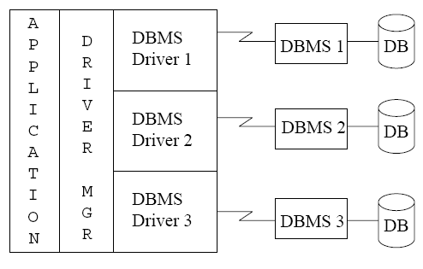
ODBC (Cont.)
Each database system supporting ODBC provides a "driver" library that must be linked with the client program.

Slide 21
ODBC (Cont.)
Each database system supporting ODBC provides a "driver" library that must be linked with the client program.
When client program makes an ODBC API call, the code in the library communicates with the server to carry out the requested action, and fetch results.
ODBC program first allocates an SQL environment, then a database connection handle.
Opens database connection using SQLConnect(). Parameters for SQLConnect:
connection handle,
the server to which to connect
the user identifier,
password
Must also specify types of arguments:
SQL_NTS denotes previous argument is a null-terminated string.

Slide 22
ODBC Code
int ODBCexample()
{
RETCODE error;
HENV env; /* environment */
HDBC conn; /* database connection */
SQLAllocEnv(&env);
SQLAllocConnect(env, &conn);
SQLConnect(conn, “db.yale.edu", SQL_NTS, "avi", SQL_NTS, "avipasswd", SQL_NTS);
{ …. Do actual work … }
SQLDisconnect(conn);
SQLFreeConnect(conn);
SQLFreeEnv(env);
}

Slide 23
ODBC Code (Cont.)
Program sends SQL commands to database by using SQLExecDirect
Result tuples are fetched using SQLFetch()
SQLBindCol() binds C language variables to attributes of the query result
When a tuple is fetched, its attribute values are automatically stored in corresponding C variables.
Arguments to SQLBindCol()
ODBC stmt variable, attribute position in query result
The type conversion from SQL to C.
The address of the variable.
For variable-length types like character arrays,
The maximum length of the variable
Location to store actual length when a tuple is fetched.
Note: A negative value returned for the length field indicates null value
Good programming requires checking results of every function call for errors; we have omitted most checks for brevity.

Slide 24
ODBC Code (Cont.)
Main body of program
char deptname[80]; float salary; int lenOut1, lenOut2; HSTMT stmt; char * sqlquery = "select dept_name, sum (salary) from instructor group by dept_name"; SQLAllocStmt(conn, &stmt); error = SQLExecDirect(stmt, sqlquery, SQL_NTS); if (error == SQL SUCCESS) { SQLBindCol(stmt, 1, SQL_C_CHAR, deptname , 80, &lenOut1); SQLBindCol(stmt, 2, SQL_C_FLOAT, &salary, 0 , &lenOut2); while (SQLFetch(stmt) == SQL_SUCCESS) { printf (" %s %g\n", deptname, salary); } } SQLFreeStmt(stmt, SQL_DROP);

Slide 25
ODBC Prepared Statements
Prepared Statement
SQL statement prepared: compiled at the database
Can have placeholders: E.g. insert into account values(?,?,?)
Repeatedly executed with actual values for the placeholders
To prepare a statement SQLPrepare(stmt, <SQL String>);
To bind parameters SQLBindParameter(stmt, <parameter#>, … type information and value omitted for simplicity..)
To execute the statement retcode = SQLExecute( stmt);

Slide 26
SQL injection（SQL注入）
An SQL injection example in Java:
“select * from instructor where name= ’ ” + name + ” ’ ”
malicious hacker enters name : X’ or ’Y’ =’Y
→
select * from instructor where name= ’ X’ or ’Y’ =’Y ’
In the resulting SQL statement, the where clause is always true and the entire instructor relation is returned.
Use of prepared statement would prevent this problem because the input string would have escape characters(转义符) inserted, so the resulting query becomes:
select * from instructor where name= ’ X\’ or \ ’Y\’ =\’Y ’
This query is harmless and returns the empty relation.
To avoid SQL injection security risk, do not create SQL strings directly using user input; instead use prepared statements to bind user inputs.

Slide 27
More ODBC Features
Metadata features
finding all the relations in the database and
finding the names and types of columns of a query result or a relation in the database.
By default, each SQL statement is treated as a separate transaction that is committed automatically.
Can turn off automatic commit on a connection
SQLSetConnectOption(conn, SQL_AUTOCOMMIT, 0)}
Transactions must then be committed or rolled back explicitly by
SQLTransact(conn, SQL_COMMIT) or
SQLTransact(conn, SQL_ROLLBACK)

Slide 28
ODBC Conformance Levels
Conformance levels specify subsets of the functionality defined by the standard.
Core
Level 1 requires support for metadata querying
Level 2 requires ability to send and retrieve arrays of parameter values and more detailed catalog information.
SQL Call Level Interface (CLI) standard similar to ODBC interface, but with some minor differences.

Slide 29
ODBC Resources
MySQL Connector/ODBC Developer Guide
https://docs.oracle.com/cd/E17952_01/connector-odbc-en/index.html

Slide 30
Embedded SQL
The SQL standard defines embeddings of SQL in a variety of programming languages such as C, C++, Java, Fortran, and PL/1,
A language to which SQL queries are embedded is referred to as a host language, and the SQL structures permitted in the host language comprise embedded SQL.
The basic form of these languages follows that of the System R embedding of SQL into PL/1.
EXEC SQL statement is used in the host language to identify embedded SQL request to the preprocessor
EXEC SQL <embedded SQL statement >;
Note: this varies by language:
In some languages, like COBOL, the semicolon is replaced with END-EXEC
In Java embedding uses # SQL { …. };

Slide 31
Embedded SQL (Cont.)
Before executing any SQL statements, the program must first connect to the database. This is done using:
EXEC-SQL connect to server user user-name using password;
Here, server identifies the server to which a connection is to be established.
Variables of the host language can be used within embedded SQL statements. They are preceded by a colon (:) to distinguish from SQL variables (e.g., :credit_amount )
Host Variables used as above must be declared within DECLARE section, as illustrated below. The syntax for declaring the variables, however, follows the usual host language syntax.
EXEC-SQL BEGIN DECLARE SECTION
int credit-amount ;
EXEC-SQL END DECLARE SECTION;

Slide 32
Embedded SQL (Cont.)
To write an embedded SQL query, we use the
declare c cursor for <SQL query>
statement. The variable c is used to identify the query
Example:
From within a host language, find the ID and name of students who have completed more than the number of credits stored in variable credit_amount in the host langue
Specify the query in SQL as follows:
EXEC SQL
declare c cursor for select ID, name from student where tot_cred > :credit_amount;

Slide 33
Embedded SQL (Cont.)
The open statement for our example is as follows:
EXEC SQL open c ;
This statement causes the database system to execute the query and to save the results within a temporary relation. The query uses the value of the host-language variable credit-amount at the time the open statement is executed.
The fetch statement causes the values of one tuple in the query result to be placed on host language variables.
EXEC SQL fetch c into :si, :sn；
Repeated calls to fetch get successive tuples in the query result

Slide 34
Embedded SQL (Cont.)
A variable called SQLSTATE in the SQL communication area (SQLCA) gets set to '02000' to indicate no more data is available
The close statement causes the database system to delete the temporary relation that holds the result of the query.
EXEC SQL close c ;

Slide 35
Updates Through Embedded SQL
Embedded SQL expressions for database modification (update, insert, and delete)
Can update tuples fetched by cursor by declaring that the cursor is for update
EXEC SQL
declare c cursor for select * from instructor where dept_name = 'Music' for update
We then iterate through the tuples by performing fetch operations on the cursor , and after fetching each tuple we execute the following code:
update instructor set salary = salary + 1000 where current of c

Slide 36
Embedded SQL Resources
Oracle Database Programmer's Guide - Embedded SQL
https://docs.oracle.com/en/database/oracle/oracle-database/20/lnpcc/embedded-SQL.html#GUID-C671CABF-202A-4503-A16B-DC78D3F1AB13

Slide 37
Procedural Constructs in SQL

Slide 38
Procedural Extensions and Stored Procedures
SQL provides a module language
Permits definition of procedures in SQL, with if-then-else statements, for and while loops, etc.
Stored Procedures
Can store procedures in the database
then execute them using the call statement
permit external applications to operate on the database without knowing about internal details

Slide 39
Functions and Procedures
Functions and procedures allow “business logic” to be stored in the database and executed from SQL statements.
These can be defined either by the procedural component of SQL or by an external programming language such as Java, C, or C++.
The syntax we present here is defined by the SQL standard.
Most databases implement nonstandard versions of this syntax.

Slide 40
SQL Functions
Define a function that, given the name of a department, returns the count of the number of instructors in that department.
create function dept_count (dept_name varchar(20)) returns integer begin declare d_count integer; select count (* ) into d_count from instructor where instructor.dept_name = dept_name return d_count; end
Find the department name and budget of all departments with more that 12 instructors.
select dept_name, budget from department where dept_count (dept_name ) > 1

Slide 41
Table Functions
SQL:2003 added functions that return a relation as a result
Example: Return all accounts owned by a given customer
create function instructors_of (dept_name char(20) )
returns table ( ID varchar(5), name varchar(20), dept_name varchar(20), salary numeric(8,2))
return table (select ID, name, dept_name, salary from instructor where instructor.dept_name = instructors_of.dept_name)
Usage
select * from table (instructors_of (‘Music’))

Slide 42
SQL Procedures
The dept_count function could instead be written as procedure:
create procedure dept_count_proc (in dept_name varchar(20), out d_count integer) begin
select count(*) into d_count from instructor where instructor.dept_name = dept_count_proc.dept_name
end
Procedures can be invoked either from an SQL procedure or from embedded SQL, using the call statement.
declare d_count integer; call dept_count_proc( ‘Physics’, d_count);
Procedures and functions can be invoked also from dynamic SQL

Slide 43
Procedural Constructs
Warning: most database systems implement their own variant of the standard syntax below
read your system manual to see what works on your system
Compound statement: begin … end,
May contain multiple SQL statements between begin and end.
Local variables can be declared within a compound statements
While and repeat statements :
declare n integer default 0;
while n < 10 do
set n = n + 1
end while
repeat
set n = n – 1
until n = 0
end repeat

Slide 44
Procedural Constructs (Cont.)
For loop
Permits iteration over all results of a query
Example: declare n integer default 0; for r as select budget from department where dept_name = ‘Music’ do set n = n - r.budget end for

Slide 45
Procedural Constructs (cont.)
Conditional statements (if-then-else)
if boolean expression then statement or compound statement elseif boolean expression then statement or compound statement else statement or compound statement end if
SQL:1999 also supports a case statement similar to C case statement

Slide 46
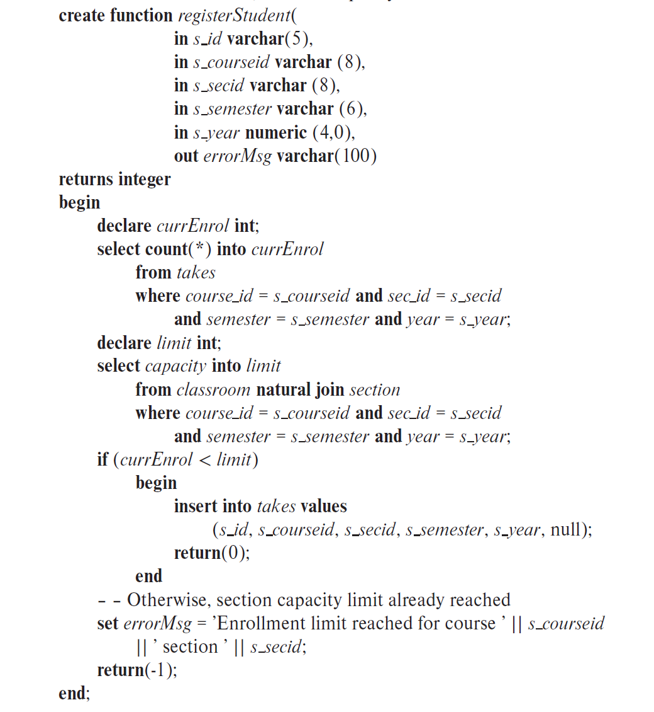
Example procedure
– – Registers a student after ensuring
– – classroom capacity is not exceeded.
– – Returns 0 on success, and -1 if
– – capacity is exceeded.

Slide 47
External Language Functions/Procedures
SQL:1999 permits the use of functions and procedures written in other languages such as C or C++
Declaring external language procedures and functions
create procedure dept_count_proc(in dept_name varchar(20), out count integer) language C external name ’ /usr/avi/bin/dept_count_proc’ create function dept_count(dept_name varchar(20)) returns integer language C external name ‘/usr/avi/bin/dept_count’

Slide 48
External Language Routines (Cont.)
Benefits of external language functions/procedures:
more efficient for many operations, and more expressive power.
Drawbacks
Code to implement function may need to be loaded into database system and executed in the database system’s address space.
risk of accidental corruption of database structures
security risk, allowing users access to unauthorized data
There are alternatives, which give good security at the cost of potentially worse performance.
Direct execution in the database system’s space is used when efficiency is more important than security.

Slide 49
Security with External Language Routines
To deal with security problems
Use sandbox techniques
that is use a safe language like Java, which cannot be used to access/damage other parts of the database code.
Or, run external language functions/procedures in a separate process, with no access to the database process’ memory.
Parameters and results communicated via inter-process communication
Both have performance overheads
Many database systems support both above approaches as well as direct executing in database system address space.

Slide 50
Triggers

Slide 51
Triggers
A trigger is a statement that is executed automatically by the system as a side effect of a modification to the database.
Trigger - ECA rule
E: Event （ insert, delete ，update）
C: Condition
A: Action
To design a trigger mechanism, we must:
Specify the conditions under which the trigger is to be executed.
Specify the actions to be taken when the trigger executes.
Triggers introduced to SQL standard in SQL:1999, but supported even earlier using non-standard syntax by most databases.

Slide 52
Trigger Example
account_log(account, amount, datetime)
create trigger account_trigger after update of account on balance referencing new row as nrow
referencing old row as orow
for each row when nrow.balance - orow.balance > =200000 or
orow.balance -nrow.balance >=50000 begin insert into account_log values (nrow.account-number,
nrow.balance-orow.balance , current_time() ) end

Slide 53
Trigger Example
E.g. time_slot_id is not a primary key of timeslot, so we cannot create a foreign key constraint from section to timeslot.
Alternative: use triggers on section and timeslot to enforce integrity constraints
create trigger timeslot_check1 after insert on section referencing new row as nrow for each row when (nrow.time_slot_id not in ( select time_slot_id from time_slot)) /* time_slot_id not present in time_slot */ begin rollback end;

Slide 54
Trigger Example Cont.
create trigger timeslot_check2 after delete on timeslot referencing old row as orow for each row when (orow.time_slot_id not in ( select time_slot_id from time_slot) /* last tuple for time slot id deleted from time slot */ and orow.time_slot_id in ( select time_slot_id from section))
/* and time_slot_id still referenced from section*/ begin rollback end;

Slide 55
Triggering Events and Actions in SQL
Triggering event can be insert, delete or update
Triggers on update can be restricted to specific attributes
E.g., after update of takes on grade
Values of attributes before and after an update can be referenced
referencing old row as : for deletes and updates
referencing new row as : for inserts and updates
Triggers can be activated before an event, which can serve as extra constraints. E.g. convert blank grades to null.
create trigger setnull_trigger before update of takes referencing new row as nrow for each row when (nrow.grade = ‘ ‘) begin atomic set nrow.grade = null; end;

Slide 56
Trigger to Maintain credits_earned value
create trigger credits_earned after update of takes on grade referencing new row as nrow referencing old row as orow for each row when nrow.grade <> ’F’ and nrow.grade is not null and (orow.grade = ’F’ or orow.grade is null) begin atomic update student set tot_cred= tot_cred + (select credits from course where course.course_id= nrow.course_id) where student.id = nrow.id; end;

Slide 57
Statement Level Triggers
Instead of executing a separate action for each affected row, a single action can be executed for all rows affected by a transaction
Use for each statement instead of for each row
Use referencing old table or referencing new table to refer to temporary tables (called transition tables) containing the affected rows
Can be more efficient when dealing with SQL statements that update a large number of rows

Slide 58
Statement Level Triggers
create trigger grade_trigger after update of takes on grade
referencing new table as new_table
for each statement when exists( select avg(grade)
from new_table
group by course_id, sec_id, semester, year
having avg(grade)< 60 ) begin rollback
end

Slide 59
When Not To Use Triggers
Triggers were used earlier for tasks such as
maintaining summary data (e.g., total salary of each department)
Replicating databases by recording changes to special relations (called change or delta relations) and having a separate process that applies the changes over to a replica
There are better ways of doing these now:
Databases today provide built in materialized view facilities to maintain summary data
Databases provide built-in support for replication
Encapsulation facilities can be used instead of triggers in many cases
Define methods to update fields
Carry out actions as part of the update methods instead of through a trigger

Slide 60
When Not To Use Triggers
Risk of unintended execution of triggers, for example, when
loading data from a backup copy
replicating updates at a remote site
Trigger execution can be disabled before such actions.
Other risks with triggers:
Error leading to failure of critical transactions that set off the trigger
Cascading execution
Notes:
60

Slide 61
Recursive Queries

Slide 62
Recursion in SQL
SQL:1999 permits recursive view definition
Example: find which courses are a prerequisite, whether directly or indirectly, for a specific course with recursive rec_prereq(course_id, prereq_id) as ( select course_id, prereq_id from prereq union select rec_prereq.course_id, prereq.prereq_id, from rec_prereq, prereq where rec_prereq.prereq_id = prereq.course_id ) select ∗ from rec_prereq;
This example view, rec_prereq, is called the transitive closure of the prereq relation

Slide 63
The Power of Recursion
Recursive views make it possible to write queries, such as transitive closure queries, that cannot be written without recursion or iteration.
Intuition: Without recursion, a non-recursive non-iterative program can perform only a fixed number of joins of prereq with itself
This can give only a fixed number of levels of prerequisites.
Given a fixed non-recursive query, we can construct a database with a greater number of levels of prerequisites on which the query will not work
Alternative: write a procedure to iterate as many times as required
See procedure findAllPrereqs in book on Page.189

Slide 64
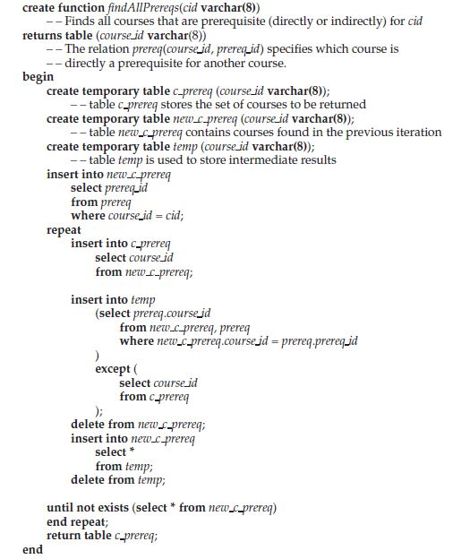
The Power of Recursion

Slide 65
Advanced Aggregation Features

Slide 66
Ranking
Ranking is done in conjunction with an order by specification.
Suppose we are given a relation student_grades(ID, GPA) giving the grade-point average of each student
Find the rank of each student.
select ID, rank() over (order by GPA desc) as s_rank from student_grades
An extra order by clause is needed to get them in sorted order
select ID, rank() over (order by GPA desc) as s_rank from student_grades order by s_rank
Ranking may leave gaps: e.g. if 2 students have the same top GPA, both have rank 1, and the next rank is 3
dense_rank does not leave gaps, so next dense rank would be 2
Notes:
66

Slide 67
Ranking
Ranking can be done using basic SQL aggregation, but resultant query is very inefficient
select ID, (1 + (select count(*) from student_grades B where B.GPA > A.GPA)) as s_rank from student_grades A order by s_rank;

Slide 68
Ranking (Cont.)
Ranking can be done within partition of the data.
“Find the rank of students within each department.”
select ID, dept_name, rank () over (partition by dept_name order by GPA desc) as dept_rank from dept_grades order by dept_name, dept_rank;
Multiple rank clauses can occur in a single select clause.
Ranking is done after applying group by clause/aggregation
Can be used to find top-n results
More general than the limit n clause supported by many databases, since it allows top-n within each partition

Slide 69
Ranking (Cont.)
Other ranking functions:
percent_rank (within partition, if partitioning is done)
cume_dist (cumulative distribution)
fraction of tuples with preceding values
row_number (non-deterministic in presence of duplicates)
SQL:1999 permits the user to specify nulls first or nulls last
select ID, rank ( ) over (order by GPA desc nulls last) as s_rank from student_grades
Notes:
69

Slide 70
Ranking (Cont.)
For a given constant n, the ranking the function ntile(n) takes the tuples in each partition in the specified order, and divides them into n buckets with equal numbers of tuples.
E.g.,
select ID, ntile(4) over (order by GPA desc) as quartile from student_grades;
Notes:
70

Slide 71
Windowing
Used to smooth out random variations.
E.g., moving average: “Given sales values for each date, calculate for each date the average of the sales on that day, the previous day, and the next day”
Window specification in SQL:
Given relation sales(date, value)
select date, sum(value) over (order by date between rows 1 preceding and 1 following) from sales
Notes:
71

Slide 72
Windowing
Examples of other window specifications:
between rows unbounded preceding and current
rows unbounded preceding
range between 10 preceding and current row
All rows with values between current row value –10 to current value
range interval 10 day preceding
Not including current row
Notes:
72

Slide 73
Windowing (Cont.)
Can do windowing within partitions
E.g., Given a relation transaction (account_number, date_time, value), where value is positive for a deposit and negative for a withdrawal
“Find total balance of each account after each transaction on the account”
select account_number, date_time, sum (value) over (partition by account_number order by date_time rows unbounded preceding) as balance from transaction order by account_number, date_time
Notes:
73

Slide 74
OLAP**

Slide 75
Data Analysis and OLAP
Online Analytical Processing (OLAP)
Interactive analysis of data, allowing data to be summarized and viewed in different ways in an online fashion (with negligible delay)
Data that can be modeled as dimension attributes and measure attributes are called multidimensional data.
Measure attributes
measure some value
can be aggregated upon
e.g., the attribute number of the sales relation
Dimension attributes
define the dimensions on which measure attributes (or aggregates thereof) are viewed
e.g., attributes item_name, color, and size of the sales relation

Slide 76
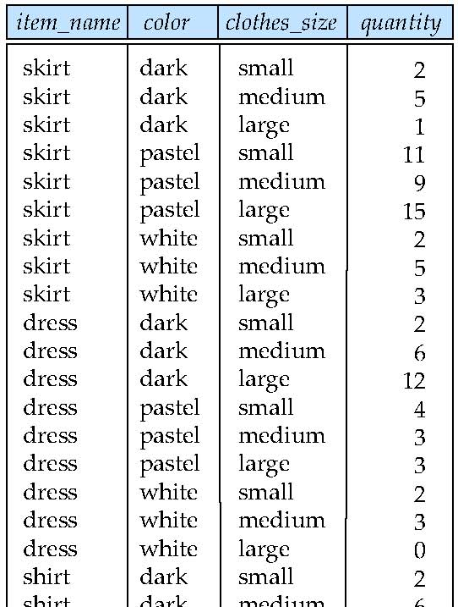
Example sales relation
...
...
...
...
...
...
...
...

Slide 77
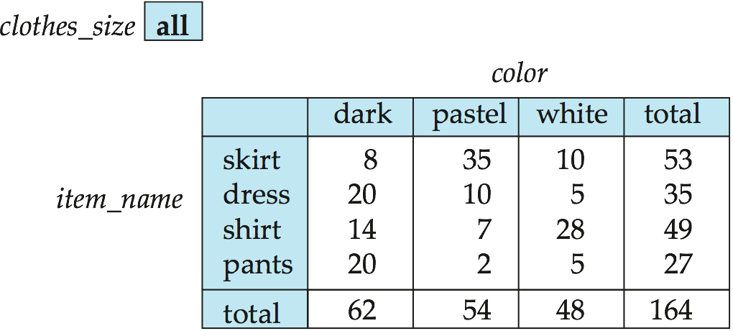
Cross Tabulation of sales by item_name and color
The table above is an example of a cross-tabulation (cross-tab), also referred to as a pivot-table.
Values for one of the dimension attributes form the row headers
Values for another dimension attribute form the column headers
Other dimension attributes are listed on top
Values in individual cells are (aggregates of) the values of the dimension attributes that specify the cell.

Slide 78
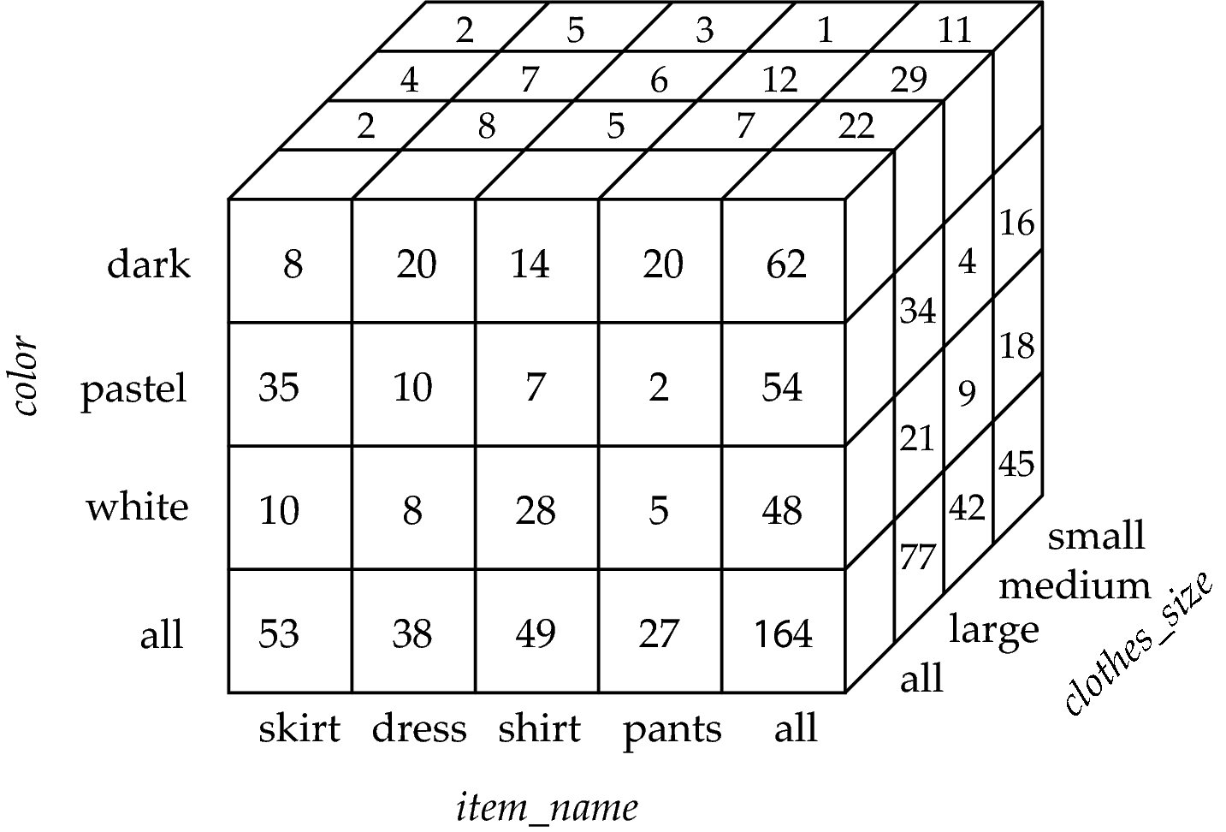
Data Cube
A data cube is a multidimensional generalization of a cross-tab
Can have n dimensions; we show 3 below
Cross-tabs can be used as views on a data cube

Slide 79
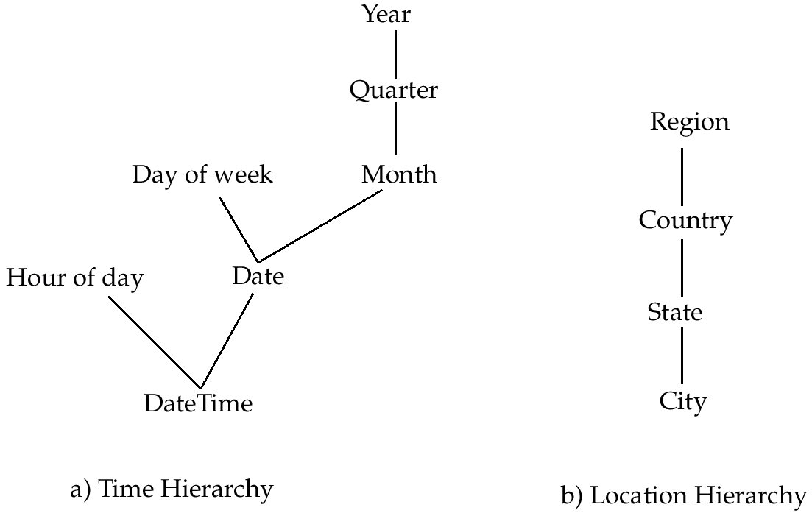
Hierarchies on Dimensions
Hierarchy on dimension attributes: lets dimensions to be viewed at different levels of detail
E.g., the dimension DateTime can be used to aggregate by hour of day, date, day of week, month, quarter or year

Slide 80
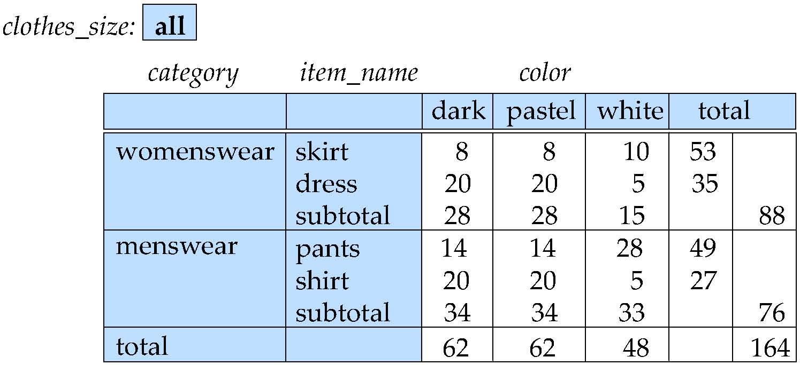
Cross Tabulation With Hierarchy
Cross-tabs can be easily extended to deal with hierarchies
Can drill down or roll up on a hierarchy

Slide 81
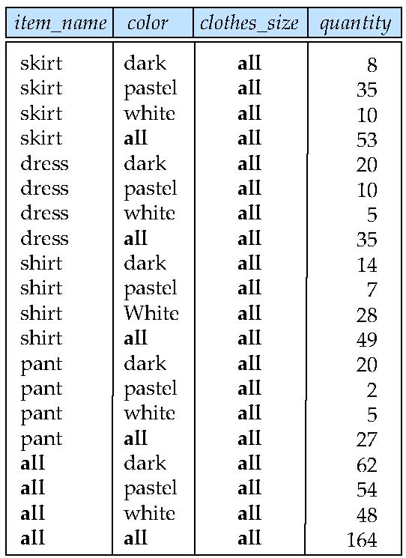
Relational Representation of Cross-tabs
Cross-tabs can be represented as relations
We use the value all is used to represent aggregates.
The SQL standard actually uses null values in place of all despite confusion with regular null values.

Slide 82
Extended Aggregation to Support OLAP
The cube operation computes union of group by’s on every subset of the specified attributes
Example relation for this section sales(item_name, color, clothes_size, quantity)
E.g. consider the query
select item_name, color, size, sum(number) from sales group by cube(item_name, color, size)
This computes the union of eight different groupings of the sales relation:
{ (item_name, color, size), (item_name, color), (item_name, size), (color, size), (item_name), (color), (size), ( ) }
where ( ) denotes an empty group by list.
For each grouping, the result contains the null value for attributes not present in the grouping.
Notes:
82

Slide 83
Online Analytical Processing Operations
Relational representation of cross-tab that we saw earlier, but with null in place of all, can be computed by
select item_name, color, sum(number) from sales group by cube(item_name, color)
The function grouping() can be applied on an attribute
Returns 1 if the value is a null value representing all, and returns 0 in all other cases.
select item_name, color, size, sum(number), grouping(item_name) as item_name_flag, grouping(color) as color_flag, grouping(size) as size_flag, from sales group by cube(item_name, color, size)
Notes:
83

Slide 84
Online Analytical Processing Operations
Can use the function decode() in the select clause to replace such nulls by a value such as all
E.g., replace item_name in first query by decode( grouping(item_name), 1, ‘all’, item_name)
Notes:
84

Slide 85
Extended Aggregation (Cont.)
The rollup construct generates union on every prefix of specified list of attributes
E.g.,
select item_name, color, size, sum(number) from sales group by rollup(item_name, color, size)
Generates union of four groupings:
{ (item_name, color, size), (item_name, color), (item_name), ( ) }
Rollup can be used to generate aggregates at multiple levels of a hierarchy.
E.g., suppose table itemcategory(item_name, category) gives the category of each item. Then
select category, item_name, sum(number) from sales, itemcategory where sales.item_name = itemcategory.item_name group by rollup(category, item_name)
would give a hierarchical summary by item_name and by category.
Notes:
85

Slide 86
Extended Aggregation (Cont.)
Multiple rollups and cubes can be used in a single group by clause
Each generates set of group by lists, cross product of sets gives overall set of group by lists
E.g.,
select item_name, color, size, sum(number) from sales group by rollup(item_name), rollup(color, size)
generates the groupings
{item_name, ()} X {(color, size), (color), ()}
= { (item_name, color, size), (item_name, color), (item_name), (color, size), (color), ( ) }
Notes:
86

Slide 87
Online Analytical Processing Operations
Pivoting: changing the dimensions used in a cross-tab is called
Slicing: creating a cross-tab for fixed values only
Sometimes called dicing, particularly when values for multiple dimensions are fixed.
Rollup: moving from finer-granularity data to a coarser granularity
Drill down: The opposite operation - that of moving from coarser-granularity data to finer-granularity data

Slide 88
OLAP Implementation
The earliest OLAP systems used multidimensional arrays in memory to store data cubes, and are referred to as multidimensional OLAP (MOLAP) systems.
OLAP implementations using only relational database features are called relational OLAP (ROLAP) systems
Hybrid systems, which store some summaries in memory and store the base data and other summaries in a relational database, are called hybrid OLAP (HOLAP) systems.

Slide 89
OLAP Implementation (Cont.)
Early OLAP systems precomputed all possible aggregates in order to provide online response
Space and time requirements for doing so can be very high
2^{n} combinations of group by
It suffices to precompute some aggregates, and compute others on demand from one of the precomputed aggregates
Can compute aggregate on (item_name, color) from an aggregate on (item_name, color, size)
For all but a few “non-decomposable” aggregates such as median
is cheaper than computing it from scratch
Several optimizations available for computing multiple aggregates
Can compute aggregate on (item_name, color) from an aggregate on (item_name, color, size)
Can compute aggregates on (item_name, color, size), (item_name, color) and (item_name) using a single sorting of the base data

Slide 90
End of Chapter

Slide 91
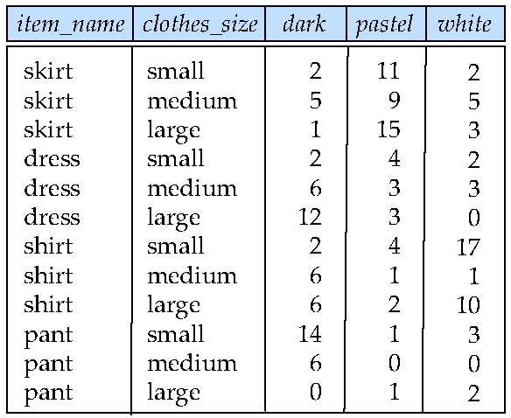
Figure 5.22

Slide 92
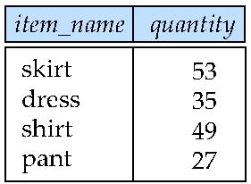
Figure 5.23

Slide 93
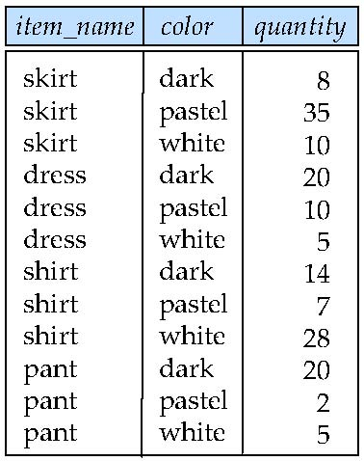
Figure 5.24

Slide 94
Another Recursion Example
Given relation manager(employee_name, manager_name)
Find all employee-manager pairs, where the employee reports to the manager directly or indirectly (that is manager’s manager, manager’s manager’s manager, etc.) with recursive empl (employee_name, manager_name ) as ( select employee_name, manager_name from manager union select manager.employee_name, empl.manager_name from manager, empl where manager.manager_name = empl.employe_name) select * from empl
This example view, empl, is the transitive closure of the manager relation
Notes:
94

Slide 95
Merge statement (now in Chapter 24)
Merge construct allows batch processing of updates.
Example: relation funds_received (account_number, amount ) has batch of deposits to be added to the proper account in the account relation
merge into account as A using (select * from funds_received as F ) on (A.account_number = F.account_number ) when matched then update set balance = balance + F.amount
Notes:
95

Slide 96
End of Chapter 5
Notes:
96

