Slide 1
Chapter 6: Entity-Relationship Model

Slide 2
Outline
Database Design Process
Modeling
Constraints
Weak Entity Sets
Reduction to Relation Schemas
Design Issues
Extended E-R Features
UML

Slide 3
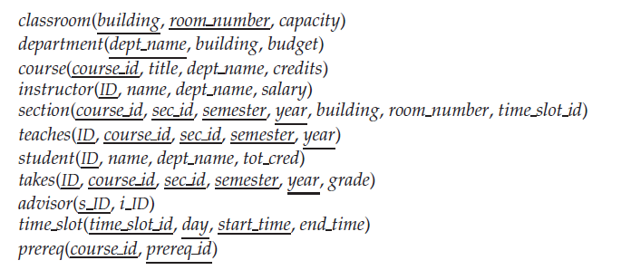
University Schemas
Relational Schemas of a University Enterprise

Slide 4
Database Design Process
requirement specification
specification of user requirement
conceptual-design
E-R diagram
logical-design
logical schema
physical-design
physical schema

Slide 5
Design Phases
Initial phase（Requirement Specification） -- characterize fully the data needs of the prospective database users.
Second phase( Conceptual Design ) -- choosing a data model
Applying the concepts of the chosen data model
Translating these requirements into a conceptual schema of the database.
A fully developed conceptual schema indicates the functional requirements of the enterprise.
Describe the kinds of operations (or transactions) that will be performed on the data.

Slide 6
Design Phases (Cont.)
Final Phase (Database Design)-- Moving from an abstract data model to the implementation of the database
Logical Design – Deciding on the database schema.
Database design requires that we find a “good” collection of relation schemas.
Business decision – What attributes should we record in the database?
Computer Science decision – What relation schemas should we have and how should the attributes be distributed among the various relation schemas?
Physical Design – Deciding on the physical layout of the database
Notes:
6

Slide 7
Design Alternatives
In designing a database schema, we must ensure that we avoid two major pitfalls:
Redundancy: a bad design may result in repeat information.
Redundant representation of information may lead to data inconsistency among the various copies of information
Incompleteness: a bad design may make certain aspects of the enterprise difficult or impossible to model.
Avoiding bad designs is not enough. There may be a large number of good designs from which we must choose.
database design can be a challenging problem
huge design space
Notes:
7

Slide 8
Design Approaches
Entity Relationship Model (covered in this chapter)
Models an enterprise as a collection of entities and relationships
Entity: a “thing” or “object” in the enterprise that is distinguishable from other objects
Described by a set of attributes
Relationship: an association among several entities
Represented diagrammatically by an entity-relationship diagram:
Normalization Theory (Chapter 7)
Formalize what designs are bad, and test for them
Notes:
8

Slide 9
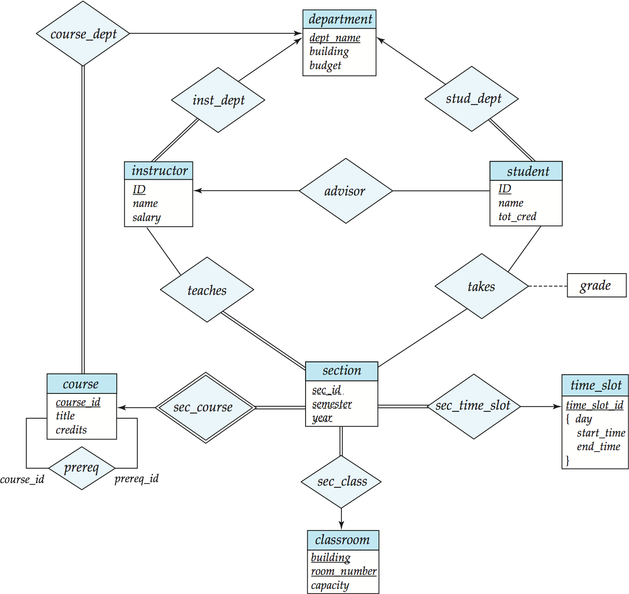
E-R Diagram for a University Enterprise

Slide 10
Outline of the ER Model

Slide 11
Database Modeling
A database can be modeled as:
a collection of entities,
relationship among entities.
An entity is an object that exists and is distinguishable from other objects.
Example: specific person, company, event, plant
Entities have attributes
Example: people have names and addresses
An entity set is a set of entities of the same type that share the same properties.
Example: set of all persons, companies, trees, holidays

Slide 12
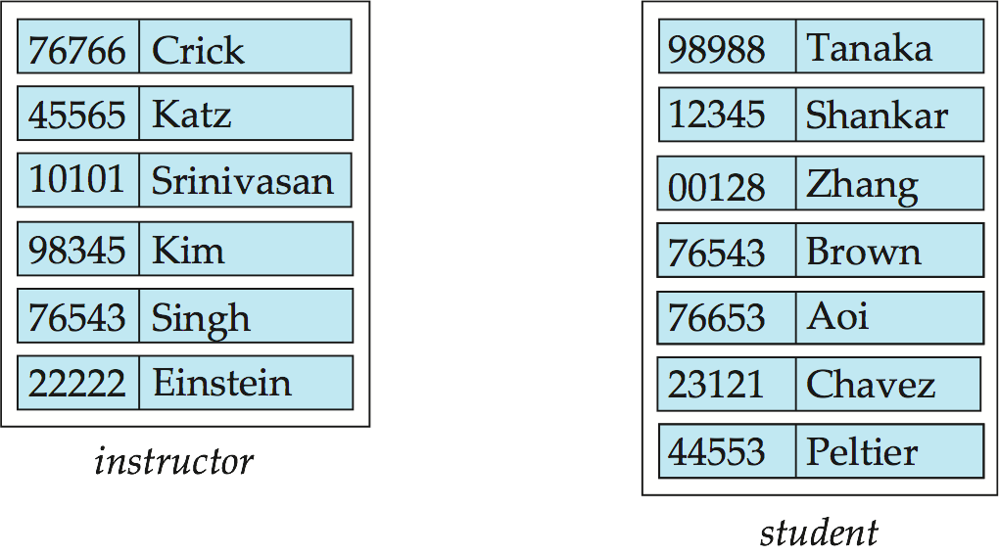
Entity Sets instructor and student
instructor_ID instructor_name student-ID student_name

Slide 13
Representing Entity sets in ER Diagram
Entity sets can be represented graphically as follows:
Rectangles represent entity sets.
Attributes listed inside entity rectangle
Underline indicates primary key attributes

Slide 14
Relationship Sets
A relationship is an association among several entities
Example: 44553 (Peltier) advisor 22222 (Einstein) student entity relationship set instructor entity
A relationship set is a mathematical relation among n ≥ 2 entities, each taken from entity sets
{(e₁, e₂, … e_{n}) | e₁ ∈ E₁, e₂ ∈ E₂, …, e_{n} ∈ E_{n}} where (e₁, e₂, …, e_{n}) is a relationship
Example:
(44553,22222) ∈ advisor

Slide 15
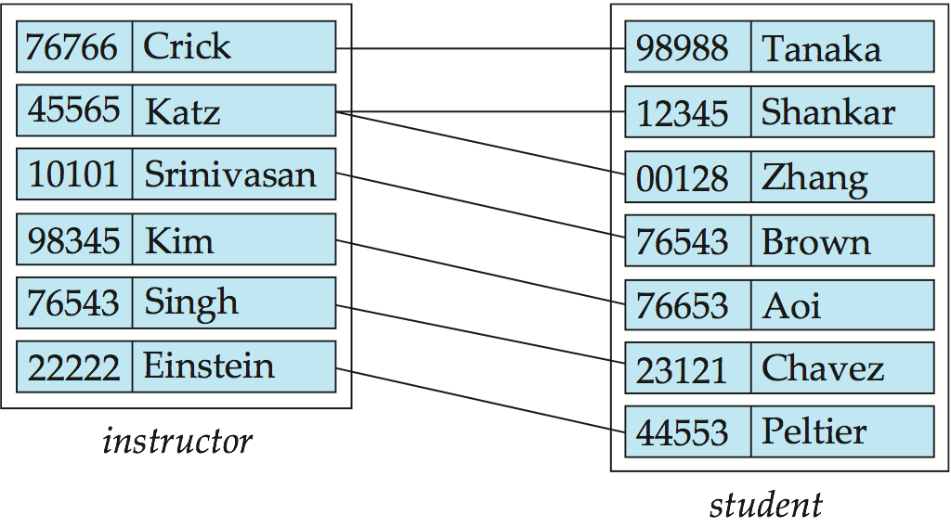
Relationship Set advisor

Slide 16
Representing Relationship Sets in ER Diagrams
Diamonds represent relationship sets.

Slide 17
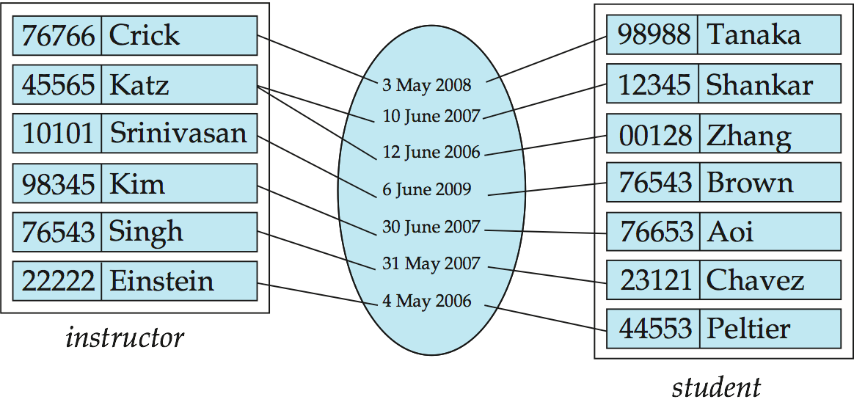
Relationship Sets with Attributes
An attribute can also be property of a relationship set.
For instance, the advisor relationship set between entity sets instructor and student may have the attribute date which tracks when the student started being associated with the advisor

Slide 18
Relationship Sets with Attributes

Slide 19
Roles
Entity sets of a relationship need not be distinct
Each occurrence of an entity set plays a “role” in the relationship
The labels “course_id” and “prereq_id” are called roles.

Slide 20
Degree(度) of a Relationship Set
binary relationship（二元联系）
involve two entity sets (or degree two).
most relationship sets in a database system are binary.
There are occasions when it is more convenient to represent relationships as non-binary.
E-R Diagram with a Ternary Relationship

Slide 21
Attributes
An entity is represented by a set of attributes, that is descriptive properties possessed by all members of an entity set.
Example:
instructor = (ID, name, street, city, salary ) course= (course_id, title, credits)
Domain – the set of permitted values for each attribute
Attribute types:
Simple （简单）and composite（复合） attributes.
Single-valued（单值） and multivalued（多值） attributes
Example: multivalued attribute: phone_numbers
Derived（派生） attributes
Can be computed from other attributes
Example: age, given date_of_birth

Slide 22
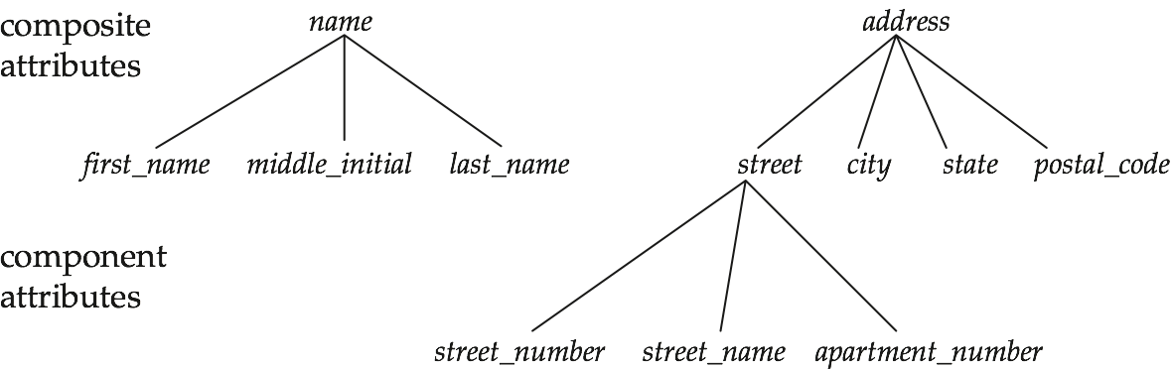
Composite Attributes

Slide 23
Representing Complex Attributes in ER Diagram

Slide 24
Mapping Cardinality Constraints （映射基数约束）
Express the number of entities to which another entity can be associated via a relationship set.
Most useful in describing binary relationship sets.
For a binary relationship set the mapping cardinality must be one of the following types:
One to one
One to many
Many to one
Many to many

Slide 25
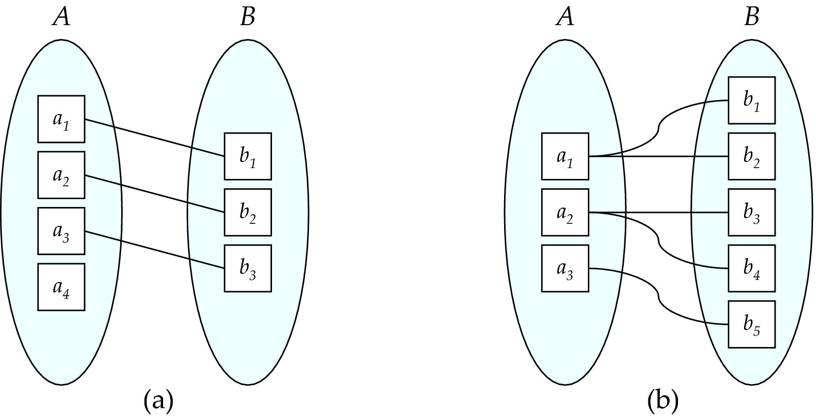
Mapping Cardinalities
One to one
One to many
Note: Some elements in A and B may not be mapped to any
elements in the other set

Slide 26
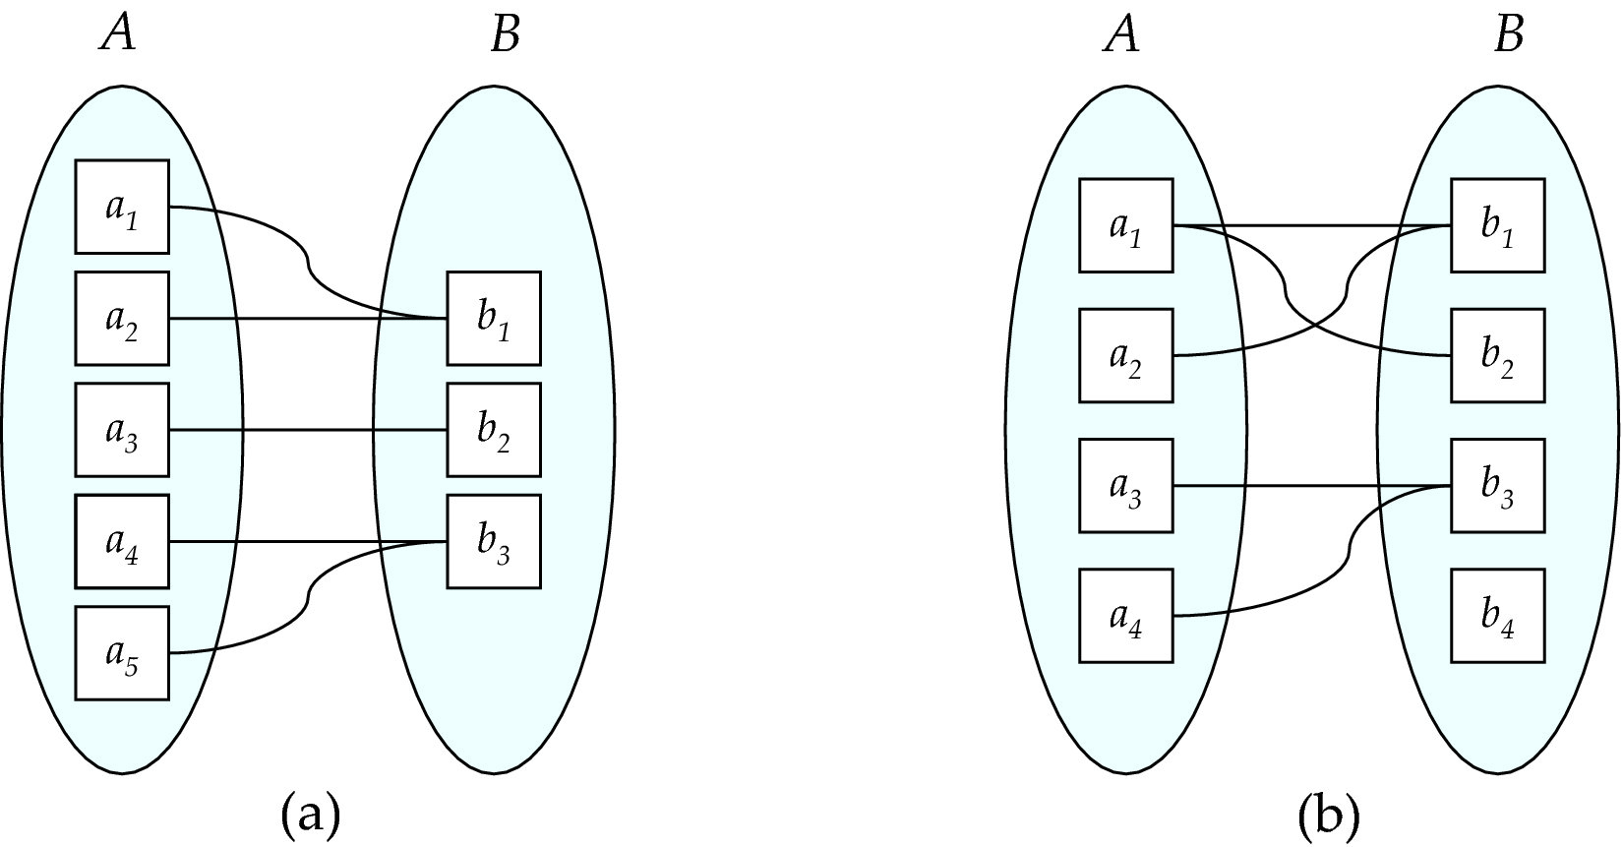
Mapping Cardinalities
Many to one
Many to many
Note: Some elements in A and B may not be mapped to any
elements in the other set

Slide 27
Representing Cardinality Constraints in ER Diagram
We express cardinality constraints by drawing either a directed line (→), signifying “one,” or an undirected line (—), signifying “many,” between the relationship set and the entity set.
One-to-one relationship between an instructor and a student :
A student is associated with at most one instructor via the relationship advisor
A instructor is associated with at most one student via the relationship advisor

Slide 28
One-to-Many Relationship
one-to-many relationship between an instructor and a student
an instructor is associated with several (including 0) students via advisor
a student is associated with at most one instructor via advisor,

Slide 29
Many-to-One Relationships
In a many-to-one relationship between an instructor and a student,
an instructor is associated with at most one student via advisor,
and a student is associated with several (including 0) instructors via advisor

Slide 30
Many-to-Many Relationship
An instructor is associated with several (possibly 0) students via advisor
A student is associated with several (possibly 0) instructors via advisor

Slide 31
Total and Partial Participation
Total participation (indicated by double line): every entity in the entity set participates in at least one relationship in the relationship set
participation of student in advisor relation is total
every student must have an associated instructor
Partial participation: some entities may not participate in any relationship in the relationship set
Example: participation of instructor in advisor is partial

Slide 32
Notation for Expressing More Complex Constraints
A line may have an associated minimum and maximum cardinality, shown in the form l..h, where l is the minimum and h the maximum cardinality
A minimum value of 1 indicates total participation.
A maximum value of 1 indicates that the entity participates in at most one relationship
A maximum value of * indicates no limit.
Example
Instructor can advise 0 or more students. A student must have 1 advisor (instructor); cannot have multiple advisors(instructors).

Slide 33
Cardinality Constraints on Ternary Relationship
We allow at most one arrow out of a ternary (or greater degree) relationship to indicate a cardinality constraint
For example, an arrow from proj_guide to instructor indicates each student has at most one guide for a project
To avoid confusion we outlaw(禁止) more than one arrow.

Slide 34
Primary Key
Primary keys provide a way to specify how entities and relations are distinguished. We will consider:
Entity sets
Relationship sets
Weak entity sets

Slide 35
Primary key for Entity Sets
By definition, individual entities are distinct.
From database perspective, the differences among them must be expressed in terms of their attributes.
The values of the attribute values of an entity must be such that they can uniquely identify the entity.
No two entities in an entity set are allowed to have exactly the same value for all attributes.
A key for an entity is a set of attributes that suffice to distinguish entities from each other

Slide 36
Primary Key for Relationship Sets
To distinguish among the various relationships of a relationship set we use the individual primary keys of the entities in the relationship set.
Let R be a relationship set involving entity sets E1, E2, .. En
The primary key for R is consists of the union of the primary keys of entity sets E1, E2, ..En
If the relationship set R has attributes a1, a2, .., am associated with it, then the primary key of R also includes the attributes a1, a2, .., am
Example: relationship set “advisor”.
The primary key consists of instructor.ID and student.ID
The choice of the primary key for a relationship set depends on the mapping cardinality of the relationship set.

Slide 37
Primary key for Binary Relationship
Many-to-Many relationships. The preceding union of the primary keys is a minimal superkey and is chosen as the primary key.
One-to-Many relationships . The primary key of the “Many” side is a minimal superkey and is used as the primary key.
Many-to-one relationships. The primary key of the “Many” side is a minimal superkey and is used as the primary key.
One-to-one relationships. The primary key of either one of the participating entity sets forms a minimal superkey, and either one can be chosen as the primary key.

Slide 38
Weak Entity Sets（弱实体集）
An entity set that does not have a primary key is referred to as a weak entity set.
The existence of a weak entity set depends on the existence of a identifying entity set（标识性实体集）
It must relate to the identifying entity set via a total, one-to-many relationship set from the identifying to the weak entity set
Identifying relationship（标识性联系） depicted using a double diamond
The discriminator (分辨符，or partial key) of a weak entity set is the set of attributes that distinguishes among all the entities of a weak entity set when the identifying entity they depend is known.
The primary key of a weak entity set is formed by the primary key of the strong entity set on which the weak entity set is existence dependent, plus the weak entity set’s discriminator.

Slide 39
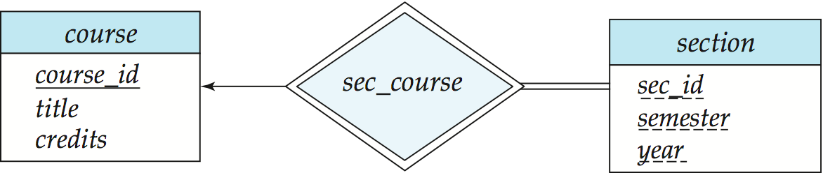
Weak Entity Sets (Cont.)
We underline the discriminator of a weak entity set with a dashed line.
We put the identifying relationship of a weak entity in a double diamond.
Primary key for section – (course_id, sec_id, semester, year)
discriminator
identifying entity set
identifying relationship
weak entity set

Slide 40
Weak Entity Sets (Cont.)
Note: the primary key of the strong entity set is not explicitly stored with the weak entity set, since it is implicit in the identifying relationship.
If course_id were explicitly stored, section could be made a strong entity, but then the relationship between section and course would be duplicated by an implicit relationship defined by the attribute course_id common to course and section

Slide 41
Redundant Attributes
Suppose we have entity sets:
student, with attributes: ID, name, tot_cred, dept_name
department, with attributes: dept_name, building, budget
We model the fact that each student has an associated department using a relationship set stud_dept
The attribute dept_name in student below replicates information present in the relationship and is therefore redundant
and needs to be removed.
BUT: when converting back to tables, in some cases the attribute gets reintroduced, as we will see later.

Slide 42
E-R Diagram for a University Enterprise

Slide 43
Reduction to Relational Schemas

Slide 44
Reduction to Relation Schemas
Entity sets and relationship sets can be expressed uniformly as relation schemas that represent the contents of the database.
A database which conforms to an E-R diagram can be represented by a collection of schemas.
For each entity set and relationship set there is a unique schema that is assigned the name of the corresponding entity set or relationship set.
Each schema has a number of columns (generally corresponding to attributes), which have unique names.

Slide 45

Representing Entity Sets With Simple Attributes
A strong entity set reduces to a schema with the same attributes course(course_id, title, credits)
A weak entity set becomes a table that includes a column for the primary key of the identifying strong entity set
Primary key of the table is the union of the discriminator of the weak entity set and the primary key of the identifying strong entity set
section ( course_id, sec_id, semester, year )

Slide 46
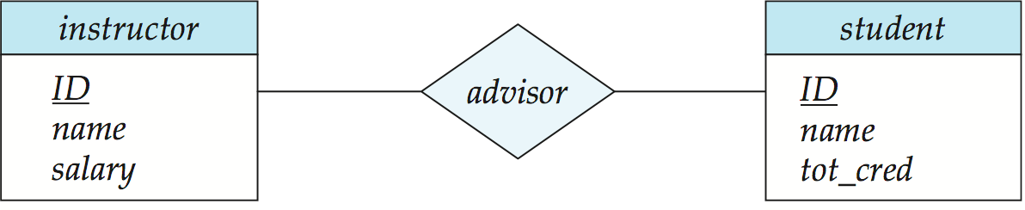
Representing Relationship Sets
A many-to-many relationship set is represented as a schema with attributes for the primary keys of the two participating entity sets, and any descriptive attributes of the relationship set.
Example: schema for relationship set advisor
advisor = (s_id, i_id)

Slide 47
Redundancy of Schemas
Many-to-one and one-to-many relationship sets that are total on the many-side can be represented by adding an extra attribute to the “many” side, containing the primary key of the “one” side
Example: Instead of creating a schema for relationship set inst_dept, add an attribute dept_name to the schema arising from entity set instructor

Slide 48
Redundancy of Schemas
department(dept_name, building, budget)
instructor(ID,name,salary)
inst_dept(ID, dept_name)
→
department(dept_name, building, budget)
instructor(ID, name, salary, dept_name)

Slide 49
Redundancy of Schemas (Cont.)
For one-to-one relationship sets, either side can be chosen to act as the “many” side
That is, extra attribute can be added to either of the tables corresponding to the two entity sets
If participation is partial on the “many” side, replacing a schema by an extra attribute in the schema corresponding to the “many” side could result in null values
The schema corresponding to a relationship set linking a weak entity set to its identifying strong entity set is redundant.
Example: The section schema already contains the attributes that would appear in the sec_course schema
Notes:
49

Slide 50
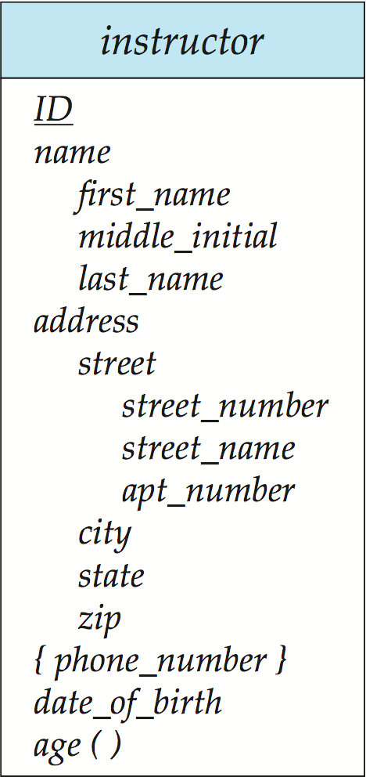
Composite and Multivalued Attributes
Composite attributes are flattened out by creating a separate attribute for each component attribute
Example: given entity set instructor with composite attribute name with component attributes first_name and last_name the schema corresponding to the entity set has two attributes name_first_name and name_last_name
Prefix omitted if there is no ambiguity
Ignoring multivalued attributes, extended instructor schema is
instructor(ID,
first_name, middle_initial, last_name,
street_number, street_name, apt_number,
city, state, zip_code, date_of_birth, age )
Notes:
50

Slide 51
Composite and Multivalued Attributes
A multivalued attribute M of an entity E is represented by a separate schema EM
Schema EM has attributes corresponding to the primary key of E and an attribute corresponding to multivalued attribute M
Example: Multivalued attribute phone_number of instructor is represented by a schema:
inst_phone= ( ID, phone_number)
Each value of the multivalued attribute maps to a separate tuple of the relation on schema EM
For example, an instructor entity with primary key 22222 and phone numbers 456-7890 and 123-4567 maps to two tuples: (22222, 456-7890)
(22222, 123-4567)
Notes:
51

Slide 52
Multivalued Attributes (Cont.)
Special case: entity time_slot has only one attribute other than the primary-key attribute, and that attribute is multivalued
time_slot(time_slot_id)
time_slot_detail(time_slot_id, day, start_time, end_time)
Optimization: Don’t create the relation corresponding to the entity, just create the one corresponding to the multivalued attribute
time_slot(time_slot_id, day, start_time, end_time)
Caveat（警告）: time_slot attribute of section (from sec_time_slot) cannot be a foreign key due to this optimization
Notes:
52

Slide 53
Design Issues

Slide 54
Common Mistakes in E-R Diagrams
Example of erroneous E-R diagrams
Notes:
54

Slide 55
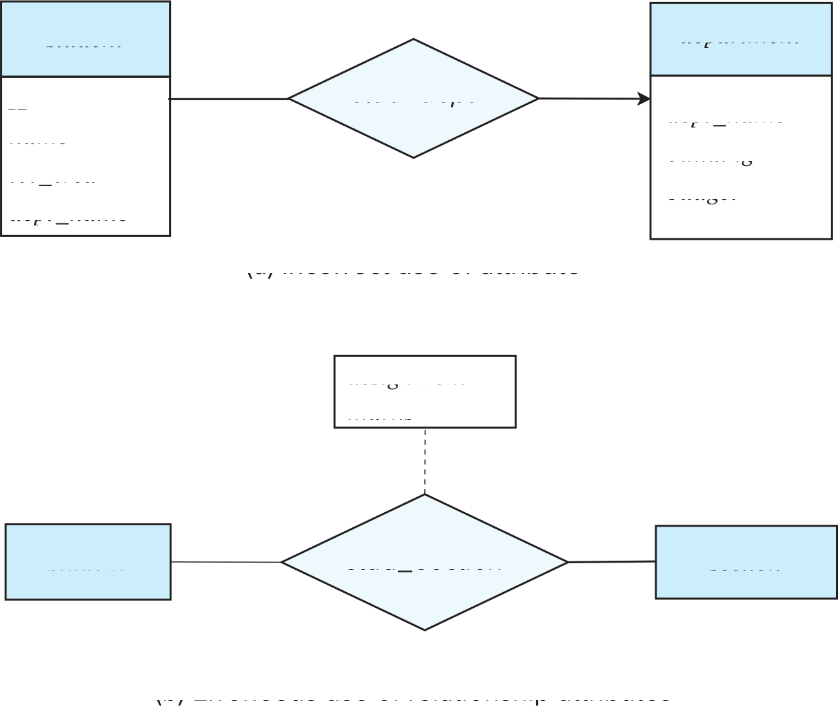
Common Mistakes in E-R Diagrams
Notes:
55

Slide 56
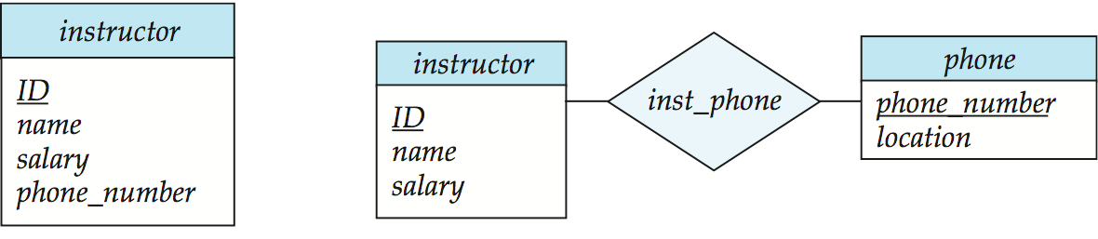
Design Issues
Use of entity sets vs. attributes
Use of phone as an entity allows extra information about phone numbers (plus multiple phone numbers)
Notes:
56

Slide 57
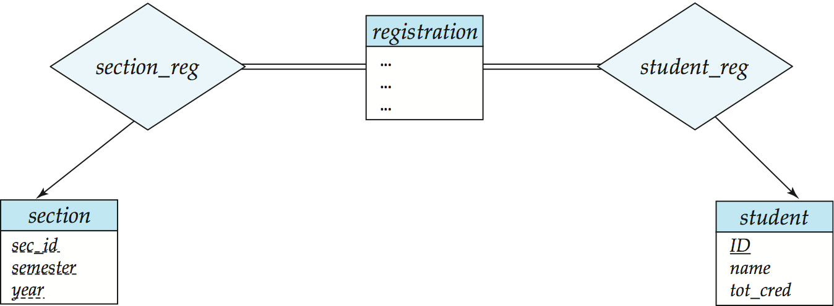
Design Issues
Use of entity sets vs. relationship sets Possible guideline is to designate a relationship set to describe an action that occurs between entities
Notes:
57

Slide 58
Design Issues
Placement of relationship attributes
e.g., attribute date as attribute of access or as attribute of account
date
customer
account
id
name
address
access
no
branch
balance
customer
account
id
name
address
access
no
branch
balance
date
Notes:
58

Slide 59
Binary Vs. Non-Binary Relationships
Binary versus n-ary relationship sets Although it is possible to replace any nonbinary (n-ary, for n > 2) relationship set by a number of distinct binary relationship sets, a n-ary relationship set shows more clearly that several entities participate in a single relationship.
Some relationships that appear to be non-binary may be better represented using binary relationships
E.g., A ternary relationship parents, relating a child to his/her father and mother, is best replaced by two binary relationships, father and mother
Using two binary relationships allows partial information (e.g., only mother being know)
But there are some relationships that are naturally non-binary
Example: proj_guide
Notes:
59

Slide 60
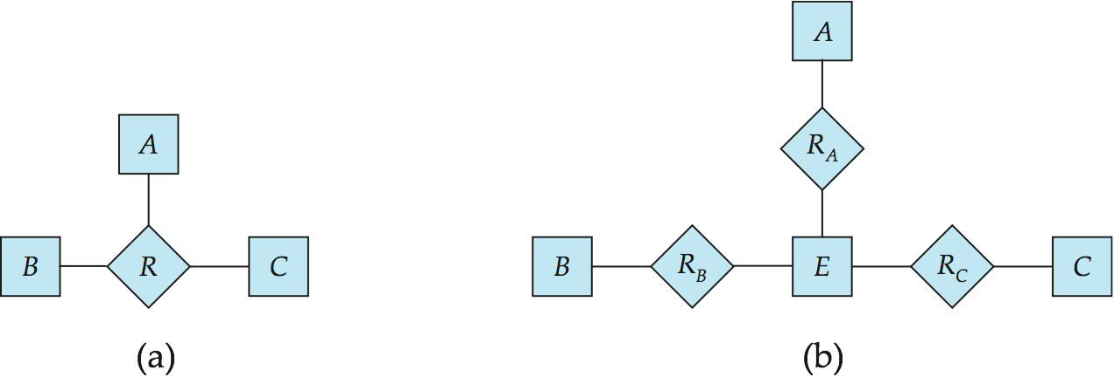
Converting Non-Binary Relationships to Binary Form
In general, any non-binary relationship can be represented using binary relationships by creating an artificial entity set.
Replace R between entity sets A, B and C by an entity set E, and three relationship sets:
1. R_{A}, relating E and A 2. R_{B}, relating E and B 3. R_{C}, relating E and C
Create a special identifying attribute for E
Add any attributes of R to E
For each relationship (a_{i} , b_{i} , c_{i}) in R, create
1. a new entity e_{i} in the entity set E 2. add (e_{i} , a_{i} ) to R_{A}
3. add (e_{i} , b_{i} ) to R_{B} 4. add (e_{i} , c_{i} ) to R_{C}
Notes:
60

Slide 61
Converting Non-Binary Relationships (Cont.)
Also need to translate constraints
Translating all constraints may not be possible
There may be instances in the translated schema that cannot correspond to any instance of R
Exercise: add constraints to the relationships R_{A}, R_{B} and R_{C} to ensure that a newly created entity corresponds to exactly one entity in each of entity sets A, B and C
We can avoid creating an identifying attribute by making E a weak entity set (described shortly) identified by the three relationship sets
Notes:
61

Slide 62
E-R Design Decisions
The use of an attribute or entity set to represent an object.
Whether a real-world concept is best expressed by an entity set or a relationship set.
The use of a ternary relationship or binary relationships.
The use of a strong or weak entity set.

Slide 63
Extended ER Features

Slide 64
Extended E-R Features: Specialization/Generalization
Specialization(特化)
Top-down design process; we designate subgroupings within an entity set that are distinctive from other entities in the set.
Attribute inheritance – a lower-level entity set inherits all the attributes and relationship participation of the higher-level entity set to which it is linked.
Generalization（概化）
A bottom-up design process – combine a number of entity sets that share the same features into a higher-level entity set.
Specialization and generalization are simple inversions of each other; they are represented in an E-R diagram in the same way.
The terms specialization and generalization are used interchangeably.

Slide 65
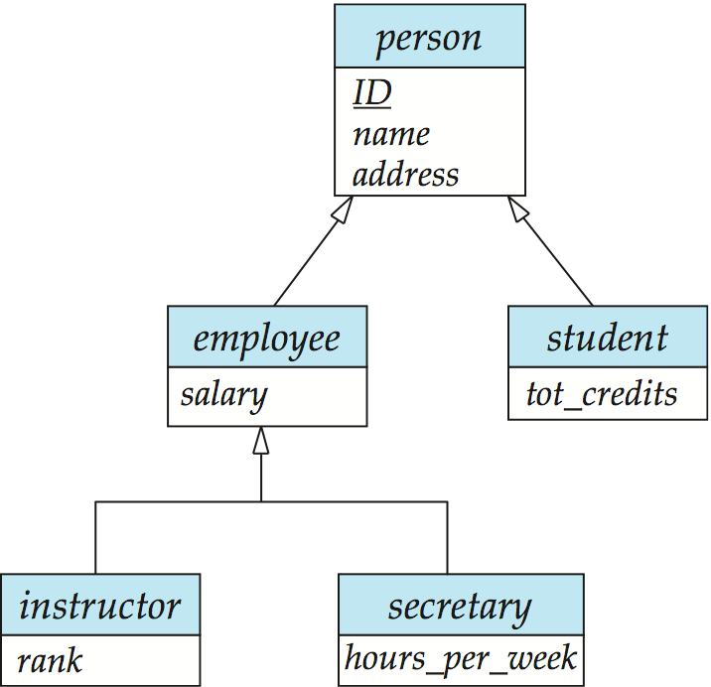
Specialization Example
overlapping
partial
disjoint
total

Slide 66
Design Constraints on a Specialization/Generalization
Constraint on whether or not entities may belong to more than one lower-level entity set within a single generalization.
Disjoint(不相交)
an entity can belong to only one lower-level entity set
Noted in E-R diagram by having multiple lower-level entity sets link to the same triangle
Overlapping（重叠）
an entity can belong to more than one lower-level entity set

Slide 67
Design Constraints on a Specialization/Generalization (Cont.)
Completeness constraint （完全性约束）-- specifies whether or not an entity in the higher-level entity set must belong to at least one of the lower-level entity sets within a generalization.
Total（全部）: an entity must belong to one of the lower-level entity sets
Partial（部分）: an entity need not belong to one of the lower-level entity sets

Slide 68
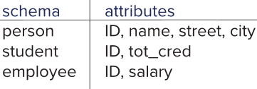
Representing Specialization via Schemas
Method 1:
Form a schema for the higher-level entity
Form a schema for each lower-level entity set, include primary key of higher-level entity set and local attributes
Drawback: getting information about, an employee requires accessing two relations, the one corresponding to the low-level schema and the one corresponding to the high-level schema
Notes:
68

Slide 69
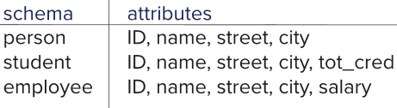
Representing Specialization as Schemas
Method 2:
Form a schema for each entity set with all local and inherited attributes
Drawback: name, street and city may be stored redundantly for people who are both students and employees
Notes:
69

Slide 70
Representing Specialization as Schemas
Method 3:
Using single schema for all super /suber entity sets , with a type attribute to differentnate entities.
schema attributes person ID, name, street, city，person_type, tot_cred, salary)

Slide 71
UML
UML: Unified Modeling Language
UML has many components to graphically model different aspects of an entire software system
UML Class Diagrams correspond to E-R Diagram, but several differences.

Slide 72
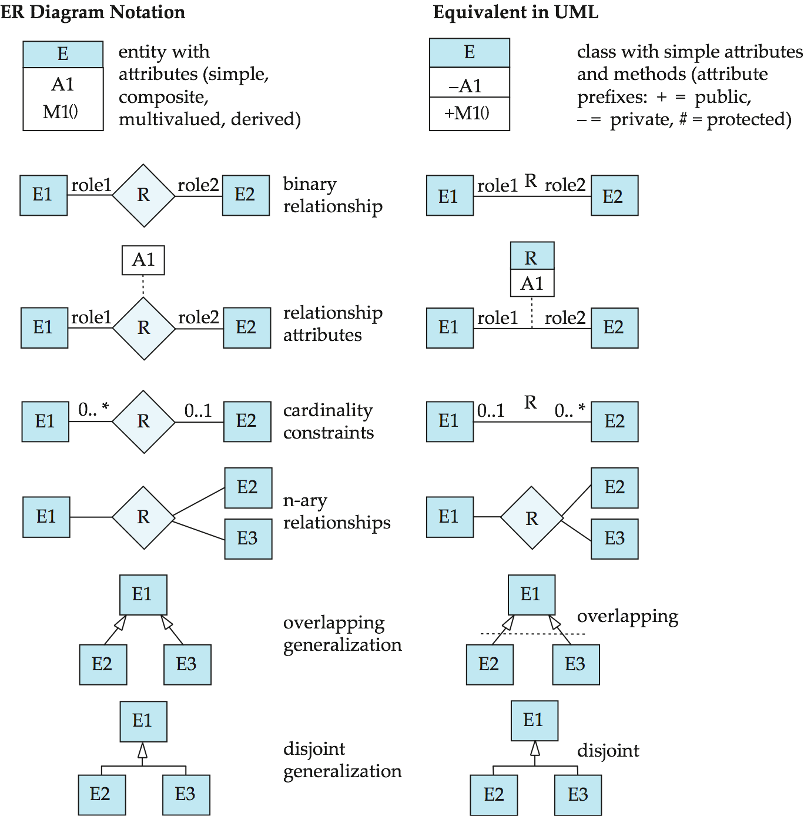
ER vs. UML Class Diagrams
*Note reversal of position in cardinality constraint depiction

Slide 73
ER vs. UML Class Diagrams
ER Diagram Notation
Equivalent in UML
*Generalization can use merged or separate arrows independent
of disjoint/overlapping

Slide 74
UML Class Diagrams (Cont.)
Binary relationship sets are represented in UML by just drawing a line connecting the entity sets. The relationship set name is written adjacent to the line.
The role played by an entity set in a relationship set may also be specified by writing the role name on the line, adjacent to the entity set.
The relationship set name may alternatively be written in a box, along with attributes of the relationship set, and the box is connected, using a dotted line, to the line depicting the relationship set.

Slide 75
End of Chapter 6
Notes:
75

