Slide 1
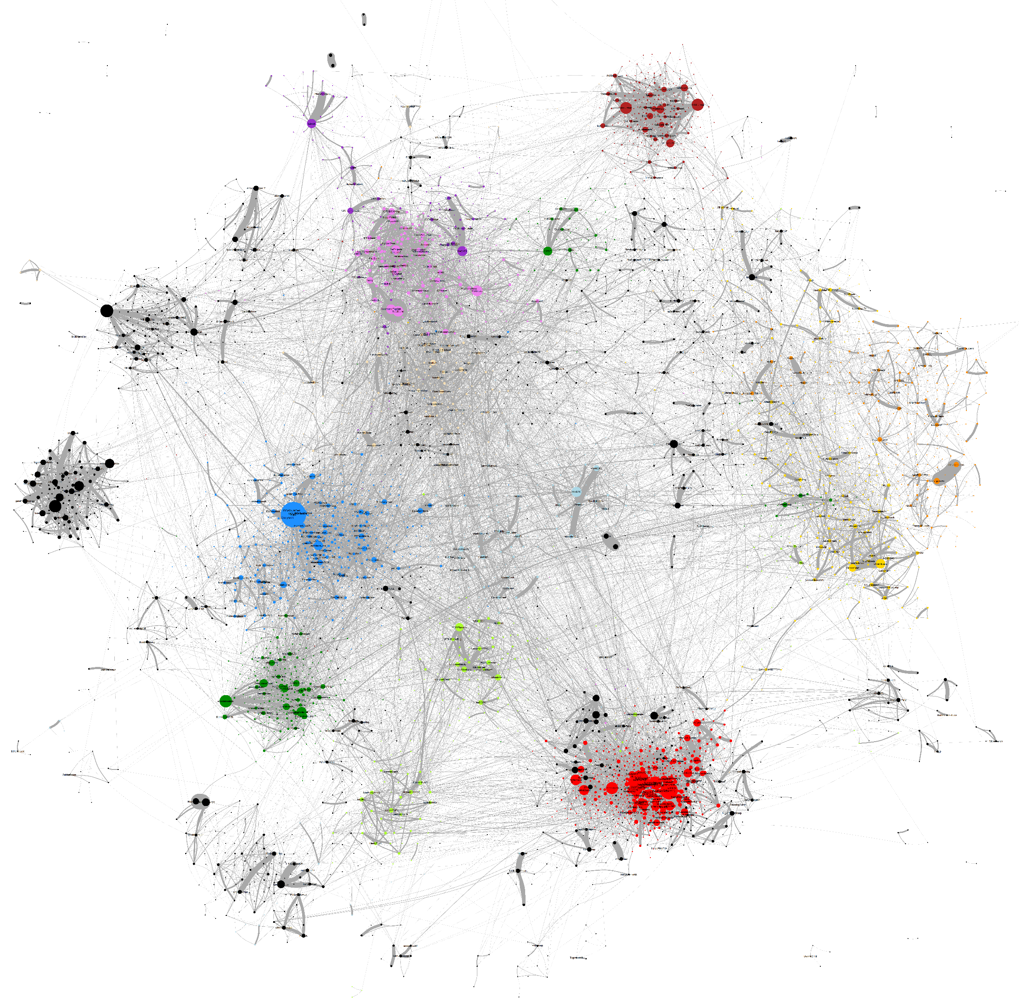
Reciprocal Mentions Fast Greedy
Plumbing & Boilers
Building Standards
Construction News
Roofing
Large Scale Construction
Low Carbon
Doors & Windows
Carbon & Renewables
Architects
Passive house
Urban Planning
Green Party
Housing
Landlords

