Slide 1
To trust, or not to trust:
Highlighting the need for data provenance in mobile apps for smart cities
Mikel Emaldi¹, Oscar Peña¹, Jon Lázaro¹, Diego López-de-Ipiña¹
Sacha Vanhecke², Erik Mannens²
¹ DeustoTech - Deusto Institute of Technology, University of Deusto
² iMinds - Multimedia Lab, Ghent University
Notes:
I come from University of Deusto, a little university in Bilbao, Spain, and I will present this paper which is a joint work between DeustoTech Internet, our research group, and the iMinds Multimedia lab from Ghent University.

Slide 2
Outline
Introduction
Related work
Semantic representation of provenance
Provenance-based trust model
Conclusions and future work
Notes:
This is the outline I will follow during the presentation. I will start introducing the context of the work and its motivation.
I will follow highlighting some related work.
And then I will start detailling our work, first explaining the proposed semantic representation for provenance, and after this our trust model.
For finishing, I will expose some conclusions and future work.

Slide 3
What is a Smart City?
Introduction
A city that makes available all the services and applications enabled by ICT to citizens, companies and authorities that are part of a city’s system.
It aims to increase all citizens’ quality of life and improve the efficiency and quality of the services provided by governing entities and businesses.
Notes:
ICT = Information and communications technology
This includes mobility information, intelligent waste management, helps for elderly people or people with disabilities, among many others.
All this things are done with two main goals:
One: - Increasing the quality of life of EVERY citizen in the city
Two: - Enabling a more efficient and effective management of the city resources.

Slide 4
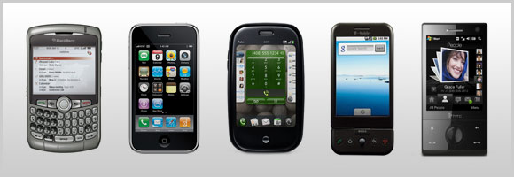
Smartphones in Smart Cities
Introduction
Enable a way to access smart cities' services
Enable the participation of the citizens in city governance
Ease the way users share they own opinion, data...
Smartphones are an essential part of Smart Cities
Notes:
To reach these goals, specially those concerning citizens, smartphones are essential.
With the popularity of smartphones, almost every citizen of those smart cities is continnously connected to the internet.
[*]
This fact makes them the most suitable devices to access the services made provided by smart cities.
[*]
But maybe more important than the posibility of accesing the services, is the posibility of being part of them, making the citizens part of the city governance.
[*]
Because smartphones ease the way that users share their own opinions, data, and so on.
But given citizens the “power” can have some problems...

Slide 5
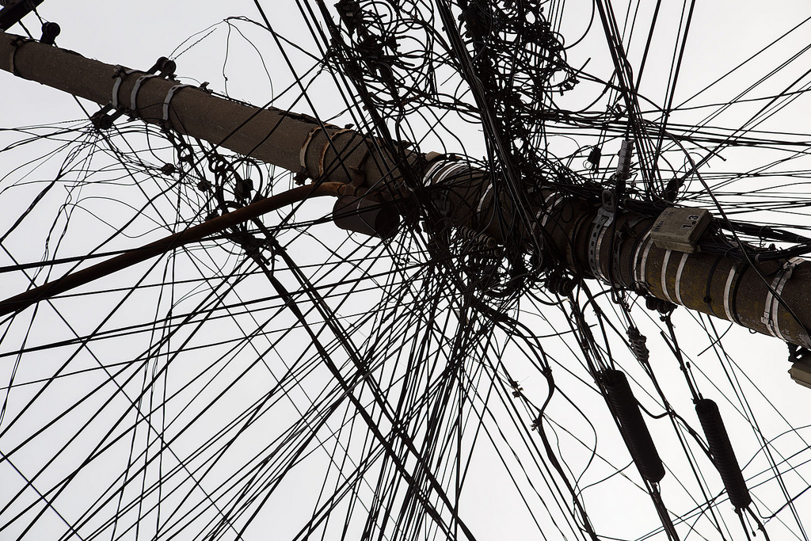
Introduction
biased information
uncompleteness
incorrect
data
contradictions
outdated
information
conflicts
partial data
Notes:
Because data provided by users can be...

Slide 6
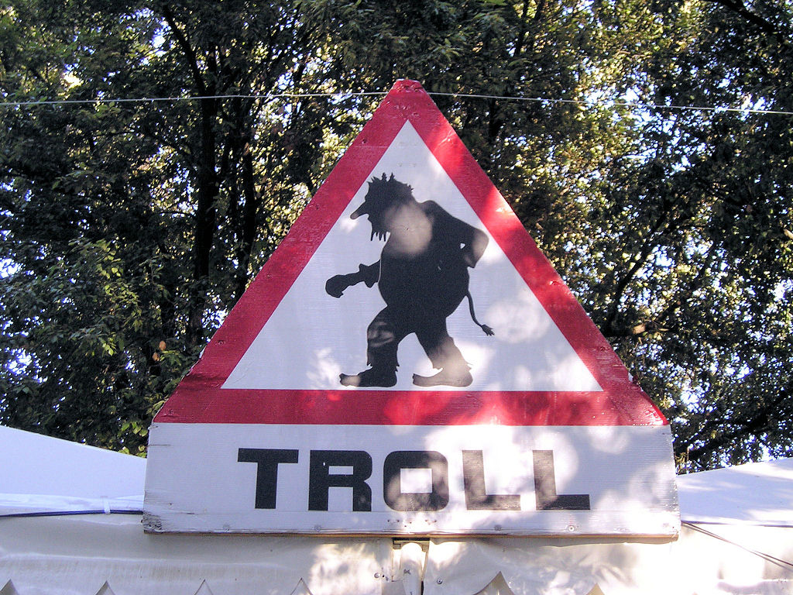
Introduction
biased information
uncompleteness
incorrect
data
contradictions
outdated
information
conflicts
partial data
Notes:
And of course, there can be trolls, spammers, etc.

Slide 7
Solution? Trust!
Introduction
We need trust mechanisms to...
Measure if submitted data is reliable.
Identify a given user and measure his/her reputation.
Build user-centric smartphone apps for smart cities that keep provenance information
Provide trust mechanisms that help authorities and users deciding if the data is reliable or not
Notes:
So, a solution to these problems can be building trust mechanisms that measure the reliability of both submitted of data, and the user who has submitted that piece of data.
[*]
What we propose is building user-centric applications for smart cities, that keeps provenance information. That means that, exploiting the capabilities of the smartphones, built apps should record some data about the context of the information in the moment it is submitted.
[*]
And, using this provenance-data, provide some trust mechanism that help authorities and other citizens in the difficult task of deciding whether a piece of data is true, or not.

Slide 8
IES Cities: Internet Enabled Services for cities across Europe
Introduction
Motivations:
Citizens must be heard & empowered
The information gathered and provided by both cities and citizens must be linked and processed
Goals:
Create a multi-device dataset and application marketplace based on standard and accessible web technologies, exploiting data shared between citizens and councils, and providing an enhanced experience to municipalities
Notes:
We are now working on providing a framework for that in the context of the IES Cities project.
IES Cities is a European project in which we are working to provide an architecture for smart cities', in which citizens have the mentioned “power”, and in which with the help of Linked Data and other technologies, this information is analyzed, enriched and exploited to provide in one hand, advanced decision making for councils, and in the other, enhanced experiences for citizens and tourists in a smart city.

Slide 9
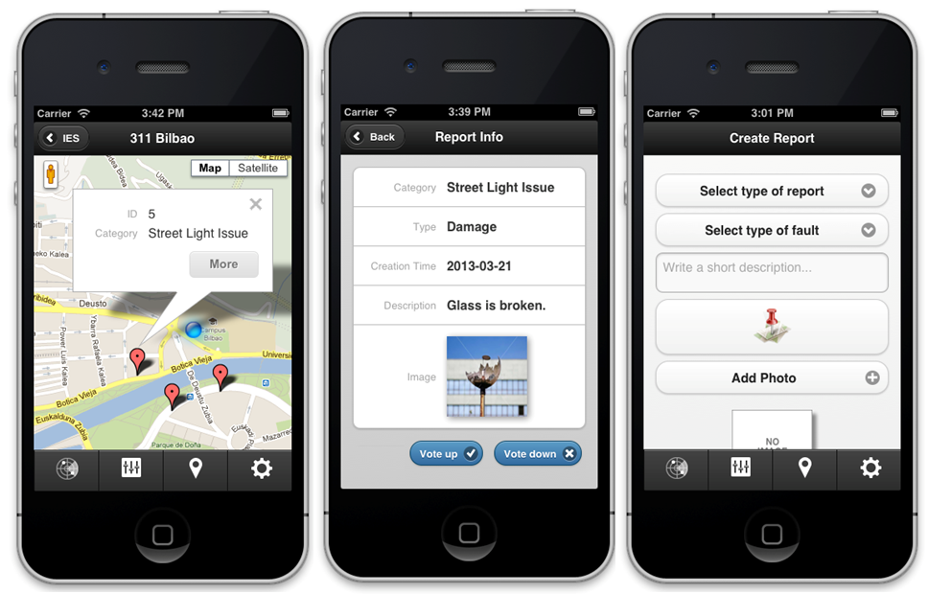
Use case: 311 Bilbao
Introduction
Consuming & reporting of complaints concerning public infrastructures
Notes:
In the context of IES Cities we have built an application called “311 Bilbao”, in which citizens of the city of Bilbao can report complaints and problems of public infrastructure.
I will use this application as use case to explain our work in next sections of the presentations.

Slide 10
Outline
Introduction
Related work
Semantic representation of provenance
Provenance-based trust model
Conclusions and future work
Notes:
But before this I will shortly explain some other work done in the context of smart cities.

Slide 11
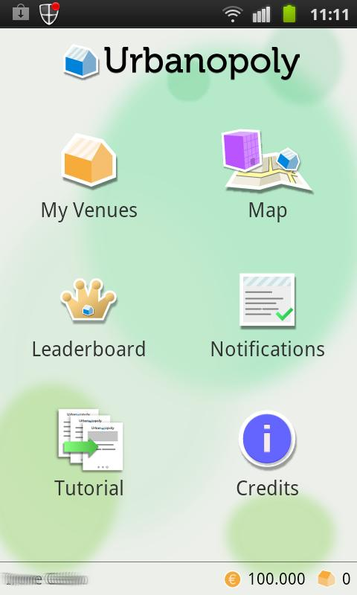
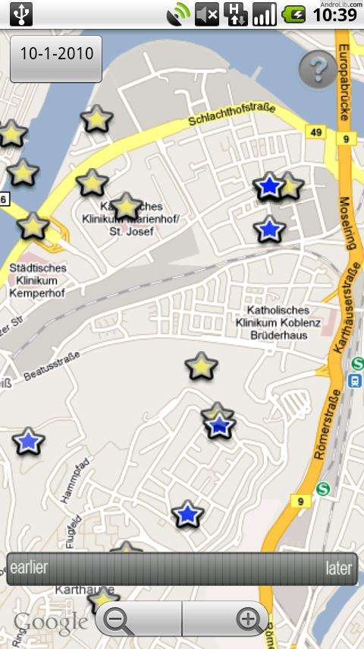
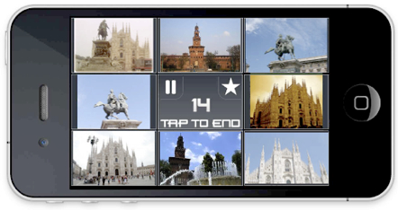
Apps for Smart Cities
Related work
Urbanopoly
Human Computation + Linked Data + Gamification to verify and correct data about POIs
Urban Match
User compares photos to link smart-cities' datasets
csxPOI
Collaborative creation, edition and share of semantic POIs
Notes:
We have identified three different smartphone applications for smart cities in which users are the ones who generate the information.
Urbanopoly is an application in which the goal is to verify and correct data about the Points of Interest of a given city. It is set out as a game, in which users need to provide information about a given place and can earn money doing it.
Urbanmatch is also a game, in which users have to match photos of places that they think are the same. The hidden goal of this application is using this matching to generate links between different datasets about smart cities.
CsxPOI is an application that allows users to create, edit and share POIs about a city.

Slide 12
Apps for Smart Cities
Related work
Different ways to “trust” user data:
Popularity (Urbanopoly)
User historical reputation (Urbanopoly)
Clustering of properties of reports (Urban Match)
Combine known real and false data (csxPOI)
Our proposal: Keep provenance information and use it in trust algoithms
Notes:
All these apps have different ways to measure the confidence in user provided data. For example, Urbanopoly uses both popularity of a given piece of data and the reputation of the user based on his or her past actions.
Another approach can be the one used in Urban Match, in which data mining techniques are used for deciding if a piece of data is true or not.
Other one can be the one used in csxPOI, which is a more psichological one, in which already known true and false picture are combined to analyze users' tendencies to lie or tu say the truth.
And as I have mentioned before, another approach can be ours, that is, keeping as many provenance information as we can on submitting moment, and then query it to measure trust with different algorithms

Slide 13
Outline
Introduction
Related work
Semantic representation of provenance
Provenance-based trust model
Conclusions and future work
Notes:
Ok, in the next two sections I will explain more deeply our approach. I will start with the representation of provenance.

Slide 14

Representation of provenance
Provenance representation
W3C PROV Data Model
RDF model for provenance representation
PROV-O ontology
Extensible: Uncertainty extension
Notes:
For this goal we decided to use the World Wide Web Consortium PROV data model, and the related PROV-O ontology.
We wanted to use RDF data, because in IES Cities we use and publish the data as Linked Data, and because its a great way to keep structured and queriable data on the web.
This model has been built in a way that is easy to add extensions. For example, we use an extension made by our colleages in Ghent to represent the uncertainty of a given piece of data.
Now, I will explain how this model is represented.

Slide 15
Representation of a report
Provenance representation
User John Doe sends a report
entity(:report_23456, [prov:value="The paper bin is broken"])
wasAttributedTo(:report_23456, :jdoe)
agent(:jdoe, [ prov:type='prov:Person', foaf:name="John Doe", foaf:mbox='<mailto:jdoe@example.org>' ])
wasGeneratedBy(:report_23456, :reportActivity_23456)
activity(:reportActivity_23456, 2013-07-22T01:01:01, geo:lat=43.25, geo:long=-2.93)
Report
User
Context

Slide 16
Representation of a revision report
Provenance representation
A worker of the council invalidates John's report
wasInvalidatedBy(:report_23456, :invActivity_639, 2013-07-22T03:05:03)
activity(:invActivity_639, 2013-07-22T02:58:01, 2013-07-22T03:04:47)
wasAssociatedWith(:invActivity_639, :jane)
entity(:report_23457, [ prov:value="It is incorrect, another paper bin has replaced the old one, but 2 meters beyond" ])
wasDerivedFrom(:report_23457, :report_23456, :invActivity_639, -, -, [ prov:type='prov:Revision' ])
wasAttributedTo(:report_23457, :jane)
agent(:jane, [ prov:type='prov:Person', foaf:name="Jane", foaf:mbox='<mailto:jane@bilbao.iescities.org>' ])
actedOnBehalfOf(:jane, :bilbao_city_council)
agent(:bilbao_city_concil, [ prov:type='prov:Organization', foaf:name="Bilbao City Council"])
Invalidation
Revision report
Worker
Council

Slide 17
Outline
Introduction
Related work
Semantic representation of provenance
Provenance-based trust model
Conclusions and future work
Notes:
Ok, in the next two sections I will explain more deeply our approach. I will start with the representation of provenance.

Slide 18
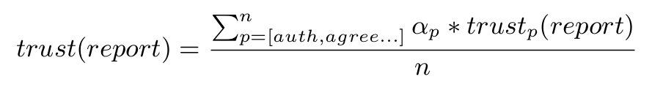
Trust model
Trust model
Gil et al. identify 19 parameters on how to determine trust in web content: authority, popularity, recency...
Trust measure funcion for a given property [0,1]
Trust parameters
Relevance of a given property [0,1]
# of measured properties
Generic and flexible model
and defined by developers or councils
Notes:
For this goal we decided to use the World Wide Web Consortium PROV data model, and the related PROV-O ontology.
We wanted to use RDF data, because in IES Cities we use and publish the data as Linked Data, and because its a great way to keep structured and queriable data on the web.
This model has been built in a way that is easy to add extensions. For example, we use an extension made by our colleages in Ghent to represent the uncertainty of a given piece of data.
Now, I will explain how this model is represented.

Slide 19
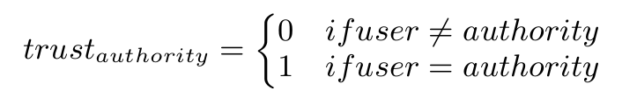

Authority
Trust model
Was the data created by an authority in a given context?
In Bilbao 311 and for John Doe, an SPARQL query like...
would have no results, so
ASK { :jdoe prov:actedOnBehalfOf :bilbao_city_concil }
Notes:
For this goal we decided to use the World Wide Web Consortium PROV data model, and the related PROV-O ontology.
We wanted to use RDF data, because in IES Cities we use and publish the data as Linked Data, and because its a great way to keep structured and queriable data on the web.
This model has been built in a way that is easy to add extensions. For example, we use an extension made by our colleages in Ghent to represent the uncertainty of a given piece of data.
Now, I will explain how this model is represented.

Slide 20
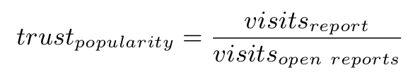

Popularity
Trust model
Is the piece of information referenced by other users?
In Bilbao 311, we measure popularity in terms of visits that a report receive:
Given John Does report has 100 visits and there has been 550 visits to all open reports...
Notes:
For this goal we decided to use the World Wide Web Consortium PROV data model, and the related PROV-O ontology.
We wanted to use RDF data, because in IES Cities we use and publish the data as Linked Data, and because its a great way to keep structured and queriable data on the web.
This model has been built in a way that is easy to add extensions. For example, we use an extension made by our colleages in Ghent to represent the uncertainty of a given piece of data.
Now, I will explain how this model is represented.

Slide 21
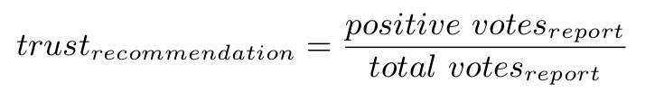

Recommendation
Trust model
Is the data relevant for other users?
In Bilbao 311, we measure recommendation with a simple voting system (+1/-1):
Given John Does report has 10 of 12 positive votes...
Notes:
For this goal we decided to use the World Wide Web Consortium PROV data model, and the related PROV-O ontology.
We wanted to use RDF data, because in IES Cities we use and publish the data as Linked Data, and because its a great way to keep structured and queriable data on the web.
This model has been built in a way that is easy to add extensions. For example, we use an extension made by our colleages in Ghent to represent the uncertainty of a given piece of data.
Now, I will explain how this model is represented.

Slide 22

Provenance / Reputation
Trust model
Can I trust the user who generated the data? What's his/her reputation?
In Bilbao 311, we use the historical reputation algorithm by Ceolin et al. 3 steps:
Evidence selection: Get every report of the user.
Evidence weighting: Apply recommendation function for every report, taking in account invalidation / validation.
Evidence aggregation: Subjective logic algorithm
Notes:
For this goal we decided to use the World Wide Web Consortium PROV data model, and the related PROV-O ontology.
We wanted to use RDF data, because in IES Cities we use and publish the data as Linked Data, and because its a great way to keep structured and queriable data on the web.
This model has been built in a way that is easy to add extensions. For example, we use an extension made by our colleages in Ghent to represent the uncertainty of a given piece of data.
Now, I will explain how this model is represented.

Slide 23

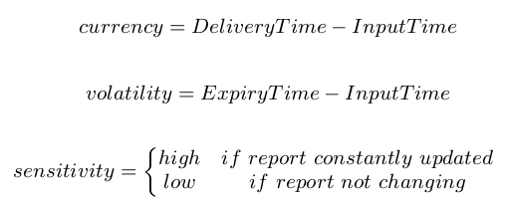
Recency / Timeliness
Trust model
Is the data up-to-date?
In Bilbao 311, we measure recency with the model by Hartig et al.
where...
Notes:
For this goal we decided to use the World Wide Web Consortium PROV data model, and the related PROV-O ontology.
We wanted to use RDF data, because in IES Cities we use and publish the data as Linked Data, and because its a great way to keep structured and queriable data on the web.
This model has been built in a way that is easy to add extensions. For example, we use an extension made by our colleages in Ghent to represent the uncertainty of a given piece of data.
Now, I will explain how this model is represented.

Slide 24
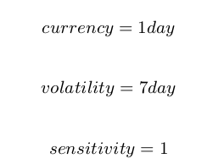
Recency / Timeliness
Trust model
Given...
Then...
Notes:
For this goal we decided to use the World Wide Web Consortium PROV data model, and the related PROV-O ontology.
We wanted to use RDF data, because in IES Cities we use and publish the data as Linked Data, and because its a great way to keep structured and queriable data on the web.
This model has been built in a way that is easy to add extensions. For example, we use an extension made by our colleages in Ghent to represent the uncertainty of a given piece of data.
Now, I will explain how this model is represented.

Slide 25
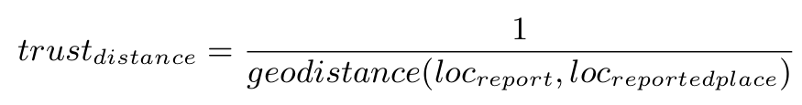

Other trust factors
Trust model
The model is flexible enough to include other factors depending on the context of the application.
e.g. in Bilbao 311, the distance between reporting and reported places is a key trust factor:
Given John Doe is very close to reporting place...
Notes:
For this goal we decided to use the World Wide Web Consortium PROV data model, and the related PROV-O ontology.
We wanted to use RDF data, because in IES Cities we use and publish the data as Linked Data, and because its a great way to keep structured and queriable data on the web.
This model has been built in a way that is easy to add extensions. For example, we use an extension made by our colleages in Ghent to represent the uncertainty of a given piece of data.
Now, I will explain how this model is represented.

Slide 26
Results of the trust model
Trust model
After applying our model we will get a trust value between 0 and 1.
If we assume that is equal for every property, John's report would have a trust value of...
That would be represented in the provenance graph as:
Enabling SPARQL queries like:
:report_23456 up:contentConfidence “0.58”
SELECT ?report WHERE {
?report up:contentConfidence ?confidence .
FILTER (?confidence < 0.5)
}
Notes:
For this goal we decided to use the World Wide Web Consortium PROV data model, and the related PROV-O ontology.
We wanted to use RDF data, because in IES Cities we use and publish the data as Linked Data, and because its a great way to keep structured and queriable data on the web.
This model has been built in a way that is easy to add extensions. For example, we use an extension made by our colleages in Ghent to represent the uncertainty of a given piece of data.
Now, I will explain how this model is represented.

Slide 27
Outline
Introduction
Related work
Semantic representation of provenance
Provenance-based trust model
Conclusions and future work
Notes:
Ok, in the next two sections I will explain more deeply our approach. I will start with the representation of provenance.

Slide 28
Conclusions
Conclusions and future work
An approach that allow to represent and evaluate the provenance of user-submitted data in IES Cities' platform.
Proposed metrics measure data trustworthiness level, providing an extra confidence layer in the project's framework.
Flexible model allowing developers and admins to develop own functions and alphas.
Using a model based on RDF makes simple the publication and querying (trough SPARQL) of these data over the web.
Notes:
For this goal we decided to use the World Wide Web Consortium PROV data model, and the related PROV-O ontology.
We wanted to use RDF data, because in IES Cities we use and publish the data as Linked Data, and because its a great way to keep structured and queriable data on the web.
This model has been built in a way that is easy to add extensions. For example, we use an extension made by our colleages in Ghent to represent the uncertainty of a given piece of data.
Now, I will explain how this model is represented.

Slide 29
Future work
Conclusions and future work
Work-in-progress: Finish the implementation of the trust layer in IES Cities platform.
Evaluation and validation of the proposed model against other implementations using RDF provenance models.
Research the posibility of adding new relevant metrics.
Notes:
For this goal we decided to use the World Wide Web Consortium PROV data model, and the related PROV-O ontology.
We wanted to use RDF data, because in IES Cities we use and publish the data as Linked Data, and because its a great way to keep structured and queriable data on the web.
This model has been built in a way that is easy to add extensions. For example, we use an extension made by our colleages in Ghent to represent the uncertainty of a given piece of data.
Now, I will explain how this model is represented.

Slide 30
Bibliography
Conclusions and future work
I. Celino, S. Contessa, M. Corubolo, D. Dell’Aglio, E. D. Valle, S. Fumeo, and T. Krüger. UrbanMatch - linking and improving smart cities data
Y. Gil and D. Artz. Towards content trust of web resources
O. Hartig and J. Zhao. Using web data provenance for quality assessment
D. Ceolin, P. T. Groth, W. R. van Hage, A. Nottamkandath, and W. Fokkink. Trust evaluation through user reputation and provenance analysis
M. Braun, A. Scherp and S. Staab. Collaborative creation of semantic points of interest as linked data on the mobile phone
I. Celino, D. Cerizza, S. Contessa, M. Corubolo, D. DellAglio, E. D. Valle, and S. Fumeo. Urbanopoly - a social and location-based game with a purpose to crowdsource your urban data.
Notes:
For this goal we decided to use the World Wide Web Consortium PROV data model, and the related PROV-O ontology.
We wanted to use RDF data, because in IES Cities we use and publish the data as Linked Data, and because its a great way to keep structured and queriable data on the web.
This model has been built in a way that is easy to add extensions. For example, we use an extension made by our colleages in Ghent to represent the uncertainty of a given piece of data.
Now, I will explain how this model is represented.

Slide 31

Introduction
All rights of images are reserved by the
original owners*, the rest of the content is licensed
under a Creative Commons by-sa 3.0 license.
* Pingdom, Sacha Vanhecke, Fernando Stankuns, Gil mnogueira, W3C, Jon Lázaro

Slide 32
Thank you
Jon Lázaro – jlazaro@deusto.es
Mikel Emaldi – memaldi@deusto.es
Oscar Peña – oscar.pena@deusto.es
Diego López-de-Ipiña – dipina@deusto.es
Sacha Vanhecke - sacha.vanhecke@ugent.be
Erik Mannens- erik.mannens@ugent.be
Notes:
So, thank you for your attention. And if you have any question I am now at your disposal, or when you want on these emails.

