Slide 1

Graph Clustering Based on Structural/Attribute Similarities Yang Zhou, Hong Cheng, Jeffrey Xu Yu Proc. Of the VLDB Endowment, France, 2009 Wednesday, November 30, 2011
Presenter
Waqas Nawaz
Data Knowledge and Engineering Lab, Kyung Hee University Korea
Notes:
Good afternoon, everyone! Today I’m going to present a paper entitled “Graph Clustering Based on Structural/Attribute Similarities”. My name is Waqas Nawaz. I’m from Ubiquitous Computing Lab, Kyung Hee University Korea. This work is done by Yang Zhou, Hong Cheng, Jeffrey Xu Yu from Database Group Department of Systems Engineering & Engineering Management, Chinese University of Hong Kong.

Slide 2

Agenda
Introduction
Related Work
Graph Clustering with Structure & Attributes
Experimental Evaluation
Conclusion, Review and Future Directions
Data and Knowledge Engineering Lab
3/8
2

Slide 3
Introduction
X = {x₁, … , x_{N}}: a set of data points
S = (s_{ij})_{i,j=1,…,N}: the similarity matrix in which each element indicates the similarity s_{ij} between two data points x_{i} and x_{j}
The goal of clustering is to divide the data points into several groups such that points in the same group are similar and points in different groups are dissimilar.
Modeling the dataset as a graph
The clustering problem in graph perspective is then formulated as a partition of the graph such that nodes in the same sub-graph are densely connected/homogeneous and sparsely connected /heterogeneous to the rest of the graph.
Distances and similarities are reverse to each other. In the following, only talk about similarities, everything also works with distances.
Data and Knowledge Engineering Lab
3/8
3

Slide 4
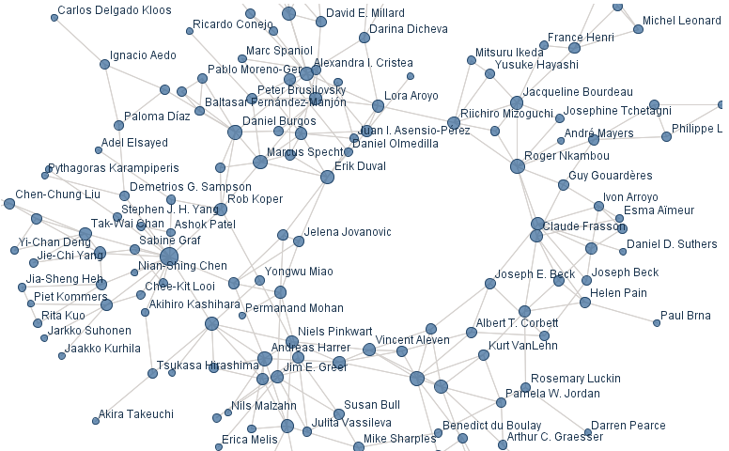
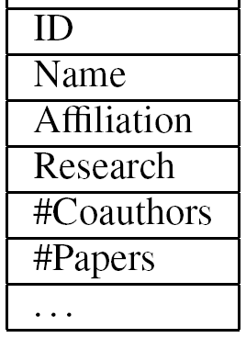
Motivation
The identification of clusters, well-connected components in a graph, which is useful in many applications from biological function prediction to social community detection
Attribute of Authors
from manyeyes.alphaworks.ibm.com
Data and Knowledge Engineering Lab
3/8
4

Slide 5
Objective
A desired clustering of attributed graph should achieve a good balance between the following:
Structural cohesiveness: Vertices within one cluster are close to each other in terms of structure, while vertices between clusters are distant from each other
Attribute homogeneity: Vertices within one cluster have similar attribute values, while vertices between clusters have quite different attribute values
Structural Cohesiveness
Attribute Homogeneity
Data and Knowledge Engineering Lab
3/8
5

Slide 6
Related Work
Structure Based Clustering
Normalized cuts [Shi and Malik, TPAMI 2000]
Modularity [Newman and Girvan, Phys. Rev. 2004]
SCAN [Xu et al., KDD'07]
The clusters generated have a rather random distribution of vertex properties within clusters
Attribute Based Clustering
K-SNAP [Tian et al., SIGMOD’08]
Attributes compatible grouping
The clusters generated have a rather loose intra-cluster structure
Is there any way to consider both factors (Structure and Attribute) simultaneously while Clustering…? YES
Data and Knowledge Engineering Lab
3/8
6
Notes:
There are mainly two approaches: structure based clustering and OLAP-style graph aggregation.
Structure based clustering includes, for example, normalized cuts by Shi and Malik, modularity by Newman and Girvan and Scan by Xu et al.. It only considers structure similarity but ignore the vertex attribute. Therefore, the clusters generated have a rather random distribution of vertex properties within clusters.
For the second approach, there is a recent study K-SNAP by Tian et al.. It follows the attributes compatible grouping. As a result, the clusters generated have a rather loose intra-cluster structure.

Slide 7
Graph Clustering with Structure & Attribute (1/11)
Structure-based Clustering
Vertices with heterogeneous values in a cluster
Attribute-based Clustering
Lose much structure information
Structural/Attribute Cluster
Vertices with homogeneous values in a cluster
Keep most structure information
Data and Knowledge Engineering Lab
3/8
7
Notes:
For the structure-based clustering, although vertices within clusters are closely connected, they could have quite attribute values.
For the attribute-based clustering, although vertices within clusters have the same attribute values, much structure information may be lost.
For the structural/attribute clustering, both vertices within clusters are homogeneous, and vertices within clusters are closely connected and the graph keeps most structure information.

Slide 8
Graph Clustering with Structure & Attribute (2/11)
Example: A Coauthor Network
Structural Clustering
Attribute-based Cluster
Structural/Attribute Cluster
Data and Knowledge Engineering Lab
3/8
8
Notes:
Let’s look at an example of a coauthor graph.
A vertex represents an author and an edge represents the coauthor relationships.
If we want to partition them into two clusters, let’s look at the results generated by different approaches.
First is the structure-based clustering. Authors within clusters are closely connected; however, they could have quite different topics, e.g., half work on XML and the other half work on Skyline in one of the clusters. This clustering result keeps the whole structure information.
The second is the attribute-based. Authors within clusters work on the same topics; however, the coauthor relationship may be lost so that authors are quite isolated in one of the clusters. The clustering makes the graph lose four edges.
The third clustering partitions the vertices in this way. As you can see, authors in each cluster are closely connected and also have the same research topic. The clustering makes the graph lose only one edge but achieves a good balance between both structural and attribute similarities. This is what we want to achieve in this work.

Slide 9
Graph Clustering with Structure & Attribute (3/11)
Proposed iDEA: Flow Diagram
G
G_{a}
Clustering on G_{a}
Clustering on G
Transform vertex attributes to attribute edges
Desired Clusters
Mapping onto the original graph
A unified distance on edges
Data and Knowledge Engineering Lab
3/8
9
Notes:
We first transform vertex attributes to attribute edges by constructing an attribute augmented graph Ga.
Then we define a unified distance measure combining both structural and attribute similarities.
Finally, we partition the graph Ga and mapping the clustering results into the oringinal graph G.

Slide 10
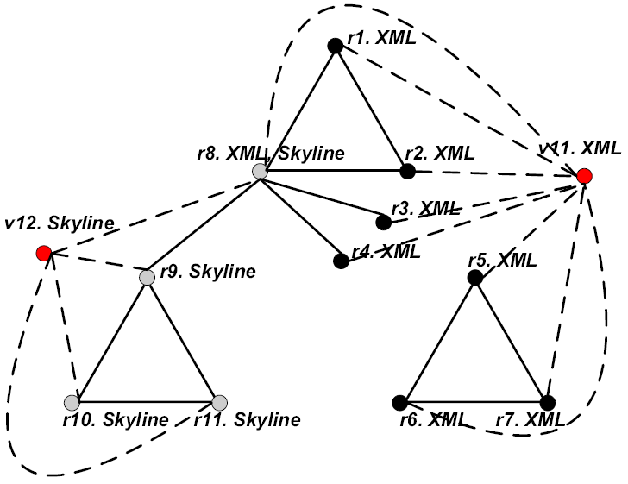
Graph Clustering with Structure & Attribute (4/11)
Attribute Augmented Coauthor Graph with Topics
Original Modified
Then we use neighborhood random walk distance on the augmented graph to combine structural and attribute similarities
Data and Knowledge Engineering Lab
3/8
10
Notes:
To combine both structural and attribute similarities, we first define the attribute augmented graph.
For example, two attribute vertices v11 and v12 representing two topics “XML” and “Skyline” are added into the attribute augmented graph. Authors with the topic “XML” are connected to v11 in dashed lines. Similarly, authors with the topic “Skyline” are connected to v12.
Then the graph has two types of edges: the coauthor edge and the attribute edge. Two authors who have the same research topic are now connected through the attribute vertex.
Then we use neighborhood random walk distance on the augmented graph to combine structural and attribute similarities.
As different attributes have different importance, we want to adjust their weights to improve the clustering quality.
Then we use weight adjustment on the augmented graph to balance structural and attribute similarities.
Although the graph is augmented, we only partition the structure vertices into clusters. Attribute vertices as attribute similarities are introduced to the graph but not real vertices.

Slide 11


Neighborhood Random Walk (1/2)
A B C
A B C
A
B
C
A
B
C
Adjacency matrix A
Transition matrix P
B
B
1
1
1
1/2
1
A
1
A
1
C
1/2
C
Data and Knowledge Engineering Lab
3/8
11

Slide 12
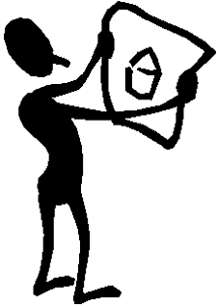


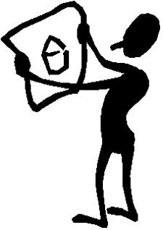
Neighborhood Random Walk (2/2)
t=0
t=1
B
1
1/2
B
A
1
1
1/2
A
1
1/2
C
1/2
C
t=2
B
1
t=3
1/2
B
A
1
1
1/2
A
1
1/2
C
1/2
C
Data and Knowledge Engineering Lab
3/8
12

Slide 13

Graph Clustering with Structure & Attribute (5/11)
The Kinds of Vertices and Edges
Two kinds of vertices
The Structure Vertex Set V
The Attribute Vertex Set V_{a}
Two kinds of edges
The structure edges E
The attribute edges E_{a}
The attribute augmented graph
Data and Knowledge Engineering Lab
3/8
13
Notes:
In the attribute augmented graph, there are two kinds of vertices: vertices and attribute vertices. Also, there are two kinds of edges: edges and attribute edges.

Slide 14
Graph Clustering with Structure & Attribute (6/11)
New Clustering Framework
Calculate the distance
Initialize the cluster centroids
K-Means
?
Assign vertices to a cluster
Update the cluster centroids
Adjust edge weights automatically
Re-calculate the distance matrix
The objective function converges
Data and Knowledge Engineering Lab
3/8
14
Notes:
This is the clustering framework.
After we construct the attribute augmented graph. We first calculate the unified random walk distance;
Then select k initial centroids with highest density values;
And then repeat the following steps until the objective function converges;
Different from the traditional k-Medoids clustering approach, there are two additional steps in the iteration: adjust edge weights automatically and Re-calculate the distance matrix.

Slide 15
Graph Clustering with Structure & Attribute (7/11)
Transition Probability Matrix on Attribute Augmented Graph
P_{V}: probabilities from structure vertices to structure vertices
A: probabilities from structure vertices to attribute vertices
B: probabilities from attribute vertices to structure vertices
O: probabilities from attributes to attributes, all entries are zero
Data and Knowledge Engineering Lab
3/8
15
Notes:
The matrix PA shows the transition probabilities for the previous example.
The submatrix PV represents the transition probabilities from one structure vertex to another through a structure edge;
The submatrix A represents the transition probabilities from one structure vertex to one attribute vertex through an attribute edge;
The submatrix B represents the transition probabilities from one attribute vertex to one structure vertex through an attribute edge.
The submatrix O represents the transition probabilities from one attribute vertex to another with all zeros.

Slide 16
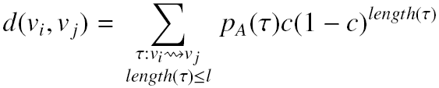
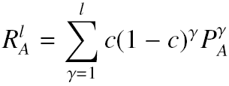

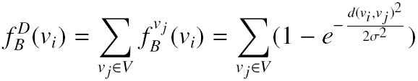
Graph Clustering with Structure & Attribute (8/11)
A Unified Distance Measure
The unified neighborhood random walk distance:
The matrix form of the neighborhood random walk distance:
Cluster Centroid Initialization
Identify good initial centroids from the density point of view [Hinneburg and Keim, AAAI 1998]
Influence function of v_{i} on v_{j}
Density function of v_{i}
Data and Knowledge Engineering Lab
3/8
16
Notes:
Based on the transition probability matrix PA, we can define the unified neighborhood random walk distance.
Given l as the length that a random walk can go, c ∈ (0, 1) as the restart probability, τ is a possible path from vi to vj.
The unified neighborhood random walk distance between two vertices is defined as this. It sums over probability of all possible paths from vi to vj.
The path uses both structure edge and attribute edge from vi to vj. So the random walk distance combines structural and attribute similarities into one measure. If two vertices share the same values on many attributes, then the unified random walk distance between them will be largely increased.
RA is the matrix form of the neighborhood random walk distance.
Good initial centroids are essential for the success of the clustering algorithms. Instead of selecting initial centroids randomly, we follow the motivation of identifying good initial centroids from the density point of view by Alexander Hinneburg and Daniel A. Keim.
The influence function of one vertex v_{i} on another v_{j} is defined as this:
The larger the random walk distance from vi to vj, the more influence vi has on vj.
The density function of one vertex vi is the sum of the influence function of vi on all vertices in V. If one vertex vi has a large density value, it means that, either vi connects to many vertices through multiple random walk paths, or vi shares attribute values with many vertices.
The goal of the clustering is to partition vertices of the original graph into clusters. Therefore, we only need to calculate the influence and the density of the structure vertices.

Slide 17


Graph Clustering with Structure & Attribute (9/11)
Clustering Process (K-means framework)
Assign each vertex v_{i} ∈ V to its closest centroid c* :
Update the centroid with the most centrally located vertex in each cluster:
Compute the “average point” v_{i} of a cluster V_{i}
Find the new centroid whose random walk distance vector is the closest to the cluster average
Data and Knowledge Engineering Lab
3/8
17
Notes:
The clustering process follows the k-medoids framework.
First, we assign each vertex vi to its closest centroid c*.
Second, we update the centroid with the most centrally located vertex in each cluster.
We first compute the “average point” in a cluster by taking the average of the random walk distance vectors. But the average point may not be a real vertex.
Therefore we find the new centroid whose random walk distance vector is the closest to the cluster average.
The clustering process iterates until convergence.

Slide 18
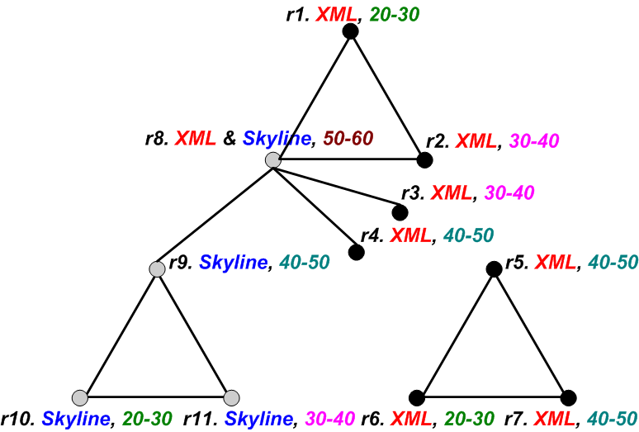
Graph Clustering with Structure & Attribute (10/11)
Edge Weight Definition
Different types of edges may have different degrees of importance
Structure edge weight fixed to 1.0 in the whole clustering process
Attribute edge weight for
All weights are initialized to 1.0, but will be automatically updated during clustering
“Topic” has a more important role than “age”
Data and Knowledge Engineering Lab
3/8
18
Notes:
Different types of edges may have different degrees of importance.
We define the structure edge weight as ω0, and it is fixed to 1.0 in the whole clustering process. Then we assign an attribute edge weight wi for an attribute ai.
All weights are initialized to 1.0, but will be automatically updated during clustering.
Given a vertex distribution of a graph, adjusting the weight of each attribute in terms of the degree of its contribution can improve the clustering quality.
This is an example of a graph with multiple attributes.
Each author has two attributes: “research topic” and “age”.
After one iteration of the clustering algorithm, the graph is partitioned into these two clusters. Many vertices share the same values on attribute “research topic” in each cluster, its weight should be increased. However, the vertices within each cluster have different values on attribute “age”, its weight should be decreased.

Slide 19

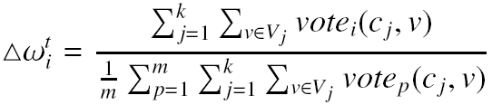
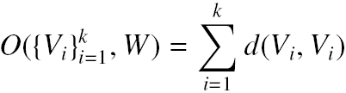
Graph Clustering with Structure & Attribute (11/11)
Weight Self-Adjustment
A vote mechanism determines whether two vertices share an attribute value:
Weight Increment:
How the weight adjustment affects clustering convergence?
Objective Function
Demonstrate that the weights are adjusted towards the direction of clustering convergence when we iteratively refine the clusters.
Data and Knowledge Engineering Lab
3/8
19
Notes:
This slide shows how to adjust the edge weight.
A vote mechanism determines whether two vertices share an attribute value. The vote is 1 if two vertices share the same attribute value on the attribute.
Δωi is estimated by counting the number of vertices which share attribute values with the centroid on attribute ai within each cluster.
If many vertices share the same value on attribute ai in each cluster, the edge weight wi should be increased. If the vertices within each cluster have different values on ai, the weight wi should be decreased. This weight adjustment equation can achieve this purpose.
As the weight adjustment step is not in the traditional k-medoids clustering framework, you may wonder how it may affect the clustering convergence. For example, will the objective function value oscillate iteration by iteration as we adjust the edge weights?
Here d(vi, vi) measures the intra-cluster distance. The objective function sums over all the k clusters.
The goal of a graph clustering is to find k partitions so that the objective function is maximized.
The similarities between two vertices on the attribute augmented graph will be changed when we adjust the attribute weights in the iteration. Will the objective function value oscillate iteration by iteration as we adjust the edge weights?
We have proved theorem on the clustering convergence.
The theorem demonstrates that the weights are adjusted towards the direction of clustering convergence when we iteratively refine the clusters.
The detail proof of this theorem is not shown here. The graph clustering problem through maximizing objective function
with constraints is a linear programming problem. We can use Lagrange Multiplier or KKT conditions to solve this kind of constrained optimization problem.
It says that given a certain partition of graph G, there exists a unique solution: attribute weights of ω1 to ωm which maximizes the objective function.

Slide 20
Experimental Evaluation (1/5)
Datasets
Political Blogs Dataset: 1490 vertices, 19090 edges, one attribute political leaning
DBLP Dataset: 5000 vertices, 16010 edges, two attributes prolific and topic
Methods
K-SNAP [Tian et al., SIGMOD'08]: attribute only
S-Cluster structure-based clustering
W-Cluster weighted function
SA-Cluster proposed method
Data and Knowledge Engineering Lab
3/8
20
Notes:
Now, we show the experimental results. We use two datasets in the experiment.
Political Blogs dataset is a network of 1490 webblogs on US politics with 19090 hyperlinks between these webblogs. Each blog in the dataset has an attribute describing its political leaning as either liberal or conservative.
For DBLP dataset, we select 5000 authors from DB, DM, ML and IR and form the coauthor graph. Each author has two relevant attributes: prolific and topic.
We compare the experimental results by four methods.
k-SNAP groups vertices with the same attribute values into one cluster.
S-Cluster only considers the structural similarity.
W-Cluster is a naïve approach. Both the weighting factors are 0.5 in the experiment.
SA-Cluster is our proposed method.

Slide 21
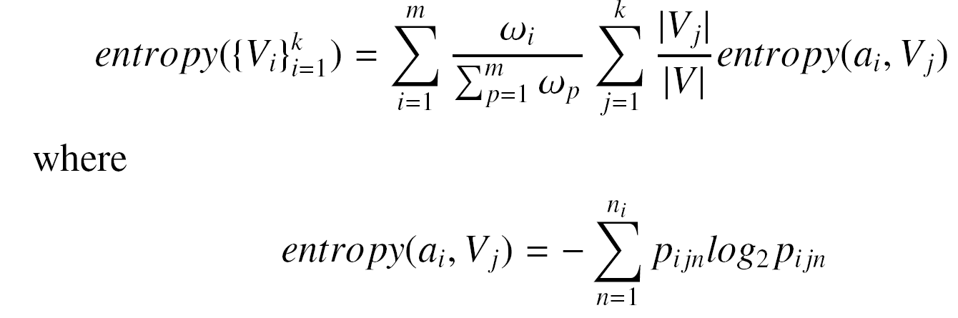
Experimental Evaluation (2/5)
Evaluation Metrics
Density: intra-cluster structural cohesiveness
Entropy: intra-cluster attribute homogeneity
Data and Knowledge Engineering Lab
3/8
21
Notes:
We mainly use two measures to evaluate the clustering quality: density and entropy. Density measures the intra-cluster structural cohesiveness. Entropy measures the intra-cluster attribute homogeneity.

Slide 22
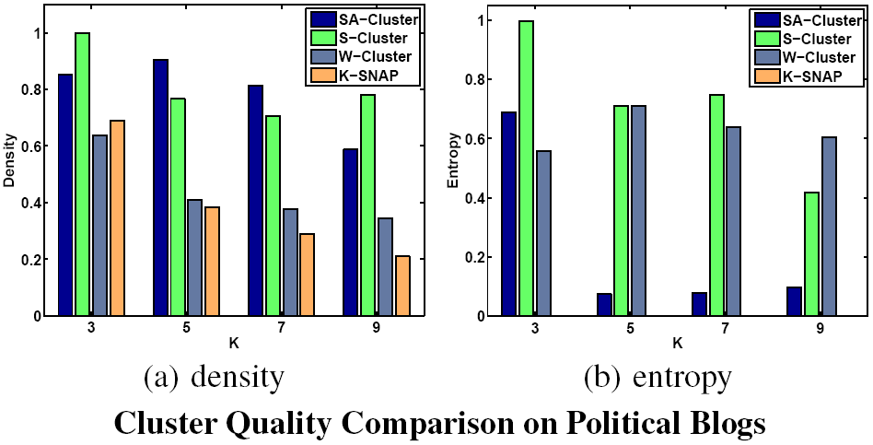
Experimental Evaluation (3/5)
Cluster Quality Evaluation
Data and Knowledge Engineering Lab
3/8
22
Notes:
The left figure shows the density comparison between the four methods on Political Blogs. The density values by SA-Cluster and S-Cluster are close. This demonstrates that both methods can find densely connected components. On the other hand, k-SNAP has a low density, and the density value decreases quickly when k increases. This is because k-SNAP partitions a graph without considering connectivity. The density by W-Cluster stands in between.
The right figure shows the entropy comparison. The entropy measure is always 0 for k-SNAP, since it partitions a graph where each partition contains nodes with the same attribute value. Besides, SA-Cluster achieves a much lower entropy than S-Cluster. The entropy by W-Cluster is similar to that of S-Cluster.

Slide 23
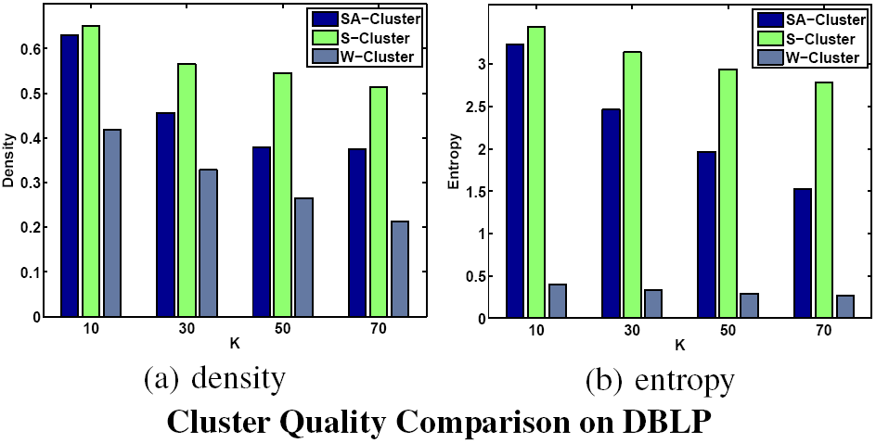
Experimental Evaluation (4/5)
Cluster Quality Evaluation
Data and Knowledge Engineering Lab
3/8
23
Notes:
Also the experiment could generate the similar results on DBLP dataset.
SA-Cluster achieves both a high density and a low entropy.
The minimum number of clusters for k-SNAP is 300. Its entropy is 0. but its density is very low. It’ is 0.1244.

Slide 24
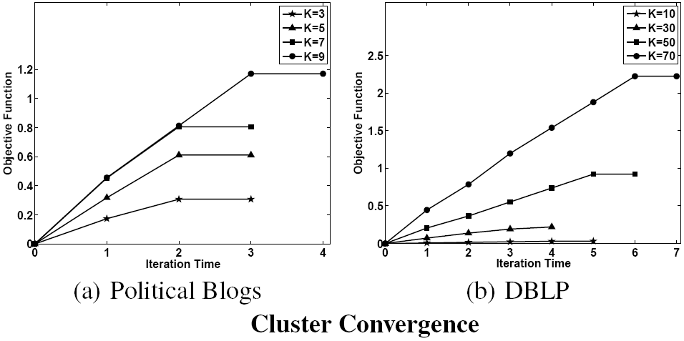
Experimental Evaluation (5/5)
Clustering Convergence
Data and Knowledge Engineering Lab
3/8
24
Notes:
These two figures show the trend of clustering convergence on Political Blogs and DBLP respectively.
Both figures show that the objective function keeps increasing and converges very quickly.

Slide 25
Conclusion
Studied the problem of clustering graph with multiple attributes on the attribute augmented graph
A unified neighborhood random walk distance measures vertex closeness on an attribute augmented graph
Theoretical analysis to quantitatively estimate the contributions of attribute similarity
Automatically adjust the degree of contributions of different attributes towards the direction of clustering convergence
Data and Knowledge Engineering Lab
3/8
25
Notes:
Finally is the conclusion of the work.
We studied the problem of clustering graph with multiple attributes on the attribute augmented graph.
We proposed a unified neighborhood random walk distance measures vertex closeness on an attribute augmented graph.
We provide theoretical analysis to quantitatively estimate the contributions of attribute similarity.
Our method automatically adjusts the degree of contributions of different attributes towards the direction of clustering convergence.

Slide 26
Critical Review
In literature, many algorithms have been proposed by various authors, however they consider structural or attribute aspect for finding similarities among nodes in the graph
In this paper, both aspects are considered simultaneously which reflect the true nature of the cluster or similarity among different objects
It utilizes the concept of Random Walk on the graph which requires matrix manipulation (i.e. multiplication) so it become unrealistic for huge dataset
Due to iterative calculation of the similarity , it can not be scalable to huge network (graph dataset)
Data and Knowledge Engineering Lab
3/8
26

Slide 27
Feasible Improvements
Iterative nature of the similarity calculation should be avoided by incorporating other feasible methods for relevancy check
It can be scalable to the network where the nodes are not densely connected with each other. In this way, they have less degree and similarity calculation can be done easily
Augmentation process can be remodeled/avoided to reduce the space complexity and time consumption
Data and Knowledge Engineering Lab
3/8
27

Slide 28

Questions
Suggestions…!
Data and Knowledge Engineering Lab
3/8
28

