Slide 1
Understanding Car Fuel Efficiency
A Data-Driven Analysis Using the mtcars Dataset Mandip Chaudhary (17)

Slide 2
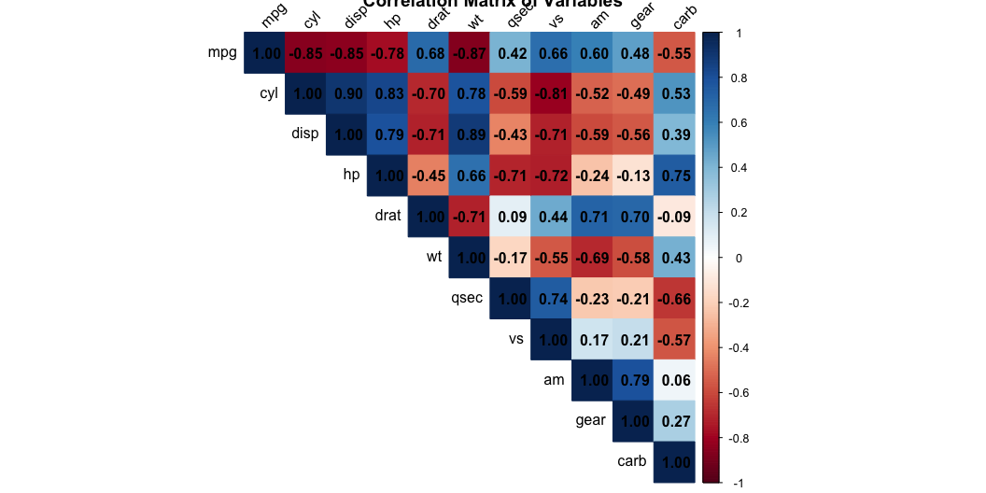
Understanding Our Data
About the Car Dataset
What We’re Working With: - 32 different car models from 1973-74 - Focus: How car features affect fuel efficiency - Goal: Predict miles per gallon (MPG)
Key Car Features: - Engine Stats: * Number of cylinders (4, 6, or 8) * Engine size (displacement) * Horsepower - Physical Features: * Car weight (in 1000 lbs) * Transmission type (Auto/Manual)

Slide 3
Data Preparation: Training vs Testing Split
Robust Split Methodology
library(datasets) library(glmnet) set.seed(17) # Data preparation train_index <- sample(2, nrow(mtcars), replace = T, prob = c(0.7, 0.3)) train_data <- mtcars[train_index==1, ] test_data <- mtcars[train_index==2, ] # Ensure train_data is properly defined in global environment assign("train_data", train_data, envir = .GlobalEnv) assign("test_data", test_data, envir = .GlobalEnv) # Prepare LASSO matrices once predictors <- setdiff(names(train_data), "mpg") x_train <- as.matrix(train_data[, predictors]) y_train <- train_data$mpg # Define these in global environment for later use assign("x_train", x_train, envir = .GlobalEnv) assign("y_train", y_train, envir = .GlobalEnv)
Training Dataset (70%) - Size: 20 observations - Purpose: Model building and parameter estimation - Used for: Initial modeling, BLUE analysis, VIF calculations
Testing Dataset (30%) - Size: 12 observations - Purpose: Unbiased performance evaluation - Used for: Model validation, prediction accuracy
Data Characteristics:
Training Set MPG Statistics: - Mean: 21.97 - Median: 20.35 - Range: 14.3 - 33.9

Slide 4
Simple Linear Regression Analysis
Individual Variable Performance
Top Performing Variables (R² values):
cyl: 73.2% (p = 0.0000014968) wt: 73.2% (p = 0.0000015375) disp: 67.9% (p = 0.0000080226) hp: 56.8% (p = 0.0001238260)

Slide 5
BLUE Test Results
Variable | R² > 0.5 | ANOVA sig. | Intercept sig. | Coef sig. | BLUE
cyl | Yes (0.73) | Yes (<0.001) | Yes (<0.001) | Yes (<0.001) | Yes
wt | Yes (0.73) | Yes (<0.001) | Yes (<0.001) | Yes (<0.001) | Yes
disp | Yes (0.68) | Yes (<0.001) | Yes (<0.001) | Yes (<0.001) | Yes
hp | Yes (0.57) | Yes (<0.001) | Yes (<0.001) | Yes (<0.001) | Yes
drat | Yes (0.53) | Yes (<0.001) | No (0.249) | Yes (<0.001) | No
qsec | No (0.23) | Yes (0.031) | No (0.424) | Yes (0.031) | No
vs | No (0.36) | Yes (0.005) | Yes (<0.001) | Yes (0.005) | No
am | No (0.41) | Yes (0.002) | Yes (<0.001) | Yes (0.002) | No
gear | No (0.19) | No (0.052) | No (0.341) | No (0.052) | No
carb | No (0.34) | Yes (0.007) | Yes (<0.001) | Yes (0.007) | No
Model Assessment Summary

Slide 6
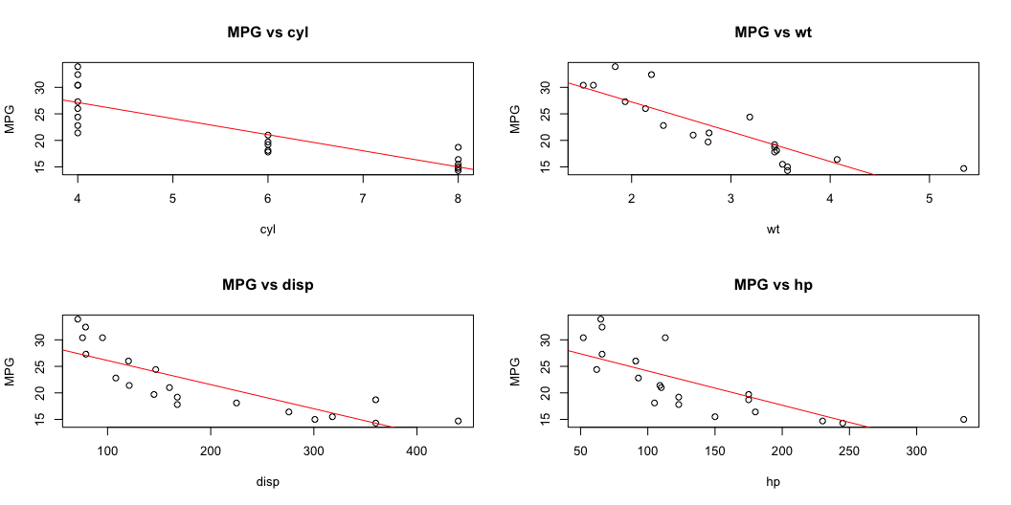
BLUE Requirements: - R² > 0.5 indicates good model fit - All significance tests must have p < 0.05 - Model must pass all criteria to be BLUE
Variable Relationships:

Slide 7
Most Important Car Features
Key Findings from Analysis
Top 4 Most Influential Features:
Number of Cylinders (cyl) (R² = 73.24%)
Explains 73% of MPG variation.
Very strong relationship with fuel efficiency.
Car Weight (wt) (R² = 73.16%)
Almost equally important as cylinders.
Heavier cars use more fuel.
Engine Size (disp) (R² = 67.87%)
Larger engines typically use more fuel.
Strong predictor of MPG.
Horsepower (hp) (R² = 56.83%)
More power means more fuel consumption.
Moderate to strong relationship.
Why These Matter: - All have strong statistical evidence (p < 0.05). - Each explains more than 50% of MPG variation. - Show clear relationships with fuel efficiency.

Slide 8
Combining Car Features
Building a Better Model
Initial Approach: - Combined all important features together - Found some features were too closely related - Needed to simplify the model
Problem Found: - Engine size (disp) overlapped with other features - VIF Analysis showed redundant information: * Engine size VIF > 10 (too high) * Other features had acceptable VIF values
Final Model: - Kept three key features: 1. Car Weight (wt) 2. Horsepower (hp) 3. Transmission Type (am) - Removed redundant engine size measure. - Maintained prediction accuracy.

Slide 9
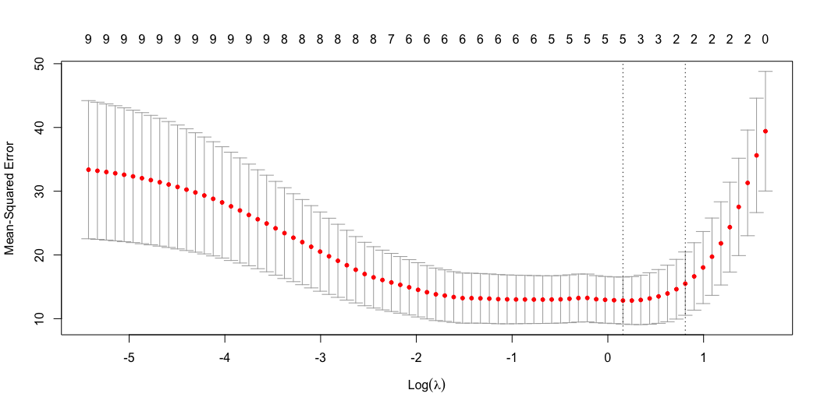
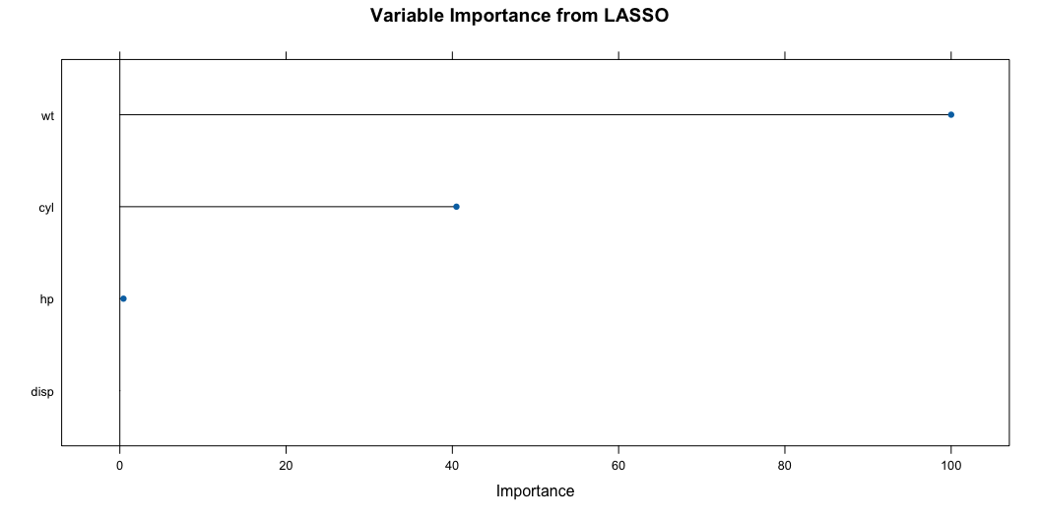
LASSO Model Results
This plot shows how the model’s error changes as LASSO adjusts its “strictness” (lambda). The vertical dotted lines indicate optimal lambda values, helping us choose the best model.
Visualizing LASSO: Which Features Matter Most?
This chart shows the “MVPs” (Most Valuable Predictors) selected by LASSO. Bigger values (further from zero) mean more impact on fuel efficiency.
Smart Feature Selection
What LASSO Does: - Automatically picks the most important car features - Removes less important features - Helps avoid overcomplicating the model
Key Results:
Most Important Features Selected:
Car Weight (wt)
Horsepower (hp)
Transmission Type (Manual/Auto)
Model Performance:
Training RMSE: Shows typical prediction error
Testing RMSE: Confirms model reliability
Similar performance to standard regression
Why This Matters: - Confirms our earlier findings. - Simpler model, similar accuracy. - More reliable predictions.
Visualizing LASSO: Finding the Best Balance
LASSO Cross-Validation: This chart helps LASSO find the best balance. It’s like tuning a radio to get the clearest signal – we’re finding the ‘sweet spot’ for our model. The dotted line shows the best point.
LASSO Coefficient Path: Imagine LASSO as a manager deciding which players (features) are most valuable. This plot shows how, as LASSO gets stricter, it keeps only the star players and lets others go. Lines that stay high are important; lines that drop to zero are removed.

Slide 10
Model Performance Comparison
Comprehensive Metrics Analysis
RMSE MAE R2 Multiple Regression 2.663 2.214 0.807 LASSO Regression 2.369 1.882 0.847

Slide 11
Predicting Fuel Efficiency
Example: 6000 lbs Car
Prediction: - For a 6000 lbs car, predicted MPG is 13.41 - 95% sure it’s between 0.93 and 25.88 MPG
Important Note: - This is an estimate for a very heavy car - Our data doesn’t include cars this heavy - Predictions outside data range are less reliable

Slide 12
Key Takeaways & Next Steps
Main Findings:
Car Weight, Horsepower, and Transmission are key for MPG
LASSO helps simplify models without losing accuracy
Predictions are useful but have limits
Recommendations:
Use modern car data for better insights
Explore more advanced modeling techniques
Always be cautious with predictions outside data range

Slide 13
Questions?
Thank you for your attention!

