Slide 1
Decision Tree and Random Forest Models Comparison
Roll Number: 17

Slide 2
Overview
Data Generation and Preparation
Model Fitting and Evaluation
Model Comparison
Conclusions

Slide 3
Data Generation
Required Packages
Data Generation Code

Slide 4
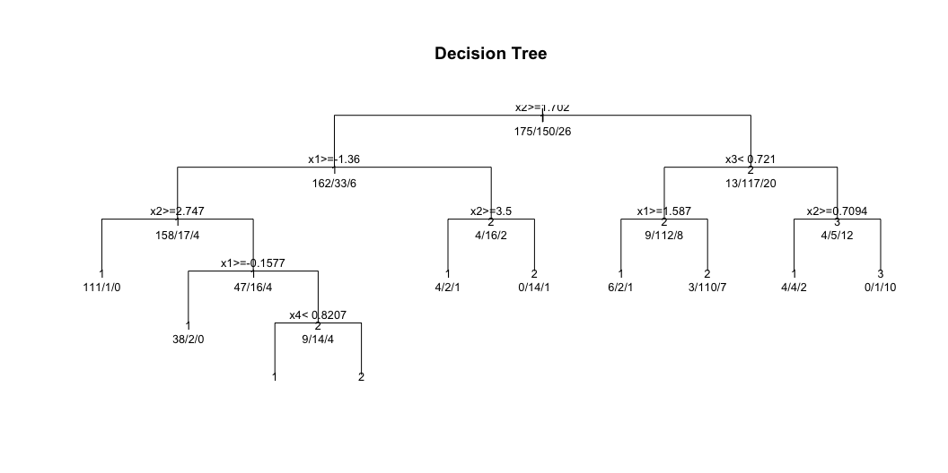
Model Fitting
Decision Tree Model

Slide 5
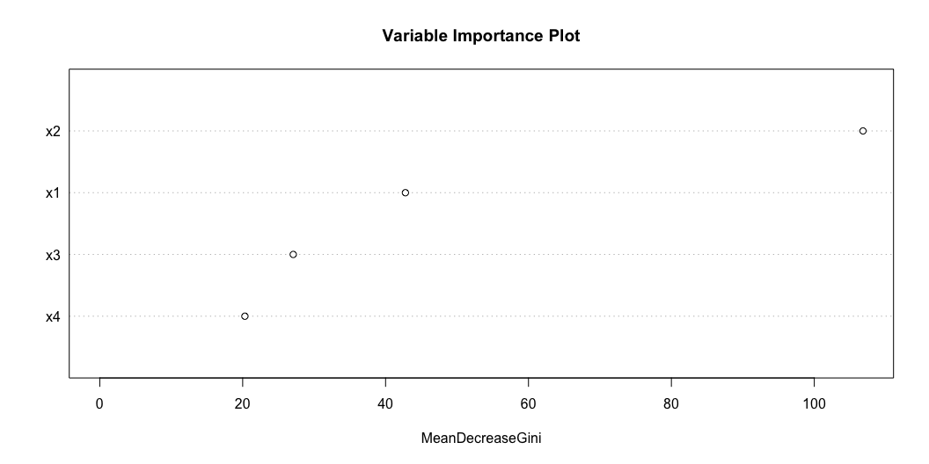
Interpretation: Decision Tree Plot
The plot above visualizes the structure of the fitted decision tree.
Each node shows a split based on a predictor variable (e.g., x1, x2, x3, x4).
The numbers at each node represent the number of observations for each class after the split.
The tree helps us understand the sequence of decisions used to classify the data.
Shallower splits (closer to the root) indicate more important variables for the initial classification.
This plot is useful for model interpretability and understanding how predictions are made.
Random Forest Model

Slide 6
Interpretation: Variable Importance Plot
The plot above shows the importance of each predictor variable in the random forest model.
The x-axis (MeanDecreaseGini) measures how much each variable contributes to reducing impurity in the forest.
Variables with higher values (e.g., x2) are more important for accurate classification.
This plot helps identify which features are most influential in the model’s predictions.
In this example, x2 is the most important variable, followed by x1, x3, and x4.
## Model Evaluation ### Confusion Matrices ::: {.cell} ::: {.cell-output .cell-output-stdout}
[1] “Decision Tree Confusion Matrix:”
::: ::: {.cell-output .cell-output-stdout}
Reference
Prediction 1 2 3 1 77 9 3 2 4 49 4 3 1 2 0
::: ::: {.cell-output .cell-output-stdout}
[1] “Forest Confusion Matrix:”
::: ::: {.cell-output .cell-output-stdout}
Reference
Prediction 1 2 3 1 77 5 0 2 5 52 6 3 0 3 1 ```
::: :::

Slide 7
Model Comparison
Model | Accuracy | Kappa
Decision Tree | 0.8456 | 0.7010
Random Forest | 0.8725 | 0.7574
Performance Metrics

Slide 8
Key Findings
Accuracy Comparison:
Decision Tree: 84.56%
Random Forest: 87.25%
Kappa Statistics:
Decision Tree: 0.7010
Random Forest: 0.7574

Slide 9
Model Selection
Decision Tree Advantages
Simpler, more interpretable model
Clear decision rules
Lower computational cost
Random Forest Advantages
Higher accuracy (87.25% vs 84.56%)
Better Kappa statistic (0.7574 vs 0.7010)
More robust predictions
Built-in feature importance

Slide 10
Conclusion
Random Forest performs better in terms of both accuracy and Kappa statistic
The improvement in accuracy (2.69%) and Kappa (0.0564) suggests Random Forest is the better choice
Variable importance plot shows which predictors are most influential
Consider using Random Forest when prediction accuracy is the primary goal

Slide 11
Thank You!
Questions?

