Slide 1
Supervised Learning with mtcars Dataset
A Comprehensive Analysis of Car Fuel Efficiency Prediction Mandip Chaudhary (17)

Slide 2
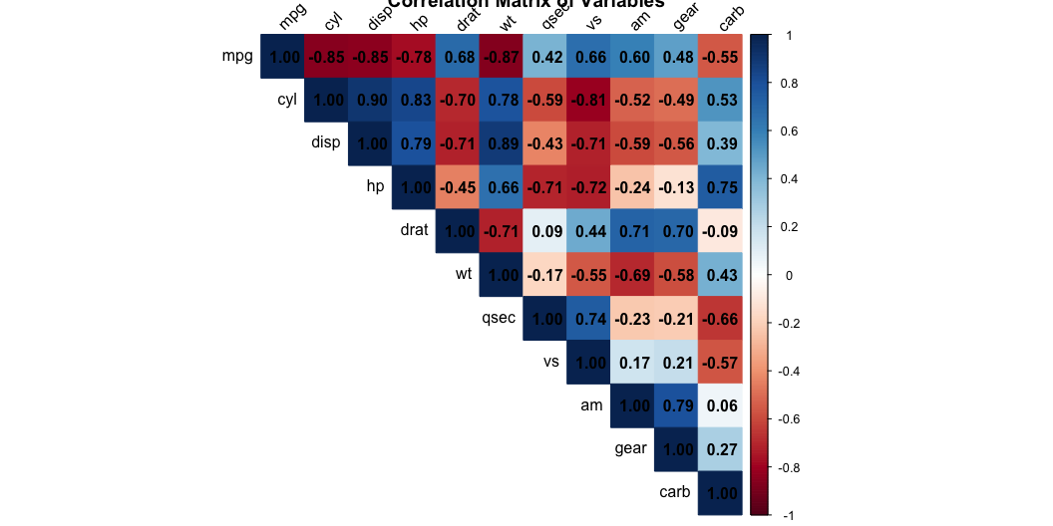
Dataset Overview
Motor Trend Car Road Tests (1974)
Dataset Characteristics: - 32 automobiles (1973-74 models) - 11 key variables measuring various aspects - Focus: Understanding fuel efficiency (MPG)
Variables in Detail: - MPG (Dependent): Miles per gallon - CYL: Number of cylinders (4, 6, 8) - DISP: Engine displacement (cu.in.) - HP: Gross horsepower - DRAT: Rear axle ratio - WT: Weight (1000 lbs) - QSEC: 1/4 mile time - VS: Engine type (V/Straight) - AM: Transmission type (Auto/Manual) - GEAR: Number of forward gears - CARB: Number of carburetors

Slide 3
Data Preparation: Training vs Testing Split
Robust Split Methodology
library(datasets) set.seed(17) train_index <- sample(2, nrow(mtcars), replace = T, prob = c(0.7, 0.3)) train_data <- mtcars[train_index==1, ] test_data <- mtcars[train_index==2, ]
Training Dataset (70%) - Size: 20 observations - Purpose: Model building and parameter estimation - Used for: Initial modeling, BLUE analysis, VIF calculations
Testing Dataset (30%) - Size: 12 observations - Purpose: Unbiased performance evaluation - Used for: Model validation, prediction accuracy
Data Characteristics:
Training Set MPG Statistics: - Mean: 21.97 - Median: 20.35 - Range: 14.3 - 33.9

Slide 4
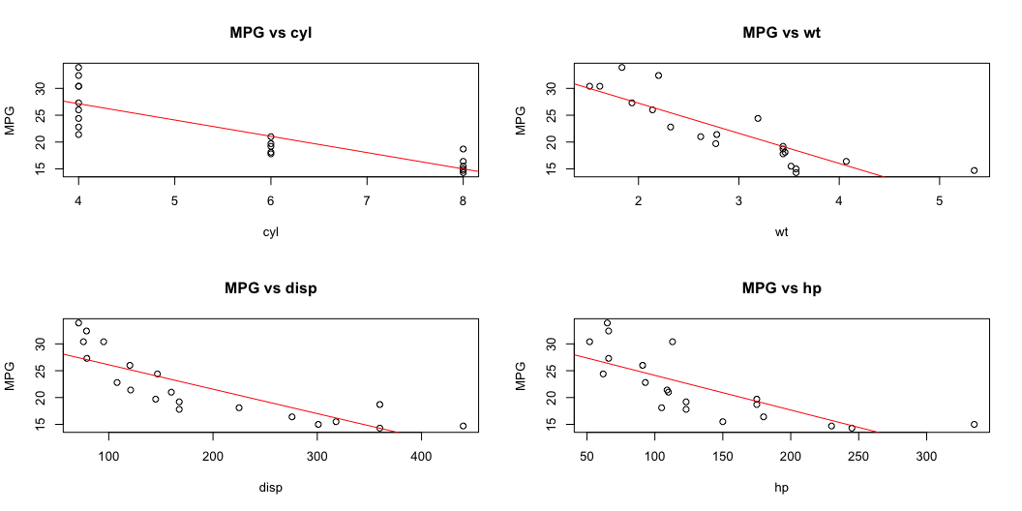
Simple Linear Regression Analysis
Individual Variable Performance
Top Performing Variables (R² values):
cyl: 73.2% (p = 0.0000014968) wt: 73.2% (p = 0.0000015375) disp: 67.9% (p = 0.0000080226) hp: 56.8% (p = 0.0001238260)
Variable Relationships:

Slide 5
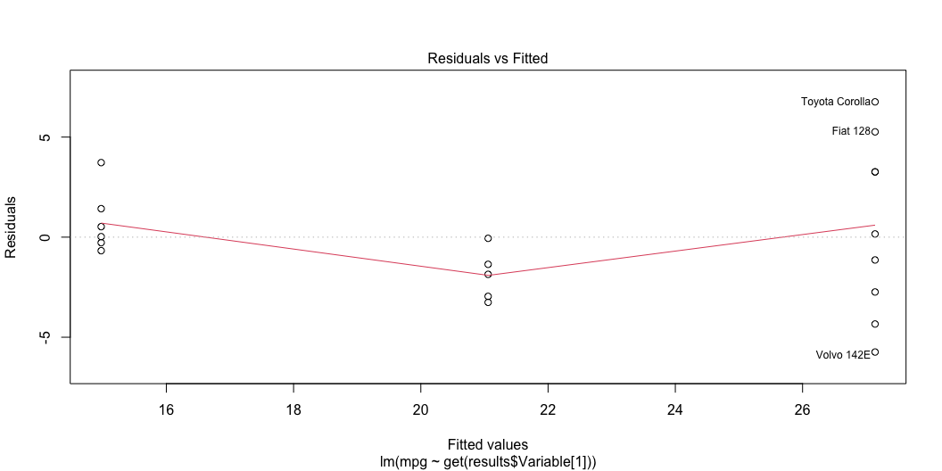
BLUE Analysis - Part 1
Gauss-Markov Assumptions Check
1. Linearity Assessment: - Scatterplots reveal non-linear patterns - Residual plots show systematic curvature - Evidence of non-linear relationships with MPG
2. Independence Verification: - Data points from different manufacturers - No obvious temporal dependencies - Assumed independent observations

Slide 6
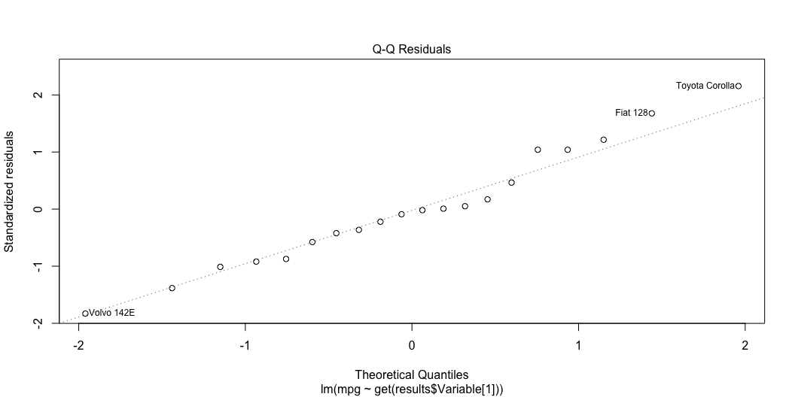

Slide 7
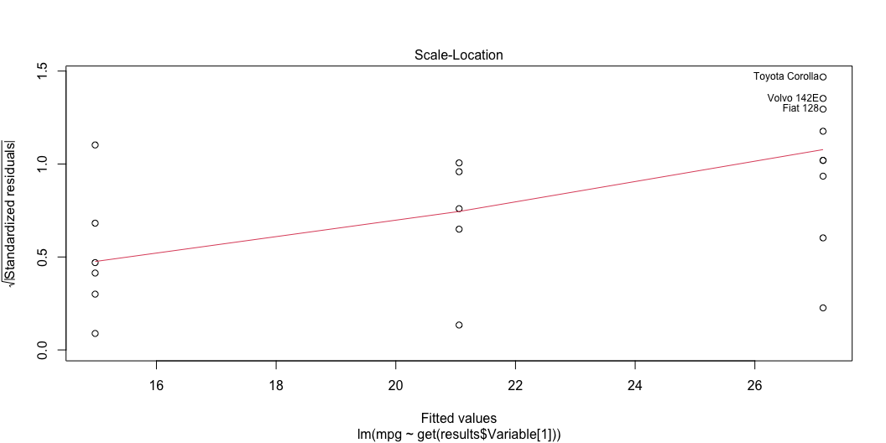

Slide 8
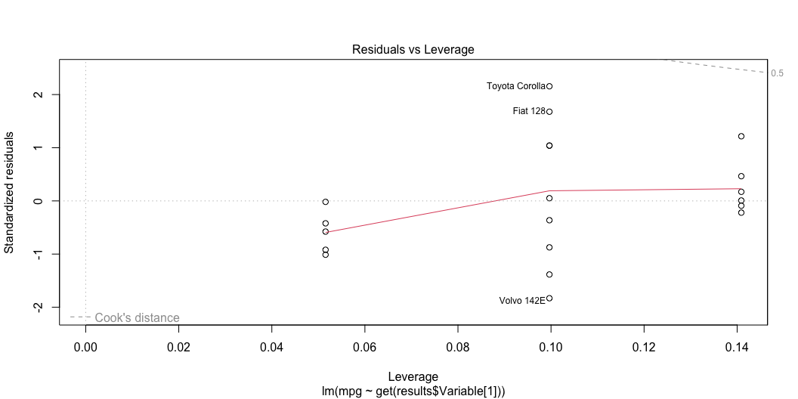

Slide 9
BLUE Analysis - Part 2
Detailed Residual Analysis
3. Homoscedasticity Check: - Varying spread in residuals - Evidence of heteroscedasticity - Scale-Location plots show patterns
4. Error Distribution: - Q-Q plots show deviations - Non-normal residuals in most models - Affects inference reliability
Statistical Evidence:
Breusch-Pagan Test (Homoscedasticity):
p-value: 0.0397
Shapiro-Wilk Test (Normality):
p-value: 0.8736

Slide 10
Multiple Regression Development
Building the Comprehensive Model
1. Variable Selection Process: - Started with significant predictors (p < 0.05):
cyl, wt, disp, hp, drat, am, vs, carb, qsec
2. Initial Multiple Regression:
R-squared: 0.875
Adjusted R-squared: 0.7625
F-statistic: 7.78 on 9 and 10 DF

Slide 11
Multicollinearity Analysis
VIF Assessment and Model Refinement
Initial VIF Values:
cyl wt disp hp drat am vs carb qsec 15.46 14.30 30.66 21.52 4.06 7.05 9.40 11.71 14.52
Variable Elimination Process: 1. Remove highest VIF variable iteratively 2. Recalculate VIF after each removal 3. Continue until all VIF < 10
Final Model Variables:
wt, hp, am

Slide 12
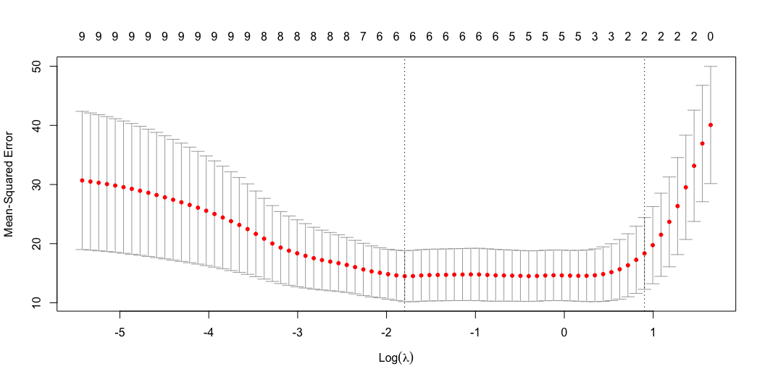
LASSO Regression Analysis
Advanced Variable Selection
LASSO Implementation: 1. Cross-validation for lambda selection 2. Automatic variable selection 3. Coefficient shrinkage effect

Slide 13
Selected Variables and Coefficients:
11 x 1 sparse Matrix of class "dgCMatrix" s1 (Intercept) 6.9840848 cyl . disp . hp . drat 2.1555483 wt -2.8676564 qsec 0.7922317 vs . am 1.3174736 gear 0.6218162 carb -0.6589320

Slide 14
Model Performance Comparison
Comprehensive Metrics Analysis
RMSE MAE R2 Multiple Regression 2.663 2.214 0.807 LASSO Regression 2.284 1.823 0.858

Slide 15
Prediction Analysis
6000 lbs Car Case Study
Prediction Setup: - Weight: 6000 lbs (wt = 6) - Other variables: Set to means
Multiple Regression Prediction:
Predicted MPG: 13.41
95% Prediction Interval: (0.93, 25.88)
Caution: This is an extrapolation! - Training data weight range: 1.51, 5.34 - Prediction reliability decreases

Slide 16
Comprehensive Recommendations
Data Science Approach
1. Data Quality Improvements: - Collect modern car data - Include hybrid/electric vehicles - Expand feature set (aerodynamics, tech)
2. Modeling Enhancements: - Consider non-linear relationships - Explore interaction terms - Implement robust regression
3. Practical Implementation: - Regular model updates - Confidence interval reporting - Extrapolation warnings
4. Future Considerations: - Alternative algorithms (RF, GBM) - Cross-validation strategies - Feature engineering

Slide 17
Questions?
Thank you for your attention!

