Slide 1
Kepler’s Sieve
Learning Asteroid Orbits
from Telescopic Observations
Masters of Data Science Thesis
Michael S. Emanuel

Slide 2
Acknowledgments
Advisor: Pavlos Protopapas
Secondary Advisor: Chris Rycroft

Slide 3
Introduction

Slide 4


The Asteroid Search Problem
Many asteroids (about 958,000 known) in the Solar System
We want to learn their orbits
Biggest data source: telescope detections
Easy once you know which detection matches which asteroid
This is like a jigsaw puzzle with millions of pieces!
This puzzle is too hard even with the COVID-19 Lockdown

Slide 5
Combining Tracklets vs. Orbital Element Search
“Tracklet”: two detections close to each other in time and direction
Existing search methods: greedy search over tracklets
Try to extrapolate a tracklet to find additional detections
Attempt to fit an orbit when you have enough tracklets
Drawbacks
Myopic – can only connect detections made close in time
Suffers from combinatorial explosion
Proposed novel method: search Orbital Elements
6D space; large, but scales well
Cost scales as
But can we make it work?

Slide 6
Search Overview
Initialize candidate orbital elements a, e, i, Ω, ω, f
Mixture parameters: N_{h}, R, τ
Compute position q and velocity v from candidate elements
Compute direction u_{pred} from q, v; include light time and topos
Compute distance s from u_{pred} to u_{obs} for ZTF observations
Compute log likelihood ℒ_{i} for each candidate element
Gradient descent…
The rest is details! Which you will now hear all about…

Slide 7
Integrating the Solar System

Slide 8
REBOUND Integrator for N-Body Problem
REBOUND is a modern, open source integrator
github.com/hannorein/rebound
It numerically solves the gravitational N-body problem
Considered the “gold standard” for orbits in this thesis
IAS15 adaptive integrator uses Gauss-Radau quadrature and a “predictor-corrector” scheme
Horizons: API provided by NASA JPL to obtain state vectors (position and velocity) of objects in the Solar System

Slide 9
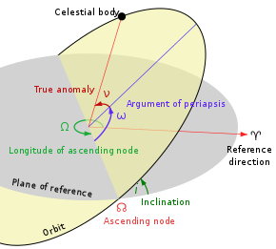
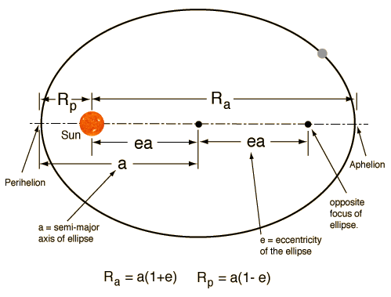
Keplerian Orbital Elements
Image Credits: WikiPedia, Cool Cosmos
Semi-major axis a and eccentricity e describe the size and shape of the orbital ellipse
Inclination i, ascending node Ω, perihelion ω are angles orienting orbit in the ecliptic plane
True anomaly f is location of the body on its orbital ellipse

Slide 10
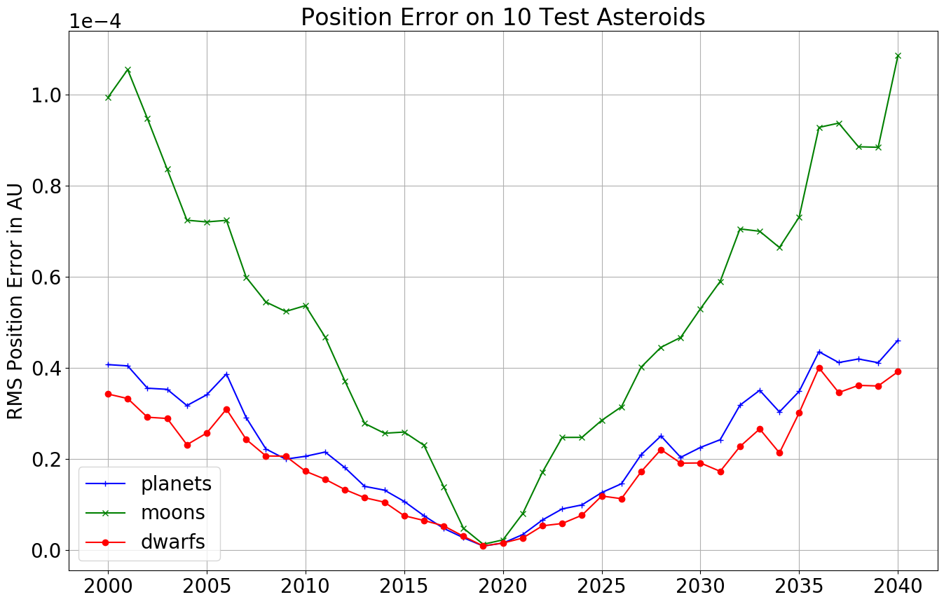
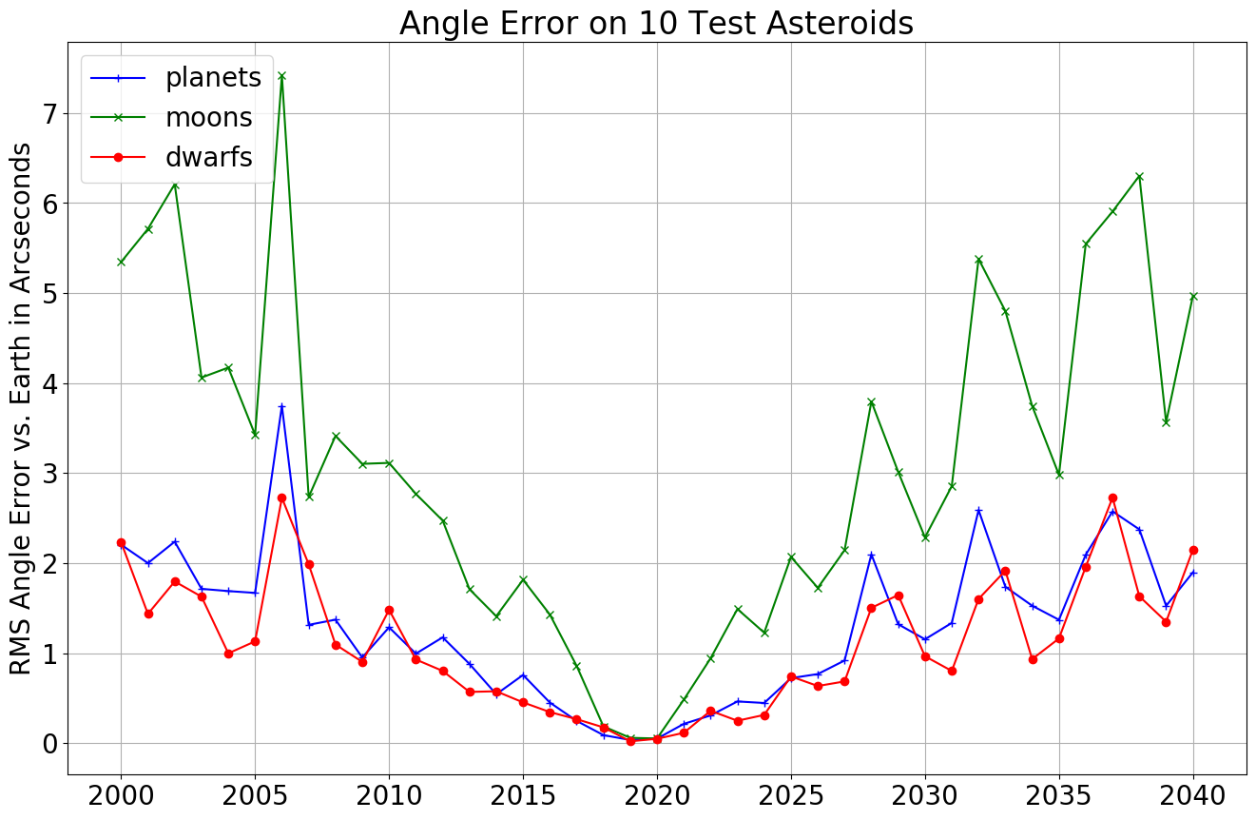
Validating Integration vs. Horizons
Integrate three collections of massive bodies for 40 years at daily interval
Initial conditions from Horizons at MJD 58600 / 2019-04-27
Test results on first 10 IAU asteroids; query their positions from Horizons
Report error in position (AU) and instantaneous angle from asteroid to Earth (arc seconds)
Accuracy is excellent!
RMS error on planets is 5.4E-6 AU
Angle error from asteroids to planets 0.8 arc seconds

Slide 11
Bulk Integration of 733,489 Asteroids
Download asteroid orbital elements from JPL
Data available for 733,489
Integrate these daily for 40 years
Save results to disk
REBOUND simulation archives
Numpy arrays
Job takes 4:30 on 40 CPU cores
Writes 1.37 TB output to disk

Slide 12
Validate Asteroid Integration vs. Horizons
Test bulk asteroid integration on first 25 IAU asteroids
Report position error in AU and angle error to Earth in arc seconds
Excellent results! RMS 2.49E-6 AU and 0.45 arc seconds

Slide 13
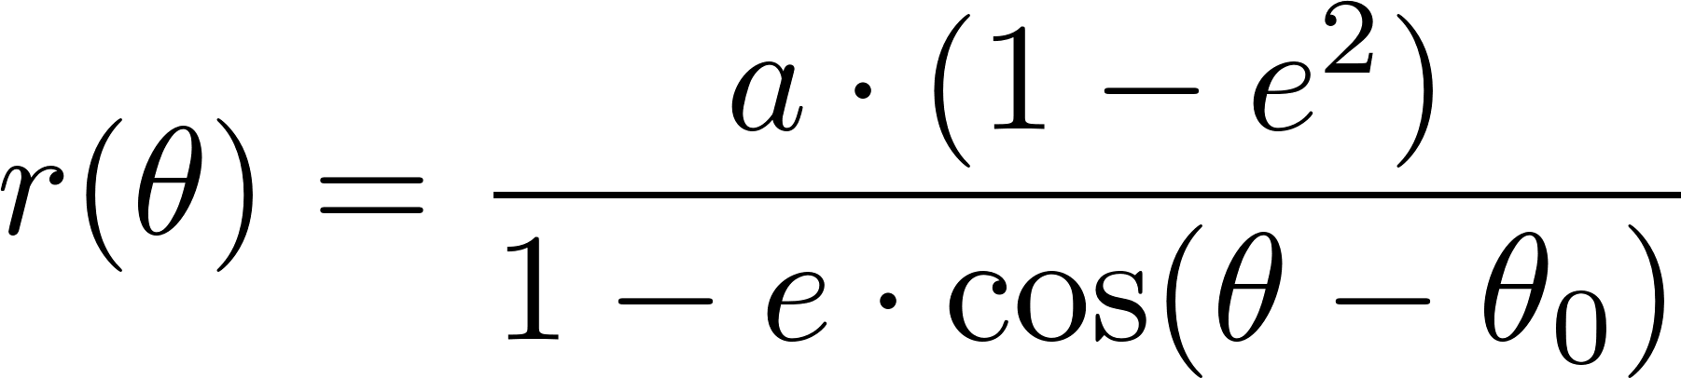
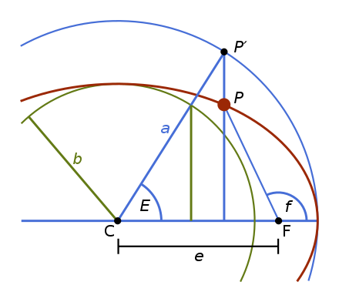
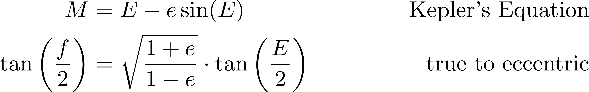
Integrate Kepler Two Body Problem in TensorFlow
Analytical solution to Kepler problem is an ellipse
5 of the 6 orbital elements a, e, i, Ω, ω constant
The Mean Anomaly M is linear in time (2nd Law)
Kepler’s Equation relates orbital anomalies:
Convert M to E to f, then to Cartesian coordinates
TensorFlow is fast! 5000 time points in ~300 μ sec
Apply calibration dq, dv to match REBOUND integration at input orbital elements

Slide 14
Predicting Directions from Positions

Slide 15
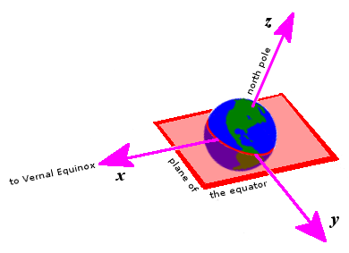
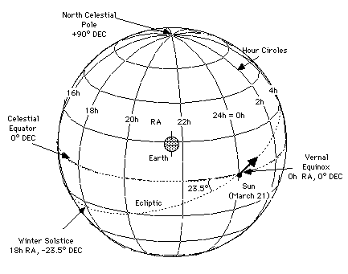
Right Ascension and Declination
Fundamental plane is aligned with Earth’s equator
Intuitive, dates to ancient astronomers
Two problems: precession (drift) and nutation (wobbles) in direction of North Pole

Slide 16
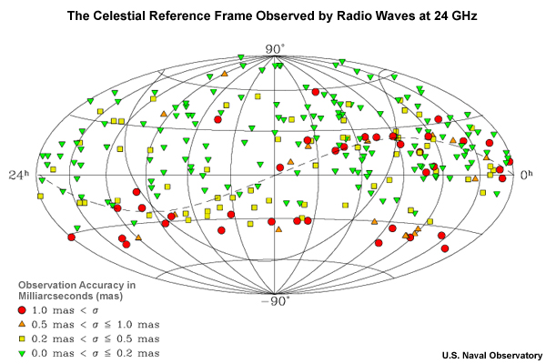
International Celestial Reference Frame (ICRF)
Modern system for RA/Dec
Based on 232 extragalactic objects
Addresses precession and nutation
Quasars don’t move!
Not in direction anyway
Amazingly accurate
~2 milliarc-seconds
Intuition: like using Polaris instead of Earth’s axis for the North Pole
Except you use 232 stars to get a highly accurate composite direction

Slide 17
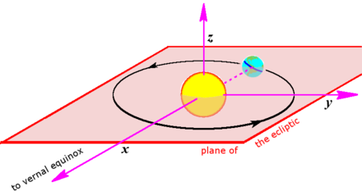
From RA/Dec to Barycentric Mean Ecliptic
RA/Dec is ideal for observing the stars
But not for calculations involving orbits in the Solar System
Inside the Solar System we want an inertial frame aligned with the ecliptic: BME
Convert between ICRF and BME using astropy library
obs_icrs = astropy.SkyCoord(ra=ra, dec=dec, obstime=obstime, frame=ICRS)
obs_ecl = obs_icrs.transform_to(BarycentricMeanEcliptic)

Slide 18
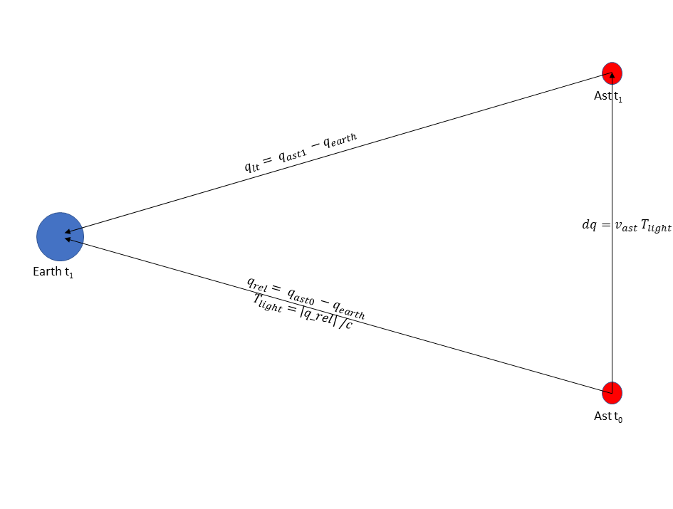
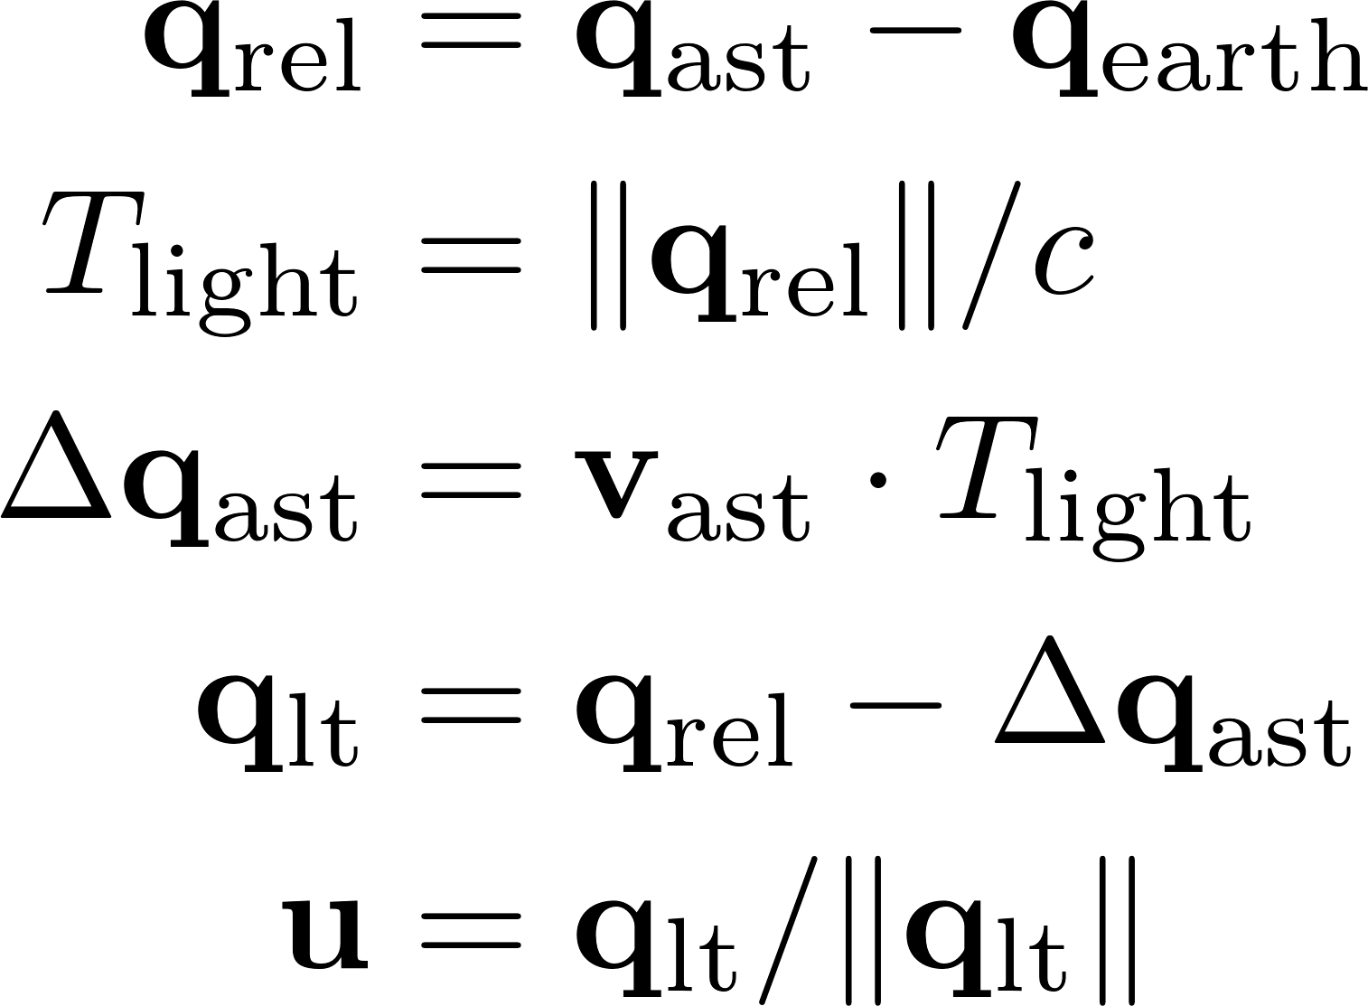
Calculate Direction from Position and Velocity
Need to remember light speed c is finite!
Otherwise wrong by ~285 arc seconds
Earth velocity doesn’t matter, only asteroid velocity
BME is an inertial frame
Also need “topos adjustment” for observatory: Palomar Mountain, not geocenter!
Topos adjustment worth 0-5 arc seconds on first 16 asteroids

Slide 19
Validating Astrometric Direction
Check these results by comparing vs. JPL, SkyField
Downloaded Mars at 3 hour intervals over 10 years (~29000 rows)
Both state vectors q, v and observer RA / Dec
Computed astrometric directions from Earth to Mars
MSE and SkyField identical: 0.027 arc seconds
Both MSE and SkyField differ from JPL by 1.6 arc seconds
Separately downloaded JPL RA/Dec on first 16 asteroids
Compared to MSE direction calculated from integrated orbits
RMS error: 0.873 arc seconds!

Slide 20
Analysis of ZTF Asteroid Detections

Slide 21
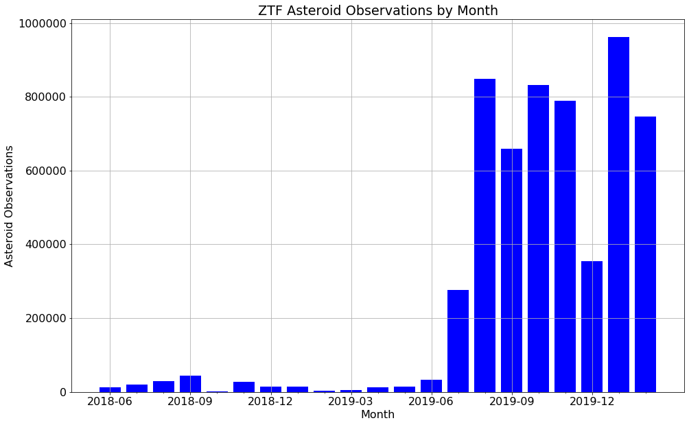
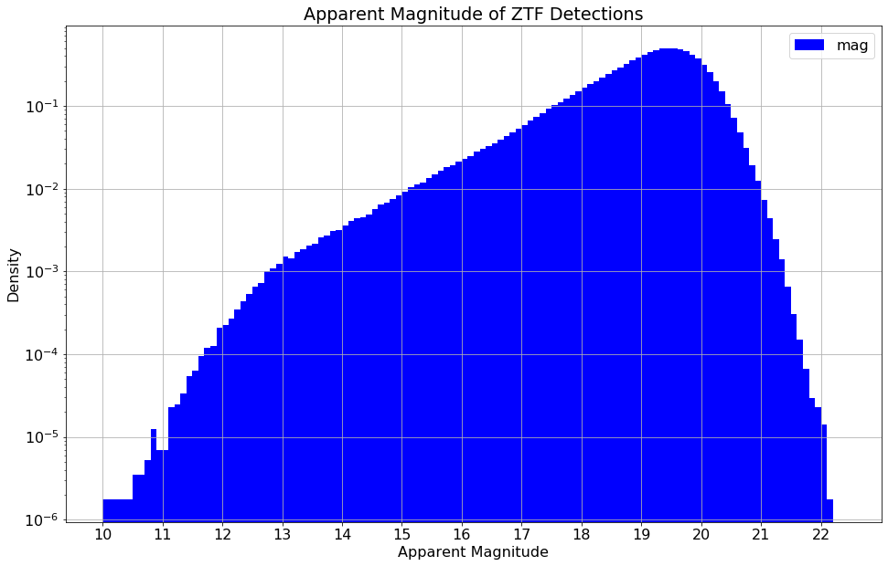
EDA of ZTF Detections
ZTF: Zwicky Transient Facility; survey of northern sky at Palomar Mountain by Cal Tech
Fast, deep survey: 3750 square degrees / hour to depth of 20.5 mag
First light in 2017, but asteroid detections ramp up in July 2019; 7 months of data
Enriched with machine learning pipeline that filters probable asteroid detections
5.69 million possible asteroid detections
Data includes: MJD, RA, DEC, MAG

Slide 22
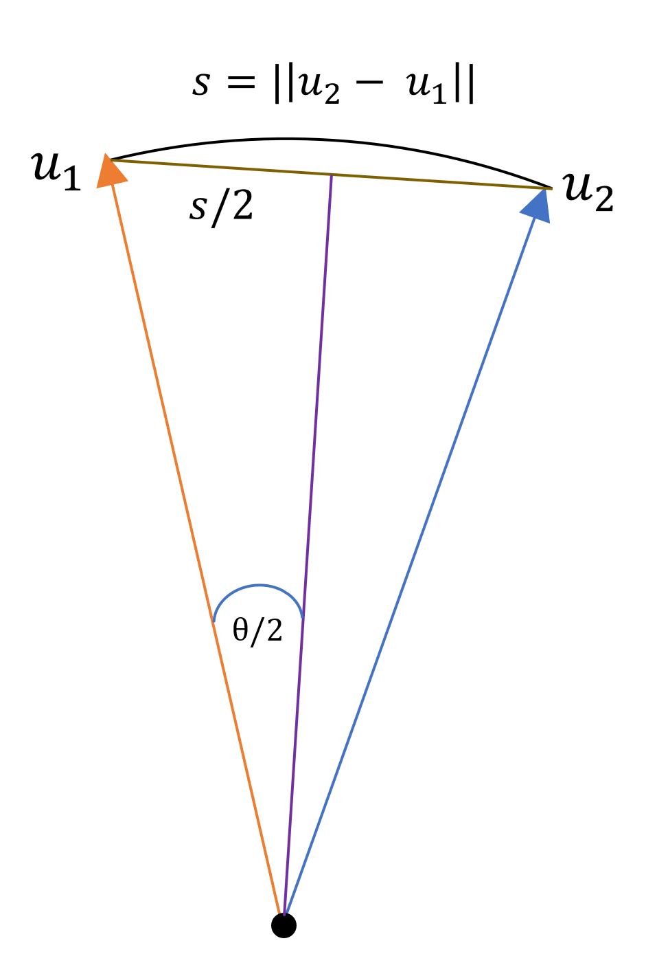
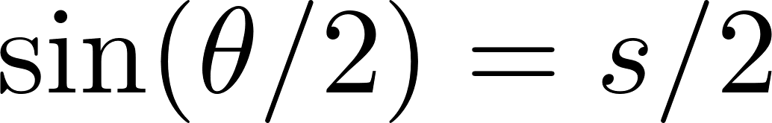
Converting Cartesian to Angular Distance
How far apart are two directions in the sky?
Convert RA/Dec to directions u₁ and u₂ in the BME
Compute Cartesian distance s between u₁ and u₂
Angular distance θ is geodesic (great circle distance)

Slide 23
Nearest Asteroid to Each ZTF Detection
Compute direction u_{obs} = (u_{x}, u_{y}, u_{z}) from RA/Dec for each detection
Compute direction u_{ast} for every asteroid in the catalogue
5.7E6 detections x 7.3E5 asteroids = 4.2E12 (4.2 trillion) interactions!
Too big for naïve brute force attack
“Only” 97,111 different MJDs with ZTF detections
Work in chunks of 1000 asteroids at a time, find nearest to each ZTF
Then perform reduction operation to find globally nearest asteroid
Still large compute job: 25 hours on 40 CPUs, 256 GB RAM server

Slide 24
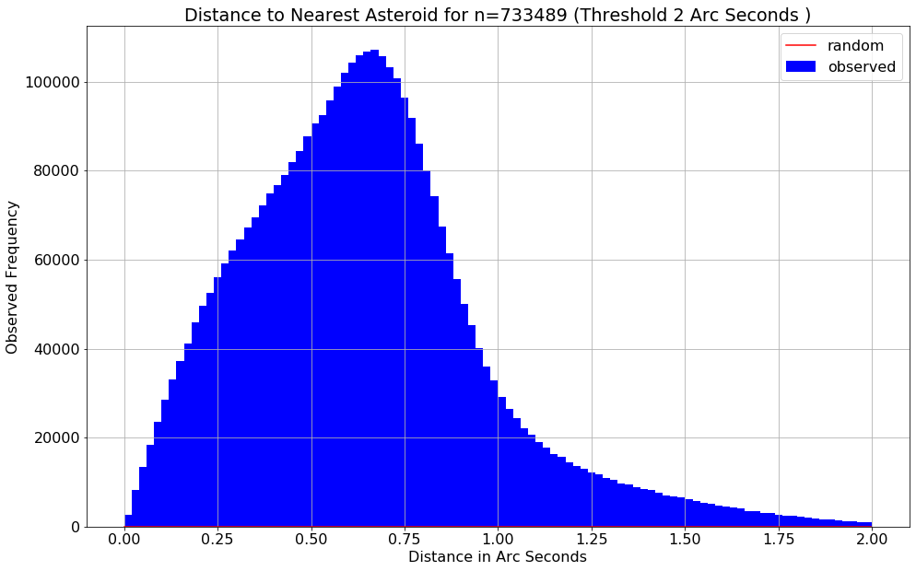
Nearest Asteroid: 65.7% Within 2.0 Arc Seconds!

Slide 25
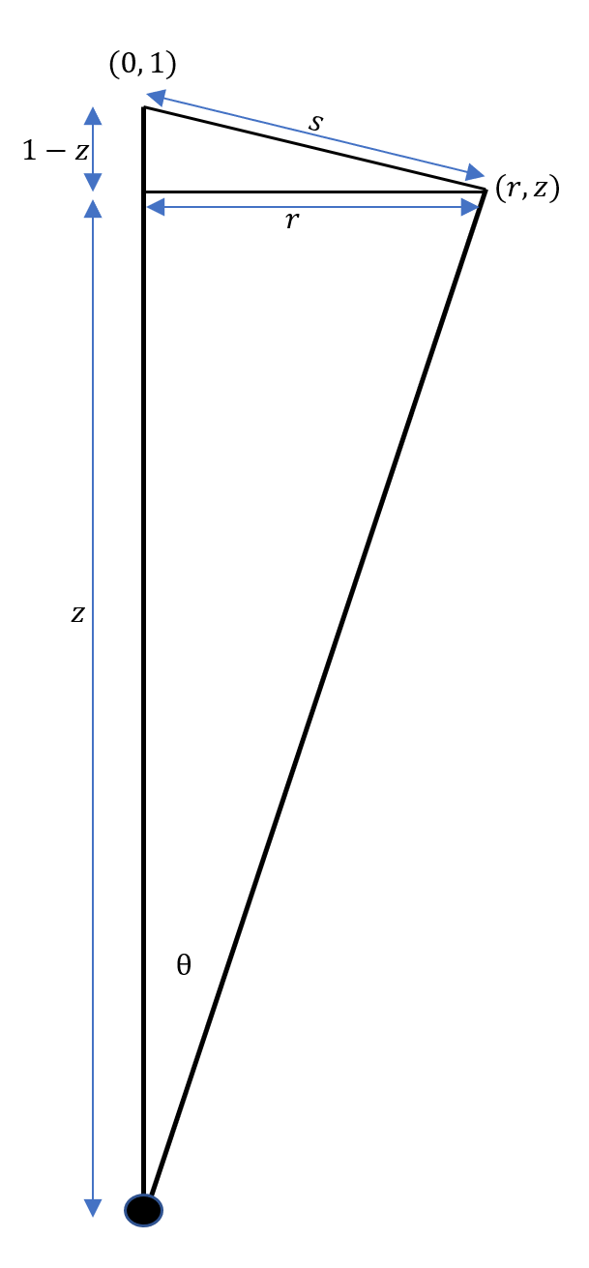
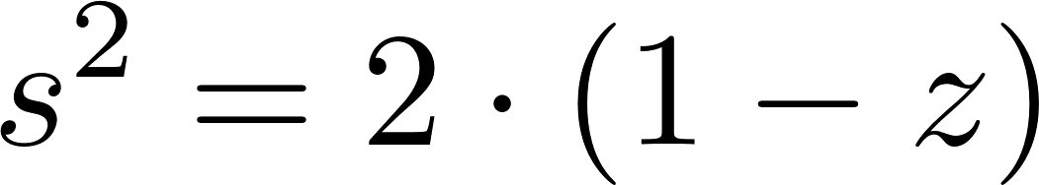
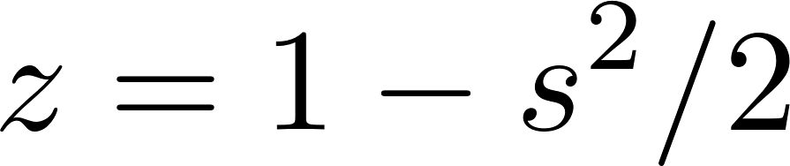
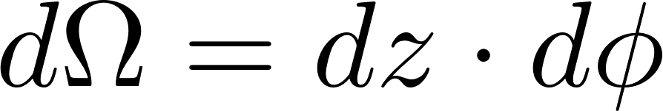

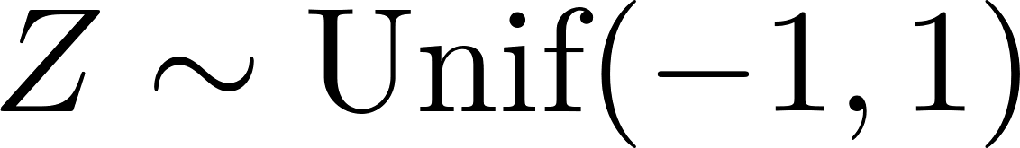
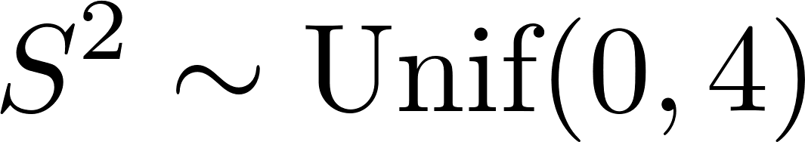
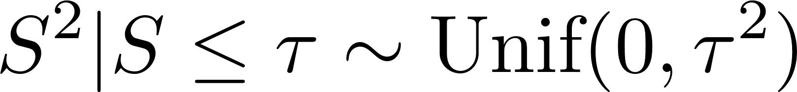
Statistical Distribution of Distance on Sphere
What is the statistical distribution of s if we guessed directions uniformly at random?
This is useful parameterization because…
“Orange Slicing Theorem” for solid angle measure:
Think of Z and S as random variables:
Conditional on a max (threshold) distance τ

Slide 26
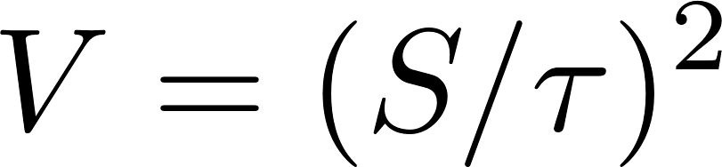
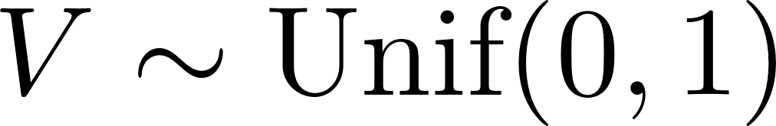
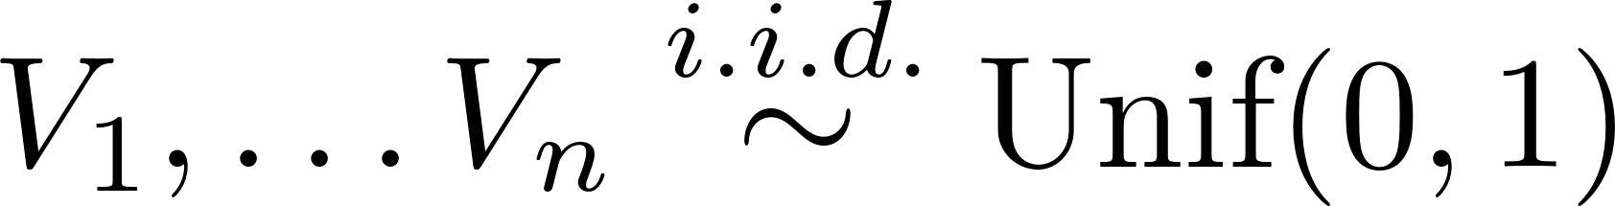
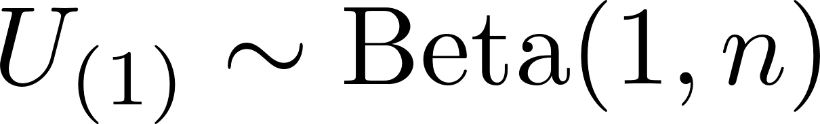
Distribution of Nearest Asteroid Distance
Set a threshold distance τ and define relative squared distance V
We have n = 733,489 guesses and are picking closest
Stat 110: The minimum of n i.i.d. uniforms has a Beta distribution
How many hits at 2.0 arc seconds would we get by luck?
Only 98. But we got 3.75 million of them!
Conclusion: This whole apparatus works to a tolerance of 2.0 arc seconds

Slide 27
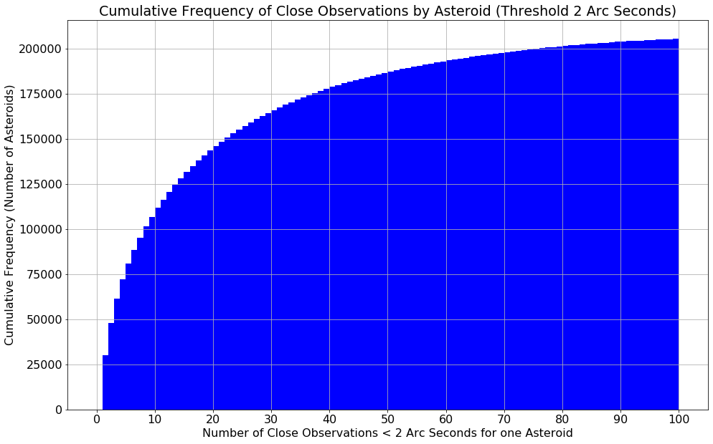
Cumulative Distribution of Hits per Asteroid
Suppose we want to rebuild the asteroid catalog…
How many asteroids do we have a sporting chance of finding?
Count hits at 2.0 arc seconds
How many asteroids have at least
20 hits? 63,746
10 hits? 100,508
We have a shot at 13.6% of the catalogue if we require 10+ hits

Slide 28
Asteroid Search Using Orbital Elements

Slide 29
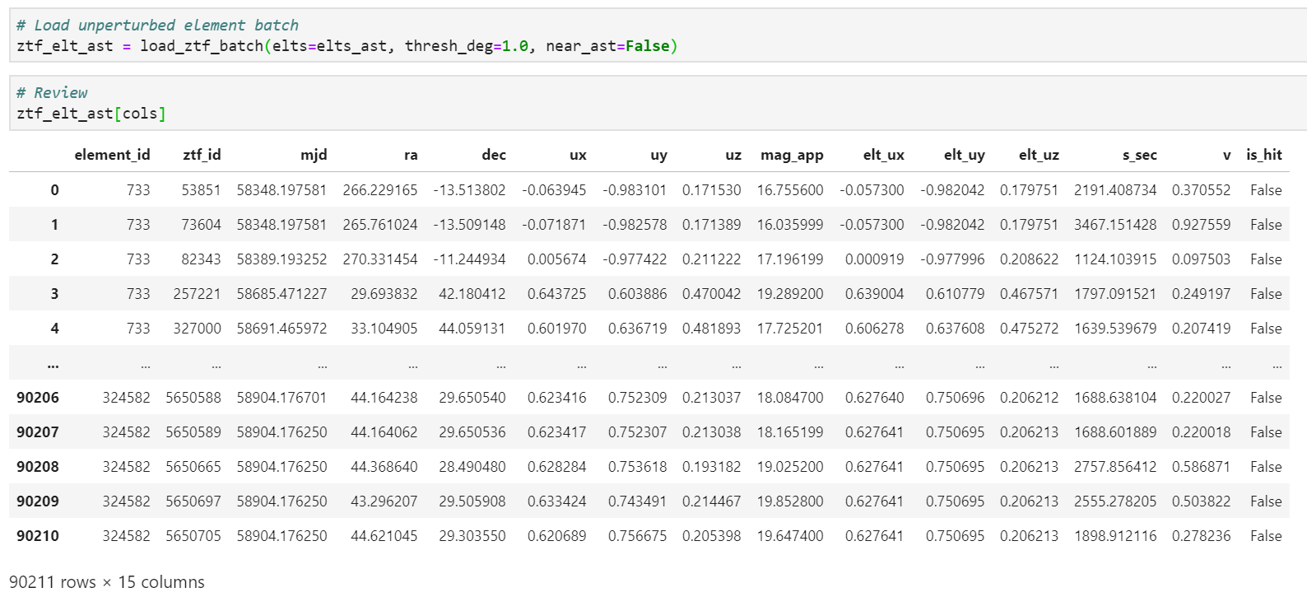
Assemble ZTF Detections Near Elements
Integrate the candidate elements on the fly in REBOUND and compute directions
Filter the ZTF detections to those within threshold of the elements

Slide 30
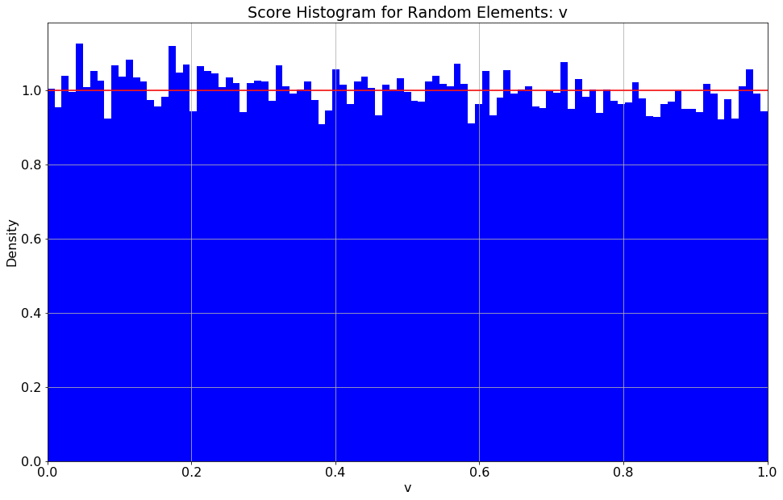
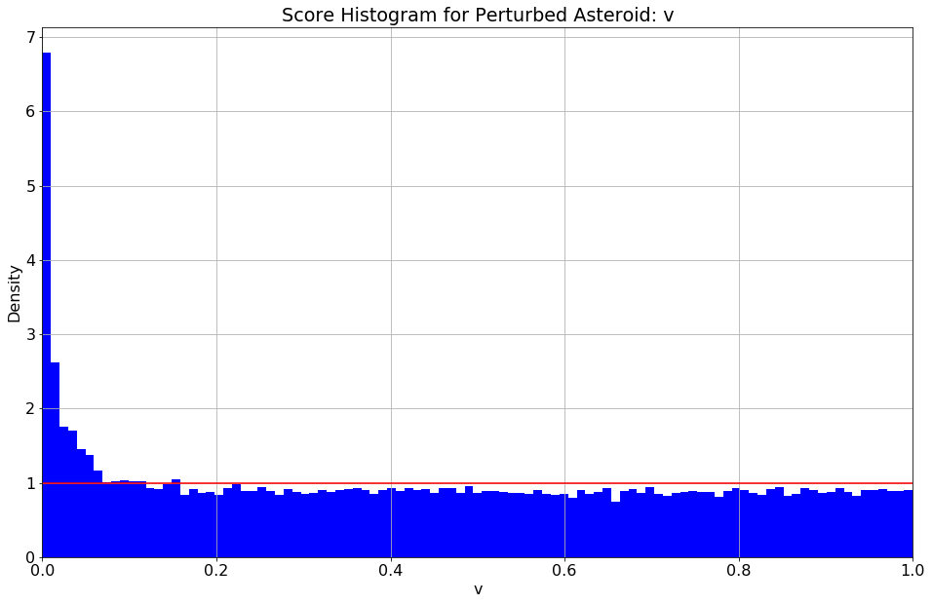
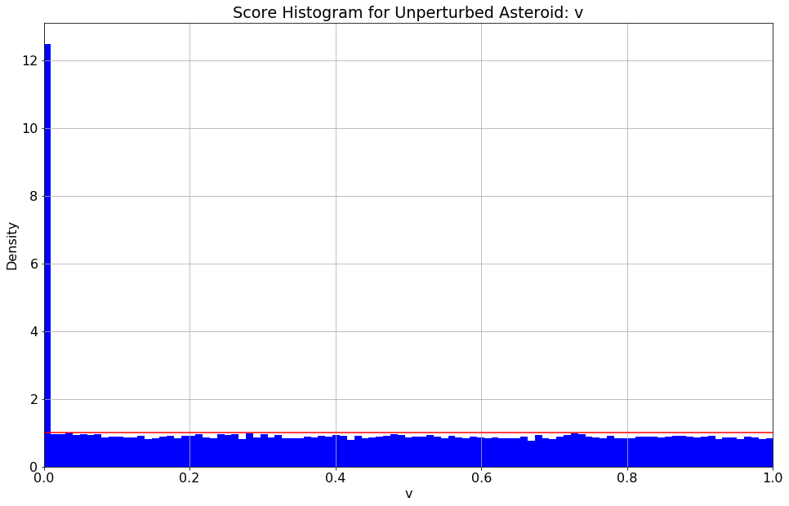
Distribution of V = (S/τ)² for 3 Element Batches
Plot V for 3 batches: random, unperturbed, perturbed
Results match theory perfectly!
Random elements close to uniform distribution
Unperturbed: uniform on misses with spike in first bucket
Perturbed: in between; hits leak out to ~250 arc seconds

Slide 31
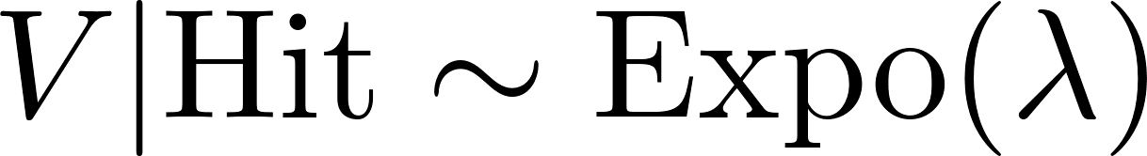
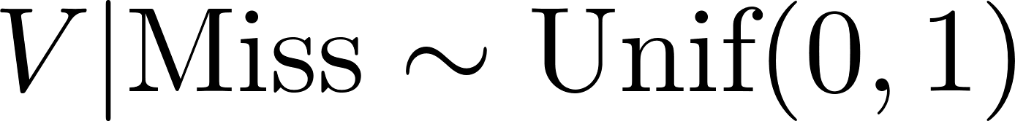
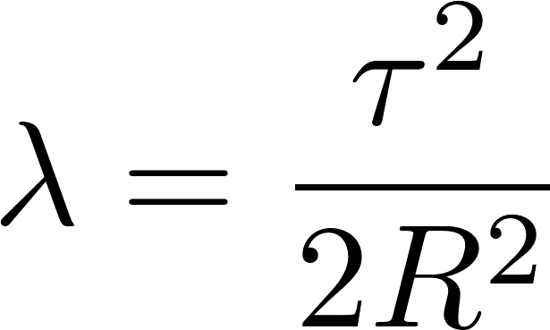
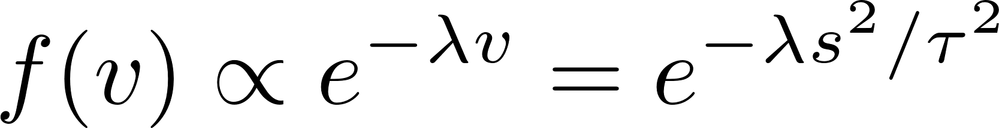
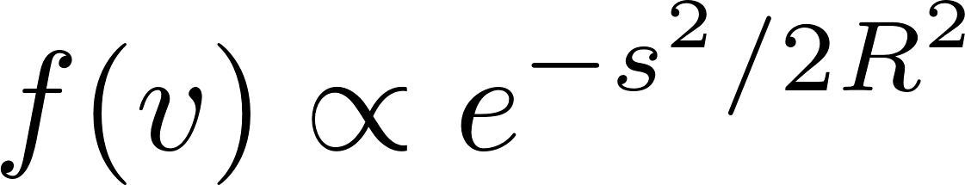
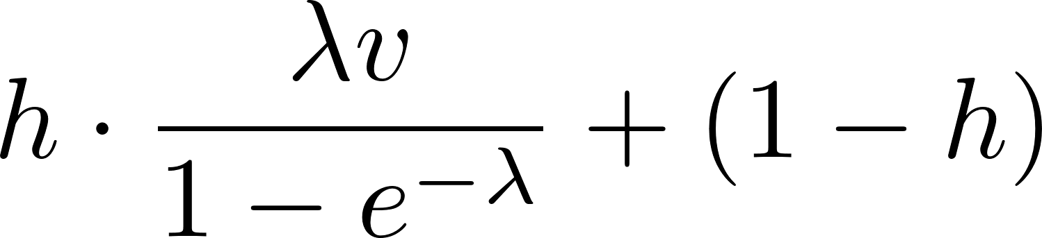
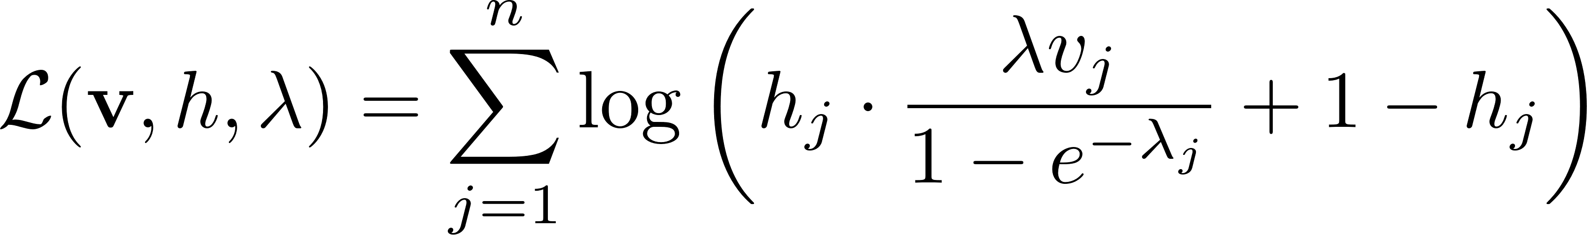
Log Likelihood Objective Function
Mixture probability model: V mixture of h hits, (1-h) misses
Relate decay rate to “resolution” parameter R
The resolution R controls how tightly the model focuses
Mixture PDF:
Log Likelihood:

Slide 32
Search Overview
Six trainable orbital elements a, e, i, Ω, ω, f; epoch not trainable
Three trainable mixture parameters: N_{h}, R, τ
Compute position q and velocity v from candidate elements
Compute direction u_{pred} from q, v; include light time and topos
Compute distance s from u_{pred} to u_{obs} for ZTF observations
Compute log likelihood ℒ_{i} for each candidate element
Gradient descent…
The rest is details!

Slide 33
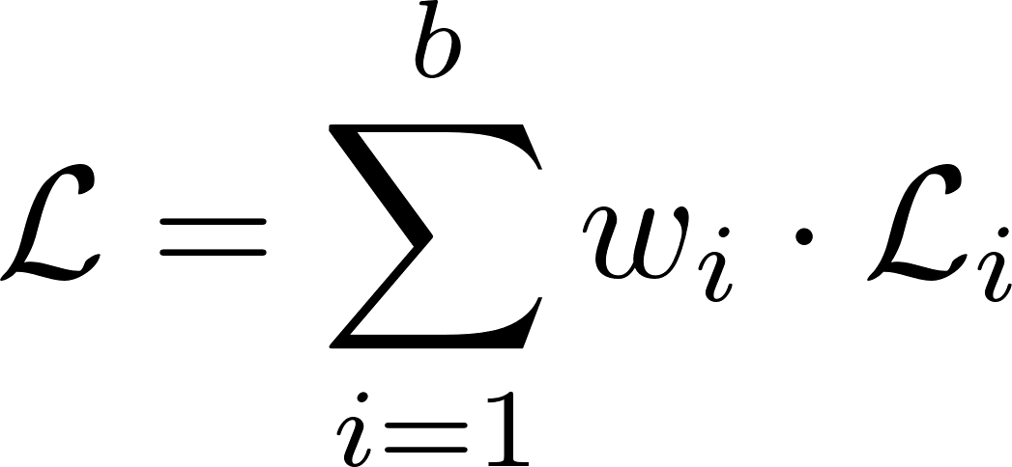
Search Techniques I: Uniform Scale, Gradient Clipping and Independent Weights
Control variables on uniform scale in [0, 1]
e.g. a = a_min x exp(a_ + log(a_max / a_min)); a_ trainable in [0,1]
Clip gradients by norm; max || Grad ℒ || = 1
would be better to do this elementwise, but requires custom class
Weight log likelihood for each element in batch independently
equivalent to controlling 64 learning rates independently
reduce learning rate on an element when it overshoots
Track of log likelihood and hits for each candidate element before summing them in the objective function
Revert changes only on elements that got worse during an episode

Slide 34
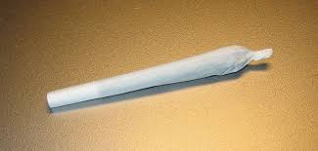

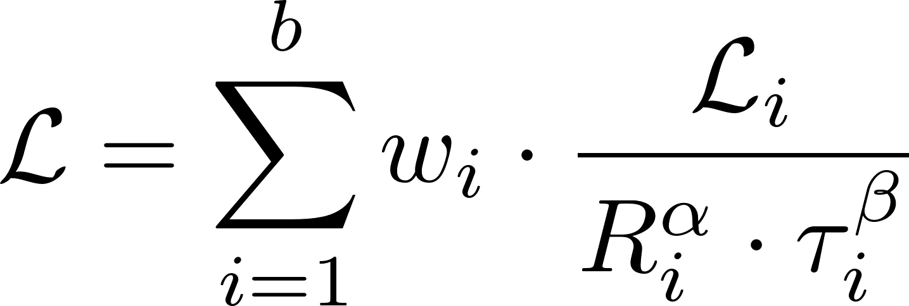
Search Techniques II: Mixture vs. Joint Mode, Encouraging Convergence
Joint mode: learn all parameters jointly
Mixture mode: only learn N_{h}, R, τ
Learning rate: 2⁻¹² in mixture mode vs. 2⁻¹⁶ in joint mode
Modified objective function in mixture mode
Theoretical motivation: likelihood would always look better with a larger τ; this encourages the model to converge
Like adjusting score for degree of difficulty in diving and gymnastics

Slide 35
Asteroid Search Results

Slide 36
Comparing Two Orbital Elements
How far apart are two 6D orbital elements ε₁ and ε₂?
A naïve Euclidean norm makes no sense at all
Idea 1: inject the elements into space at a set of times
The distance between two elements is the mean distance in AU between the orbits they describe
Set 240 sample time points at monthly intervals from 2010 to 2030
Idea 2: transform elements into low dimensional Cartesian space
Try to make each component approximately normal
Try to make joint distribution approximately multivariate normal
Use the Mahalanobis distance on these transformed elements

Slide 37
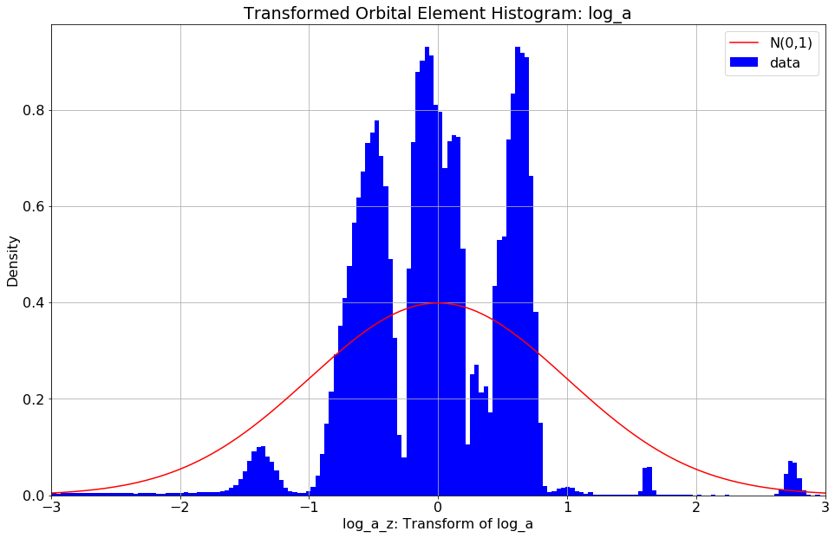
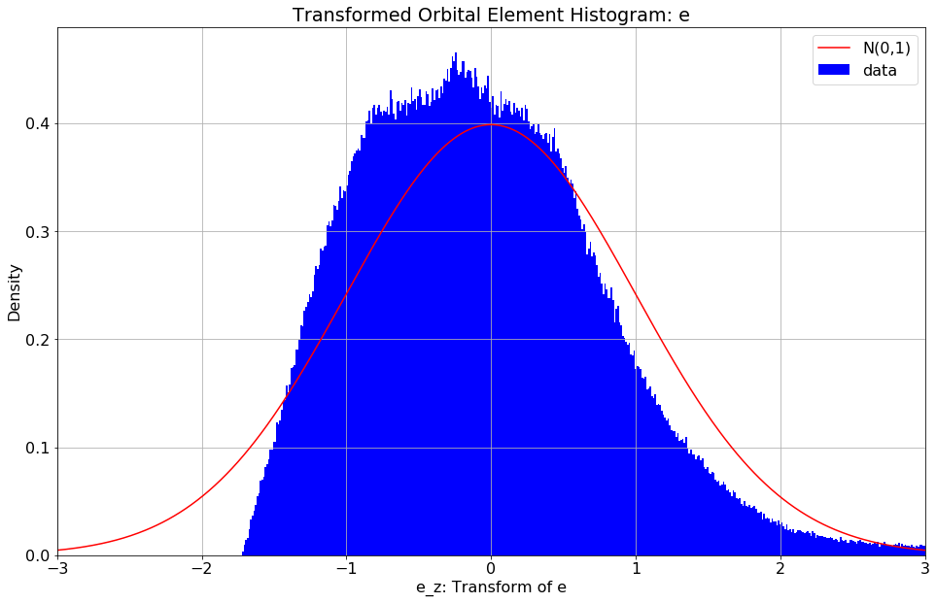
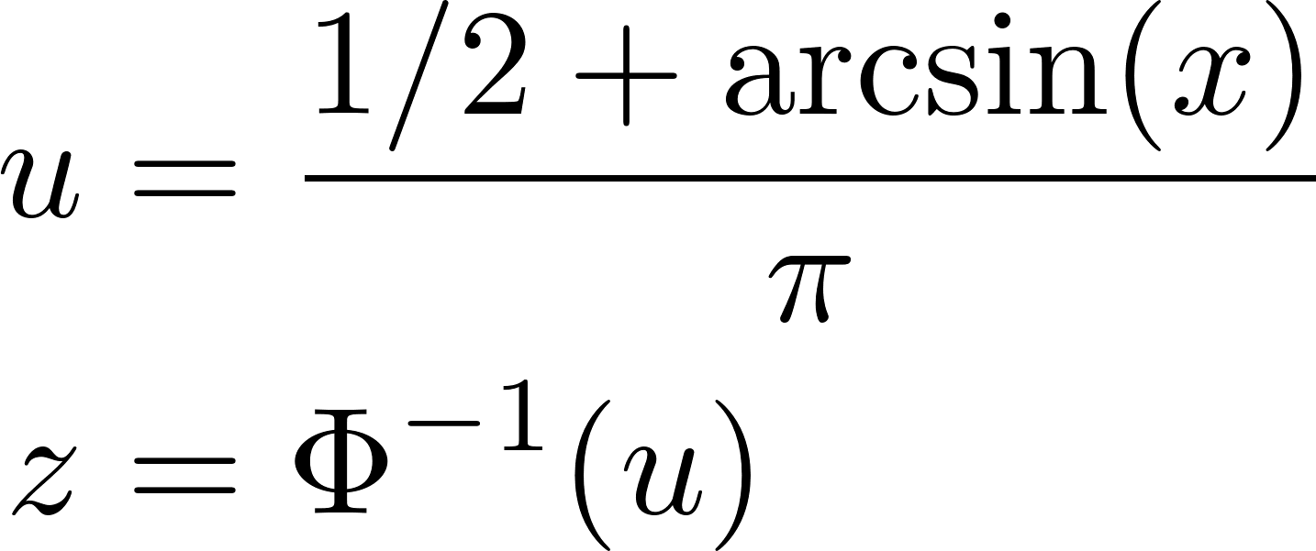
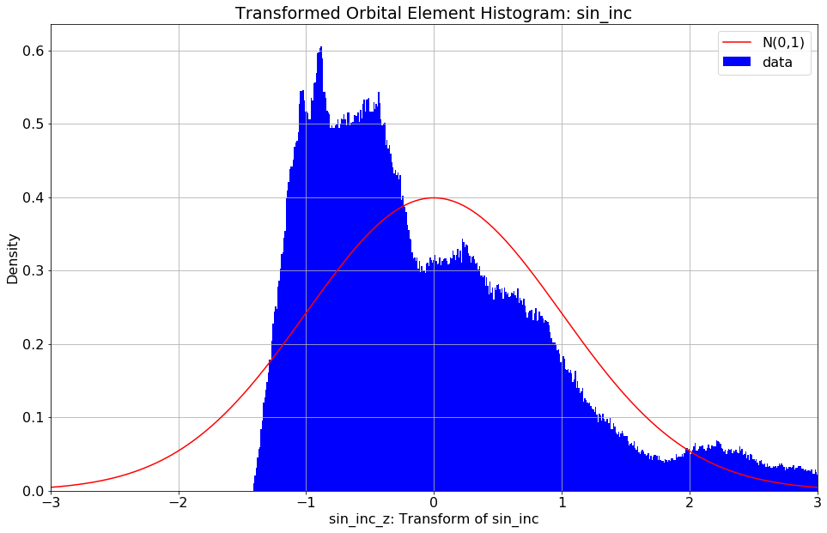
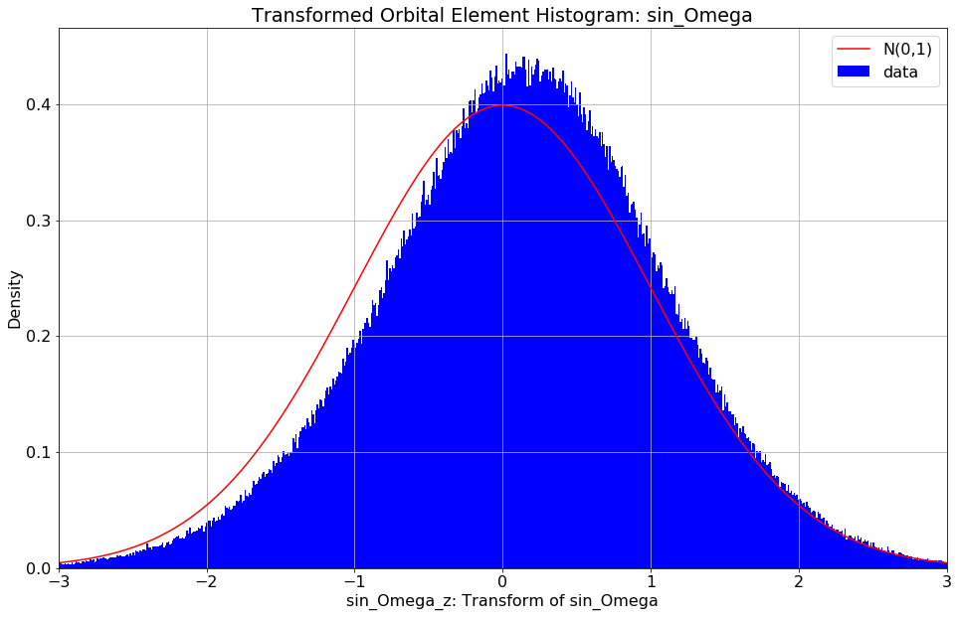
Transforming Elements for Covariance Norm
Standardize log(a)
Standardize e
Standardize sin(i)
Same transformation for sin and cos of Ω, ω, f
This injects elements into R⁹
Apply importance weights
1.0 for a, e
0.5 for i
0.1 for sin, cos of Ω, ω, f
Use PCA to find β such that X β has covariance matrix I₉

Slide 38
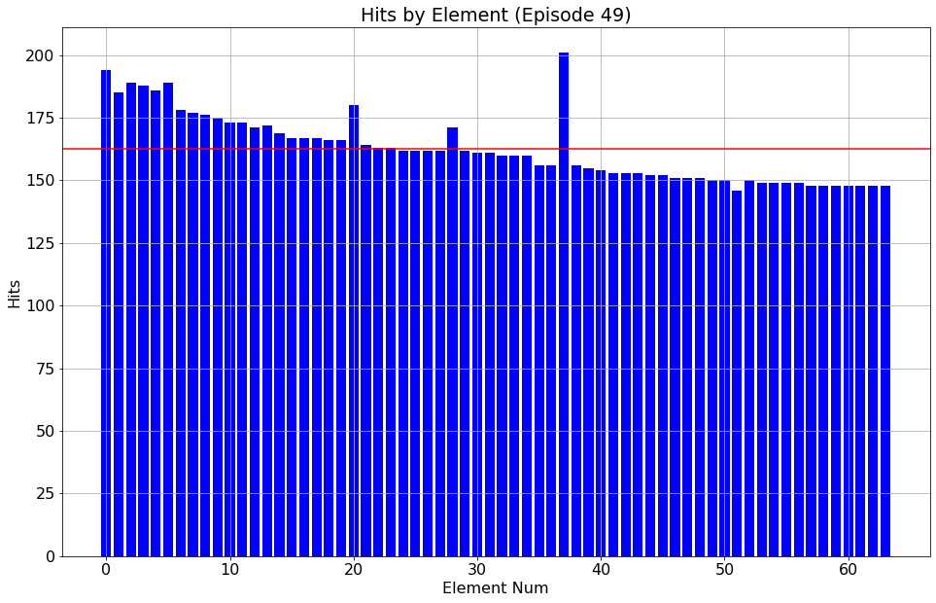



Train Known Asteroid Elements: Unperturbed
Start with correct elements but uniformed mixture parameters
Convergence is almost perfect
Recovered Elements: 64 (100%)
Hits: 162.6
Resolution: 3.0 arc seconds
Log Like: 1097

Slide 39


Fit Quality: Unperturbed Elements
Do recovered elements match the nearest asteroid?
4.6E-8 AU mean distance
5.7E-6 covariance norm
The fit is almost perfect
Big deal, this is about as hard as hitting a baseball off a tee…

Slide 40




Train Known Asteroid Elements: Small Perturbation
Small perturbation:
1.0% to a
0.25% to e
0.05 degrees to i
0.25 degrees to Ω, ω, f
Convergence is very good
Recovered Elements: 42 (65.6%)
Hits: 117.5
Resolution: 18.2 arc seconds
Log Like: 798

Slide 41


Fit Quality: Small Perturbation
Do recovered elements match the nearest asteroid?
2.6E-4 AU mean distance
0.012 covariance norm
This is still a very good fit on the 42 elements that have been recovered
This is like your little league coach lobbing the ball over the plate in batting practice…

Slide 42




Train Known Asteroid Elements: Large Perturbation
Small perturbation:
5.0% to a
1.0% to e
0.25 degrees to i
1.0 degrees to Ω, ω, f
Convergence is decent
Recovered Elements: 12 (18.8%)
Hits: 98.2
Resolution: 32.4 arc seconds
Log Like: 748
Many of these elements were perturbed so far the original is no longer even the nearest asteroid!

Slide 43


Fit Quality: Large Perturbation
Do recovered elements match the nearest asteroid? Quite well.
4.5E-4 AU mean distance
0.032 covariance norm
This is a decent fit on the 12 elements that have been recovered
This is a lot harder than the last task-like facing a high school pitcher…

Slide 44




Search Known Asteroids with Random Initializations
~4096 random seeds
Each batch started with 1024 random elements
Selected best 64 by mean log(v)
Trained for ~5 days on 4 GPUs
Reported fits with ≥ 8 hits and resolution < 20 arc seconds
Recovered Elements: 125
Hits: 19.2
Resolution: 9.3 arc seconds
Nearest Asteroid Distance: 2.66E-3 AU
Nearest Asteroid Cov. Norm: 0.73
Comments on fit quality:
Decent fit on some
Probably spurious on others
Overall shows that this can work
But not ready for production
Baseball analogy continued: facing Roger Clemens, but trying to get hit by the pitch to get on base cheaply

Slide 45




Search Unknown Asteroids with Random Initializations
4096 random seeds
Each batch started with 1024 random elements
Selected best 64 by mean log(v)
Trained for ~5 days on 4 GPUs
Reported fits with ≥ 8 hits and resolution < 20 arc seconds
Recovered Elements: 9
Hits: 9.1
Resolution: 5.3 arc seconds
Nearest Asteroid Distance: 4.10E-3 AU
Nearest Asteroid Cov. Norm: 1.10
Comments on fit quality:
Pretty good resolution
But not many hits
Not surprising: searching for new asteroids!
Would prefer to see greater differentiation in distance to nearest known asteroid vs. previous run

Slide 46

Presenting 9 New Asteroid Candidates

Slide 47




ZTF Hits for Selected Asteroid Candidates
Should we believe these new asteroid candidates? Look at ZTF hits to decide.
Element 178421 has 4 hits on ZTF18aboluox and 4 hits on ZTF18acewaex, made 433 days apart
Magnitudes are too different (4), spurious connection of 2 different objects
Element 3308 has 6 hits on ZTF18abtpdzg and 2 hits on ZTF18abspkzw, made 193 days apart
Element 191915 has 6 hits on ZTF19abtsqmn and 2 hits on ZTF18abtxtgd, made 469 days apart
Magnitudes are compatible: The model has made a non-obvious connection on compatible tracks!
Element 170789 has 8 hits on ZTF17aaaqwwg made in a 55 minute interval
Model agrees with ZTF that this is one track for the same object

Slide 48
Conclusions
Prove that asteroid search over orbital elements works
Need an adequate initialization and representation in data set
Built a working prototype in TensorFlow
First demonstration of efficient astrometric computations on GPU?
High quality integration of the Solar System and astrometric directions
Associated each of 5.7E6 ZTF observations to nearest asteroid
4.2E12 interactions, possibly novel and useful data set
Proposed candidate orbital elements for 9 new asteroids
Proof of concept for an automated pipeline to search for new asteroids

Slide 49
Future Work I: Initialization, More Data
Intelligent initialization of candidate elements
Random initialization was just a quick and dirty placeholder; ran out of time
ZTF ObjectID is a great starting point for initializations
Provisionally assume that all the detections belong to same object
Build least squares fit for candidate element
Code mostly there now; modify AsteroidSearch with new loss function
Add a second data set
ZTF is great, but it only dates back to July 2019
Want to add a second data source
Ideally this should have an ML pipeline to classify probable asteroid hits
Failing that, can use any data set with a real-bogus classifier, then subtract known stars and galaxies
Is Pan-STARRS a good choice?
Advice from astronomers on my Committee would be welcome here!

Slide 50
Future Work II: Magnitude, Automated Pipeline
Incorporate magnitude into log likelihood
Have prototype to predict magnitude and incorporate it
It was too finicky, needed to turn it off to get first version working on time
Develop an automated pipeline
Initial goal: Accurately rebuild a large fraction of the asteroid catalogue
ZTF alone has over 100,000 asteroids with 10 or more hits in the data
Plausible that with intelligent initialization, we can recover many of these
With a second data set, we could really go far
An automated process that can accurately recreate the known catalogue…
…is also an automated process that can provisionally classify new asteroids!

Slide 51
Mille Grazie: Thank you for Your Attention!
Questions?
Comments?
Suggestions?

Slide 52


Density of Distance to Nearest Asteroid
Plot absolute density in hits per square degree
Plot relative density: absolute density over beta distribution PDF
Both plots on log scale
Right tail seems to have an exponential decay pattern

Slide 53






Random Sampling of Candidate Elements
Four elements sampled empirically: a, e, i, Ω
Randomly choose an index from 1 to 733,489 and take element of that asteroid
Two elements sampled uniformly at random: ω, M
Convert mean anomaly M to true anomaly f in REBOUND

